Slide 1
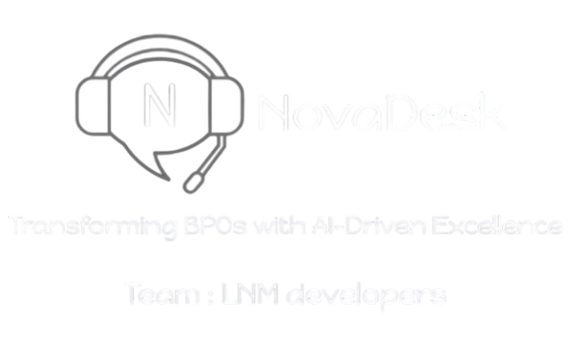

EY Techathon 5.0
Detailed Submission
Date of submission: 12th January’ 2025
T

Slide 2





TEAM INTRODUCTION
Team Name: LNM Coders
Problem Statement : AI for workflow and efficiency enhancement in Indian BPOs
SAHIB SALUJA
LNMIIT,JAIPUR
8209516480
FULL STACK DEVELOPER
PRIYANSHU GUPTA
LNMIIT,JAIPUR
6378434732
DEEP LEARNING DEVELOPER
SAMYAK JAIN
LNMIIT,JAIPUR
9772935611
MACHINE LEARNING DEVELOPER
GOVIND BANSAL
LNMIIT,JAIPUR
9660663738
BACKEND DEVELOPER
DIVYAM TALWAR
LNMIIT,JAIPUR
7051340907
FRONTEND DEVELOPER

Slide 3





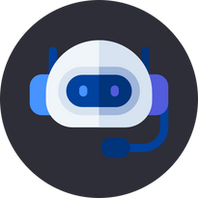

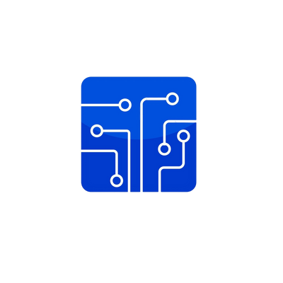


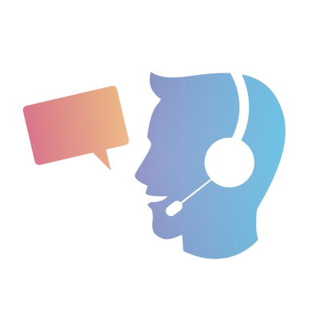


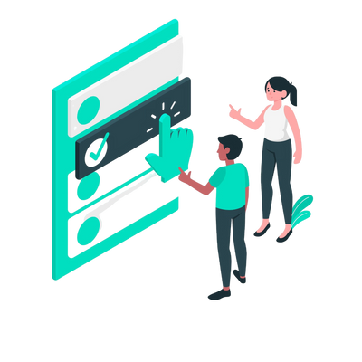

Executive Summary
Customer Pain Points
Growth and Revenue
Proposed Solution
High Call Volume
AI Chatbot for Call Efficiency
$ 7.19 Bn.
Excessive call volume makes timely and personalized customer support challenging.
Expected Revenue of BPO industry in 2024
An AI chatbot refining user queries to reduce unnecessary calls.
4Mn+
People are employed in the BPO sector
Scheduling & Data Entry
Scheduling & Data Entry
Automated AI-based scheduling of follow-up calls and data entry.
Manual handling of repetitive tasks causes inefficiency and delays in resolution.
Vision
NovaDesk
Sentiments Analysis
AI based voice recognition system to analyze customer sentiments
Feedback Challenges
Challenges in understanding customer sentiment hinder service improvements.
Operator
Smart Operator
NovaDesk, our AI-powered software, automates BPO tasks like call scheduling, record-keeping, and customer support, with tools for sentiment analysis and AI chatbot for rapid issue resolution.
Curated Latest Knowledge
AI Chatbot and Menus for Accessing Latest Knowledge by Call Center Agents

Slide 4




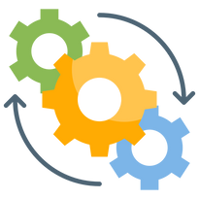




BPO/BPM - AI for workflow and efficiency enhancement in Indian BPOs
Our Understanding
Target Industry
User Department
The Problem statement requires us to build a platform through which The workflow of BPO’s can be made more efficient.
It requires us to build modules to a software where agents can view their scheduled tasks and calls.
An automated data entry section where the client’s data can be stored
An AI chatbot trained on the company’s rules and regulations which allows agents to find quick answers to client queries.
Also an automated chatbot for clients as well so normal queries could be resolved with it and incoming volume of calls and chats are reduced
Business Process Outsourcing (BPO) companies specifically those offering customer interaction services for their clients
The User department would be the Operations Department in the BPO companies as it sees the day to day functioning of call center agents.
Industry Type
User Group
The main User Group would be the Call Center Executives which would use the software to resolve client queries efficiently and quickly.
The Industry type is Business to Business (B2B) as well would sell software
directly to those business that provide services for other companies.

Slide 5


Solution Scenario
Data Flow
The client ordered a product from the application which has been defective and not working properly. The client connects with the AI chatbot on support page of application
The client discuss his problem with chatbot if the issue is resolved client leaves else is prompted to connect with customer center executive either through call or chat.
All this while the call center executive can login on the NovaDesk software where he/she can perform his/her daily scheduled tasks and make scheduled calls.
The client queries arrives on the executive screen where he can either accept the conversation or transfer. If accepted the executive resolves queries of client. If he has doubt in anything then executive can use AI chatbot trained on company’s rules and regulations.
The client data is stored in the database. If the client query is resolved he/she rates the conversation and leaves else the problem is escalated to higher level where the resolution would be provided afterwards and included in scheduled calls.
The executive can also view ratings given by the client and past conversations and also check the AI analysis of the conversation and provided constructive feedback.
The company rules and regulations data is stored in a separate database and AI chatbot is trained on it.
The client’s and executive’s conversation with the chatbot is stored for further analysis and improves the quality of output being provided
when the client connects with executive the phone number is stored and AI analysis of the ongoing call or chat allows automated data entry.
The calls are converted to text using whisper API. Calls and chats are then fed into an LLM model which analyses conversation based on certain keywords and provides rating and constructive feedback. This data is displayed to executive and helps them in increasing performance.

Slide 6




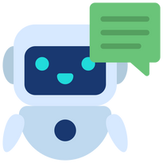




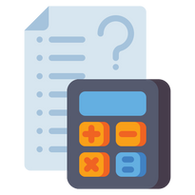






NovaDesk Insights
Solution Value Proposition
Technologies Involved
Impact Metrics
Chatbot for clients and agents
Increased Client’s Satisfaction
AI chatbot for clients which reduces volume of calls and chat to executive and chatbot for agents allowing agents to resolve problems efficiently
Predicted 40% increase in
client’s satisfaction due AI
chatbot implementation and
faster resolution.
FrontEnd Framework
HTML, CSS, JavaScript, React,Tailwind
Operational Cost Savings
Backend and DataBase
Automated Call logging
Due to minimized manual intervention we predict upto 30% decrease in operational cost .
SpringBoot,Firebase, MySQL, AWS
AI model which analyzes the
ongoing conversation and
automatically fills the client
related data.
Increased Profits
Sentiment Analysis
Due to increased customer satisfaction and reduced resolution time , company would attract more businesses and thus increasing profits
AI models
AI model which analyses the calls & chat by converting them into text and provides ratings and constructive feedback
TensorFlow,PyTorch,
Python
Automated Scheduling
Increased Productivity
API’s and Hosting
The calls and tasks of the agents are scheduled by analyzing the calls and chats data
Boost efficiency by 40% through automated task handling like data entry and call scheduling.
Gemini API, Whisper API,
GitHub, Vercel

Slide 7



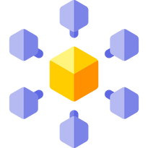



Solution Decision points
Ease Of
Implementation
Assumptions
Users will have a stable internet connection.
The software would primarily be used by trained call center agents
The organization infrastructure can support required hardware and cloud services.
The solution is designed to integrate effortlessly with existing tools like CRM platforms and telephony systems, minimizing disruption to current workflows.
The software features are intuitive and user-friendly interface tailored for call center executives, reducing the need for extensive training and enabling quick adoption.
As a cloud-enabled solution, it eliminates the need for extensive on-premise infrastructure. This reduces initial setup costs and shortens deployment time.
Gemini and Whisper APIs provide easy-to-use endpoints for seamless integration.
Vercel automates scaling and hosting, reducing setup and maintenance efforts.
Microservices Architecture
A microservices architecture was chosen to ensure the system can scale with increased user demand.
AWS cloud storage
AWS was selected over other cloud providers because of its competitive pricing for specific services
Constraints
PyTorch for Training
Only open-source tools can be used due to cost considerations.
The development cost must stay within a specific limit.
The system must support at least 1,000 concurrent users.
The software must integrate with pre-existing tools like a CRM.
PyTorch was chosen for its strong community support and frequent updates.
TensorFlow for integration
TensorFlow was preferred because of its seamless integration with existing tools.

Slide 8




Robustness
Further Improvements and Additions
Gemini and Whisper APIs are backed by reliable infrastructure with high availability.
Vercel provides a fault-tolerant, globally distributed platform for stability.
We aim to create a chatbot for client as well, that we have mentioned with which the client would first communicate and only if unsatisfied with the chatbot’s response the problem would be forwarded to the executive thus it would significantly reduce the volume of calls that executive have to handle and they can focus on main problems.
We are also working to incorporate Google cloud speech to text API through which we would be able to analyze the ongoing conversation between client and the executive and could provide features such as automated Data entry which would further streamline the workflow of BPO’s.
The AI chatbot currently is fine tuned on a demo company specific rules and regulations. We are currently working on developing a local LLM model by ourselves which would be able to answer client’s and agents’ queries better. This would be finished before the next round.
We would also like to make some changes to the UI interface of the website and add some help pages and user account settings sidebar to the website to initiate its growth from a prototype to a full fledged ready to deploy company software.
Security
All API interactions are secured using HTTPS and encryption protocols.
APIs implement authentication (e.g., API keys or tokens) to restrict unauthorized access.
Scalability
React apps handle large-scale UI updates efficiently with a virtual DOM
Vercel automatically scales serverless apps based on user demand.

Slide 9
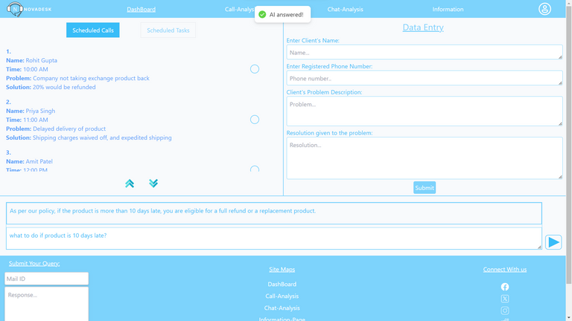
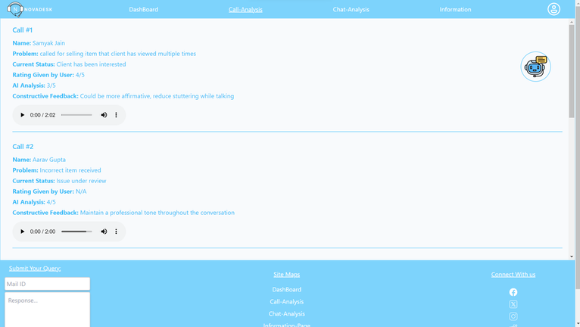
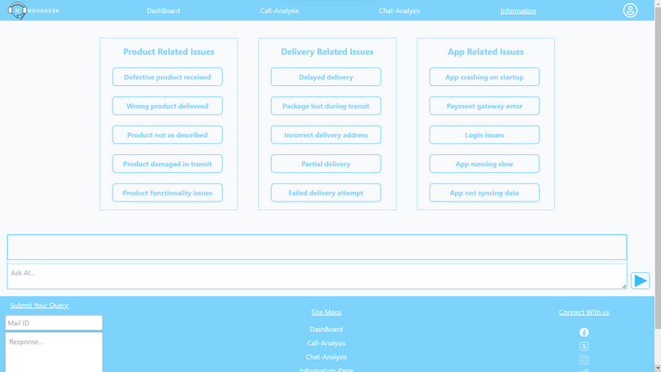
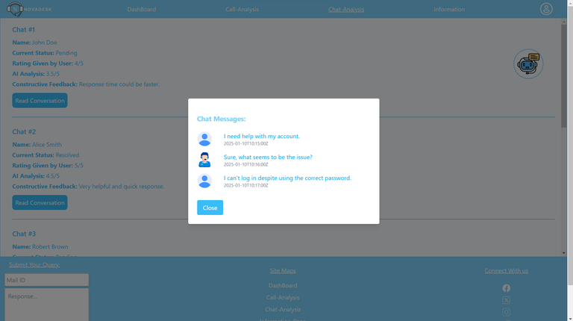
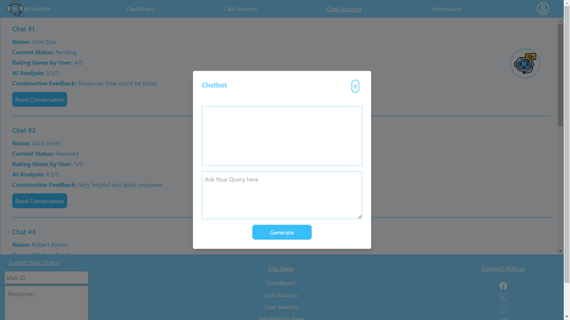
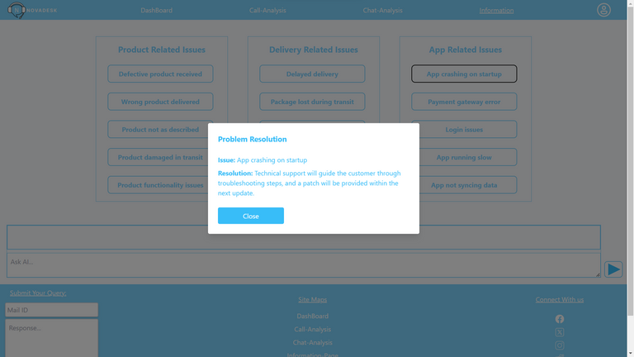
ScreenShots of the website

Slide 10
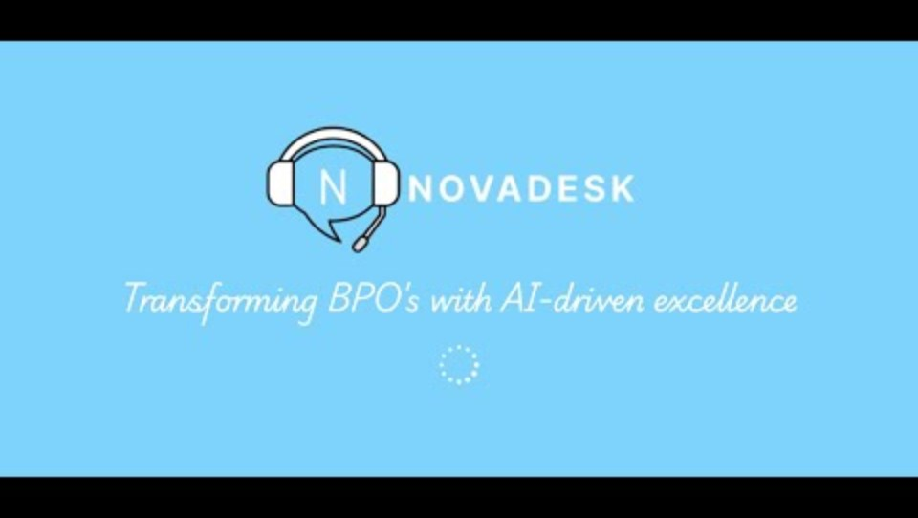
NovaDesk prototype video demonstration ->
https://youtu.be/g0GnYcS0kco?si=W45W_t3XxDSwLF71
Youtube link-
GitHub code repository ->
https://github.com/sahib-singh13/novadesk-prototype
https://novadesk.vercel.app/
Try our website here->
Thank You

