Slide 1

Priyanshu Luhar
David Ayeni
Solomon Anagha

Slide 2
General
Communication
Discord
Messaging
Meetings
Conflicts
Version Control
GitHub
Multi Branch
One person responsible for merging
IDE – Vim (GOATED), VS Code

Slide 3
Purpose of doxudio
An application that allows users to have a way to share and review documents (for the scope of this project limited to books, specifically pdf)
PDF viewer incorporated into the application fit for small computing devices along with rating system and user management

Slide 4
Tools Used
Utilities
Python
Sqlite3
Php
Clibre
Libraries
customtkinter
Fitz (PyMuPDF)
API
OpenLibrary
Custom
LemonTurtle

Slide 5
Features Attempted
PDF/Epub file viwer
PDF-Epub convertor (nice to have)
PDF tools to isolate a chapter for goal binding
peer-to-peer file sharing (nice to have)
Book(File) review system
Centralized database option to make a book public
File sharing via websockets through odin(server)
Audiobook option (really nice to have)
Persistent option
API calls for information on any book that is not available
Dual database system, local for personal features and global for server features
Related Books using graph theory (just wanted to give it a shot)

Slide 6
Features Completed
PDF/Epub file viwer
PDF-Epub convertor
PDF tools to isolate a chapter for goal binding
peer-to-peer file sharing (good luck dealing with unauth port transfer)
Book(File) review system
Centralized database option to make a book public
File sharing via websockets through odin(server)
Audiobook option (we wish)
Persistent option
API calls for information on any book that is not available
Dual database system, local for personal features and global for server features
Related Books using graph theory (have no idea why its here)

Slide 7
Features Added
Stand alone Custom APIs connected to Artemis
Server-side file storage
Multi-View desktop GUI
Light/Dark mode support

Slide 8
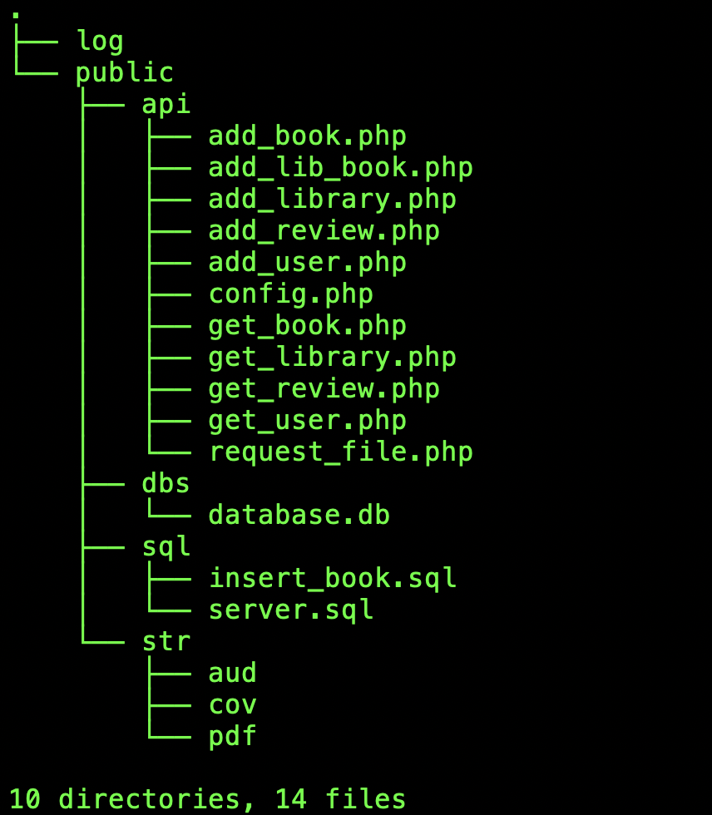
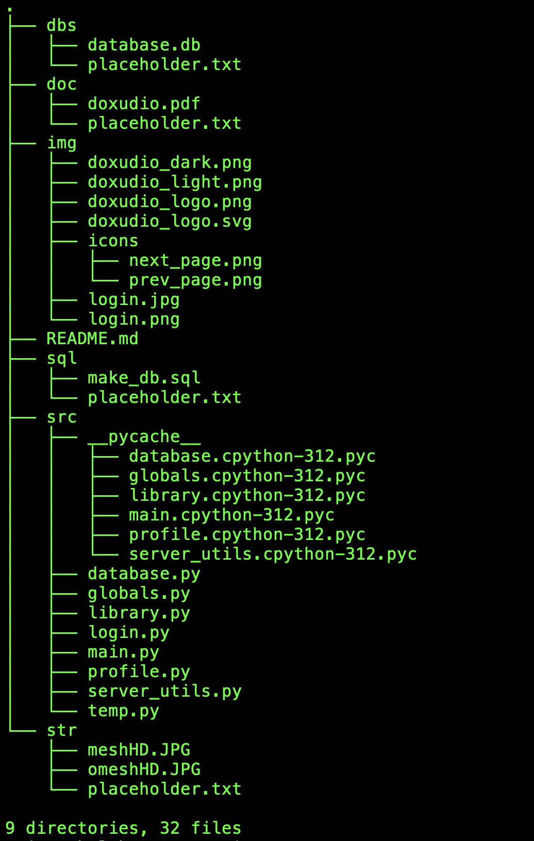
Server
Client

Slide 9
GUI Design
Old School
Drew multiple models on paper
Decided upon some of them based on their feasibility
Made a plane out of the paper

Slide 10
Demonstration

Slide 11
Issues we ran into
API calls
Database permissions
Json request validation
GUI formatting

Slide 12
Questions

