Slide 1

Hotel Reservation and Maintenance system
Priyanshu Madan

Slide 2
Scenario
Optimize the internal operations and management of all the hotels.
Develop an entire data pipeline that is efficient and minimizes the paperwork of all the hotels.
Own reservation portal for the guests to reserve their rooms and pay online for the same.
Automate the whole record keeping process of all the hotels they own
Notes:
The owners of an old hotel chain want to optimize their internal operations and management of all the owners. They want to develop an entire data pipeline that is efficient and minimizes the paperwork of all the hotels. Currently the owners maintain all the records of the guests, rooms, staffs and employees on paper. It is not very efficient, reliable and it consumes a lot of time to maintain these records moreover it’s not real time.
Apart from this, in today’s day and age they want their own reservation portal for the guests to reserve their rooms and pay online for the same. This way they will also maintain a record of the previous loyal guests.

Slide 3
Database deliverables
Reservations: Keep record of all the reservations, cancelations.
Keep past records: To know who the loyal customers are for implementing reward system.
Inventory management: To maintain inventory of the items in the hotels like toiletries, food, drinks, etc.
Room management: To know which rooms are available to reserve and which are occupied.
Duty assignment: To know who manages the hotel, who attends to a guest and what duties others are responsible for.

Slide 4
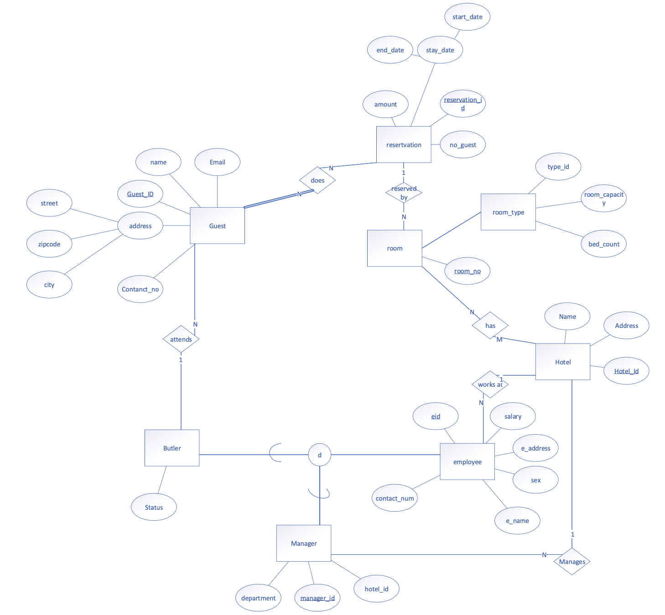

Slide 5
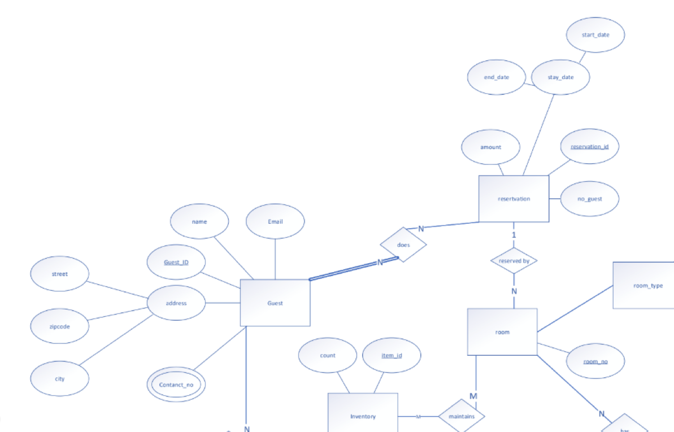
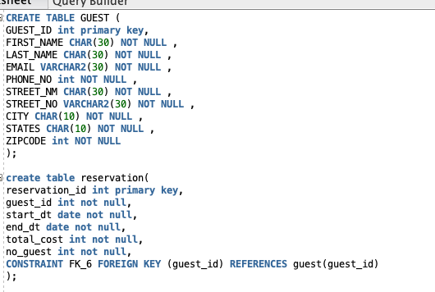
Relational Model (Guest Portal)

Slide 6
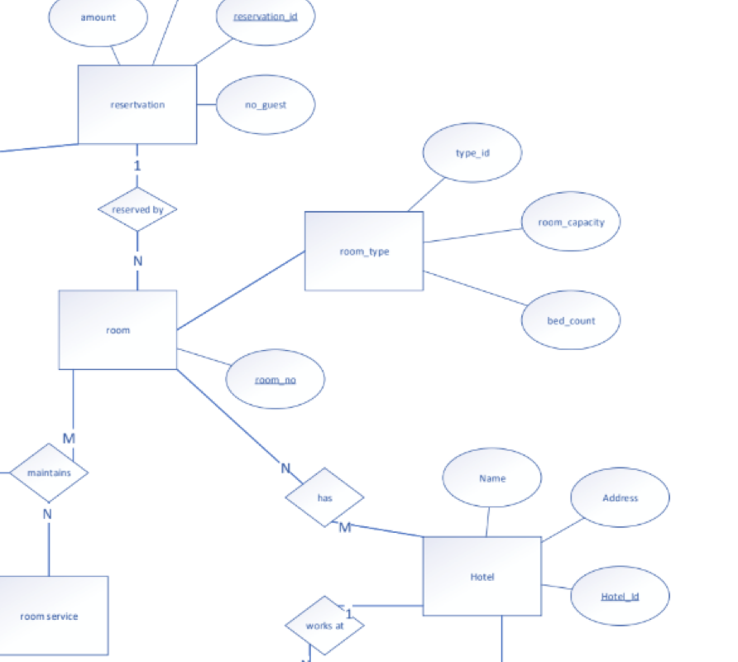
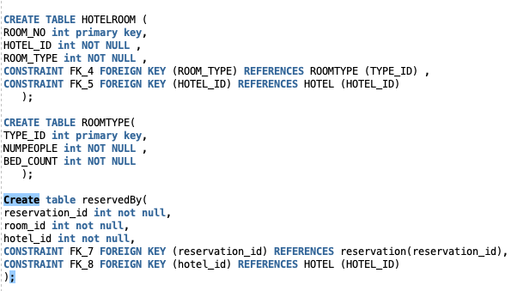
Relational Model (room and reservation management)

Slide 7
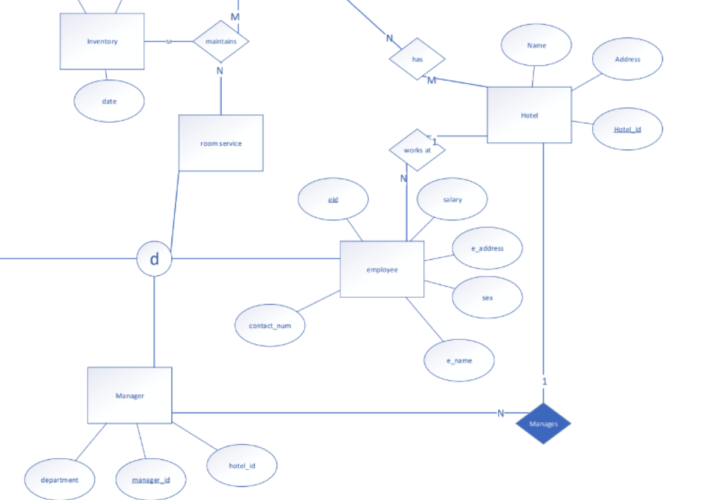
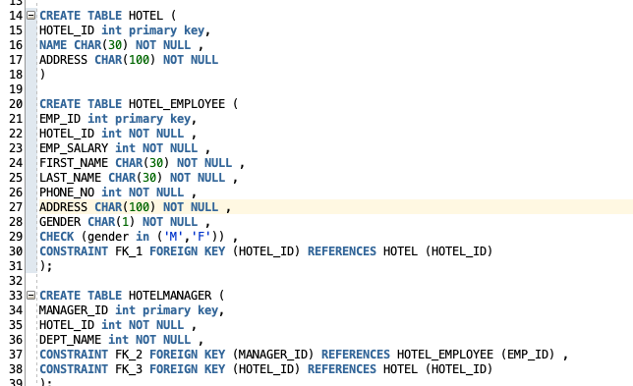
Relational Model (Employee management)

