Slide 1
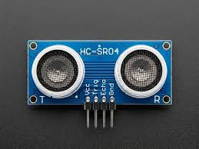
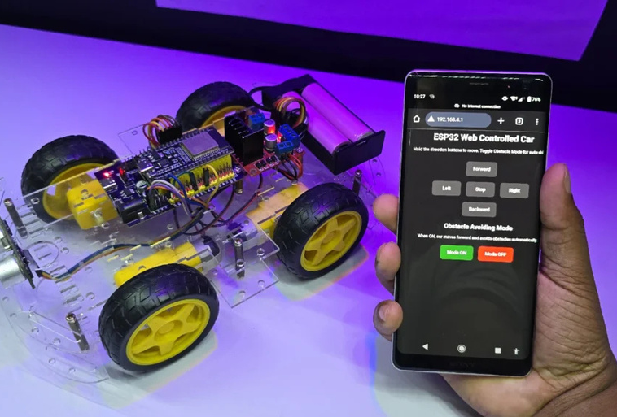
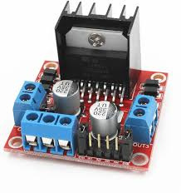
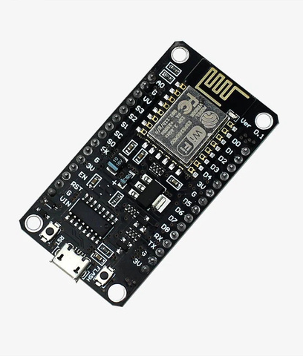
Multifunctional Robot Car
Web-Controlled + Obstacle Avoidance
Major components used:-
ESP-8266 NODE-MCU
Ultrasonic Sensor(SR04)
Motor Driver
12 V battery
Car Chasis
Functions:-
Controlled by smartphone using ESP-8266
Automatically avoid obstacle when toggle mode is on.
Working:-
User → WiFi → ESP8266 → Motor control
Sensor → ESP8266 → Auto movement

