Slide 1
Cysteine Prediction in Pea Cultivars using Raman Spectroscopy and Machine Learning
July 16, 2026

Slide 2
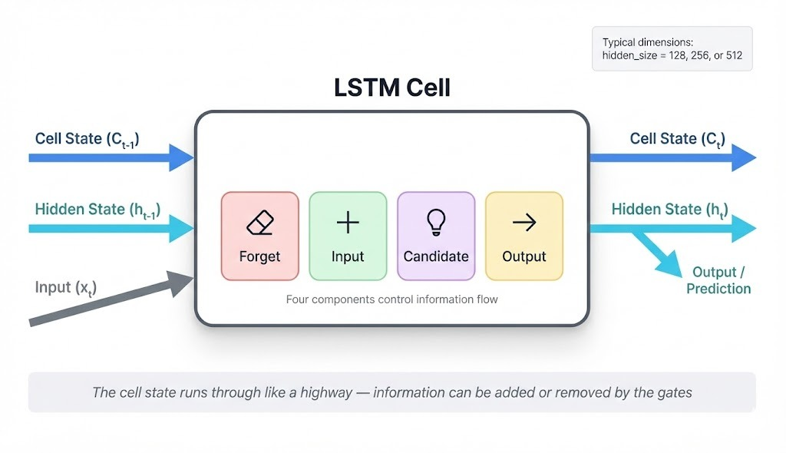
LSTM – Long Short-Term Memory
LSTM stands for Long Short-Term Memory, a type of recurrent neural network (RNN) designed to handle sequences where context from much earlier in the input still matters.
The core idea behind LSTMs is a gating mechanism that regulates information flow through the network.

Slide 3
KEY CONCEPT
Unlike CNN which looks at local windows, LSTM maintains a memory that carries information across the entire 1,530-point sequence. It decides what to remember, what to forget, and what to output at each step using three gates:
Bidirectional LSTM: Our LSTM reads the spectrum in both directions simultaneously: left to right AND right to left. This means a peak at 200 cm⁻¹ can influence the prediction based on what happens at 1,500 cm⁻¹ and vice versa.
Input gate → decides what new information to store
Forget gate → decides what old information to discard
Output gate → decides what to pass to the next step
Forward LSTM: 97.8 cm⁻¹ → 200 cm⁻¹ → ... → 3361.7 cm⁻¹
Backward LSTM: 3361.7 cm⁻¹ → ... → 200 cm⁻¹ → 97.8 cm⁻¹
Combined output at each step

Slide 4
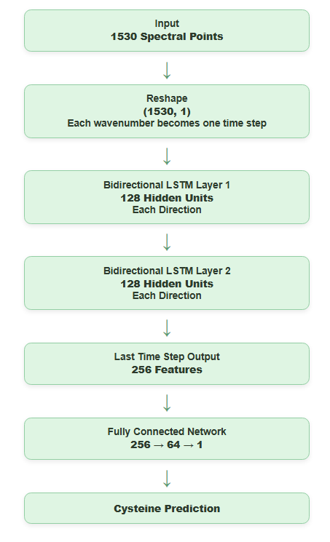
LSTM - Architecture:
Total parameters: 545,921 : lightest of all three DL models

Slide 5
LSTM Code Step by Step
Step – 1: Reshape Input:
Step - 2: Bidirectional LSTM processes sequence:
Step – 3: Fully Connected prediction:
Raw spectrum: (batch, 1530)
Reshaped to: (batch, 1530, 1)
↑ each wavenumber = one time step with 1 feature
Forward pass: reads from wavenumber 97.8 to 3361.7
Backward pass: reads from wavenumber 3361.7 to 97.8
At each step: outputs 128 + 128 = 256 features
Final output: last time step → (batch, 256)
256 features → 64 → 1 (cysteine value)
Dropout 0.3 applied between layers

Slide 6
LSTM Code Step by Step
Step – 4: Key difference from CNN:
Step – 5: Why LSTM is slower than CNN:
CNN: sliding window sees 5 consecutive points at a time
LSTM: sees ALL 1530 points sequentially, remembers context
CNN: convolves all positions simultaneously (parallel)
LSTM: must process each of 1530 time steps sequentially (Cannot be fully parallelised — slower on GPU)

Slide 7

LSTM Preprocessing Comparison
Preprocessing | RMSE 80/20 | R² 80/20 | RMSE LOCO | R² LOCO | RPD LOCO
SG + SNV | 0.0162 | 0.0202 | 0.0114 | 0.5236 | 1.4488
SG + MSC | 0.0143 | 0.2348 | 0.0091 | 0.6918 | 1.8014
SG + 1st Deriv | 0.0163 | 0.0113 | 0.0109 | 0.5605 | 1.5085
SG + 2nd Deriv | 0.0163 | 0.0061 | 0.0115 | 0.5143 | 1.4349
SG + SNV + 1st Der | 0.0164 | 0.0004 | 0.0112 | 0.5364 | 1.4687
SG + SNV + 2nd Der | 0.0164 | 0.0007 | 0.0112 | 0.5366 | 1.4690
SG + MSC + 1st Der | 0.0161 | 0.0372 | 0.0109 | 0.5605 | 1.5085
SG + MSC + 2nd Der | 0.0162 | 0.0225 | 0.0115 | 0.5143 | 1.4349
Raw | 0.0161 | 0.0335 | 0.0093 | 0.6772 | 1.7602
SG + MSC performs best for both 80/20 and LOCO. MSC corrects multiplicative scattering effects, which benefits sequential processing.
80/20 $R^{2}$is very low across all combinations. LSTM struggles with within cultivar discrimination.

Slide 8
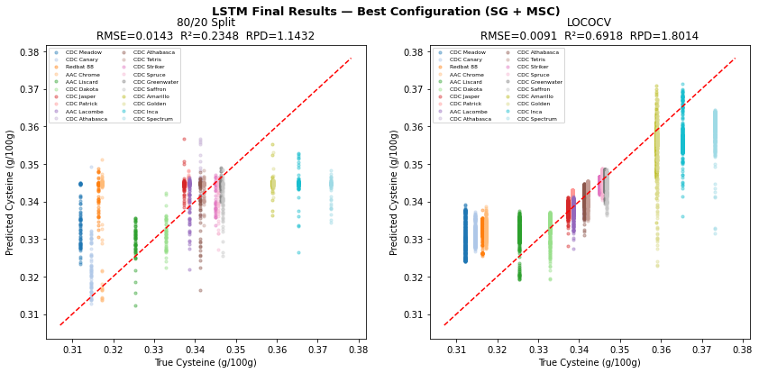

LSTM Final Results
Metric | 80/20 Split | LOCOCV
RMSE | 0.0143 | 0.0091
R² | 0.2348 | 0.6918
RPD | 1.1432 | 1.8014
Preprocessing | SG + MSC | SG + MSC
LOCO $R^{2}=0.69$: Good generalization to unseen cultivars.
80/20 $R^{2}=0.23$: Weak within cultivar discrimination compared with CNN and CNN LSTM.

Slide 9
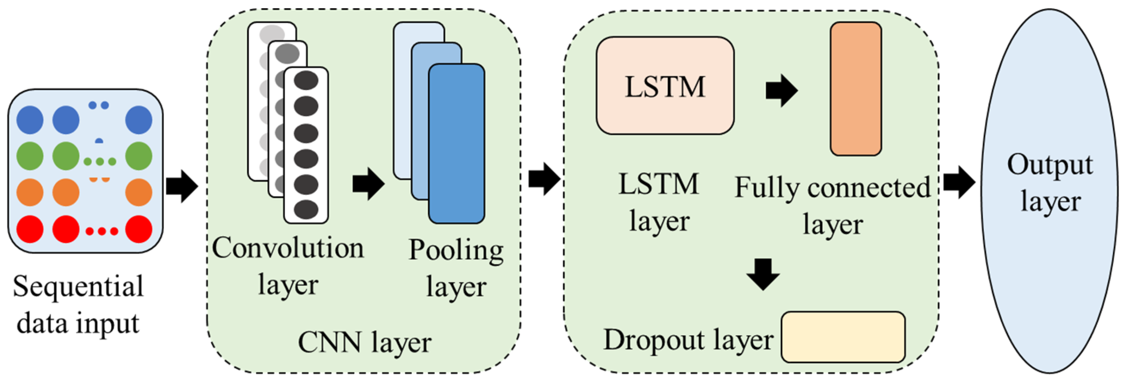
CNN-LSTM
The CNN LSTM architecture involves using Convolutional Neural Network (CNN) layers for feature extraction on input data combined with LSTMs to support sequence prediction.
A CNN LSTM can be defined by adding CNN layers on the front end followed by LSTM layers with a Dense layer on the output.

Slide 10
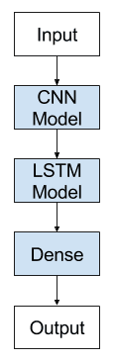
Key Concept – CNN LSTM
CNN extracts local peak features from the spectrum.
Compresses 1,530 spectral points into 191 feature vectors.
LSTM processes these feature vectors as a sequence.
Captures long range relationships between spectral regions.
Combines local feature extraction with sequential learning for improved performance.

Slide 11
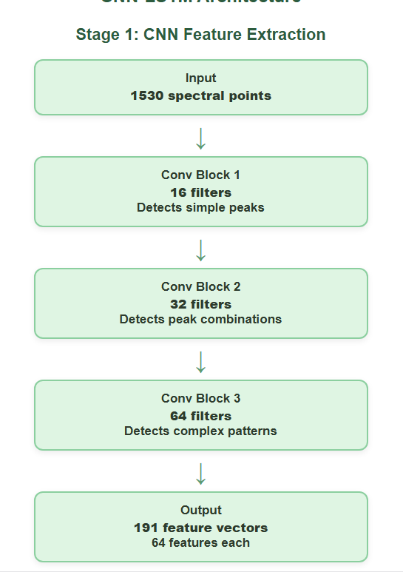
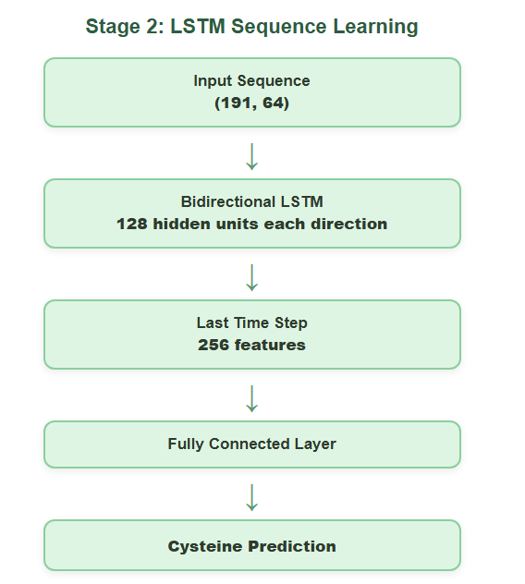
CNN-LSTM ARCHITECTURE
Notes:
Why combine CNN and LSTM:
CNN alone: great at local features, misses long range spectral relationships
LSTM alone: captures long range context but struggles with raw 1,530 point sequences
CNN-LSTM: CNN reduces sequence length from 1,530 to 191 making LSTM more efficient, while LSTM captures relationships between distant spectral regions

Slide 12
CNN-LSTM Code Step by Step
Step 1: CNN extracts features
Step 2: Reshape for LSTM
Input: (batch, 1530)
↓ unsqueeze
(batch, 1, 1530)
↓ 3 Conv blocks with MaxPool
(batch, 64, 191)
1530 / 2 / 2 / 2 = 191 time steps
each with 64 learned features
CNN output: (batch, 64, 191)
↓ permute dimensions
LSTM input: (batch, 191, 64)
191 time steps, 64 features each

Slide 13
CNN-LSTM Code Step by Step
Step 3 : LSTM reads feature sequence
Step 4 : Final prediction
Bidirectional LSTM processes 191 steps
Forward: step 1 → step 2 → ... → step 191
Backward: step 191 → ... → step 1
Last step output: (batch, 256)
256 → 64 → 1 (cysteine value)

Slide 14
Key advantage over standalone LSTM:
Model | Processing | Efficiency
LSTM | Processes all 1,530 raw spectral points sequentially | Slow due to long sequence length
CNN LSTM | CNN compresses the input to 191 feature vectors before LSTM processing | 8× fewer LSTM steps, faster and more meaningful input

Slide 15

CNN-LSTM Preprocessing Comparison
Preprocessing | RMSE 80/20 | R² 80/20 | RMSE LOCO | R² LOCO | RPD LOCO
SG + SNV | 0.0142 | 0.2496 | 0.0086 | 0.7282 | 1.9183
SG + MSC | 0.0141 | 0.2547 | 0.0091 | 0.6937 | 1.8068
SG + 1st Deriv | 0.0160 | 0.0466 | 0.0107 | 0.5729 | 1.5302
SG + 2nd Deriv | 0.0162 | 0.0166 | 0.0106 | 0.5818 | 1.5463
SG + SNV + 1st Der | 0.0153 | 0.1242 | 0.0108 | 0.5718 | 1.5281
SG + SNV + 2nd Der | 0.0154 | 0.1147 | 0.0105 | 0.5934 | 1.5683
SG + MSC + 1st Der | 0.0154 | 0.1205 | 0.0108 | 0.5700 | 1.5250
SG + MSC + 2nd Der | 0.0154 | 0.1178 | 0.0106 | 0.5848 | 1.5519
Raw | 0.0162 | 0.0224 | 0.0091 | 0.6959 | 1.8133
SG + SNV performs best for LOCO ($R^{2}=0.7282$), unlike standalone CNN where raw spectra performed best.
80/20 $R^{2}=0.25$, indicating limited within cultivar discrimination, similar to the standalone LSTM.

Slide 16
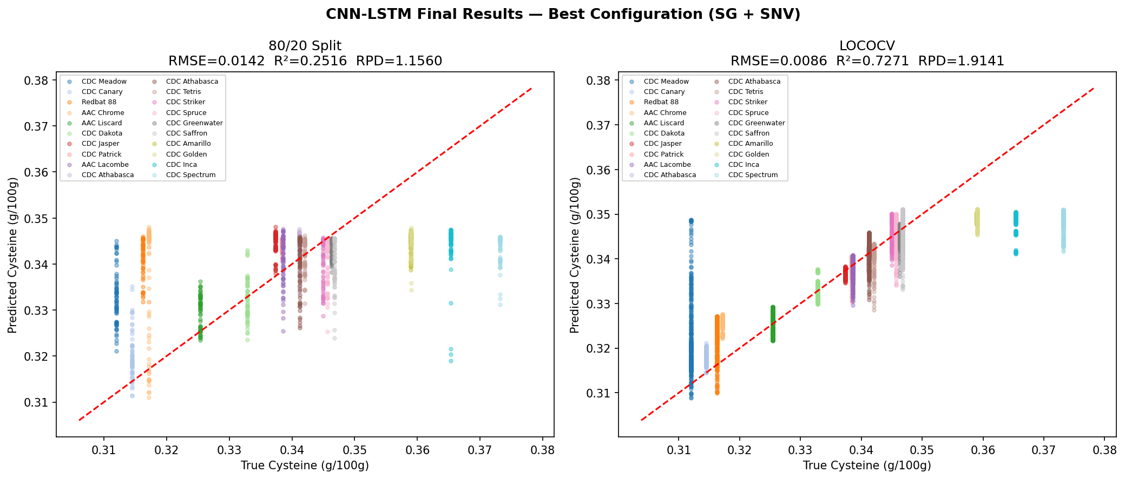
CNN-LSTM Final Results
Metric | 80/20 Split | LOCOCV
RMSE | 0.0142 | 0.0086
R² | 0.2496 | 0.7282
RPD | 1.1544 | 1.9183
Preprocessing | SG + SNV | SG + SNV
Best LOCO RMSE = 0.0086, the lowest prediction error among all three deep learning models.
LOCO RPD = 1.918, close to the acceptable value of 2.0, but standalone CNN performs better (RPD = 2.148).

Slide 17

Deep Learning Model Comparison
Model | Best Config | 80/20 R² | LOCO R² | LOCO RPD
CNN | SG + SNV | 0.7828 | 0.6863 | 1.786
CNN | Raw | 0.7027 | 0.7833 | 2.148
CNN-LSTM | SG + SNV | 0.2496 | 0.7282 | 1.918
CNN-LSTM | Raw | 0.0224 | 0.6959 | 1.813
LSTM | SG + MSC | 0.2348 | 0.6918 | 1.801
LSTM | Raw | 0.0335 | 0.6772 | 1.760
CNN with raw data performs best overall, with the highest LOCO $R^{2}$(0.7833) and RPD (2.148).
CNN LSTM gives the lowest LOCO RMSE (0.0086), showing the most accurate predictions.
All three deep learning models achieve positive LOCO $R^{2}$, demonstrating good cross cultivar generalization.
Models with an LSTM component have low 80/20 $R^{2}$, indicating limited within cultivar discrimination.

