Slide 1
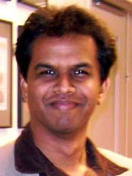

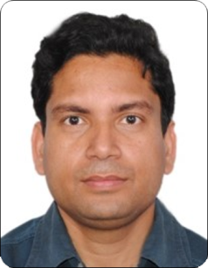
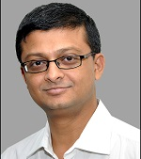
1st Semester
Chemistry Lab Course (CH – 1102)
3 January 2022
Instructors
Prof. Raja Shunmugam Prof. Alakesh Bisai
Prof. Debasish Haldar Prof. Rahul Banerjee

Slide 2
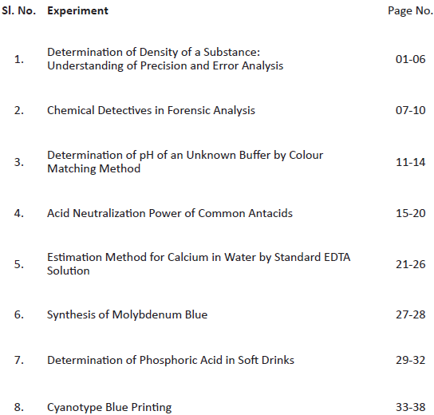

Slide 3
General Instructions
1. Attendance is mandatory. In case of illness etc. the student must contact the instructor. All labs must be completed in order to get a passing grade.
2. All data and results should be recorded directly in the lab notebook. The recording should include, title of the experiment, date of experiment, working procedure, results and calculations.
3. Send photograph of notebook to ch1102.2022@gmail.com
4. Instructor should review the data, before next experiment.
5. computer print outs may be directly pasted on the lab notebook.

Slide 4
Grading :
The lab grade will be given as follows:
Experiment ……….…………………………..10X8 = 80
4. END SEM ……….……………………………….20

Slide 5
Lab Safety
Lab coat
Shoes
Protective glass
Send data to ch1102.2022@gmail.com

Slide 6
Calendar
First Phase
January 7, 21, 28,
February 4, 11
MID SEM February 18
Second Phase
March 4, 11, 25
END SEM April 1

Slide 7
Teaching assistans
1. Mahesh Prasad
2. Surajit Singh
3. Ishita Ghosh
4. Ananda Shit 5. Debgopal Jana
6. Ranjit Murmu

