Slide 1
You tube link
https://www.youtube.com/watch?v=ZFAwcVq4zAg
https://www.youtube.com/watch?v=76YoDXP-3IE&feature=youtu.be

Slide 2
Determination of Density of a Substance: Understanding of Precision and Error Analysis
Accuracy versus Precision: Accuracy is a measure of how close your measured value is to the correct value. For example, if a substance has a density of 1.23 g/mL and you measure its density to be 1.24 g/mL, then you were accurate. The difference between the experimentally measured value and the accepted value is very small.
Precision is a measure of how close repeated measurements are to each other. For example, if you measure the same substance in four trials and get densities of 1.430 g/mL, 1.431 g/mL, 1.431 g/mL, and 1.429 g/mL, your measurements are very precise since the difference between the highest and lowest measurement (the range) is small. However, these measurements are not accurate since they differ greatly from the accepted value of 1.23 g/mL. Ideally, your measurements should be both accurate and precise. The figure below provides a pictorial representation of accuracy and precision in terms of golf.

Slide 3
Determination of Density of a Substance: Understanding of Precision and Error Analysis

Slide 6
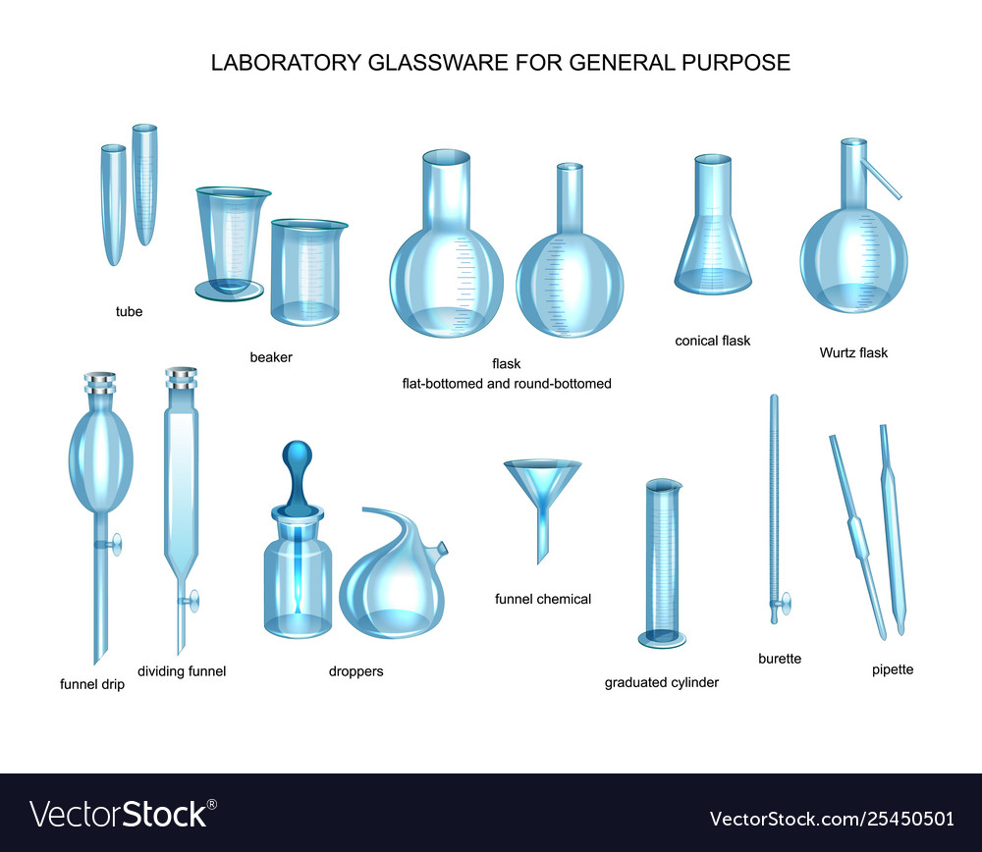

Slide 7
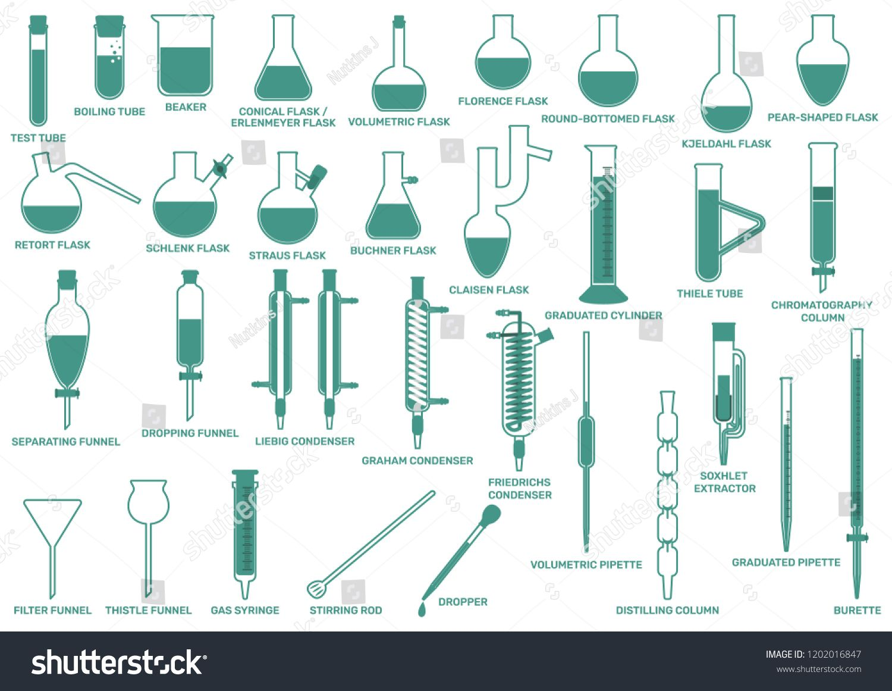

Slide 11
0.983

