Slide 1

Meetrack
– Project Management
PRESENTED BY
SUBMITTED TO
Krishnakant Sharma
Priyanshu Shukla
Akashi Gupta
Md. Farman Sir

Slide 2
Introduction
Meetrack is a project management tool.
This will provide a project leader to keep the record of performed task.
With this website, Team leader or any organization can keep the record of following things :
Status of project
Member of project
Duration of project

Slide 3
Technologies used
Sqlite
HTML 5
CSS
BootStrap
Django
JavaScript

Slide 4
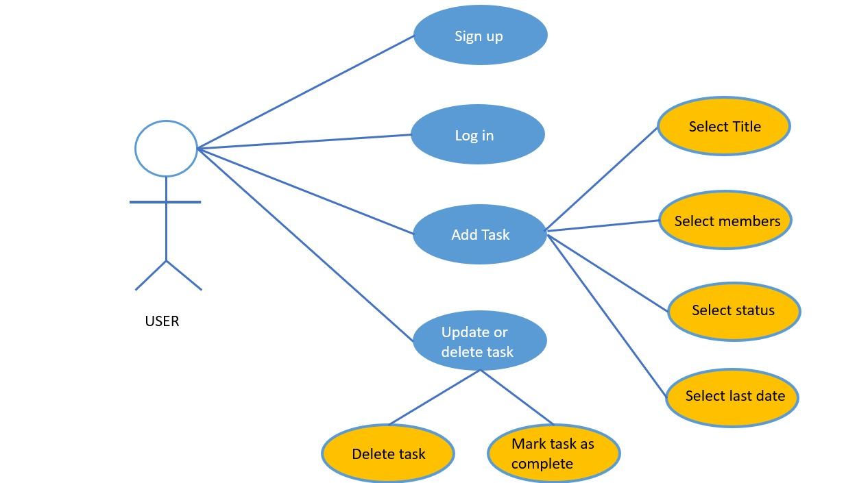
Use Case Diagram

Slide 5
Functional Requirements
Require Internet connection.
Provide accessibility to the website through browser.
Minimum 4 GB RAM for PC
Minimum android 6.0 for phone

Slide 6
Applications
Used to keep the track of Projects
Assign and Delete the Task
Organizations are recently developing Such Project Management Tool
They can also be used as to-do list

Slide 7
User Interface

Slide 8
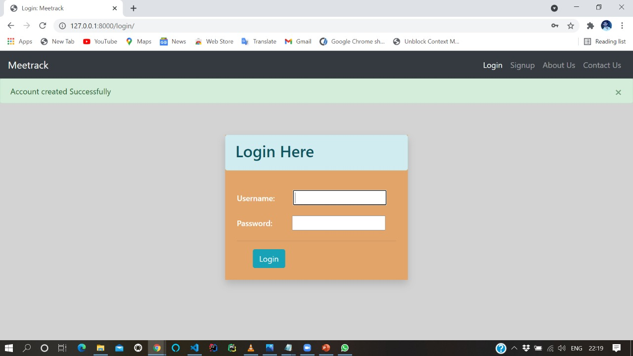
Log in

Slide 9
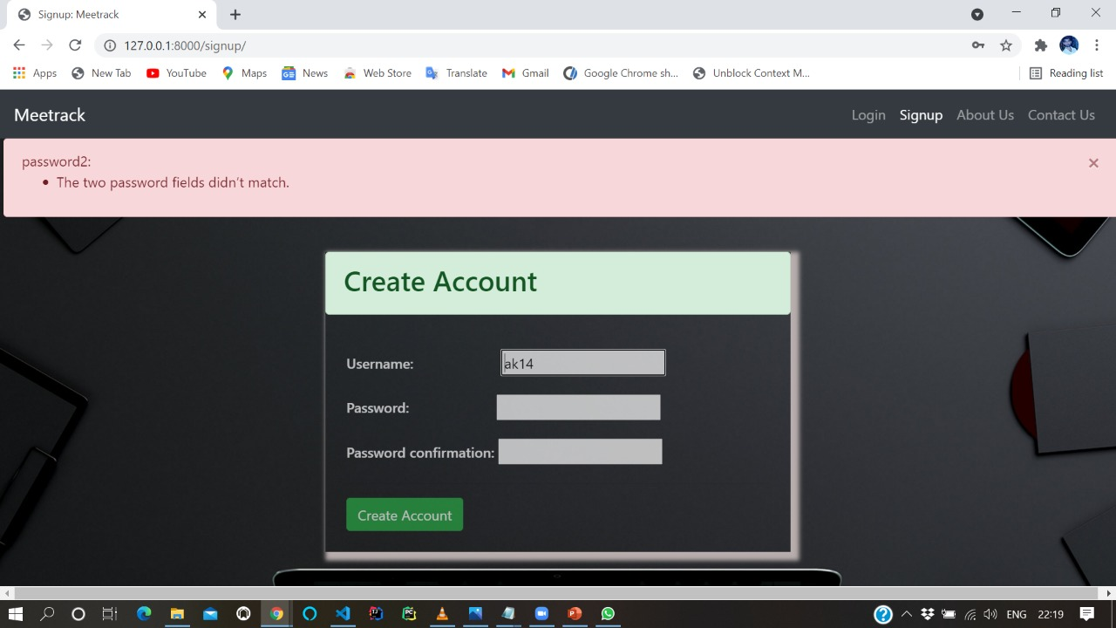
Sign up

Slide 10
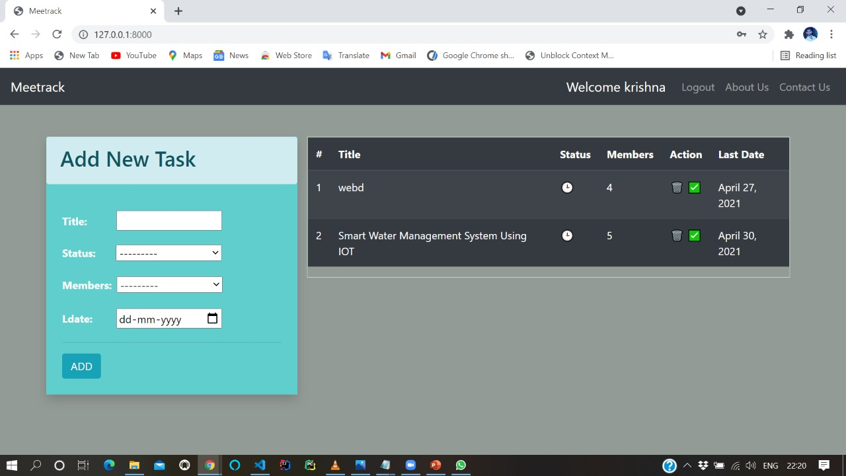
Home Page

Slide 11
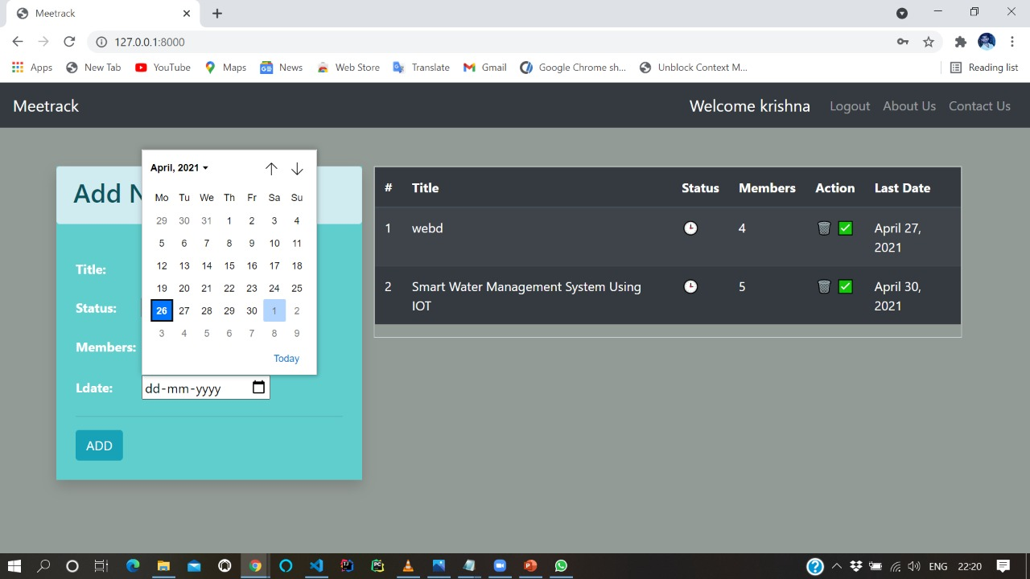
Task Assignment

Slide 12
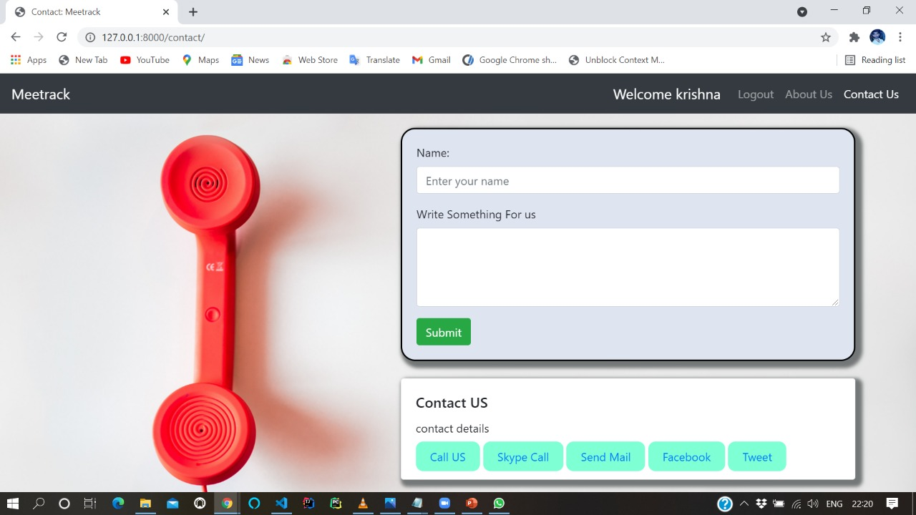
Contact Us

Slide 13
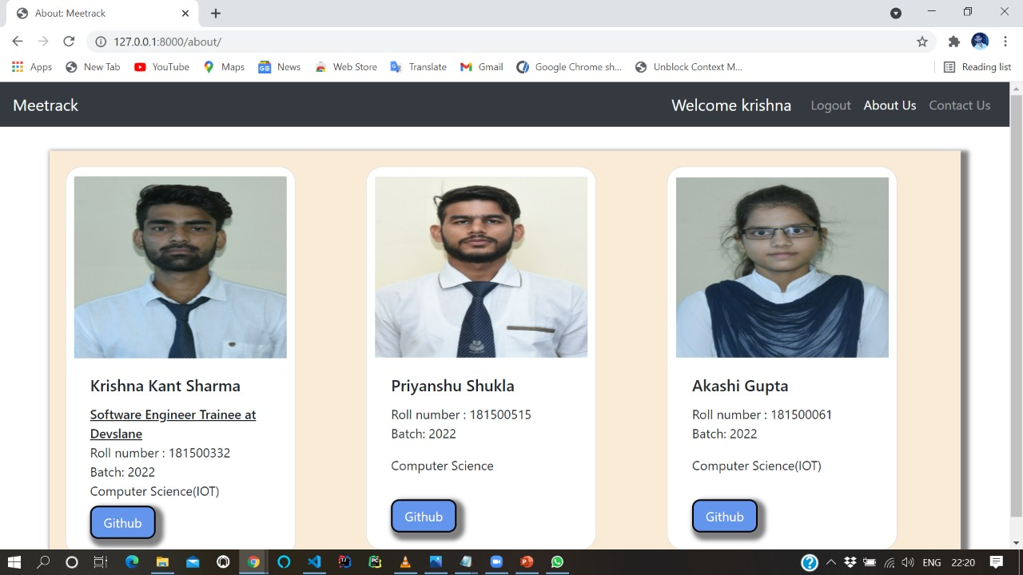
About Us

Slide 14
Testing
Testing Objectives
To ensure that during operation the system will perform as per specification.
To make sure that the system makes user requirement during operation.
Testing Principles
All tests should be traceable to user requirements.
Tests should be planned long before testing begins.

Slide 15
Conclusion
After working on the ‘Meetrack’ we would like to conclude that most of the work in this domain (website development) is currently worked upon by the students. But still there are many things which are need to be addressed. So basically by doing this project we are trying to focus the attention of Computer Science and Information Technology Students in this domain and urges them to work upon this domain as Big companies like Google , Yahoo are hiring people which has appropriate knowledge of FullStack Development and contributed most of the time to this domain.

