Slide 1
MediCost Lab
Predicting medical insurance costs with linear models, Bayesian methods and kernels
Priyanshu | Ashish Kumar | Salil Pratap Singh | Vedang Pratap Singh
Machine Learning course project | Unit 2: Linear Models
Notes:
Introduce the project: one interactive web app that applies every Unit 2 topic to a real medical insurance dataset.

Slide 2
An insurer asks two questions about every customer
A
What will this customer's yearly bill be?
B
Will this be a high-cost customer?
Regression. Target: charges, in US dollars per year.
Classification. Target: bill above the median of $9,386.
1,337
$9,386
3.8x
insurance customers
median yearly bill
smokers' average bill vs non-smokers'
Notes:
Regression predicts the yearly bill in dollars. Classification flags customers whose bill is above the median of $9,386; by construction that is half of them, so the baseline accuracy is 50%. Smokers are 20.5% of customers but their average bill is 3.8 times higher.

Slide 3
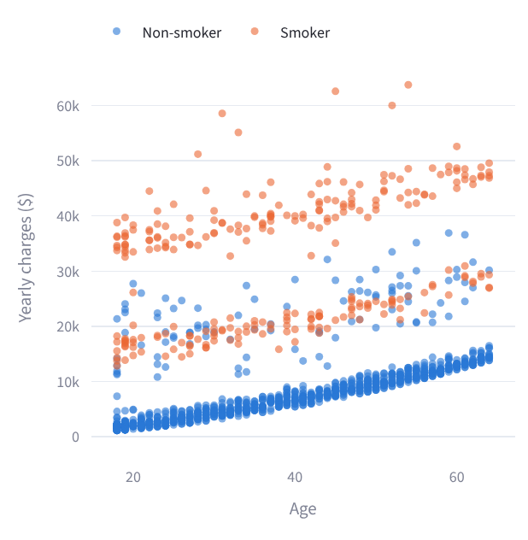
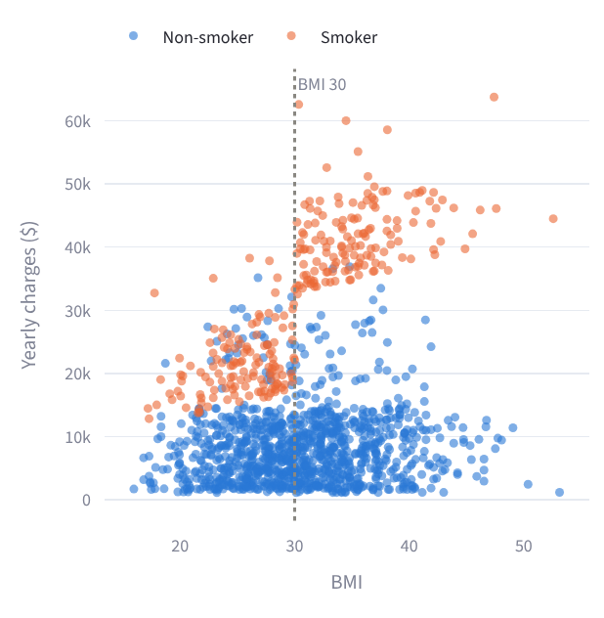
Smoking and BMI interact: smokers' bills jump at BMI 30
Six inputs
age
sex
BMI
children
smoker
region
Blue: non-smoker. Orange: smoker. Screenshots from page 1 of the app.
Notes:
Left: charges against age form three parallel bands; smokers (orange) occupy the upper two. Right: for smokers, charges jump at BMI 30, while for non-smokers BMI barely matters. This interaction is the key fact of the dataset: a purely linear model cannot represent it. Data: Medical Cost Personal dataset from Kaggle, 1,338 rows, one duplicate removed.

Slide 4
Seven app pages cover every Unit 2 topic
1
Data
2
Least squares and MLE
3
Robust, ridge, Bayesian
4
Classifiers
Explore the dataset
Hour 10
Hour 11
Hours 12, 13, 16
5
Laplace approximation
6
Kernels and SVM
7
Cost predictor
+
Infographic
Hour 14
Hours 15, 16
Hour 17 practice
Hour 18
Notes:
Built with Streamlit. Pages 2 and 3 are regression, 4 and 5 classification, 6 kernels for both, 7 the live demo. The hour 18 infographic is a separate PNG.

Slide 5
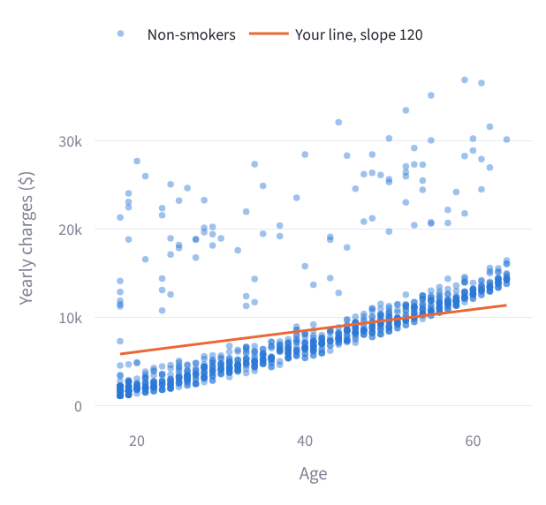
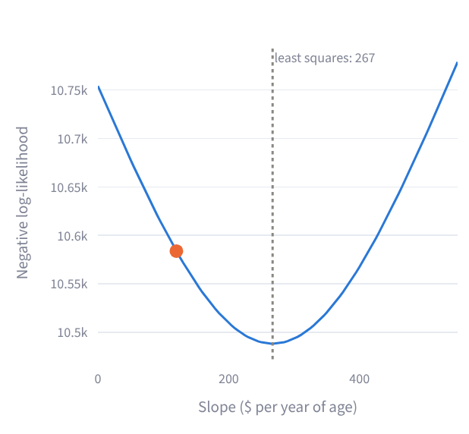
The likelihood is highest exactly at the least squares slope
$267
least squares slope per year of age
0.796
test R², all six features
$23,096
weight on smoker: the largest by far
Notes:
Hour 10. Assume y = w'x + Gaussian noise. Then maximising the log-likelihood over w is the same as minimising the sum of squared errors. The demo uses one feature, age, for non-smokers. The slider line (slope 120) is off the optimum; the negative log-likelihood curve bottoms out at the least squares slope of $267 per year of age. On all six features least squares reaches test R² 0.796, and the noise standard deviation at its MLE is about $6,100.

Slide 6
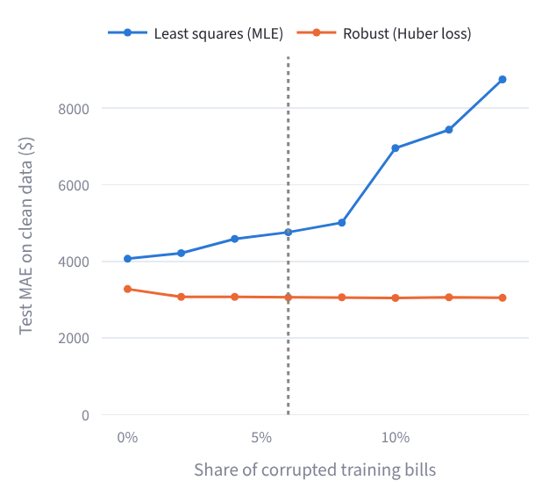
Huber regression barely moves when training bills are corrupted
$4,069 → $8,749
least squares test MAE: clean data to 14% corrupted
$3,278 → $3,049
Huber test MAE over the same range
On clean data Huber has the lower MAE but the higher RMSE: it fits the typical customer and gives up on the expensive few.
Notes:
Hour 11, robust regression. A random share of training bills is multiplied by 5 to mimic data-entry errors, and both models are tested on clean data. Least squares test MAE rises from $4,069 to $8,749 at 14% corruption. Huber stays near $3,049. Huber loss is quadratic for small errors and linear for large ones, so bad points pull less.

Slide 7
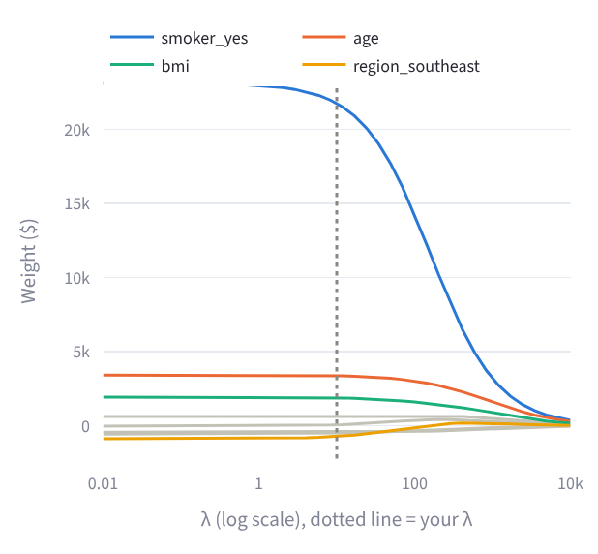
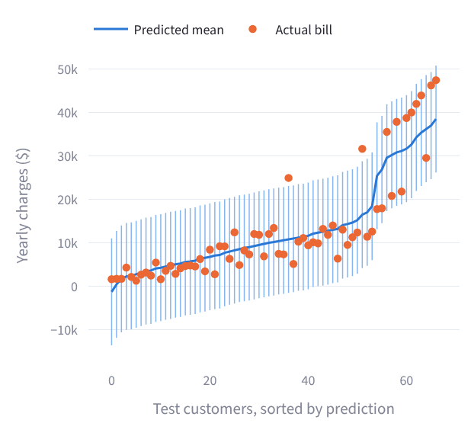
Ridge shrinks the weights; Bayesian regression adds an error bar
Ridge: weight against λ (log scale)
Bayesian: 95.2% of test bills fall inside the ±2 std bars
Notes:
Hour 11. Left: ridge coefficient paths; as lambda grows every weight shrinks toward zero. Ridge is the MAP estimate under a Gaussian prior. Right: Bayesian linear regression keeps a posterior over the weights, so each prediction has a predictive standard deviation. 95.2% of test bills fall within plus or minus two standard deviations (about $12,295).

Slide 8
The four linear models score R² 0.78 to 0.80; the RBF kernel reaches 0.87
Model | RMSE | MAE
Least squares (MLE) | $5,940 | $4,069
Robust (Huber loss) | $6,189 | $3,278
Ridge regression | $6,084 | $4,227
Bayesian linear regression | $5,947 | $4,077
Kernel ridge (RBF) | $4,774 | $2,862
Errors in US dollars per year on 335 test customers.
Notes:
Test set of 335 customers. The four linear models differ only slightly because they share the same linear form. Kernel ridge with an RBF kernel captures the smoker and BMI interaction, lifting R² and cutting the mean absolute error by about $1,200.

Slide 9
Seven of eight classifiers reach about 90% accuracy; Naive Bayes does not
92.5%
best accuracy: SVM with RBF kernel (AUC 0.965)
90.7%
logistic regression, LDA within 1 point of it
74.3%
Naive Bayes accuracy, despite AUC 0.941
Notes:
Hours 12, 13 and 16. Target: bill above the median, so the baseline is 50%. LDA is the discriminant-function approach, Naive Bayes is generative, logistic regression is discriminative. The SVM with an RBF kernel is best on both accuracy and AUC. Naive Bayes is the outlier at 74% accuracy, explained on the next slide.

Slide 10
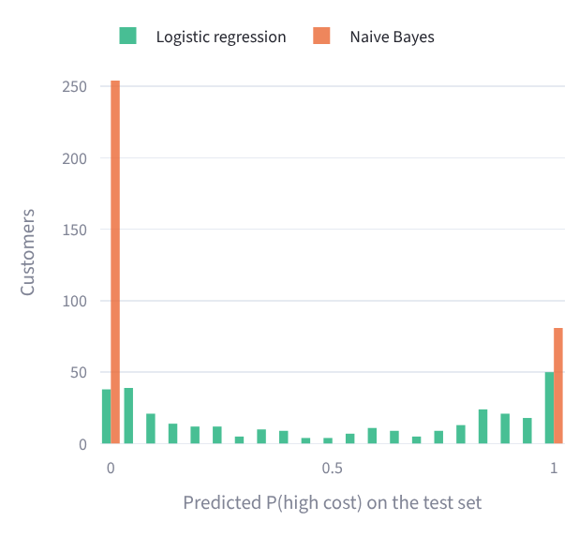
Naive Bayes ranks customers well but its probabilities are distorted
G
Generative
Models p(x | class), then applies Bayes rule. Wrong feature assumptions distort the probabilities.
D
Discriminative
Models p(class | x) directly. No assumption about how features are distributed.
24% of customers labelled high cost by Naive Bayes; the true share is 50%.
Notes:
Hour 13, generative versus discriminative. Naive Bayes assumes features are independent given the class and Gaussian. The one-hot columns are neither. Its predicted probabilities pile up at 0 and 1, and it labels only 24% of test customers as high cost when the truth is 50%. Precision is 100% but recall only 48.5%. Its AUC is still 0.94 because the ordering of customers is fine. Logistic regression models p(class | x) directly and stays calibrated.

Slide 11
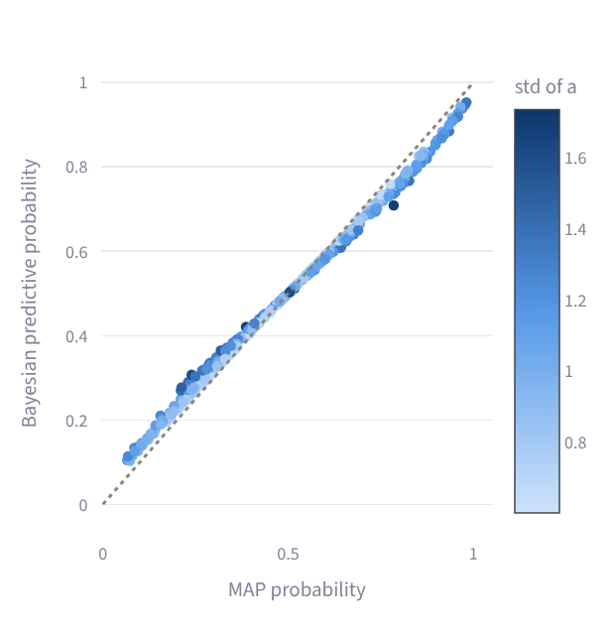
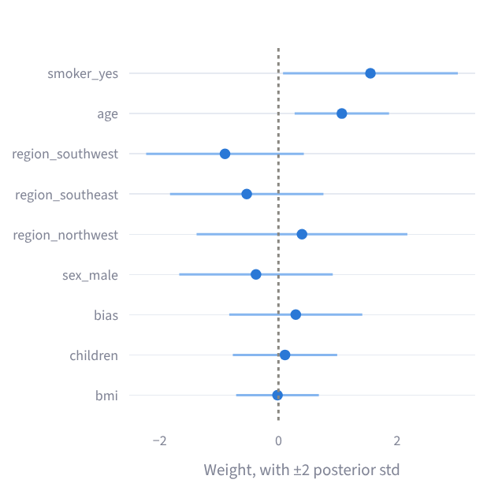
With 40 training customers, weight uncertainty pulls predictions toward 0.5
0.076
largest shift toward 0.5
The 0.5 decision boundary never moves; only the confidence changes.
Notes:
Hour 14. Logistic regression has no closed-form posterior, so the Laplace approximation fits a Gaussian at the MAP weights with covariance from the Hessian. Left: each test customer's MAP probability against the Bayesian predictive probability, trained on only 40 customers; points bend toward 0.5 by up to 0.076. Right: posterior mean and plus or minus two standard deviations for each weight; only smoker and age are clearly non-zero with so little data. With all 1,002 training customers the two predictions agree. Implemented from scratch in models.py.

Slide 12
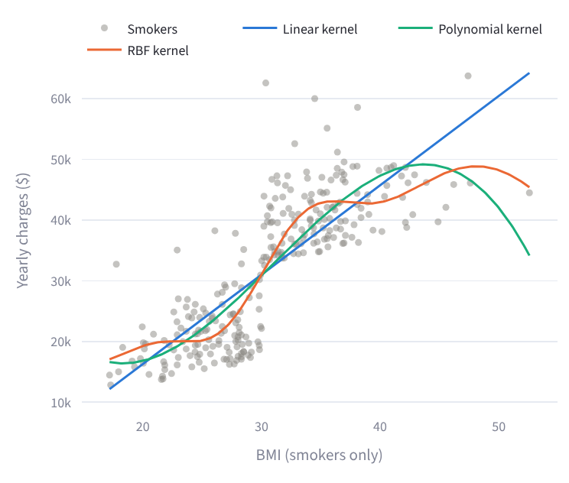
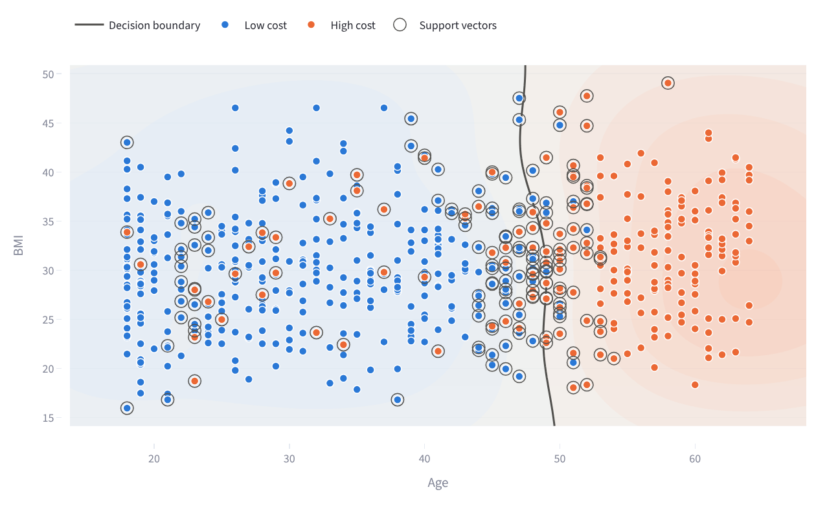
An RBF kernel follows the jump at BMI 30 that a straight line cuts through
Kernel ridge regression, smokers only
SVM boundary, non-smokers: blue = low cost, orange = high cost
Notes:
Hours 15 and 16. Left: kernel ridge regression on smokers' charges against BMI with linear, polynomial and RBF kernels. Only the RBF kernel follows the step. Right: SVM decision boundary on age and BMI for non-smokers; the boundary is essentially an age threshold, so here a linear kernel does as well as RBF. Kernels help where there is a real non-linearity, not everywhere.

Slide 13
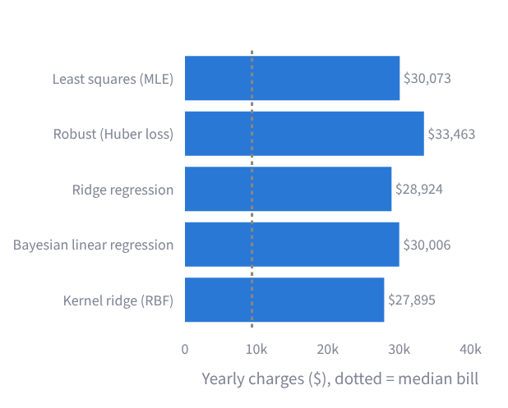
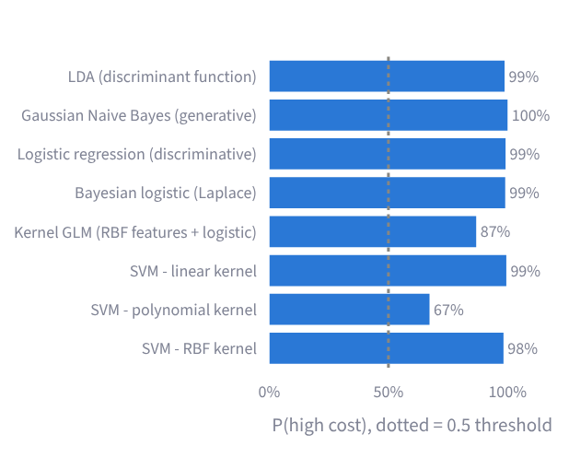
Live demo: a 35-year-old smoker is rated high cost by all eight classifiers
Notes:
Hour 17 practice. The predictor page takes one customer and shows every regression estimate and every classifier's probability. For a 35-year-old female smoker with BMI 28 and one child, the estimates range from about $27,900 (kernel ridge) to $33,500 (Huber), and all eight classifiers say high cost.

Slide 14
What the project shows, and where it stops
✓
Findings
!
Limits
Smoking is the dominant cost driver: about +$23,000 a year.
Linear models score R² 0.78 to 0.80; the RBF kernel reaches 0.87 by learning the smoker and BMI interaction.
Huber regression stays stable under corrupted data; least squares does not.
Naive Bayes shows that a good ranking does not mean good probabilities.
US textbook dataset of 1,337 customers; not Indian insurance pricing.
The high-cost label is derived from the charges target.
Hyperparameters are set by hand, not tuned by cross-validation.
One fixed train and test split; no confidence intervals on the scores.
Notes:
Summarise: the linear family behaves almost identically on clean data; the differences appear with outliers, small samples and non-linear structure. Be upfront about the limits.

Slide 15
Thank you
Questions and live demo
Data: kaggle.com/datasets/mirichoi0218/insurance
Run: pip install -r requirements.txt, then streamlit run app.py
Priyanshu | Ashish Kumar | Salil Pratap Singh | Vedang Pratap Singh
Notes:
Offer to run the app live: start with page 7, then page 3 to move the corruption slider, then page 6 to change the kernel.

