Slide 1

NHAI Secure Biometric Attendance System
Offline Edge-AI Face Verification · 3-State Blink Liveness Detection · Dynamic Geofencing · Datalake 3.0 Integration
Team: Priyanshu Solanki · Ayush Saini · Ansh Aryan
NHAI · June 2026

Slide 2
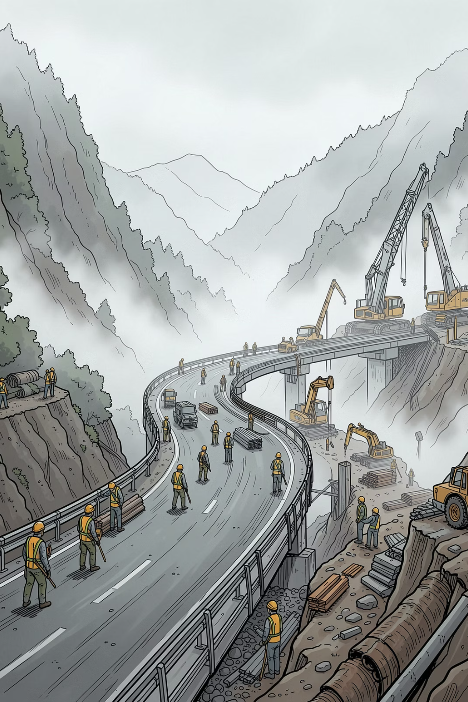

The Challenge: Remote Highway Construction Sites
FIELD REALITIES
Zero / Intermittent Network
Cloud-based systems fail across remote passes, forests, and rural valleys.
Photo & Video Spoofing
Printed photos and video replays let ghost workers clock in remotely.
Fluid Project Zones
Shifting boundaries demand dynamically reconfigurable geofences.
ADMINISTRATIVE IMPACT
Ghost Worker Profiles
Manual registers inflate headcounts and enable data fraud.
Biometric Data Exposure
Third-party SaaS clouds risk NHAI worker biometric data.
Delayed Data Sync
Weeks of latency syncing logs to NHAI Datalake via spreadsheets.

Slide 3

The Edge-AI Solution: Offline-First Biometric Attendance
100% on-device processing. No cloud. No network dependency. No compromise.
Edge-AI ML Core
TFLite + MediaPipe runs entirely on-device. Zero server calls.
Active Liveness Detection
3-state blink machine blocks all photo and video spoofing.
Smart Geofencing
Haversine-powered location lock with circular and square boundary modes.
Auto Sync Engine
Offline SQLite queue auto-uploads to NHAI Datalake 3.0 on reconnect.

Slide 4

System Architecture: Four Autonomous Layers
Camera Input
Storage & Sync
Face Embedding
End-to-end pipeline: raw camera frames flow through detection, embedding, and matching stages before being stored locally and queued for secure sync to NHAI Datalake 3.0.
1
2
Presentation & Camera Interface
On-Device ML Engine
React Native TSX screens with alignment overlays and laser sweep animations.
MediaPipe landmark tracking + TFLite MobileNet CNN → 128-dim vectors.
3
4
Local SQLite Storage
Connectivity & Auto-Sync
5 relational tables: employees, sites, attendance, sessions, sync_queue.
NetInfo polling, HTTP POST to AWS Datalake 3.0 REST API.

Slide 5

Local Face Recognition: 128-Dimensional Edge-AI Matching
Two-Step Recognition Pipeline
Cosine Similarity Formula
Step 1 — MediaPipe Face Detection
Detects face bounding box, computes eye open probability at 30 fps. ~2.4 MB memory footprint.
Step 2 — TFLite MobileNet CNN
Converts cropped face region into a 128-dimensional floating-point embedding vector representing unique facial geometry ratios.
A = live face vector · B = registered SQLite vector
≥ 0.65 = MATCH CONFIRMED
Invariant to lighting changes and camera noise. Euclidean Distance fallback supported.

Slide 6
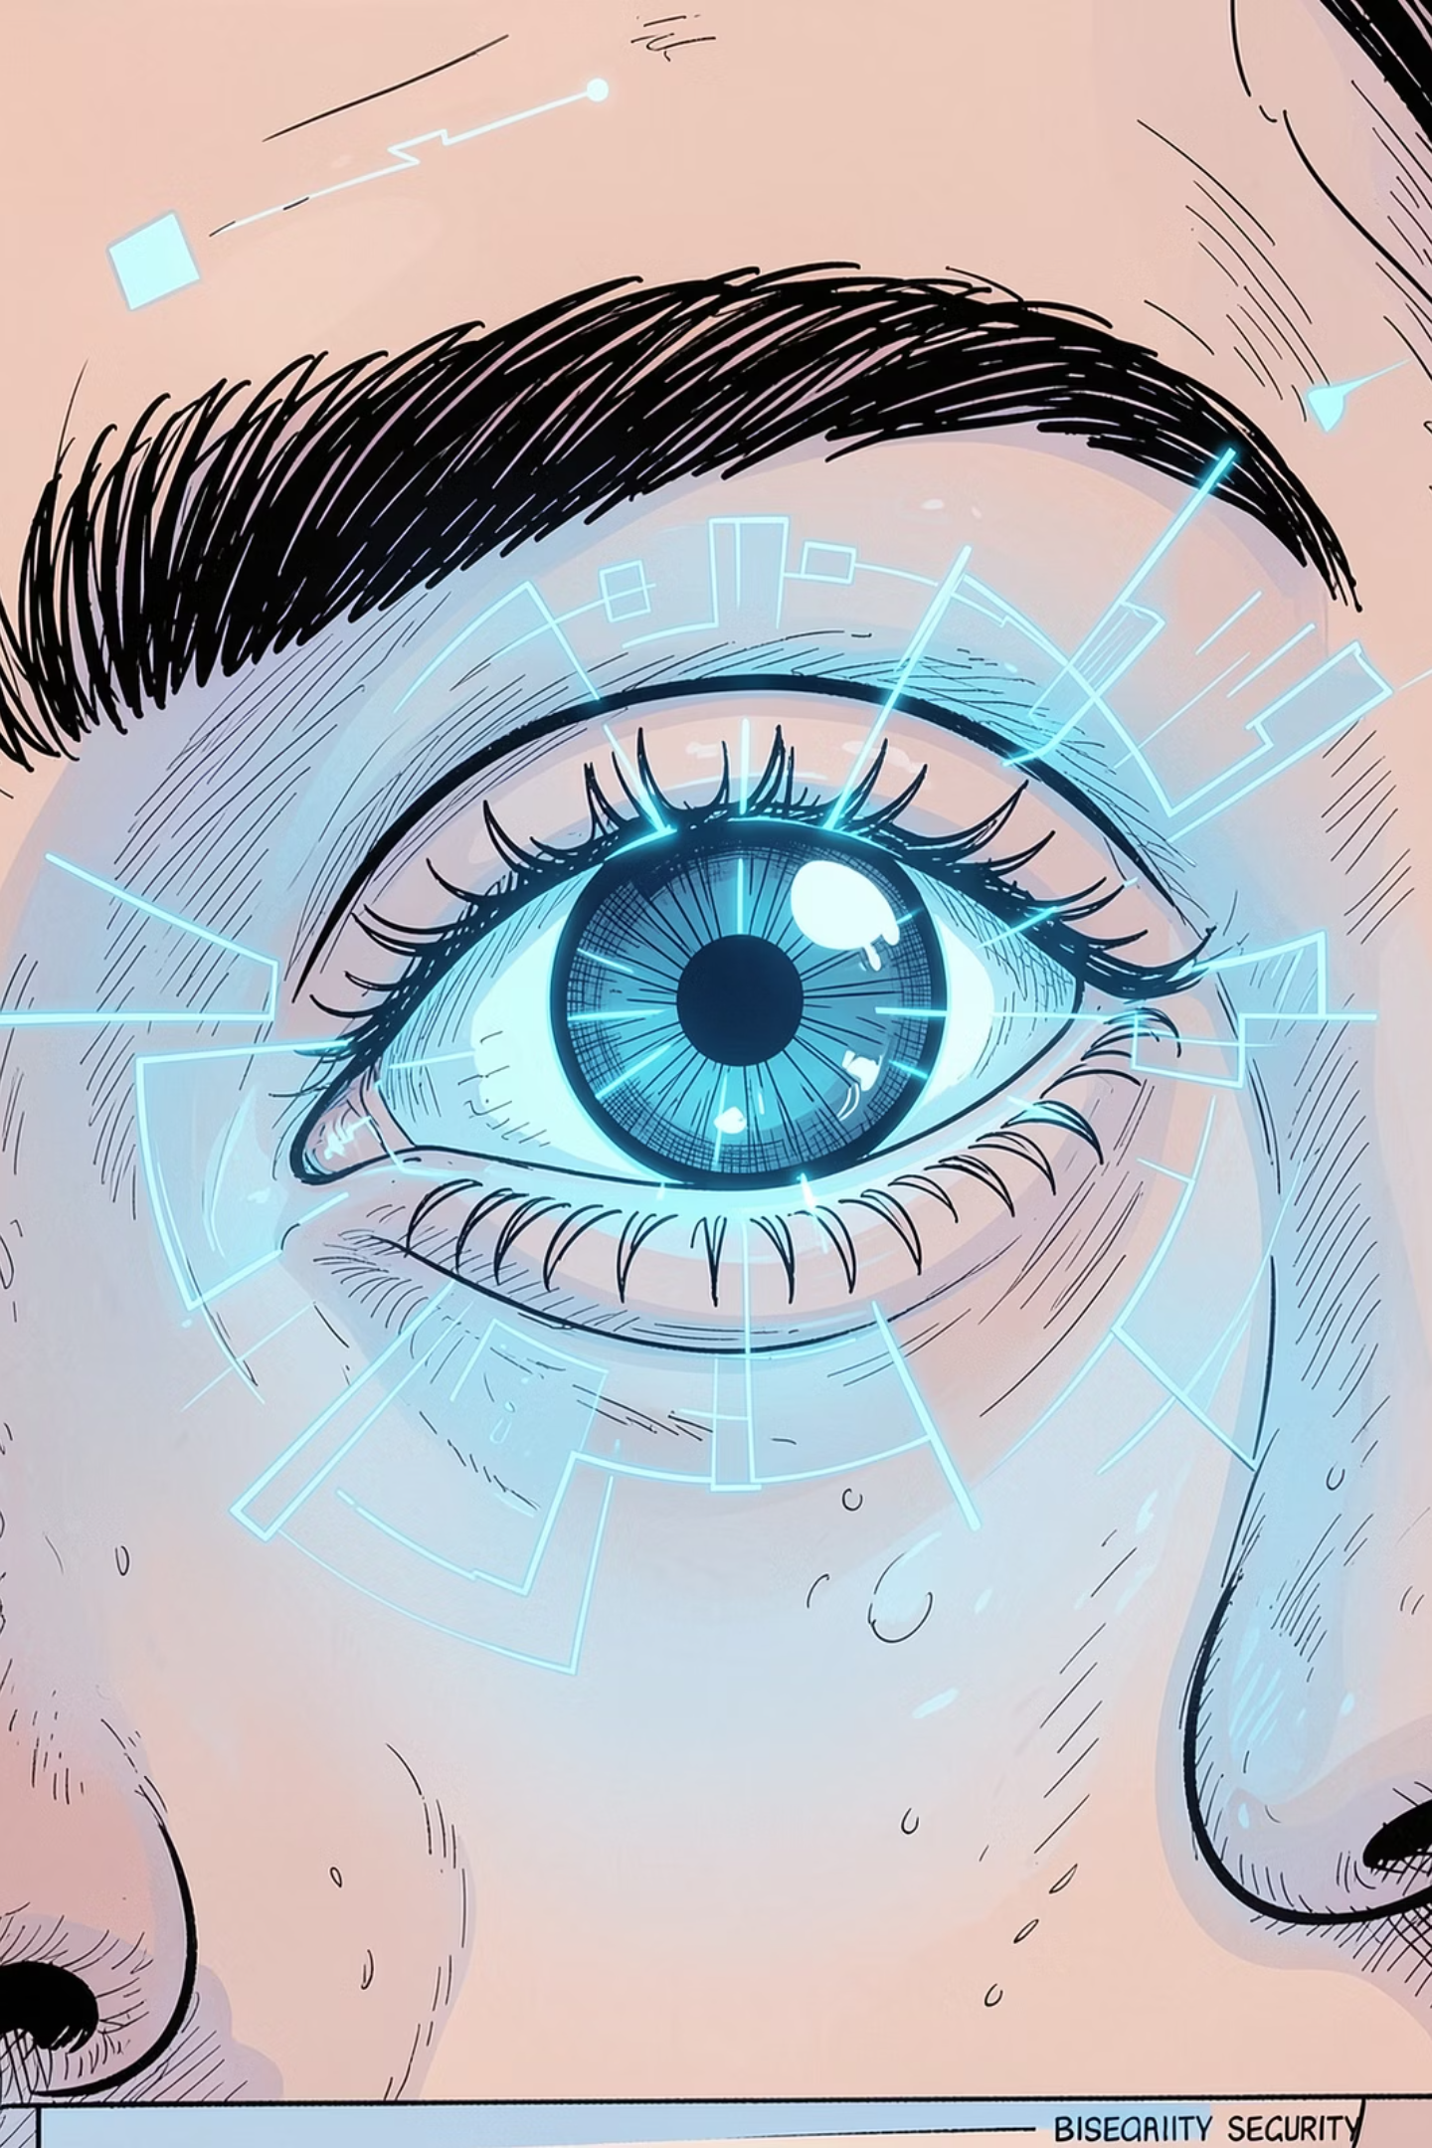



3-State Blink Liveness: No Live Face, No Entry
Blocks printed photos, screen replays, and all passive spoofing attacks — processed at 30 fps via native ML Kit frame scanning.
State 1 — Eyes Open
Face aligned, eyes open. Avg probability ≥ 0.70.
State 2 — Eyes Closed
User performs natural blink. Avg probability ≤ 0.25.
State 3 — Blink Confirmed
Eyes re-open, completing the blink cycle. Face comparison runs only now.

Slide 7
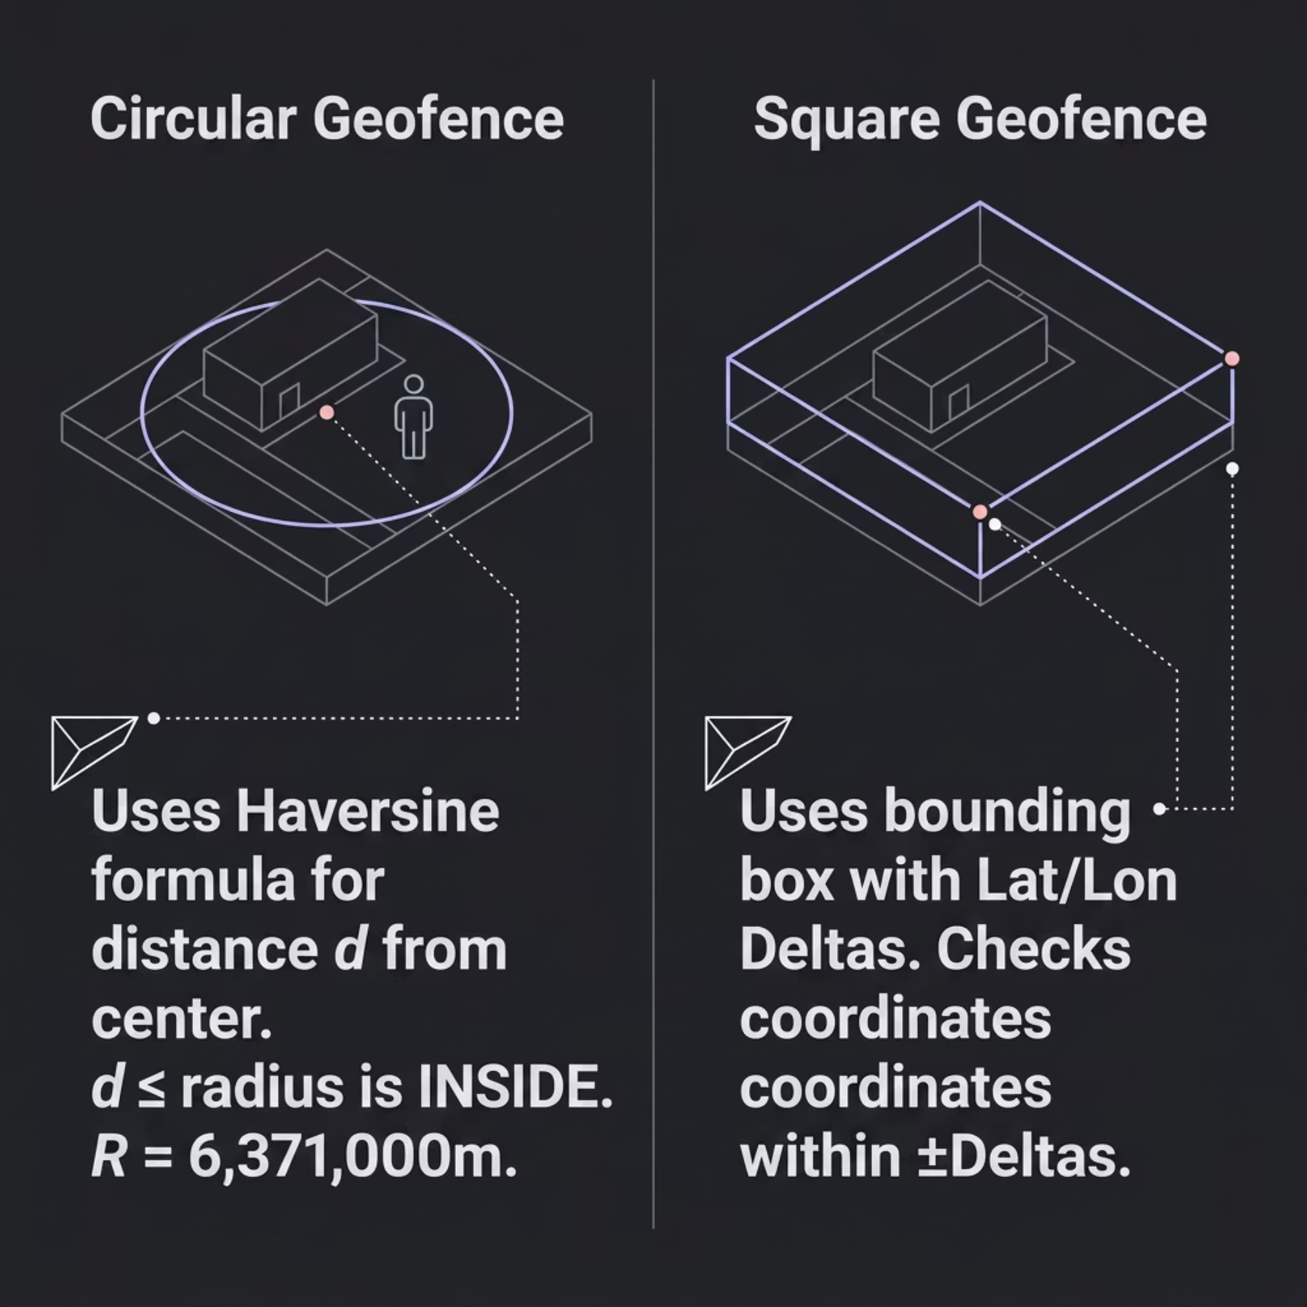
Dynamic Geofencing: Precise On-Site Boundary Enforcement
Admin Configuration Features
Interactive Leaflet.js map for admin pin-drop configuration
Supports both circular and square boundary types
GPS Fallback: defaults to NHAI HQ Delhi (28.5702°N, 77.2241°E) if signal lost — flags log as 'Unable to fetch location'
Search by address or tap map to capture GPS coordinates
Auto-generates unique Site IDs (e.g. SITE_MEERUT_HIGHWAY_3920)

Slide 8
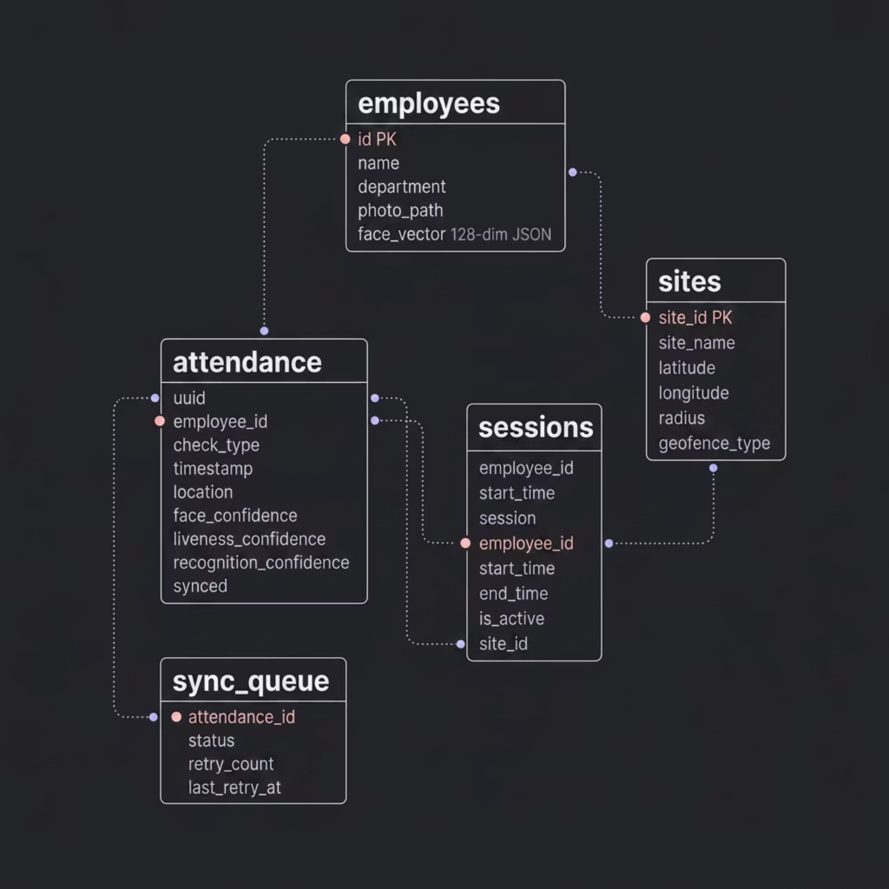

Offline-First SQLite Architecture: 5-Table Relational Schema
Schema Design
Five relational tables enforce data integrity across the full attendance lifecycle — from on-device registration through offline logging to cloud sync.
Performance Indexes: idx_employee_id · idx_timestamp · idx_synced · idx_session_employee — query latency kept under 15 ms.

Slide 9
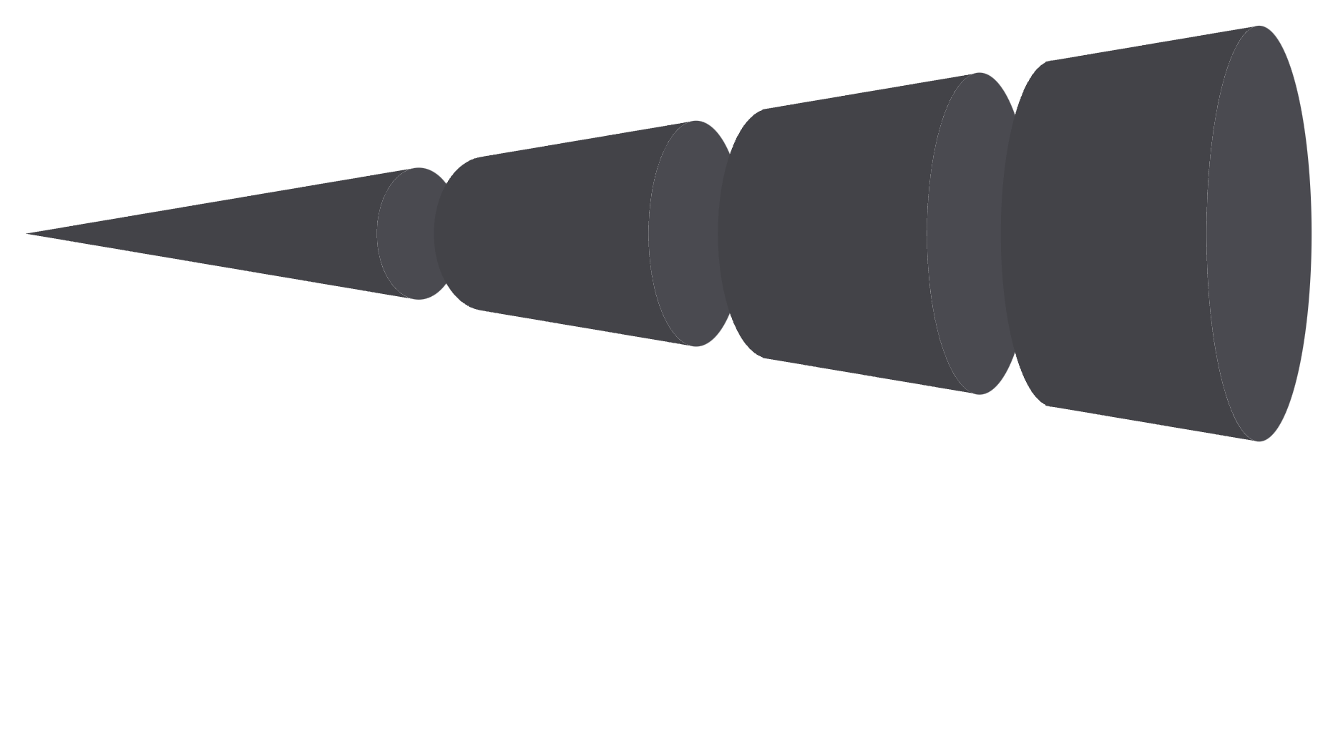
Datalake 3.0 Auto-Sync: Zero Data Loss, Zero Manual Upload
Write Offline Log
Detect Network
Data is recorded locally on the device.
Upload POST
The application checks for an active connection.
Local data is sent to the server.
Mark Synced
The local record is updated as synchronised.
NetInfo continuously polls network state, waking the sync engine immediately on reconnect. Pending records upload in order of creation via HTTP POST to NHAI Datalake 3.0 AWS endpoints.
0
100%
<500B
Manual Uploads
Auto Sync Rate
Per Log Entry
Fully automated — no human intervention required.
Every record syncs automatically on network reconnect.
Ultra-lightweight payloads minimise bandwidth consumption.

Slide 10
User Experience: Complete Verification Flow
01
02
Employee Login
Liveness Check
Enter Employee ID + Department → verified against local SQLite.
Blink detection prompt with eye probability overlay UI.
03
04
Face Scan
Matching
Laser sweep animation + face alignment guide overlay.
Cosine similarity calculation running against stored vector.
05
06
Result Receipt
Sync Dashboard
Check-In/Check-Out confirmation with confidence %, site name, session duration, UUID.
Online/offline banner, date filter chips, log index, key metric cards.

Slide 11
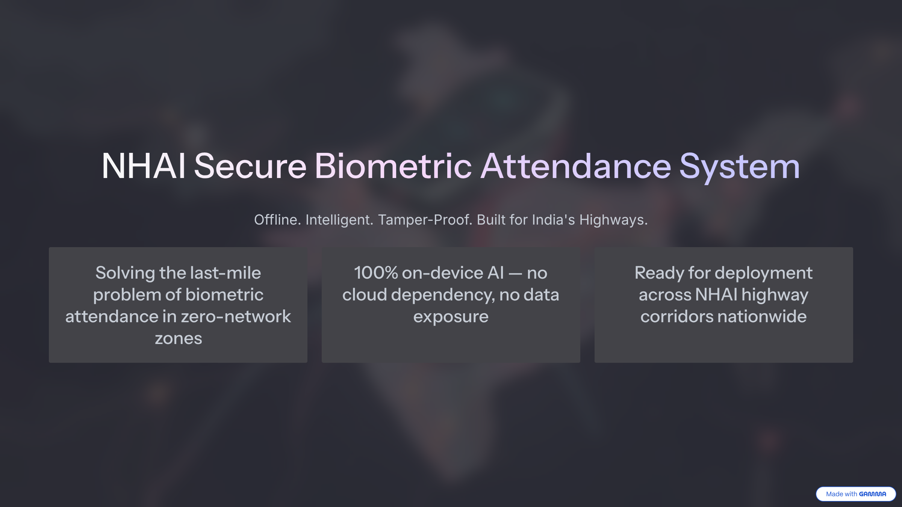

Slide 12
Thank You
We appreciate your time and attention today. We are confident our Edge-AI solution can transform biometric attendance for NHAI.

