Slide 1
SMART INDIA HACKATHON 2026 · GOVERNMENT OF INDIA · MINISTRY OF EDUCATION & AICTE
PROBLEM STATEMENT ID: SIH26056 | THEME: SMART AUTOMATION | CATEGORY: SOFTWARE
REAL-TIME AIRFARE PRICE INDEX FOR INDIA
AeroCPI + AeroGuide
MEASURE THE MARKET. EXPLAIN THE MOVEMENT. GUIDE THE DECISION.
Developed by Team BuzzCodeX | 36K+ Persisted Observations | 140 Tier-1 Panel Cells | 3 Live Ingestion Paths
01 THE MARKET CHALLENGE
• 150M+ domestic air travellers face extreme price volatility across routes, carriers, and horizons.
• Standard CPI captures lagged physical goods; airfares change continuously by minute and seat class.
• Lack of high-frequency price indices leaves policymakers and travellers without real-time signals.
02 DUAL-LAYER SOLUTION
• AeroCPI: Experimental economic airfare index using DGCA passenger weights & Jevons geometric aggregation.
• AeroGuide: Consumer intelligence layer delivering explainable BOOK / WAIT / WATCH fare decisions.
• 5A Log-Linear Econometric Decomposition: Carrier, Horizon, DOW, Seasonality, Route.
03 SCIENTIFIC DISCIPLINE
• Multi-Source Ingestion: Google Flights, EaseMyTrip Scrapy, Duffel API pilot.
• Evidence-Gated ML Gate: Forecasting strictly locked (0/7 pairs) until longitudinal depth is proven.
• Immutable Cryptographic Provenance: Every quote tied to SHA-256 raw HTML/JSON capture.
METHODOLOGY BOUNDARY: AeroCPI is an independent prototype measurement system for SIH 2026. It is not official MoSPI CPI.

Slide 2
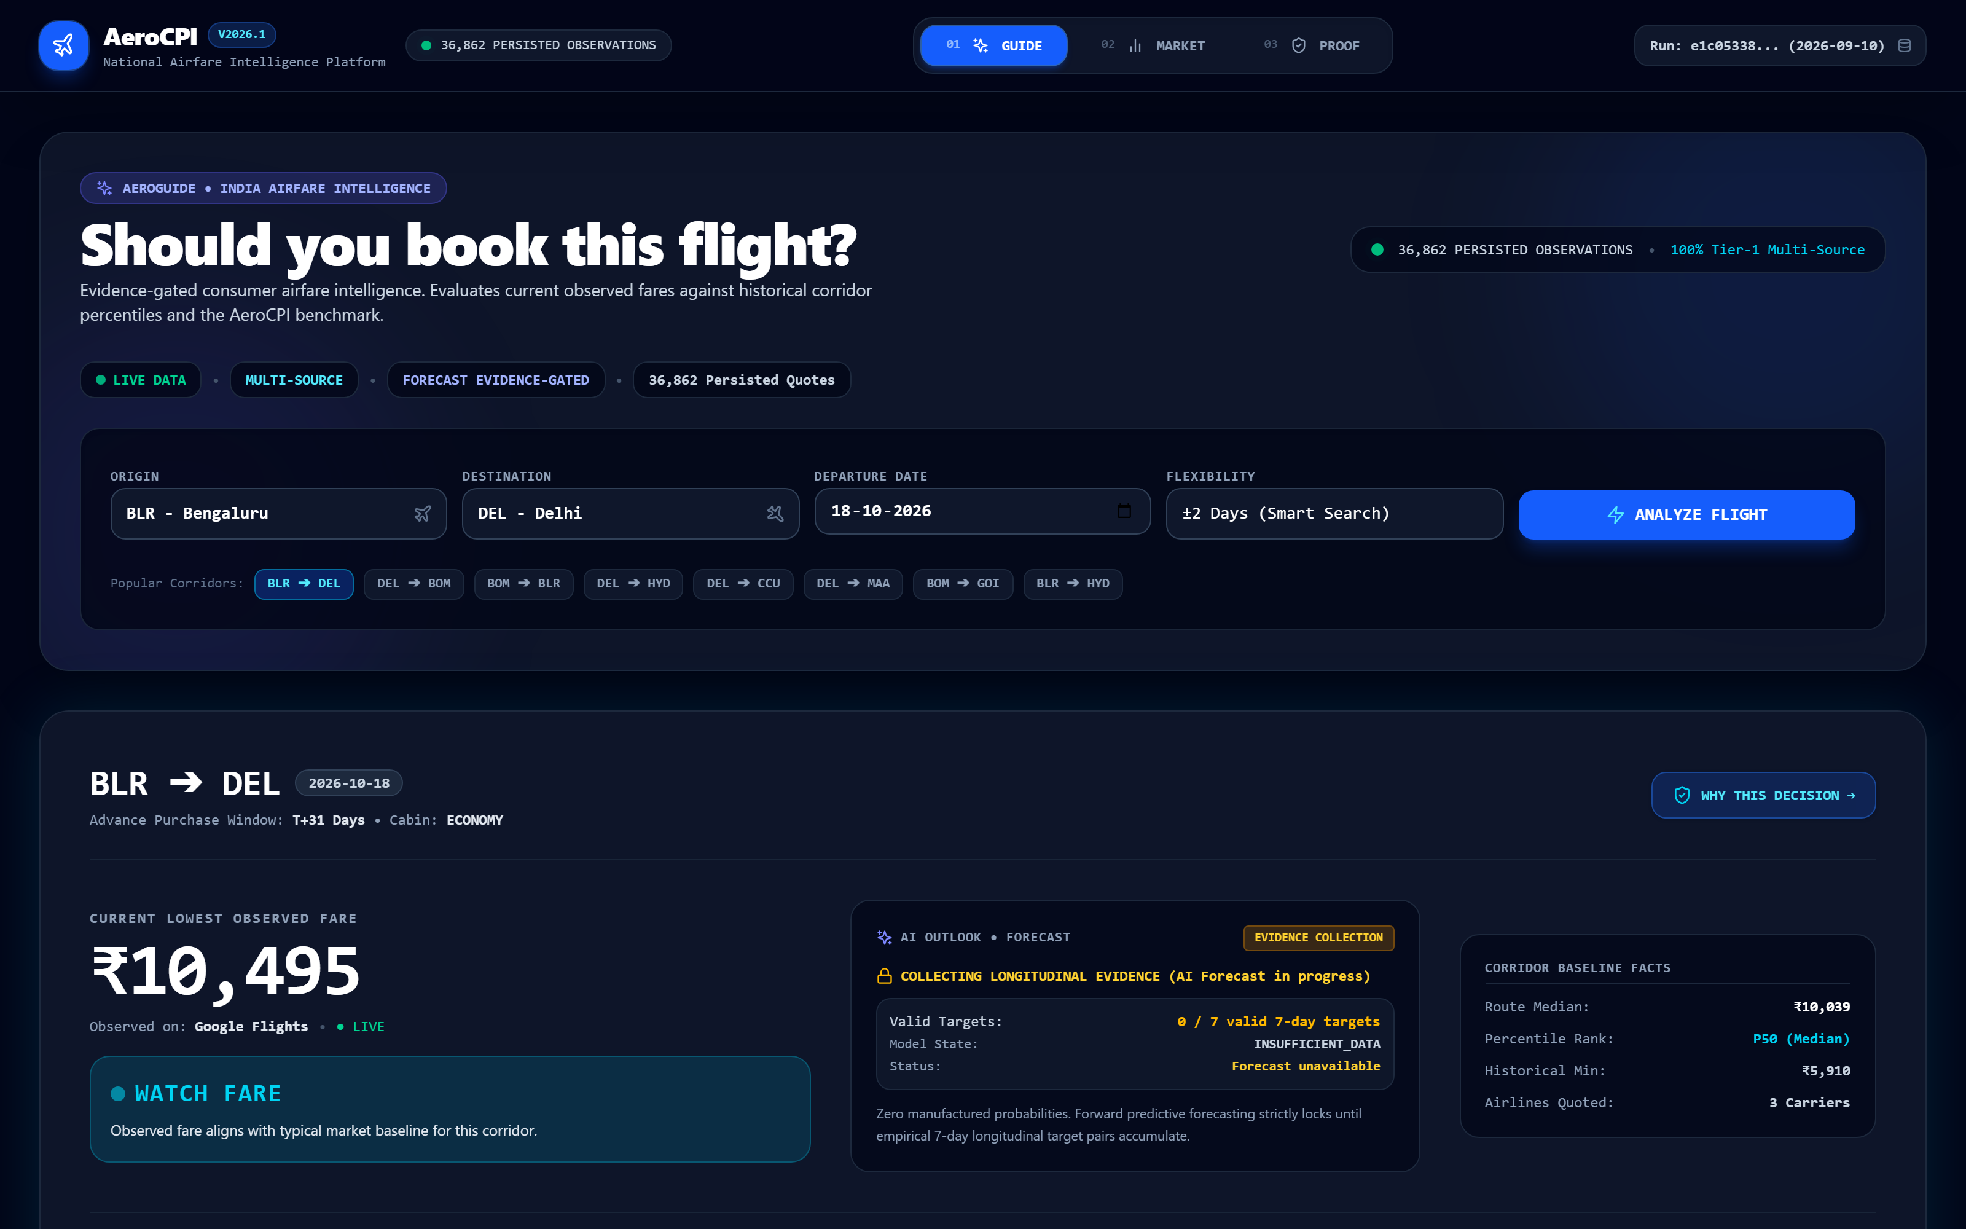
SMART INDIA HACKATHON 2026 | TEAM BUZZCODEX | PROBLEM STATEMENT ID: SIH26056 | THEME: SMART AUTOMATION
AEROCPI + AEROGUIDE: PROPOSED SOLUTION
FROM BASIC SCRAPING TO AN AUDITABLE MEASUREMENT & CONSUMER INTELLIGENCE PLATFORM
CORE INNOVATION
THE PROBLEM WE SOLVED
01 Multi-Dimensional Volatility
Airfares vary simultaneously across route distance, airline carrier, departure date, booking lead time (T+1 to T+60), and booking platform.
02 Cross-Source Market Dispersion
Different sources show materially different fare distributions (e.g. Google Flights vs EaseMyTrip median spread of 5.45%). A single source skews reality.
03 The Need for Trust & Auditability
Travellers and researchers distrust opaque algorithms. Every decision must be mathematically comparable, explainable, and provable.
MEASUREMENT PIPELINE
➔ OBSERVE
Multi-source extraction (Google, EaseMyTrip, Duffel)
➔ NORMALIZE
Standardized 10-field canonical quote schema
➔ MEASURE
Jevons geometric index + DGCA passenger weights
➔ COMPARE
Cross-source agreement lab & fare dispersion
➔ GUIDE
Explainable BOOK / WAIT / WATCH policy engine
➔ VERIFY
SHA-256 provenance & calculation manifests
AEROGUIDE CONSUMER INTELLIGENCE LAYER
🟢 1. MEASURE
National airfare movement across 10 trunk routes using DGCA passenger weighting.
🔵 2. EXPLAIN
Route & source pricing drivers decomposed via 5A log-linear attribution.
🟣 3. VERIFY
SHA-256 provenance hashes & evidence-gated forecasting safeguards.
CORE DISTINCTION: We did not stop at scraping. We engineered a national measurement layer AND an auditable consumer decision engine.

Slide 3
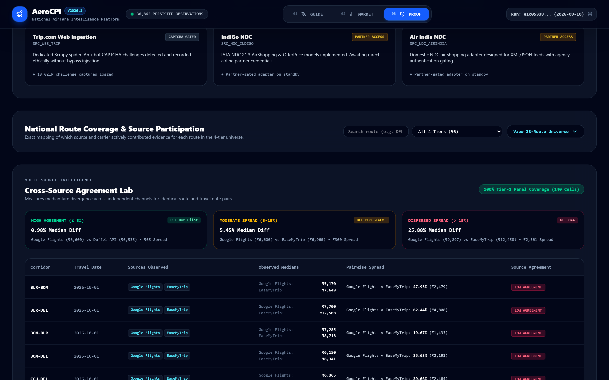
SMART INDIA HACKATHON 2026 | TEAM BUZZCODEX | PROBLEM STATEMENT ID: SIH26056 | THEME: SMART AUTOMATION
TECHNICAL APPROACH
MULTI-SOURCE INGESTION ➔ CANONICAL OBSERVATION ➔ JEVONS INDEX ➔ EVIDENCE-GATED DECISIONS
ARCHITECTURE
01 SOURCE COLLECTION
02 CANONICAL SCHEMA
03 QUALITY & PROVENANCE
04 INDEX ENGINE
05 AEROGUIDE ENGINE
06 AUDIT & EVIDENCE
• Google Flights (Live)
• EaseMyTrip (Scrapy)
• Duffel API (Pilot)
• NDC Partner Adapters
• Route & Travel Date
• Search Timestamp
• Airline & Cabin
• Base, Tax, Total Fare
• Stops, Duration, APW
• Deduplication filter
• Comparability rules
• SHA-256 raw capture
• Quote fingerprinting
• Anomaly thresholds
• 10 DGCA trunk routes
• Jevons geometric mean
• AeroCPI Headline
• 5A Log-Linear model
• Advance Horizon APW
• Cross-Source Spread
• Airline Intelligence
• Flexible Dates Matrix
• Decision Policy Engine
• 11-Node Decision Trace
• Manifests
• Reproducibility CLI
• ML Gate: LOCKED
• 301 backend tests
• Immutable audit trail
EVIDENCE: CROSS-SOURCE AGREEMENT & DECISION TRACE
MATHEMATICAL FORMULATION (JEVONS INDEX)
I_h = 100 · exp( Σ w_r · ln( J_{r,h} / 100 ) )
Where w_r is DGCA annual route passenger share, and J_{r,h} is the geometric mean of observed fares for route r at advance purchase horizon h.
PRODUCTION TECH STACK & ENGINE INTEGRITY
• Backend: Python 3.13, FastAPI (Async), SQLAlchemy 2.0, SQLite / PostgreSQL
• Ingestion: Scrapy Crawler Layer, Playwright Browser Engine, REST API Client
• Frontend: React 18, TypeScript, Tailwind CSS, Lucide Icons, Vitest (25/25 passed)
• Test Suite: 301/301 Pytest Verified (Pre-4B Hardening & Provenance Audits)
ONE CANONICAL OBSERVATION MODEL · MULTIPLE ACQUISITION PATHS · ONE AUDITABLE MEASUREMENT CHAIN

Slide 4
SMART INDIA HACKATHON 2026 | TEAM BUZZCODEX | PROBLEM STATEMENT ID: SIH26056 | THEME: SMART AUTOMATION
FEASIBILITY & VIABILITY
EMPIRICAL PROOF, OPERATIONAL STABILITY, RISK MITIGATIONS & SUSTAINABILITY MODEL
VERIFIED METRICS
WHY IT IS BUILDABLE & ROBUST
✓ Multiple Ingestion Paths
Web Scraping, Scrapy Spiders & REST APIs operational
✓ Canonical Normalization
10-field strict typing eliminates parser divergence
✓ Source-Isolated Architecture
Failure in one scraper never degrades other sources
✓ Automated Daily Collection
OS Task Scheduler runs daily batch pipelines
✓ Cryptographic Provenance
SHA-256 payload fingerprints on every raw observation
✓ Frozen Methodology
Mathematical index calculation is versioned & static
✓ Evidence-Gated ML
Forecast lock prevents false or unscientific signals
REAL CURRENT EMPIRICAL EVIDENCE
● 36K+ Persisted Observations
Real multi-source airfare quotes stored in database
● 140 Tier-1 Panel Cells
10 routes × 14 departure dates tracked longitudinally
● 100% Multi-Source Coverage
All 140 panel cells have ≥2 independently observed sources
● 3 Observed Sources in Pilot
Google Flights (Live), EaseMyTrip (Scrapy), Duffel (Pilot)
● 0.98% Median Diff (DEL-BOM)
High agreement between Google Flights & Duffel
● 5.45% Median Spread
Moderate dispersion between Google Flights & EaseMyTrip
🔒 ML FORECAST GATE: LOCKED
0/7 required 7-day longitudinal target pairs recorded. Forecast model locked by scientific safeguard.
RISKS ➔ ARCHITECTURAL MITIGATIONS
• Website UI Changes
➔ Mitigation: Modular adapters + Scrapy/Playwright decoupling
• Dynamic Carrier Pricing
➔ Mitigation: Fixed standard specifications (Economy, Direct Trunk)
• Source Disagreement
➔ Mitigation: Cross-Source Agreement Lab measuring spread
• Data Quality Anomaly
➔ Mitigation: Strict 10-point validation rules & fingerprinting
• Insufficient Temporal Depth
➔ Mitigation: Evidence-gated AI locks forecasting automatically
• Channel Access Restrictions
➔ Mitigation: Permission-aware collection + NDC direct API roadmap
POTENTIAL SUSTAINABILITY & INSTITUTIONAL MODEL
Freemium Consumer Airfare Guide (AeroGuide) ➔ Enterprise & OTA Market Analytics ➔ Government / MoSPI Policy Dashboards ➔ Academic Research API
HIGH SCALABILITY: Horizontally expandable across 100+ domestic airports, global NDC APIs, and hourly collection intervals.

Slide 5
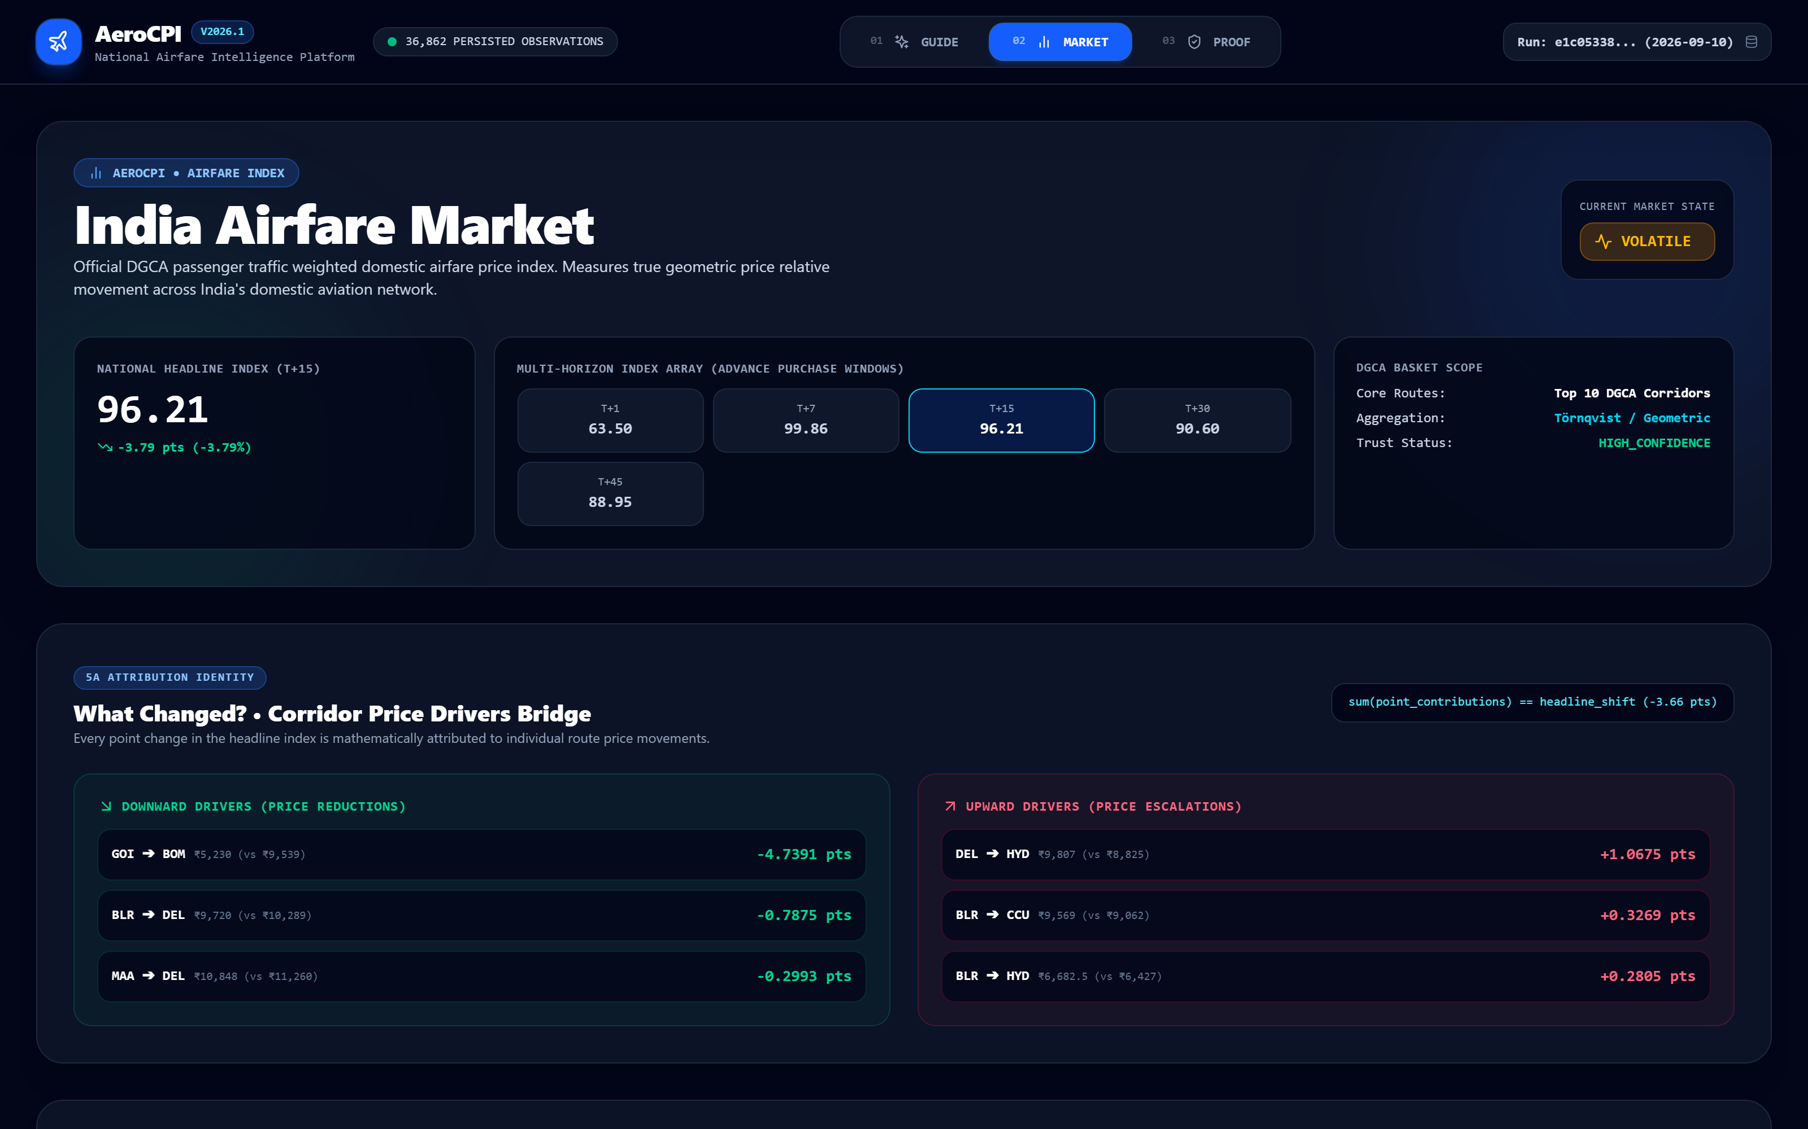
SMART INDIA HACKATHON 2026 | TEAM BUZZCODEX | PROBLEM STATEMENT ID: SIH26056 | THEME: SMART AUTOMATION
IMPACT & BENEFITS
DELIVERING TANGIBLE VALUE TO POLICYMAKERS, TRAVELLERS & RESEARCHERS
STAKEHOLDER VALUE
01 POLICY / STATISTICAL AGENCIES
02 TRAVELLERS & CONSUMERS
03 RESEARCH & AVIATION INDUSTRY
• High-Frequency Measurement: Daily airfare indices supplementing lagged monthly CPI reports.
• Standardized Route Basket: DGCA passenger-weighted city pairs reflect actual mobility demand.
• Econometric 5A Attribution: Decomposes fare movements into carrier, horizon, and seasonal drivers.
• Audit Trail: Complete calculation manifests ready for institutional verification.
• Real-Time Fare Context: Instant visibility into whether current fare (₹10,495) is elevated vs baseline.
• Cross-Source Spread: Unbiased comparison between Google Flights, EaseMyTrip, and API feeds.
• Nearby Alternative Dates: Calendar fare matrices showing cheapest departure windows.
• Actionable Advice: Clear BOOK / WAIT / WATCH guidance backed by 11-node decision trace.
• Multi-Source Dataset: Canonical observations covering trunk corridors across multiple lead horizons.
• Market Dispersion Analysis: Measures yield management divergence between low-cost and full-service carriers.
• Longitudinal Panel Studies: Foundation for academic research in transportation pricing elasticity.
• Open Architecture: Modular Scrapy & API schemas enabling broader aviation study.
AEROGUIDE: CONSUMER DECISION HERO (BLR ➔ DEL · WATCH FARE)
AEROCPI: NATIONAL HEADLINE INDEX (96.21 · 5A ATTRIBUTION)
OBSERVE ➔ UNDERSTAND ➔ DECIDE ➔ VERIFY | NOT JUST THE PRICE: THE SIGNAL, THE REASON, THE EVIDENCE.

Slide 6




SMART INDIA HACKATHON 2026 | TEAM BUZZCODEX | PROBLEM STATEMENT ID: SIH26056 | THEME: SMART AUTOMATION
RESEARCH & REFERENCES
INSTITUTIONAL GROUNDING, METHODOLOGICAL PRECEDENTS & AUDIT PROVENANCE
CREDIBILITY & AUDIT
01 MoSPI / PIB (Government of India)
02 DGCA (Ministry of Civil Aviation)
03 SIH 2026 (Ministry of Education)
• Consumer Price Index (Base 2012=100) framework.
• Transport & Communication subgroup CPI weights.
• High-frequency experimental airfare measurement context.
https://mospi.gov.in
• Monthly Domestic City-Pair Passenger Traffic Reports.
• Route volume weights (w_r) derived from annual traffic.
• Top 10 domestic trunk corridor basket definition.
https://www.dgca.gov.in
• Problem Statement SIH26056: Real-time Airfare Price Index.
• Theme: Smart Automation | Category: Software.
• Team BuzzCodeX official prototype submission.
https://sih.gov.in
04 METHODOLOGICAL PRECEDENTS
05 AEROCPI AUDIT EVIDENCE
METHODOLOGICAL BOUNDARY & AUDIT RULE
• U.S. Bureau of Labor Statistics (BLS): Airline Fare Index sampling methodology across advance horizons.
• Jevons Elementary Geometric Formula: Standard axiomatic price index formula mitigating substitution bias.
• APW Sampling Set: Horizon analysis across {1, 7, 15, 30, 45, 60} days.
• 301/301 Pytest Verification Suite.
• 25/25 Vitest UI Component Tests.
• SHA-256 Provenance Hashes.
• Immutable JSON Calculation Manifests.
• Reproducibility Engine CLI.
AeroCPI is an independent experimental measurement system developed for SIH 2026. It is NOT official CPI and does not replace official MoSPI statistics.
CORE AUDIT PRINCIPLE:
Never fabricate missing evidence. If longitudinal depth is insufficient, ML forecasting is strictly locked with clear disclosure.
AUDIT PRINCIPLE: NEVER FABRICATE MISSING EVIDENCE | OFFICIAL SIH 2026 SUBMISSION | TEAM BUZZCODEX

