Slide 1
VOCATIONAL TRAINING PROJECT
Predictive Maintenance using Machine Data
Real-time telemetry • MQTT pipeline • SQLite persistence • RUL dashboard
Organization
Training Period
Submitted By
Nandini
Priyanshu
Suhani Goel
Vinit Kumar
510 Army Base Workshop Meerut Cantt
1 July 2026 – 28 July 2026
Submitted to: COL G S PHANI RAJ (OIC TT CELL)
Project Report basis: Predictive Maintenance using machine data

Slide 2
1. Project Context & Problem Statement
Objective foundation
Why predictive maintenance?
The project proposes a shift from traditional time-based maintenance toward a data-driven predictive maintenance approach for mission-critical assets.
Operational challenge
Unscheduled equipment breakdowns can increase downtime and affect operational readiness. The project targets earlier visibility into machine health and degradation.
Workshop environment
Target assets
Core outcome
510 Army Base Workshop, Meerut supports repair and overhaul activities for military equipment. The report highlights the role of EME engineering support.
The prototype models multiple machinery profiles, including Pinaka_MBRL_1, Tactical_Veh_2 and Tatra_Engine_3.
Estimate Remaining Useful Life (RUL), display health status, and raise maintenance alerts through a live dashboard.
Project basis: real-time telemetry → reliable local storage → feature engineering → RUL inference → visual alerts.
510 Army Base Workshop, Meerut Cantt | Vocational Training Project | 2026
2

Slide 3
2. Objective / Aim of the Project
Mandatory Point #1
Project objectives
01
Capture machine telemetry
Continuously ingest temperature, vibration, pressure and rotational-speed data.
02
Build a decoupled pipeline
Separate telemetry publishing, message brokering, ingestion, storage and analytics.
03
Predict Remaining Useful Life
Use current and rolling telemetry features to estimate RUL for the selected asset.
04
Provide actionable alerts
Classify the asset as nominal, warning or critical using RUL thresholds.
Problem Statement: improve maintenance visibility and reduce the risk of unscheduled breakdown downtime.
510 Army Base Workshop, Meerut Cantt | Vocational Training Project | 2026
3

Slide 4
3. Methodology
Mandatory Point #2
Step-by-step development methodology
1
Telemetry Simulation
2
Message Brokering
3
Data Ingestion
mqtt_publisher.py generates multi-machine sensor streams and degradation patterns.
Eclipse Mosquitto routes MQTT messages asynchronously.
mqtt_subscriber.py validates JSON payloads and forwards telemetry to storage.
4
Persistence
5
Feature Engineering
6
RUL & Dashboard
database_manager.py stores telemetry in SQLite with a unified schema.
Rolling temperature average and vibration standard deviation are calculated.
app.py performs inference, shows RUL, status alerts and degradation trajectory.
Approach: decoupled microservices pipeline with continuous streaming and live analytics.
510 Army Base Workshop, Meerut Cantt | Vocational Training Project | 2026
4

Slide 5
4. Tools Used & System Design
Mandatory Point #3
Decoupled real-time architecture
Machine / Edge Telemetry
mqtt_publisher.py Edge Simulation
Eclipse Mosquitto
mqtt_subscriber.py Ingestion
SQLite telemetry.db
Feature Engineering
RUL Inference
Streamlit UI
Rolling 5-cycle temperature moving average + vibration moving standard deviation.
RUL prediction is generated from the selected asset's engineered telemetry features.
Live metrics, alerts and RUL trajectory.
Python • Paho MQTT • Eclipse Mosquitto • SQLite • Pandas • NumPy • Plotly • Streamlit
510 Army Base Workshop, Meerut Cantt | Vocational Training Project | 2026
5

Slide 6
5. Tools, Technologies & Components
Implementation stack
Python
Paho MQTT
Eclipse Mosquitto
SQLite
Core implementation language
MQTT client communication
Message broker
Local telemetry persistence
Pandas / NumPy
Plotly
Streamlit
NASA C-MAPSS
Data processing & feature engineering
Interactive RUL trajectory chart
Real-time analytical dashboard
Telemetry dataset benchmark referenced by the project
Core project modules
mqtt_publisher.py | mqtt_subscriber.py | database_manager.py | app.py
510 Army Base Workshop, Meerut Cantt | Vocational Training Project | 2026
6

Slide 7
6. Database Layer & Data Processing
Implementation detail
Telemetry schema and processing flow
Incoming JSON
SQLite: telemetry table
Primary key: id Unique key: (machine_id, cycle) Sensor fields: • temperature • vibration • pressure • rotational_speed Operational settings: • operational_setting_1 • operational_setting_2 • operational_setting_3 Timestamp is stored automatically.
Schema validation
SQLite write
Latest records
Rolling features
RUL prediction
Duplicate cycle keys are gracefully ignored during retransmission.
510 Army Base Workshop, Meerut Cantt | Vocational Training Project | 2026
7

Slide 8
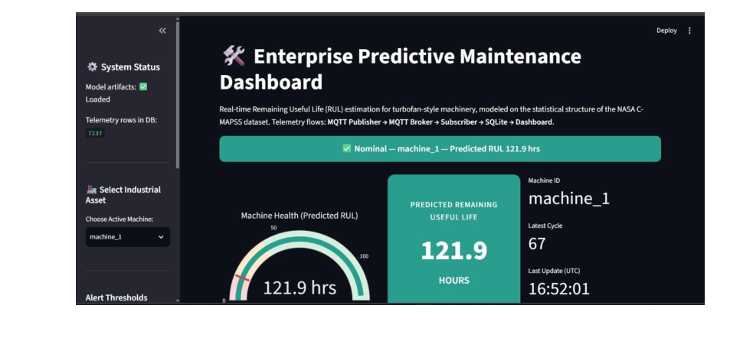
7. Real-Time ML Inference & Dashboard
User-facing analytics
Live operational view
Live metrics
Current operational cycle • instantaneous temperature • calculated RUL
Alert logic
RUL < 50 hrs → Critical RUL < 100 hrs → Warning Otherwise → Nominal
Visualization
Interactive RUL degradation trajectory plotted against machine cycle.
Dashboard refresh interval: 2 seconds
510 Army Base Workshop, Meerut Cantt | Vocational Training Project | 2026
8

Slide 9
8. Results Obtained
Mandatory Point #4
Prototype outcomes achieved
1
Real-time ingestion
MQTT telemetry is continuously published and consumed through the broker/subscriber pipeline.
2
Persistent storage
Incoming telemetry is written to the SQLite telemetry database for rolling analysis.
3
RUL estimation
The dashboard calculates a predicted Remaining Useful Life value for the selected asset.
4
Health alerts
Nominal, warning and critical states are displayed according to RUL thresholds.
5
Interactive analytics
Users can select assets and view live metrics plus an RUL degradation trajectory.
The report demonstrates functional pipeline outputs; it does not provide a measured model-accuracy percentage.
510 Army Base Workshop, Meerut Cantt | Vocational Training Project | 2026
9

Slide 10
9. Benefits / Advantages & Future Scope
Mandatory Point #5
Key benefits
Future scope
Earlier visibility into asset degradation
Data-driven maintenance decision support
Reduced dependence on purely time-based maintenance
Centralized telemetry and analytics
Modular architecture that can be extended to additional workshop divisions
Potential to reduce unscheduled downtime and strengthen operational readiness
1
Raspberry Pi / Arduino edge hardware for real sensor acquisition
2
Acoustic-emission data from workshop engine testbeds
3
LSTM neural networks for long-term degradation trends
4
TLS client-certificate verification for MQTT security
510 Army Base Workshop, Meerut Cantt | Vocational Training Project | 2026
10

Slide 11
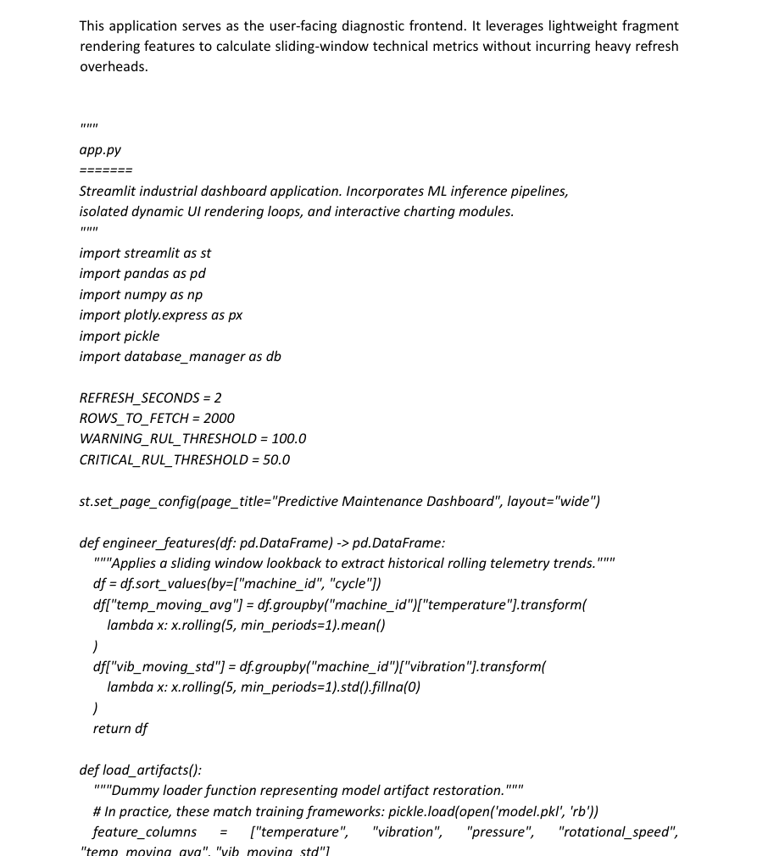
10. Screenshots / Project Evidence
Mandatory Point #6
Evidence from the project report
Real-time Streamlit dashboard showing machine health and predicted RUL.
Implementation evidence from app.py / dashboard logic.
Screenshots reproduced from the submitted project report.
510 Army Base Workshop, Meerut Cantt | Vocational Training Project | 2026
11

Slide 12
Conclusion
The project demonstrates a modular predictive-maintenance prototype that connects machine telemetry, MQTT messaging, local persistence, feature engineering, RUL inference and a live analytical dashboard.
By moving toward data-driven maintenance, the solution provides a foundation for earlier maintenance decisions and stronger operational readiness.
THANK YOU
Questions & Answers
Nandini • Suhani Goel • Vinit Kumar • Priyanshu

