Slide 1
Project Presentation of FSE - ETE
Confectionery E-Commerce
PLUM
Priyanshu 2210990685
Raghav Thakur 2210990701
Rahul 2210990702
Supervised By
Dr. Shaffu
Assistant Professor
Department of Computer Science and Engineering,
Chitkara University, Punjab

Slide 2
Problem Statement
The Need for a Smarter Sweet Shopping Experience
Traditional sweet shops have limited reach and inventory visibility.
Many existing online platforms lack an intuitive and engaging interface.
Customers often face difficulty discovering new or trending confections that match their preferences.
There’s a growing need for a modern, fast, and customer-centric platform tailored to sweet lovers.
2

Slide 3
Introduction
What is PLUM?
PLUM is a full-stack web application crafted for sweet and candy lovers.
It offers a smooth and delightful platform to explore, search, and purchase treats across various categories.
The focus is on providing detailed product insights, easy navigation, and a visually engaging shopping experience.

Slide 4
Technologies Used
Frontend:
React.js – for building dynamic, responsive UI
Post CSS – A CSS preprocessor for transforming styles with JavaScript plugins (e.g., auto prefixing, variables).
Tailwind CSS – for modern styling
Backend:
Node.js+Express.js – for API and server-side logic.
MongoDB – NoSQL database for storing books, users, and orders
JWT – for authentication
Mongoose – for schema-based interaction with MongoDB.

Slide 5
Features
Key Features of Bookify
Finding Items by category.
Admin Panel for inventory management.
User sign-up/login with protected routes.
User Dashboard to track past purchases.
Highlighting Recently Added and Best Seller Items.

Slide 6
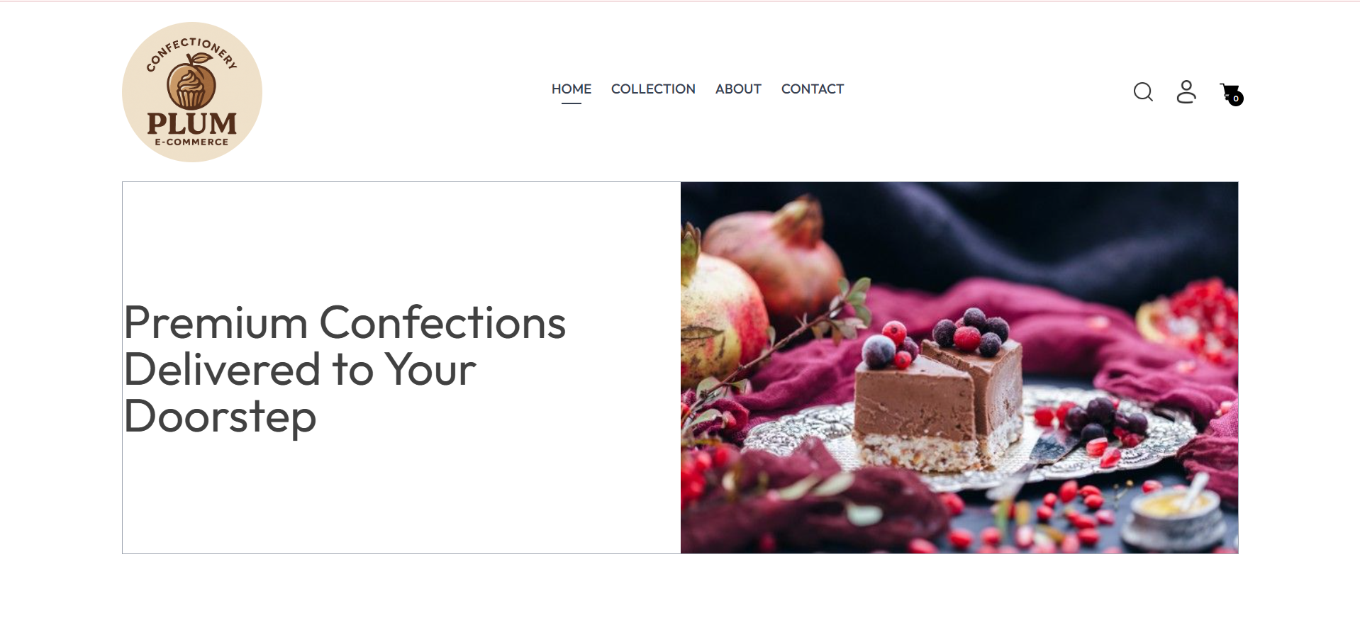
Screenshots
HOME PAGE

Slide 7
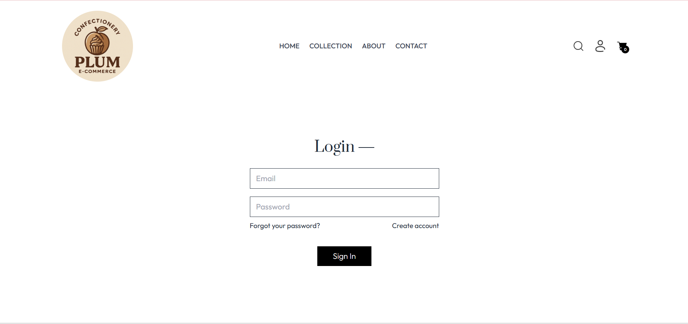
Screenshots
LOGIN PAGE

Slide 8
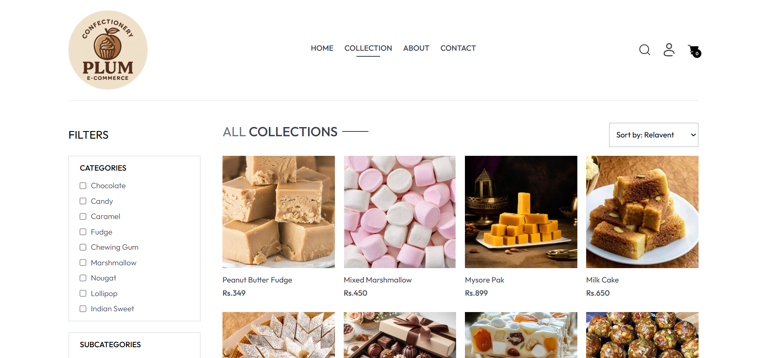
Screenshots
Items Collection

Slide 9
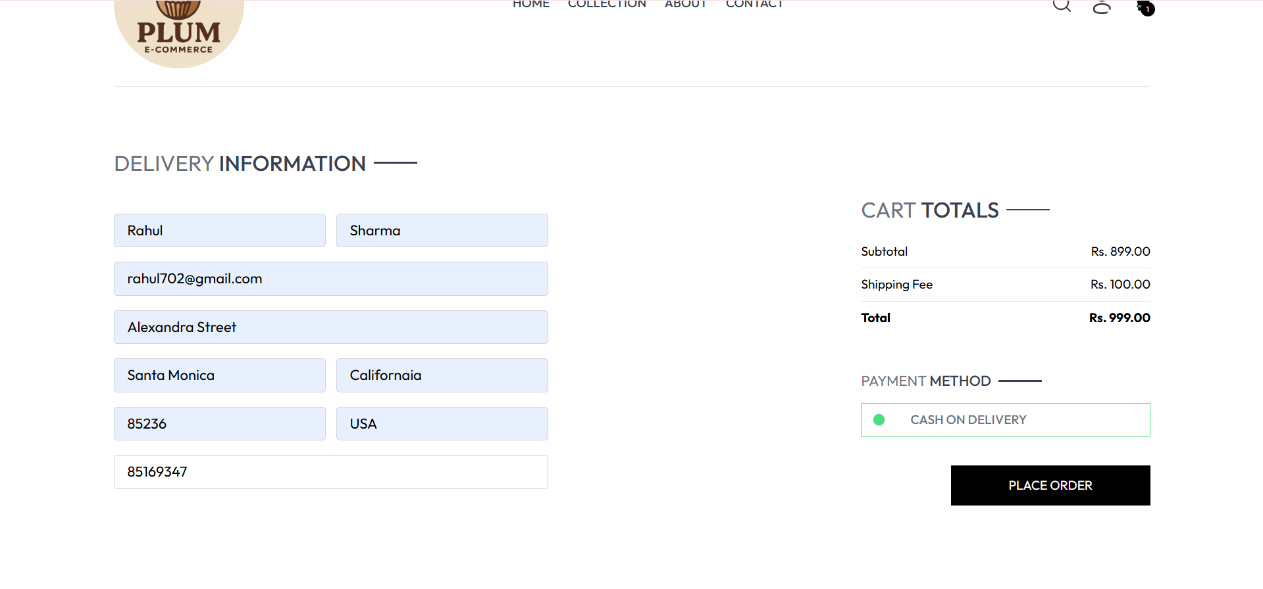
Screenshots
CHECKOUT PAGE

Slide 10
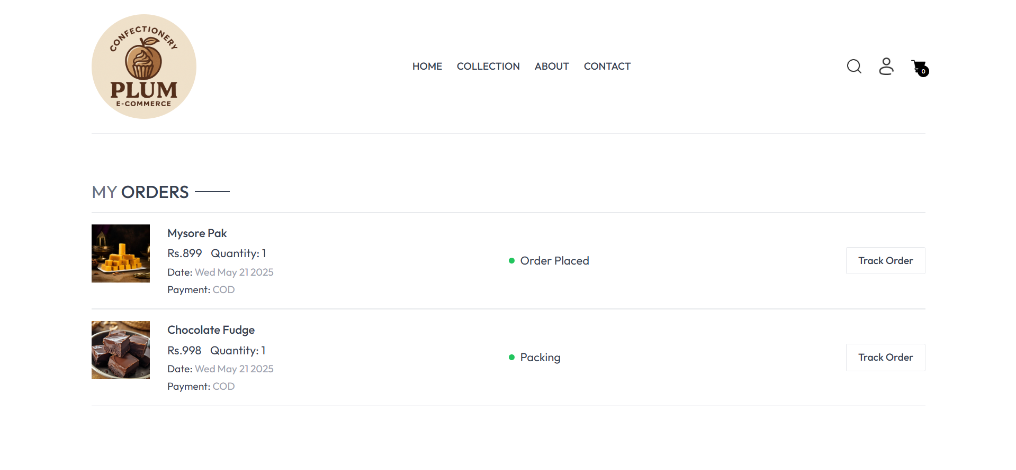
Screenshots
User Dashboard

Slide 11
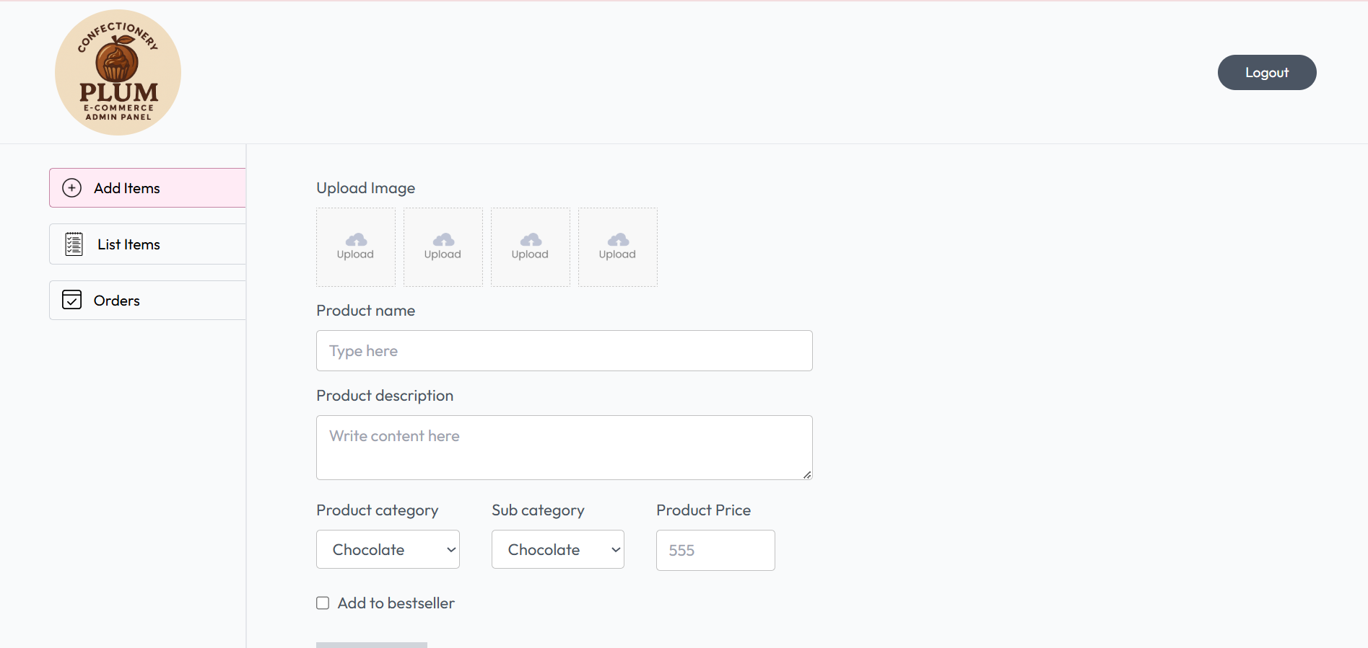
Screenshots
ADMIN PANEL

Slide 12
Conclusion
Final Thoughts
PLUM redefines the sweet indulgence experience by merging the joy of traditional confectionery with modern digital convenience.
Our platform offers a delightful, responsive, and feature rich shopping experience, designed for sweet lovers who crave quality, variety, and seamless online purchasing.
With user-centric design and a focus on effortless browsing, PLUM is the next step in revolutionizing online sweet shopping, making every treat just a click away.

Slide 13
Thank You
13

