Slide 1
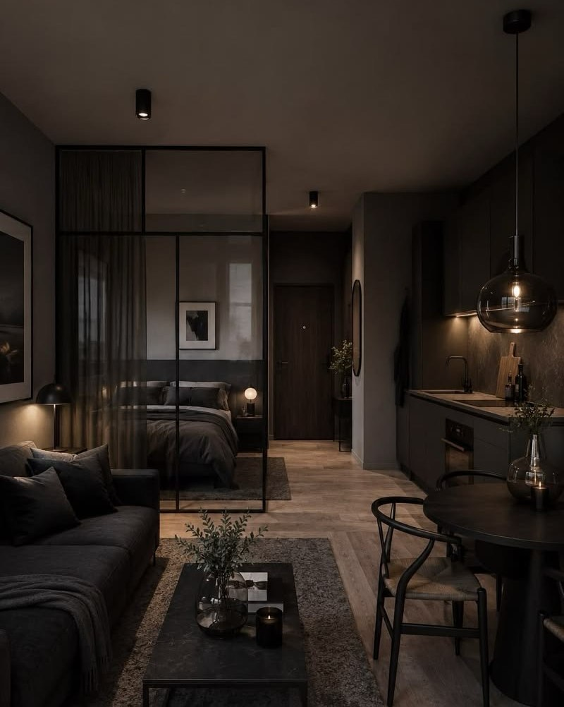

RED FLAG HOMES NETWORK · THE DROP
The Drop
Studio · Noir
One room. One delivery.
Guest-ready in ten days.
85+ PIECES · DELIVERED · INSTALLED · PHOTOGRAPHED
SAMPLE IMAGE

Slide 2
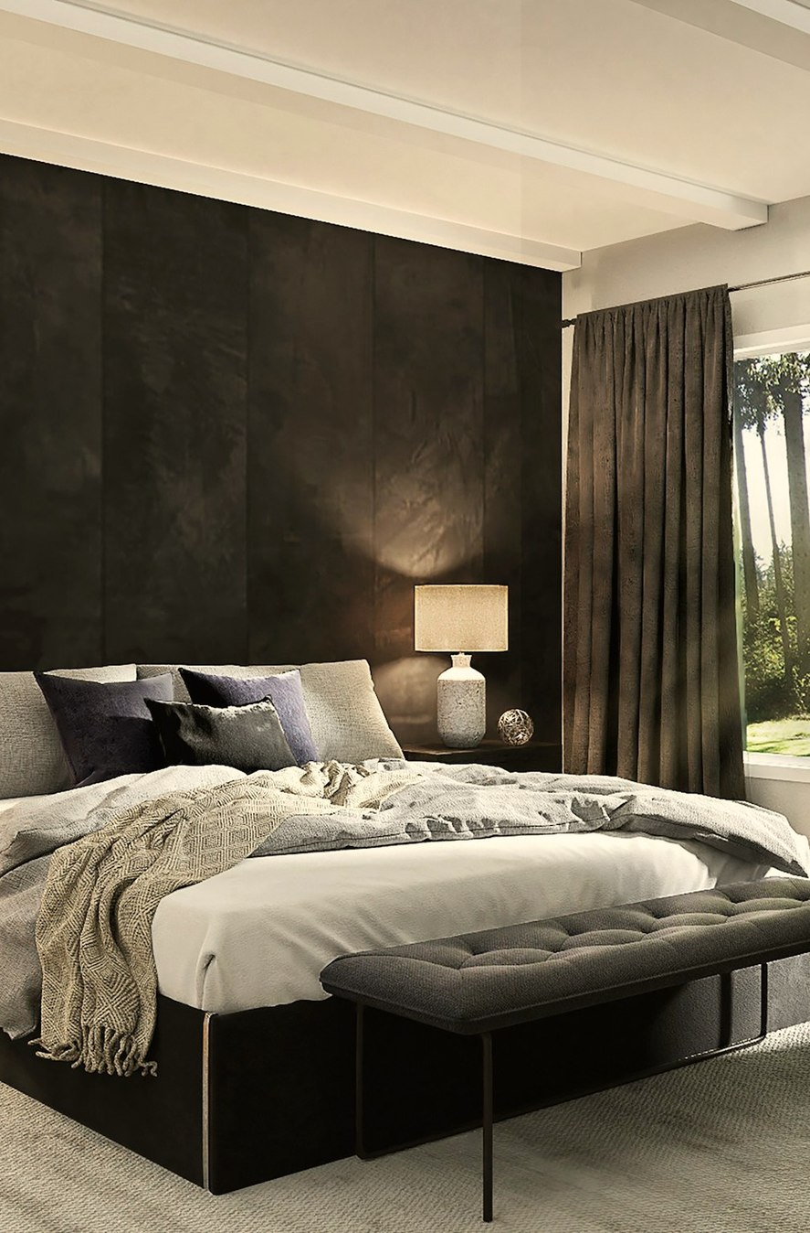
THE DROP · STUDIO NOIR
WHAT THIS IS
Ten days after you order, your studio looks like a boutique hotel room.
You have a studio with an AC, a fan, a wardrobe and white tubelights. We turn it into a room that is ready to take bookings.
One
One
One
order
delivery
install day
We source everything, bring it, assemble it, style it, deep clean it and photograph it. You unlock the door once and we hand it back finished.
NO MARKET TRIPS · NO FIFTEEN DELIVERIES · NO CARPENTER WHO DOESN’T TURN UP
REDFLAGHOMES.IN
02 / 17

Slide 3
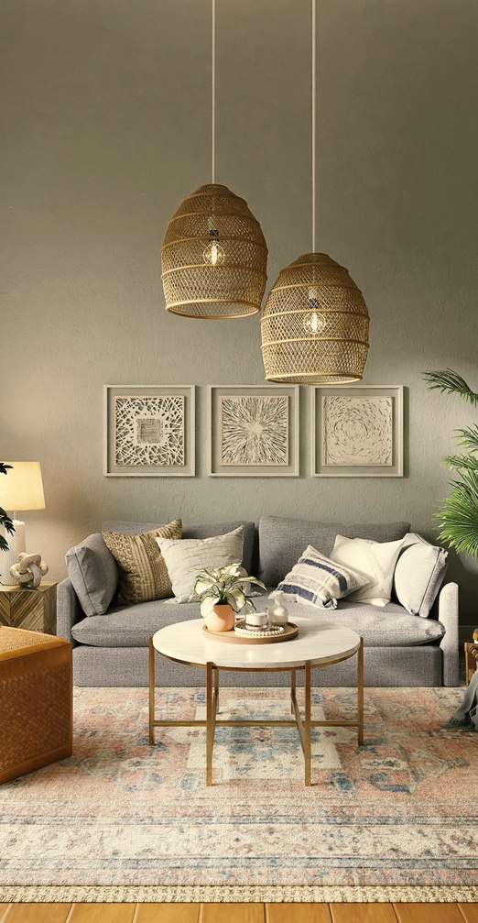

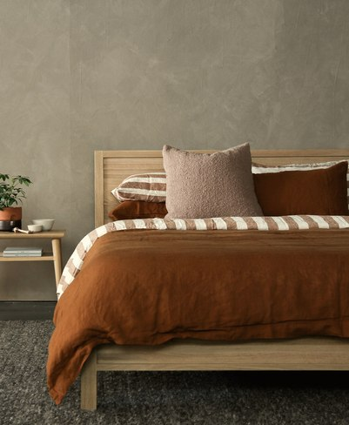
THE DROP · STUDIO NOIR
THE LOOK
Noir is warm,
not cold.
Charcoal
Warm wood
Cream & oatmeal
Black metal
Brass
Green
— Deep charcoal surfaces in matte — never gloss
— Jute and wood texture to keep the room soft
— Cream and oatmeal bedding layered over dark furniture
— Black-framed art, terracotta pots, real plants, brass accents
REDFLAGHOMES.IN
03 / 17

Slide 4
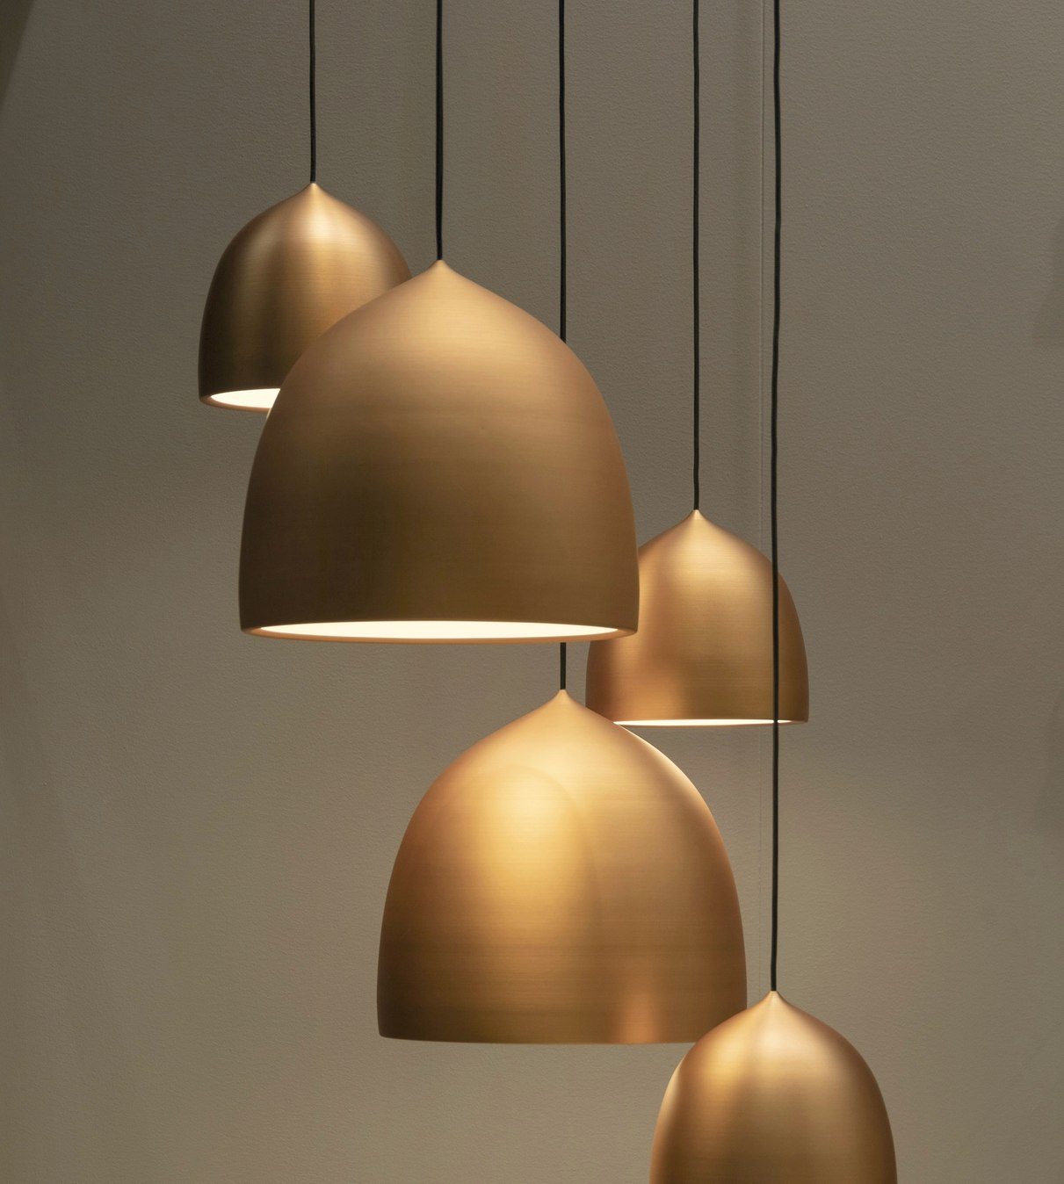
THE DROP · STUDIO NOIR
THE SINGLE BIGGEST CHANGE
It’s the light.
2700K
warm, in every fitting we install
White tubelights make any room photograph like a clinic. We light from lamps, sconces and a pendant instead of one ceiling tube — the difference between a dark room and an expensive one.
REDFLAGHOMES.IN
04 / 17

Slide 5
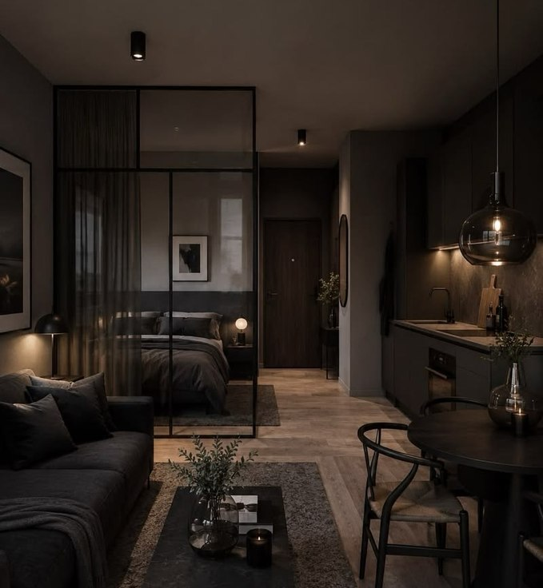
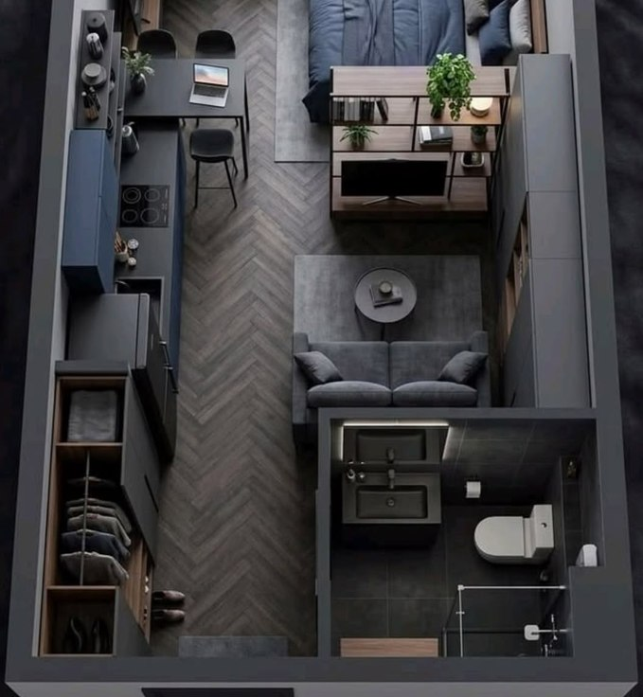
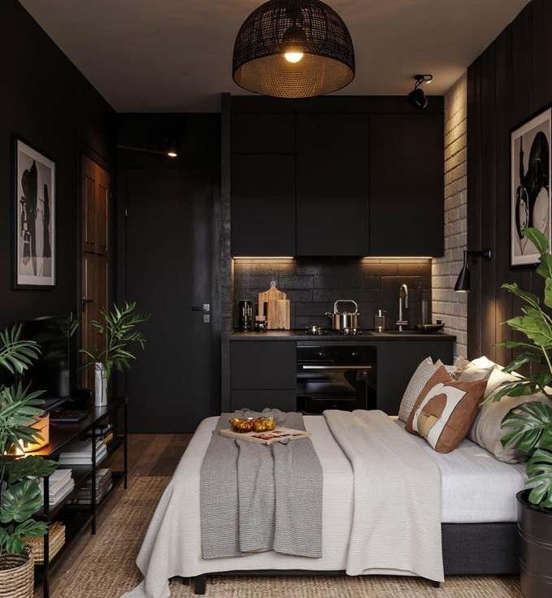
THE DROP · STUDIO NOIR
SAMPLE IMAGES · HOW YOUR AIRBNB COULD LOOK
Picture your studio like this.
SAMPLE IMAGE
SAMPLE IMAGE
SAMPLE IMAGE
Living, sleeping, dining
The whole studio, planned
Kitchenette and bed
REDFLAGHOMES.IN
05 / 17

Slide 6
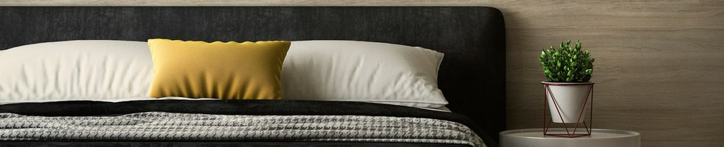
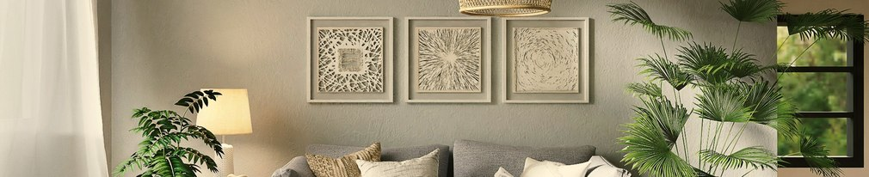
THE DROP · STUDIO NOIR
EVERYTHING INCLUDED, WITH SIZES · 1 OF 4
Sleep
Lighting
Queen bed frame with box storage, dark finish
78 × 60 in
Rattan or smoked-glass pendant over the bed
40 cm dia
Medium-firm mattress
78 × 60 × 6 in
Black metal wall sconces with brass inner
15 × 25 cm
Mattress protectors
78 × 60 in
Table lamp with amber shade
35 cm high
Pillows — soft and firm, with protectors
18 × 28 in
Slim black floor lamp
150 cm high
Full linen sets — fitted, flat, pillow covers, 300TC
Flat 90 × 108 in
Under-cabinet warm LED strip
1 m
Knit throw and waffle throw
50 × 60 in
Warm 2700K bulbs throughout, plus a night light
2700K
Cushion covers with inserts
45 × 45 cm
Black metal bedside tables
40 × 40 × 55 cm
REDFLAGHOMES.IN
06 / 17

Slide 7
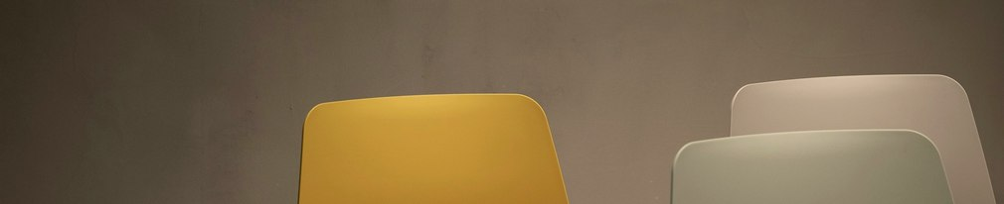
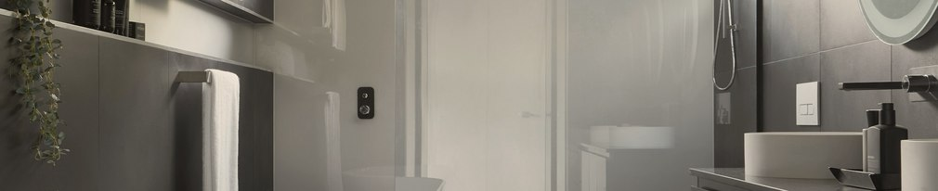
THE DROP · STUDIO NOIR
EVERYTHING INCLUDED, WITH SIZES · 2 OF 4
Furniture
Bathroom
Console or open shelf unit, black metal and wood
100 × 35 × 75 cm
Bath towels
75 × 150 cm
Accent chair, cane or wishbone style
55 × 55 × 80 cm
Hand towels and face towels
40 × 60 · 30 × 30 cm
Round side table, dark wood
45 cm dia
Bath mats
50 × 80 cm
Full-length mirror, black frame
150 × 40 cm
Refillable dispensers — shampoo, conditioner, body wash, hand wash
300 ml
Floor and windows
Mirror, shelf, towel rail and hooks
60 × 80 cm mirror
Bin, toilet brush, bucket and mug
—
Jute rug under the bed
6 × 4 ft
Hair dryer
1200 W
Blackout curtains, oatmeal, with black rod
4.5 × 9 ft panels
Upgraded shower head
—
REDFLAGHOMES.IN
07 / 17

Slide 8
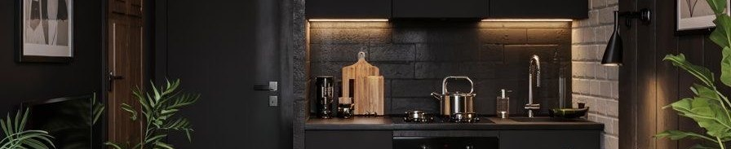
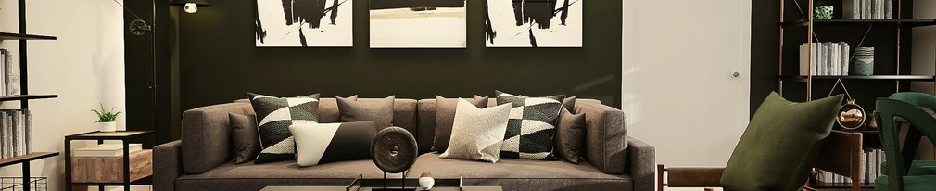
THE DROP · STUDIO NOIR
EVERYTHING INCLUDED, WITH SIZES · 3 OF 4
SAMPLE IMAGE
Kitchenette
Safety, utility and access
Induction hob
2000 W
Keyless smart lock — fingerprint, PIN and key backup
Fits 35–60 mm doors
Electric kettle
1.5 L
Water purifier
7 L RO
Crockery, cutlery and glassware for two
—
Smoke alarm, fire extinguisher, fire blanket, first-aid kit
2 kg ABC
Pan and pot
24 cm · 2 L
Chopping board and knife
30 × 20 cm
Iron and board, drying rack, laundry basket
—
Storage jars, tea and coffee station on a brass tray
35 cm tray
Hangers, extension boards, cleaning set
4-socket
Dish rack and bin
—
REDFLAGHOMES.IN
08 / 17

Slide 9

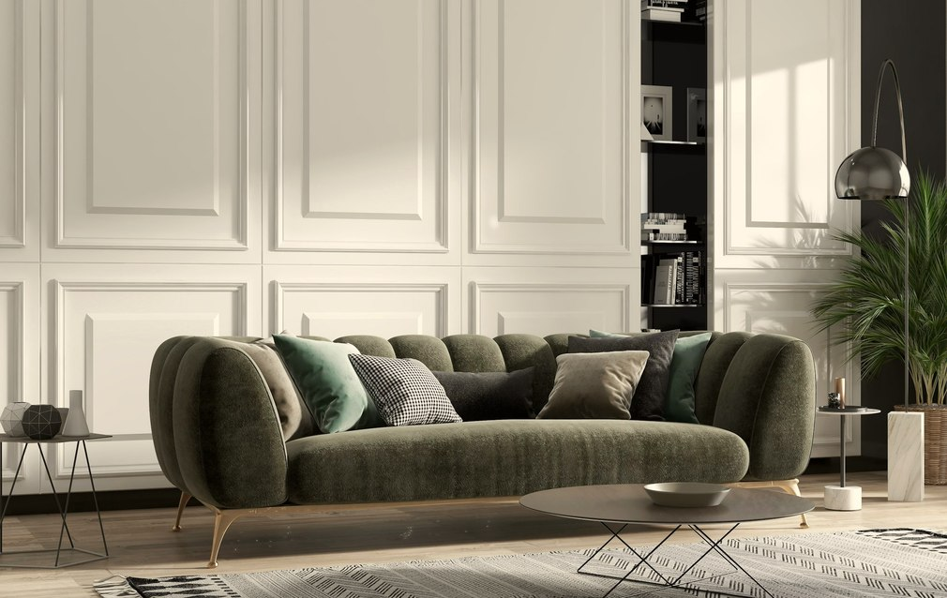
THE DROP · STUDIO NOIR
EVERYTHING INCLUDED, WITH SIZES · 4 OF 4
Styling and welcome
Framed prints, black frames
A2 · 42 × 59 cm
Plants in pots, plus a woven basket planter
60–120 cm
Tray, vase, books, candle and coasters, styled on the day
—
Scent diffuser with first refill
200 ml
Welcome basket and a printed house guide
A5, bound
Fridge and microwave?
Not included as standard — most studios don’t need them, and it keeps your price down. Add either as an add-on if you want them.
REDFLAGHOMES.IN
09 / 17

Slide 10
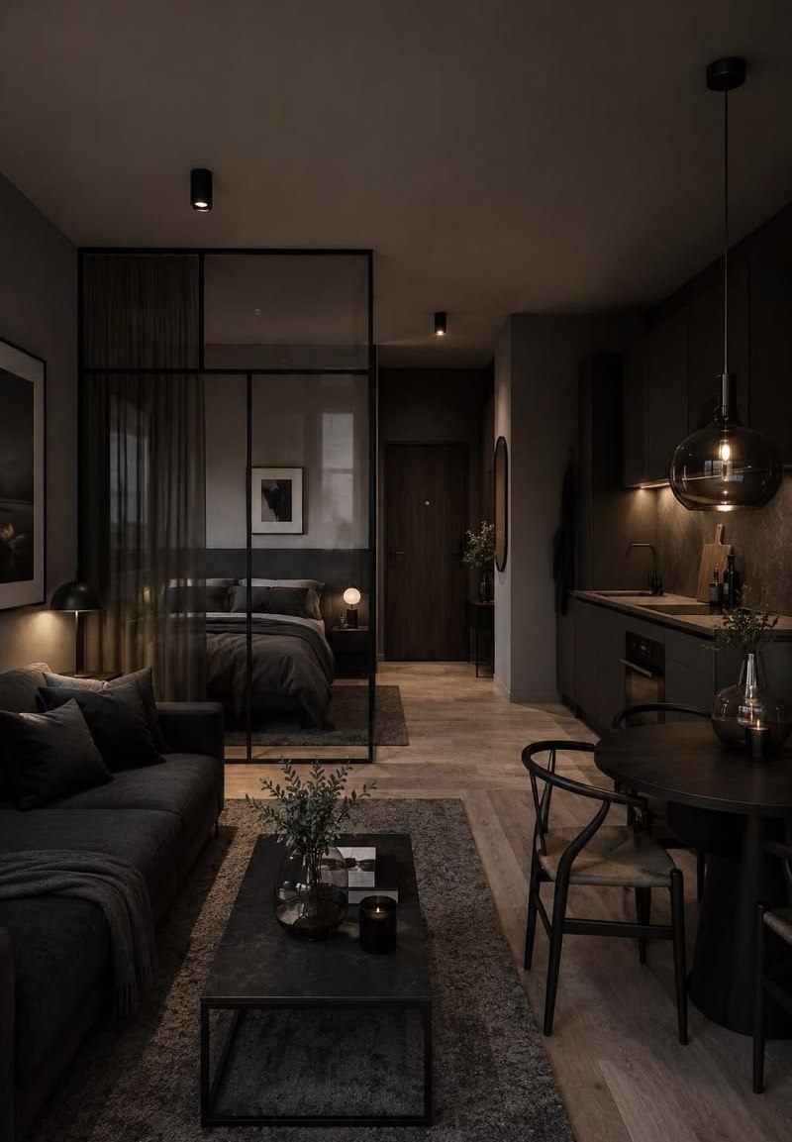
THE DROP · STUDIO NOIR
AND THE PART NOBODY ELSE DOES
Not a kit. A finished room.
Design plan
A full layout before anything is ordered, so the room works as a whole
Sourcing and delivery
One order, one contact — not fifteen sellers
Full install day
Assembled, hung, placed and styled by our team
Deep clean
Guest-ready, not builder-dusty
Professional shoot
20+ edited images, ready to upload the same evening
Photographs are 80% of the booking decision. A kit without a shoot is half a job.
REDFLAGHOMES.IN
10 / 17
SAMPLE IMAGE

Slide 11
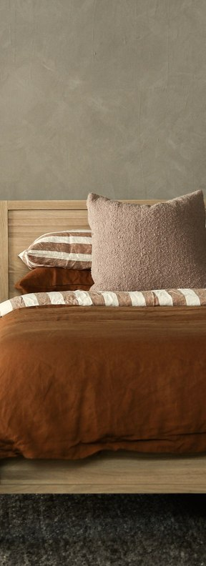
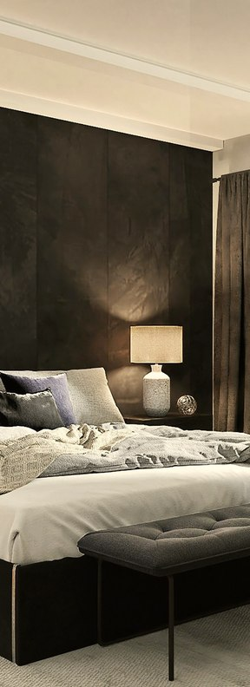
THE DROP · STUDIO NOIR
TWO VERSIONS
Choose your Noir.
35% OFF
35% OFF
Core
Full Noir
₹3,21,538
₹4,29,231
₹2,09,000
₹2,79,000
plus GST
plus GST
✓
Everything listed in this brochure
✓
Everything listed in this brochure
—
Charcoal matte paint, two walls
✓
Charcoal matte paint, two walls
—
Warm wood vinyl plank flooring
✓
Warm wood vinyl plank flooring
—
Wardrobe refinished in matte black
✓
Wardrobe refinished in matte black
If your floor and walls are already presentable.
If the room still looks like a builder handed it over.
Plus applicable GST. For studios up to 350 sq ft. Delivery and installation included in Goa, Mumbai, Bengaluru, Delhi NCR and Lucknow; outside these, at cost.
REDFLAGHOMES.IN
11 / 17

Slide 12

THE DROP · STUDIO NOIR
ADD WHAT YOU NEED
Make it yours.
Mini fridge, 45–50 L
₹14,000
Microwave, 20 L
₹10,000
WiFi router with guest network, set up
₹4,500
Smart TV 32" with streaming stick, wall-mounted
₹22,000
Round table with chair — eating or working
₹9,500
Branded amenity kit — tissue, toiletries, coasters, welcome card
₹8,000
Reels package — vertical video for Instagram and your listing
₹15,000
Restock subscription — linen, toiletries, consumables
₹2,500 / month
Add-ons plus applicable GST. Installed on the same day.
REDFLAGHOMES.IN
12 / 17

Slide 13
THE DROP · STUDIO NOIR
WHAT’S NOT INCLUDED
Said plainly,
up front.
✕
Structural, plumbing or electrical work, false ceilings, rewiring
✕
Air conditioner, fan and wardrobe — we work with what you already have
We work with what you already have — and quote anything bigger separately.
✕
Washing machine and dishwasher
✕
Additional or sofa beds — quoted separately
✕
Studios above 350 sq ft — quoted separately
✕
Your society or building permissions
REDFLAGHOMES.IN
13 / 17

Slide 14
THE DROP · STUDIO NOIR
HOW IT WORKS
Ten days from your advance to a bookable room.
Day 0
Day 1
Day 2–8
Day 9
Day 10
You send photos and measurements. We confirm the price within 24 hours.
You pay 50%, approve the design plan, and we start sourcing.
Everything is made and collected at our end. Nothing lands at your door piecemeal.
Install day. We assemble, place, hang and style the entire room.
Deep clean, professional shoot, balance 50%. Images sent that evening.
50% to start · 50% on day 10, when the room is finished and photographed
REDFLAGHOMES.IN
14 / 17

Slide 15
THE DROP · STUDIO NOIR
QUESTIONS
Everything owners ask us.
Why no fridge or microwave?
Can I change items?
Can I see it before you order?
What if something arrives damaged?
Most studio guests don’t cook, and leaving them out keeps your price lower. Add them and we install them the same day.
Yes, within the palette. Swap the chair, choose a different pendant, change the art. We keep the room coherent.
Yes. You approve the design plan with the actual items before anything is bought.
We replace it. Every appliance carries its manufacturer warranty, registered in your name.
Will it fit my studio?
Do you do 1BHK and villas?
I want you to run it too.
Send measurements with your photos. If the room is tight we adjust the layout, or suggest a smaller bed.
Yes. The Drop comes in Studio, Villa and Estate. Tell us the property and we’ll quote it.
That’s Red Flag Outpost Classic — we design, brand, launch and operate it for 8% of bookings. Join within 90 days and we deduct what you spent on The Drop from the Outpost setup fee.
REDFLAGHOMES.IN
15 / 17

Slide 16
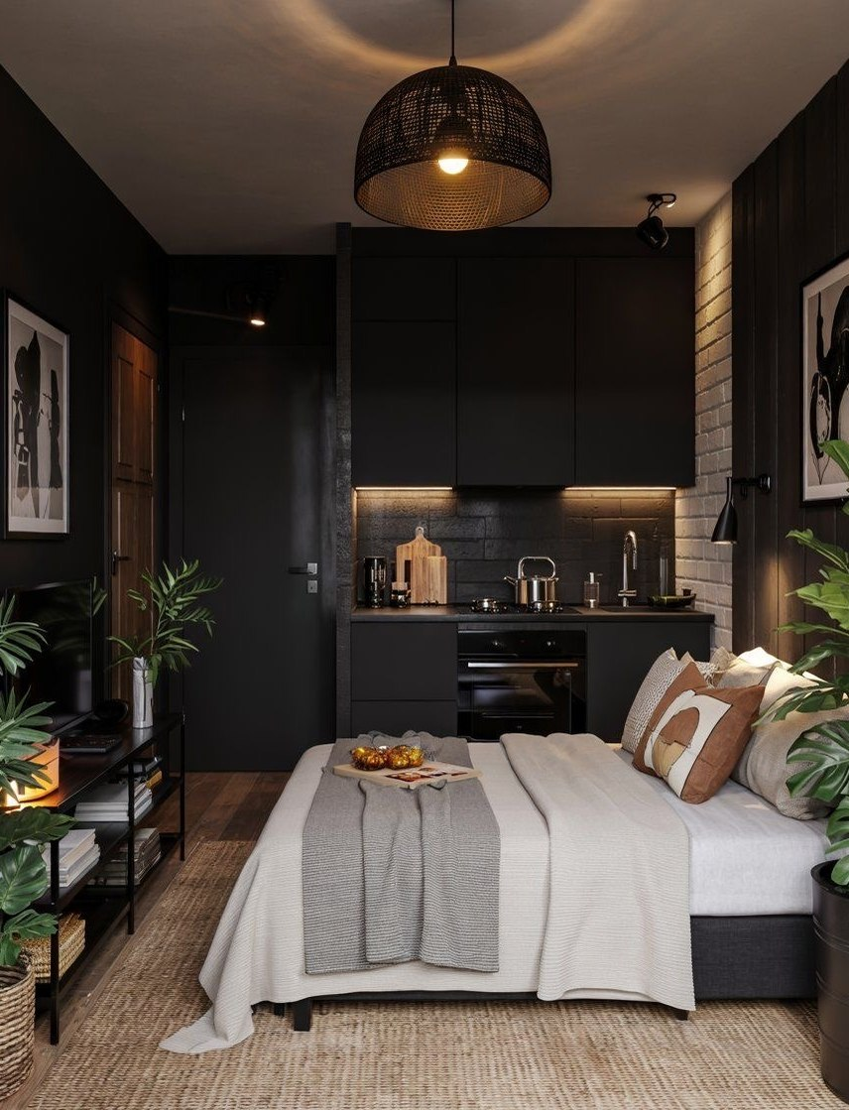
THE DROP · STUDIO NOIR
ORDER YOURS
A price in 24 hours.
A finished room
in ten days.
Send photos of the studio and its measurements. That’s all we need to start.
CORE
FULL NOIR
₹3,21,538
₹4,29,231
₹2,09,000
₹2,79,000
35% off · plus GST
REDFLAGHOMES.IN
16 / 17
SAMPLE IMAGE

Slide 17
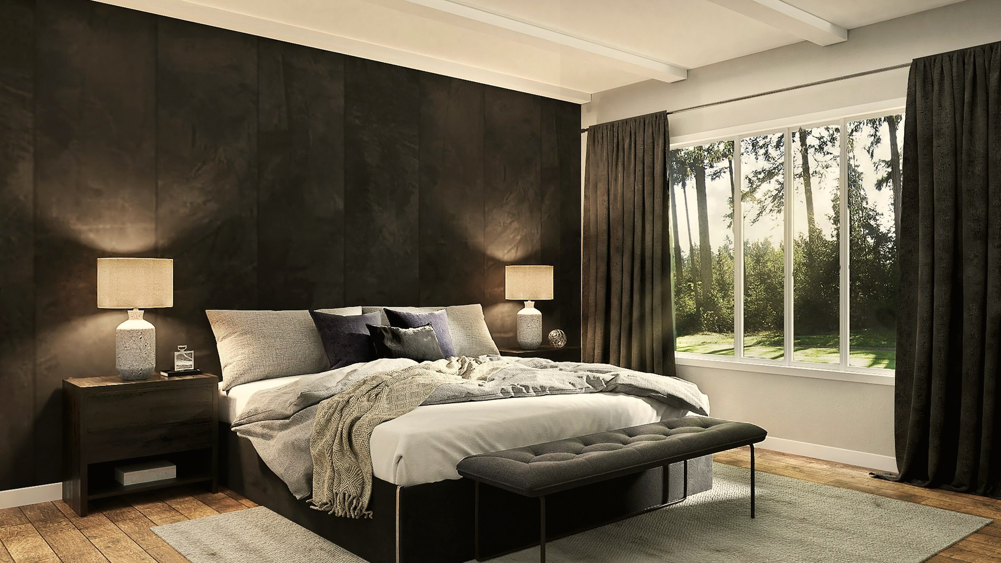
redflaghomes.in
hello@redflaghomes.in
The Drop by Red Flag · Studio · Villa · Estate
Red Flag Homes Network · a company of Red Flag World Holdings Ltd, London
Prices plus applicable GST, for studios up to 350 sq ft in our delivery cities. Sizes are standard and may vary slightly by supplier. Specific items may be substituted for equivalents of the same quality and palette where stock requires it — the design plan you approve is what we deliver. Images marked “Sample image” are for illustration.

