Slide 1
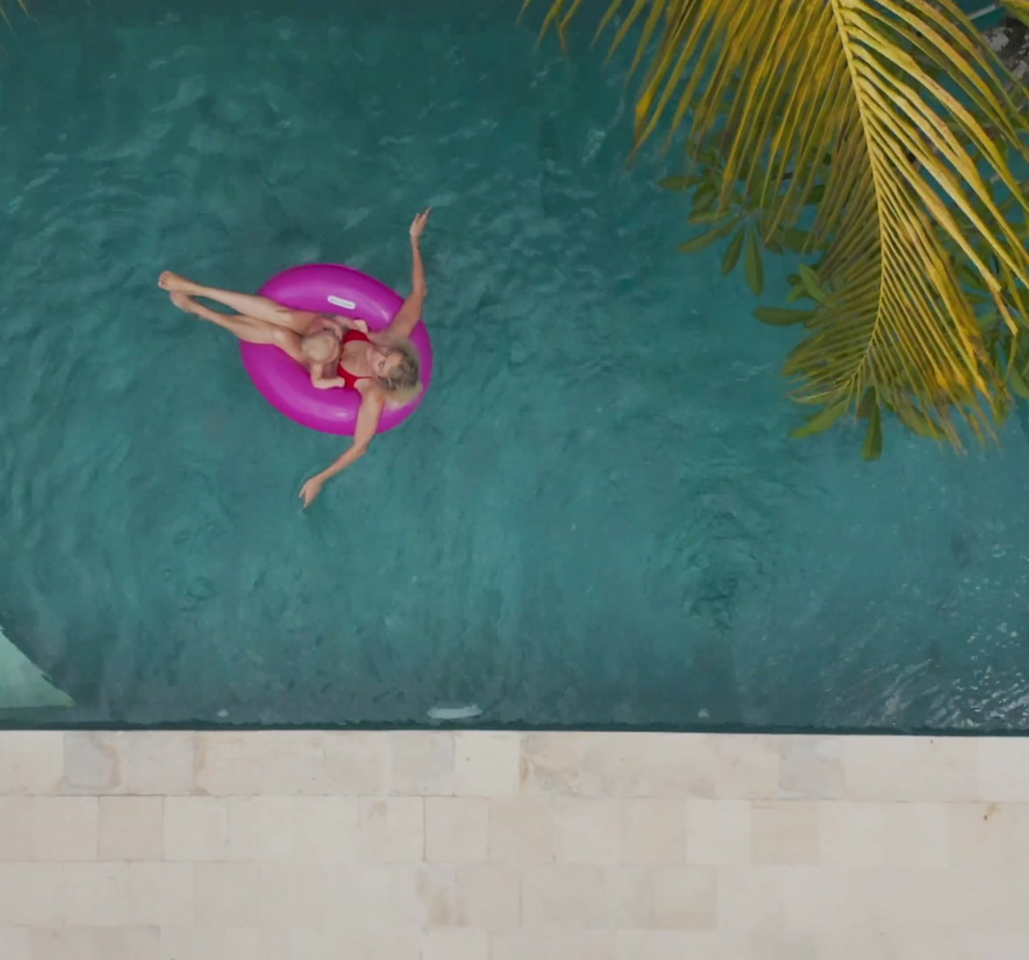

RED FLAG HOMES NETWORK · PARTNER GUIDE
Outpost
Classic
You bring the property.
We build it, brand it and run it.
THE EARN-BACK PROMISE
Earn back your programme fee in 12 months — or we pay you the difference.
8% COMMISSION · 200 FOUNDING ALLOCATIONS · INDIA

Slide 2
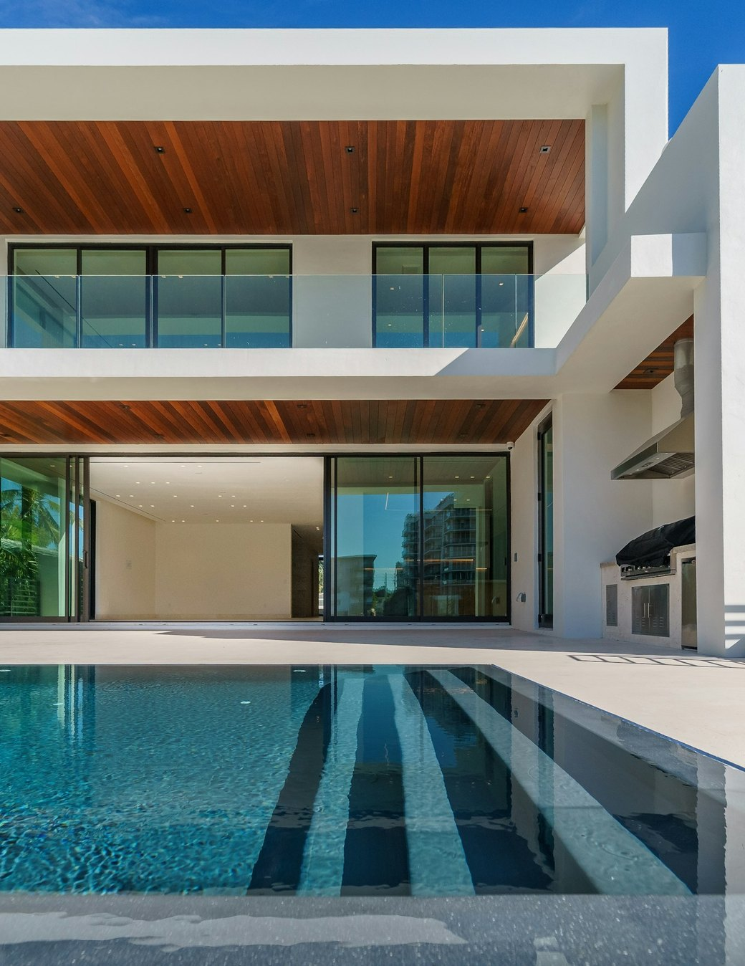
OUTPOST CLASSIC · PARTNER GUIDE
THE MODEL, IN ONE LINE
You own or lease the property.
We do everything else.
Red Flag designs it, brands it, launches it through creators and runs it completely — pricing, guests, cleaning, repairs. You pay one programme fee and 8% of what it books.
01
02
03
04
Design
Brand
Launch
Run
REDFLAGHOMES.IN
02 / 24

Slide 3
OUTPOST CLASSIC · PARTNER GUIDE
WHY NOW
Earn it back in 12 months,
or we pay the difference.
200
8%
1 Oct
founding allocations
for life
2026
across India, reviewed in the order they arrive.
for founding partners. After the 200, the rate rises.
is when allocations open.
REDFLAGHOMES.IN
03 / 24

Slide 4
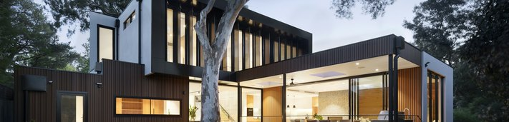
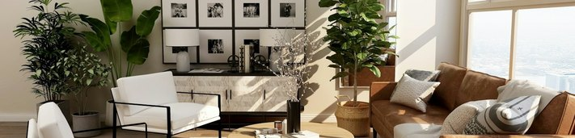
OUTPOST CLASSIC · PARTNER GUIDE
TWO WAYS IN
Two ways in. One system.
Same fee. Same 8%. Same promise. The only difference is whether you pay a landlord.
I OWN A PROPERTY
I DON’T OWN ONE
Franchise fee, one time
₹59,999
Setup & procuring, up to 3 keys
₹1,11,111
Programme fee
₹1,71,110
Rent and deposit
None
Paid by you to your landlord
Electricity, water, internet
You
Red Flag commission
8%, min ₹4,999 a month
Cleaning & minor maintenance
From booking revenue, at cost
Earn-Back Promise
Yes
All prices plus applicable GST. Setup covers up to 3 keys; each extra key ₹45,000. Furniture for an unfurnished property is quoted separately, itemised, at cost.
REDFLAGHOMES.IN
04 / 24

Slide 5
OUTPOST CLASSIC · PARTNER GUIDE
THE PRICE
One fee. Then 8% of what it books.
FRANCHISE FEE
THEN, EVERY MONTH
₹59,999
8%
one time
+
SETUP & PROCURING
₹1,11,111
of booking revenue, min ₹4,999 a month
up to 3 keys
=
PROGRAMME FEE
Founding partners keep 8% for life.
₹1,71,110
Setup covers up to 3 keys; each extra key ₹45,000.
one time, plus GST
You pay nothing until your property passes assessment. We look first, then you decide.
REDFLAGHOMES.IN
05 / 24

Slide 6

OUTPOST CLASSIC · PARTNER GUIDE
THE EARN-BACK PROMISE
If it doesn’t earn back its fee in year one, we pay the difference.
If your Outpost’s net operating profit over its first 12 full months after going live is less than the programme fee you paid, Red Flag pays you the difference.
WORKED EXAMPLE
Programme fee you paid
₹1,71,110
Your Outpost nets in 12 months
₹1,20,000
We pay ₹51,110
— Net operating profit = your payouts, minus the rent and utilities you paid.
— Maximum payment is the programme fee you paid. Everything installed stays yours either way.
REDFLAGHOMES.IN
06 / 24

Slide 7
OUTPOST CLASSIC · PARTNER GUIDE
THE EARN-BACK PROMISE
The conditions, stated plainly.
01
The property stays bookable at least 27 nights a month, excluding your agreed owner nights.
No quibbles.
Written terms.
Paid within 30 days.
02
We set the pricing, and you don’t override it.
03
The property passed our assessment — and for a leased property, the rent is within the range we assessed.
We can only make this promise because we run the property ourselves, to one standard. No manager who leaves the cleaning to you could offer it.
04
You approve major repairs within 7 days of us asking.
05
You claim in writing within 30 days of month 12.
REDFLAGHOMES.IN
07 / 24

Slide 8
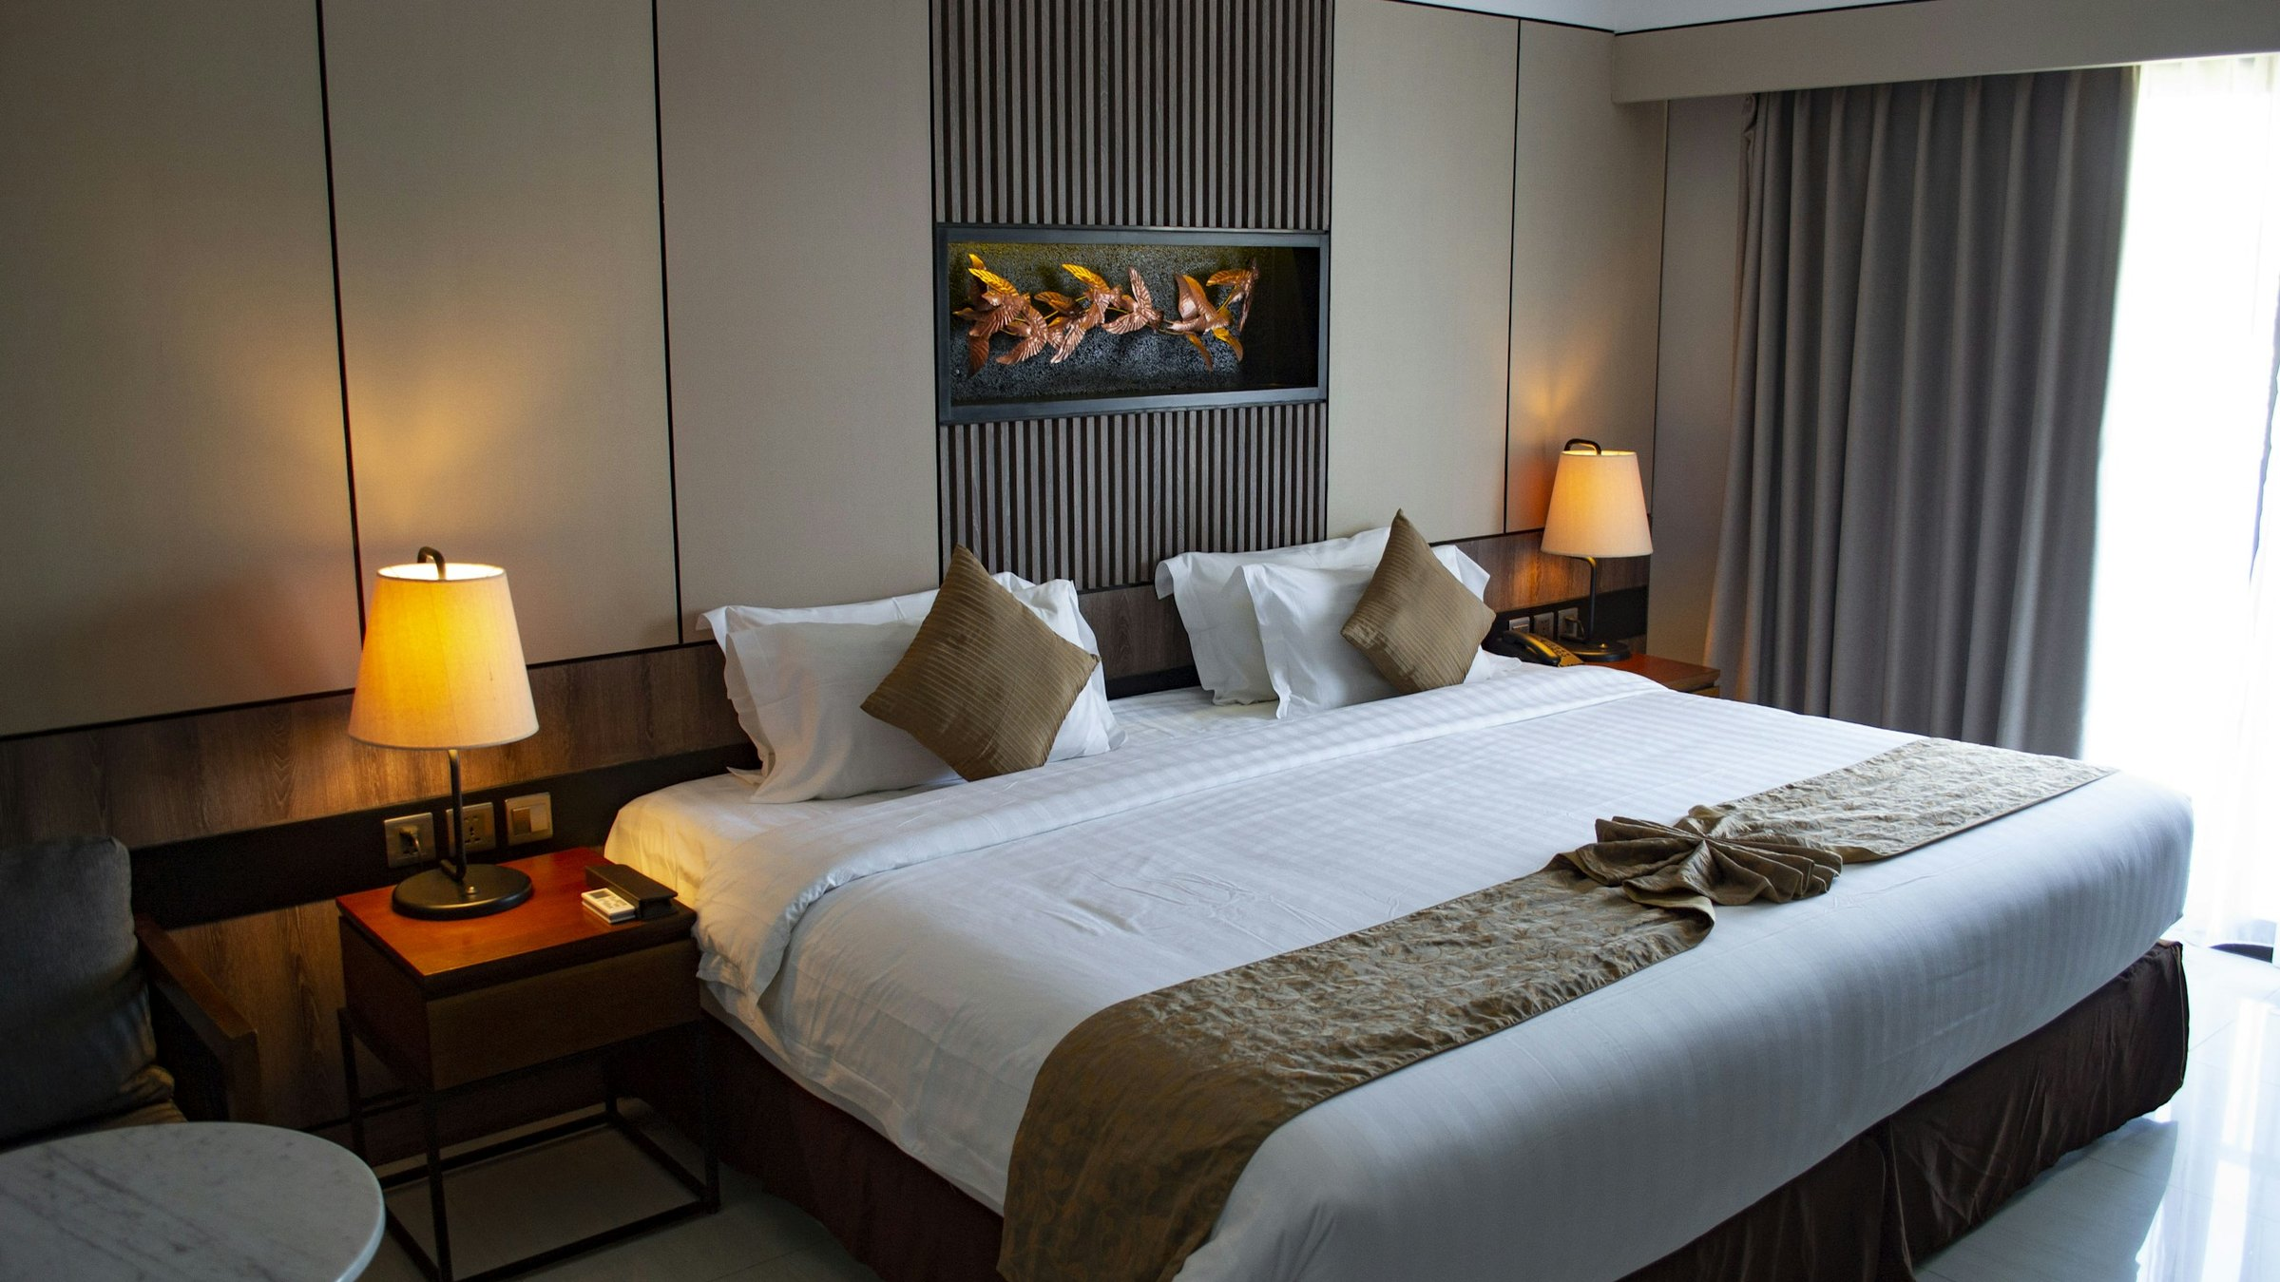
WHAT YOUR ₹1,11,111 ACTUALLY BUYS
90+
pieces — sourced, delivered, installed and photographed.
Plus the launch.

Slide 9

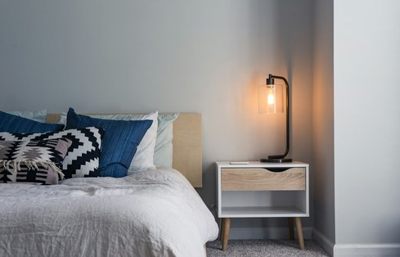


OUTPOST CLASSIC · PARTNER GUIDE
THE KIT · 1 OF 2
Everything a guest touches — chosen for you.
Lighting
Bedding & bath, hotel standard
Soft styling
Decor & finishing
— Pendant lights, bedside lamps, floor lamp and plug-in wall sconces
— Warm 2700K bulbs in every fitting, dimmable where possible
— Balcony or headboard string lights, hallway and bathroom night lights
— White cotton linen for every bedroom
— Mattress and pillow protectors; soft and firm pillows
— Bath towels, hand towels and bath mats
— Waffle robes, slippers, laundry bag, hamper
— Designer cushion covers with inserts, textured throws
— Blackout curtains for every bedroom window
— Living and bedside rugs
— Statement mirror and framed prints in the Outpost style
— Plants in ceramic or terracotta pots
— Coffee-table and bedside styling sets
— Scent diffuser and first refill
REDFLAGHOMES.IN
09 / 24

Slide 10
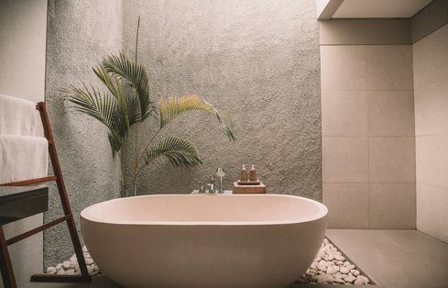
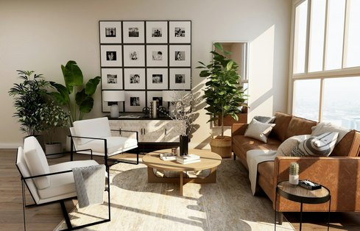
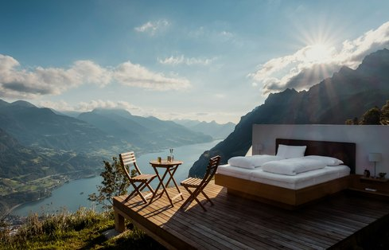
OUTPOST CLASSIC · PARTNER GUIDE
THE KIT · 2 OF 2
Ready for guests on day one.
RED FLAG ×
YOUR PROPERTY
Guest kit
Safety & technology
Your branding — the Signature Kit
The work, not just the things
— Tea and coffee station: kettle, jars, mugs, tray
— Welcome basket, first fill
— Refillable toiletry dispensers
— Hair dryer, iron and board, umbrella stand
— Smoke alarm, extinguisher, fire blanket, first-aid kit, emergency card
— Keyless smart lock; WiFi with a guest network
— Smart TV stick; bedside USB and charging points
— Engraved RED FLAG × [Your Property] brass door plate
— Branded tissue boxes, coasters, key tags, labels, door hanger
— Branded welcome card and printed house guide
— Design plan, sourcing, delivery and a full installation day
— Deep clean and styling before the shoot
— Professional photo and video shoot, 25+ edited images
— Listings on Airbnb, Booking.com and your direct page
— AI pricing, creator launch, guidebook and house rules
Optional Icon Kit: monogram curtains, branded linen, blankets, ceramics, robes and slippers. Studio ₹35,000 · Villa ₹75,000.
REDFLAGHOMES.IN
10 / 24

Slide 11
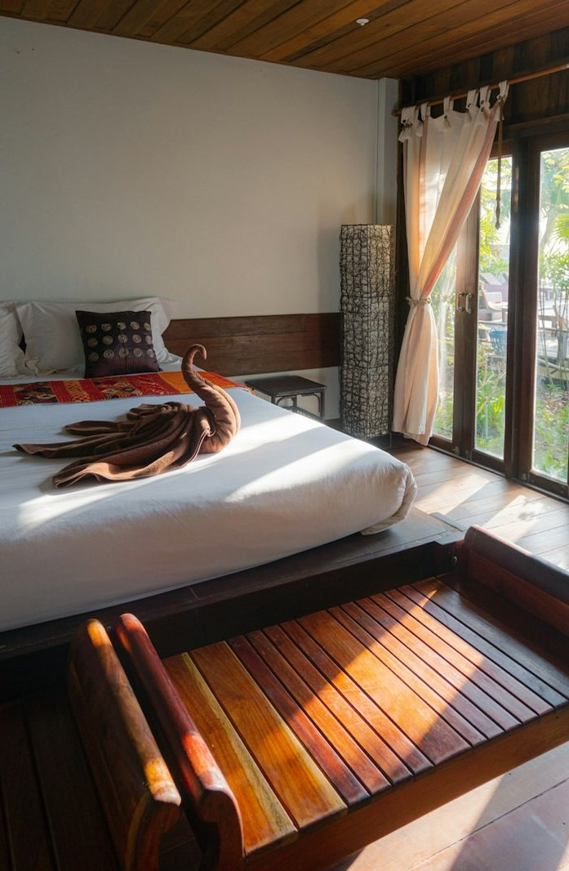
OUTPOST CLASSIC · PARTNER GUIDE
WHAT WE DO EVERY MONTH
You step back. We run it.
Dynamic AI pricing, adjusted daily to demand, season and local events
24/7 guest messaging, from first enquiry to check-out
Every clean, turnover and linen change arranged and inspected
Minor maintenance up to ₹2,000 per incident, with all vendor coordination
Review and reputation management
Listings kept in sync across every channel
Payouts twice a month with an itemised statement
REDFLAGHOMES.IN
11 / 24

Slide 12
OUTPOST CLASSIC · PARTNER GUIDE
WHAT IS NOT INCLUDED — STATED UPFRONT
No surprises on your first statement.
ITEM
WHO PAYS
Rent and security deposit (leased properties)
You
Electricity, water, internet, society charges, property tax
You
Repairs above ₹2,000 per incident
You — and we ask before we spend
Major appliance replacement (AC, geyser, fridge)
You
Furniture for an unfurnished property
You — quoted separately, itemised, at cost
Keys beyond the first three
You — ₹45,000 per extra key
Building and contents insurance
You
Cleaning, linen, consumables, minor repairs
Deducted from booking revenue at cost
REDFLAGHOMES.IN
12 / 24

Slide 13
OUTPOST CLASSIC · PARTNER GUIDE
HOW IT WORKS
Four stages. You step back after the first.
YOU + US
US — YOU STEP BACK
01
02
03
04
The Hunt
The Flip
The Drop
The Yield
We check your property, or help you find one, against real demand data — before you commit a rupee.
Design, furnishing, branding kit, smart lock and WiFi. Photograph-ready in under 45 days.
Creators stay and post, a professional shoot, and listings go live on every channel.
AI pricing, 24/7 guests, every clean and repair handled. Payouts on the 1st and 16th.
REDFLAGHOMES.IN
13 / 24

Slide 14
OUTPOST CLASSIC · PARTNER GUIDE
HOW YOU GET PAID
One statement. Twice a month.
You never receive a separate bill.
Gross
bookings
8%
At
cost
Your
payout
−
−
=
everything guests pay
Red Flag commission
cleaning & maintenance
straight to your account
Payouts land on the 1st and 16th of every month, with a statement showing every booking and every deduction. Gross bookings, minus 8%, minus cleaning and maintenance at cost, equals your payout.
1st
16th
REDFLAGHOMES.IN
14 / 24

Slide 15
OUTPOST CLASSIC · PARTNER GUIDE
ILLUSTRATIVE MONTHLY NUMBERS · 3-KEY VILLA
What a month could look like.
OCCUPANCY
45%
55%
60%
65%
READ THE FIRST COLUMN HONESTLY
At 45% occupancy the fee takes longer than 12 months to earn back — which is exactly when the Earn-Back Promise pays you. We publish that column deliberately. A company that only shows you its best case is showing you the wrong thing.
Gross booking revenue
₹1,21,500
₹1,48,500
₹1,62,000
₹1,75,500
Less Red Flag 8%
₹9,720
₹11,880
₹12,960
₹14,040
Less cleaning & maintenance
₹16,500
₹18,500
₹20,400
₹22,300
= Net payout
₹95,280
₹1,18,120
₹1,28,640
₹1,39,160
Less electricity & utilities
₹12,000
₹12,000
₹12,000
₹12,000
Owner: more than a tenant pays
+₹8,280
+₹31,120
+₹41,640
+₹52,160
Owners: compare with what a tenant pays you today (₹75,000 assumed). Lessees: rent is ₹75,000. Breakeven for a leased Outpost is around 41% occupancy.
Lessee: net after rent
₹8,280
₹31,120
₹41,640
₹52,160
Months to earn back the fee
20.7
5.5
4.1
3.3
Illustrative only — ₹9,000 average nightly rate, ₹75,000 market rent. You receive a projection for your own property during assessment.
REDFLAGHOMES.IN
15 / 24

Slide 16
OUTPOST CLASSIC · PARTNER GUIDE
THREE WAYS TO RUN A PROPERTY
Compare honestly.
DO IT YOURSELF
A CO-HOST
OUTPOST CLASSIC
Commission
None
15–20%
8%, min ₹4,999/month
Joining fee
None
₹20,000–50,000 typical
₹59,999 one time
Setup and design
Yours
Yours
₹1,11,111 · 90+ pieces, shoot, launch
Cleaning
You arrange and pay
Usually you
We arrange — at cost from bookings
Repairs
You
Usually you
Handled to ₹2,000 per incident
Guests at 2am
You
Rarely
Us, 24/7
Pricing
You guess
Usually manual
AI, daily
Marketing
Your problem
Listing only
Creator launch + direct bookings
Your time
10–15 hrs a month
4–6 hrs a month
Close to zero
If it underperforms
Your loss
Your loss
We pay you the difference
REDFLAGHOMES.IN
16 / 24

Slide 17

OUTPOST CLASSIC · PARTNER GUIDE
YOUR NAME ON THE DOOR
An identity, not a listing number.
A higher nightly rate
Free guest content
Design detail supports premium pricing. You stop being compared to the flat next door.
Guests photograph and post branded details unprompted.
Instant credibility
The collection effect
Reads as a hospitality brand, not someone’s spare flat.
Guests who stay in one Red Flag property recognise and book others.
Exit value
Your name on the door
A branded, operating, revenue-producing property sells for more than a furnished flat.
An engraved RED FLAG × [Your Property] plate.
REDFLAGHOMES.IN
17 / 24

Slide 18
OUTPOST CLASSIC · PARTNER GUIDE
IS THIS FOR YOU?
Honest fit, both ways.
It works well if
It is not for you if
✓ You own a flat or villa that is empty, under-used, or earning a modest rent
✓ You can put ₹1,71,110 to work without needing it back next month
✓ You want the income without the job
✓ Your property is in or near Goa, Mumbai, Bengaluru, Delhi NCR or Lucknow — or you live abroad and own one there
✕ You want a guaranteed monthly income regardless of bookings. Short stays don’t work that way — anyone promising it is not telling you the truth.
✕ You want to set your own nightly rates. Our pricing control is what makes the Earn-Back Promise possible.
✕ You need the property free for long stretches. Owner nights are agreed at signing.
✕ Your society or landlord prohibits short stays and won’t give written permission.
REDFLAGHOMES.IN
18 / 24

Slide 19
OUTPOST CLASSIC · PARTNER GUIDE
WHAT WE NEED FROM YOU
Six simple requirements.
01
02
03
Age & residency
Proof
Permission
You are 18 or older, and an Indian citizen or valid resident.
Proof of ownership, or a lease permitting short-stay use.
Written permission from your society or landlord where required.
04
05
06
Clear title
KYC
Access
The property free of legal dispute or encumbrance.
Basic KYC and bank details for payouts.
Access for cleaning, maintenance and guests — and approval of major repairs within 7 days.
REDFLAGHOMES.IN
19 / 24

Slide 20

OUTPOST CLASSIC · PARTNER GUIDE
WHERE WE ARE
Goa
Mumbai
Bengaluru
Delhi NCR
Lucknow
Living in Dubai, London or New York?
Plant your flag at home — we run your Indian property end to end, fully remotely, and you join without flying back. Dubai Outposts open in 2027.
REDFLAGHOMES.IN
20 / 24

Slide 21
OUTPOST CLASSIC · PARTNER GUIDE
FREQUENTLY ASKED QUESTIONS · 1 OF 2
Straight answers.
01
What is Outpost Classic?
02
What does it cost?
03
When do I pay?
A programme where Red Flag designs, brands, launches and runs your short-stay property end to end. You pay a one-time programme fee and 8% of booking revenue.
₹59,999 franchise fee plus ₹1,11,111 setup, one time — ₹1,71,110 for up to three keys, plus GST. Extra keys ₹45,000 each. Commission 8%, min ₹4,999 a month.
After your property passes assessment and you sign. Nothing before that. The free assessment carries no obligation.
04
I already own a property. What do I pay?
05
I don’t own a property. Can I still join?
06
What if my property doesn’t qualify?
The programme fee, electricity and utilities. No rent, no deposit.
Yes. We help you find and assess a high-demand property before you sign a lease. You pay the programme fee, and rent and deposit to your landlord.
We tell you why, in writing, and you pay nothing. We would rather decline a property than run one that will disappoint you.
07
What is the Earn-Back Promise?
08
Is my return guaranteed?
09
Who pays for cleaning and repairs?
If net operating profit in the first 12 full months is less than the programme fee you paid, we pay the difference within 30 days of a valid claim. Full terms in the Programme Terms.
No. Earnings depend on occupancy, rates, season and location, and a property can earn less than its costs. The only guarantee is the Earn-Back Promise, exactly as written.
Cleaning, linen, consumables and repairs up to ₹2,000 per incident are arranged by us and deducted at cost, itemised. Anything above ₹2,000 needs your approval first.
REDFLAGHOMES.IN
21 / 24

Slide 22
OUTPOST CLASSIC · PARTNER GUIDE
FREQUENTLY ASKED QUESTIONS · 2 OF 2
More straight answers.
10
Why is your commission only 8%?
11
How long until my property is live?
12
When and how am I paid?
Our operations run on an AI system rather than a large payroll, so each extra property costs us little to run. The first 200 partners lock 8% for life.
Under 45 days from signing, if the property is ready to work on.
Twice a month, on the 1st and 16th, with a statement showing every booking and deduction.
13
Can I still use my property?
14
Can I add a second property later?
15
I live abroad. Can I join?
Yes. Owner nights are agreed at signing and blocked in the calendar. Nights beyond that allowance are excluded from the Earn-Back Promise.
Yes, and performing partners are prioritised. Each property has its own programme fee and its own Earn-Back Promise.
Yes. NRIs can join fully remotely for a property in India. Payouts go to your NRO account and Indian tax is deducted at source as the law requires.
16
Can I leave the programme?
17
What happens to the branding if I leave?
Yes, with 90 days’ notice after an initial 12-month term. The fee is not refundable except under the Earn-Back Promise; everything installed stays yours.
We remove the Red Flag name and door plate. Furniture and fittings you paid for stay with you.
REDFLAGHOMES.IN
22 / 24

Slide 23
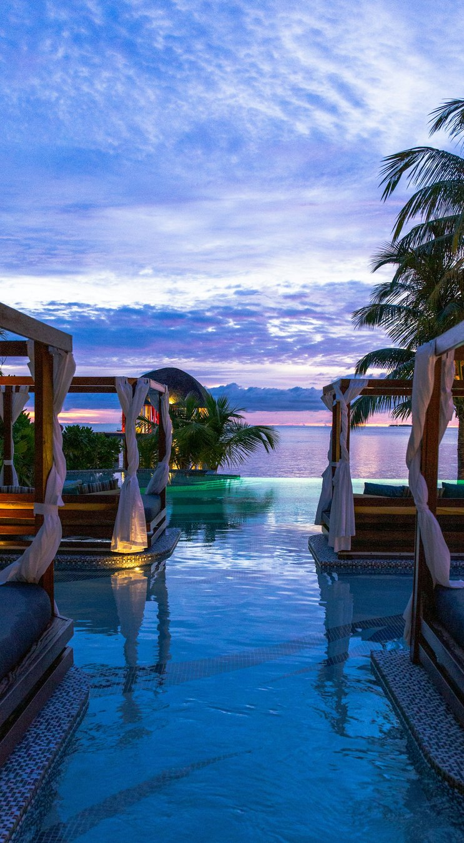
OUTPOST CLASSIC · PARTNER GUIDE
YOUR NEXT STEP
It takes 48 hours.
1
Apply for allocation at redflaghomes.in. Two minutes.
2
We call you — usually the same day — and ask about your property and your city.
3
We assess it against real demand data, free, with no obligation.
4
You receive a projection within 48 hours — your rent, your city, your numbers.
5
If the numbers work for both of us, you sign and pay. Live in under 45 days.
LIMITED ALLOCATION · APPLICATIONS REVIEWED IN THE ORDER RECEIVED
REDFLAGHOMES.IN
23 / 24

Slide 24
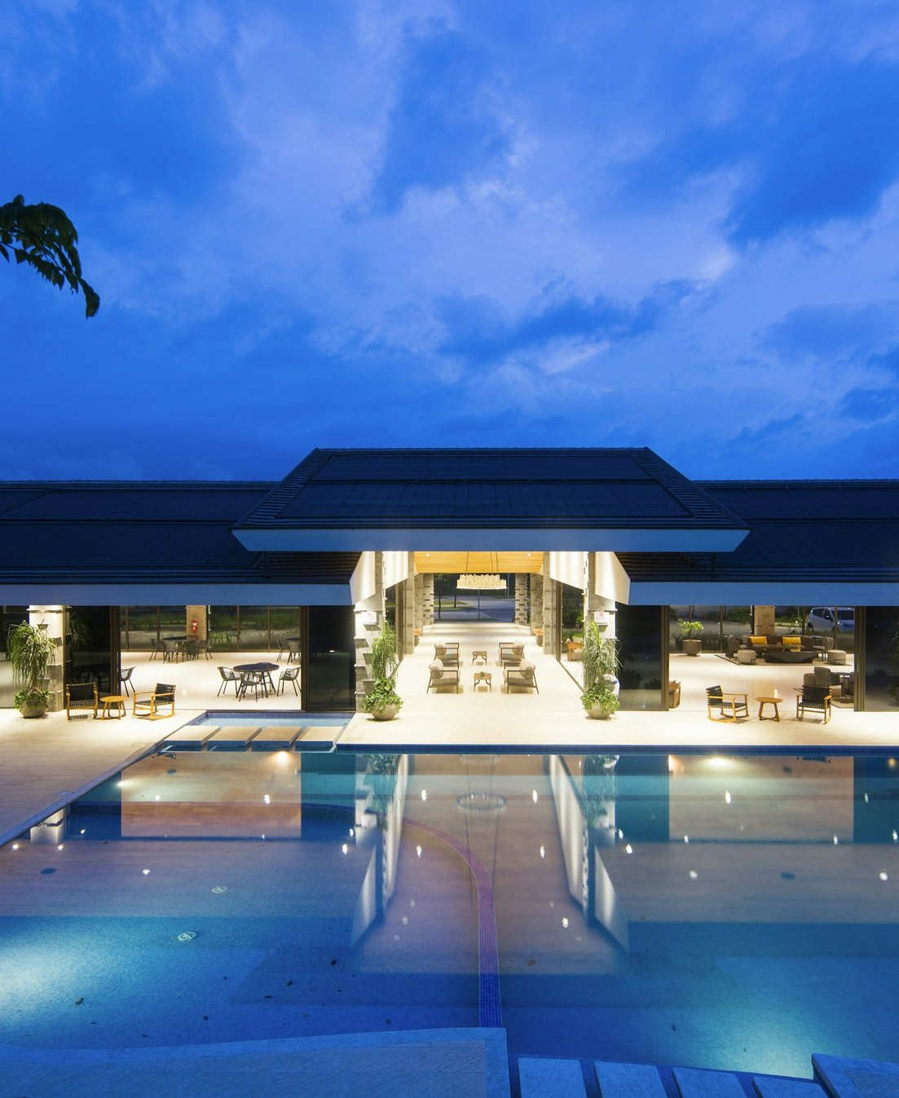
APPLY FOR ALLOCATION
redflaghomes.in
Two minutes to apply. A projection for your own property within 48 hours — free, with no obligation.
hello@redflaghomes.in
Red Flag Homes Network · a company of Red Flag World Holdings Ltd, London
Figures are illustrative, based on a 3-key villa, ₹9,000 average nightly rate and ₹75,000 market rent. Returns are not guaranteed and a property can earn less than its costs. The Earn-Back Promise is subject to the Programme Terms. All prices plus applicable GST.

