Slide 1


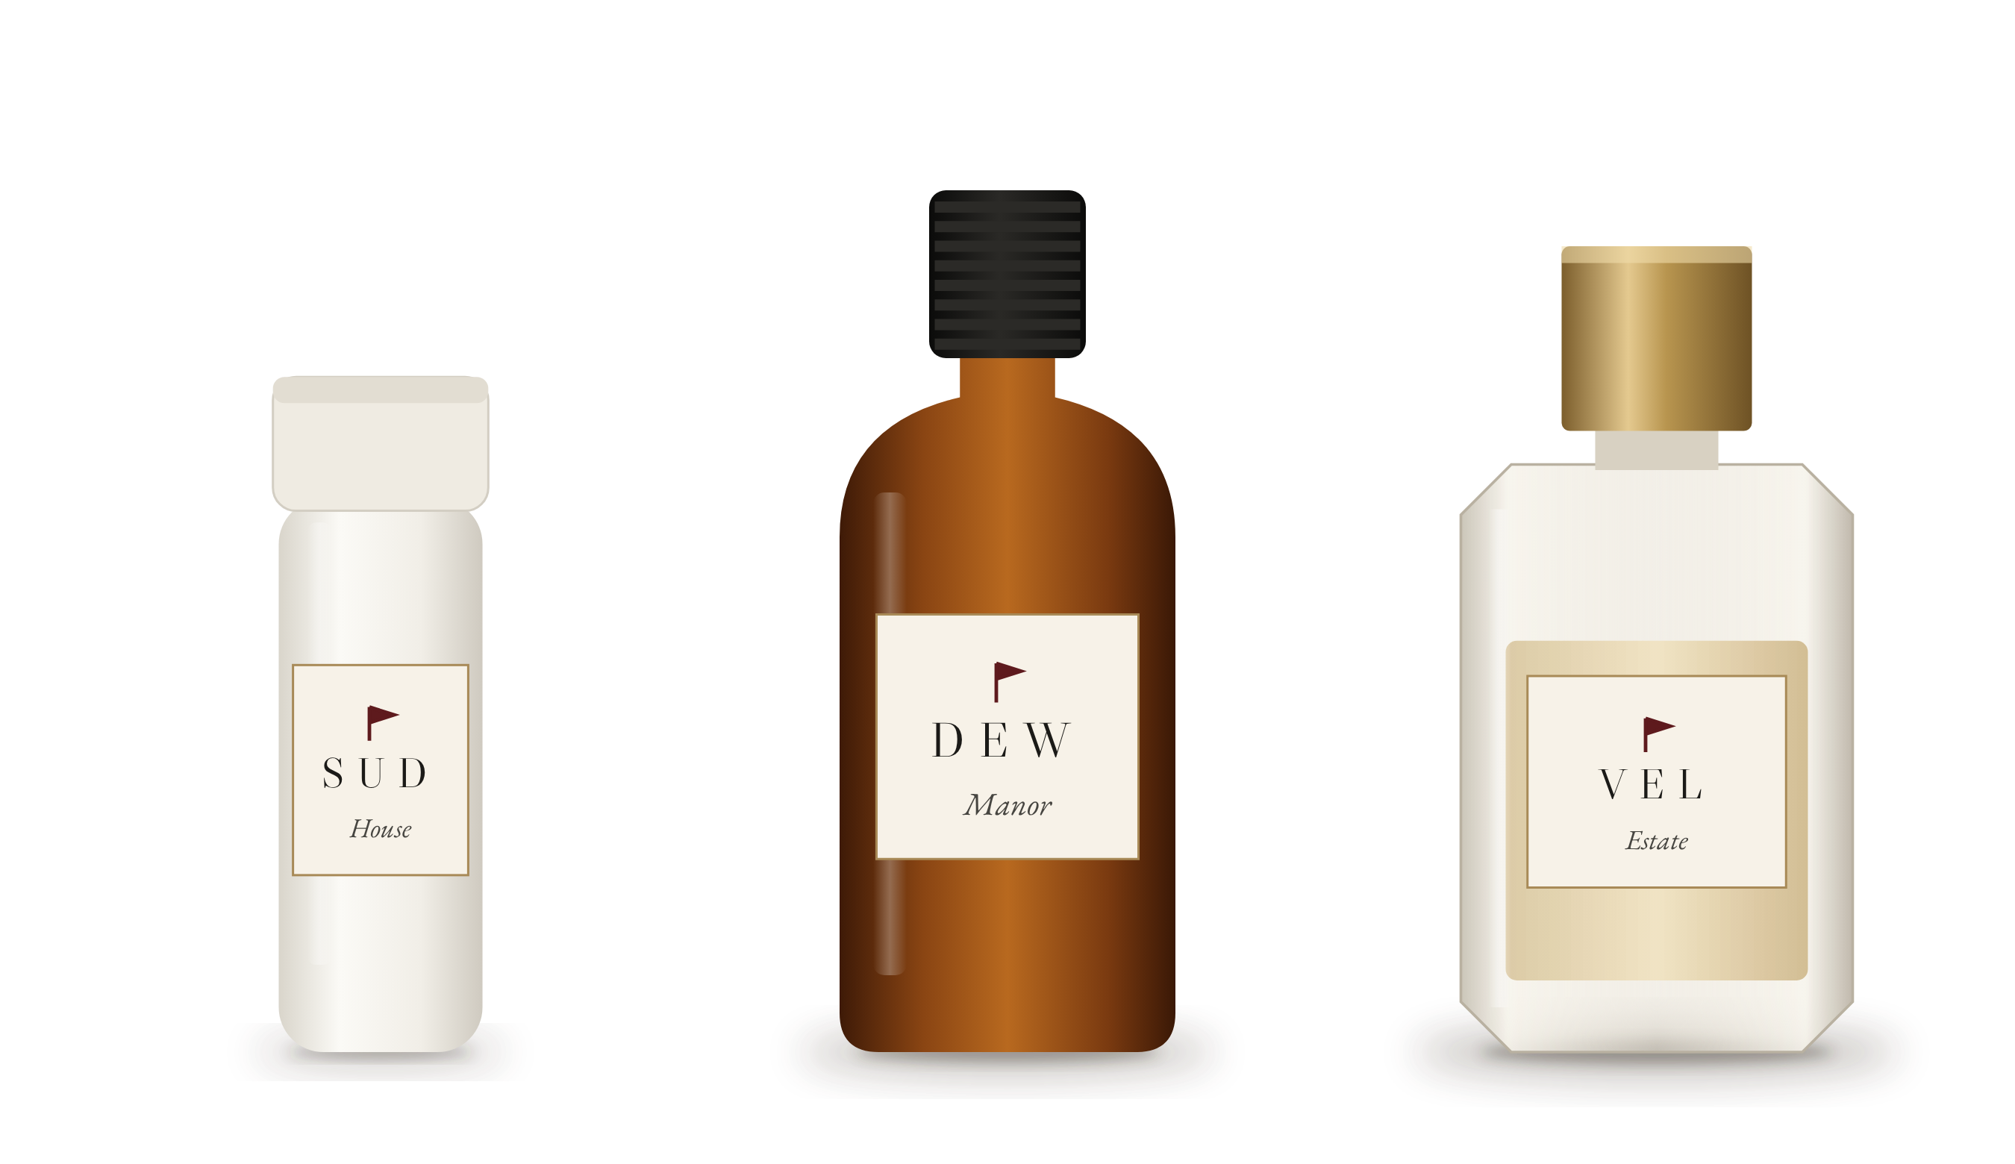
BRAND PRESENTATION
Red Flag Ritual
Green flags only.
Signature-scent amenities for stays worth remembering.

Slide 2
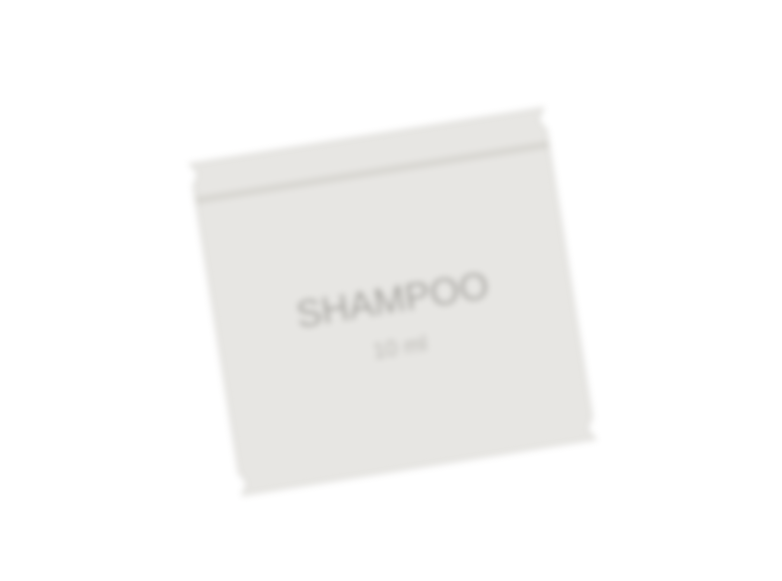
THE PROBLEM
Guests forget
most stays.
Generic sachets. Mismatched bottles. A room that smells like nothing.
Guests don’t complain about it. They just don’t come back — and they don’t mention you in reviews.
The stay nobody remembers.
II
RED FLAG RITUAL

Slide 3

THE ANSWER
Meet the ritual.
Red Flag Ritual turns your bathroom and bedroom into one quiet, luxurious experience.
One signature scent runs through every bottle, every spray and every guest kit. It arrives at your door every month. You never think about restocking again.
III
RED FLAG RITUAL

Slide 4

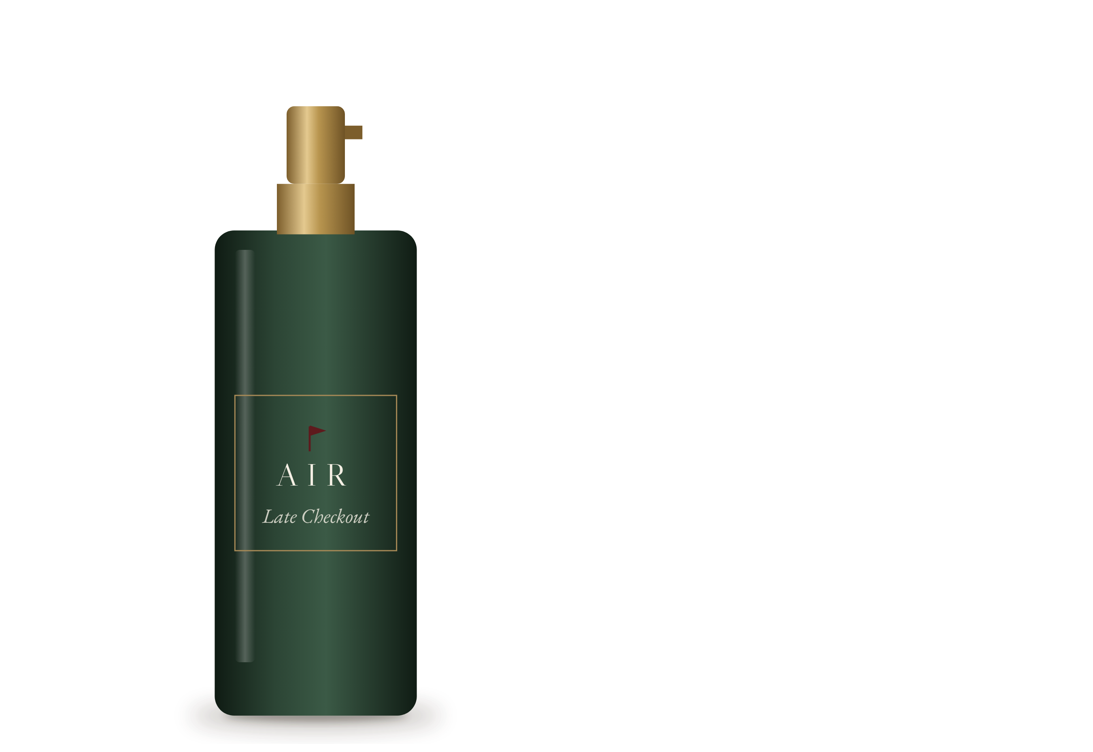
OUR SIGNATURE SCENT
No. 01
Late Checkout
Warm, clean, slow-morning. It smells like you didn’t have to leave yet.
“Guests remember how a place made them feel. Scent is how they remember it.”
IV
RED FLAG RITUAL

Slide 5
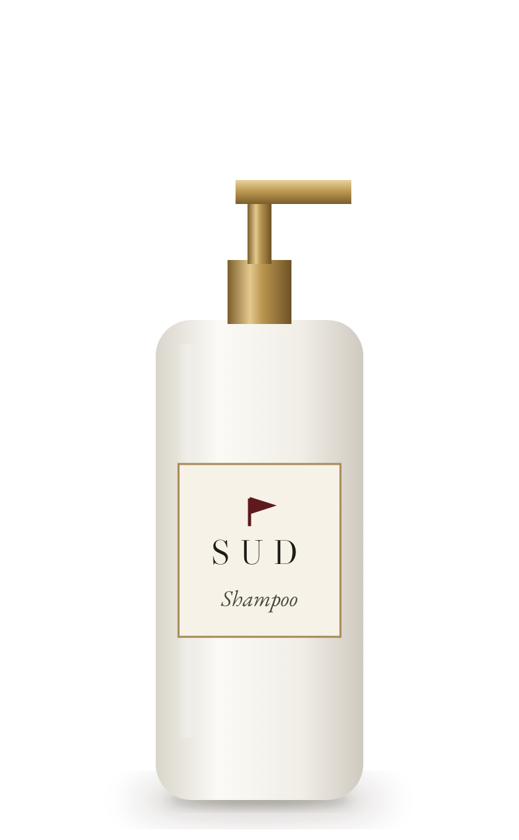
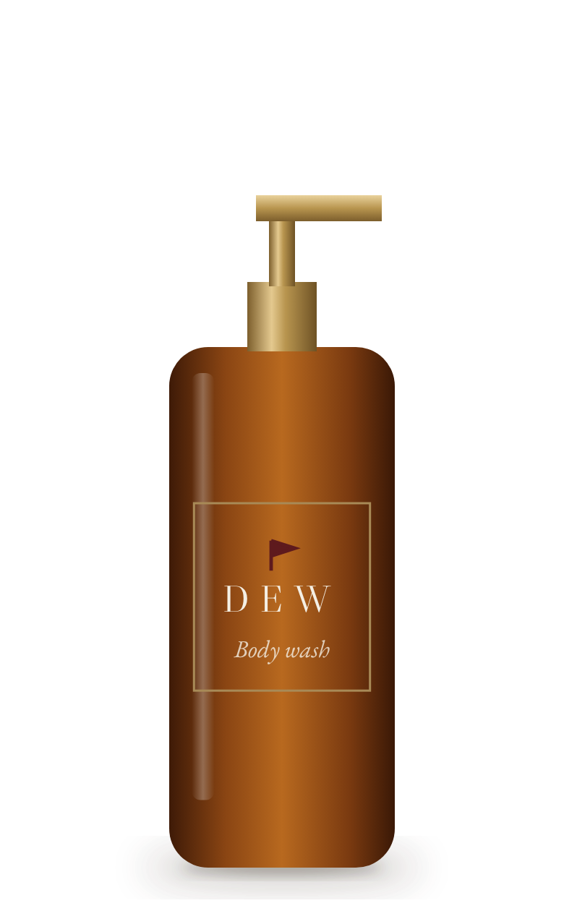
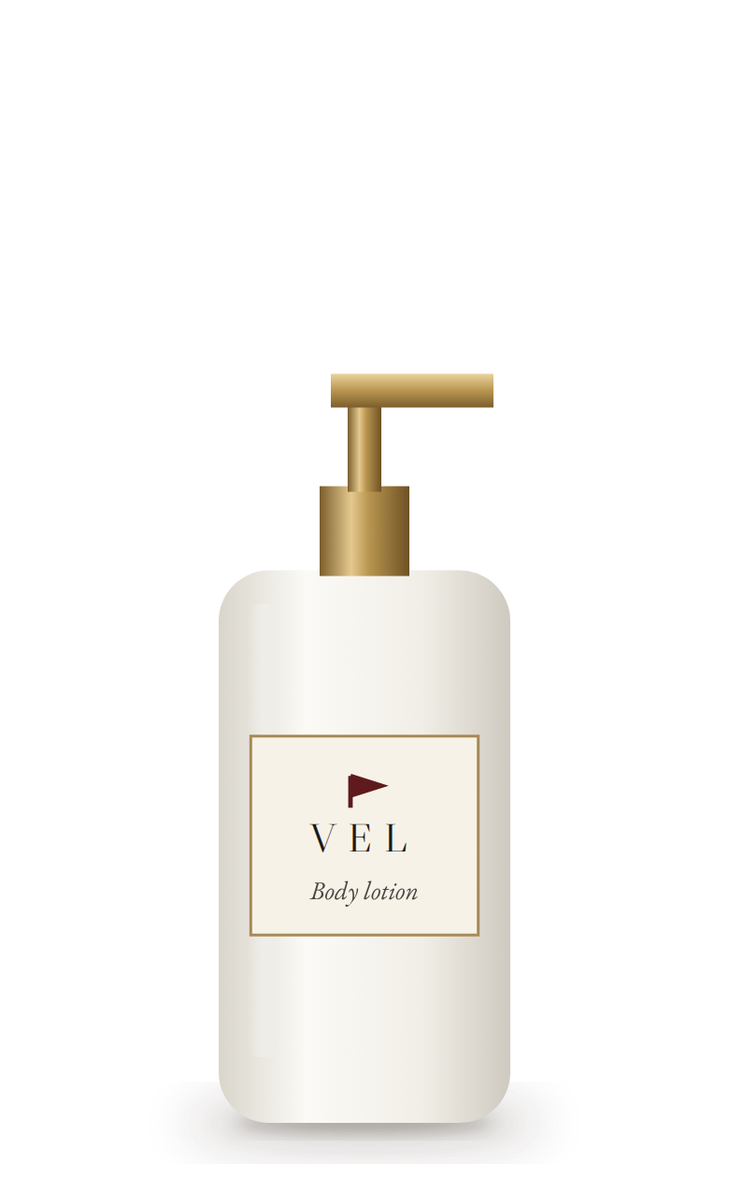
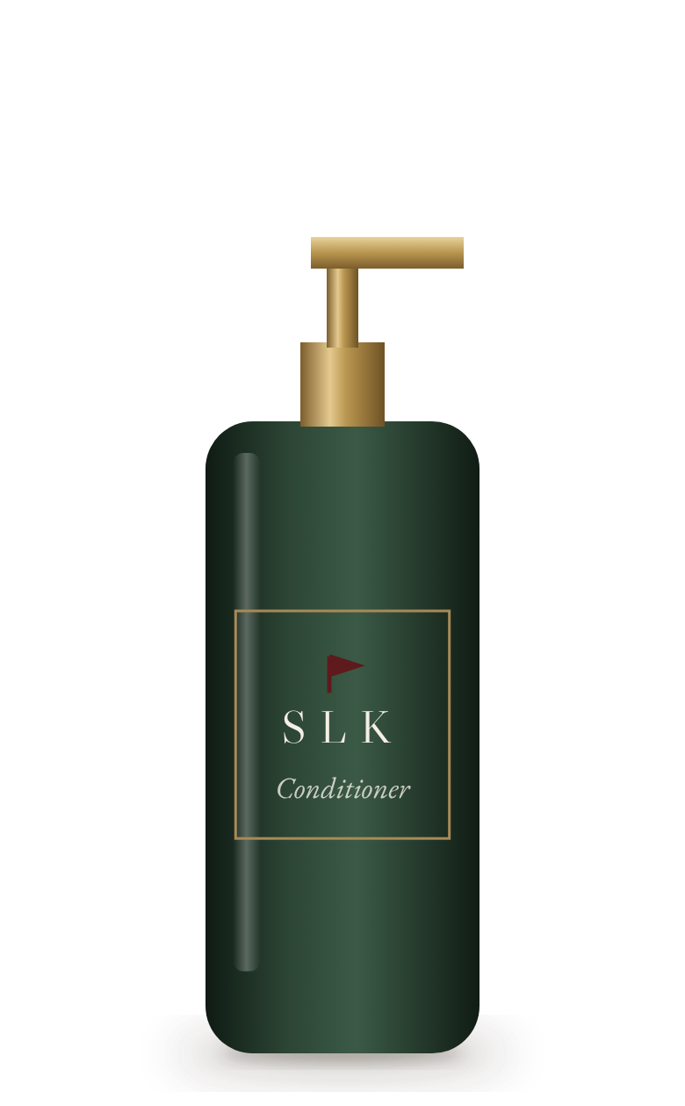
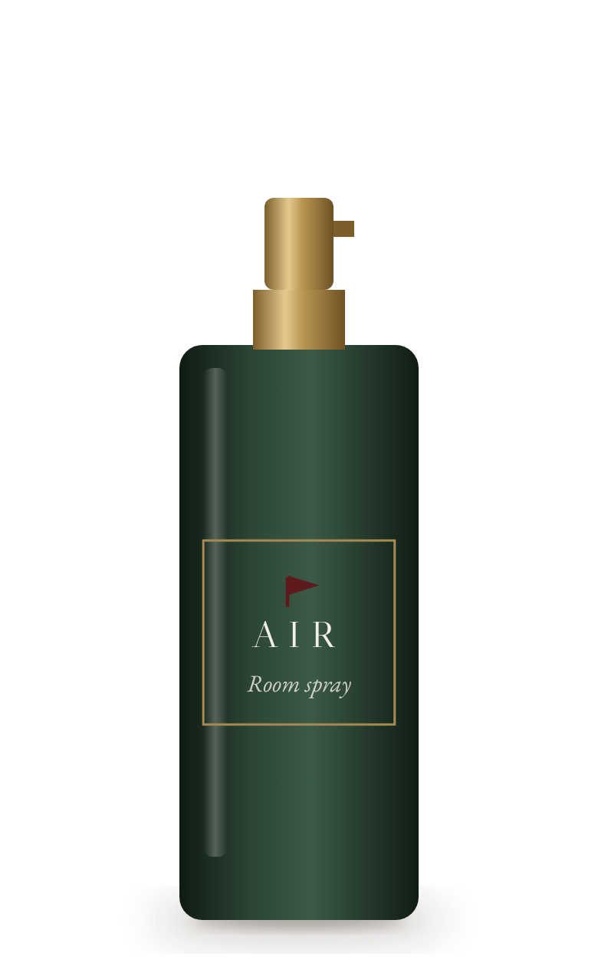
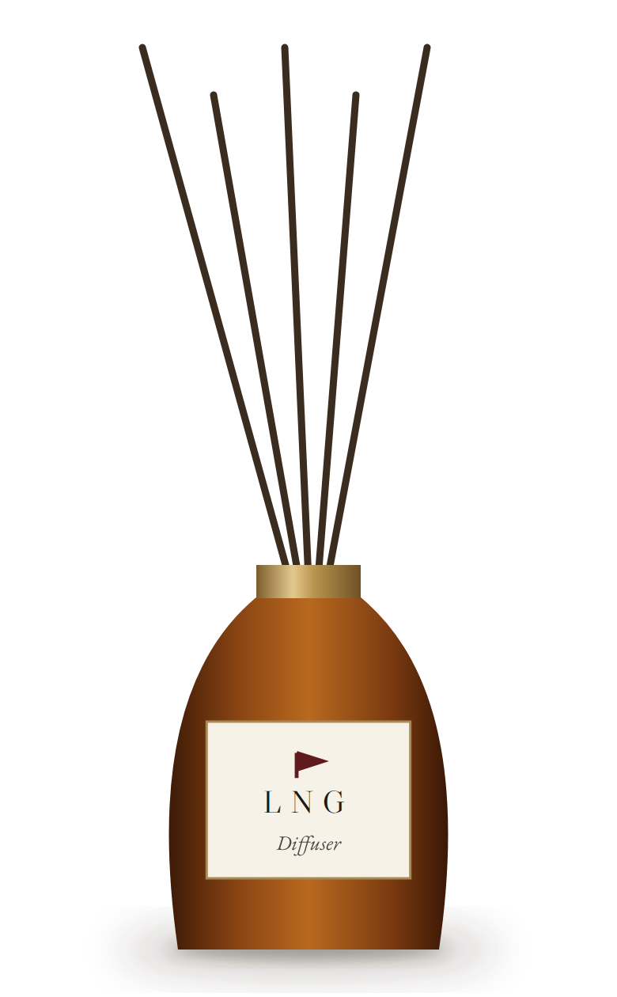
THE COLLECTION
Six bottles. One scent.
SUD
DEW
VEL
SLK
AIR
LNG
Shampoo
Body wash
Body lotion
Conditioner
Room spray
Diffuser refill
Rich, soft lather. Leaves hair clean without stripping it.
Fresh, light wash. The scent stays on the skin after the shower.
Velvet-soft, fast-absorbing, non-greasy finish.
Smooth, silky detangle.
Signature scent for rooms and linen. The first thing guests notice.
Short for “linger”. Keeps the scent in the room all day.
ESTATE ONLY
ESTATE ONLY
V
RED FLAG RITUAL

Slide 6
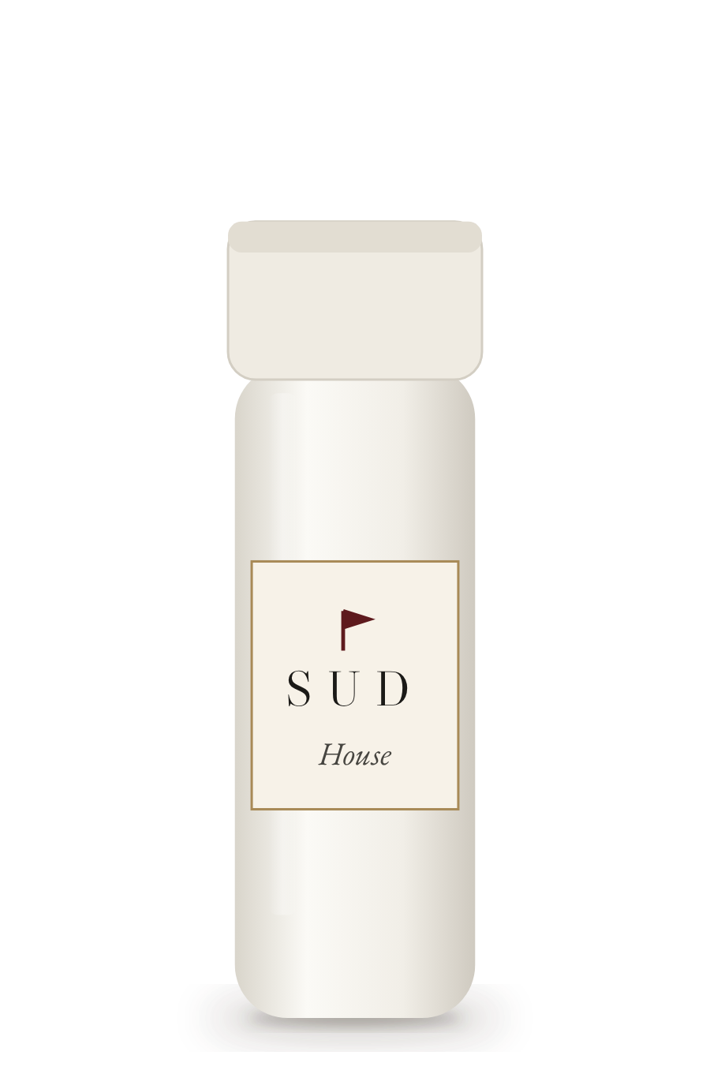
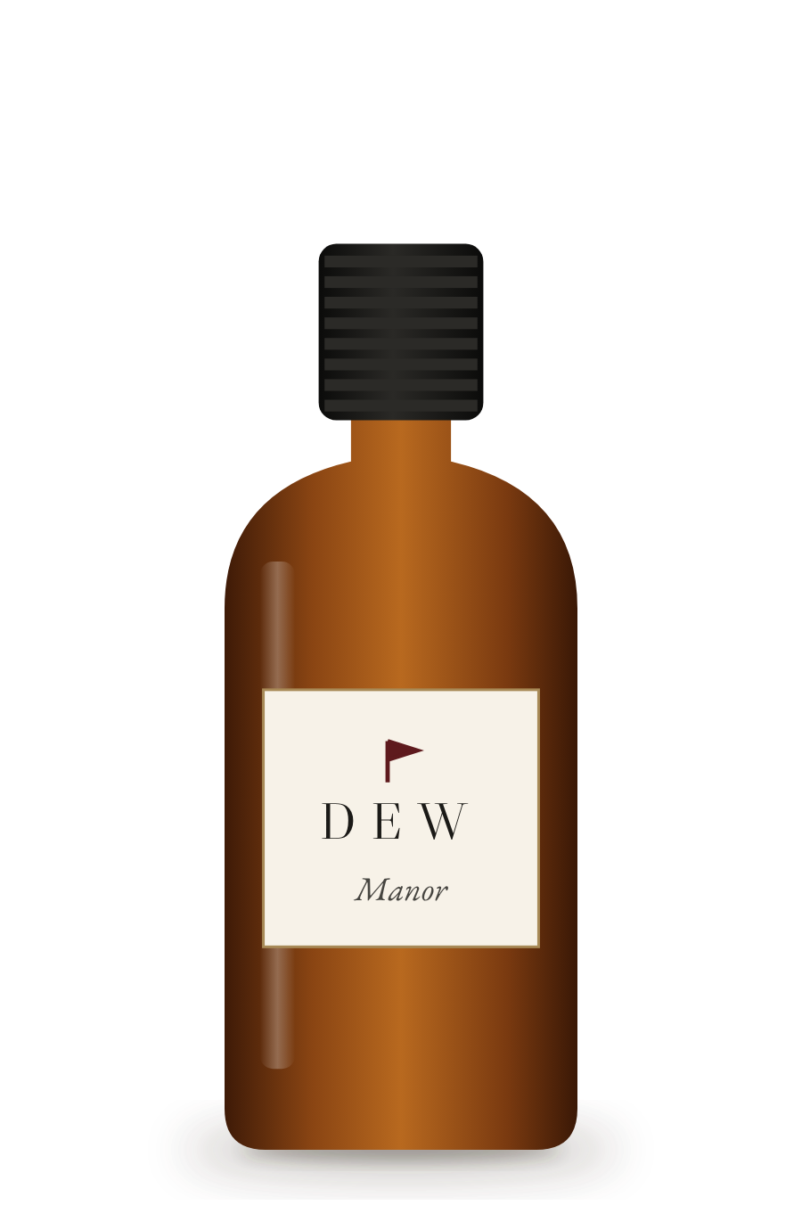
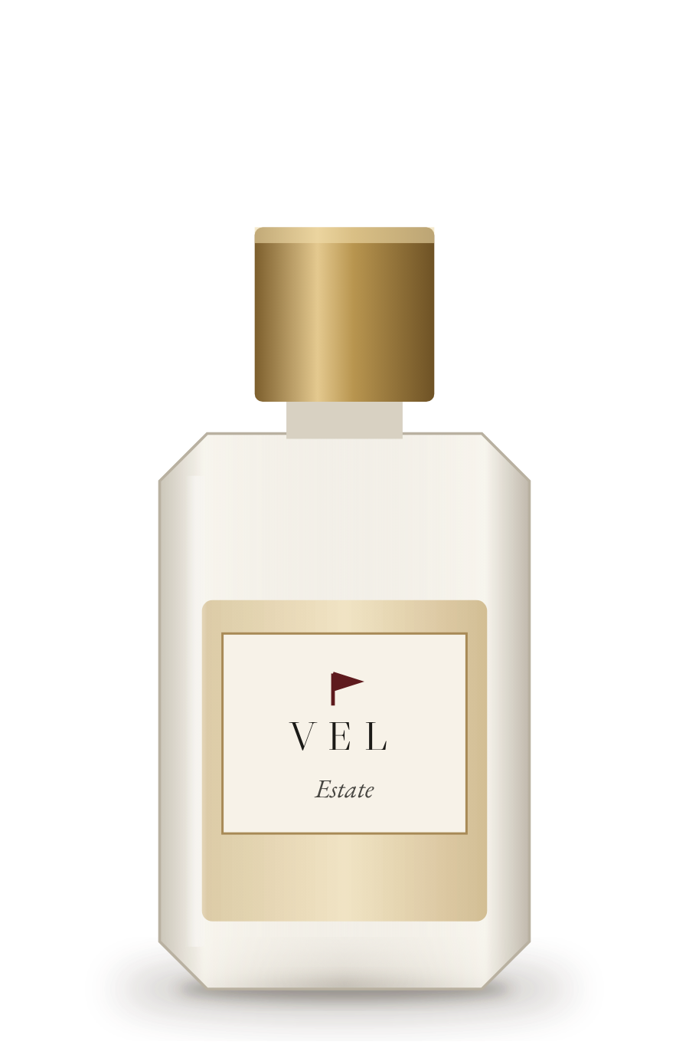
PLANS
Choose your house rules.
Every plan includes 30 guest sets a month, delivered to your property. · Prices exclusive of applicable taxes. Cancel anytime.
MOST HOSTS
House
Manor
Estate
₹999
₹1,999
₹3,999
per month
per month
per month
≈ ₹33 per guest
≈ ₹67 per guest
≈ ₹133 per guest
SUD + DEW in 10 mL vials
SUD + DEW + VEL in 10 mL amber glass
SUD + DEW + VEL + SLK in 15 mL designer glass
AIR room spray
AIR glass spray
AIR glass spray
LNG diffuser
VI
RED FLAG RITUAL

Slide 7

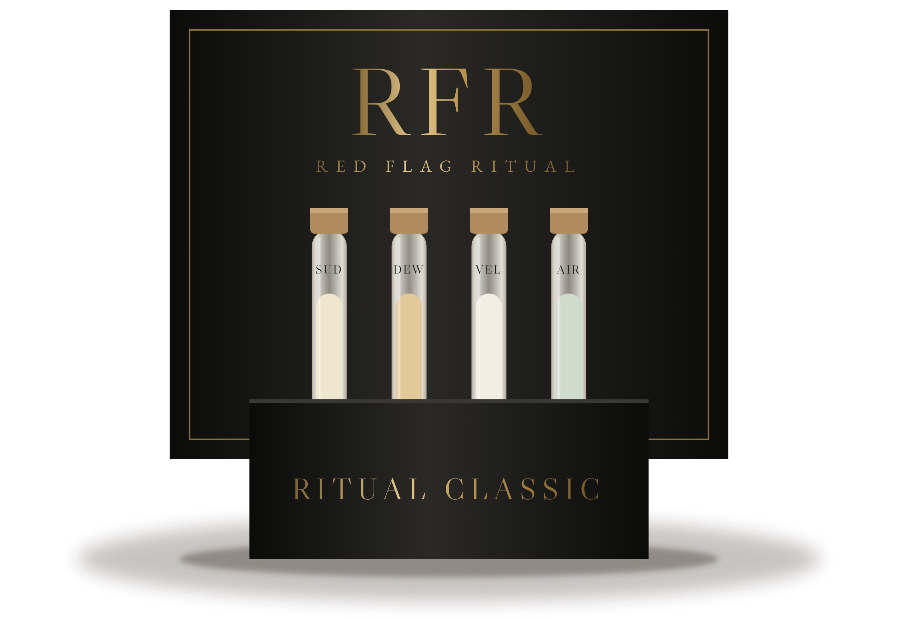
THE GUEST TAKE-HOME KIT
Ritual Classic
Four test tubes of the ritual in a monogrammed box: SUD, DEW, VEL and AIR.
A thank-you guests keep — and a QR code that lets them bring the scent home.
₹149
per kit · minimum 10
add to any plan
VII
RED FLAG RITUAL

Slide 8




HOW IT WORKS
Set it once. It simply repeats.
I
II
III
IV
Pick your plan.
We deliver monthly.
Guests notice.
It just repeats.
House, Manor or Estate.
30 guest sets, sealed and ready.
The scent shows up in reviews.
Auto-renews every month. Change or cancel anytime.
VIII
RED FLAG RITUAL

Slide 9
WHY HOSTS CHOOSE RED FLAG RITUAL
Green flags, only.
★ ★ ★ ★ ★
I
Hotel-grade experience from ₹33 per guest
“The room smelled incredible.”
II
One signature scent across the whole stay
III
Sealed, single-stay bottles for every guest
IV
No restocking runs. It arrives every month.
SAMPLE REVIEW
V
Trusted in Red Flag Homes properties first
IX
RED FLAG RITUAL

Slide 10


The only red flag
is leaving.
Start your ritual today.
REDFLAGHOMES.IN · [WHATSAPP NUMBER] · [INSTAGRAM HANDLE]

