Slide 1
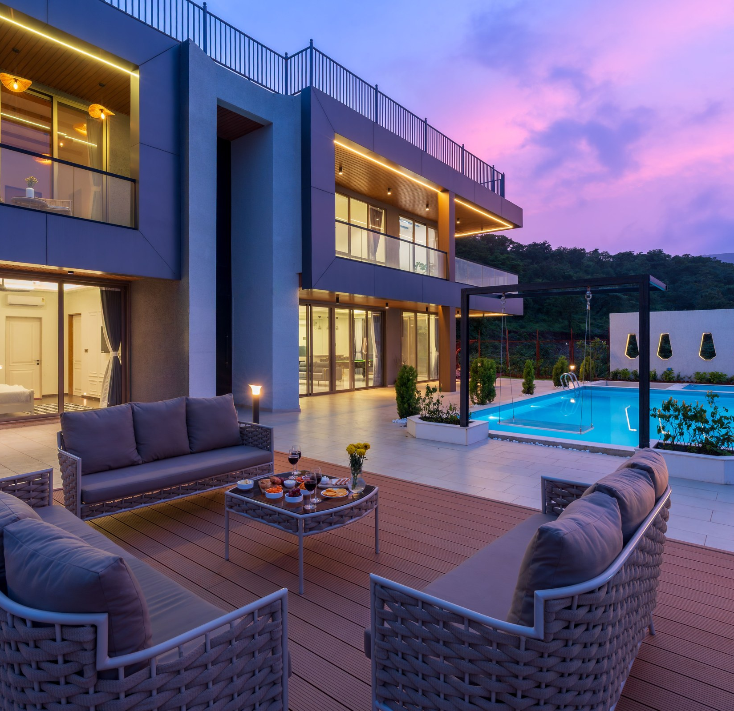

RED FLAG HOMES NETWORK · HOST DOSSIER
The Visibility
Booster
14 things that get your Airbnb seen —
and booked
REDFLAGHOMES.IN

Slide 2
THE VISIBILITY BOOSTER
THE PREMISE
Most empty listings
aren’t bad.
Airbnb doesn’t show guests the best property. It shows the property most likely to get booked and reviewed well.
Those are different things — and the gap between them is where your occupancy goes.
They’re invisible.
Everything that follows is a lever you control. Work down the list in order — the first five move the most.
RED FLAG HOMES NETWORK
02 / 14

Slide 3

I
PART ONE · LEVERS 01–05
The five that matter most.
They cost nothing — and they move occupancy faster than any amount of new furniture.

Slide 4
THE VISIBILITY BOOSTER
I · THE FIVE THAT MATTER MOST
Start where the algorithm looks first.
01
02
03
Reply within an hour, every time
Turn on Instant Book
Update your calendar every few days
Response rate and speed feed directly into ranking — and guests book whoever answers first. Set saved replies and phone notifications. Falling below a 90% response rate quietly buries a listing.
Listings that need approval rank lower and lose impulse bookings — most weekend bookings. Keep control by requiring verified ID and setting clear house rules instead.
Airbnb favours listings that look actively managed. Even opening the app and confirming availability signals the listing is alive. A calendar untouched for weeks is treated as stale.
RED FLAG HOMES NETWORK
04 / 14

Slide 5

THE VISIBILITY BOOSTER
I · THE FIVE THAT MATTER MOST
04
05
80%
−25–30%
of the decision is the first image
below target for your first ten bookings
Fix the first photograph
Price low, deliberately
On a phone it is roughly 80% of the decision. Lead with your single most impressive view — not the front door, not the lobby. Test a new first image for two weeks and compare views.
A listing with no reviews cannot win at full price. Collect ten reviews fast, then raise in steps. Wasting the new-listing boost at a price nobody books is the costliest mistake here.
RED FLAG HOMES NETWORK
05 / 14

Slide 6
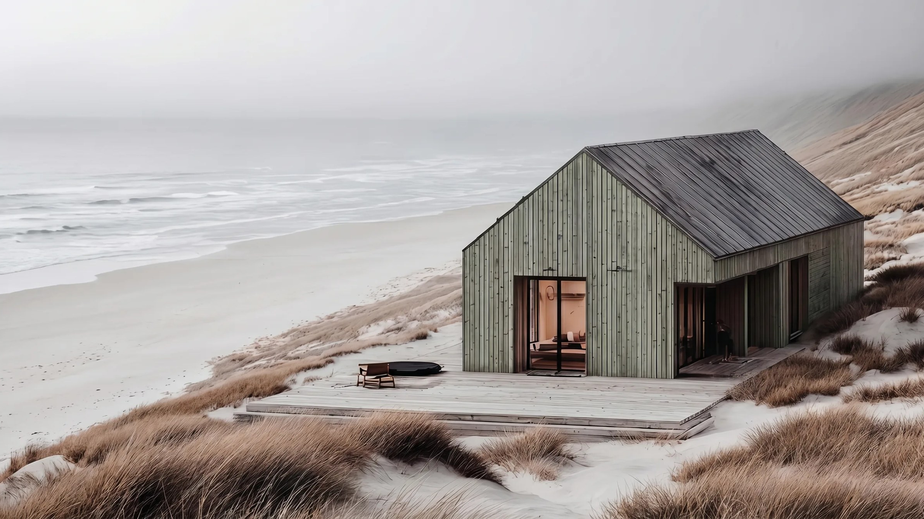
II
PART TWO · LEVERS 06–14
Nine more that compound.
Each is small on its own. Together they decide who sees you — and how often.

Slide 7
THE VISIBILITY BOOSTER
II · NINE MORE THAT COMPOUND — THE LISTING & THE CALENDAR
Be findable in every search you qualify for.
06
Write a title that says what, why and where
07
Tick every amenity you genuinely have
“Sea-view 3BR villa with private pool · 5 min to Ashwem” beats “Beautiful villa in Goa”. Guests scan titles; specifics stop the scroll.
Guests filter by amenity — a missing tick removes you from entire searches: WiFi speed, parking, workspace, kitchen, AC, pet-friendly. Never tick one you don’t have.
08
Lower your minimum nights
09
Open your calendar further ahead
A two-night minimum removes you from every one-night search — in city markets, up to half the demand. Try one night midweek, keep two at weekends.
Many guests book three to six months out, especially for peak season and weddings. A calendar open only 60 days ahead is invisible to them.
RED FLAG HOMES NETWORK
07 / 14

Slide 8
THE VISIBILITY BOOSTER
II · NINE MORE THAT COMPOUND — REPUTATION & REACH
10
Add weekly and monthly discounts
Longer stays cut cleaning and vacancy risk, and Airbnb surfaces them to long-stay searchers. Even 10% weekly, 20% monthly.
“
11
Never cancel a booking
Host cancellations suppress ranking for months. Move the guest, refund generously — but don’t cancel.
Ten reviews at 4.9 beats forty at 4.6.
12
Chase reviews in the first 48 hours
Ask in person at check-out and once by message. Early on, review velocity matters more than count.
13
List on a second platform
Booking.com fills midweek gaps and reaches a different traveller. Sync calendars to avoid double-booking.
The only visibility an algorithm can’t change is a direct booking.
14
Build a direct route
A simple page, a WhatsApp number, a link in your Instagram bio. No commission — and yours forever.
RED FLAG HOMES NETWORK
08 / 14

Slide 9

THE VISIBILITY BOOSTER
YOUR FIRST WEEK
Start with these five,
this week.
Turn on Instant Book and set enquiry notifications on your phone.
Swap your first photograph for your single most impressive view.
Tick every honest amenity and drop minimum nights midweek.
Open your calendar six months ahead; add weekly and monthly discounts.
Ask every departing guest for a review — in person, and once by message.
Then change one thing at a time — and compare views and bookings against the previous fortnight.
RED FLAG HOMES NETWORK
09 / 14

Slide 10

RED FLAG OUTPOST CLASSIC
Or let someone do
all fourteen for you.
Everything in this guide is work — daily pricing, hourly replies, calendars, reviews, cleaning, repairs. Most owners manage it for three months, then stop. Occupancy follows.
We design, brand, launch and run your property completely. You pay rent and electricity. That’s the list.

Slide 11
THE VISIBILITY BOOSTER
THE DIFFERENCE
Your month, before and after.
DOING IT YOURSELF
RED FLAG OUTPOST CLASSIC
Guest replies
You, at 2am
Us, 24/7
Pricing
You guess
AI, adjusted daily
Cleaning & linen
You arrange and pay
We arrange — deducted from bookings at cost
Repairs
You chase them
Handled up to ₹2,000 per incident
Marketing
None
Creator launch campaign + direct booking page
Your time each month
10–15 hours
Close to zero
RED FLAG HOMES NETWORK
11 / 14

Slide 12
THE VISIBILITY BOOSTER
WHAT IT COSTS
Transparent, from day one.
FRANCHISE FEE
SETUP & PROCURING
COMMISSION
₹59,999
₹1,11,111
8%
one time
up to 2 keys
of bookings, or ₹4,999 per listing / month — whichever is higher
Own the property already?
200 founding allocations across India
That’s your entire investment — no rent, no deposit.
The first 200 partners keep 8% for life.
Prices plus applicable GST.
RED FLAG HOMES NETWORK
12 / 14

Slide 13
THE VISIBILITY BOOSTER
THE EARN-BACK PROMISE
Earn it back in 12 months.
Or we pay the difference.
If your Outpost’s net operating profit over its first 12 months after going live is less than the programme fee you paid, we pay you the difference.
— No quibbles
— Written terms
— Paid within 30 days
We can promise it because we run the property ourselves, to one standard. Full conditions in the Programme Terms.
RED FLAG HOMES NETWORK
13 / 14

Slide 14
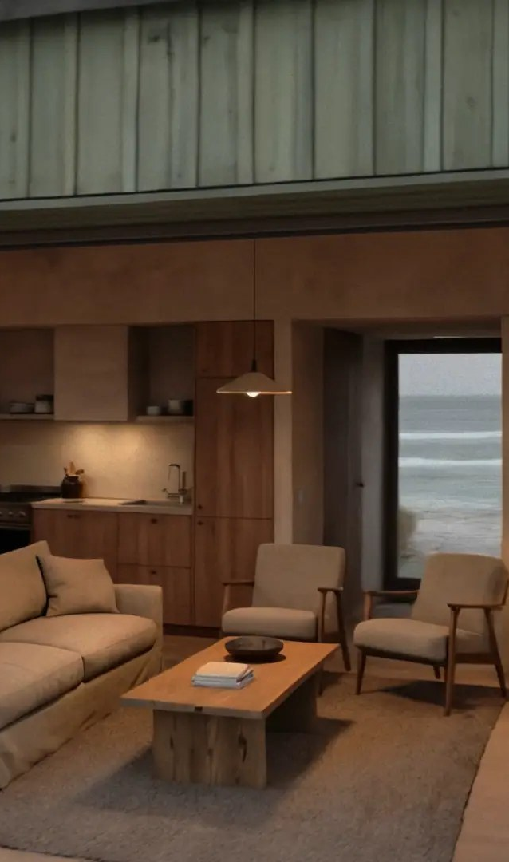
APPLY FOR ALLOCATION
redflaghomes.in
We assess your property and send you a projection for it — free, before you commit anything.
hello@redflaghomes.in
Red Flag Homes Network, a company of Red Flag World Holdings Ltd, London
General information, not legal, tax or investment advice. Airbnb ranking factors change and are not published in full; the guidance here reflects widely observed practice. All figures are illustrative and depend on location, season, occupancy and costs; a property can earn less than its costs. Prices plus applicable GST. The Earn-Back Promise is subject to the Programme Terms.

