Slide 1
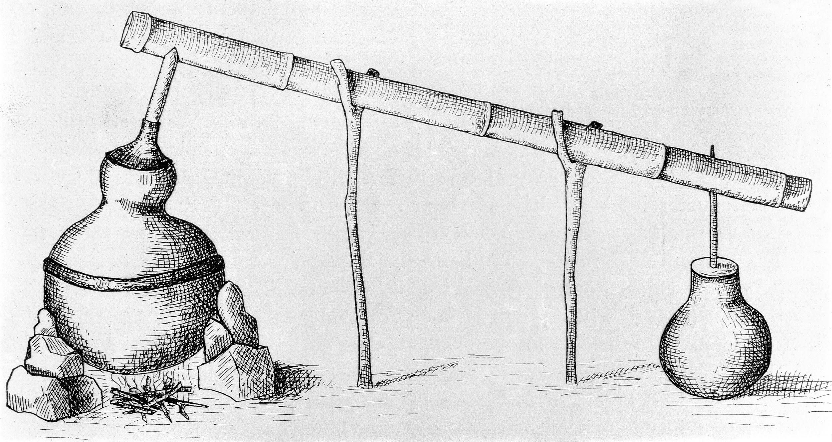
KNOWLEDGE DISTILLATION
OELP Word Spotting

Slide 2
Knowledge Distillation
Transferring knowledge from large model to small model
There can be one or more large models or Teacher Models
Practically deployable Student Model

Slide 3
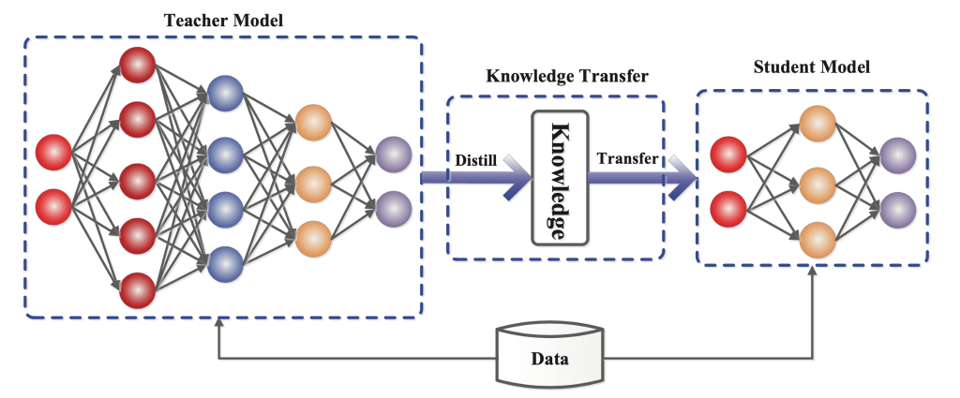
Student model learns to mimic the outputs of Teacher model for similar or higher accuracy

Slide 4
Knowledge
Typically refers to learned weights and biases.
On basis of the parameters that learning is done from Teacher Model we can categorize the knowledge grasped by Student Models into three main categories :
1. Response-Based Knowledge
2. Feature-Based Knowledge
3. Relation-Based Knowledge

Slide 5
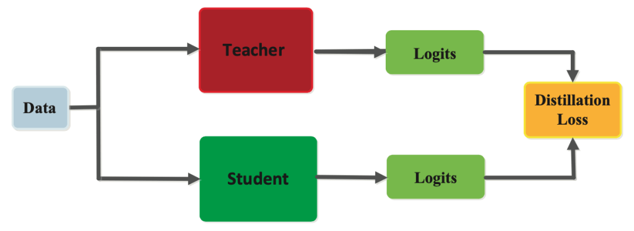
Response Based Knowledge
Focuses upon the final output layer generated by the Teacher Model
Hypothesis is Student Model will learn to predict the outputs of Teacher Model
Minimize the loss function over training (Distillation Loss)

Slide 6
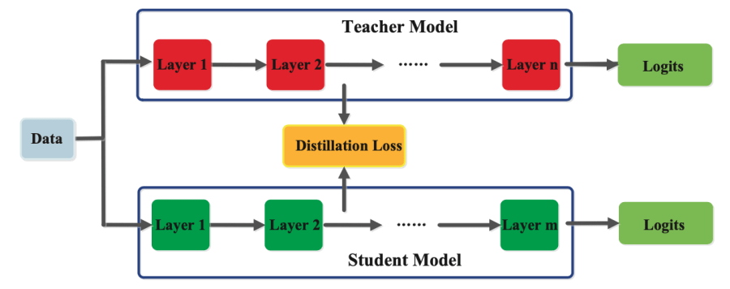
Feature Based Knowledge
Trained Teacher Model also captures the knowledge in its intermediate layers which can discriminate specific features.
This knowledge can be used to train Student Model and work upon minimizing Distillation Loss.

Slide 7
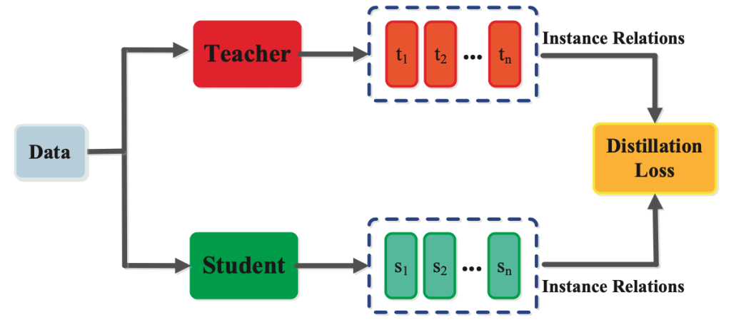
Relation Based Knowledge
Captures the relationship between feature maps.
It is modelled as correlation between graphs, similarity matrices or feature embeddings.

Slide 8
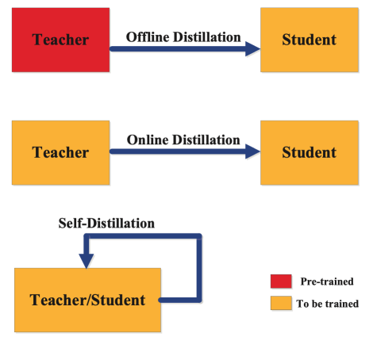
Training
Offline Distillation: We have a pre-trained Teacher Model which is used to train Student Model.
Online Distillation: Teacher Model and Student Model are trained end to end. Parallel computation makes it more efficient.
Self Distillation: Same model is used as Teacher and Student Model. Special case of Online Distillation.

