Slide 1
RULE FRAMEWORK EDITOR
Created by:
Prudhvi katherapalli
Shivani Sinha
Priyanshu bansal
Neeraj asdev

Slide 2
Introduction
Every programming language (C, Java, etc.) has some predefined set of rules that apply on their syntax. These rules validate every single word/line of the code when the code is being parsed.
The parser usually accepts the input in the form of tokens and then generates the output either as a parse tree or some positive statement when passed. Otherwise, it would generate a syntax error. Or the most simplest output forms can be either it’s VALID or INVALID.
This project aims to develop a system where we would implement the function of a parser to parse some simple statements called CONDITIONAL CONSTRUCTS (which we will see later on..) and it will validate them in multiple syntax definitions (language/environment).

Slide 3
Conditional constructs
Conditional constructs are nothing but various conditional statements/blocks that are predefined in the programming language. The code is usually directed forward on the basis of some condition or else it will skip and execute the alternate/different block.
Examples include:
if(*condition*)-else, if(*condition*)-elseif(*condition*)-else
Nested ifs (if(){if(){}})
for( ;*condition*; ), while(*condition*), until
do{..}while(*condition*)
Etc.

Slide 4
BASIC STRUCTURE
VALIDATOR
X
Y
RULE ADDER
RULE CHECKER
OUTPUT
X (Rule Adder object)→Adds rules to the validator for syntaxes in different languages from JSON file.
Validator→ A system where adder writes/defines rules and checker tests it.
Y (Rule checker object) → Inputs a code in some language and tests it against predefined rules for that language in the validator.

Slide 5
VALIDATOR
Accepts adder’s JSON file as reference/rulebook and checker’s code as an input then it will parse it accordingly. Basically, validator can be also be called as a parser.
Consists of following operation stages:
Tokenization
→ Will tokenize the given code by checker/tester and verify it against adder’s conditional construct syntax.
→ Generates tokens and their types and passes them onto the next stage i.e. parsing.
Parsing
→ Parses the tokens and identifies whether the code is syntactically correct or not.
Finally, provides an output to the user or checker whether the code entered is valid or not.

Slide 6
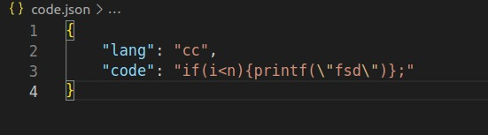
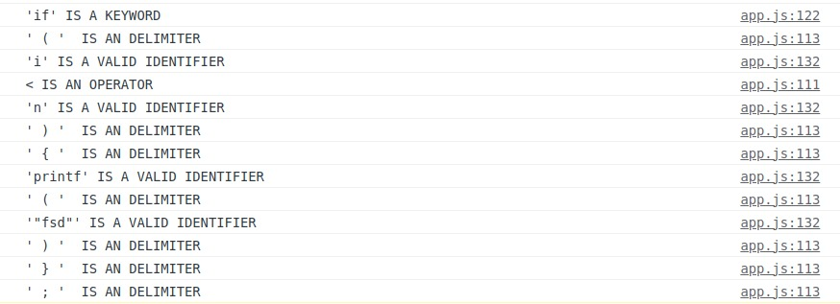
TOKENIZATION SAMPLES
SAMPLE 1

Slide 7
AUTHENTICATION MODULES
Every RULE ADDER and RULE CHECKER is required to register and subsequently login to the validation component.
Register/Login modules for adder and checker will be different. Adder can add rules only after login whereas checker can test the code only after login.
This authentication module is necessary in order to prevent unauthorised access to the rule editor.

Slide 8
ENCODING MODULE
To enhance security, the validated code can be converted into a secure encrypted hash using base-64 encryption method.
NOTE that the CONVERT TO HASH option is provided ONLY after the code has been successfully validated. For the invalid code, the option will remain frozen on the client page.
Now, once hash is generated for the code, it will be stored in the database which can be utilized for further applications such as data transfer, merging different modules, etc.
Decoding option will be provided to the user in the form of a checkbox on the top where the encrypted hash will be decoded back to the original code.

Slide 9
SCREENSHOTS

Slide 10
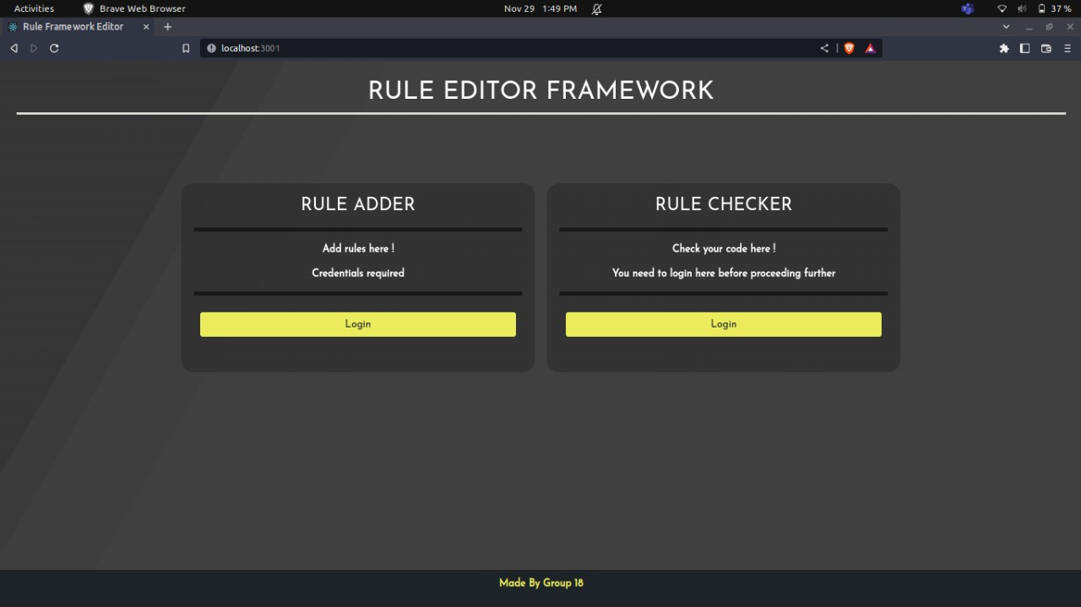
START PAGE

Slide 11
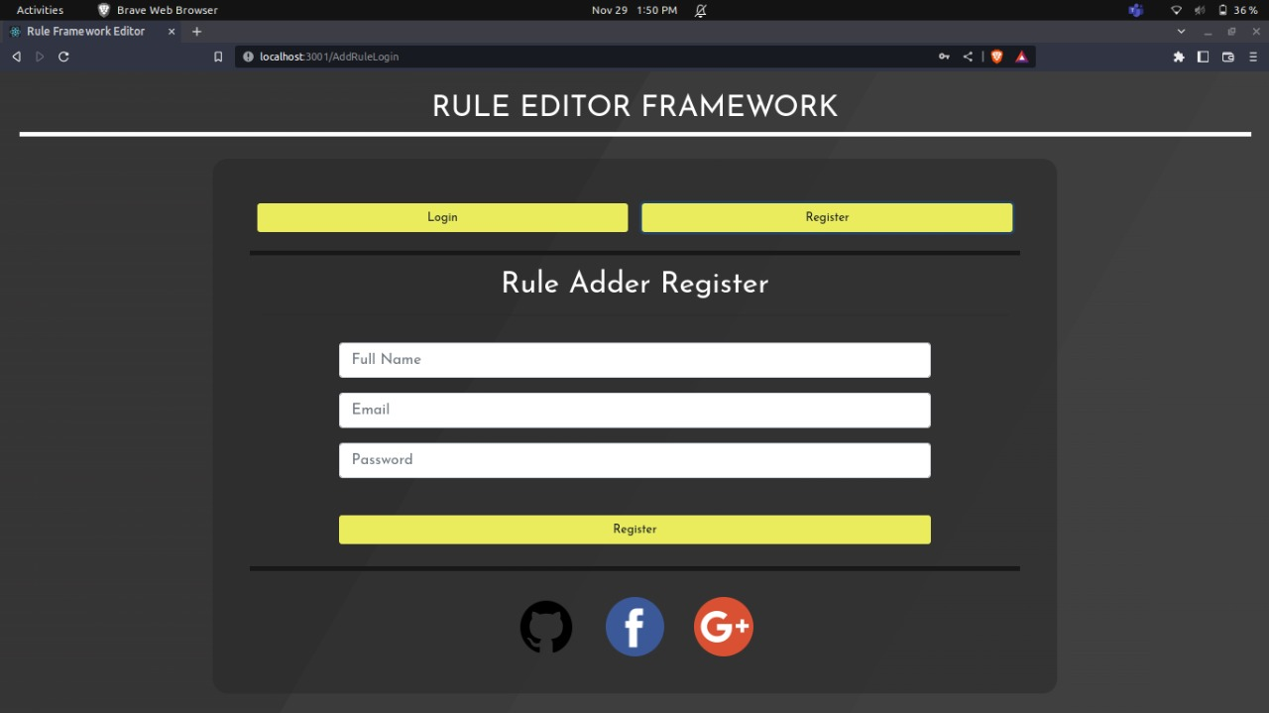
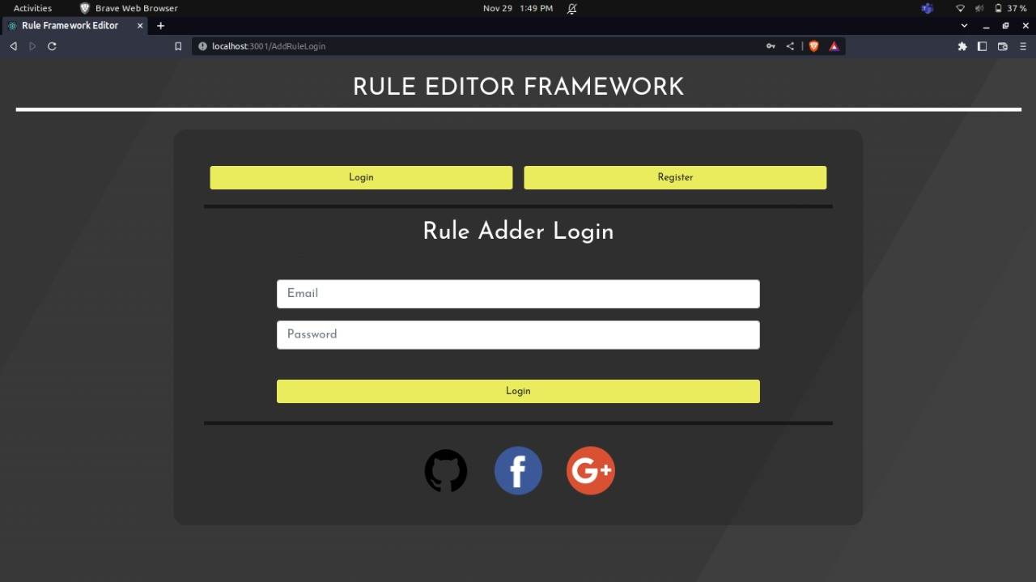
ADDER SIGNUP AND LOGIN

Slide 12
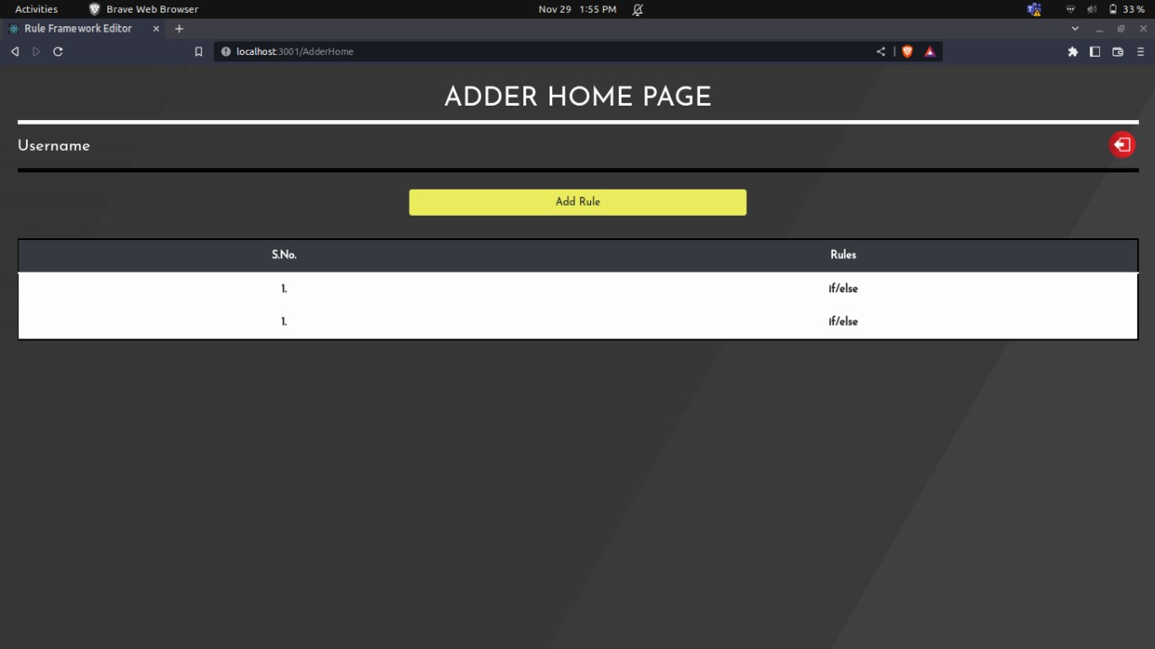
ADDER HOME

Slide 13
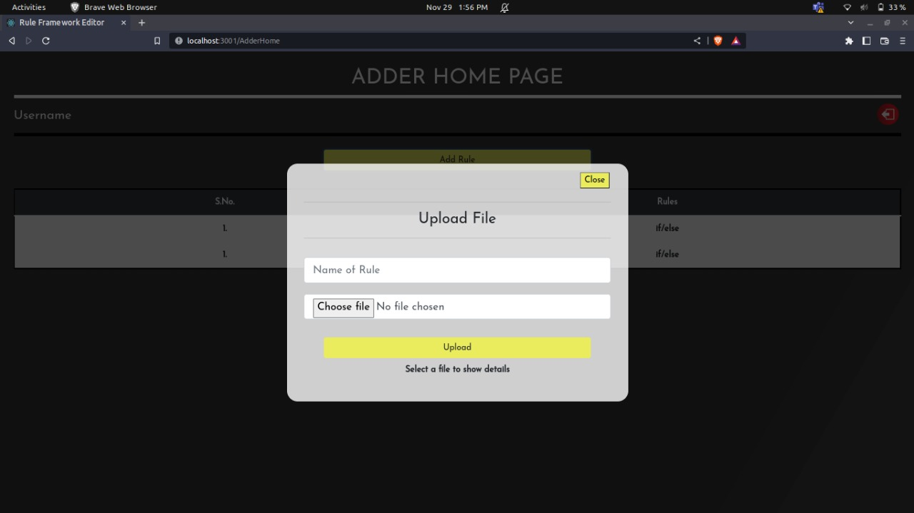
ADD RULE POPUP

Slide 14
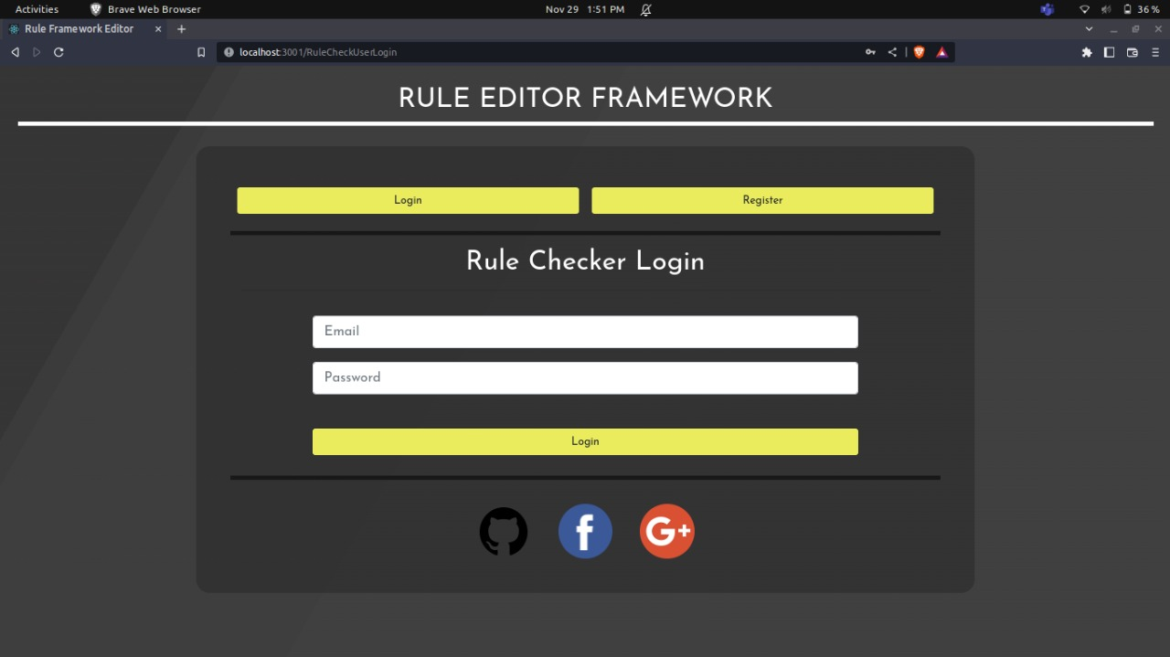
CHECKER LOGIN

Slide 15
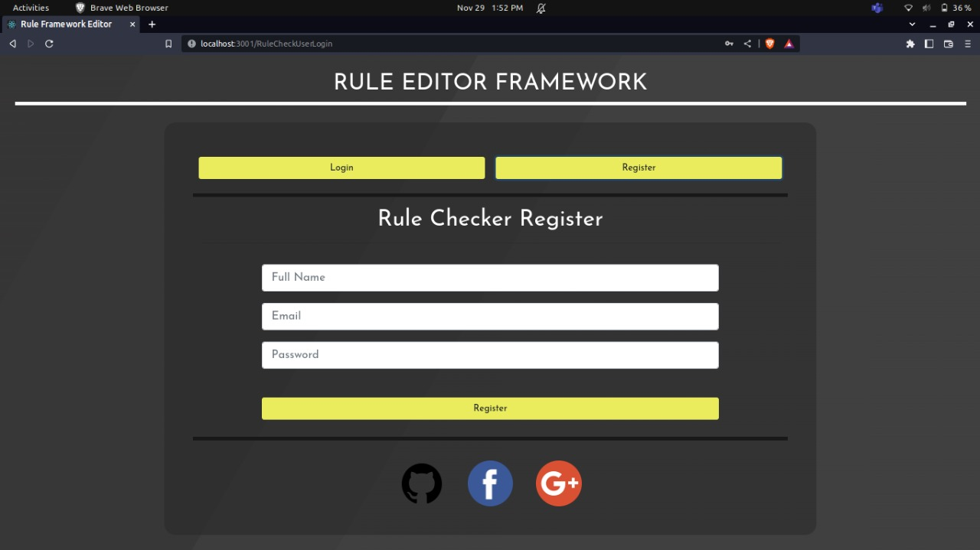
CHECKER SIGNUP

Slide 16
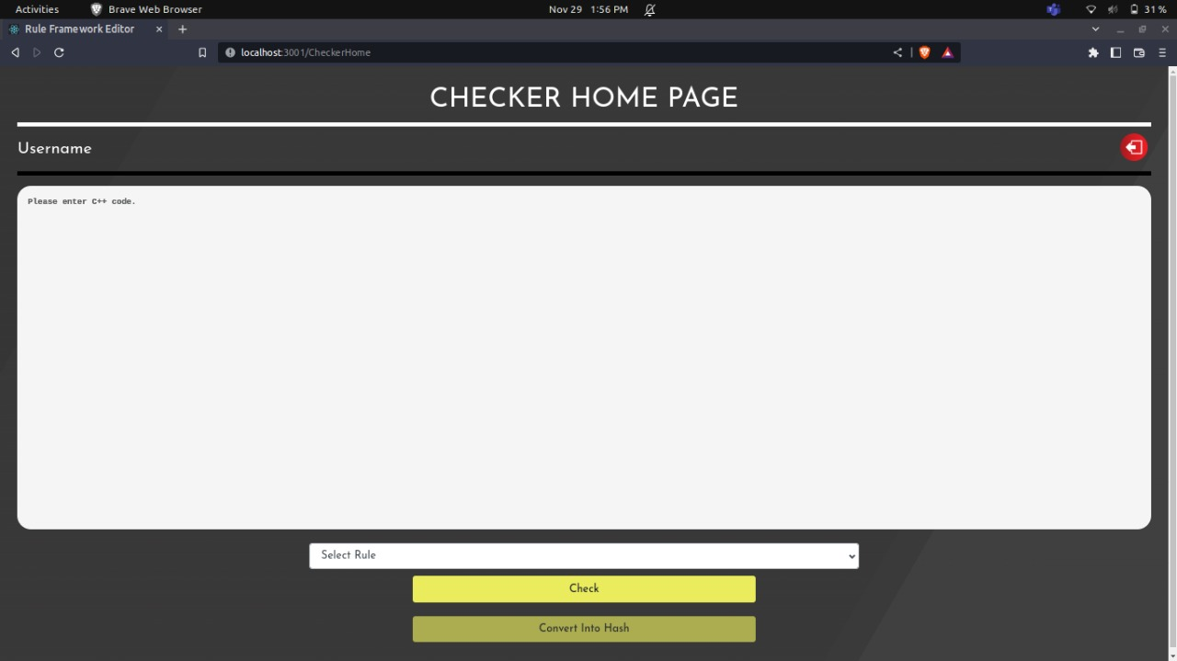
CHECKER HOME

Slide 17
THANK YOU

