Slide 1


SCHOOL OF MANAGEMENT SCIENCES, LUCKNOW
Department of Computer Science & Engineering
Problem Statement Title - Smart Crop Advisory System for Small and Marginal Farmers.
Theme - Agriculture, FoodTech & Rural Development
PS Category - Software
Team Name – Hack Harvesters

Slide 2

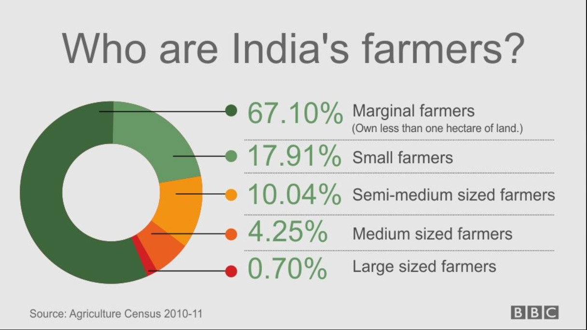
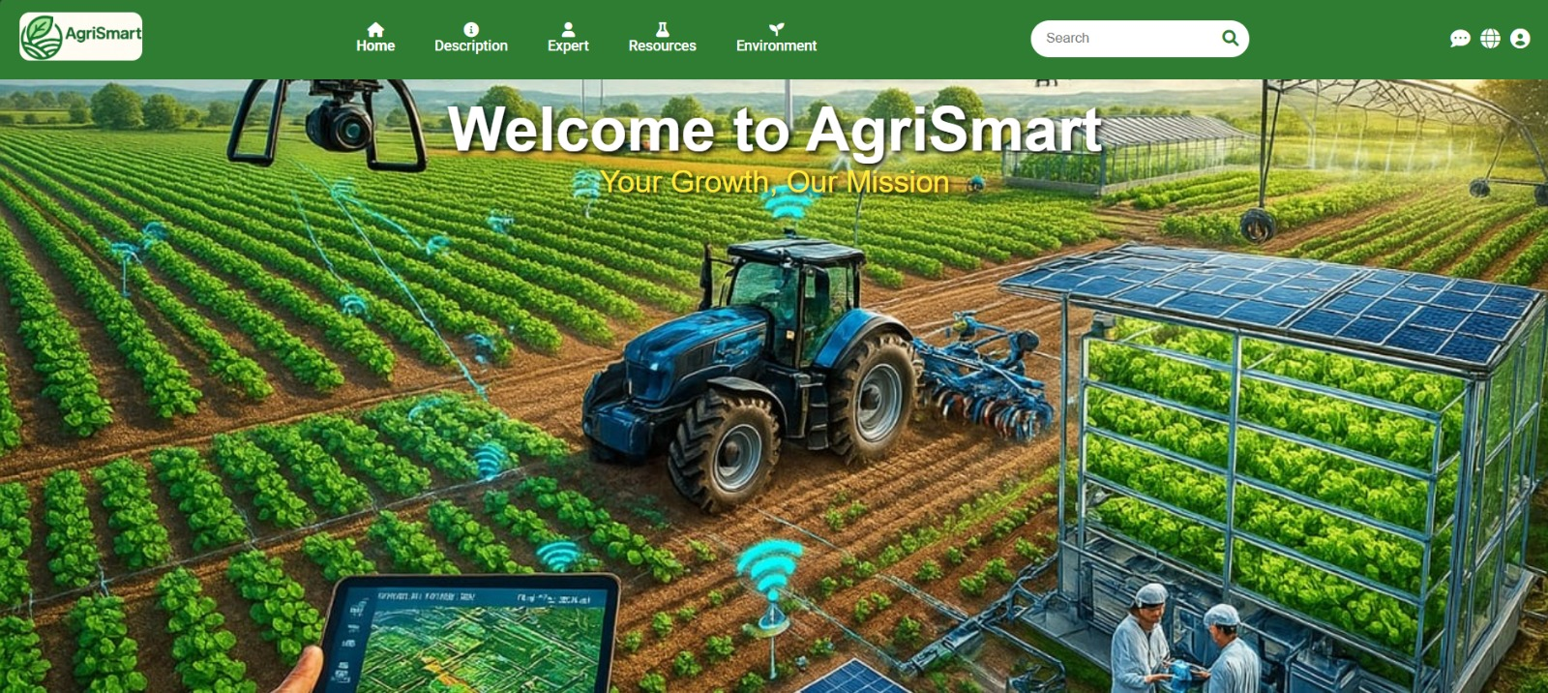
AgriSmart: Mobile Advisory System for Farmers
1. Detail Explaination
Mobile-based Crop Advisory Website for small and marginal farmers.
Real-time weather updates.
Chatbot support.
Information on government schemes/subsidies.
User-friendly interface designed for easy use, even for farmers with limited literacy.
2. How It Addresses the Problem :
Offering instant expert advice
Region-specific crop recommendations.
Confidential, accessible, and affordable guidance without dependency on middlemen.
Make informed decisions that increase yield and reduce losses.
PROTOTYPE
3. Innovation and Uniqueness of the Solution
AI + Expert Hybrid Advisory
Farmer-Centric Design
End-to-End Support: Covers the full farming cycle
Integration with Government Schemes

Slide 3
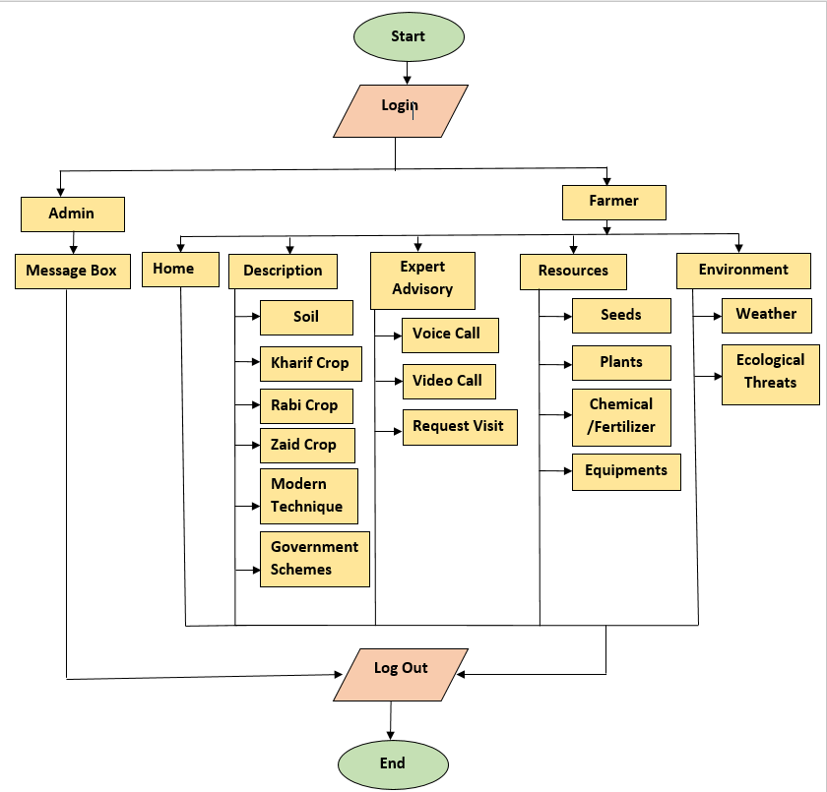
TECHNICAL APPROACH
Frontend Languages: HTML5, CSS3,JavaScript
Frameworks/Libraries: React.js, Bootstrap
2. Backend (Server)Languages: Python (Django), Node.js(Express)
Database: MySQL, MongoDB
Authentication: JWT / OAuth
3. AI/MLLibraries: TensorFlow, PyTorch, Scikit-learn, OpenCV
4. Cloud & HostingPlatform: Google Cloud
5. APIs & IntegrationsWeather (OpenWeather, IMD)Government schemesAgri-market prices
6. Hardware (Future Scope)Smartphone/computer (basic access)
IoT devices: soil sensors, pH meters, weather stations
Prototype link - https://youtu.be/vqORNXzhB3s?si=uQBgPC0wqIod-cHB

Slide 4
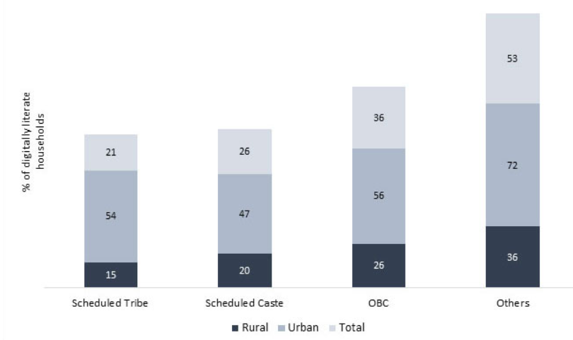
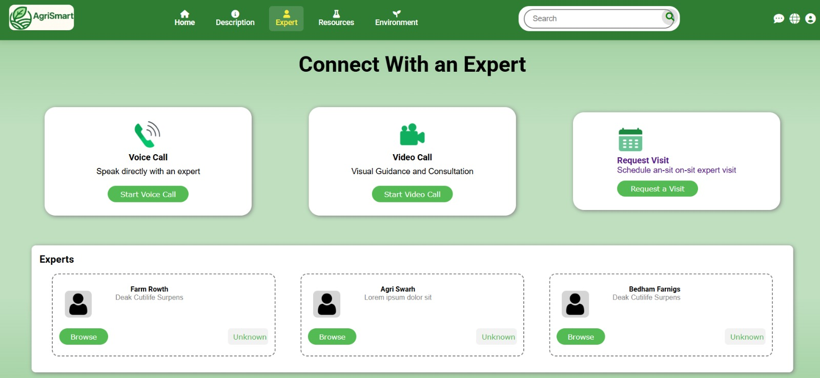
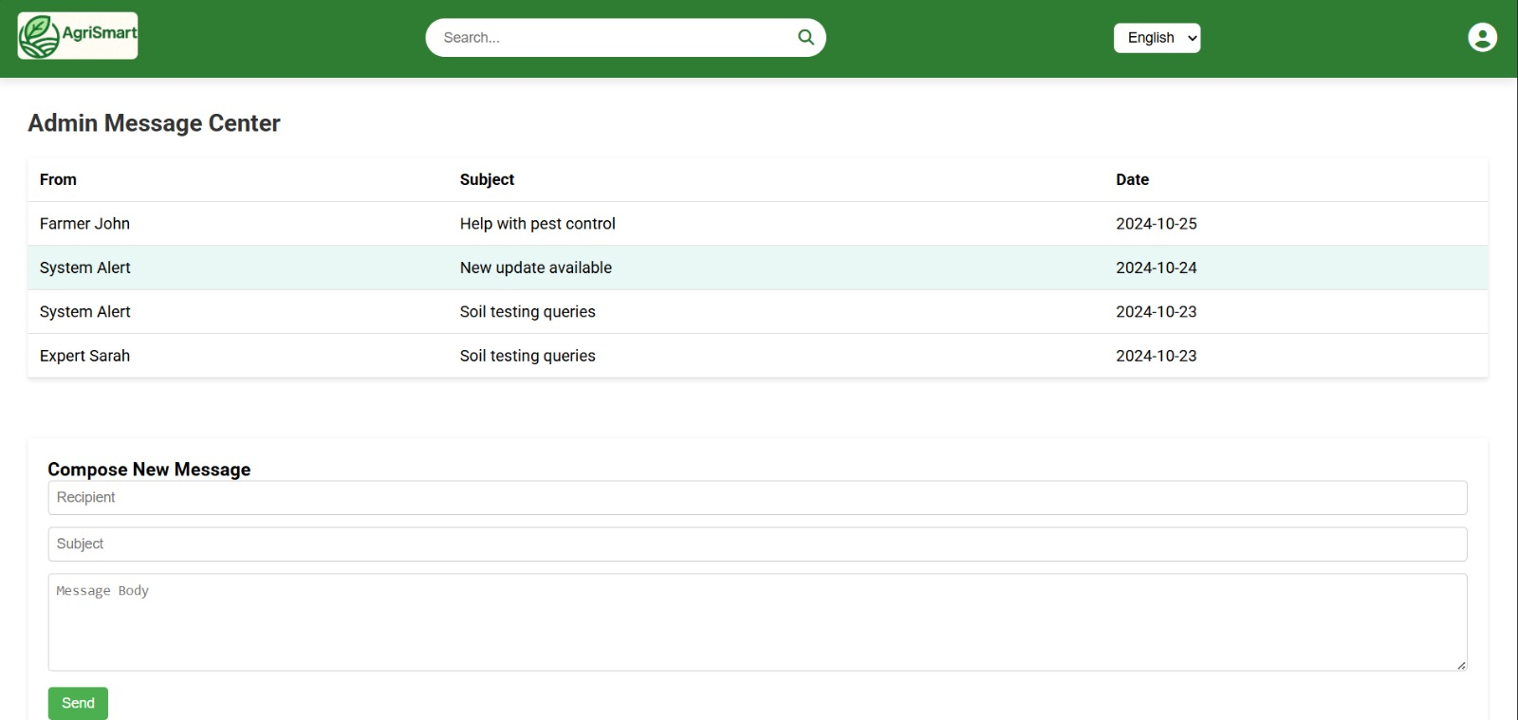
FEASIBILITY AND VIABILITY
1. Analysis of the Feasibility of the Idea
Technical Feasibility
Operational Feasibility
Scalability Feasibility
Sustainability Feasibility
Adoption Feasibility
Economic-Feasibiity
3. Strategies for Overcoming These Challenges
Digital Literacy: Workshops & tutorials in local languages.
Offline Access: Limited features, sync when online.
Trust Building: Partner with agri officers, NGOs & cooperatives.
Sustainability: Support via govt. schemes & agri-tech collaborations
PROTOTYPE
PROTOTYPE
2. Potential Challenges and Risks
Digital Literacy
Internet Connectivity
Data Accuracy
Trust Issues
Financial Viability
Language Barriers
Device Affordability
Privacy Concern

Slide 5
IMPACT AND BENEFITS
1. Potential Impact on the Target Audience :
Empowers small and marginal farmers with timely, reliable, and personalized crop advisory.
Increases awareness about modern farming techniques and government schemes.
Improves decision-making in crop selection, pest control, and resource utilization.
Enhances farmer confidence by reducing dependency on middlemen and unverified information sources.
2. Benefits of the Solution :
Environmental Benefits:
Encourages sustainable farming practices
Promotes crop diversification to maintain soil fertility.
Helps in efficient water management through weather-based irrigation advice.
Reduces environmental impact by minimizing resource wastage.
reducing overuse of chemicals.
Social Benefits:
Promotes digital inclusion by providing easy-to-use, multilingual, and voice-enabled features.
Builds stronger farmer communities through shared knowledge and expert-farmer interaction.
Reduces stress among farmers by offering instant support for farming challenges.
Economic Benefits:
Increases crop yield and productivity through better farming practices.
Reduces losses caused by pest attacks, diseases, and unpredictable weather.
Enhances farmer income by suggesting profitable crops and connecting with markets.
Lowers costs by optimizing fertilizer, pesticide, and water usage.

Slide 6
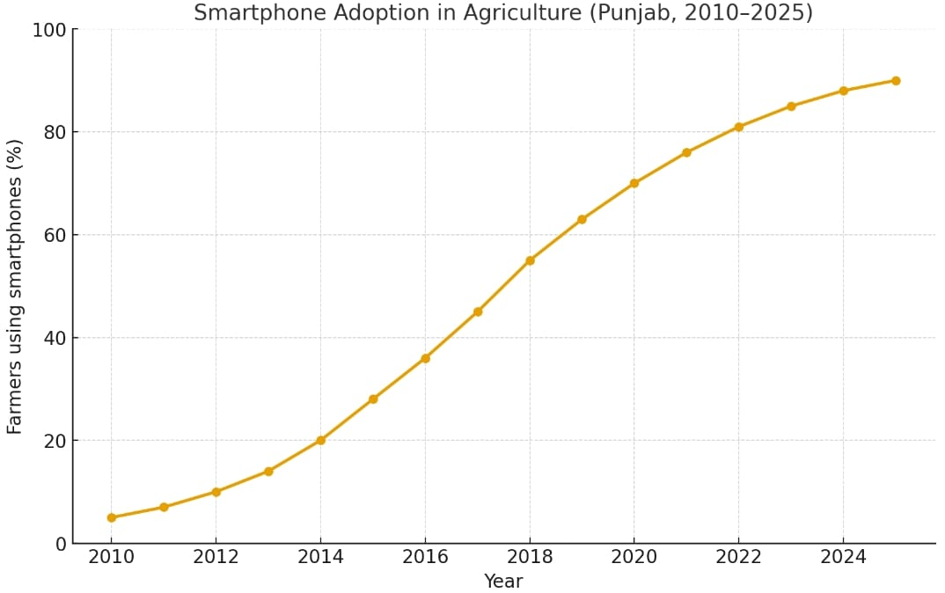
RESEARCH AND REFERENCES
Saagu Baagu (Telangana’s AI4AI Initiative): Farmers saw income doubling, yield increases, reduced pesticide & fertilizer usage through advisory, soil testing, quality AI tools. World Economic Forum
APAIMS 2.0 (Andhra Pradesh): Digital agriculture platform providing plot-level pest/disease alerts, personalized advisories, real-time notifications. The Times of India
Plantix: An existing crop advisory app using image-based disease detection and recommendations. Wikipedia
Problems with data availability & quality, poor infrastructure in rural areas, low smartphone penetration, cost barriers, and lack of trust in AI-generated advice. India Today
Low Digital Literacy & Trust Issues: Many smallholders struggle with using digital tools; trust & privacy concerns limit adoption Springer Link
Infrastructure & Training Barriers : Lack of internet, devices, and
farmer training reduce the effectiveness of digital extension services
MDPI Sustainability.
Prototype link - https://youtu.be/vqORNXzhB3s?si=uQBgPC0wqIod-cHB

