Slide 1
KOSHAGRAH
A Treasure House
For
EDUTHON
2020

Slide 2
KOSHAGRAH Lets bring digitization to learning .
A Treasure House

Slide 3
TEAM MEMBERS
MUSKAN MAHESHWARI
PRIYANSHU ARORA
PRIYANSHU AGARWAL
RAJAT ShRivastava

Slide 4
PRESENTING KOSHAGRAH
KOSHAGRAH
KOSH + GRAH
(Treasure) (House)
Koshagrah is a cross-platform solution for teachers and students to interact with each other in particular organization.
We can also make dynamic resumes using Koshagrah .
Users within an organisation can also do personal chat conversation

Slide 5
It also provide a secure and common platform to hold achievements , certificates and resume for students .
Koshagrah allows teachers to make necessary announcements .
It also give access to everyone to share their interview or other experiences .

Slide 6

THE NEED
No platform provide us the interface so that people within a particular organization can interact.
We cannot interact with our seniors or alumni without knowing them personally.

Slide 7
SOLUTION
Koshagrah provides you the interface to interact with people within one organization .
It also provide options for seniors to share their interview or other helpful experiences .
College announcements can also be done on Koshagrah.

Slide 8
WORKING
College admin will contact super admin for registering college on Koshagrah through mail .
Super admin after verifying all documents , registers college on the portal .
All the students/teacher who will sign up on Koshagrah need clarification form college admin.

Slide 9
If details of student/teachers are matches then admin can accept their requests otherwise deny it .
Now after clarification students/teachers can access their accounts and enjoy various functionality.
Functions such as sharing experiences , uploading posts , chatting with mates , dynamic resume maker and many more .

Slide 10
UNIQUENESS
Seniors can share their interview or any other experience with everyone among the organization.
Any two students/teachers can interact with each other even without having any personal relation.
Now teachers are only one ping away from making an announcement among thousands of students.
Teachers/students can chat with highly end to end encrypted messages.

Slide 11
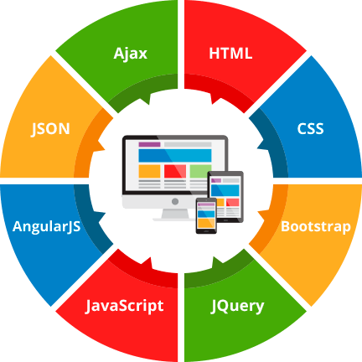
TECHNOLOGIES USED
Django
HTML
CSS
JavaScript
Jquery
Ajax
JSON
SQL Lite
Progressive Web App
Web Real Time Communication

Slide 12
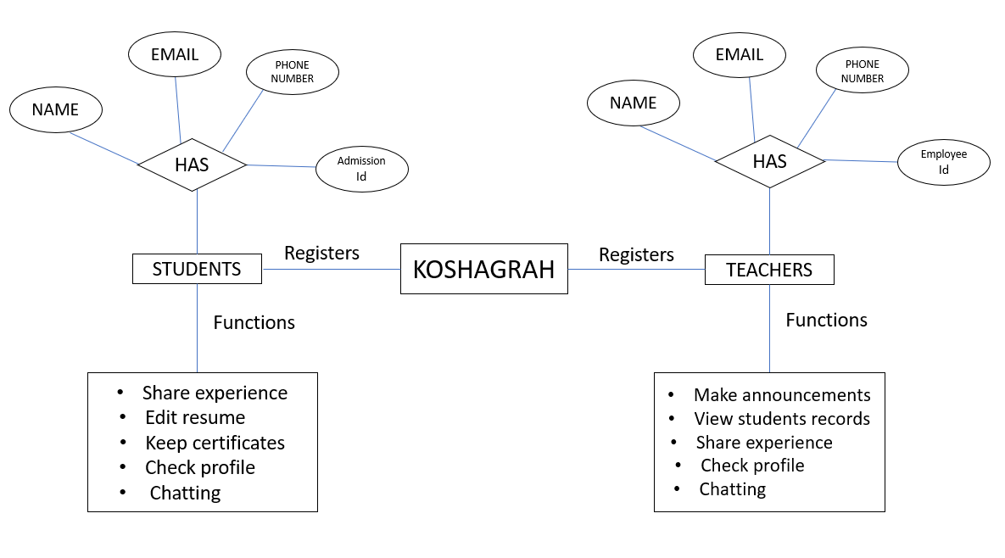
ER DIAGRAM

Slide 13
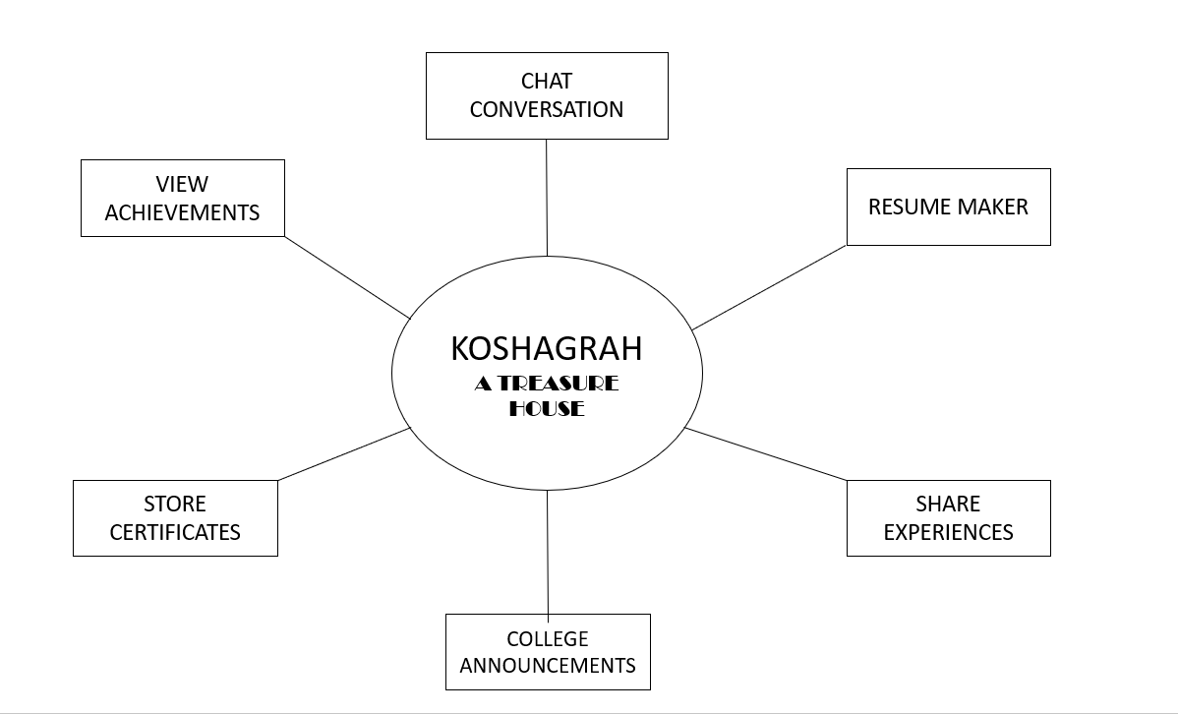
ZERO LEVEL DFD

Slide 14
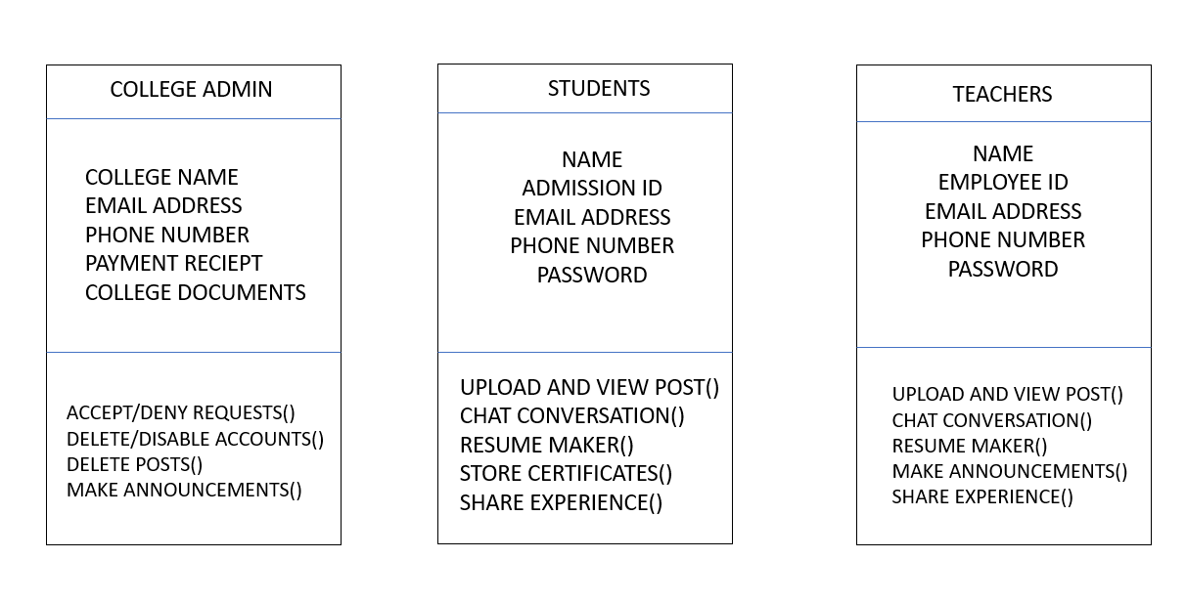
CLASS DIAGRAM

Slide 15
FUTURE WORKS
To build a flutter mobile application.
To provide public and private option to users while uploading a file.
To enable group chat options within Koshagrah itself.

Slide 16
REFERENCES
Django : https://docs.djangoproject.com/en/3.1/
W3 Schools : https://www.w3schools.com/
Stack Overflow : https://stackoverflow.com/
TailBlocks : https://mertjf.github.io/tailblocks/

Slide 17


