Slide 1
TRAFFIC SIGN RECOGNITION
Presenting By
~Priyanshu (2161274)
~Nirmit Srivastava (2161252)

Slide 2
INTRODUCTION
Traffic Sign Recognition:
Refers to the process of automatically identifying and classifying traffic signs or road signs in images or videos captured by cameras or sensors.
Enables autonomous vehicles and driver assistance systems and plays a crucial role in enhancing road safety.
Poses several challenges, including variations in lighting conditions, weather, occlusions, and viewpoints.
It has practical applications in autonomous driving, advanced driver assistance systems (ADAS), smart city infrastructure, and traffic management.
Accurate and efficient recognition is crucial for autonomous vehicles and driver assistance systems to ensure safe and reliable decision-making in real-time.

Slide 3
OVERVIEW OF COVOLUTIONAL NEURAL NETWORK(CNN)
Hierarchical Feature Extraction: CNNs are designed to automatically learn hierarchical representations of images.
Local Receptive Fields and Parameter Sharing: CNNs employ local receptive fields in their convolutional layers.
Translation Invariance: CNNs exhibit translation invariance, meaning they can recognize patterns or objects regardless of their position within the image.
Scalability and Training Efficiency: CNNs are highly scalable and can process larger images without a significant increase in computational complexity.

Slide 4
DATA PREPROCESSING
Data Collection and Labeling
Data Pipeline and Loading
Data Split
Class Balancing
Data Preprocessing

Slide 5
LIBRARIES USED
PANDAS
Use to load the data frame in a 2D array format.
NumPY
NumPy arrays are very fast and can perform large computations in a very short time..
Matplotlib
This library is used to draw visualizations.
Sklearn
It contains multiple libraries having pre-implemented functions of model development and evaluation.
TensorFlow
It provides a range of functions to achieve complex functionalities with single lines of code.

Slide 6
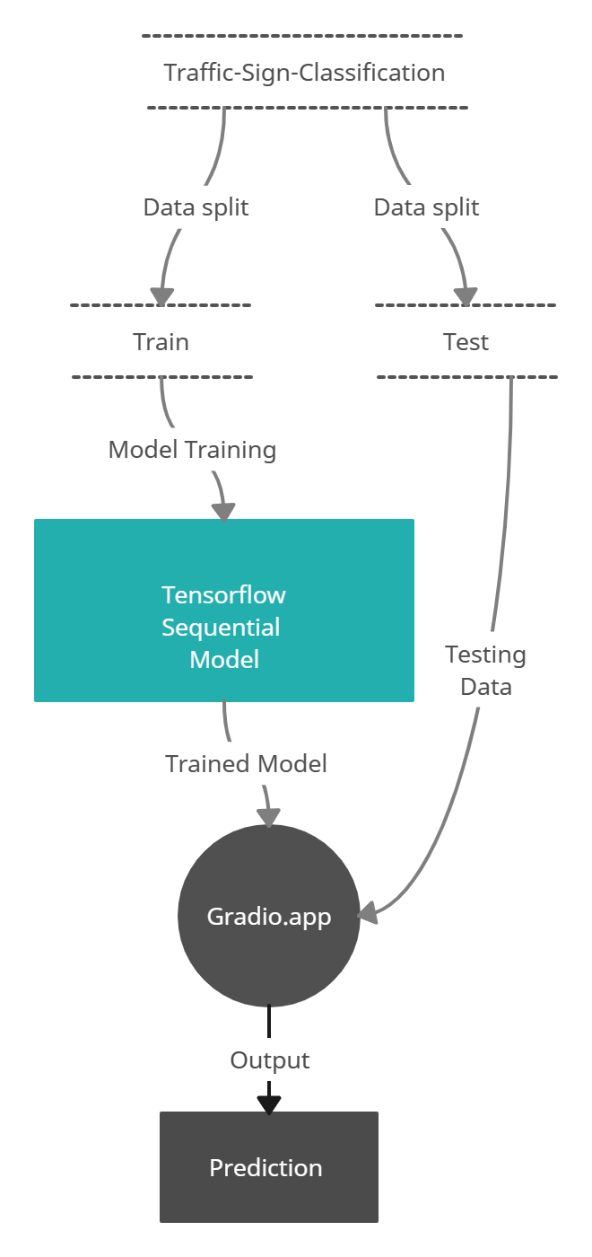
DATA FLOW DIAGRAM(LEVEL 2)

Slide 7
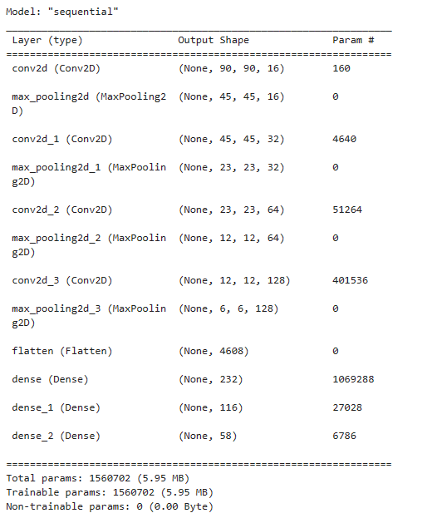
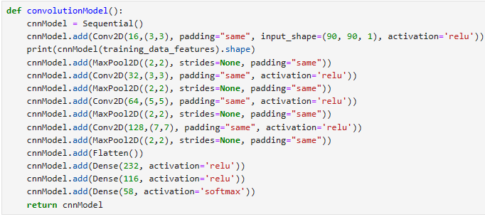
MODEL ARCHITECTURE
TensorFlow Sequential Model

Slide 8
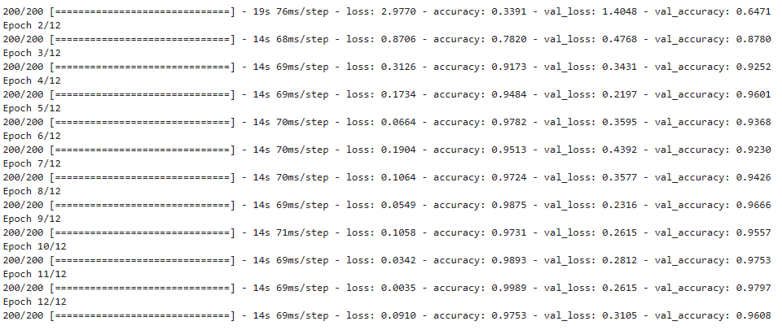
Training Dataset

Slide 9
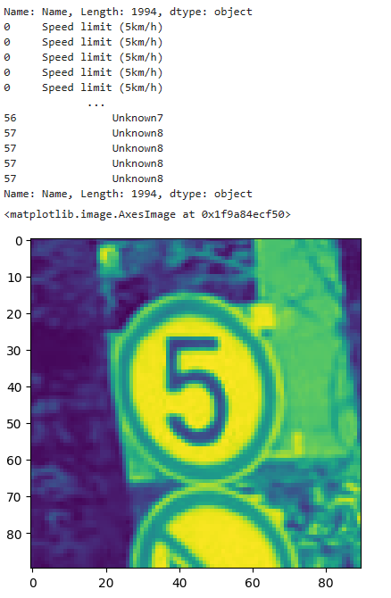
Testing Dataset

Slide 10
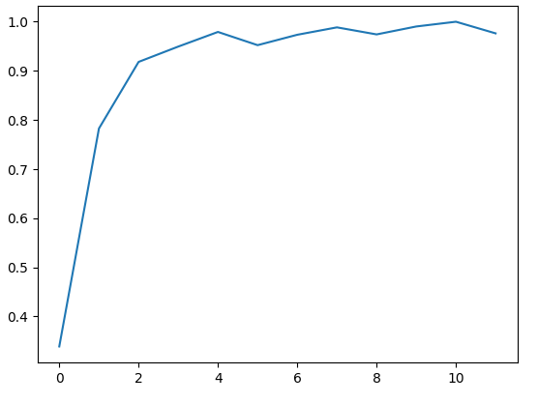
Accuracy

Slide 11
Gradio
Gradio is an open-source Python library that simplifies the process of creating and sharing custom machine learning interfaces.
Fast, easy setup
Gradio can be installed with pip. Creating a Gradio interface only requires adding a couple lines of code to your project.
Present and Share
Gradio can be embedded in Python notebooks or presented as a webpage.
Permanent Hosting
Once you've created an interface, you can permanently host it on Hugging Face.

Slide 12
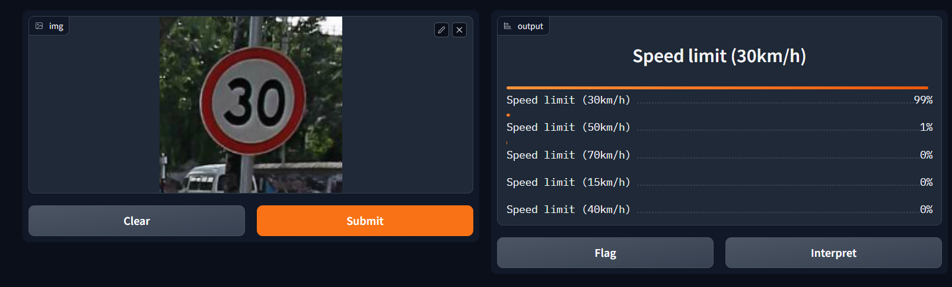
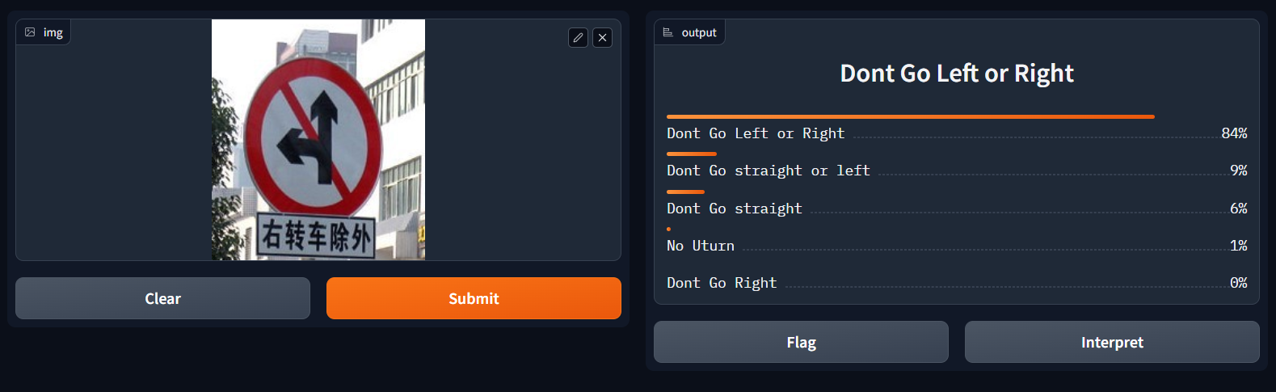
OUTPUT

Slide 13
THANK YOU!!

