Slide 1
PS-13 · AI-Powered Air Quality Forecasting
Delhi AirCast
A simple forecast for your neighbourhood:
PM2.5 and AQI for the next 1 to 24 hours
Priyanshu Chawda · Aryan Babel · Shruti Agrawal · Aditya Gayal
Undergraduate project · September 2026

Slide 2
Why this project
• People in Delhi need to know the air in their own neighbourhood.
• They also need the next few hours, so they can plan a walk, a run, or school pickup.
• We build Delhi AirCast: a short-term air forecast for each monitoring station.
• The app shows today’s air, the next 6–24 hours, and a clear line in simple words.
PS-13 · Delhi AirCast
2 / 10

Slide 3
What the user sees
Right now
Next 6 hours
In simple words
Anand Vihar, 10:00
PM2.5 145 µg/m³
AQI about 187
Category: Poor
11 AM 151
12 PM 158
1 PM 163
2 PM 157
4 PM 142
Air quality may get
worse over the next
3 hours.
Then it eases a little
in the afternoon.
PS-13 · Delhi AirCast
3 / 10

Slide 4
Our data — all free, already working
• Pollution: CPCB / DPCC station data from OpenCity (15-minute files for 2024–2025).
• Live updates: official data.gov.in CPCB API (stations were updating on 7 Sep 2026).
• Weather: Open-Meteo — history and the next 48 hours, no API key.
• Backup: OpenAQ, the same government stations through a second free API.
• We checked these sources ourselves. They respond in a few seconds.
PS-13 · Delhi AirCast
4 / 10

Slide 5
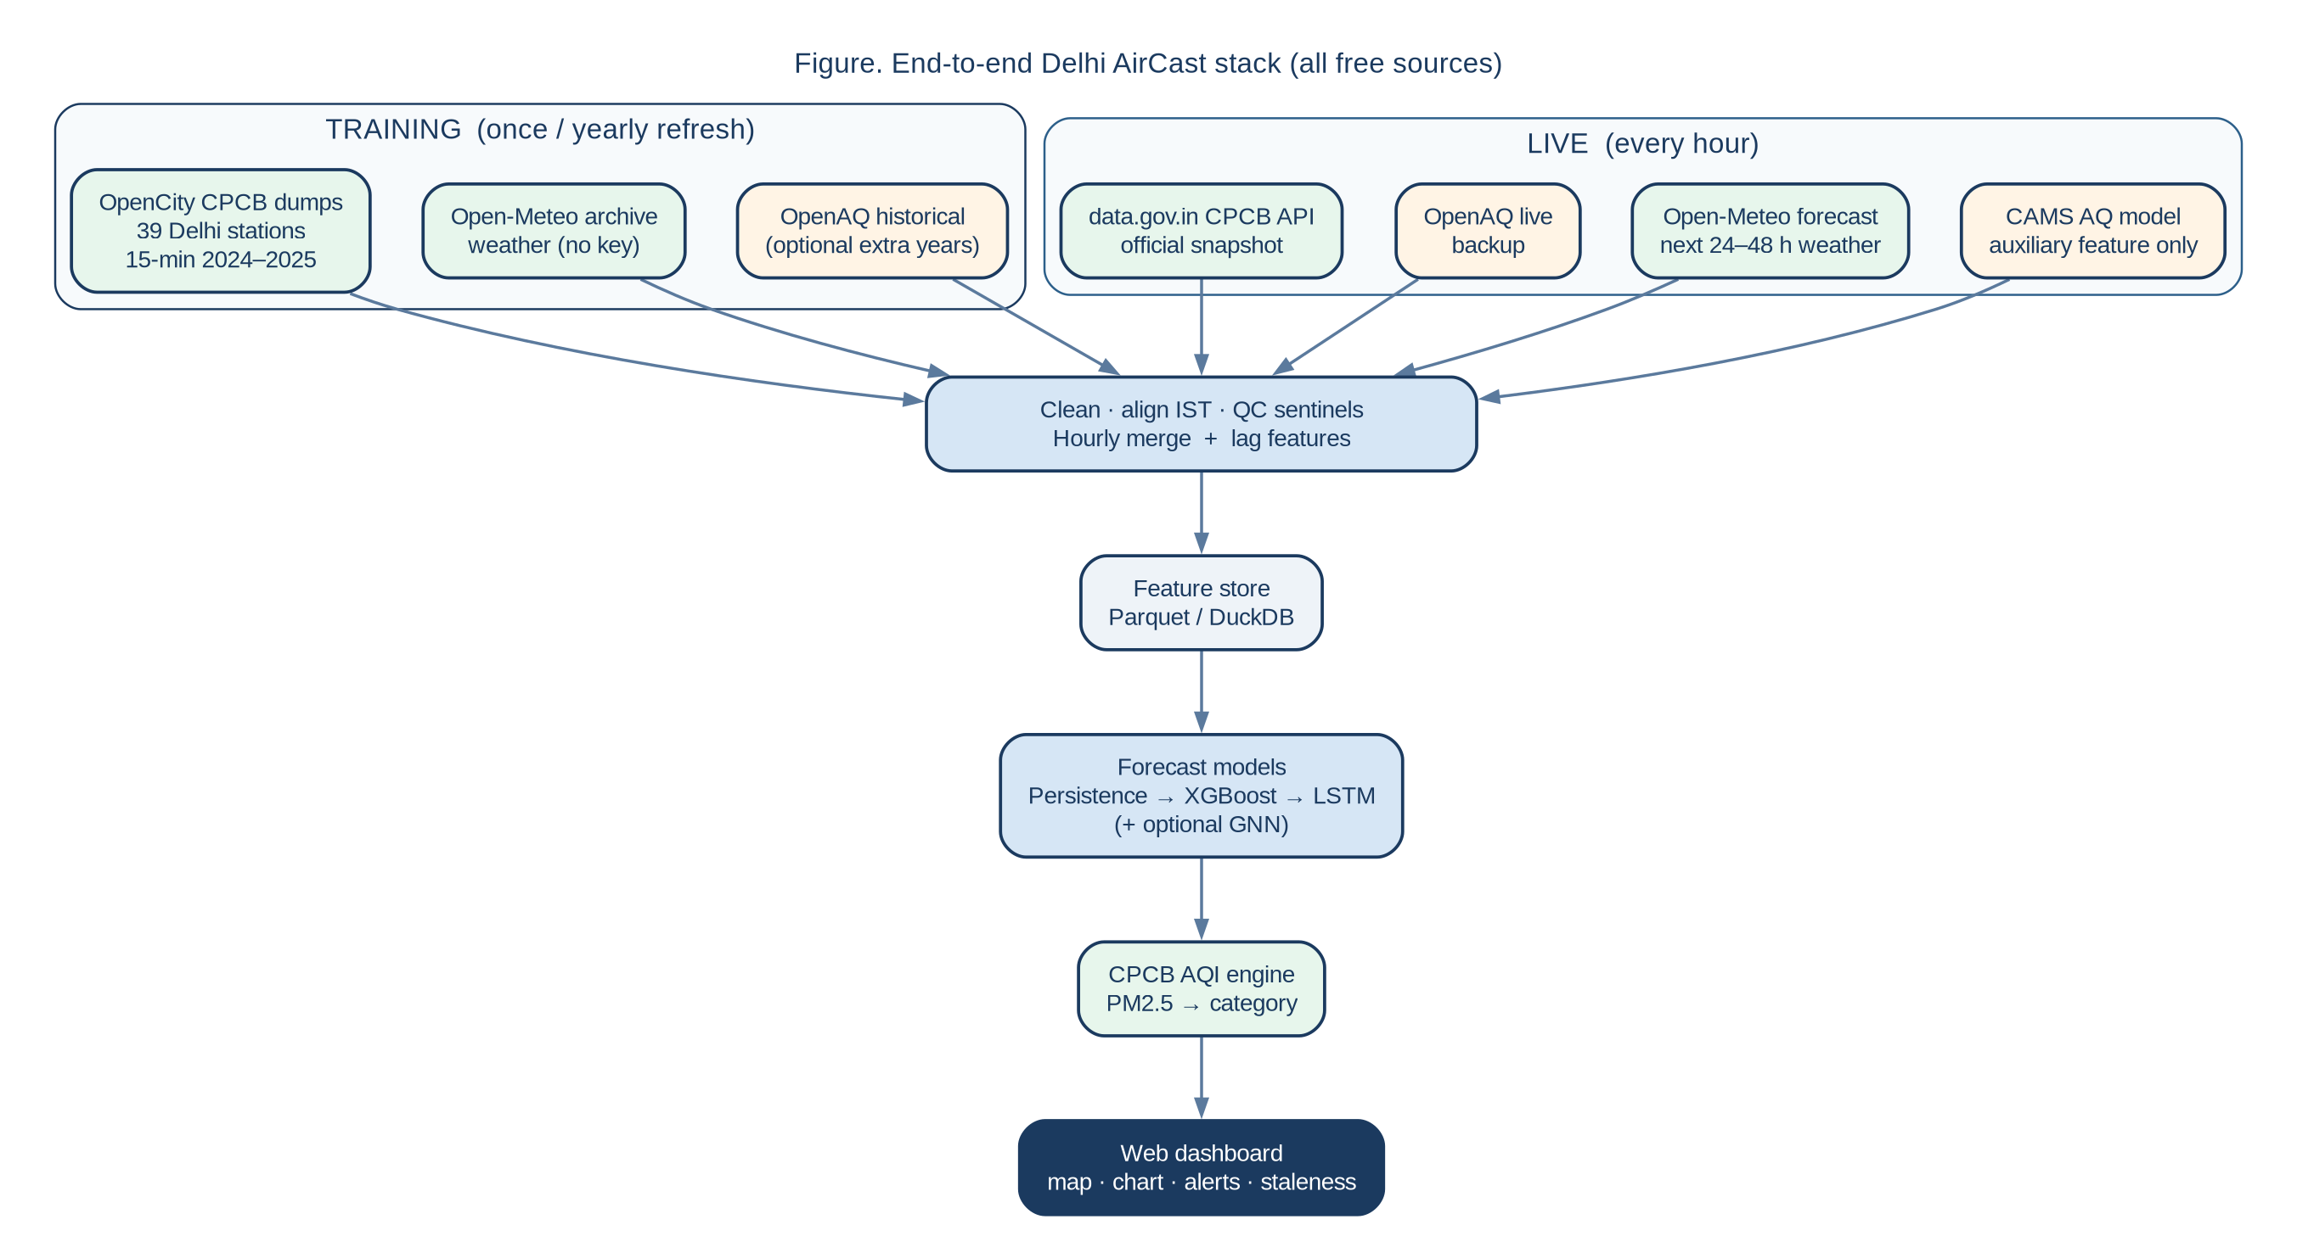
How the system fits together
PS-13 · Delhi AirCast
5 / 10

Slide 6
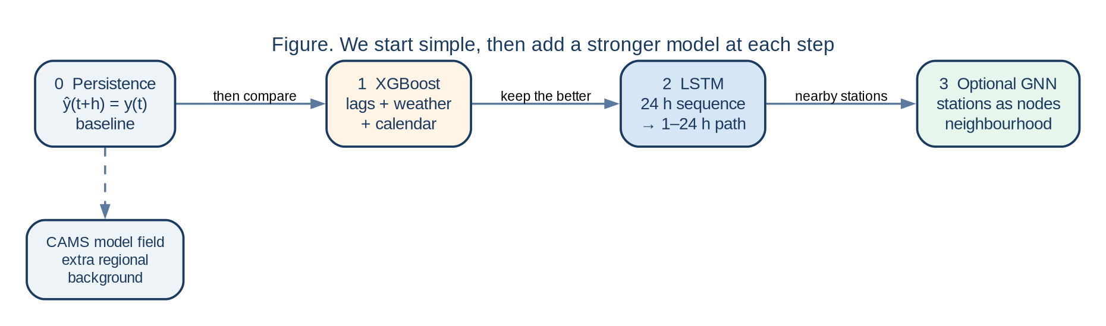
How we forecast
• The model predicts PM2.5. The app then converts that number to Indian AQI.
• We compare three models and keep the one that works best.
PS-13 · Delhi AirCast
6 / 10

Slide 7
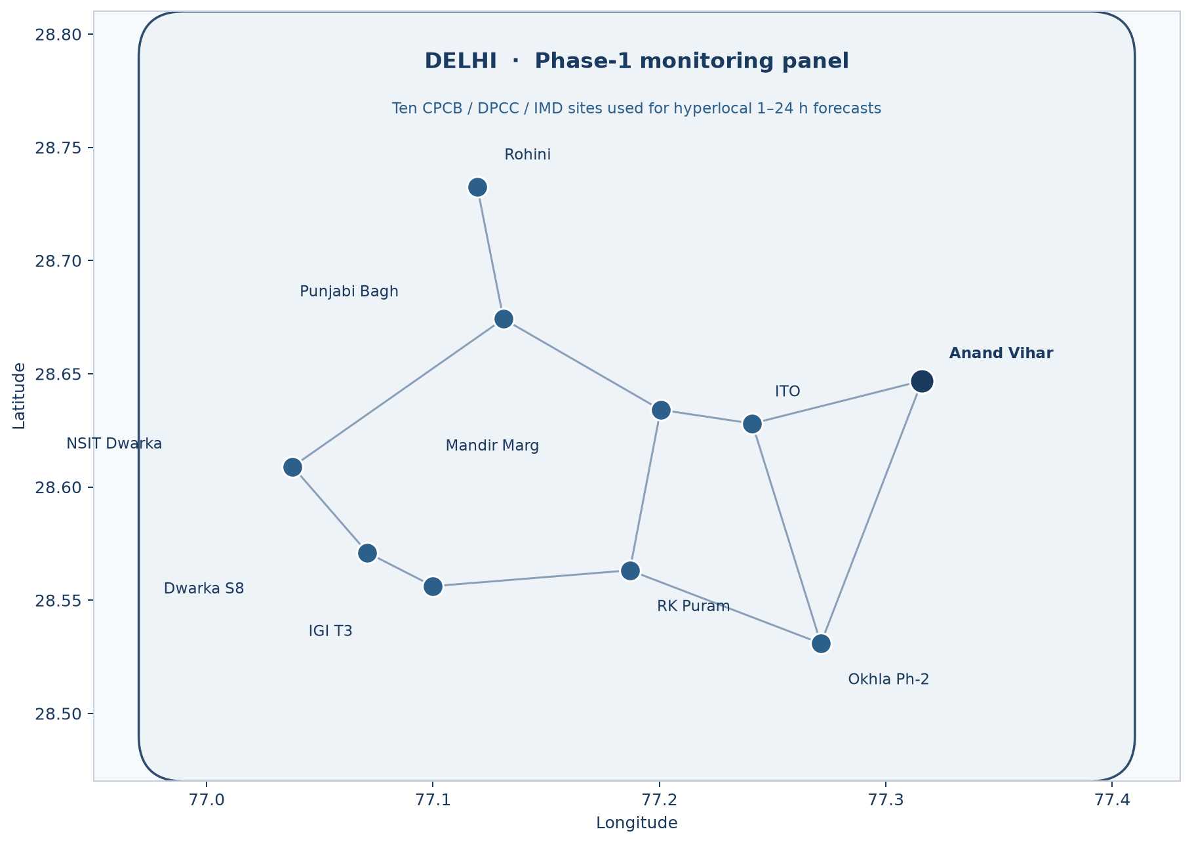
Ten stations across Delhi
• Anand Vihar, ITO, Okhla
• Dwarka, NSIT, IGI Airport
• Rohini, Punjabi Bagh
• RK Puram, Mandir Marg
• Each place gets its own forecast.
• Later we can add more stations and nearby NCR cities.
PS-13 · Delhi AirCast
7 / 10

Slide 8
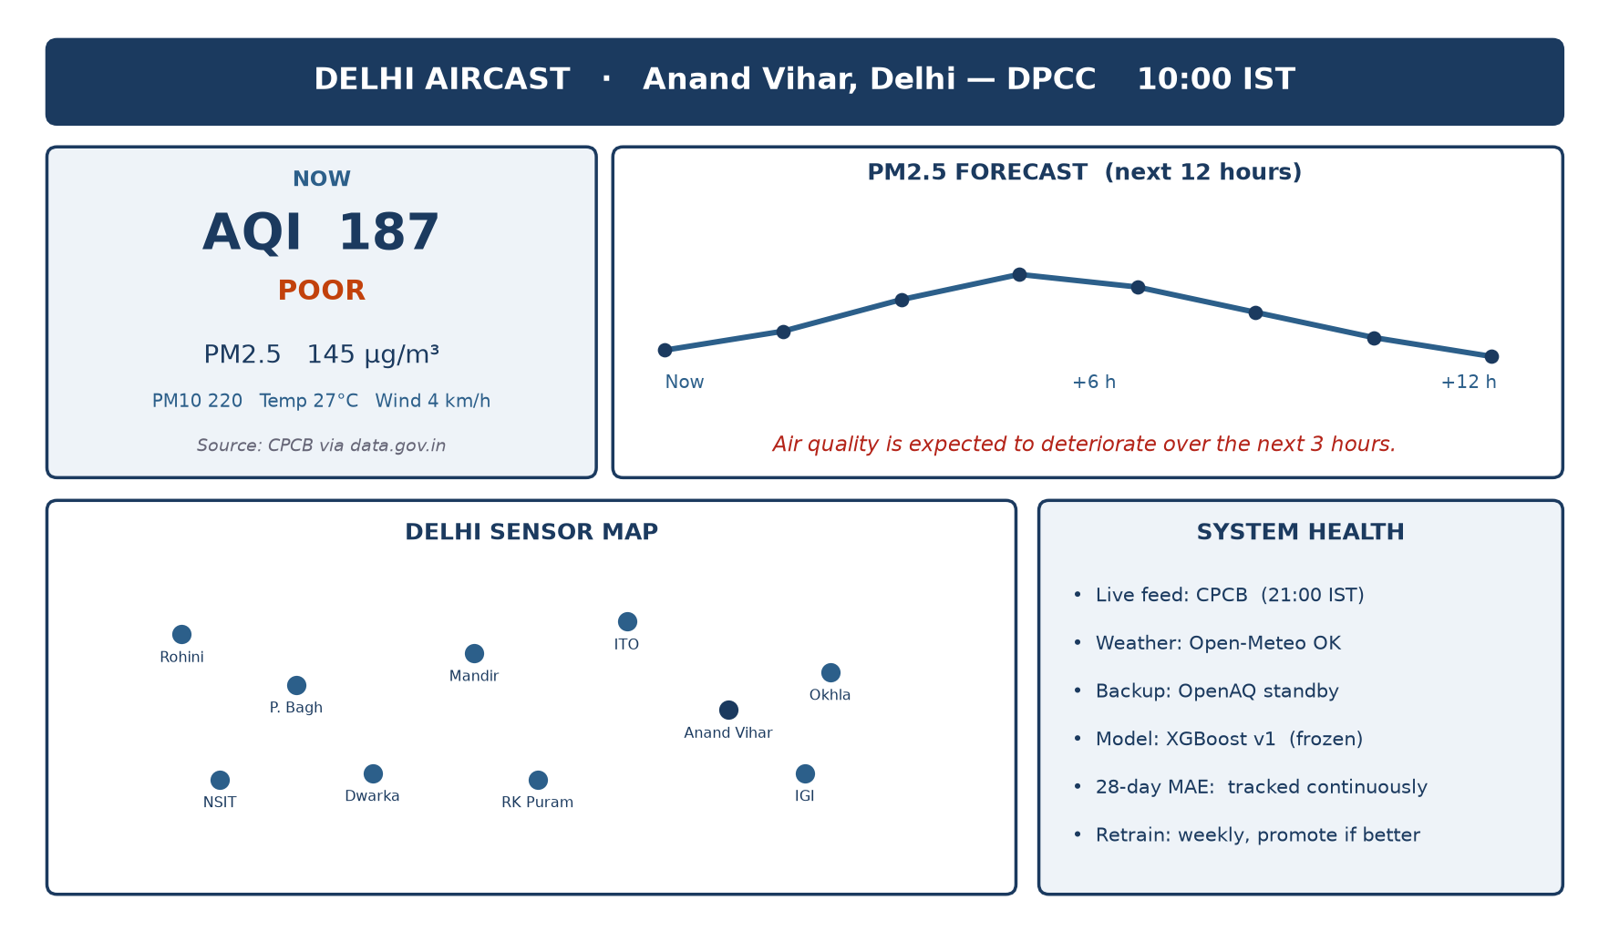
The dashboard
PS-13 · Delhi AirCast
8 / 10

Slide 9
Our plan, and how we grow
1
2
3
4
Clean data
First models
Deeper AI
Live app
Merge pollution
and weather
Simple baseline,
then XGBoost
LSTM, then a
station graph
Hourly update
and weekly improve
• Every hour the app collects new readings and shows a fresh forecast.
• Every week we add the new data and keep the better model.
• The same design can later cover more Delhi stations, NCR, and other cities such as Pune.
PS-13 · Delhi AirCast
9 / 10

Slide 10
Thank you
Delhi AirCast · a clear air forecast for every neighbourhood
Priyanshu Chawda · Aryan Babel
Shruti Agrawal · Aditya Gayal

