Slide 1


Analytics & Cognitive
Project - RMIT
February 2020

Slide 2
RMIT(Project Pi) – Data Conversion Implementation
RMIT goal is to further progress towards being the leading global university of technology, design and enterprise. Project Pi will assist in unifying RMIT processes and introducing Workday - a simple, smart platform for all of the University’s HR, finance and procurement functions
ISSUE
SOLUTION
IMPACT
Need for efficient strategy to get insights into data
No system architecture to serve as a single-source of truth for client
Need for standardized frameworks for data ingestion and provisioning the data into ERP
Establish an ETL based data platform to meet client needs of day-to-day business operations
Design a business transformation program, involving redesigning core business processes
The project is coupled with introducing Workday as the new Enterprise Resource Platform (ERP) for all of the university’s HR, Finance and Procurement functions
Made all day-to-day university interactions seamless
Provide RMIT with reliable and accurate information so they can better support, create and deliver transformative education programs
Enabled students and staff to access what they need anywhere, anytime and however they choose.
Key Accomplishments(so far) Accelerators Accolades
Created ABC framework which is leveraged by RMIT data warehouse to capture records violating pre-defined data integrity criteria
Completed P1 build for HR and FIN/ PRC subject areas in a timeframe of 12 weeks
A flexible and reusable QAQC framework was built to ensure that staging data matches with the source data
Delivered draft version of Technical Validation and Business Reconciliation documents
Created reporting layer for checking data conversion framework (ABC and QAQC) effectiveness.
ETL Extract Generator
BC & QC Frameworks
Hoover : Deloitte’s proprietary tool that reads data from CSV files and loads into Workday
Custom solution to compare SSIS’s generated extract and data which is actually loaded into Workday
Upcoming
Resource Mix
(On:Offsite:Client) = 8:5:5
Delivery Methodology
Hybrid
Project Duration
17 Months
Data Volume
~20 GB
Industry
TMT
DevOps
Not Applied
Highlights

Slide 3
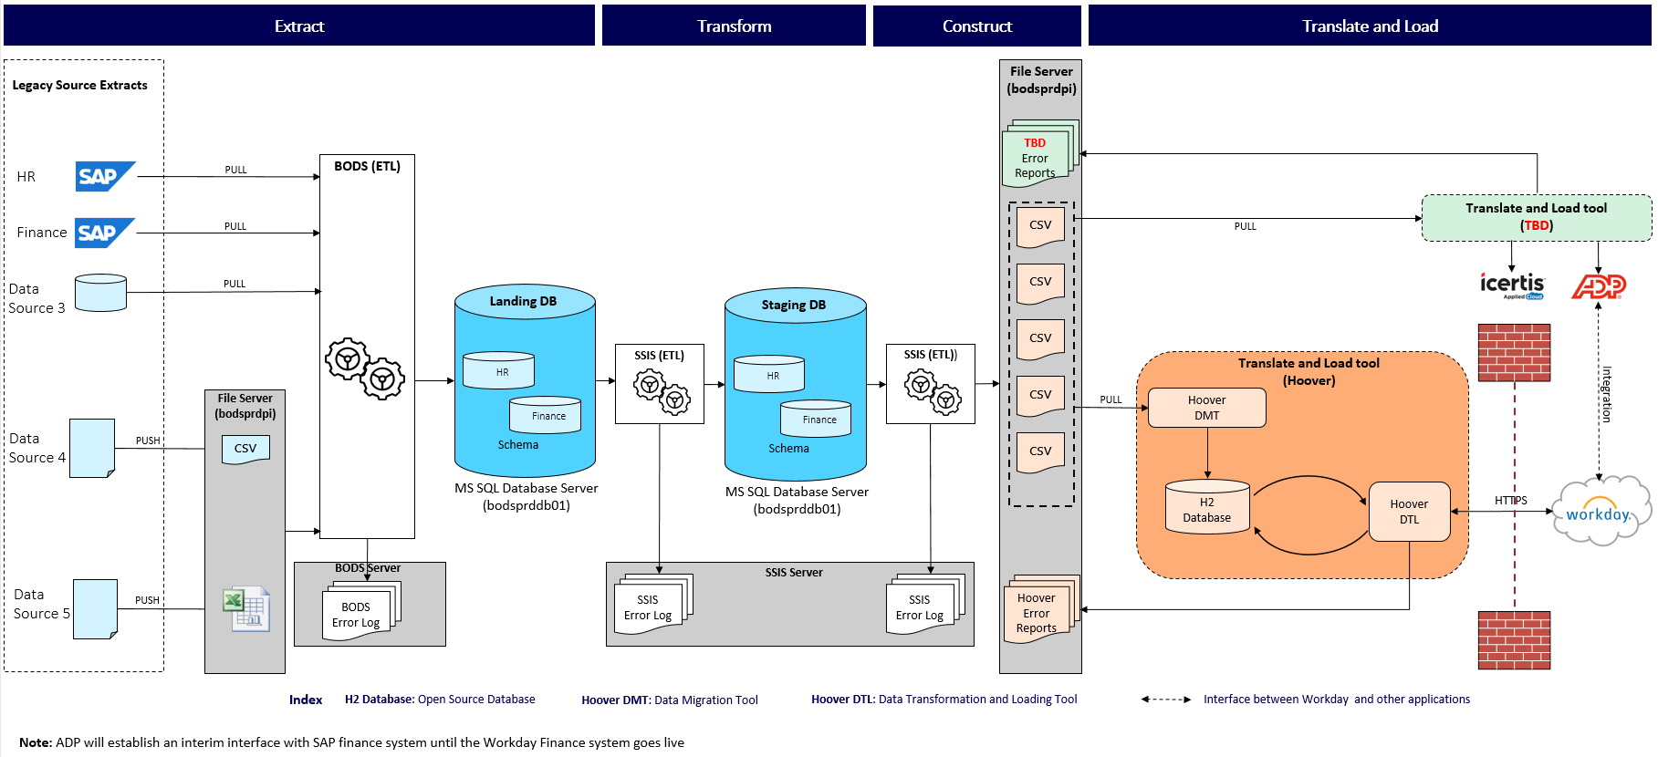
RMIT – Data Conversion Implementation
Reference architecture of the implementation.
RMIT
DELOITTE
Data from SAP source systems will be extracted and loaded into the Landing database (SQL Server) using ETL- SAP BODS.
Other source systems will push the data in the form of files (CSV, Excel etc.) into RMIT’s secured file server. Data from these files is then loaded into the Landing database (SQL Server) using SAP BODS.
Data from the Landing database will be consolidated and transformed based on target system requirements and loaded into the Staging database (SQL Server) using SSIS.
Furthermore, migration extracts (to be consumed by the translate and load tool) will be built using SSIS and stored in RMIT’s secured file server.
The translate and load tool will pull files from the file server and translate the data into target system format and consequently load it into the target system using Deloitte’s proprietary application i.e. Hoover. All conversion errors will be listed in the error reports. The target system will generate reports for validation and reconciliation.

Slide 4
Relevant Accelerators to fast-track Migration
Reusable accelerators, framework and utilities developed by Deloitte for rapid and quality deliverables for Data Conversion delivery during different project phases.
Accelerator | Description | Prior Impacts / Benefits | Phase of the Project
 |  |  | Build | Testing | Deploy | Audit & Validation | Data Load
ETL Job Generator | Metadata driven ETL extract generator enables automated development of SSIS ETLs and supporting SQL Query in build | Saved effort for building individual ETLs through the use of Metadata, reducing 60% effort
ABC and QAQC Framework | ABC is a tool-agnostic framework to capture job execution information with Job statistics, rejected & error records and QAQC framework makes sure the data is as expected and the counts are matching between the landing and staging databases and also captures the percentage of required field getting populated as null among the total target data | Saved manual effort of job monitoring, errors tracking, etc. through a quick deployable template. It certifies and enriches the results of technical validations Ensures data extracted from the source systems is correctly reflected in the target systems
Data comparison custom solution | Custom solution build on C# and SSIS to compare SSIS’s extract generated and output file received after workday loads | Saved manual efforts to compare data between staging and workday

Slide 5
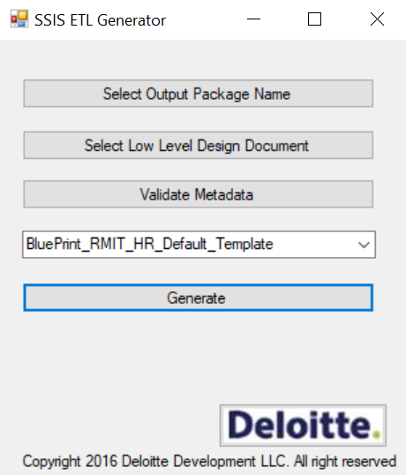
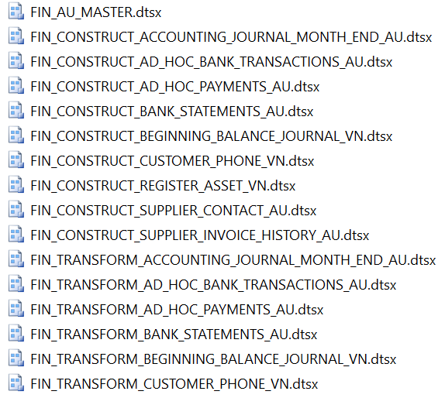
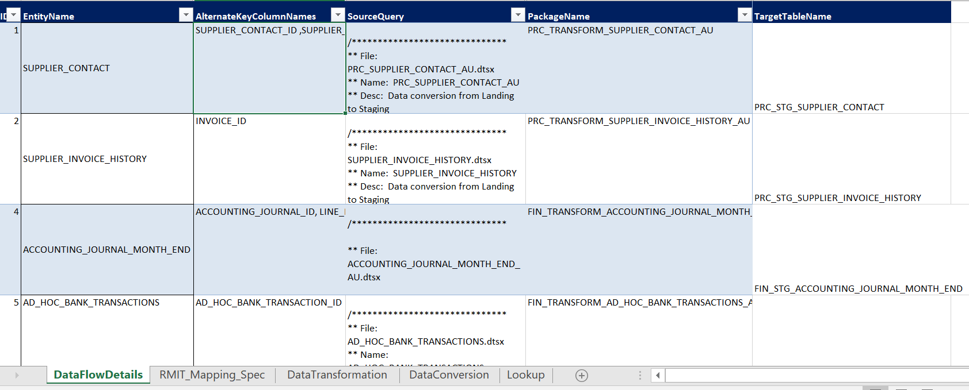
SSIS ETL Builder Accelerator
Enables creation of SSIS packages dynamically using C# object model
Use Case
Manually building Dataflow tasks of consistent type requires significant efforts if built through SSIS Designer.
Code review is time consuming when done by opening individual Dataflow Tasks and go through each of the transformation and verify the naming convention and logic.
Minor changes across all multiple dataflow tasks again requires significant amount of time.
Mass Dataflow tasks having similar logic requires lot of time when built individually.
Impact analysis of code change can done through design template only, no need to open the code and hence reduces the time in effort estimates of any change request.
Solution
User can input an low level design document for which multiple packages are to be generated.
Tool extracts the configurable properties from the input and displays in grid.
Tool accepts the number of packages to be generated from user and provides a user friendly approach (Excel) to configure the properties for those new packages at one time.
Dynamically builds SSIS dtsx files using the properties provided by the user.
Benefits
Reduced manual effort of creating packages by automating package creation from a generic template provided as input.
Provides consistency in the new packages created which can help in maintaining quality of the code with reduced code review comments
Adopting the app
Application needs installation of SQL Server data tools, Dot Net 4.5 framework, MS Excel, MS Access
Application needs a database instance where user must have admin access
SQL Server instance must have read access to the location where dtsx files under review are kept
User Interface
Output dtsx files
Low Level Design Document

Slide 6
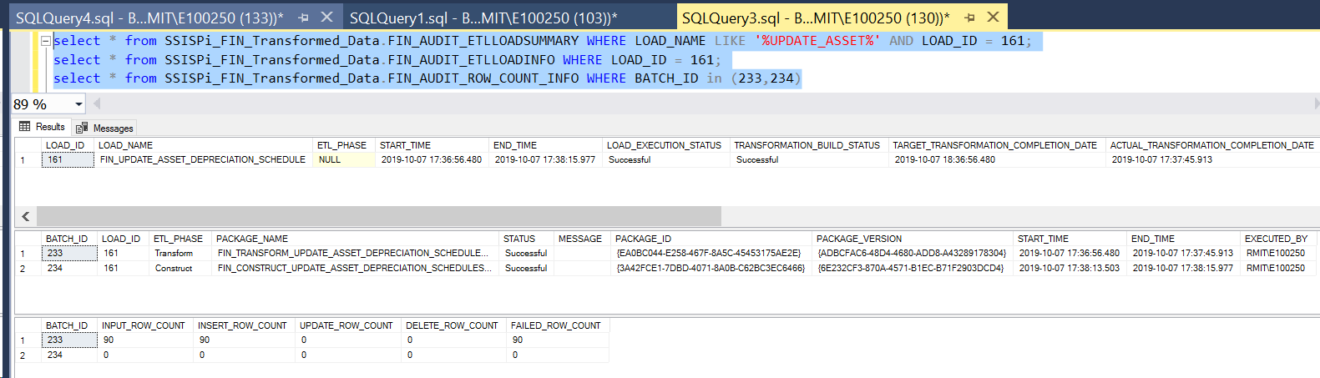
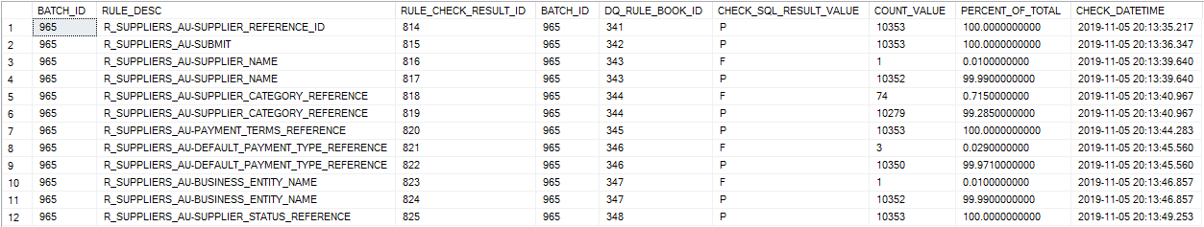
ABC and QAQC Framework
ABC Framework provides ABC design principles for the data integration and data conversion processes.
QAQC Framework highlights all actions and conventions necessary to handle exceptions that may arise during and after data migration cycle.
Use Case
Manual process of tracking the SSIS jobs at various ETL layers requires significant efforts
Manual process of checking the ETL errors or data inconsistencies requires significant efforts
Manual system of error tracking and storing the error counts requires a lot of time
Solution
ABC framework (Audit, Balance and Control) compares the count of records at different layers of data warehouse with the source records, as per business needs
QAQC framework is an ETL- SSIS based automated DQ validation solution for storing all the exceptions in exception database
ABC ensures running of the ETL jobs in the pre-defined sequence and QAQC ensures reporting of all the successful and failed data comparisons
Benefits
Reduced manual effort of monitoring and tracking the job statistics and data validations after every ETL run
It ensures that the data is complete, consistent and accurate as expected
QAQC can catch different types of errors like:
Count check between different layers
Attribute data match between layers
Null or blank checks in the not null columns
Referential integrity checks
Raised errors can be further used for generating exception reports
ABC Framework Output
QAQC Framework Output

Slide 7
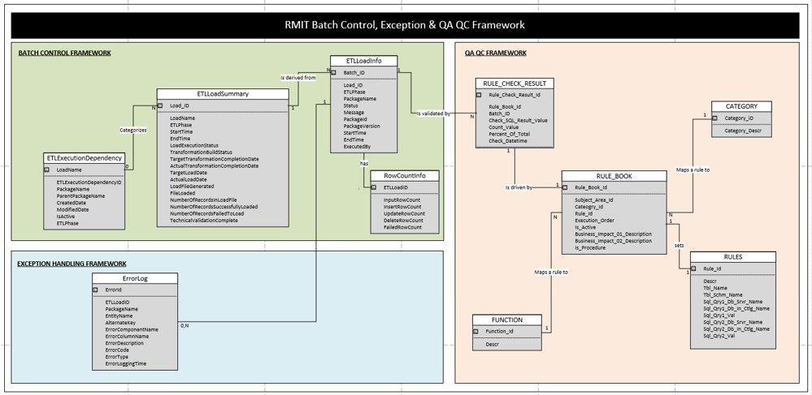
Overall ABC Framework model

Slide 8
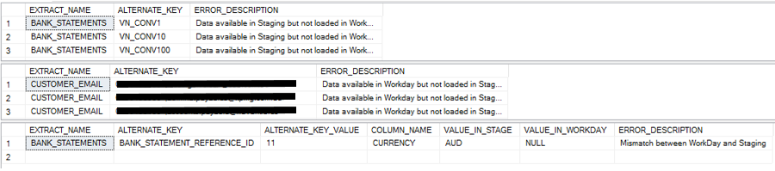
Custom Solution for Data Comparison
Enables different levels of comparison between data loaded in staging tables and workday.
Use Case
Manually finding the gaps in data when the extract from Staging tables is loaded into the ERP Workday requires significant efforts
Developer don’t have any access to the data loaded in workday
Solution
Custom solution is a dynamic system to compare the data loaded in staging and workday tables
Data loaded in workday is restored back in tables as well
It accepts configurable tables as the input and displays the reports in tabular format
Generates 3 kind of reports:
a. Data loaded in Staging tables but not in Workday
b. Data loaded in Workday but not in Staging tables
c. Field by field comparison between Staging and Workday tables
Benefits
Reduced manual effort of finding the discrepancies while loading the data into the ERP Workday
No changes need to be made in the code for comparing ‘n’ number of extracts
Input Config Table
Output Reports

Slide 9
KEY TAKEAWAYS AND CONTACTS
KEY LEARNINGS / TAKEAWAYS
CHALLENGES
Cross skilled 8 resources on niche technology i.e. SSIS
Gained in-depth knowledge of client’s business during development and unit testing phase
Need to perform rigorous data profiling activities before starting the transformation effort
Researched the environmental parameters setup in SSIS after looking at the size of the data
Lack of expertise on the technology i.e. SSIS resulted in delays in the initial days of the project
Most of the clarifications/ defects raised during the development phase lead to either changing business requirements or source data issues. This resulted in multiple iterations to close a single extract
Project planning changes were required due to the provisioning of access to only 1 functional system to each practitioner initially. This restriction practitioner reshuffling based on bandwidth
Limited understanding on how Hoover works and integrated validation process resulted in lot of rework in mapping specification and build
KEY CONTACTS
Leadership – Vikas Mahajan
Tech Architect – Gaurav Garg
Tech Lead – Deepakkumar ShioPrakashTiwari

