Slide 1

Azure Ingestor
Digital FTE

Slide 2

Azure Ingestor
Azure Ingestor is a collection of reusable metadata driven engine to automate data ingestion pipelines for structured files, perform Data Quality validations and ingest to data lake (ADLS).
The salient features Azure Ingestor framework are :
Batch Data Integration
Data Validation, Auditing , Monitoring
Error handling and notifications
Metadata Driven
The Overall Impact of the Ingestion Framework on business :
Reduces development efforts by 60%.
Enhance operational efficiencies.
Azure Ingestor

Slide 3
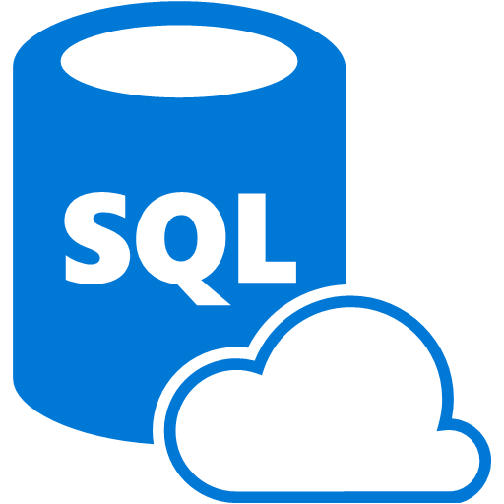

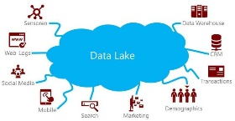
Azure Ingestor Process Flow
Azure Data ingestion framework is a collection of reusable metadata driven engine to automate data ingestion pipelines for structured files, perform configurable Data Quality validations and ingest to Azure SQL Datawarehouse.
HOW IT WORKS ?
Process
Sources
1
Inputs
Make entries into Metadata Tables for the files to be ingested.(Azure SQL DB, On-Prem File Share)
Azure Ingestor
1
SQL DB
On-Premise file share
Reads the Metadata tables
2
Ingestion
Ingestion Process is started by starting Batch and making entries in pipeline_run_stats. Here the source files are loaded to inbound layer (ADLS)
Initiate Batch and pipeline run stats
2
Validation
Digital FTE will consume the inputs and validate the
Files based on entries in metadata tables and perform Data qualities/ Data Cleansing.
3
Fetches the source files & loads inbound layer
Output
The valid records are loaded in staging layer which is in SQL DW.
4
3
Data Quality/Data Cleansing
4
Data Scientists / Data Discovery Team
Loads Staging Table

Slide 4
Technology Stack
The technology stack used in Azure Ingestor.
Ingestion and Orchestration | Azure Data Factory
Storage | Azure Data Lake Gen2, Azure SQL Datawarehouse
Controls & Stats | Stored Procedure and Databricks Key Vault
ETL | Azure Databricks

Slide 5
Live Demo

