Slide 1

Drone Delivery System
By Priyanshu Gupta IT
Shaumitra Sahu ECE
Mayank Saxena IT
Uttkarsh Gupta ME
Mohit Singh IT

Slide 2






















































How This System Will Work ?

Slide 3
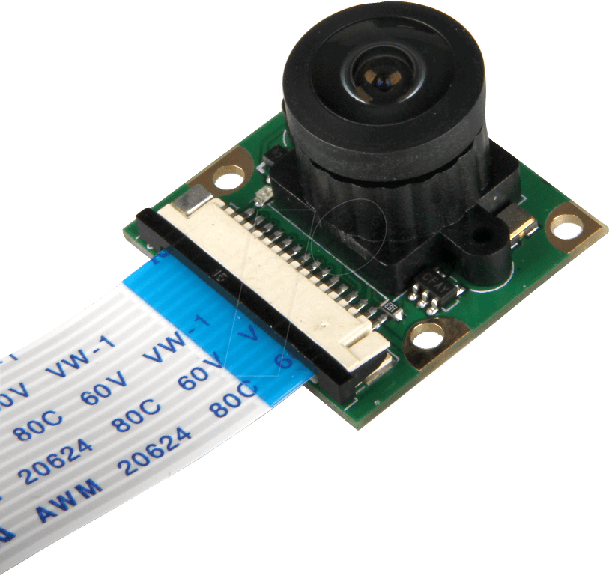


























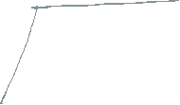
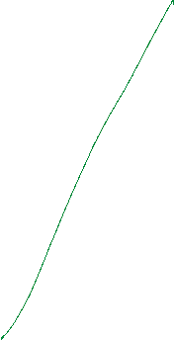








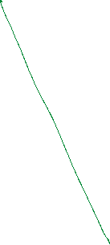

- It will detect helipad symbol using Open CV
- If the image will match, drone will land or will directly deliver the parcel

Slide 4
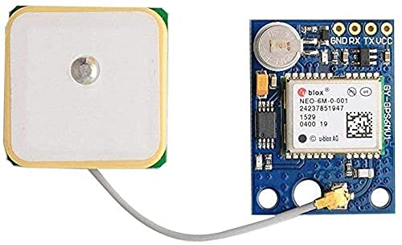





















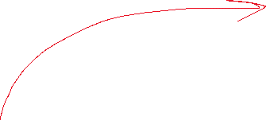










How Drone Will Travel from Point A to B, and B to A ?
- GPS module will keep track of the position of Drone
- Drone will fly at proper distance from ground to save from obstacles

Slide 5
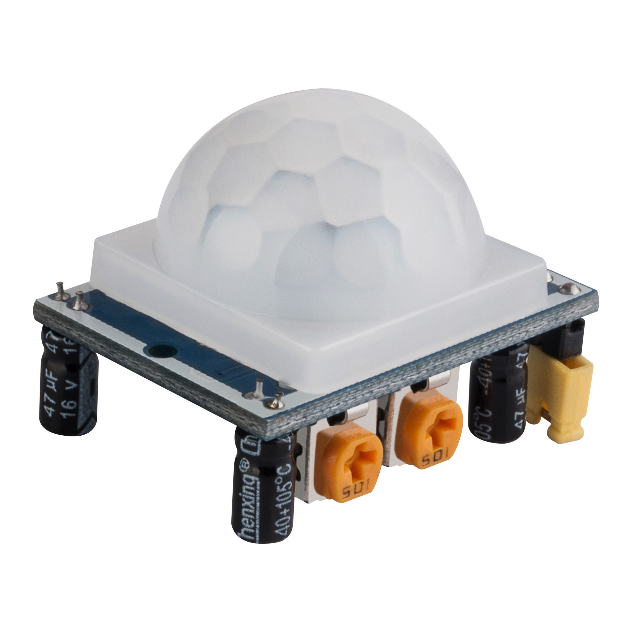
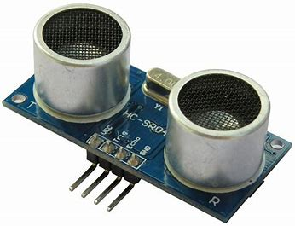






































Obstacle Detection and Defence
- Ultrasonic Sensor and PIR Motion Detection Sensor will be used as Obstacle Detection.
- Whenever an Unknown object will be detected by Drone, it will counter-act by moving in opposite direction until object is out of range

Slide 6
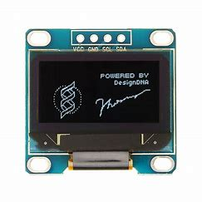


































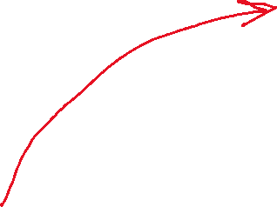






How Package Will Be Delivered ?

Slide 7
Presentation Ends Here

