Slide 1
MILORA · PRODUCT DESIGN CASE STUDY
Milora Customer App — Onboarding & Subscription Journey
Fresh milk delivered simply.
The first-use path from brand entry to an active recurring subscription.

Slide 2
JOURNEY AT A GLANCE
From first tap to a dependable recurring delivery
Every screen moves the customer toward a clear, eligible, reviewable subscription.
01
02
03
04
Trust
Account
Eligibility
Commitment
Establish the promise.
Create and verify.
Locate a partner.
Configure, review, pay.
UX goals
Review lens
Keep onboarding low-friction, explain location and partner eligibility, expose commitment details before payment, and preserve continuity after activation.
Every screen has one clear next action, visible system status, and enough context for designers, UX reviewers, developers, and evaluators.
Compact mobile-screen placeholders appear only where they clarify hierarchy; this deck documents the supplied journey, not fabricated UI.
2

Slide 3
01–02 · ENTRY
The first impression explains the promise before it asks for data
01 · SPLASH SCREEN
02 · WELCOME
Make the pause feel intentional
State the benefit first
The flowing M symbol/wordmark, milk-and-nature visual language, quiet visual field, and loading treatment establish Milora while the app initializes.
Primary interaction: wait, then transition into onboarding.
UX rationale: a brief branded pause makes the service feel intentional. No decision is required yet.
“Fresh milk. Delivered simply.”
“Get fresh dairy delivered to your doorstep from trusted local partners.”
Primary interaction: choose Get started or return through Already have an account? Log in.
UX rationale: a direct benefit statement and two clear paths reduce uncertainty at the first decision.
3

Slide 4
03–04 · ACCOUNT
Account creation stays focused on one piece of information at a time
03 · CREATE ACCOUNT
04 · VERIFY PHONE
Start with a phone number
Confirm contact ownership
Country-code selector, phone-number field, Continue CTA, and consent copy linking Terms and Privacy.
Primary interaction: enter a number and continue.
UX rationale: one field lowers effort while explicit consent keeps the exchange clear and reviewable.
Masked phone number, OTP entry, resend timer or resend action, and Verify CTA.
Primary interaction: enter the one-time code, with resend available after the timer.
UX rationale: the masked number reinforces where the code went without exposing the full contact detail.
4

Slide 5

05–06 · FIRST VALUE
The new-user home makes the next action obvious, then asks for location at the right moment
05 — Home — New User
06 — Location Modal
Purpose: Give a newly verified customer a clear launch point into the core value: a recurring milk delivery. Visible content: Greeting, fresh-milk imagery, value proposition, Start subscription CTA, and bottom navigation: Home, Subscription, Deliveries, Billing, Profile. Primary interaction: Start a subscription. UX rationale: The page is useful without pretending the customer has an order history; the CTA maps directly to the stated job.
Purpose: Request location only when it enables partner discovery and delivery eligibility. Visible content: Dimmed background, explanation of why location is needed, Use my current location CTA, and manual location search fallback. Primary interaction: Grant location or search manually. UX rationale: The blocking treatment signals a meaningful decision while preserving an accessible alternative.
5

Slide 6
07–08 · ELIGIBILITY → PLAN
Partner selection turns an abstract service into a local, eligible choice
07 · CHOOSE DAIRY PARTNER
08 · CONFIGURE SUBSCRIPTION
Make availability visible
Turn preference into routine
Show the delivery address, Change location, nearby partner list, partner name, rating and review count, distance, availability or nearest indicator, selectable radio state, and Continue.
Primary interaction: select one partner and continue.
UX rationale: transparent comparison makes eligibility feel determined by the customer’s real location, not hidden system logic.
Selected partner summary; A2 Cow Milk, Cow Milk, and Buffalo Milk options with concise descriptions and per-litre prices; quantity stepper; Morning/Evening; Every day/Weekdays.
Primary interaction: choose milk, quantity, window, and frequency, then Review subscription.
UX rationale: grouping the decisions in one place helps customers understand the recurring commitment before they review the total.
6

Slide 7
09–10 · COMMITMENT
Review and payment make the recurring commitment legible before money moves
09 · REVIEW SUBSCRIPTION
10 · PAYMENT
Give every decision a correction point
Keep the plan context visible
Selected milk and quantity, partner, delivery window and time, schedule, monthly price estimate, delivery fee if applicable, total monthly estimate, recurring-payment and terms disclosure.
Primary interaction: inspect the summary, then choose Continue to Payment.
UX rationale: consolidate all decision variables before commitment.
Amount due, plan context, supported payment methods such as UPI, credit/debit card, and net banking; selected-method state; security reassurance.
Primary interaction: choose a supported method and Pay.
Implementation check: show autopay only if supported by the backend/payment policy; payment and autopay wording must match implementation policy exactly.
7

Slide 8
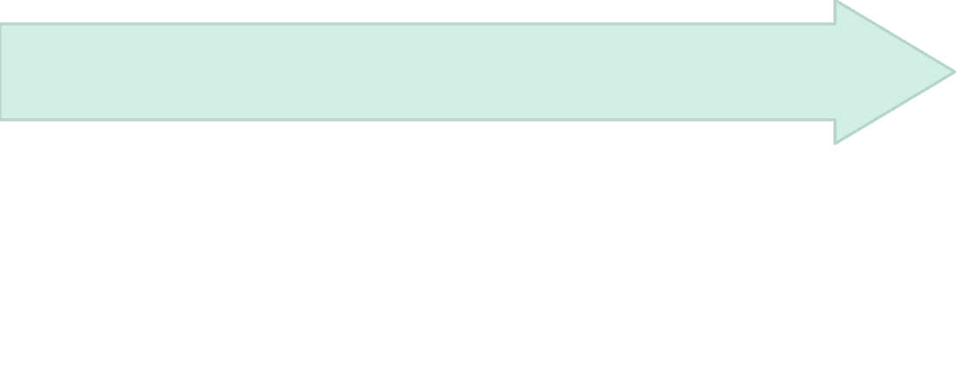

11 · ACTIVATION
Activation closes the setup loop with a concrete service promise
Success is expressed as an operating plan, not just a celebratory message.
Choose the next view
Plan is visible
View Subscription or Go to Home.
Subscription Active
Milk plan, quantity, delivery schedule, selected partner, next delivery date, payment status, and paid amount.
Confirm that the recurring service is live.
Reviewer check: the confirmation should map directly to the earlier flow and make the next service promise concrete.
8

Slide 9
12 · CONTINUITY AFTER ACTIVATION
After activation: Home answers “what happens today?”; Subscription answers “what did I commit to?”
HOME · LIVE OPERATIONAL VIEW
SUBSCRIPTION · DURABLE SOURCE OF TRUTH
What happens today?
What did I commit to?
Greeting and location; today’s delivery card with ETA and status progression: Schedule, Packed or Dispatched, and Delivered as applicable; Track delivery.
My Subscription: plan, quantity, partner, price, and status. Quick actions: Pause delivery and Change quantity; upcoming deliveries: View all; bottom navigation retained.
Plan status, next delivery, and details: seller, product, quantity/day, delivery time, and schedule.
Management actions: Future Requirement, Pause subscription, and Cancel subscription. Continuity rule: Future Requirement changes one selected future delivery only, without changing the recurring plan.
Implementation checks: loading/error/empty; disabled/invalid; location denied/manual search; OTP resend/invalid OTP; payment failure/retry; partner availability; delivery cutoff; consistency across Home, Subscription, and Deliveries; actual payment and pricing rules.
9

