Slide 1

Ethereum : A blockchain platform with its own cryptocurrency
PRIYANSHU GUPTA [202123034]
MSc Mathematics & Computing
Department of Mathematics
Indian Institute of Technology Guwahati

Slide 2

Ethereum
DECENTRALISED(1)
OPEN SOURCE(2)
BLOCKCHAIN SYSTEM(3)
That features its own
CRYPTOURRENCY(4)

Slide 3
What is decentralization ?
The power is not in the hand of a single person (unlike umpire or scorer in sports) but the power is distributed among various nodes or peers.
What is open-source ?
The term open source refers to something people can modify and share because its design is publicly accessible and not any secret as such e.g. – VLC Media.
What is cryptocurrency ?
A cryptocurrency is a digital or virtual currency that uses cryptography and is difficult to counterfeit because of this security feature e.g. – Bitcoin or Ether.

Slide 4
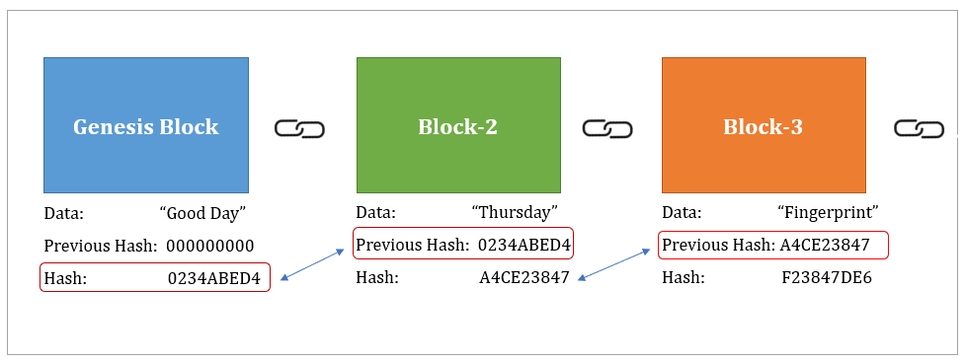
What is blockchain system ?
How do we check fake or legit things e.g. a bill , currency note or licence ?
Yes, the centralised owner keep a record or a database for this.
But he has the sole rights or power to modify / delete this data.
“All power tends to corrupt and absolute power corrupt absolutely” – Lord Acton.
What if everyone is accessing or verifying the data ?
Modifications become unreal.
That is where Blockchain comes into the picture.
Blockchain is a distributed ledger that stores data in blocks chained together. Each block has data, previous hash value and current hash value.
The important elements of blockchain include – P2P network, cryptography, consensus algorithms, punishment and rewards.

Slide 5

History of Ethereum
Ethereum’s co-founder is Russian-Canadian programmer Vitalik Buterin and he was just 19 when he made this technology. He told that he got motivated after an incident. He was fond of a game called World of Warcraft. One morning, he found that his favourite weapon of his favourite character was changed by the owner (company). He felt cheated and decided to make a platform with no centralized authority.
Ethereum was conceived in 2013, development work & crowdfunding was commenced in 2014 and the network went live on 30 July 2015.

Slide 6
Usage of Ethereum
Ethereum has great intrinsic value such as programming money.
Ethereum can be used for various Decentralized Apps or simply DApps which can be deployed using smart contracts. There are over 3000 DApps (more than half of DApps) deployed on Ethereum as of June 2021 e.g. – Weifund , Uport etc.
Ethereum connects people directly through a powerful decentralized super computer (Imagine – Drivers offering services directly to passengers and removing ola/uber from real world).
EVM (Ethereum Virtual Machine) is a software that runs on the Ethereum network and enables the development of thousands of different applications all on one platform. It means you don’t have to create new blockchain for each application.

Slide 7
DApps & smart contracts
Decentralized Apps or DApps:
Simple apps earn commission to facilitate users to do easy tasks (e.g. – matrimonial apps charge fee for matchmaking) or possess full control (e.g. – one couldn’t access his own documents hosted on google drive when servers were down few days back).
DApps don’t earn commission for easy tasks and no single entity controls them.
Creation :
Write an efficient code (Solidity for ETH) and run this code on huge network of computers.
Either you can do it yourself (DIY) or hire people to write smart contracts for you.
Smart Contract (CODE IS LAW):
These contracts execute themselves by using predetermined conditions.
It automate the execution part and does not need any human for execution.
They have beautiful applications in the field of Real Estate or Finance.

Slide 8
Use cases of DApps
Two important use cases of these DApps include DeFi and NFTs.
Decentralized Finance or DeFi:
In the field of finance, there have been various centralized authority, for example - SBI (for fund transfers) or BSE (for trading shares).
Any finance related system with no centralization comes under DeFi. For example – Aave Bank (for fund transfer) or Uniswap (for trading shares).
Non Fungible (replaceable) tokens or NFTs:
Probably one of the best way to prove your ownership for anything that you want.
NFTs are digital asset whose ownership is recorded publicly on a blockchain.
NFTs can really be anything digital such as drawings, music, domain names or tickets.

Slide 9
Evolution of money
Barter System – Goods in place of goods
Exact match of goods became an issue.
Classic Gold Std. – Gold in place of goods
Carrying huge amount of gold became an issue.
Gold Std. – Gov. issued currency based on gold
Countries wanted to print more money for world war.
Bretton Std. – Gold coin price -> USD -> Currency
Convertibility became an issue.
Fiat Money – Variable exchange rate (demand & supply) came into the picture.
All control to central banks and hyper-inflation are becoming big issues.
Cryptocurrency – Decentralised system
e.g. – BTC, ETH,DOGE etc.

Slide 10
Is ether a successful currency ?
There are 6 key attributes for a currency to be successful :
Scarcity : 18M ETH / year.
Divisibility : 1 ETH = 1e18 Wei.
Fungibility : An ETH can be exchanged with another ETH.
Transportability : Transferrable to another wallet using crypto exchanges.
Durability : Digital currencies are neither torn nor burnt.
Counterfeit-ability : Fake ether is not possible due to decentralised blockchain system.
TEST PASS ☑

Slide 11
Ether as investment
Last 1 month : +45.66% returns
Last 3 months : +82.01% returns
Last 6 months : +54.37% returns
Last 1 year : +984.31% returns
Last 2 years : +2,179.41% returns
Last 5 years : +36,129.40% returns
=> It has proven out to be a great source of investment and the has the high potential to carry the same performance in the coming time as well.

Slide 12
Comparing with Bitcoin
BTC
ETH
1 BTC = 1e8 Satoshis.
Supply cap is 21 M all time.
Average transaction time is 10 mins.
Its application is digital currency.
Reward for mining is 6.25 BTC per block.
It runs on the algorithm “Proof of Work”.
1 ETH = 1e18 Wei.
Supply cap is 18 M per year.
Average transaction time is 15 seconds.
It has multiple utility applications.
Reward for mining is 2 ETH per block.
It runs on the algorithm “Proof of Stake”.

Slide 13
Thank You ☺
Check out my project BITPE: A Wallet of Bitcoins at 🔗pgupta.me
Reach out to me at 🔗 pgupta@iitg.ac.in

