Slide 1
BITPE
A WALLET OF BITCOINS
MA518 COURSE PROJECT BY
- PRIYANSHU GUPTA & AYUSHMAN TIWARI
SUPERVISOR: MR. ASHOK SINGH SAIRAM

Slide 2
REFERENCE /
MOTIVATION FOR THE PROJECT
India is a developing country and the rise in the latest budget for Digital India of $477M by the Indian Government shows their belief in technology. In March 2021, Tesla CEO Elon Musk agreed to accept the most popular and largest cryptocurrency, Bitcoin as a mode of payment in Tesla. Sooner or later India will be doing the same. This Project helps the users to make virtual transactions as a mode of payment via Bitcoin.
“THE FUTURE OF MONEY IS DIGITAL CURRENCY”
~ BILL GATES

Slide 3
FEATURES
OUR WEBSITE WILL HAVE FOLLOWING OPTIONS…..
REGISTER/LOGIN
RECHARGING WALLET
MAKING TRANSACTION
TRANSACTION HISTORY
SHOPPING
TRACKING BITCOIN PRICE
WE AIM TO CREATE A RESPONSIVE AND DYNAMIC WEBSITE WHERE USER CAN REGISTER HIMSELF, BUY PRODUCTS AND MAKE ONLINE TRANSACTIONS IN BITCOINS DIRECTLY FROM HIS BIT-WALLET

Slide 4
REQUIREMENTS OF THE WEBSITE-1
BITCOINS ARE LIKE THE EMAIL OF THE FINANCIAL WORLD. WITH ITS GROWING POPULARITY WORLDWIDE, COMES THE NEED TO SEAMLESSLY AND SECURELY TRANSACT WITHOUT COMPROMISING TIME AND SECURITY. THAT IS WHERE OUR WEBSITE IS USEFUL.
TO KEEP UP WITH THE GROWTH OF CRYPTOCURRENCY IN TODAY’S WORLD

Slide 5
REQUIREMENTS OF THE WEBSITE-2
WITH THE USE OF THIS, ANYONE CAN ACCEPT ONLINE PAYMENTS FROM OTHERS THAT TOO ACROSS TOWNS OR BORDERS FROM ANY MOBILE OR COMPUTER FROM ANYWHERE IN THE WORLD.
PAYMENT ADVANTAGES OVER CASH TRANSACTIONS

Slide 6
REQUIREMENTS OF THE WEBSITE-3
THE PRICE OF THE BITCOINS KEEPS ON CHANGING VERY FREQUENTLY. AT TIMES IT WILL BE PROFITABLE IF YOU JUST BUY AND STORE THE BITCOINS IN THE DIGITAL CRYPTO WALLET RATHER THAN STORING IN BANKS. FOR A LONG SPAN, IT HAS ALWAYS BEEN PROFITABLE INVESTMENT AS IT HAS PRODUCED RETURNS OF -
47.94% IN LAST 3 MONTHS ,
366.22% IN LAST ONE YEAR,
680.12% IN LAST 3 YEARS ,
7581% IN LAST 5 YEARS AND
99999.99% IN LAST 10 YEARS.
INVESTING IN BITCOIN TO EARN MORE RETURNS THAN ANY BANK.

Slide 7
REQUIREMENTS OF THE WEBSITE-4
AGAIN SHOPPING VIA BITCOINS IS USEFUL SO AS TO KEEP UP WITH THE PACE OF THE GROWTH OF BITCOINS IN TODAY’S WORLD WHICH OUR WEBSITE WILL FACILITATE TO POSITIVE MINDED CRYPTO USERS.
TO SHOP IN TERMS OF BITCOINS

Slide 8
CHALLENGE
DURING EVERY TRANSACTION WE NEED TO FETCH THE REAL TIME PRICE OF BITCOIN. FOR THIS PURPOSE WE ARE USING FOLLOWING API -
https://bitpay.com/api/rates

Slide 9
QUERIES / ACTIONS RELATED TO USER
AFTER LOGGING IN, THE USER MAY -
RECHARGE HIS BIT-WALLET
TRANSACT BITCOINS WITH OTHER USERS
SHOP PRODUCTS AT BIT-BAZAR USING BITCOINS .
BUY/ SELL BITCOINS TO ADMIN DIRECTLY.
COMPARE BITCOINS PRICES WITH OTHER CURRENCIES.

Slide 10
QUERIES / ACTIONS RELATED TO ADMIN
AFTER LOGGING IN THE ADMIN CAN-
SELL PRODUCTS TO USERS.
BUY/SELL BITCOINS TO USERS.
SEE TRANSACTION HISTORY AND WALLET BALANCE OF ALL USERS

Slide 11
BUSINESS RULES & CONSTRAINTS
ANY USER WITH A VALID EMAIL ID NEEDS TO REGISTER FIRST IN ORDER TO USE THIS PORTAL. USERNAME & EMAIL ID MUST BE UNIQUE FOR ALL USERS.
WHILE REGISTRATION, USER ACCEPTS TERMS AND CONDITIONS RELATED TO RISKS.
AFTER SUCCESSFUL REGISTRATION, USER NEEDS TO EXCHAGE INR TO BTC THAT IS CALLED ‘RECHARGING THE BIT - WALLET’.
RECHARGE OF USERS’ WALLET IS POSSIBLE ONLY THROUGH ADMIN’S WALLET.
AT ANY POINT OF TIME SUM OF WALLET BALANCES OF ALL USERS (INCLUDING ADMIN) MUST REMAIN SAME AS THE REAL LIFE SCENERIO OF CRYPTO-CURRENCY.
USER CAN LEARN ABOUT BITCOIN AND CAN COMPARE REAL TIME PRICES OF DIFFERENT CURRENCIES – CRYPTO OR NATIONAL.
REAL TIME PRICE WILL BE FETCHED USING THIS API - https://bitpay.com/api/rates
USER CAN INVEST IN BITCOIN TO GROW HIS MONEY VIA HIS BIT-WALLET.

Slide 12
BUSINESS RULES & CONSTRAINTS (CONT…)
USER CAN BUY/SELL BITCOINS TO ADMIN AT ANY POINT OF TIME AS PER HIS NEEDS.
USER CAN SEND MONEY TO ANY REGISTERED USER OF BITPE USING RECEIVER’S USERNAME.
IF USERNAME IS INCORRECT OR NOT FOUND, USER WILL BE NOTIFIED.
A USER CAN MAKE ANY NUMBER OF TRANSACTIONS WITH HIS ACCOUNT, BUT A TRANSACTION MUST INVOLVE EXACTLY TWO ACCOUNTS – SENDER AND RECEIVER.
THE PORTAL HAS A BIT-BAZAR WHERE USER CAN BUY OUR SPONSORED PRODUCTS - BitPe Note 10 Pro , Bitpe Ultra Watch , Bitpe Artwork & Bitpe Super Bike.
PRODUCTS CAN ONLY BE SOLD BY ADMIN.
USERS CAN BUY ANY NUMBER OF PRODUCTS.
PRICE OF PRODUCTS WILL BE ADDED IN ADMINS’ WALLET i.e. ADMIN IS THE RECEIVER.
ADMIN CAN SEE THE WALLET BALANCE AND TRANSACTION HISTORY OF ALL USERS.
ANY USER CAN TRACK THE WALLET BALANCE AND TRANSACTION HISTORY RELATED TO HIMSELF ONLY.

Slide 13
CONCEPTUAL SCHEMA
ENTITIES:
ADMIN(USERID, EMAIL, USERNAME, BALANCE, PASSWORD)
USER(USER ID, EMAIL, USERNAME, BALANCE, PASSWORD)
PRODUCTS(PROD ID, PRODNAME, PRICE)
CRYPTOCURRENCY(SNO, CODE, NAME)
TRANSACTION(SNO, SENDER, RECEIVER, BALANCE, PURPOSE, DATETIME)

Slide 14
CONCEPTUAL SCHEMA
RELATIONSHIPS-
TRANSFER BETWEEN USERS’ ACCOUNT.
API CALL BY USERS TO FETCH REAL TIME PRICES.
BUY/SELL BITCOINS BETWEEN USERS AND ADMIN.
(PRODUCTS) SOLD BY ADMIN.
SHOPPING PRODUCTS BY USER.
(USERS) INVOLVED IN TRANSACTIONS.

Slide 15
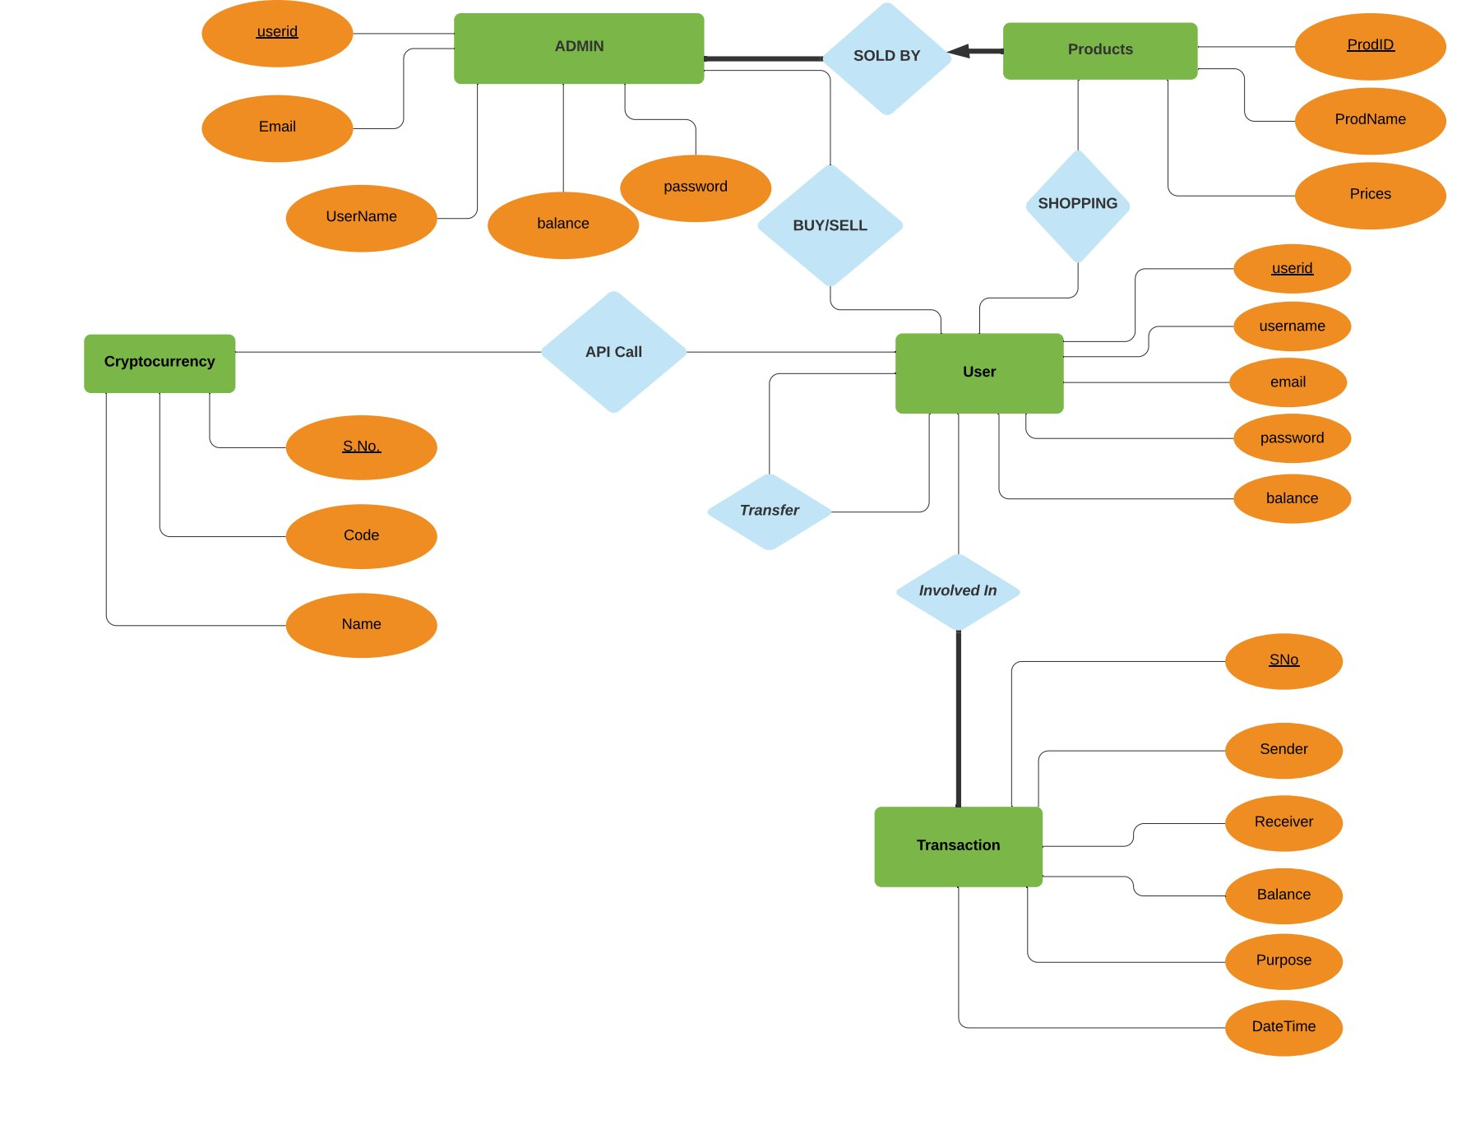

Slide 16
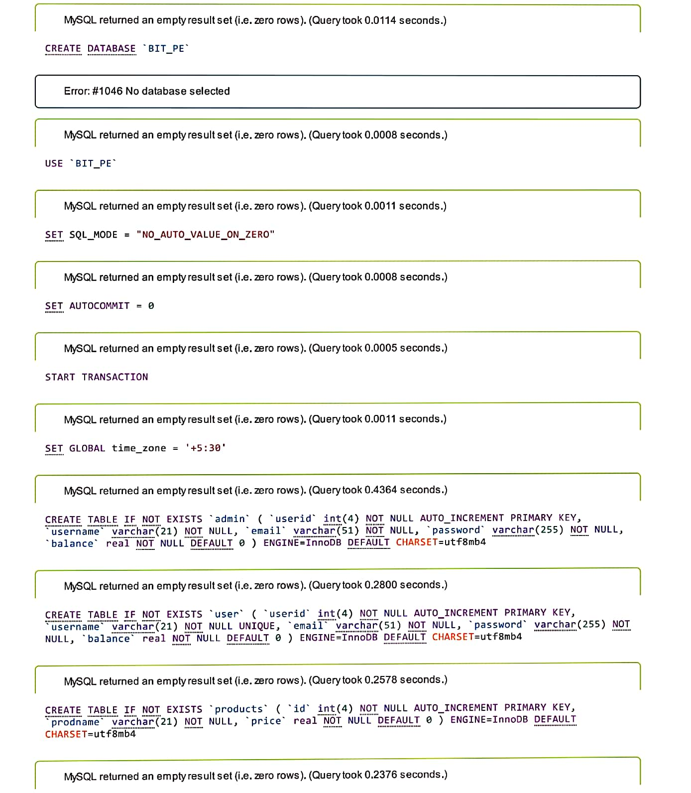
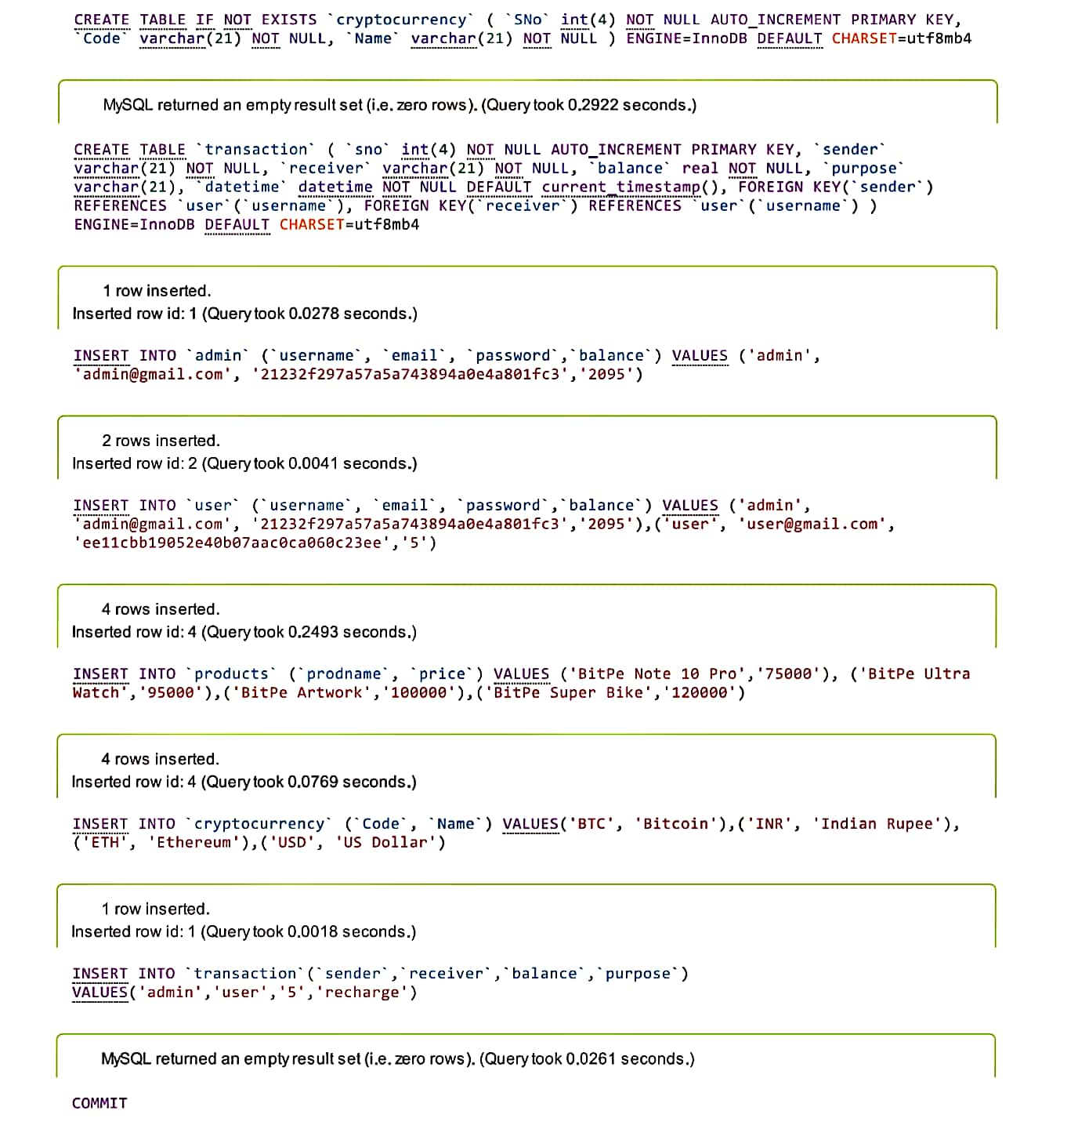

Slide 17
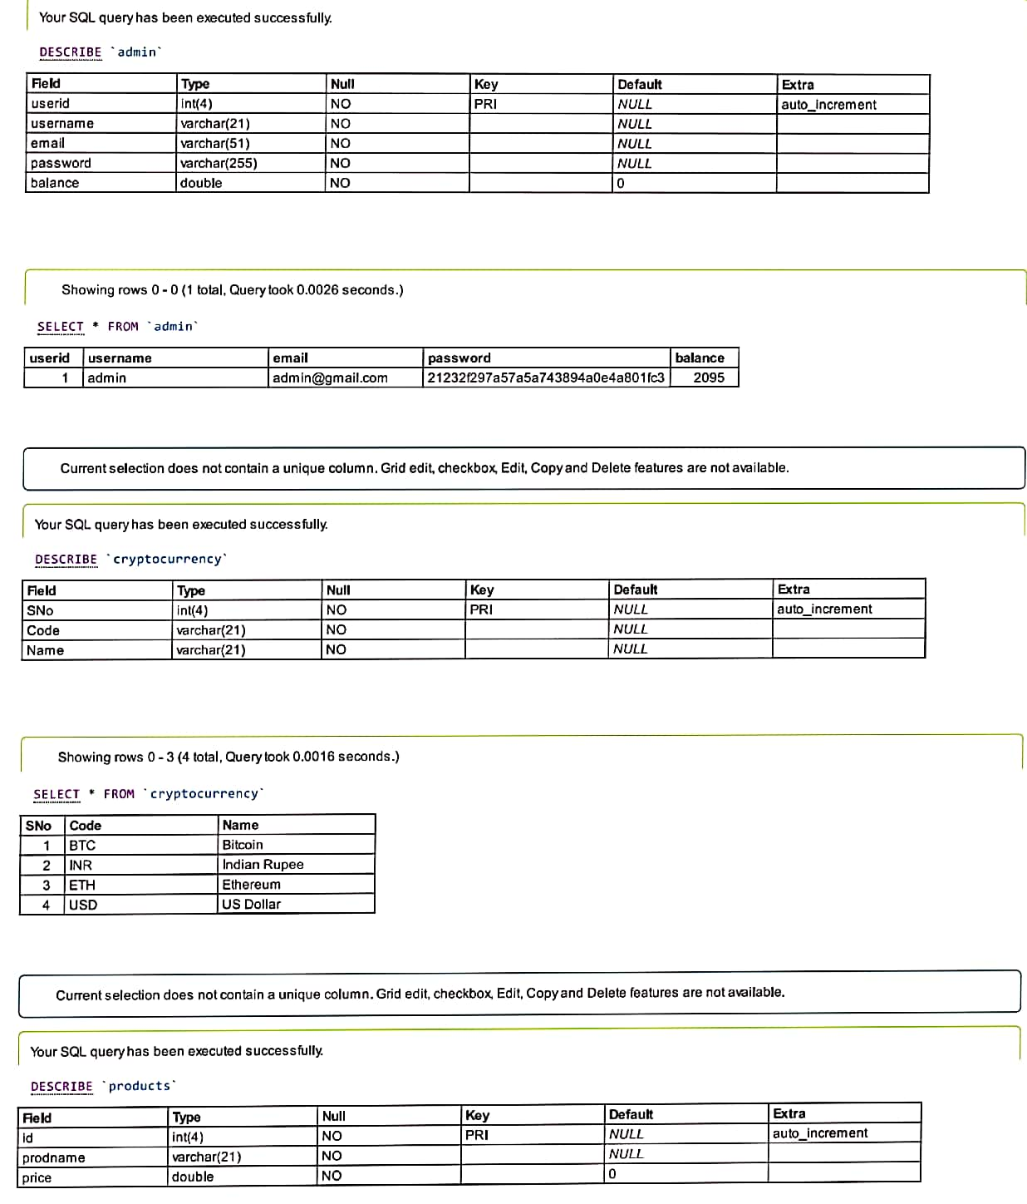
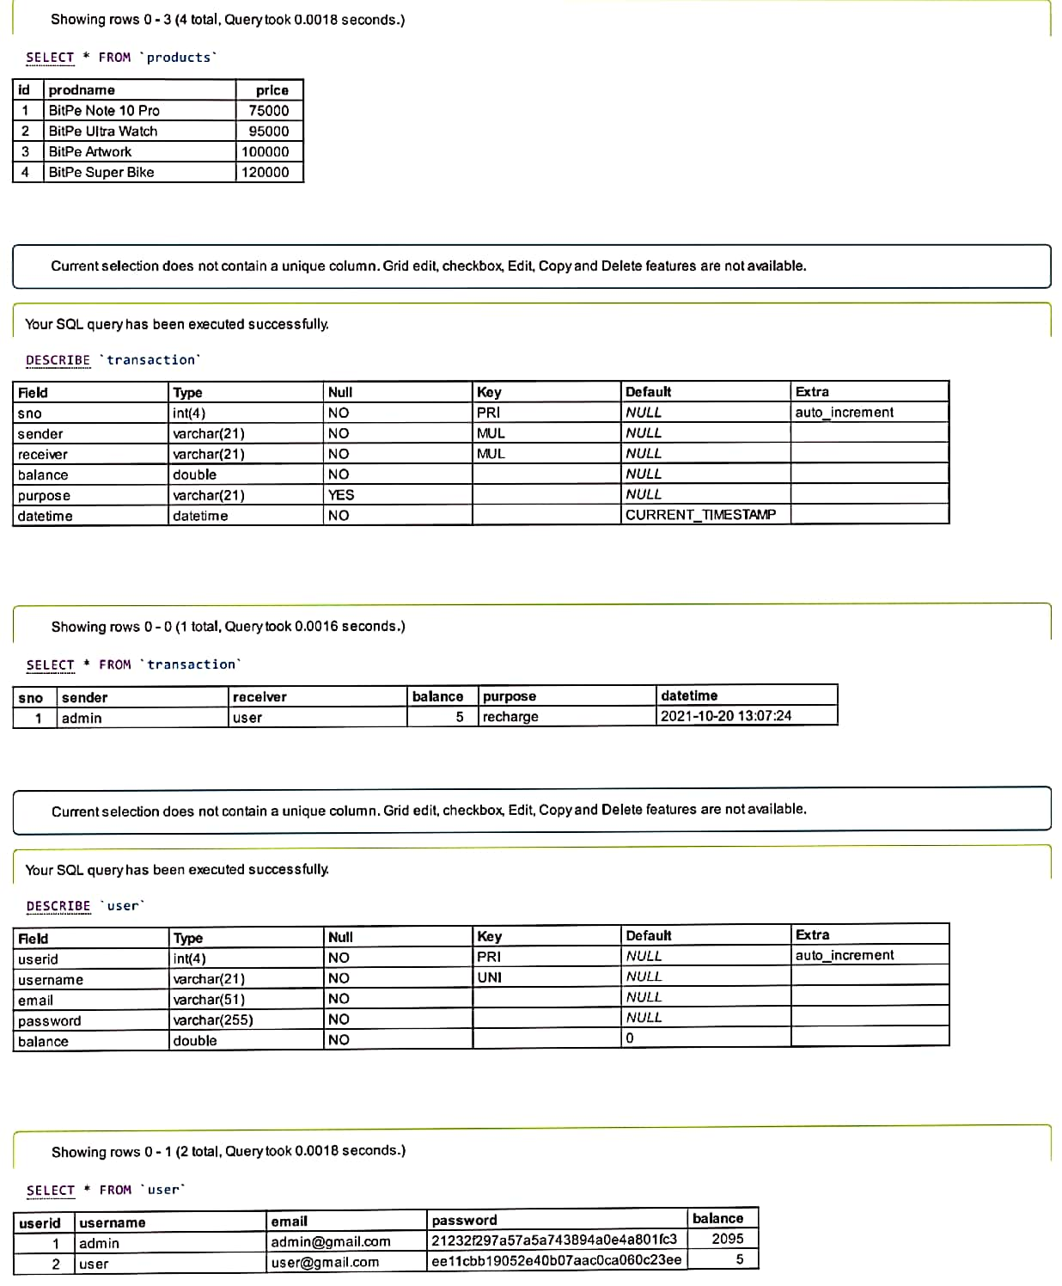

Slide 18
Functional Dependencies
ADMIN TABLE
USER TABLE
PRODUCTS TABLE
TRANSACTION TABLE
CRYPTOCURRENCY TABLE

Slide 19
ADMIN/USER TABLE
R(USERID, USERNAME, EMAIL, BALANCE, PASSWORD)
MAJOR FDs :
USERID -> { USERNAME, EMAIL, BALANCE, PASSWORD }
USERNAME -> { USERID, EMAIL, BALANCE, PASSWORD }
EMAIL -> { USERNAME, USERID, BALANCE, PASSWORD }
BCNF FORM

Slide 20
PRODUCT TABLE
R(PRODID, PRODNAME, PRICES)
MAJOR FD :
PRODID -> { PRODNAME, PRICES }
BCNF FORM

Slide 21
TRANSACTION TABLE
R(SNO,SENDER,RECEIVER,BALANCE,PURPOSE,DATETIME)
MAJOR FD :
SNO -> {SENDER,RECEIVER,BALANCE,PURPOSE,DATETIME}
BCNF FORM

Slide 22
CRYPTOCURRENCY TABLE
R (SNO, NAME, CODE)
MAJOR FDs :
SNO-> { NAME, CODE }
CODE-> {SNO, NAME}
BCNF FORM

Slide 23
USER INTERFACE
SOURCE CODE :
github.com/priyanshuguptaiitg/bitpe
PROJECT IS LIVE AT :
https://pgupta.me/

Slide 24
SCOPE OF FUTURE IMPROVEMENTS
AUTHENTICATE USER VIA OTP.
MAKE TRANSACTIONS SECURED.
SEND WEEKLY REPORTS TO USER EMAIL ID.
ADD DYNAMIC GRAPH OF BITCOINS GROWTH.

Slide 25
THANKYOU
REACH OUT TO US :
PRIYANSHU GUPTA (pgupta@iitg.ac.in )
AYUSHMAN TIWARI (atiwari@iitg.ac.in )

