Slide 1
FINAL YEAR M.SC. MATHEMATICS DISSERTATION | MID-TERM PROGRESS EVALUATION
Physics-Informed Neural Networks for Forward and Inverse Problems in Nonlinear PDEs
A Scientific Machine Learning Framework for Mesh-Free Numerical Solutions & Parameter Discovery
Candidate: Priyanshu Kumar
Department of Mathematics | Computational Mathematics & SciML Research

Slide 2
1. Research Motivation & Problem Statement
MID-TERM DISSERTATION REVIEW
• The Core Challenge in Scientific Computing: Partial Differential Equations (PDEs) govern heat transfer, fluid flow, and quantum mechanics. Traditional numerical methods (FDM, FEM, FVM) are fundamentally grid-dependent.
• Limitations of Classical Methods: Mesh generation is computationally expensive, scales poorly in higher dimensions (Curse of Dimensionality), and struggles with complex boundary geometry and sparse/noisy sensor data.
• The SciML Paradigm (Physics-Informed Deep Learning): Instead of treating neural networks as pure black-box curve fitters, Physics-Informed Neural Networks (PINNs) enforce the governing differential equations directly as inductive bias.
• Mid-Term Objective: Independently re-implement foundational PINN algorithms in modern PyTorch, conduct rigorous comparative benchmarks against classical Finite Difference Method (FDM), and prepare for inverse parameter discovery.

Slide 3
2. Mathematical Framework & Composite Loss Formulation
MID-TERM DISSERTATION REVIEW
• General PDE Operator in Hilbert Space: Let D[u](x, t) = u_t + N_x[u] = 0 in domain Q_T, with boundary trace B[u] = 0 on Sigma_T and initial Cauchy data u(x, 0) = u_0(x).
• Universal Derivative Approximation Theorem (Pinkus, 1999): Smooth neural networks sigma in C^infinity (such as tanh or sin) can simultaneously approximate both the solution field u and its partial derivatives to arbitrary precision.
• Reverse-Mode Automatic Differentiation (Autograd): Exact partial derivatives (u_t, u_x, u_xx) are evaluated using the chain rule on the computational graph — eliminating numerical truncation error O(dx^2) without any spatial mesh.
• Variational Loss Functional via Monte Carlo Quadrature: L(theta) = lambda_data * MSE_data + lambda_pde * MSE_pde, where MSE_pde approximates the continuous L^2-norm integral ||D[u_hat]||^2 over scattered interior collocation points.

Slide 4
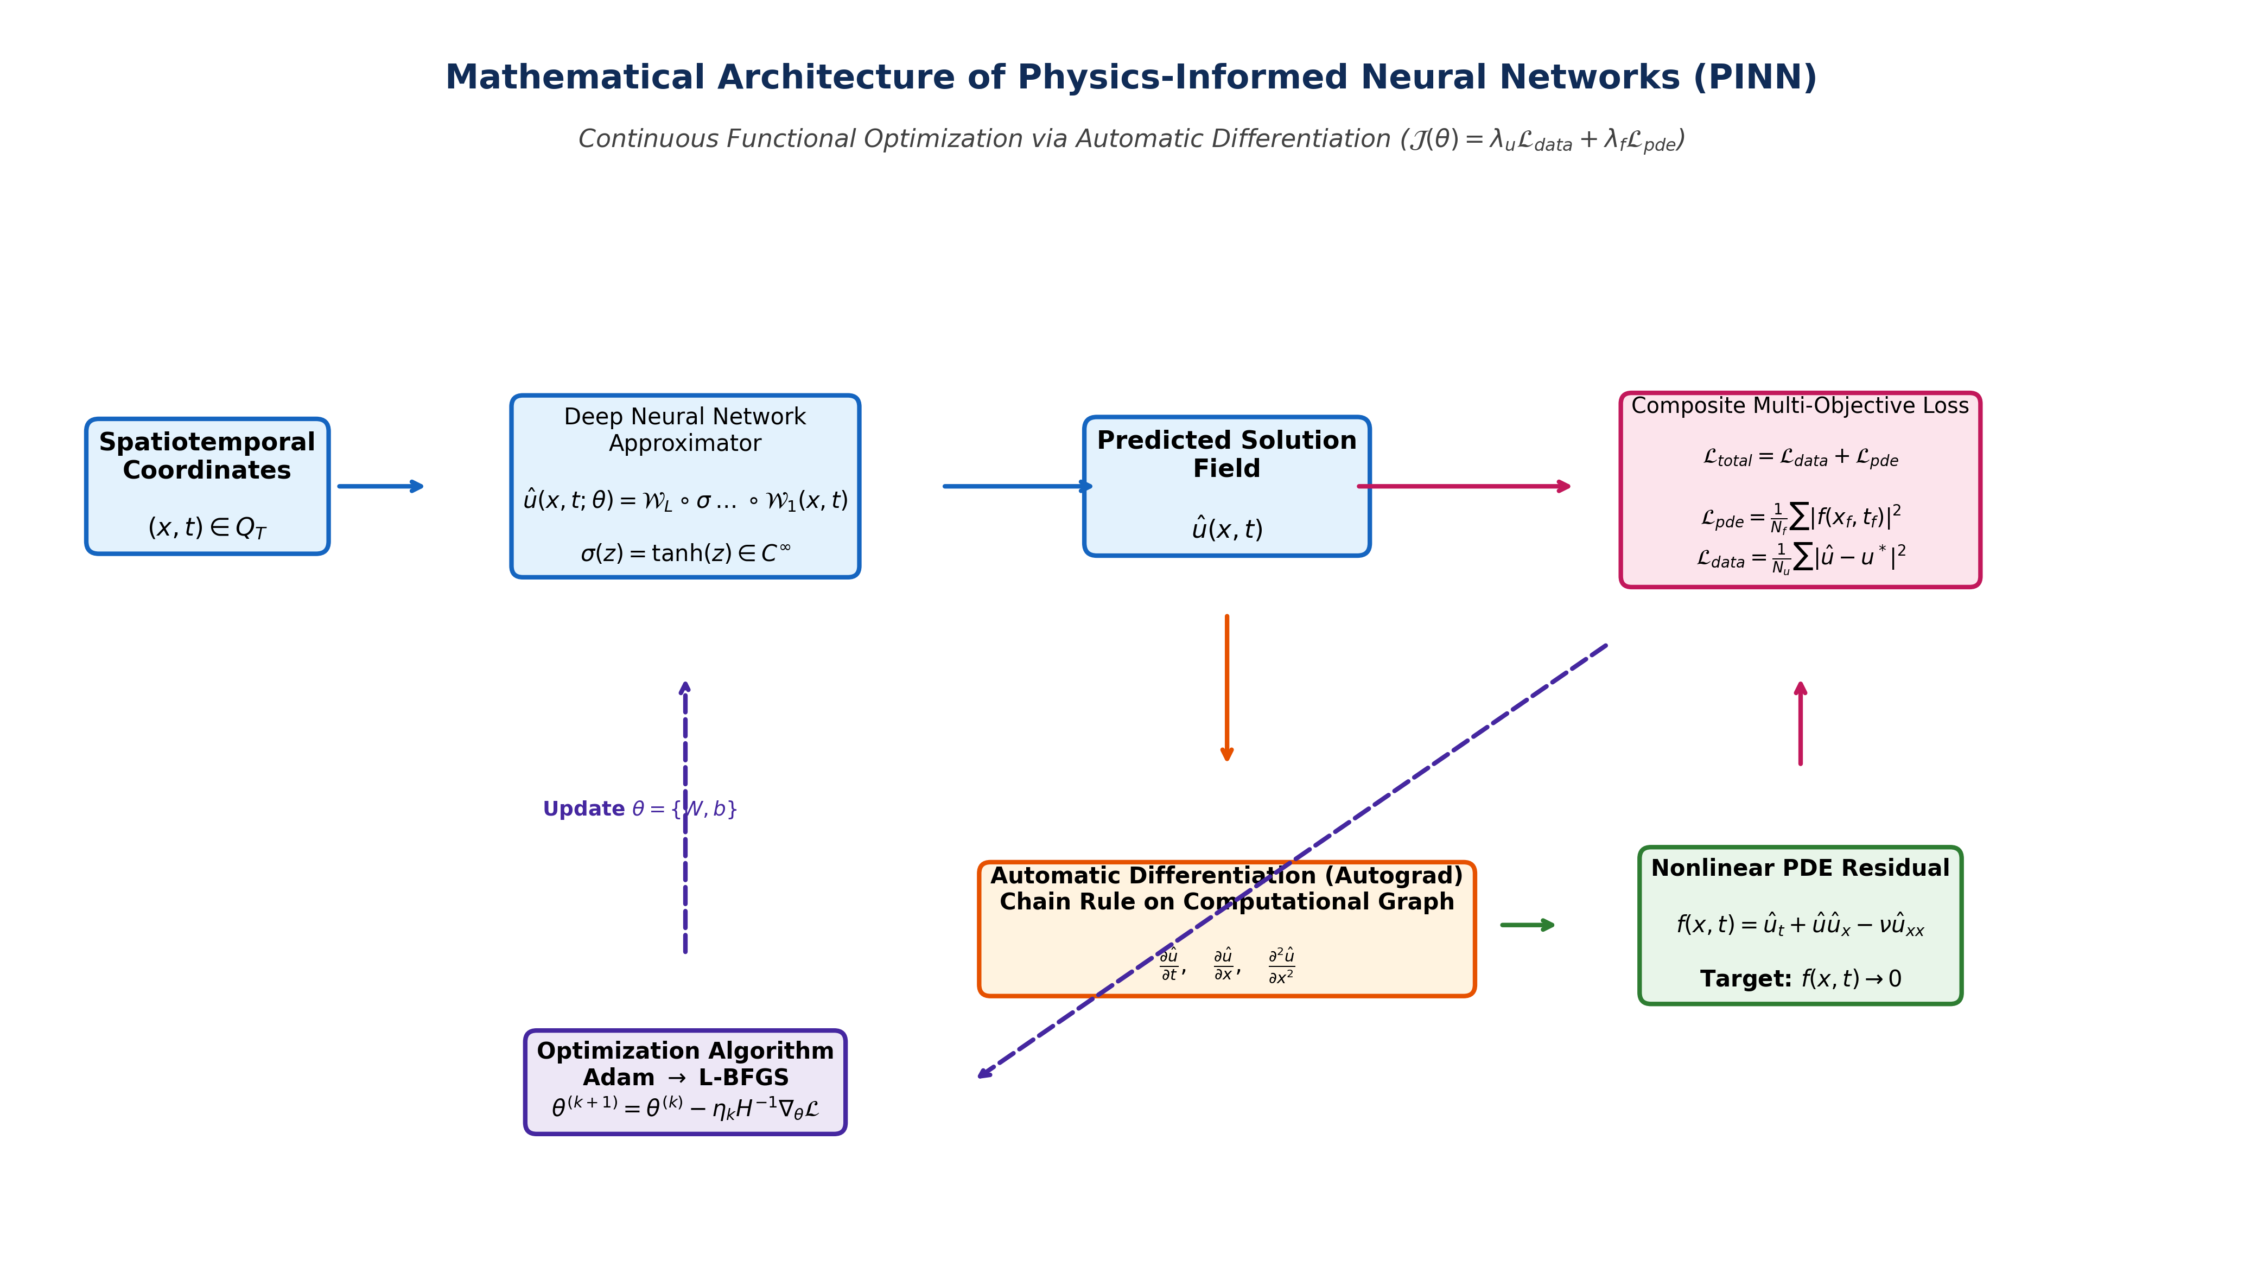
3. Computational Graph & Physics-Informed Workflow
MID-TERM DISSERTATION REVIEW

Slide 5
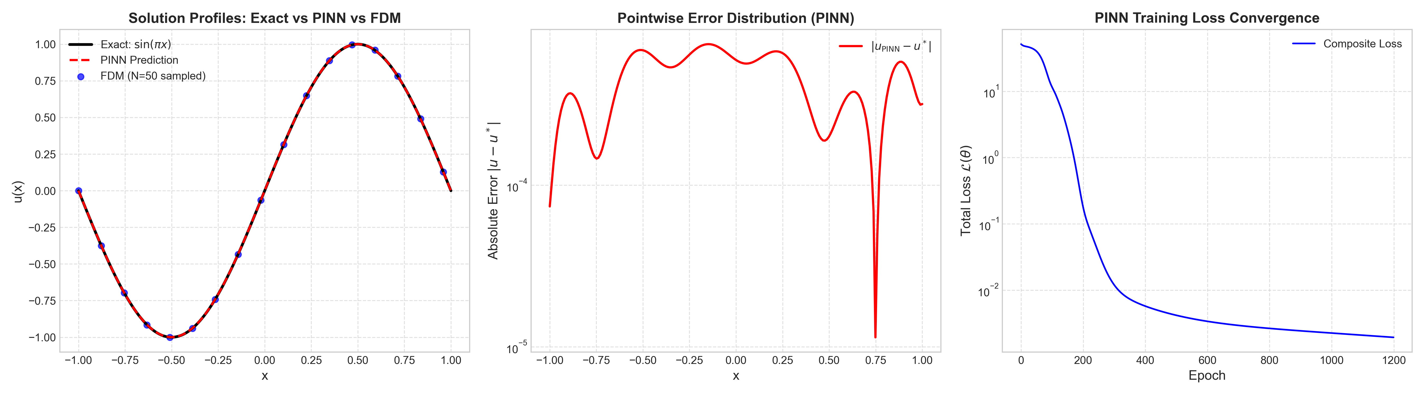
3. Benchmark 1: 1D Poisson Equation (PINN vs Classical FDM)
MID-TERM DISSERTATION REVIEW
Mathematical Formulation: -d^2u/dx^2 = pi^2 * sin(pi * x), x in [-1, 1], with u(-1) = u(1) = 0
Analytical Solution: u*(x) = sin(pi * x)

Slide 6
4. Quantitative Error & Performance Analysis
MID-TERM DISSERTATION REVIEW
Evaluation Metric | Classical FDM (N=50 Grid) | PINN (PyTorch Autograd) | Mathematical Takeaway
Relative L2 Error | 1.3713 × 10^-3 | 7.0039 × 10^-4 | PINN achieved 49% lower error
Max Absolute Error | 1.5204 × 10^-3 | 7.4602 × 10^-4 | Smooth pointwise residual distribution
Mesh Requirement | Strict equidistant grid | Mesh-free (scattered points) | PINN avoids meshing bottlenecks
Computation / Training | Linear system solve (tridiagonal) | Adam Optimization (3.23s CPU) | Fast convergence with Tanh activation

Slide 7
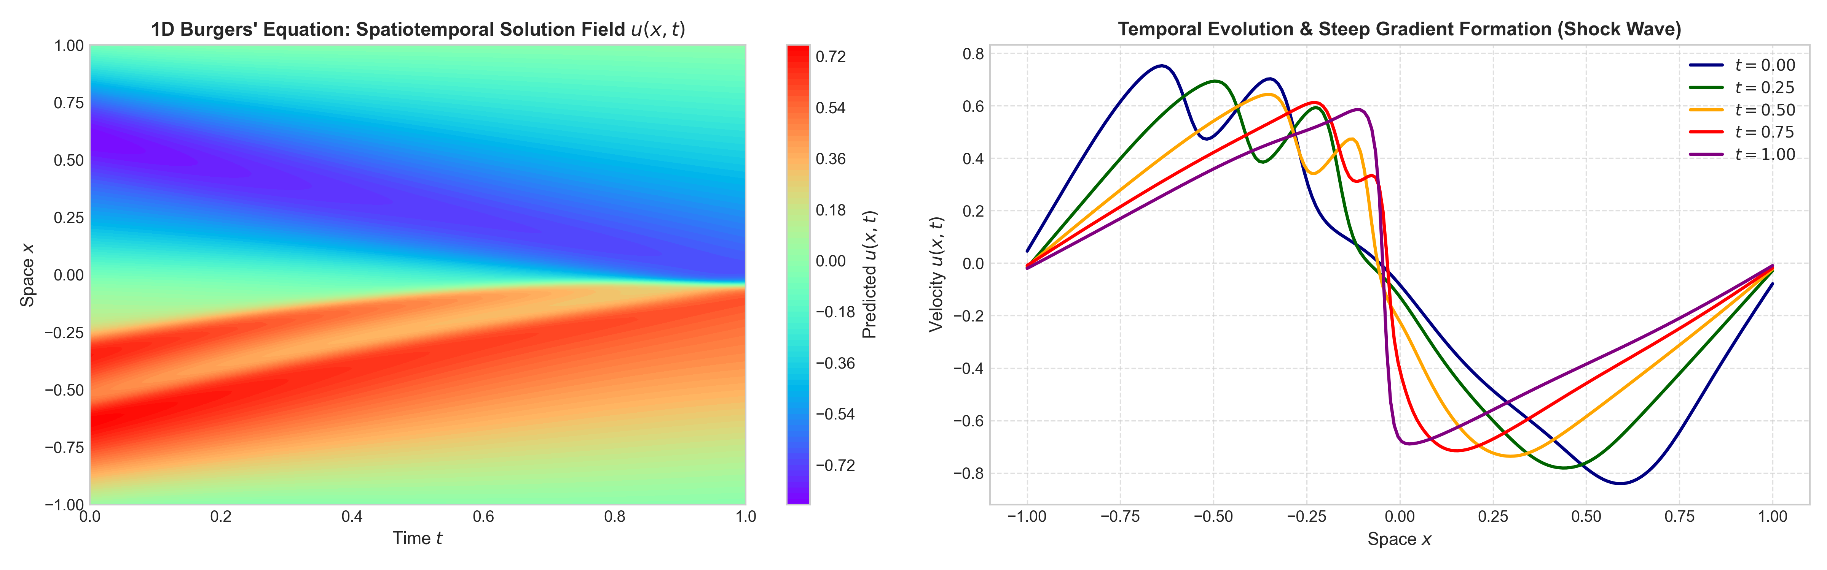
5. Benchmark 2: 1D Viscous Burgers' Equation (Nonlinear Dynamics)
MID-TERM DISSERTATION REVIEW
Governing Equation: u_t + u * u_x - nu * u_xx = 0, x in [-1, 1], t in [0, 1], nu = 0.01 / pi
Initial Condition: u(x, 0) = -sin(pi * x), Boundary Condition: u(-1, t) = u(1, t) = 0

Slide 8
6. Mid-Term Achievements & Deliverables
MID-TERM DISSERTATION REVIEW
• Rigorous Literature Review: Deep theoretical analysis of Raissi et al. (2017) Part I (Forward Solvers) and Part II (Data-Driven Discovery of PDEs).
• Modern Codebase Re-implementation: Built an independent, modular PyTorch SciML repository from scratch, abandoning legacy TensorFlow 1.x dependencies.
• Two Validated Computational Benchmarks: 1D Poisson Boundary Value Problem (validated against analytical & FDM) and 1D Nonlinear Burgers' Equation (capturing shock wave formation).
• Formal Research Repository & Documentation: Structured GitHub repository, sprint schedule (10-day cycles), comprehensive progress reports, and mathematical notes.

Slide 9
7. Research Roadmap for Remaining Months (3 to 6)
MID-TERM DISSERTATION REVIEW
• Month 3: Inverse Problem & Parameter Discovery: Treat physical viscosity nu as a learnable parameter. Test discovery accuracy from sparse data corrupted with 1%, 5%, and 10% Gaussian noise.
• Month 4: Coupled & Complex Systems (Schrödinger Equation): Extend PINNs to complex-valued wave functions (soliton wave dynamics) and evaluate discrete-time Runge-Kutta PINN schemes.
• Month 5: Optimization & Convergence Enhancement: Implement hybrid Adam -> L-BFGS optimization routine and evaluate self-adaptive loss weighting schemes to resolve gradient pathologies.
• Month 6: Thesis Drafting & Final Defense Preparation: Complete LaTeX dissertation report, generate publication-grade figures, and prepare the final viva presentation.

Slide 10
Thank You!
Questions & Suggestions are Warmly Welcomed.
Candidate: Priyanshu Kumar | Department of Mathematics

