Slide 1

IBM SkillsBuild Decoding Data PBL Program 2025 Final Project Presentation
Project Name: HR Attrition Analysis
Team Name: Data Warriors
College Name: Ajay Kumar Garg Engineering College

Slide 2
Team Members
Priyanshu Mishra (Team Leader)
Harsh Gupta
Atul Tyagi
Nikesh Upadhyay

Slide 3
Introduction
HR Attrition Dashboard – Overview
An interactive Power BI dashboard designed to analyze employee attrition patterns by tracking key HR metrics such as attrition rate, job satisfaction, income, and overtime. It helps HR teams identify high-risk areas, understand reasons for turnover, and make data-driven decisions to improve employee retention.
Objective
To monitor and analyze employee attrition trends, identify key factors influencing turnover, and support HR in making data-driven decisions to enhance employee retention and organizational stability.

Slide 4
Problem Identification
Problem Statement
Many organizations struggle with retaining employees, leading to increased costs, productivity loss, and workflow disruptions. This dashboard aims to identify key drivers of attrition through data analysis, enabling HR to take proactive measures to reduce turnover and enhance workforce stability.
Significance of the Problem
High attrition affects business continuity, increases hiring costs, and lowers employee morale and customer satisfaction. The HR Attrition Dashboard leverages data analytics to uncover the root causes of turnover, enabling organizations to make informed decisions that improve employee retention and organizational stability.
Relevant SDGs
SDG 8: Supports decent work and economic growth by improving employee retention and job satisfaction
SDG 9: Promotes innovation through data-driven HR practices and analytical infrastructure.

Slide 5
Data Collection
Sources Of Data
HR Analytics Employee Attrition Dataset.[http://www.kaggle.com/datasets/pavansubhasht/ibm-hr-analytics-attrition-dataset ]
Data Description
Total Rows: 1470
Columns: 35 before cleaning, 32 after cleaning
Attributes: Age, Gender, Department, Job Role, Monthly Income, Years at Company, etc.
Data Collection Methods
Downloaded publicly available datasets in CSV format.

Slide 6
Data Preprocessing
Data Cleaning Methods
Removed irrelevant columns: Employee Count, Employee Number, Over 18, Standard Hours
Dropped statics or redundant fields.
Handling Missing Values
Checked with filters and formulas, datasets had no Missing Values.
Data Transformation Techniques
Created new columns: Average Tenure

Slide 7
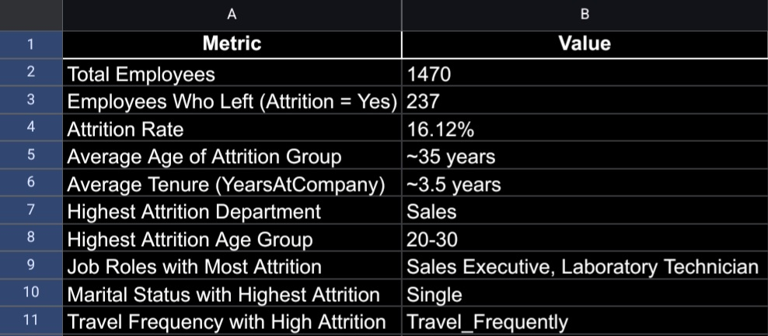
Data Analysis
Analytical Tools And Methods Used
Microsoft Excel for Data Preprocessing
Microsoft Excel dashboard creation and visualization.
Key Findings
Fig. HR ATTRITION ANALYSIS-Summary(Findings from Excel)
Insights Derived
Attrition is highly affected by Age, travel frequency, and job roles.
Work environment and role satisfaction play a crucial role.

Slide 8
Hypothesis Development
Formulated Hypothesis
“ Younger employees and those who travel frequently are more likely to leave the Company.”
Rationale Behind the Hypothesis
Data shows concentration of attrition in the 20-30 Age group and among frequent travelers.
Method for Testing the Hypothesis
Used MS Excel visual filters and segment comparisons to validate patterns.

Slide 9
Solution Design
Proposed Solution
Develop a targeted retention statregy focusing on high risk group(Young, frequent travelers and sales roles).
Implementation Plan
Conduct exit interviews and satisfaction surveys.
Provide flexible travel policies and career growth plans.
Alignment with SDGs
Supports SDG8 by enhancing Job Satisfaction.
Aligns with SDG 9 via Data driven innovation in HR policies.

Slide 10
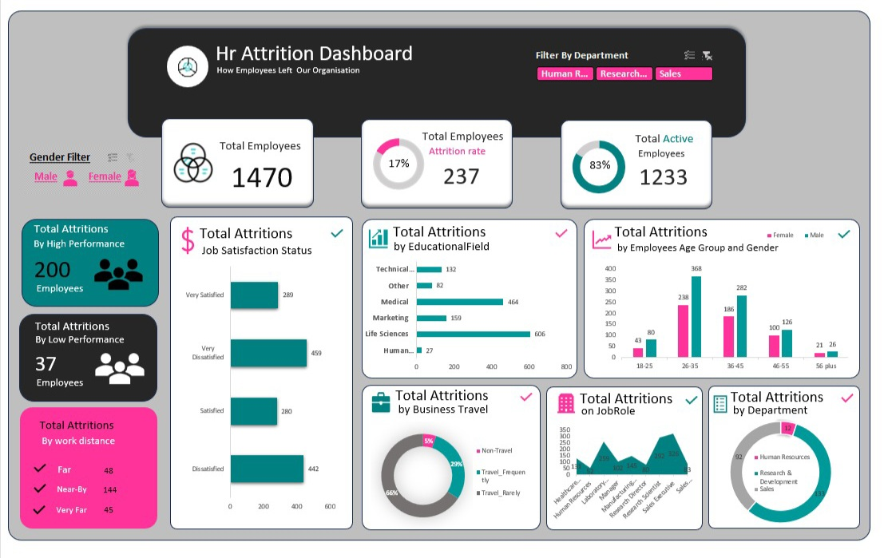
Visualization
Prominent Features of the Platform
Interactive slicers: Gender, Marital Status, Education Field etc.
Visuals: Bar Charts, donut charts, card visuals etc.
Site Map

Slide 11
Conclusion
Screenshot of the Dashboard
Fig. HR Attrition Analysis- Dashboard
Impact of Proposed Solution
Improves employees retention by identifying risk areas , helping HR teams act proactively and reduce costs.
Future Work
Apply ML models to predict attrition.
Extend dashboard with Live employee Data integration.

Slide 12
References
Tools and Software Used
Microsoft Excel
KAGGLE
Chatgpt
Additional References
HR Analytics Dataset on Kaggle ( http://www.kaggle.com/datasets/pavansubhasht/ibm-hr-analytics-attrition-dataset )
SDG Guidelines ( United Nations)

