Slide 1
MAIN PRESENTATION
Gold Price Forecasting
• Applied Time Series Analysis | B.Tech AI Semester VII | 2026-27
• ARIMA / SARIMA analysis with an INR-per-gram application
• 18K, 20K, 22K and 24K fine-gold estimates
• Priyanshu Modak (I080) | Vishesh Dokania (I019) | Parth Zanwar (I074)
ATSA | Gold Price Forecasting | Saved analysis: 26 Oct 2026
01
Notes:
Good morning, Professor. Our project studies daily gold futures with the complete ATSA workflow. We first build and evaluate the model in USD per troy ounce, then convert forecasts into rupees per gram for four purities. We will show measured results and limitations. The analysis snapshot ends October 26, 2026.

Slide 2
MAIN PRESENTATION
The questions we investigated
• Can past prices support useful daily forecasts?
• Does ARIMA or weekly SARIMA improve on tomorrow = today?
• How does uncertainty change with the forecast horizon?
• How can forecasts be displayed for Indian users?
ATSA | Gold Price Forecasting | Saved analysis: 26 Oct 2026
02
Notes:
This is a univariate time-series study with a demonstrable application. Success means correct preprocessing, a defensible evaluation and clear uncertainty. It does not require the most complex model to win. The Indian-price output estimates metal value, not a city-specific retail quote.

Slide 3
MAIN PRESENTATION
All 11 required ATSA steps
• 1 Collection | 2 EDA | 3 Missing values
• 4 ADF/stationarity | 5 Transformations | 6 Seasonality
• 7 ACF/PACF | 8 Model family | 9 Lags
• 10 AIC/BIC | 11 Streamlit deployment
ATSA | Gold Price Forecasting | Saved analysis: 26 Oct 2026
03
Notes:
Map the work explicitly to the supplied slide. EDA includes line plots, scatter plots, histograms, QQ plots and descriptive statistics. Residual diagnostics, baseline evaluation and optional GARCH extend the checklist. The walkthrough identifies exact notebook sections and output files for each step.

Slide 4
MAIN PRESENTATION
Real data and provenance
• Yahoo Finance GC=F: rolling COMEX gold futures
• 2,971 source rows | 02 Jan 2015 to 26 Oct 2026
• Native price: USD per troy ounce
• USD-INR source: INR=X; dated snapshot retained
ATSA | Gold Price Forecasting | Saved analysis: 26 Oct 2026
04
Notes:
Show data/gold_daily.csv and PROVENANCE.md. The actual analysis uses real historical market observations. It is not Indian retail or MCX data. A rolling futures series can contain contract-roll effects, and current-session data may be provisional. FX is a separate dataset used for display conversion.

Slide 5
MAIN PRESENTATION
Architecture: analysis and application
• Notebook: collect -> clean -> analyse -> select -> evaluate
• Artifacts: charts, CSVs, fitted model and metadata
• App: fetch/cache -> refit ARIMA -> forecast -> convert
• GitHub holds source; Streamlit provides hosting
ATSA | Gold Price Forecasting | Saved analysis: 26 Oct 2026
05
Notes:
The app reads the default order from metadata and refits the selected model on its selected history. It does not use the saved pickle as its main forecasting path. The notebook provides a separate saved-model helper. SARIMA comparison and GARCH are notebook analyses; the interactive app uses ARIMA. GitHub publication is verified. The user confirmed Streamlit deployment on October 27, 2026; the exact production URL was not supplied for independent verification.

Slide 6
MAIN PRESENTATION
Cleaning and chronological split
• Sort/deduplicate; require positive numeric closes
• Forward-fill 111 missing weekdays: 3.60%
• Regular series: 3,082 business weekdays
• Train 2,982 through 08 Jun | Test 100 from 09 Jun 2026
ATSA | Gold Price Forecasting | Saved analysis: 26 Oct 2026
06
Notes:
Forward fill carries the last known price; no future price is used. Generic Monday-Friday indexing includes exchange holidays and introduces some zero returns. The hold-out consists of regularised weekdays, not strictly 100 observed trading sessions. Random splitting would mix past and future. The grid is fitted on training only.

Slide 7
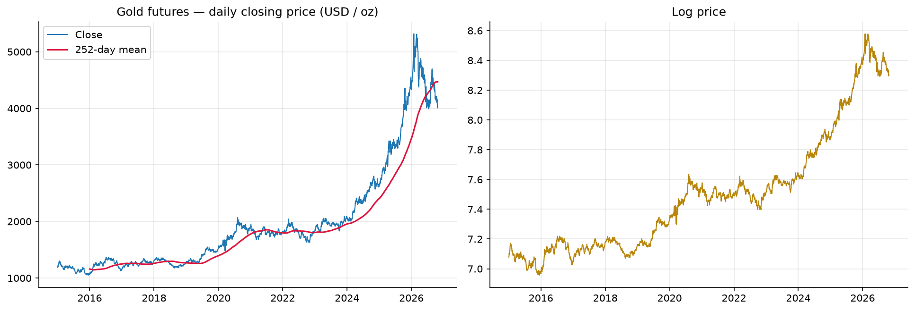
MAIN PRESENTATION
EDA: price levels and dependence
• Source mean: USD 1,966.46 per troy ounce
• Source-price standard deviation: USD 956.73
• Lagged prices move together; returns need separate study
• A rising price level alone does not establish predictability
ATSA | Gold Price Forecasting | Saved analysis: 26 Oct 2026
07
Notes:
Explain the level and rolling mean from the saved chart. These descriptive statistics use the 2,971 source observations before weekday filling. Consecutive price levels can be highly correlated simply because both share a stochastic trend. That is not proof of an exploitable forecasting signal. Lag scatter plots are saved separately.

Slide 8
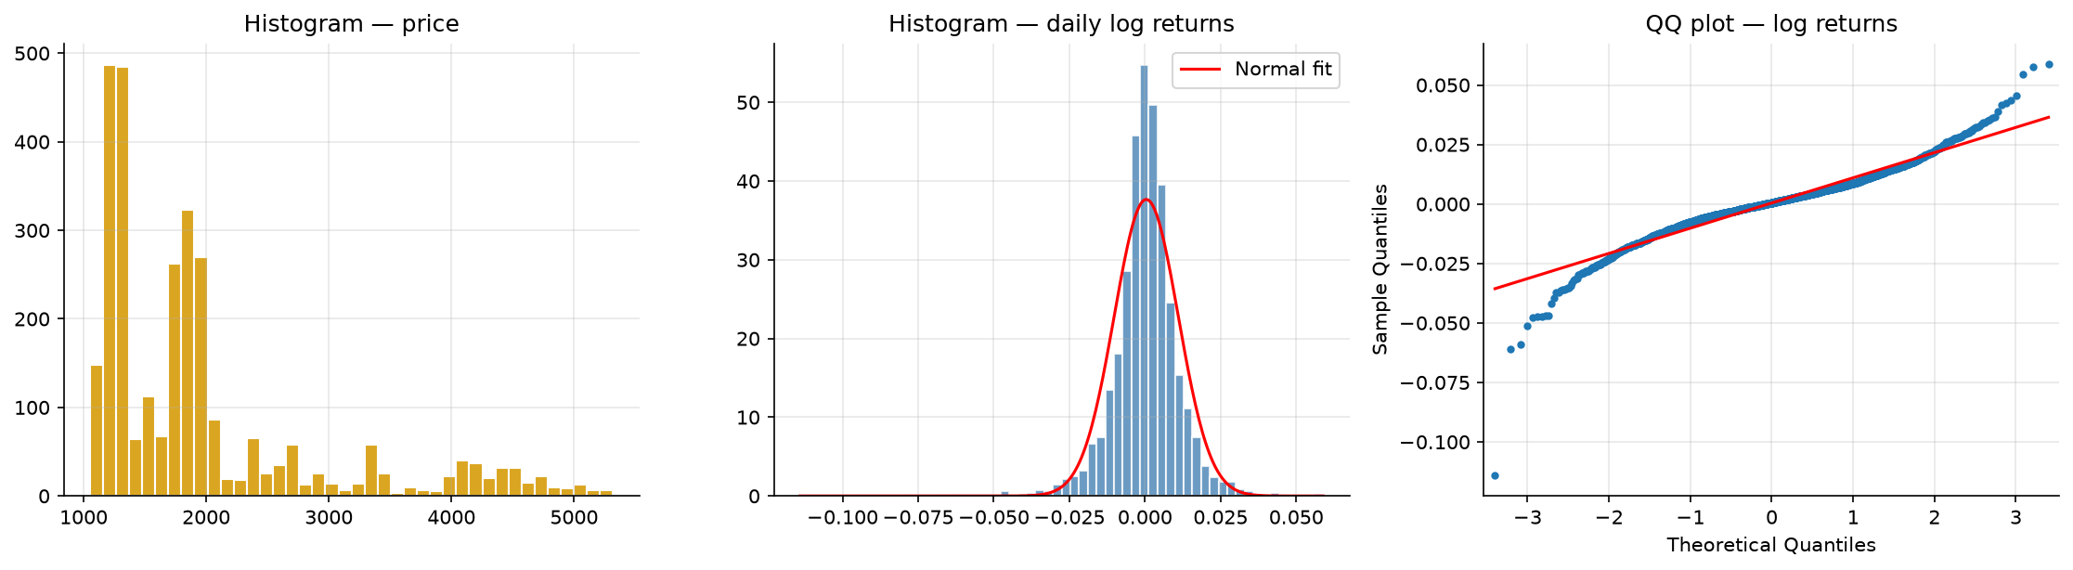
MAIN PRESENTATION
EDA: distribution and heavy tails
• Source-return excess kurtosis: 7.7843
• Jarque-Bera rejects normality; QQ tails depart
• Source-return annualised volatility: about 16.8%
• Heavy tails limit unqualified Gaussian interval claims
ATSA | Gold Price Forecasting | Saved analysis: 26 Oct 2026
08
Notes:
The QQ plot compares empirical return quantiles to normal quantiles. Tail departures suggest more extreme moves than the normal reference. Volatility is descriptive historical information, not a guaranteed future estimate. Normality failure matters especially for uncertainty assumptions; it does not automatically invalidate every point forecast.

Slide 9
MAIN PRESENTATION
Stationarity: opposite null hypotheses
• Price: ADF p=.9755; KPSS lower reported bound .01
• Log price: ADF p=.9897; KPSS lower bound .01
• Log return: ADF p about 6.83e-27; KPSS upper bound .10
• The sample supports first-differenced logs: d=1
ATSA | Gold Price Forecasting | Saved analysis: 26 Oct 2026
09
Notes:
ADF has a unit-root null; KPSS has a stationarity null. Small ADF and non-small KPSS support stationarity in this sample. ADF non-rejection does not prove a unit root. A printed zero is rounded, not a literally zero probability. KPSS reports tabulated bounds. Mean-process stationarity can coexist with changing conditional variance.

Slide 10
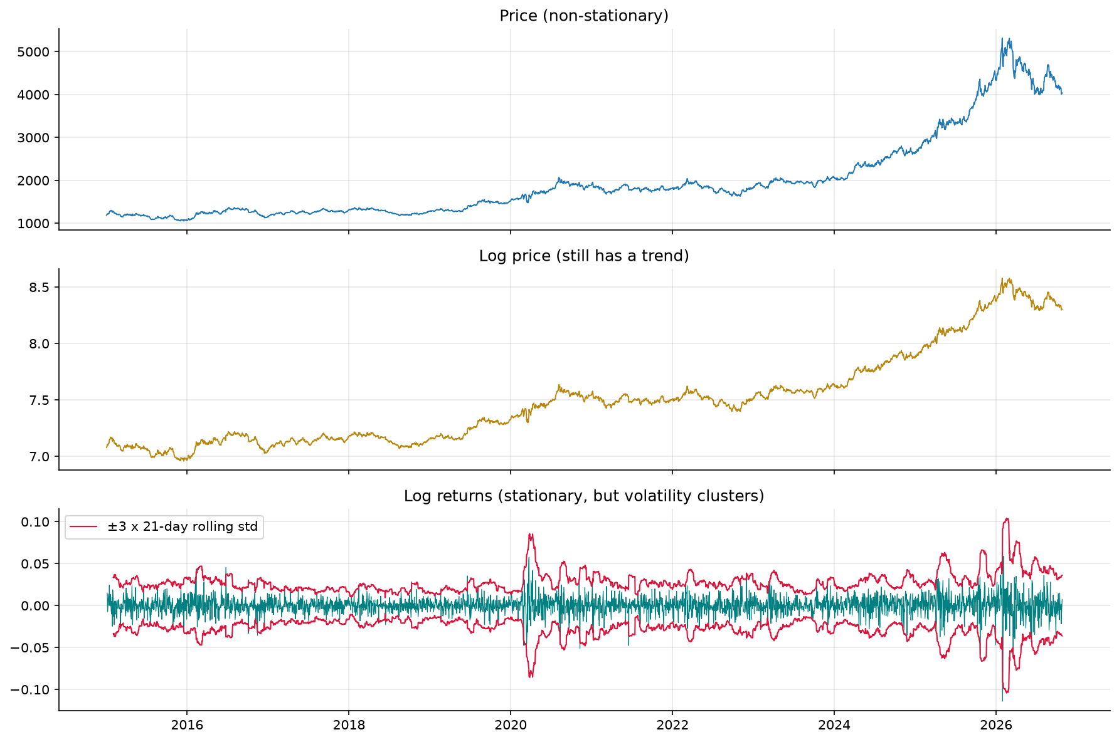
MAIN PRESENTATION
Transformation and selected equation
• z(t) = log(P(t)); r(t) = z(t) - z(t-1)
• ARIMA(p,1,q) models short-memory dynamics in r(t)
• Selected: z(t) = z(t-1) + drift + innovation
• exp(log forecast) is a conditional median
ATSA | Gold Price Forecasting | Saved analysis: 26 Oct 2026
10
Notes:
Logs express proportional changes and keep inverse forecasts positive. First differences remove the integrated level. With p=q=0 this is a log random walk with drift. A mean on the price scale would require a distribution-appropriate bias correction, such as exp(mu+v/2) for Gaussian log uncertainty. The app reports the exponentiated location without that correction.

Slide 11
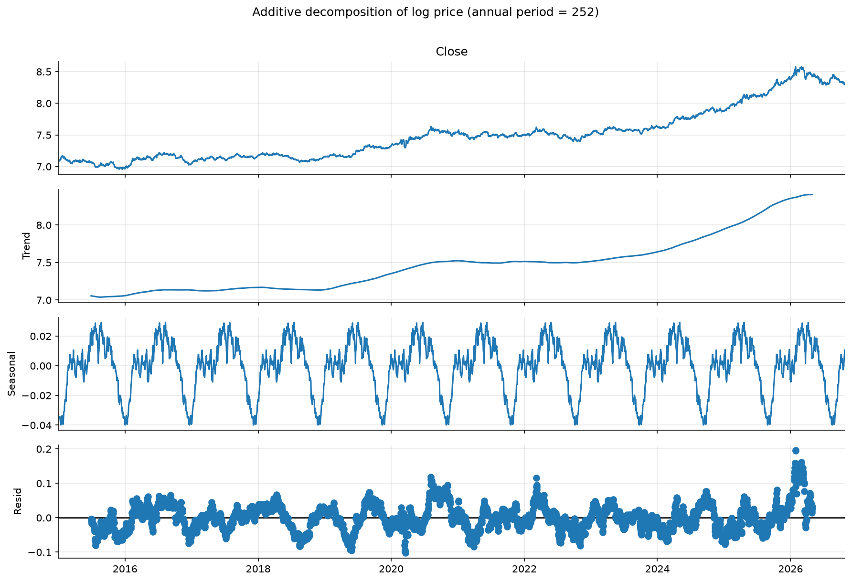
MAIN PRESENTATION
Seasonality: examine rather than assume
• Strength: 5 days .0002 | 21 days .0084
• 252-business-day strength: .1747
• Annual decomposition is descriptive evidence only
• A weekly SARIMA competitor is evaluated
ATSA | Gold Price Forecasting | Saved analysis: 26 Oct 2026
11
Notes:
A 252-day period approximates an annual business-day cycle rather than an exact calendar year. Classical decomposition imposes a periodic structure and uses centred calculations, so it is exploratory here. We did not evaluate every seasonal order or annual SARIMA. The actual forecasting competitor uses seasonal order (1,0,1,5).

Slide 12
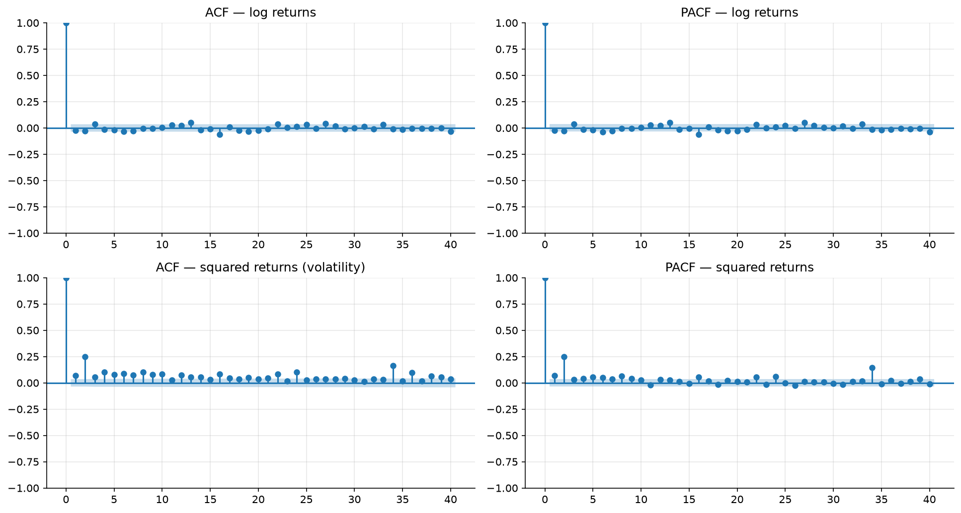
MAIN PRESENTATION
ACF/PACF and model identification
• AR: PACF cutoff; ACF usually decays
• MA: ACF cutoff; PACF usually decays
• ARMA: both decay; seasonal spikes motivate SARIMA
• Squared-return dependence motivates variance analysis
ATSA | Gold Price Forecasting | Saved analysis: 26 Oct 2026
12
Notes:
These are finite-sample heuristics, not automatic proofs. Some spikes occur by chance across many inspected lags. AR and MA terms act on the differenced log process inside ARIMA. Moving-average innovation terms are not the same as a rolling mean. The squared-return plot concerns volatility rather than just mean predictability.

Slide 13
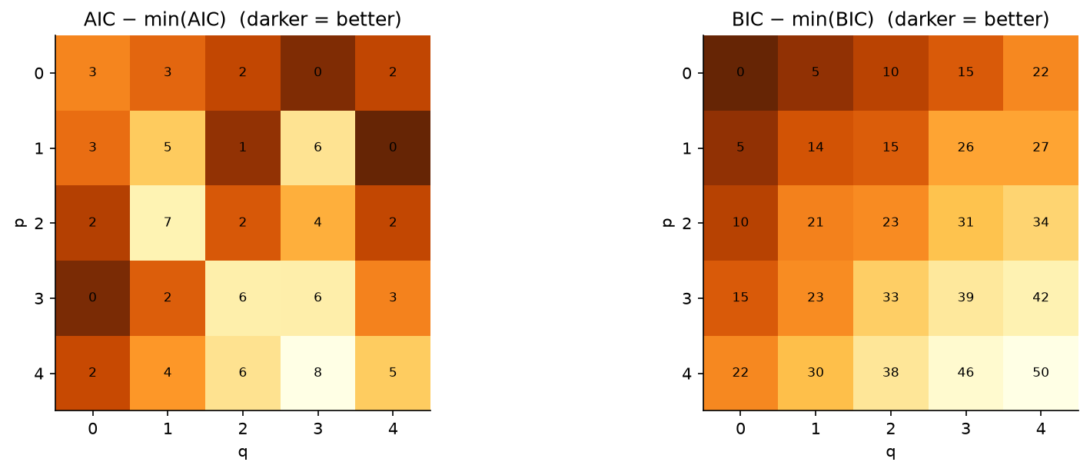
MAIN PRESENTATION
The recorded 25-model search
• p=0..4; d=1; q=0..4 -> 25 candidate orders
• Same training log-price series; drift in every candidate
• AIC selects (1,1,4); BIC selects (0,1,0)
• Convergence warnings occurred: rankings need a caveat
ATSA | Gold Price Forecasting | Saved analysis: 26 Oct 2026
13
Notes:
AIC is 2k minus twice log likelihood; BIC is k log n minus twice log likelihood. BIC penalises complexity more at this sample size. Negative scores are valid. The notebook keeps finite scores and does not persist a convergence flag for every candidate. Therefore do not claim 25 certified converged fits or an optimum over all possible ARIMA models.

Slide 14
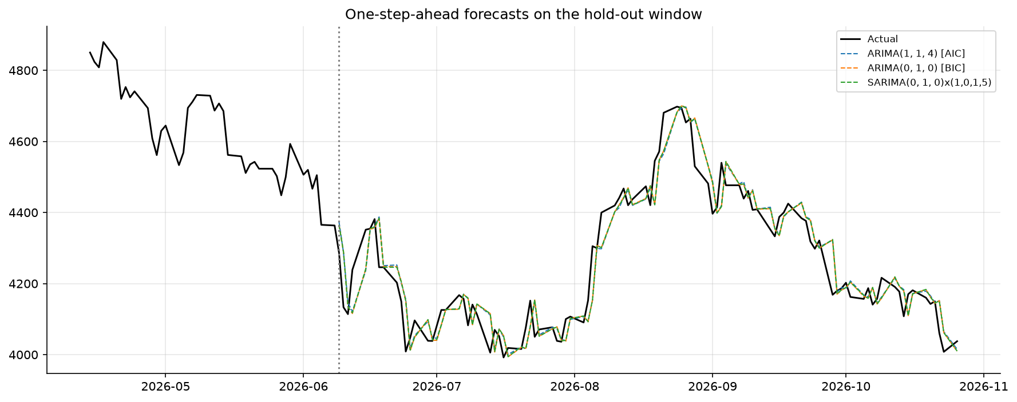
MAIN PRESENTATION
Two evaluation designs
• One-step: forecast, then observe for later predictions
• Model parameters stay fixed during hold-out updates
• Fixed-origin: forecast 100 dates with no test updates
• The app refits available history and forecasts 5..60 weekdays
ATSA | Gold Price Forecasting | Saved analysis: 26 Oct 2026
14
Notes:
Appending test observations with refit=False and obtaining one-step predictions updates model states with past observations while retaining training parameters. This differs from forecasting the whole test path at once. The reported RMSE comparison is one-step; do not call it 30-day-ahead RMSE. The separate fixed-origin chart addresses the harder multi-step problem.

Slide 15
MAIN PRESENTATION
Measured performance: naive wins RMSE
• Naive 60.5337 | BIC ARIMA 60.6723 USD/oz
• AIC ARIMA 60.6684 | SARIMA 60.6085 USD/oz
• BIC MAPE 1.0778%; directional agreement 49%
• HAC loss-difference p=.4639: BIC ARIMA vs naive
ATSA | Gold Price Forecasting | Saved analysis: 26 Oct 2026
15
Notes:
State the result directly. Naive has the lowest RMSE, while AIC ARIMA has slightly lower MAE/MAPE. Different metrics can rank models differently. BIC is a prespecified simple-model choice, not the hold-out RMSE winner. A non-small p-value fails to detect a loss difference; it does not prove equality or market efficiency. MAPE is not classification accuracy.

Slide 16
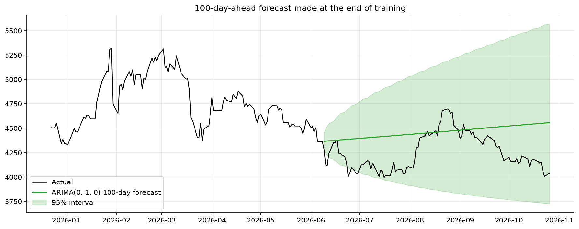
MAIN PRESENTATION
Intervals and residual diagnostics
• Fixed-origin 100-day interval coverage: 94/100
• Residual Ljung-Box p=.08397 at lag 10; .000589 at lag 20
• ARCH-LM p about 6.28e-45; normality rejected
• Longer-lag dependence and changing variance remain
ATSA | Gold Price Forecasting | Saved analysis: 26 Oct 2026
16
Notes:
This is a single correlated path, not independent proof of interval calibration. Residual diagnostics use the training fit with the first initialisation residual removed. It would be false to say all assumptions passed. Longer-lag correlation, squared-residual dependence and non-normality limit strong adequacy claims. The nominal 95% bands depend on model assumptions.

Slide 17
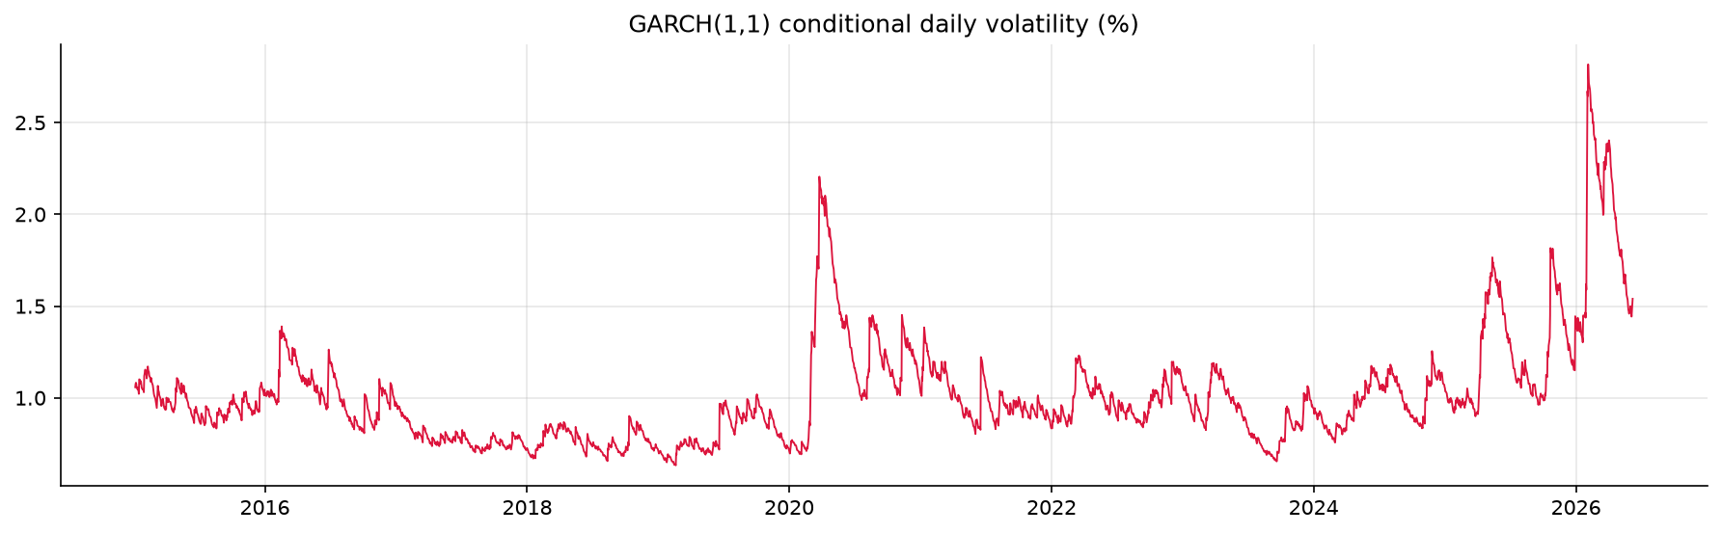
MAIN PRESENTATION
Optional GARCH volatility extension
• Variance = omega + alpha*past shock^2 + beta*past variance
• Training alpha=.0359; beta=.9583; sum=.9942
• Student-t innovations fitted to percentage log returns
• Final normal-quantile bands remain approximate
ATSA | Gold Price Forecasting | Saved analysis: 26 Oct 2026
17
Notes:
ARIMA models conditional mean; GARCH models changing conditional variance. Persistence near one indicates slow decay in the fitted variance process. The final band sums predicted daily variances and uses 1.96 around the ARIMA log forecast. It is not an exact Student-t interval or a jointly simulated ARIMA-GARCH system. The interactive app does not offer a GARCH engine.

Slide 18
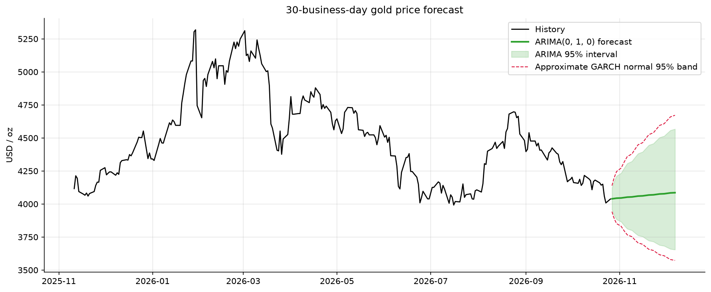
MAIN PRESENTATION
Final saved forecast
• Selected ARIMA refitted on all 3,082 observations
• 30-business-day snapshot saved as a forecast CSV
• 27 Oct 2026 median: USD 4,039.29 per troy ounce
• ARIMA interval: USD 3,957.84 to 4,122.41
ATSA | Gold Price Forecasting | Saved analysis: 26 Oct 2026
18
Notes:
This is the saved October 26 analysis snapshot. A later live app can differ because of new data or the default ten-year app history versus the notebook start in 2015. It is not a contradiction. Demonstrate outputs/forecast_next_30_days.csv and explain the difference between a point median and an uncertainty interval.

Slide 19
MAIN PRESENTATION
INR per gram and all four karats
• INR/g = USD/oz x INR/USD / 31.1034768 x fineness
• 18K .750 | 20K .833 | 22K .916 | 24K .999
• Dated automatic FX or a positive manual override
• Same factor scales history, median and both bounds
ATSA | Gold Price Forecasting | Saved analysis: 26 Oct 2026
19
Notes:
Precious metals use a troy ounce, not the ordinary ounce. We use linked BIS fineness values: 22K=.916 rather than exactly 22/24 and 24K fine gold=.999 rather than exactly one. These are four purity scalings of one underlying forecast, not four independently trained models. Units and conversion assumptions are visible in the app.

Slide 20
MAIN PRESENTATION
What the Indian-price display means
• Selected FX is held fixed for all future dates
• History is revalued at that same selected rate
• Future FX risk, GST, duties and making charges excluded
• Metal-value estimates are not jewellery-shop quotations
ATSA | Gold Price Forecasting | Saved analysis: 26 Oct 2026
20
Notes:
The displayed history is not an observed historical INR series. We would need date-aligned historical FX and future FX modelling to build that. At fixed USD gold prices a 10% rise in INR per USD scales every INR value by 10%, without changing native-model AIC/BIC. Location, premiums, taxes and making charges explain differences from a retail quote.

Slide 21
MAIN PRESENTATION
Professor demo: deliberate actions
• Start 24K, 30 weekdays, ARIMA(0,1,0)
• Switch 22K -> 20K -> 18K; inspect comparison table
• Compare horizons 5 and 60; change FX and order
• Export CSVs; explain valid upload and real-data fallback
ATSA | Gold Price Forecasting | Saved analysis: 26 Oct 2026
21
Notes:
Predict each effect before clicking. Purity scales the output but does not invent a new price pattern. Longer horizons create additional rows and generally broader uncertainty for the selected random walk. Changing history or order triggers a model change and can be slow. Show saved results at the end, including the naive baseline and failed diagnostic tests. Do not delete data to stage an outage.

Slide 22
MAIN PRESENTATION
All finite setting combinations
• 4 karats x 13 history values x 56 horizons x 72 orders
• 72 orders = 6 p choices x 2 d choices x 6 q choices
• 209,664 discrete tuples are fully enumerated
• Enumeration is not 209,664 executed model fits
ATSA | Gold Price Forecasting | Saved analysis: 26 Oct 2026
22
Notes:
History ranges 3..15, horizon 5..60, p/q 0..5 and d 1 or 2. The compressed CSV lists all finite setting tuples. Continuous FX inputs, arbitrary upload contents, future observations and network conditions cannot be exhaustively enumerated. The scenario matrix selects useful boundary and operational cases. High-order combinations may fail or be impractical.

Slide 23
MAIN PRESENTATION
Decision combinations and evidence
• ADF rejects + KPSS does not: stationarity supported
• ADF does not reject + KPSS rejects: investigate differencing
• Both reject or neither rejects: evidence is inconclusive
• ARCH rejection: inspect variance, not just mean dynamics
ATSA | Gold Price Forecasting | Saved analysis: 26 Oct 2026
23
Notes:
Avoid automatic test-based buttons. Examine trend specification, sample size, structural breaks and diagnostics. If AIC improves but hold-out RMSE worsens, complexity may not generalise. Repeatedly tuning to the same hold-out biases conclusions. The walkthrough includes decision tables, the complete order catalogue and professor Q&A.

Slide 24
MAIN PRESENTATION
Code walkthrough and deployment
• streamlit_app.py: root cloud entry point
• app.py: loaders -> ARIMA -> INR conversion -> exports
• run_analysis.py and make_report.py: analysis/report generation
• Public GitHub source; Streamlit deployment confirmed by user
ATSA | Gold Price Forecasting | Saved analysis: 26 Oct 2026
24
Notes:
The root requirements file is the runtime stack; the inner file also includes notebook dependencies. File paths are anchored to app.py. The app is deployed on Streamlit Community Cloud according to the user. Temporary deployment buttons were removed after deployment. Use the actual production URL in the viva; no URL is invented here. The walkthrough maps functions to their actual behaviour.

Slide 25
MAIN PRESENTATION
Limitations and next steps
• No demonstrated RMSE advantage over naive
• Convergence flags and rolling-origin checks need improvement
• No forecast of FX, interest rates, inflation or news
• Next: aligned INR target, trading calendar, calibrated intervals
ATSA | Gold Price Forecasting | Saved analysis: 26 Oct 2026
25
Notes:
Separate completed work from future work. Proposed improvements include storing and filtering convergence outcomes, multiple rolling origins, horizon-specific accuracy, aligned FX and an exchange-aware calendar. Prophet, LSTM, annual SARIMA and exogenous regressors are not implemented and have no results in this project.

Slide 26
MAIN PRESENTATION
Conclusion and handover
• Complete ATSA workflow on preserved real market data
• d=1 supported; BIC favours a drifted random walk
• Measured errors and diagnostic failures reported honestly
• Working INR/g app with four purity views
ATSA | Gold Price Forecasting | Saved analysis: 26 Oct 2026
26
Notes:
Our contribution is a reproducible statistical workflow and an understandable application. We can demonstrate provenance, preprocessing, model selection, baseline evaluation and currency/purity arithmetic. Every team member should explain the code and actual contributions, and disclose AI assistance in line with faculty requirements.

Slide 27
BACKUP / VIVA
Backup: order families and trend rules
• (0,1,0): random walk with log drift
• (p,1,0): AR in differences | (0,1,q): MA in differences
• (p,1,q): ARMA in first-differenced log prices
• App d=2 is available; its deterministic trend is n
ATSA | Gold Price Forecasting | Saved analysis: 26 Oct 2026
27
Notes:
For d=1 the app uses trend t, giving drift in first differences. For d=2 it uses no deterministic trend. So d comparisons change both differencing and trend assumptions. d=0, seasonal order controls and GARCH selection are not offered in the app. The 72-order table records these rules.

Slide 28
BACKUP / VIVA
Backup: failure and fallback combinations
• Gold live fails + real cache: labelled cached prices
• FX live fails + snapshot: dated saved exchange rate
• No FX source: require a positive manual rate
• Bad CSV / insufficient data: stop rather than fabricate
ATSA | Gold Price Forecasting | Saved analysis: 26 Oct 2026
28
Notes:
Evidence labels distinguish verified UI checks from code-reviewed or planned scenarios. Required CSV columns are Date and Close; units must be USD per troy ounce. Invalid numeric and nonpositive prices are filtered; at least 100 valid observations are needed. Dates are sorted and duplicates keep the last. Fit warnings are not always hard failures.

Slide 29
BACKUP / VIVA
Backup: four questions to answer precisely
• Does 1.1% MAPE mean 98.9% accuracy?
• Why can naive outperform fitted ARIMA?
• Why does the app differ from the notebook?
• Why is a 24K result different from a jeweller quote?
ATSA | Gold Price Forecasting | Saved analysis: 26 Oct 2026
29
Notes:
Answers: MAPE is average relative error, not classification accuracy. Weak predictable structure and estimation error can make naive competitive. A new window, order, data date or FX setting changes the app output. Jewellery quotes include local/tax/product effects absent from a futures-derived metal estimate. Never turn these results into unsupported trading claims.

Slide 30
REFERENCES
References and assistance disclosure
• Yahoo Finance GC=F and INR=X; source dates disclosed
• statsmodels, arch and Forecasting: Principles and Practice
• NIST conversion and BIS fineness grades
• AI-assisted implementation; state actual team contributions
ATSA | Gold Price Forecasting | Saved analysis: 26 Oct 2026
30
Notes:
Primary references are linked in the walkthrough. The course PDF states a GenAI allowance and citation expectations. The implementation and this pack used AI assistance. Do not claim unaided authorship or automatic compliance with a numerical policy limit. This is an educational project.

