Slide 1

INTERNSHIP REPORT
on
C++ PROGRAMMING
School of Computer Science and Engineering
IILM University, Greater Noida, U.P.
By
PRIYANSHU KUMAR SINGH
Enrollment No.: 25SCS1003004444 | B.Tech CSE, 3rd Semester | Batch: 2026-27
Organization: CodSoft

Slide 2
01
Introduction
The internship at CodSoft focused on C++ programming and console-based application development.
DOMAIN
C++ Programming
During the internship, programming logic, problem-solving, control structures, functions, and user input handling were practiced. The practical work involved developing multiple mini-projects using C++.
ORGANIZATION
CodSoft
DURATION TYPE
Console Applications
Internship Report — C++ Programming | Priyanshu Kumar Singh
2

Slide 3
02
Organization Profile & Problem Statement
Organization Profile
Problem Statement
CodSoft provided an internship focused on C++ Programming, with emphasis on practical programming and application development.
The main problem addressed was to convert basic programming concepts into functional, interactive console applications.
The internship offered an opportunity to apply programming concepts through console-based projects.
This required:
Designing correct program logic
Handling user inputs
Managing application flow
Testing different possible cases
Internship Report — C++ Programming | Priyanshu Kumar Singh
3

Slide 4
03
Project Objectives
1
2
3
Strengthen C++ programming fundamentals
Improve logical thinking and problem-solving
Understand control structures and functions
4
5
Gain practical experience through projects
Develop user-interactive console applications
Internship Report — C++ Programming | Priyanshu Kumar Singh
4

Slide 5
04
Scope of the Project & Technologies Used
Scope of the Project
Technologies & Tools
C++
The project work covers console-based C++ applications and the practical use of programming fundamentals.
C++ Standard Library
The developed applications include a Number Guessing Game, To-Do List, and Tic-Tac-Toe.
VS Code / C++ Compiler
The scope includes programming logic, user input handling, control structures, functions, testing and debugging.
Console-based Interface
Internship Report — C++ Programming | Priyanshu Kumar Singh
5

Slide 6
05
System Architecture & Methodology
System Architecture
User Input
→
Program Logic
→
Processing
→
Output
Methodology
1
2
3
4
5
Understanding the problem
Breaking it into smaller steps
Designing the logic
Implementing the solution in C++
Testing and debugging
Internship Report — C++ Programming | Priyanshu Kumar Singh
6

Slide 7
06
Projects Developed
Project 1
Project 2
Project 3
Number Guessing Game
To-Do List
Tic-Tac-Toe
A console-based C++ application in which the user attempts to guess a number. Uses conditions and control structures for an interactive way to practice programming logic.
A console-based task management application that allows users to manage tasks. Uses C++ programming concepts and user input handling to organize information.
A two-player console-based game implementing game logic using C++. Uses conditions, loops and functions to handle player input and game outcomes.
Internship Report — C++ Programming | Priyanshu Kumar Singh
7

Slide 8
07
Skills Developed & Challenges Faced
Skills Developed
Challenges Faced
C++ Programming
Designing correct program logic
Handling different user inputs
Debugging errors
Managing game/application flow
Testing different possible cases
Logical Thinking
Problem-Solving
Debugging
User Input Handling
Console Application Development
Internship Report — C++ Programming | Priyanshu Kumar Singh
8

Slide 9
08
Learning Outcomes & Conclusion
Learning Outcomes
Conclusion
Improved confidence in C++
Better understanding of programming fundamentals
Learned to convert ideas into working applications
Improved debugging and problem-solving abilities
The internship provided practical exposure to C++ programming. Three console-based applications were developed: Number Guessing Game, To-Do List, and Tic-Tac-Toe.
The work strengthened programming logic and problem-solving skills, and provided hands-on experience in developing and testing C++ applications.
Internship Report — C++ Programming | Priyanshu Kumar Singh
9

Slide 10
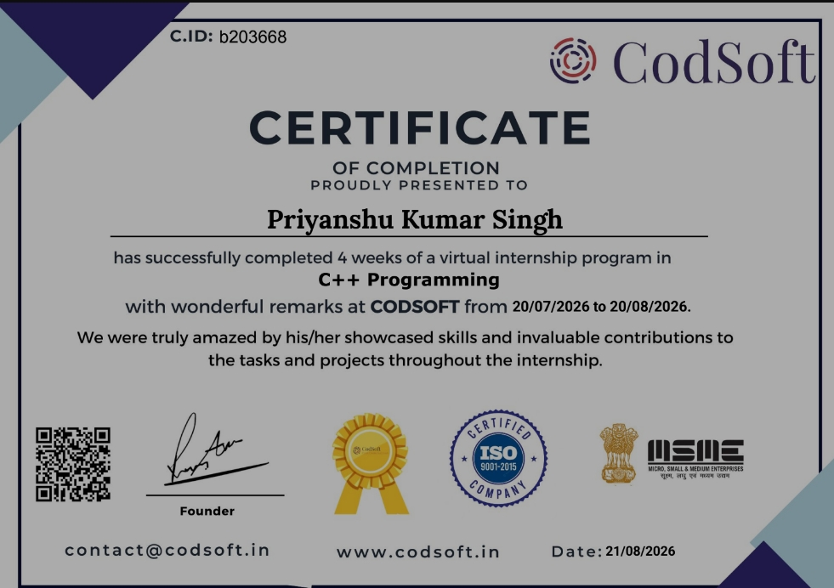
09
Certificate of Completion
Internship Report — C++ Programming | Priyanshu Kumar Singh
10

Slide 11
BIBLIOGRAPHY / REFERENCES
C++ Standard Library documentation and learning resources used during the internship.
CodSoft internship project materials and instructions.
Relevant C++ programming references consulted during project development.
Thank You
Priyanshu Kumar Singh | 25SCS1003004444 | IILM University

