Slide 1
Web Services Using SOAP, WSDL, and UDDI
Soam Acharya, PhD
Enterprise Search
Inktomi
sacharya@inktomi.com
2/1/2002

Slide 2
What are “Web Services”?
IBM
  “A Web service is an interface that describes a collection of operations that are network accessible through standardized XML messaging”
Microsoft: XML Web Services
  “.. expose useful functionality to Web users through a standard Web protocol”
  “.. provide a way to describe their interfaces in enough detail to allow a user to build a client application to talk to them”
  “.. are registered so that potential users can find them easily”

Slide 3
Why Web Services?
From business standpoint
  Integration
    Within an organization
    Between companies
    Allows time/cost efficiencies
      Purchase orders
      Answering inquiries
      Processing shipment requests
    Do this without locking in to a single partner

Slide 4
Web Service Architecture
Service Registry
Find
Publish
Service
Provider
Service
Requestor
Bind
Service-Oriented Architecture

Slide 5
Architecture II
Registry
(UDDI)
Publish
Find
(WSDL)
(SOAP)
Service
Provider
Service
Requestor
Bind
(SOAP)
All the technologies are XML based …

Slide 6
XML Leveraging Features
XML Namespaces
  Collision
    Common XML element names
      Application specific or embedded in message?
  Allows composition of multiple XML documents
    Identifies elements belonging to the same document type

Slide 7
XML Leveraging Features II
XML Schemas
  Alternative to DTDs for describing document structure
  Written in XML
    Simple types
    Complex types
  Reusable
    Intended to be used with namespaces

Slide 8
SOAP
Simple Object Access Protocol
Web service messaging and invocation
2nd Generation XML Protocol
  Takes advantage of
    XML Namespaces
    XML Schema

Slide 9
First Generation XML Protocol
Based on XML 1.0
Example: XML-RPC
  Introduced by Userland in 1998
  Uses HTTP as underlying transport
Call
Response
<methodResponse>
<params>
<param>
<value>
<string>twenty-eight</string>
</value>
</param>
</params>
</methodResponse>
<methodCall>
<methodName>NumberToText</methodName>
<params>
<param>
<value><i4>28</i4></value>
</param>
</params>
</methodCall>

Slide 10
First Gen. XML Protocol Issues
Extensibility
  All protocol architects had to agree for changes
  Avoid with namespaces
Datatyping
  Single DTDs
    Limited in use of XML elements
    Descriptive nature of XML sacrificed
  XML schema is a better solution

Slide 11
SOAP History
1998
Term SOAP coined at Microsoft
1999
Microsoft works with BizTalk to release SOAP 0.9
Submitted to IETF
SOAP 1.0 released in December
2000
SOAP 1.1 submitted to W3C with IBM
IBM releases a Java SOAP implementation
Sun starts work on Web services in J2EE
SOAP 1.2 released by XML Protocol working group at W3C
2001
Currently, about 80+ SOAP implementations available
including Apple…

Slide 12
SOAP Messaging Layers
View
Client
Provider
Developer
App API
App API
SOAP Service Provider
SOAP, XML Processing
SOAP, XML Processing
SOAP Message
SOAP Message
HTTP
HTTP
HTTP

Slide 13
SOAP Message
<?xml version="1.0" encoding="UTF-8"?>
<Envelope>
<Header>
</Header>
<Body>
</Body>
</Envelope>

Slide 14
SOAP Envelope
Root element
Mandatory
Does not expose any protocol versions
  Protocol version is the URI of SOAP envelope namespace
  encodingStyle attribute for complex types
<SOAP-ENV:Envelope
SOAP-ENV:encodingStyle=http://schemas.xmlsoap.org/soap/encoding/
xmlns="http://schemas.xmlsoap.org/soap/envelope/"
xmlns:SOAP-ENV="http://schemas.xmlsoap.org/soap/envelope/"
xmlns:xsi="http://www.w3.org/1999/XMLSchema-instance"
xmlns:xsd="http://www.w3.org/1999/XMLSchema">

Slide 15
SOAP Header
Optional
Allows packaging of information orthogonal to message
  Transactions
    Authentication information
    Account information
SOAP-ENV:mustUnderstand

Slide 16
SOAP-ENV:mustUnderstand
Attribute for Header element
Value 0 – skip this element if it doesn’t make sense
Value 1 – must fail if it doesn’t make sense
  Ensures recipients be aware of important protocol extensions
<SOAP-ENV:Header>
<t:client xmlns:t=“Some-URI”
SOAP-ENV:mustUnderstand=“0”>
sacharya@inktomi.com
</t:client>
</SOAP-ENV:Header>

Slide 17
SOAP Body
Can contain arbitrary XML
Conventions for
  RPCs
  Faults
    Faultcode – lookup string
    Faultstring – human readable string
    Faultactor – where in the message path
    Detail – optional
  Data encoding

Slide 18
Data encoding in SOAP
SOAP provides default encoding schema
  Why reinvent the wheel?
Simple data types
  Use “xsi:type”
  String, floats etc
Complex data types
  SOAP arrays
  Structs: compound types
Data referencing
  Href and id attributes

Slide 19
Data encoding in SOAP
Binary data
  Base64 encoding
Can roll your own schema
  encodingStyle
  Interoperability issues

Slide 20
SOAP Protocol Binding: HTTP
POST /ServiceLoc HTTP/1.1
Host: www.foo.com
Content-Type: text/xml; charset=“utf-8”
Content-Length: nnnn
SOAPAction: “Directory/Service”
Out-of-message context
<?xml version="1.0" encoding="UTF-8"?>
<Envelope>
<Header>
In-message context
</Header>
<Body>
<LookupPerson …>
</LookupPerson>
</Body>
</Envelope>
Sample RPC Call

Slide 21
Other SOAP Protocol Bindings
HTTPS
  Similar to HTTP
    Use POST
    Return 200 for success
    500 for failure + SOAP fault
    SOAPAction HTTP header for hint
    MIME media type: text/html
SMTP
SOAP messages with Attachments

Slide 22
SOAP RPC Example: getQuote
import SOAP
server = SOAP.SOAPProxy("http://services.xmethods.com:80/soap",
namespace = 'urn:xmethods-delayed-quotes')
print "IBM>>", server.getQuote(symbol = 'IBM')

Slide 23
RPC Invocation Message
<?xml version="1.0" encoding="UTF-8"?>
<SOAP-ENV:Envelope
SOAP-ENV:encodingStyle="http://schemas.xmlsoap.org/soap/encoding/"
xmlns:xsd="http://www.w3.org/1999/XMLSchema"
xmlns:xsi="http://www.w3.org/1999/XMLSchema-instance"
xmlns:SOAP-ENV="http://schemas.xmlsoap.org/soap/envelope/"
xmlns:SOAP-ENC="http://schemas.xmlsoap.org/soap/encoding/">
<SOAP-ENV:Body>
<ns1:getQuote
xmlns:ns1="urn:xmethods-delayed-quotes" SOAP-ENC:root="1">
<symbol xsi:type="xsd:string">IBM</symbol>
</ns1:getQuote>
</SOAP-ENV:Body>
</SOAP-ENV:Envelope>

Slide 24
RPC Reply Message
<?xml version='1.0' encoding='UTF-8'?>
<soap:Envelope
xmlns:soap='http://schemas.xmlsoap.org/soap/envelope/'
xmlns:xsi='http://www.w3.org/1999/XMLSchema-instance'
xmlns:xsd='http://www.w3.org/1999/XMLSchema'
xmlns:soapenc='http://schemas.xmlsoap.org/soap/encoding/'
soap:encodingStyle='http://schemas.xmlsoap.org/soap/encoding/'>
<soap:Body>
<n:getQuoteResponse xmlns:n='urn:xmethods-delayed-quotes'>
<Result xsi:type='xsd:float'>107.89</Result>
</n:getQuoteResponse>
</soap:Body>
</soap:Envelope>
Returns:
IBM>>107.89

Slide 25
Roadmap
Registry
(UDDI)
Publish
Find
(WSDL)
(SOAP)
Service
Provider
Service
Requestor
Bind
(SOAP)

Slide 26
WSDL
Web Service Definition Language
Predecessors include
  COM, CORBA IDLs
  Network Accessible Service Specification Language (IBM)
  SOAP Contract Language (Microsoft)
  First submitted to W3C in Sep 2000
  Current version is 1.1

Slide 27
WSDL
Define a web service in WSDL by
  Writing an XML document conforming to the WSDL specs
Describes three fundamental properties
  What a service does
    Operations (methods) provided by the service
  How a service is accessed
    Data format and protocol details
  Where a service is located
    Address (URL) details

Slide 28
WSDL Components
definitions
types
All the data types used by the Web service
message
Parameters and messages used by method
portType
Abstract interface definition – each operation element defines a method signature
operation
binding
Binds abstract methods to specific protocols
service
A service is a collection of ports.
A port is a specific method and its URI
port

Slide 29
Sample WSDL: getQuote
<?xml version="1.0" encoding="UTF-8" ?>
<definitions name="net.xmethods.services.stockquote.StockQuote" targetNamespace="http://www.themindelectric.com/wsdl/net.xmethods.services.stockquote.StockQuote/" xmlns:tns="http://www.themindelectric.com/wsdl/net.xmethods.services.stockquote.StockQuote/"
xmlns:electric="http://www.themindelectric.com/" xmlns:soap="http://schemas.xmlsoap.org/wsdl/soap/" xmlns:xsd="http://www.w3.org/2001/XMLSchema" xmlns:soapenc="http://schemas.xmlsoap.org/soap/encoding/" xmlns:wsdl="http://schemas.xmlsoap.org/wsdl/" xmlns="http://schemas.xmlsoap.org/wsdl/">
<message name="getQuoteResponse1">
<part name="Result" type="xsd:float" />
</message>
<message name="getQuoteRequest1">
<part name="symbol" type="xsd:string" />
</message>

Slide 30
Sample WSDL: getQuote
<portType name="net.xmethods.services.stockquote.StockQuotePortType">
<operation name="getQuote" parameterOrder="symbol">
<input message="tns:getQuoteRequest1" />
<output message="tns:getQuoteResponse1" />
</operation>
</portType>
<binding name="net.xmethods.services.stockquote.StockQuoteBinding“
type="tns:net.xmethods.services.stockquote.StockQuotePortType">
<soap:binding style="rpc"
transport="http://schemas.xmlsoap.org/soap/http" />
<operation name="getQuote">
<soap:operation soapAction="urn:xmethods-delayed-quotes#getQuote" />
<input>
<soap:body use="encoded" namespace="urn:xmethods-delayed-quotes"
encodingStyle="http://schemas.xmlsoap.org/soap/encoding/" />
</input>
<output>
<soap:body use="encoded" namespace="urn:xmethods-delayed-quotes"
encodingStyle="http://schemas.xmlsoap.org/soap/encoding/" />
</output>
</operation>
</binding>

Slide 31
Sample WSDL: getQuote
<service name="net.xmethods.services.stockquote.StockQuoteService">
<documentation>net.xmethods.services.stockquote.StockQuote web service
</documentation>
<port name="net.xmethods.services.stockquote.StockQuotePort"
binding="tns:net.xmethods.services.stockquote.StockQuoteBinding">
<soap:address location="http://64.39.29.211:9090/soap" />
</port>
</service>
</definitions>

Slide 32
WSDL to Code
Translators available that can
  Convert WSDL document to code
    IBM’s WSTK Toolkit
    Apache AXIS WSDL2java program
    Soapy.py in Python
    Not perfect
  Derive WSDL from Java classes
    Apache WSDL program
    Much work remains to be done

Slide 33
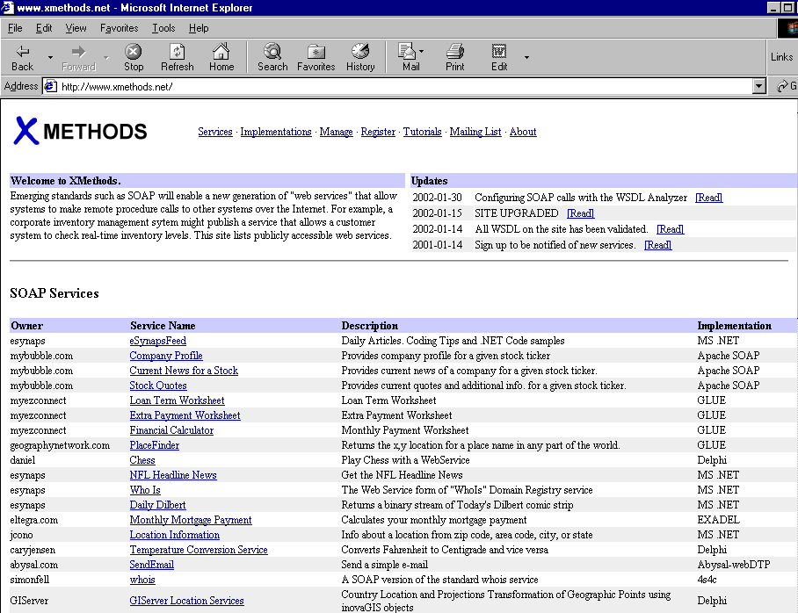

Slide 34
Roadmap
Registry
(UDDI)
Publish
Find
(WSDL)
(SOAP)
Service
Provider
Service
Requestor
Bind
(SOAP)

Slide 35
UDDI
Universal Description, Discovery, and Integration
API for a Web based registry
Implemented by an Operator Site
  Replicate each others’ information
Formally announced in Sept, 2000
  Collaboration between IBM, Microsoft, Ariba
  Community of 310 companies

Slide 36
A UDDI Registry
Who?
  Basic business information
    Name, contact information
What?
  Get classification
    Standard Industry Codes, NA Industry Code Std
Where?
  Service URI
How?
  Describes a how a given interface functions

Slide 37
UDDI Data Structures
businessEntity:
  Basic business information
  Used by UDDI for “yellow” pages
businessService:
  Services provided by that business
  Grouping of related businesses
bindingTemplate:
  What the service looks like (tModel element)
  Where to access the service

Slide 38
UDDI Data Structures
tModel
  Technology model
  Could contain just about anything
  Has service details
    Abstract industry specs
    Service specs
Designed to be reusable
Can contain pointer to WSDL document

Slide 39
Query Pattern
Browse:
  UDDI yellow page data has hierarchy
  Search via Web/standalone client app
Drill down:
  Given a specific candidate, get all details
Invocation

Slide 40
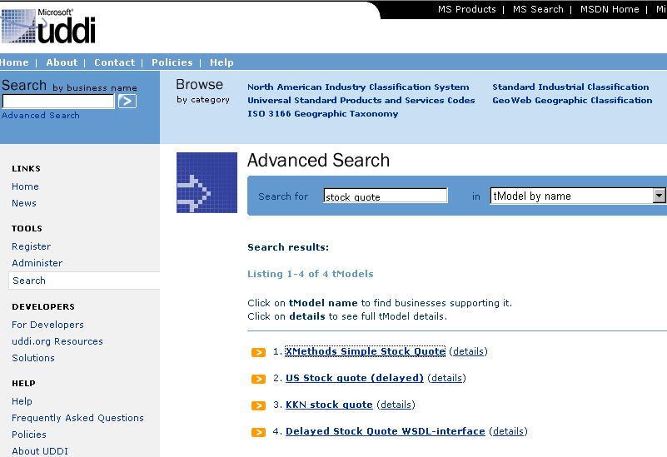
Sample Browsing

Slide 41
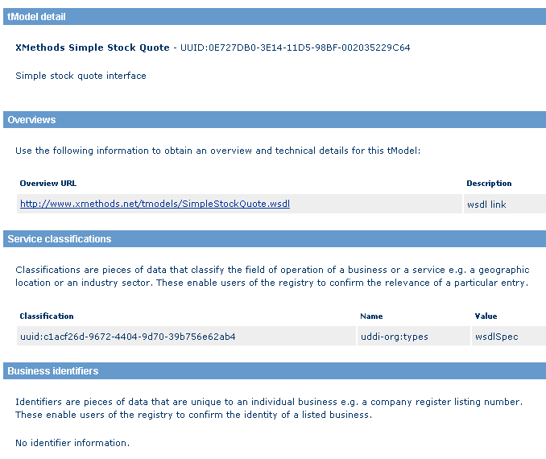
tModel Detail

Slide 42
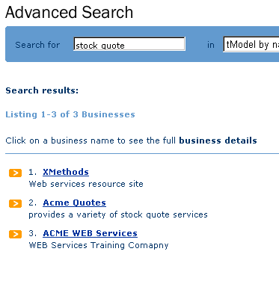
Associated Businesses

Slide 43
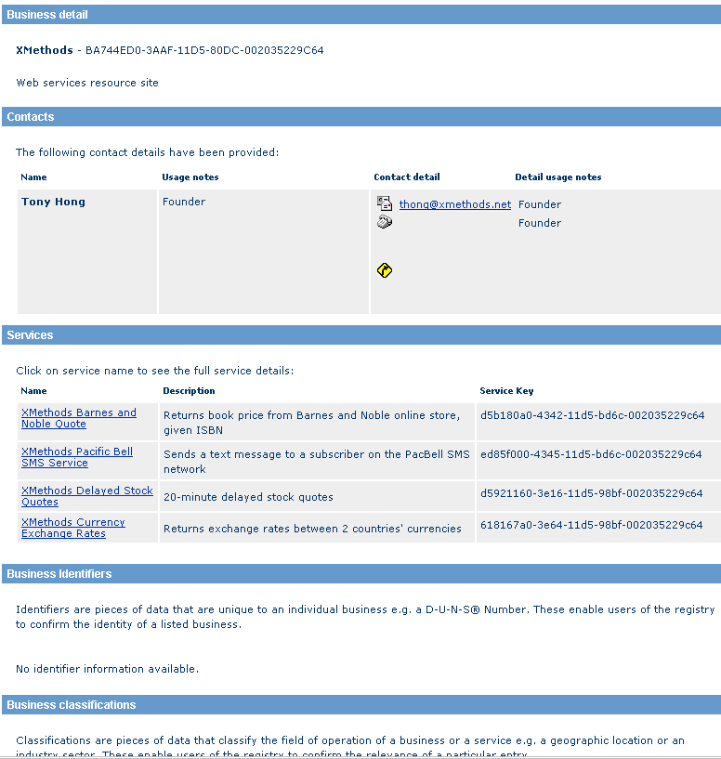
Single Business

Slide 44
Inquiry API
Generally accessible
  Find_binding
  Find_business, find_relatedBusiness
  Find_service
  Find_tmodel
  Get_bindingDetail
  Get_businessDetail
  Get_serviceDetail
  Get_tModelDetail
Use SOAP to access

Slide 45
Publishing API
Restricted access
  Save_service, save_business, save_binding, save_tModel
  Delete_service, delete_business, delete_binding, delete_tModel
  Get_binding, get_registeredInfo, get_authToken
  Add_publisherAssertions, get …, delete …

Slide 46
Other UDDI Issues
Security
  No global standard
  Each operator site must select/implement an authentication protocol that still allows publishing
Versioning
  Numbers not used
  Generic element used in function calls

Slide 47
Open UDDI Issues
Effective search
  Classification and Categorization
Private UDDI registries
  E-marketplace
  Portal
  Partner catalog
  Internal Application Integration

Slide 48
Roadmap
Registry
(UDDI)
Publish
Find
(WSDL)
(SOAP)
Service
Provider
Service
Requestor
Bind
(SOAP)

Slide 49
Overall Issues
Interoperability
Web Services Everywhere
  Peer to peer vs centralized

