Slide 1
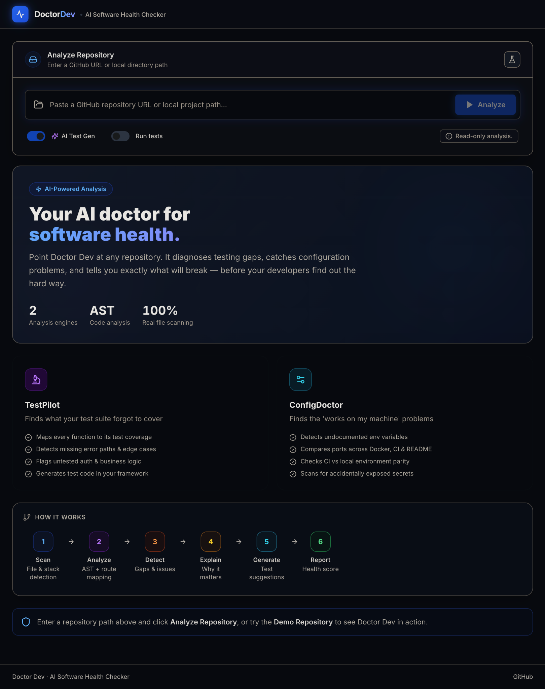
DOCTOR DEV / IBM BOB 2.0 HACKATHON
01
Doctor Dev
Find repository risks before they reach developers
A connected health check for tests, configuration and release readiness
TestPilot
ConfigDoctor
Notes:
Source: supplied Doctor Dev screenshot 1 and project README.

Slide 2
DOCTOR DEV / IBM BOB 2.0 HACKATHON
02
The repo can look healthy while its parts disagree
A passing test suite and valid config files do not expose every cross-file risk.
01
Untested behavior
A route exists, but its error or authorization path lacks test evidence.
02
Configuration drift
Code, environment templates, Docker, CI and README disagree.
03
Slow triage
Separate warnings leave developers to connect the evidence manually.
Notes:
Source: supplied project README, Why Doctor Dev and problem sections.

Slide 3
DOCTOR DEV / IBM BOB 2.0 HACKATHON
03
One scan connects the evidence
Submit a public GitHub URL or an approved local path; Doctor Dev builds an actionable report.
01
02
03
SCAN
DIAGNOSE
ACT
Files, stack, routes and test assets
TestPilot finds test gaps. ConfigDoctor detects drift.
Review severity, confidence, evidence and a concrete next step.
Read-only analysis · Markdown and JSON export · Optional starter tests
Notes:
Source: supplied project README, solution and user workflow.

Slide 4
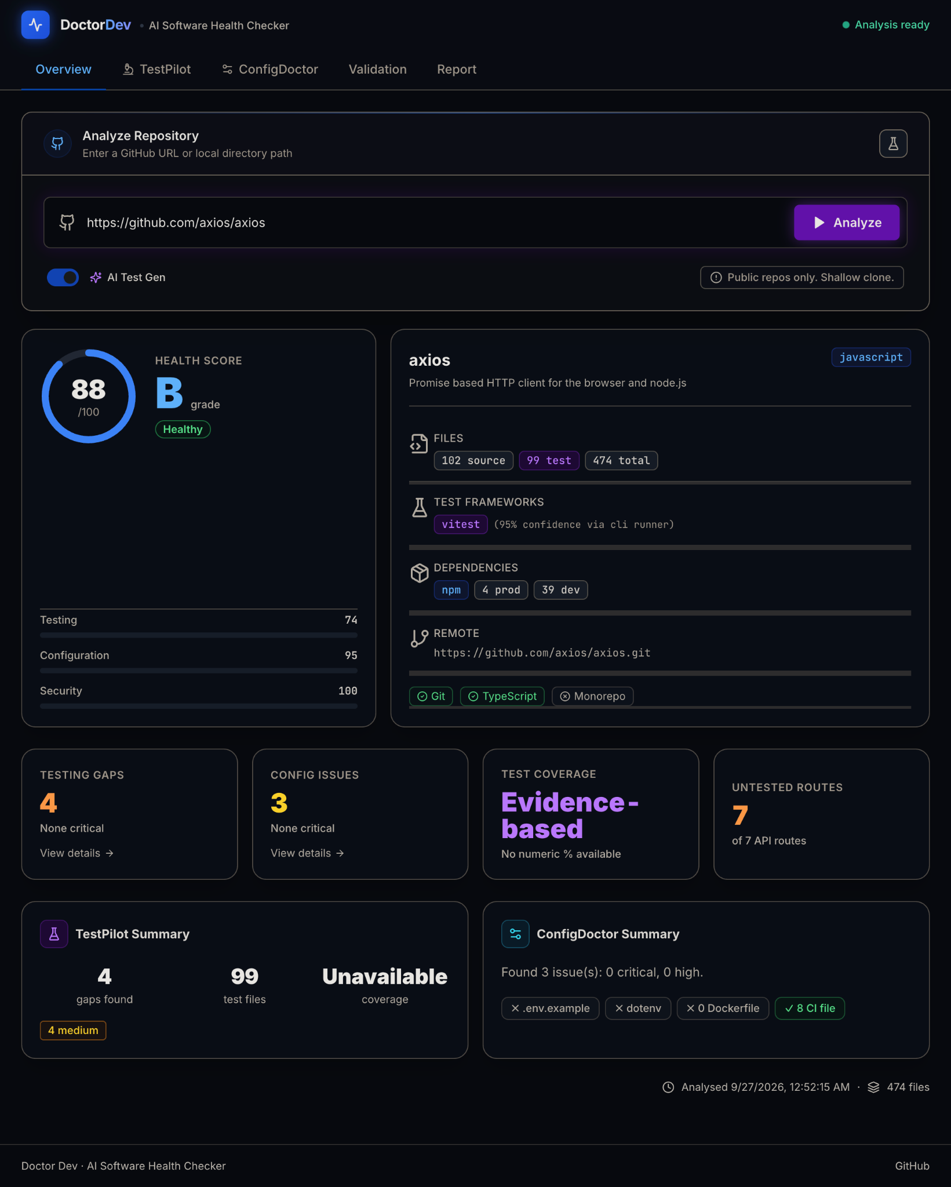
DOCTOR DEV / IBM BOB 2.0 HACKATHON
04
A real repository scan reveals the gaps
Example shown: the public Axios repository, as captured in the supplied product screenshots.
88
/100 health score
4 test gaps
3 configuration issues
Evidence based coverage label when no numeric report exists
Notes:
Source: supplied Doctor Dev screenshot 2. These are screenshot metrics for one Axios scan, not a measured productivity result.

Slide 5
DOCTOR DEV / IBM BOB 2.0 HACKATHON
05
Two focused diagnostic engines
Each finding points back to repository evidence and states how confident the analysis is.
TestPilot
ConfigDoctor
Maps tests to source and routes
Cross-checks the whole setup
Highlights missing error, edge and authorization cases. Reads numeric coverage only when a supported artifact exists.
Compares environment variables, Docker, ports, CI, runtime metadata and README instructions.
Notes:
Source: supplied project README, solution and evidence-based coverage sections; screenshots 3 and 4.

Slide 6
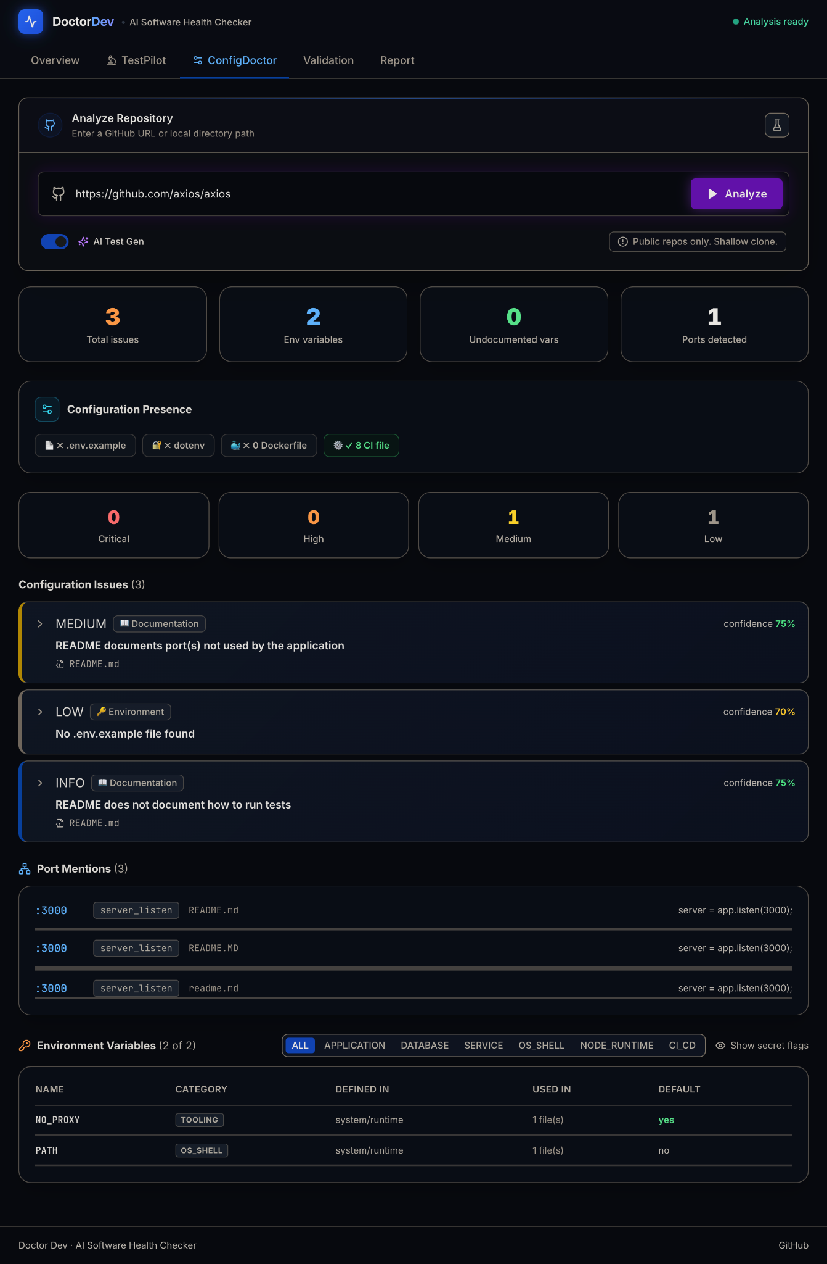
DOCTOR DEV / IBM BOB 2.0 HACKATHON
06
A finding you can act on
The report identifies the file, issue and recommended change.
README port mismatch
Doctor Dev flags ports documented in the README that the application does not use.
The same scan also notes a missing .env.example and absent test instructions.
Notes:
Source: supplied Doctor Dev screenshot 4, Axios example. Findings are heuristic, with confidence labels in the UI.

Slide 7
DOCTOR DEV / IBM BOB 2.0 HACKATHON
07
Built with IBM Bob 2.0
Bob helped reason across the repository, from analyzer logic through UI, security and review.
Architecture
TestPilot, ConfigDoctor and shared backend types
Implementation
Repository discovery, AST analysis and evidence mapping
Hardening
False-positive debugging, path safety and regression review
Explore the public source
github.com/priyanshusharan-cmd/doctor-dev
Notes:
Source: supplied project README, IBM Bob section. Session-summary screenshots are separate required submission evidence and are not represented in this deck.

Slide 8
DOCTOR DEV / IBM BOB 2.0 HACKATHON
08
Thank you
Doctor Dev
Find repository risks before they reach developers
github.com/priyanshusharan-cmd/doctor-dev
Notes:
Project repository: https://github.com/priyanshusharan-cmd/doctor-dev

