Slide 1
Smart contract solution for copyright issues of cover songs
Presented By:
B009- Dhruv Raj Singh Bhadauria
B013- Priyanshu Bindal
Mentor: Prof. Gaurav Londhe

Slide 2
Introduction
Cover Song is the reproduction of an already existing song in some way majorly over the YouTube platform
Helps an artist to showcase his talent to the world
There’s no space for copied illegal content anymore
With the help of content id algorithm the YouTube flags the cover song and report it to the copyright owner which is usually a big record label
The record label either monetize the video or take it down
Monetizing means, any ad-revenue earned or will the video earn, record label get to keep it
So, let’s make your cover song video legal through smart contract solution

Slide 3
Introduction
What are we suggesting?
A user would be able to acquire copyrights of a certain video to be able to reproduce it only on YouTube
As a result he/she would be entitled to an earning according to contract’s T&C
Compared to earlier where the earning was zero
The list of registered users would be sent by Label to YouTube
For which the YouTube will distribute the amounts accordingly
The Label do not double cross users that’s where smart contract comes into play
Every registered user would be visible to everyone and the data is immutable hence an immutable public ledger

Slide 4
Problem Definition
To create a smart contract solution to facilitate revenue sharing for the cover song artists over the YouTube platform

Slide 5
How Real is this Problem
Let’s take an example of a reputed cover YouTube channel
It is able to garner 15million views on this video
CPM(cost per 1000 impressions) is 1.5 dollars (countries like Australia has $4.5 CPM)
Total revenue will be $(15,000,000/1000)*1.5 = $22,500
YouTube takes flat 50% of this revenue, so left revenue = $11,250
Imagine this $11,250 figure going all to a big company
You left with nothing, this sure is not a trivial problem

Slide 6
Literature Review
Copyright in the blockchain era: Promises and challenges:
The paper focuses on various legal-related aspects of the application of blockchain technologies in the copyright sphere. Specifically, it outlines the existing challenges for distribution of copyrighted works in the digital environment, how they can be solved with blockchain, and what associated issues need to be addressed in this regard. It is argued that blockchain can introduce long-awaited transparency in matters of copyright ownership chain; substantially mitigate risks of online piracy by enabling control over digital copy and creating a civilized market for “used” digital content.
What Blockchain Can and Can’t Do for Copyright:
This paper further discusses the lengths and limitations of the blockchain technology in Copyright management. It further discusses the possibility of how blockchain can present the possibility of rightsholders becoming the intermediary themselves, or otherwise disintermediating the relationship between rightsholder and user. The blockchain protocol also operates across jurisdictions, eliminating the territorial complexity, and absurdity, of national collective licensing systems and reciprocal relationships. They can also be linked to real-time content distribution networks, automated licensing agents, and open DRM(digital rights management) systems that can automate licensing conditions and interact with user identities. This paper puts forth a positive and doable approach for the blockchain technology towards Copyright.

Slide 7
Literature Review
Smart Contract Applications within Blockchain Technology: A Systematic Mapping Study:
With the advent of blockchain, smart contracts have become one of the most sought-after technologies because of the high customizability they add to transactions. This has given rise to many smart contract applications in areas ranging from financial services, life sciences and healthcare to energy resources and voting. However, due to their infancy, smart contracts still pose many challenges that encumber the stakeholders who interact with them: users, developers and the organizations that are built on top of smart contracts.
Since 2016, there has been an increasing trend towards the publication of blockchain-based smart contract articles at conferences and journals, mainly reflecting experiments and presenting methods, tools and models. According to the results, the most commonly discussed problems and solutions in the literature are related to the security, privacy and scalability of blockchain and the programmability of smart contracts.

Slide 8
Literature Review
Literature Review

Slide 9
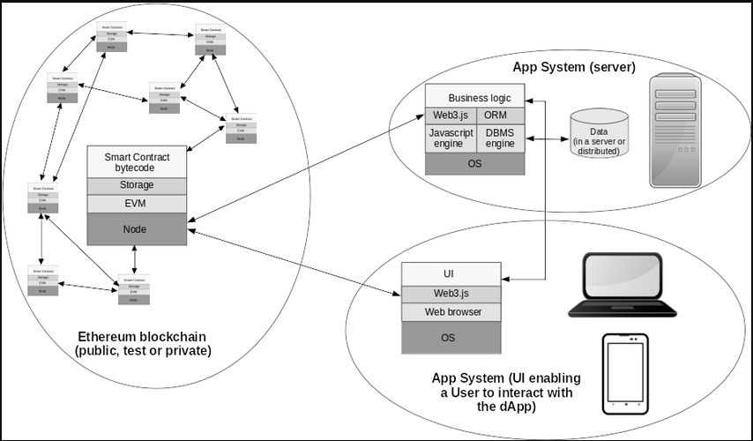
Architecture

Slide 10
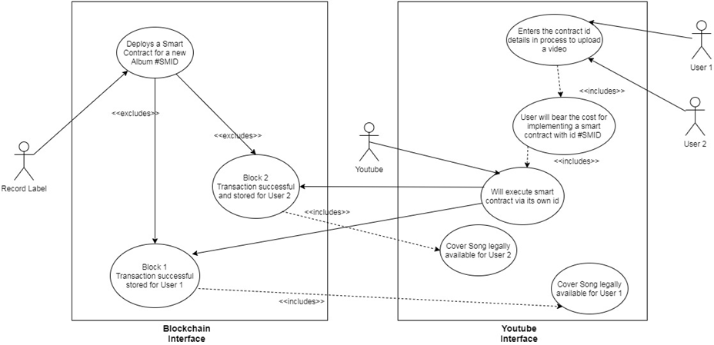
UML Diagrams
Use Case Diagram

Slide 11
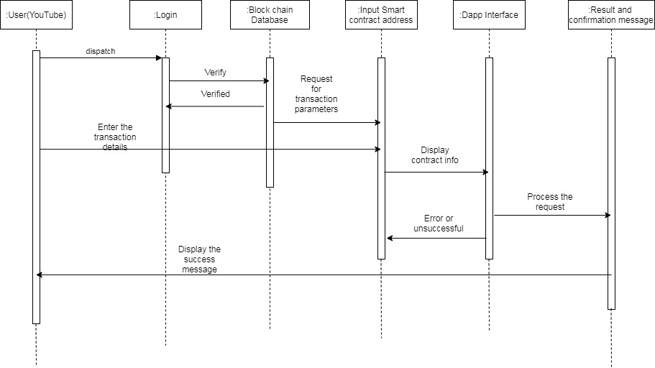
UML Diagrams
Sequence Diagram

Slide 12
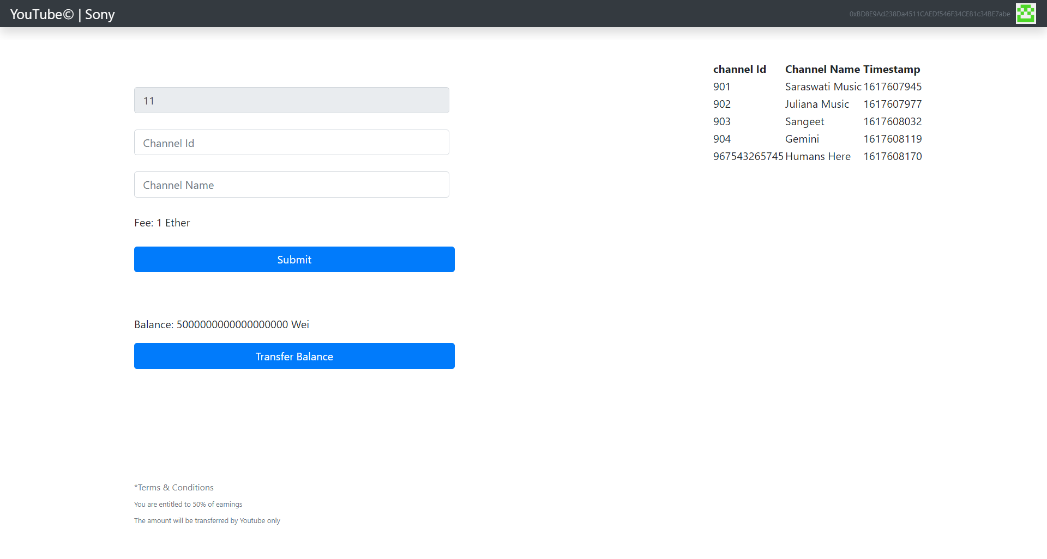
Implementation

Slide 13


Implementation
Clickable link of video in concern
Connected Account

Slide 14
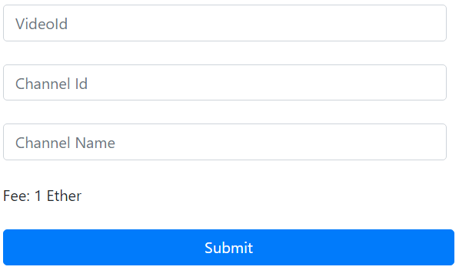
Implementation
Form for User

Slide 15
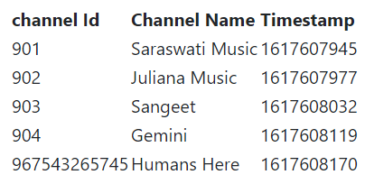
Implementation
Live Update for registered users

Slide 16
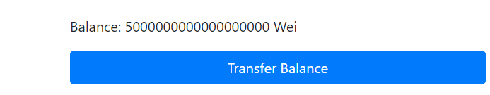
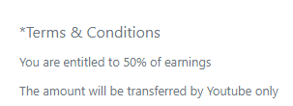
Implementation
Transfer Balance Functionality for the owner of the contract
Terms & Conditions

Slide 17
Result and Analysis
The proposed solution is very efficient and logical
A user can successfully acquire the copyrights of a certain video with a single click
Compared to earlier methods which takes months to get a copyright
The data is stored in immutable public ledger
This will appreciate more and more users to acquire copyrights since they can earn now
This directly is benefitting both the label and users
The label will have the added income from selling copyright to each user

Slide 18
Conclusion & Future work
The proposed system provides a great solution for where the Label has all the rights. It also does not leave room for label to dupe the users. It captures almost all the aspects needed for it to work seamlessly.
The future work is to add more functionalities if needed and make the UI more appealing as well to make the table displayed on frontend more dynamic.

Slide 19
References
[1] Solomon, Leron (2015) "Fair Users or Content Abusers? The Automatic Flagging of Non-Infringing Videos by Content ID on YouTube," Hofstra Law Review: Vol. 44: Iss. 1, Article 8
[2] Liikkanen, Lassi A., and Antti Salovaara. "Music on YouTube: User engagement with traditional, user-appropriated and derivative videos." Computers in Human Behavior 50 (2015): 108-124.
[3] Savelyev, A., 2018. Copyright in the blockchain era: Promises and challenges. Computer law & security review, 34(3), pp.550-561.
[4] Tresise, A., Goldenfein, J. and Hunter, D., 2018. What Blockchain Can and Can't Do for Copyright.
[5]Bodó, Balázs, Daniel Gervais, and João Pedro Quintais. "Blockchain and smart contracts: the missing link in copyright licensing?." International Journal of Law and Information Technology 26.4 (2018): 311-336.

Slide 20
References
[6]Wu, Kaidong. "An empirical study of blockchain-based decentralized applications." arXiv preprint arXiv:1902.04969 (2019).
[7]Macrinici, Daniel, Cristian Cartofeanu, and Shang Gao. "Smart contract applications within blockchain technology: A systematic mapping study." Telematics and Informatics 35.8 (2018): 2337-2354.
[8]De León, Ignacio L., and Ravi Gupta. "The impact of digital innovation and blockchain on the music industry." Washington, DC: Inter-American Development Bank (2017).
[9]O'Dair, Marcus. "The networked record industry: how blockchain technology could transform the consumption and monetisation of recorded music." (2016).
[10]Kim, Kenneth Chi Ho. "The Impact of Blockchain Technology on the Music Industry." International journal of advanced smart convergence 8.1 (2019): 196-203.

Slide 21
Thank You

Slide 22
References
Introduction
Problem definition
Literature review in brief (2 slides)
Algorithms /Architecture
UML Diagrams(Usecase, sequence,class diagram)
Implementation
Result and Analysis
Conclusion & Future work
References

Slide 23
Rubrics
The following are the rubrics for Mid-2 (week: 22/03/2021 To 27/03/2021 )
Interim Presentation 2
Parameter | Marks out of | Exceeds Expectation | Meets Expectation | Below Expectation | Unsatisfactory
Implementation | 10 | Progress is beyond expectations wrt plan & timeline (9-10) | Progress is mostly satisfactory wrt plan & timeline (6-8) | Slow progress wrt plan & timeline (4-5) | No noticeable progress (below 4)
Presentation & Viva | 5 | Answers all questions exceptionally by rationalizing & explaining (5) | Answers almost all questions. (3-4) | Answers only few basic questions. Misses out some questions. (2) | Unable to answer the questions. (below 2)

