Slide 1
Real Time Weather Forecast
Submitted in the partial fulfillment for the award of the degree of
BACHELOR OF ENGINEERING
IN
COMPUTER SCIENCE WITH SPECIALIZATION IN
ARTIFICIAL INTELLIGENCE AND MACHINE LEARNING
Submitted by:
Priyanshu Yadav 21BCS6104
Darsh Gautam 21BCS9578
Shreyas Paraj 21BCS6332
Sartaj Alam21BCS8928
Under the Supervision of:
Ruksana
Department of AIT-CSE
DISCOVER . LEARN . EMPOWER

Slide 2
Outline
Introduction to Project
Problem Formulation
Objectives of the work
Methodology used
Results and Outputs
Conclusion
Future Scope
References

Slide 3
Introduction to Project
Real-time weather forecasting represents the pinnacle of meteorological science and technological innovation. It harnesses a diverse array of tools and methodologies to continuously monitor, analyze, and predict atmospheric conditions, providing invaluable insights into current and upcoming weather phenomena.
At the heart of real-time forecasting are advanced meteorological instruments, including satellites, radar systems, weather balloons, and ground-based sensors. These tools constantly collect vast amounts of data on various atmospheric parameters such as temperature, humidity, air pressure, wind speed, and precipitation levels. This wealth of information is transmitted to sophisticated computer models and weather prediction systems in real-time, where it undergoes rigorous analysis and interpretation.

Slide 4

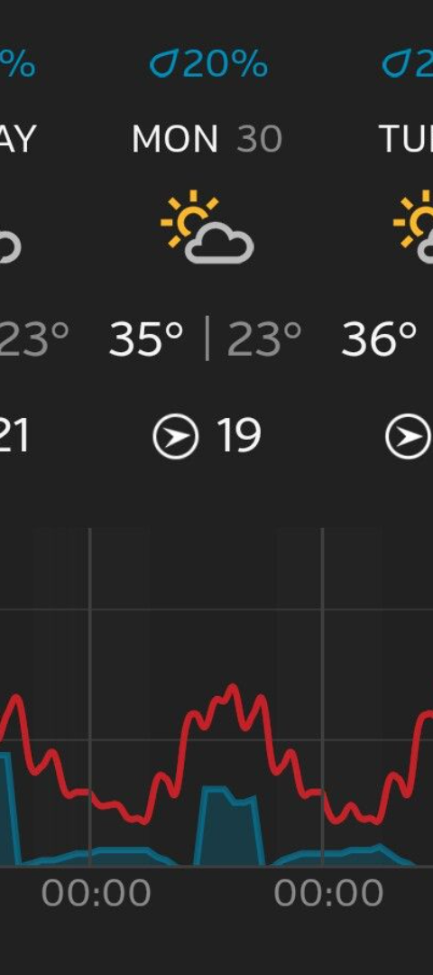
Problem formulation
1
Data Accuracy
2
Resource Constraints
Challenges related to the accuracy of real-time data collection and interpretation.
Issues arising from limited resources for maintaining real-time weather forecasting systems.
3
Dynamic Conditions
Adapting to the dynamic nature of weather systems, which presents unique challenges.

Slide 5
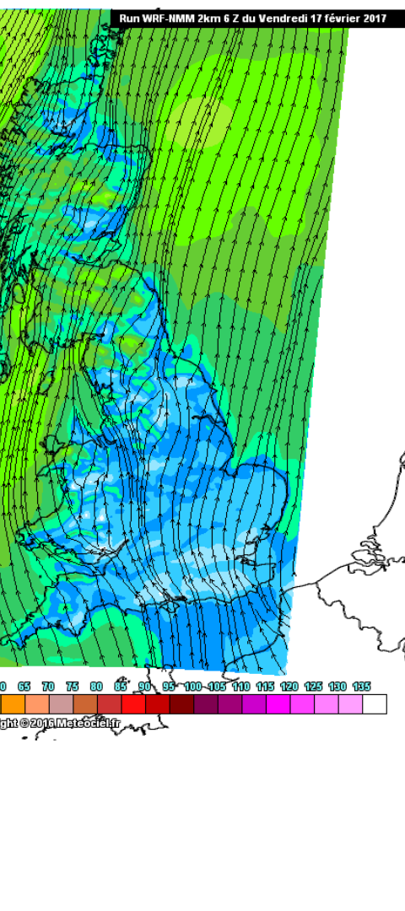
Objective of the work
Evaluate Accuracy
Enhance Technology
Determine the accuracy and reliability of real-time weather forecasts.
Develop and implement advanced technological solutions for real-time weather monitoring.
Optimize Resource Allocation
Find efficient ways to allocate resources for maintaining and updating real-time weather forecasting systems.

Slide 6

Components Required
HTML
CSS
JavaScript
React.js

Slide 7
Methodology used
Data Collection
Technology Integration
Model Development
Detail the processes involved in collecting and analyzing real-time meteorological data.
Explain the creation and refinement of weather models used for real-time predictions.
Discuss how advanced technology is integrated into real-time weather forecasting algorithms.

Slide 8
Applications of real-time weather forecasts
1
Disaster Management
Using real-time weather forecasts to prepare and respond to natural disasters.
2
Agriculture
Applying real-time weather predictions to optimize crop management and harvesting processes.
3
Aviation
Utilizing real-time weather data to ensure safe and efficient air travel.

Slide 9
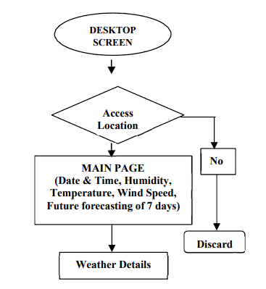
Flowchart

Slide 10
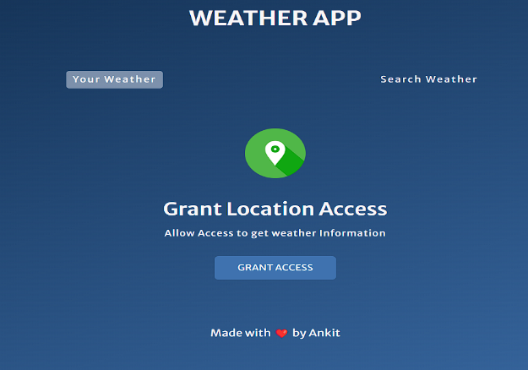
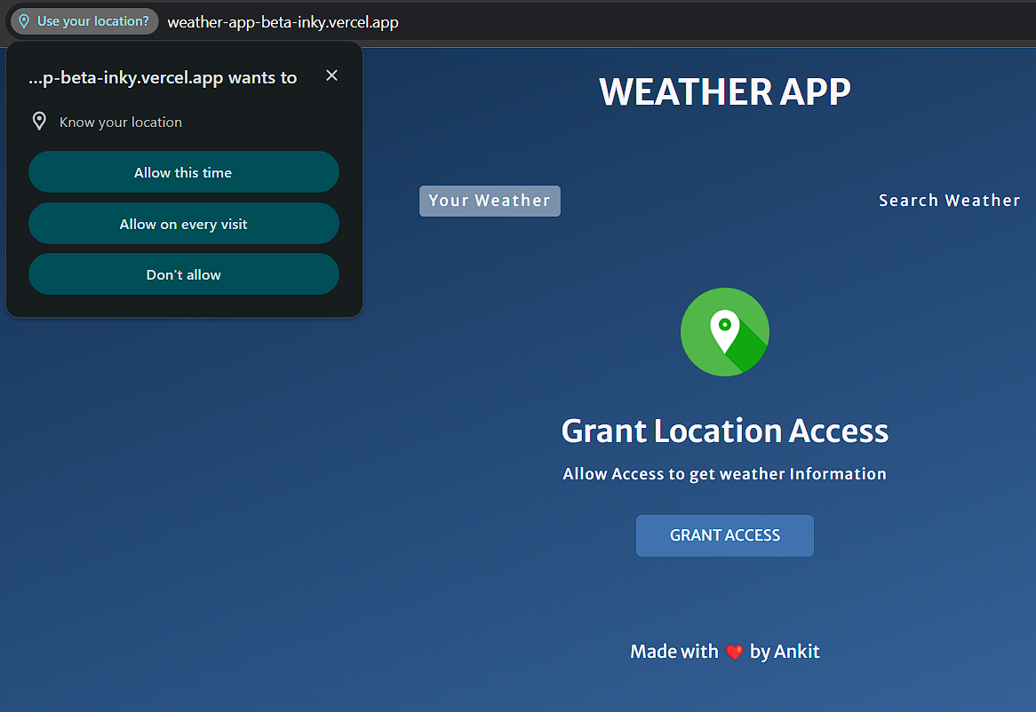
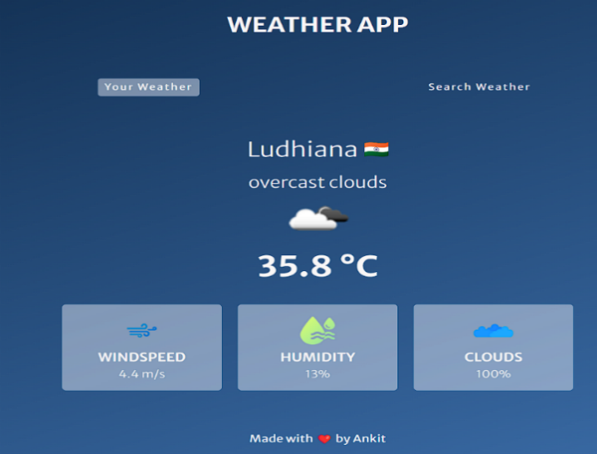
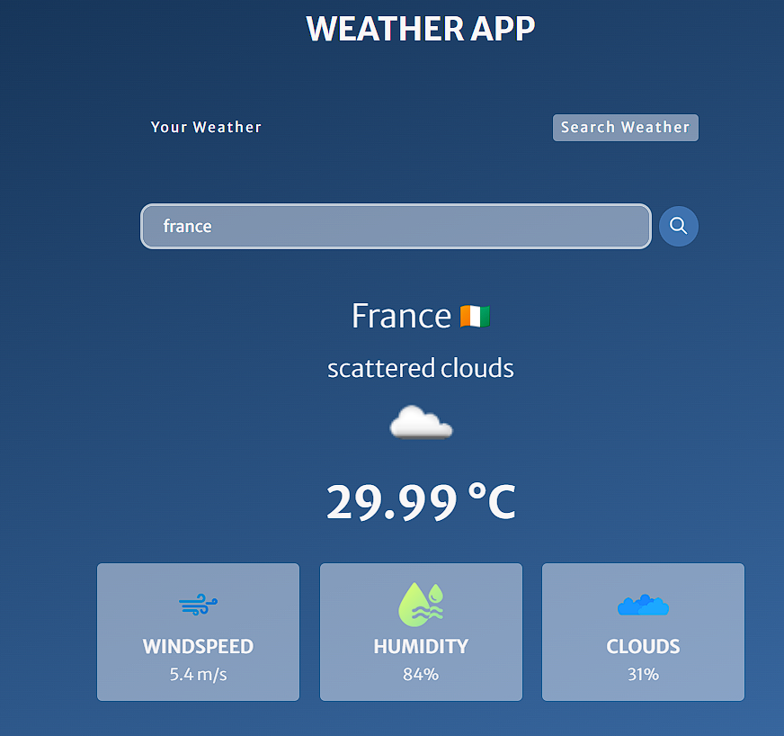
Result And Output

Slide 11
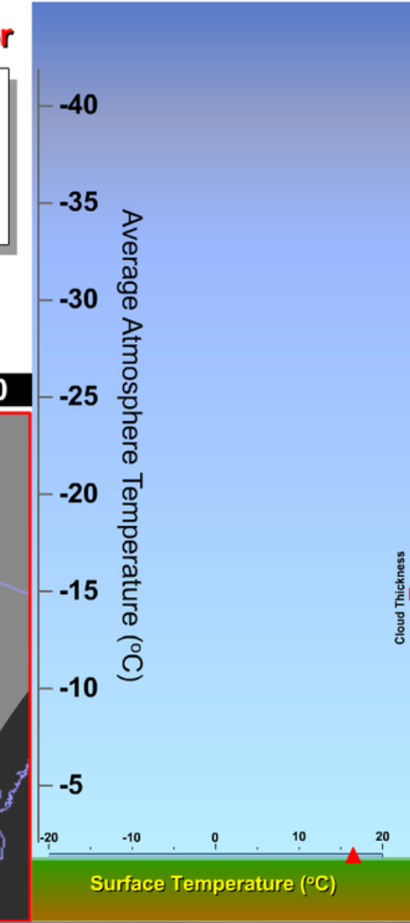
Future scope
1
Enhanced Accuracy
2
Global Reach
Further advancements in technology to improve the accuracy and reliability of real-time weather forecasting.
Expanding access to real-time weather forecasting systems for global coverage and benefits.
3
Interdisciplinary Collaboration
Enhanced collaboration among meteorologists, technology experts, and policymakers for comprehensive real-time weather forecasts.

Slide 12



Challenge in Real-time weather forecasts
Meteorological Data Quality
Rapid Weather Changes
Infrastructure Maintenance
Ensuring the accuracy and reliability of real-time meteorological information.
Adapting to rapidly changing weather patterns for precise forecasts.
Maintaining cutting-edge infrastructure for real-time weather monitoring and predictions.

Slide 13
References
K.U Jaseena, Bisnu. Konvoor. (2020) Deterministic weather forecasting fashions based on sensible predictors: A survey. https://digitallibrary.mes.ac.in/server/api/core/bitstreams/4 98a40d3-6012-4768-993e-8b045eff55c0/content
Weather forecasting the use of API references and AJAX by Dr. Vishal, Abhishek Kumar Singh. Easy chair preprint no (10131) 2023.
Dr. S. Santhosh Baboo and I.Kadar Shereef. International Journal of Environmental Science and Development, Vol. 1, No. 4, October 2010 ISSN: 2010-0264
Fathi, Marzieh, Mostafa Haghi Kashani, Seyed Mahdi Jameii, and Ebrahim Mahdipour. "Big data analytics in weather forecasting: A systematic review." Archives of Computational Methods in Engineering 29, no. 2 (2022): 1247-1275.
Sunil Taruna and Vishal Choudhary (2021). An Intrusion detection technique using frequency analysis for wireless sensor network. An Intrusion Detection Technique Using Frequency Analysis for Wireless Sensor Network | IEEE Conference Publication | IEEE Xplore

