Slide 1

Python
Pandas &
Matplotlib
Presented by Priyansu Pattanaik
Student Volunteer Revision Session | Topics Covered: Pandas & Matplotlib

Slide 2
🐼 What is Pandas? — Definition & Uses
DEFINITION
Pandas is an open-source Python library used for data manipulation and analysis. It provides fast, flexible, and expressive data structures designed to make working with structured (tabular, labelled) data both easy and intuitive.
import pandas as pd
🔎
⚙️
🧹
🗂️
Data Analysis
Data Manipulation
Data Cleaning
Structured Data
Explore, summarise and understand data distributions and patterns.
Filter, sort, reshape, merge, and transform datasets easily.
Handle missing values, duplicates and data type inconsistencies.
Work with labeled rows/columns like a spreadsheet or SQL table.

Slide 3
📋 Pandas — Series (1D Data Structure)
WHAT IS A SERIES?
A Series is a one-dimensional labeled array that can hold data of any type (int, float, string, etc.). It has an index on the left and values on the right — like a single column of a spreadsheet.
PYTHON CODE
OUTPUT
import pandas as pd
# Series from a list (auto index 0,1,2...)
s1 = pd.Series([10, 20, 30, 40, 50])
# Access by index label
print(s1)
s1:
0 10
1 20
2 30
3 40
4 50
dtype: int64
s2['a']: 100

Slide 4
📋 Pandas — DataFrame (2D Data Structure)
WHAT IS A DATAFRAME?
A DataFrame is a two-dimensional, tabular data structure with labeled rows and columns — like an Excel spreadsheet or a SQL table. Each column is a Series.
PYTHON CODE
OUTPUT
# DataFrame from a Dictionary
data = {"Name": ["Amit", "Neha", "Raj" ],
"Age": [21, 22, 20 ],
"Marks": [85, 92, 78 ]}
df = pd.DataFrame(data)
print(df)
# DataFrame from list of lists
df2 = pd.DataFrame(
[["Alice", 25, "Delhi"],
["Bob", 30, "Mumbai"]],
columns=["Name", "Age", "City"])
print(df2)
df:
Name Age Marks
0 Amit 21 85
1 Neha 22 92
2 Raj 20 78
df2:
Name Age City
0 Alice 25 Delhi
1 Bob 30 Mumbai

Slide 5
📂 Reading & Writing Data from Files
WHAT DOES THIS DO?
Pandas can read data from many file formats into a DataFrame with a single function call. The most common are CSV (comma-separated) and Excel files. After analysis you can also write back to those formats.
PYTHON CODE
OUTPUT
# ── Read from CSV ─────────────────────────
df = pd.read_csv("data.csv")
# ── Read from Excel ────────────────────────
df = pd.read_excel("data.xlsx")
# ── Write / Save ───────────────────────────
df.to_csv("output.csv")
df.to_excel("output.xlsx")
After pd.read_csv("data.csv"):
Name Age Salary City
0 Alice 25 50000 New York
1 Bob 30 60000 London
2 Charlie 35 70000 Paris
3 David 40 80000 Tokyo
4 Eva 45 90000 Berlin
📄 CSV
read_csv()
📗 Excel
read_excel()
🗃️ JSON
read_json()
🛢️ SQL
read_sql()

Slide 6
🔍 Data Exploration Methods
PURPOSE
Before analysing data, you must explore it. These methods give a quick overview of size, data types, statistics, and missing values — they help you understand what your dataset looks like.
PYTHON CODE
OUTPUT
df = pd.read_csv("data.csv")
df.head() # First 5 rows
df.tail(3) # Last 3 rows
df.info() # Data types + non-null count
df.describe() # Mean, std, min, max
df.shape # Returns (rows, columns)
df.columns # Returns column name list
df.dtypes # Data type of each column
df.isnull().sum() # Count missing values
df.shape → (5, 4)
df.columns →
Index(['Name', 'Age', 'Salary', 'City'])
df.describe():
Age Salary
count 5.00 5.00
mean 35.00 70000.00
std 7.91 15811.39
min 25.00 50000.00
max 45.00 90000.00
head()
info()
describe()
shape
Quick preview, first rows
Types & null counts
Stats summary (numeric)
(rows, cols) tuple

Slide 7
🎯 Data Selection — Columns, loc & iloc
DEFINITION
Data selection lets you extract specific rows, columns, or individual cells from a DataFrame. loc uses label-based indexing (index name/label). iloc uses integer position-based indexing (0, 1, 2 ...).
PYTHON CODE
OUTPUT
df = pd.read_csv("data.csv")
# ── Select ONE column ──────────────────────
df["Name"] # Returns a Series
# ── Select MULTIPLE columns ────────────────
df[["Name", "Salary"]] # Returns DataFrame
# ── loc → by index LABEL ─────────────────
df.loc[0] # Row where index label = 0
df.loc[2, "Name"] # Row 2, column Name
# ── iloc → by integer POSITION ────────────
df.iloc[0] # First row (position 0)
df.iloc[0, 1] # Row 0, Column at position 1
df["Name"]:
0 Alice
1 Bob
2 Charlie
df.loc[2, "Name"] → 'Charlie'
df.iloc[0]:
Name Alice
Age 25
Salary 50000
City New York
Name: 0, dtype: object
loc — uses the INDEX LABEL (could be 'a', 'b' or 0,1,2)
iloc — always uses the POSITION number (0, 1, 2 ...)

Slide 8
🔎 Data Filtering — Boolean Conditions
WHAT IS BOOLEAN FILTERING?
Filtering returns only the rows that satisfy a condition. A boolean condition returns True/False for each row, and Pandas keeps only the True rows. Multiple conditions can be combined using & (AND) or | (OR).
PYTHON CODE
OUTPUT
df = pd.read_csv("data.csv")
# ── Single condition ───────────────────────
df[df["Salary"] > 60000]
# ── AND condition (&) ────────────────────
df[(df["Salary"] > 60000) & (df["Age"] < 40)]
# ── OR condition (|) ─────────────────────
df[(df["City"] == "London") | (df["Age"] < 30)]
df[df["Salary"] > 60000]:
Name Age Salary City
2 Charlie 35 70000 Paris
3 David 40 80000 Tokyo
Eva 45 90000 Berlin
5 Rahul 25 100000 London
df[(Salary>60000) & (Age<40)]:
Name Age Salary City
Charlie 35 70000 Paris
5 Rahul 25 100000 London
df[(City == London) | (Age < 30)]
Name Age Salary City
5 Rahul 25 100000 London
Operators: & → AND | | → OR | ~ → NOT | Always wrap each condition in ( ) brackets!

Slide 9
✏️ Adding, Modifying & Deleting Data
PURPOSE
After loading a dataset you often need to add new calculated columns, update existing values, or remove columns/rows that are not needed. Pandas makes all three operations simple.
PYTHON CODE
OUTPUT
df = pd.read_csv("data.csv")
# ── ADD a new column ──────────────────────
df["Dept"] = ["HR","EDU"]
# ── MODIFY an existing column ────────────
df["Salary"] = df["Salary"] + 5000
# ── RENAME a column ───────────────────────
df.rename(columns={"Salary":"Pay"},
inplace=True)
# ── DELETE a column (axis=1) ─────────────
df.drop("Dept", axis=1, inplace=True)
# ── DELETE a row (axis=0) ────────────────
df.drop(0, axis=0, inplace=True)
After adding Dept column:
Name Age Salary Dept
0 Alice 25 50000 HR
1 Bob 30 60000 EDU
...
After Salary + 5000:
Name Salary
0 Alice 55000
1 Bob 65000
After drop("Dept"):
Name Age Salary City
inplace=True → changes the original df directly | axis=1 → column | axis=0 → row | Without inplace, assign result back to df

Slide 10
🧹 Handling Missing Data
WHAT IS MISSING DATA?
Real-world datasets are rarely complete. Missing values appear as NaN (Not a Number) in Pandas. You must detect them, then decide to drop those rows or fill them with a sensible value like mean/median.
PYTHON CODE
OUTPUT
import pandas as pd
import numpy as np
data = {"Month": ["Jan","Feb","Jan","Feb", None],
"Product": ["A", None, "A", None, "B"],
"Sales": [1000, None, 3000, None, 5000]}
df = pd.DataFrame(data)
# ── Detect missing values ──────────────────
print(df.isnull()) # Boolean mask
print(df.isnull().sum()) # Count per column
# ── Drop rows with ANY NaN ─────────────────
df.dropna(inplace=True)
# ── Fill with mean / constant ──────────────
df["Sales"].fillna(df["Sales"].mean(),
inplace=True)
df["Month"].fillna("Unknown", inplace=True)
df["Product"].fillna("Other", inplace=True)
df.isnull().sum():
Month 1
Product 2
Sales 2
dtype: int64
After fillna():
Month Product Sales
0 Jan A 1000.0
1 Feb Other 3000.0
2 Jan A 3000.0
3 Feb Other 3000.0
4 Unknown B 5000.0
isnull() – Returns True where NaN exists
dropna() – Removes rows containing NaN
fillna() – Fills NaN with given value

Slide 11
📊 Sorting & GroupBy
DEFINITIONS
sort_values() arranges rows in ascending or descending order by one or more columns. groupby() splits the DataFrame into groups based on a column, letting you compute aggregates (sum, mean, count) per group.
PYTHON CODE
OUTPUT
data = {"Department": ["HR","IT","HR","IT","HR","IT"],
"Salary": [50000,40000,30000,60000,45000,90000]}
df = pd.DataFrame(data)
# ── SORT by Salary descending ──────────────
df.sort_values("Salary", ascending=False)
# ── GROUPBY Department → mean salary ───────
df.groupby("Department")["Salary"].mean()
# ── GROUPBY with multiple aggregations ─────
df.groupby("Department")["Salary"].agg(
["sum", "mean", "count"])
sort_values (descending):
Dept Salary
5 IT 90000
3 IT 60000
0 HR 50000
4 HR 45000
groupby mean:
Department
HR 41666.67
IT 63333.33
agg:
sum mean count
Department
HR 125000 41666.67 3
IT 190000 63333.33 3

Slide 12
🔗 Merging DataFrames — pd.merge()
WHAT IS MERGING?
pd.merge() combines two DataFrames based on a common column (key), exactly like a SQL JOIN. The default is an inner join (keeps only matching rows). You can also do left, right, and outer joins.
PYTHON CODE
OUTPUT
df_left = pd.DataFrame({
"ID": [1, 2, 3, 4, 5],
"Name": ["Alice","Bob","Charlie","Dave","Eva"]})
df_right = pd.DataFrame({
"ID": [1, 2, 3, 4, 5],
"Salary": [10000,20000,30000,40000,50000]})
# Inner Join (default) – only matching rows
merged = pd.merge(df_left, df_right, on="ID"
merged (inner join):
ID Name Salary
0 1 Alice 10000
1 2 Bob 20000
2 3 Charlie 30000
3 4 Dave 40000
4 5 Eva 50000
INNER
Only rows that match in BOTH DataFrames
LEFT
All rows from left + matches from right
RIGHT
All rows from right + matches from left
OUTER
All rows from BOTH, NaN where no match

Slide 13
📈 What is Matplotlib? — Definition & Overview
DEFINITION
Matplotlib is an open-source Python library for creating static, animated, and interactive 2D visualisations. It provides a MATLAB-like interface through pyplot. Every plot requires: import matplotlib.pyplot as plt
import matplotlib.pyplot as plt # Every matplotlib script starts with this
📈
Line Plot
📊
Bar Chart
📉
Histogram
plt.plot()
plt.bar()
plt.hist()
Shows trends over time or sequence
Compares values across categories
Shows data frequency distribution
🔵
Scatter Plot
🥧
Pie Chart
⬛
Subplots
plt.scatter()
plt.pie()
plt.subplot()
Shows relationship between 2 variables
Shows proportions of a whole
Multiple plots in one figure

Slide 14
📈 Matplotlib — Line Plot plt.plot()
WHAT IS A LINE PLOT?
A line plot connects data points with a line. It is best used to show trends over time, sequences, or continuous data. Customisable with colour, linestyle, markers, labels, and legends.
PYTHON CODE
Parameters
import matplotlib.pyplot as plt
x = [1, 2, 3, 4, 5]
y1 = [10, 20, 30, 40, 50]
y2 = [100, 200, 300, 400, 500]
plt.figure(figsize=(8, 5)) # canvas size
# ── Basic line ─────────────────────────────
plt.plot(x, y1, color='red',
linestyle='--', marker='*',
label='Product B')
# ── Second line ────────────────────────────
plt.plot(x, y2, color='blue',
linestyle='-', marker='o',
label='Product A')
plt.title("Sales Comparison")
plt.xlabel("Month")
plt.ylabel("Sales")
plt.legend()
plt.show()
color=
'red', 'blue', '#FF5733'
linestyle=
'-' '--' '-.' ':'
marker=
'o' '*' 's' '^' '+'
label=
Text shown in legend
linewidth=
Thickness of line (e.g. 2)
plt.legend() shows labels | plt.figure(figsize=(w,h)) sets size in inches | plt.show() renders the plot

Slide 15
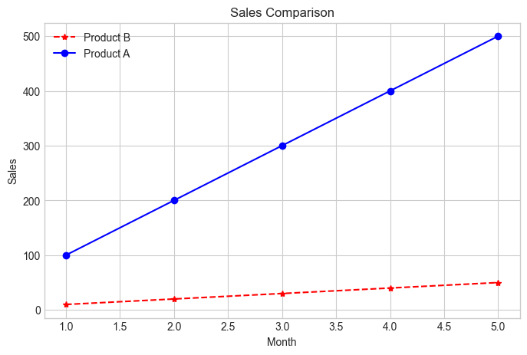
📈 Matplotlib — Line Plot plt.plot()
plt.legend() shows labels | plt.figure(figsize=(w,h)) sets size in inches | plt.show() renders the plot

Slide 16
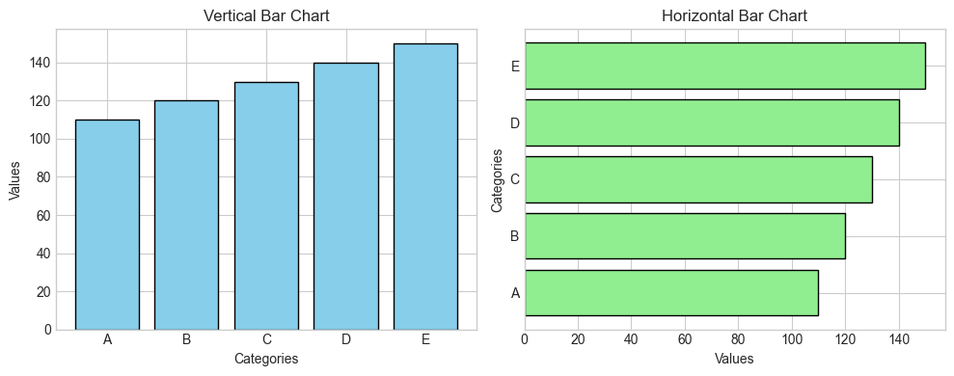
📊 Matplotlib — Bar Chart plt.bar() / plt.barh()
WHAT IS A BAR CHART?
Bar charts compare values across different categories using rectangular bars. plt.bar() draws vertical bars, plt.barh() draws horizontal bars. plt.subplot() lets you place both side by side in one figure.
import matplotlib.pyplot as plt
categories = ["A", "B", "C", "D", "E"]
values = [110, 120, 130, 140, 150]
plt.figure(figsize=(10, 4))
# ── Vertical Bar ───────────────────────────
plt.subplot(1, 2, 1) # 1 row, 2 cols, plot 1
plt.bar(categories, values, color='skyblue',
edgecolor='black')
plt.title("Vertical Bar Chart")
plt.xlabel("Categories")
plt.ylabel("Values")
# ── Horizontal Bar ─────────────────────────
plt.subplot(1, 2, 2) # 1 row, 2 cols, plot 2
plt.barh(categories, values, color='lightgreen',
edgecolor='black')
plt.title("Horizontal Bar Chart")
plt.xlabel("Values")
plt.ylabel("Categories")
plt.tight_layout() # prevent overlap
plt.show()

Slide 17
🔵 Matplotlib — Histogram & Scatter Plot
HISTOGRAM — plt.hist()
SCATTER PLOT — plt.scatter()
Shows how frequently values fall within ranges (bins). Used for continuous data to understand distribution — e.g., are values evenly spread or skewed to one side?
Plots individual data points as dots on x-y axes. Best for finding the relationship or correlation between two continuous numeric variables.
HISTOGRAM
SCATTER PLOT
data = [110,120,130,140,150,
110,130,150,120,140]
plt.figure(figsize=(7, 4))
plt.hist(data,
bins=5,
color='orange',
edgecolor='black')
plt.title("Histogram")
plt.xlabel("Value Range")
plt.ylabel("Frequency")
plt.show()
x = [10, 220, 130, 40, 150]
y = [110, 120, 130, 140, 150]
plt.figure(figsize=(7, 4))
plt.scatter(x, y,
color='purple',
s=100, # marker size
alpha=0.7) # transparency
plt.title("Scatter Plot")
plt.xlabel("X Values")
plt.ylabel("Y Values")
plt.show()

Slide 18
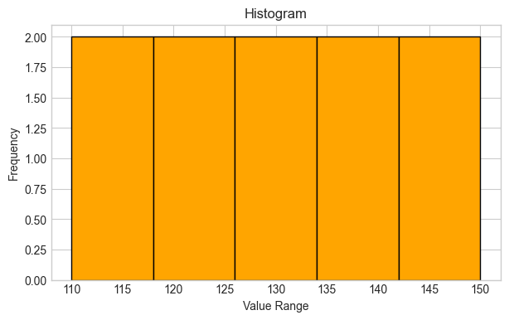
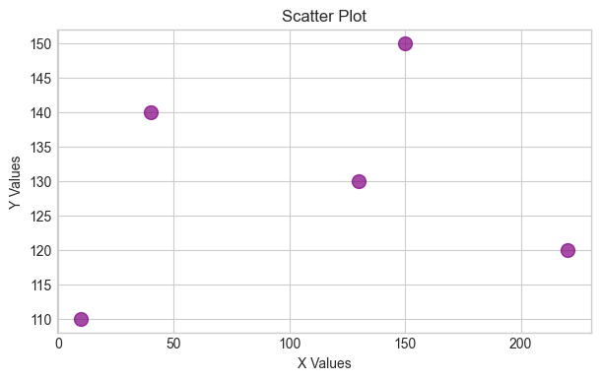
🔵 Matplotlib — Histogram & Scatter Plot
HISTOGRAM — plt.hist()
SCATTER PLOT — plt.scatter()
Shows how frequently values fall within ranges (bins). Used for continuous data to understand distribution — e.g., are values evenly spread or skewed to one side?
Plots individual data points as dots on x-y axes. Best for finding the relationship or correlation between two continuous numeric variables.
HISTOGRAM
SCATTER PLOT

Slide 19
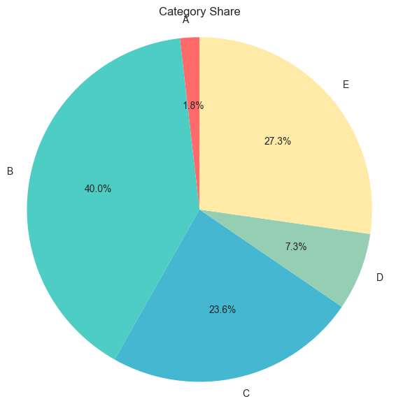
🥧 Matplotlib — Pie Chart & Subplots
PIE CHART — plt.pie()
Displays data as proportional slices of a circle. Each slice shows the percentage share of a category. Best for showing part-to-whole relationships with a small number of categories.
PIE CHART
sizes = [10, 220, 130, 40, 150]
labels = ["A", "B", "C", "D", "E"]
plt.figure(figsize=(7, 7))
plt.pie(sizes,
labels=labels,
autopct='%1.1f%%', # show % labels
colors=['#FF6B6B','#4ECDC4',
'#45B7D1','#96CEB4',
'#FFEAA7'])
plt.title("Category Share")
plt.show()

Slide 20
Thank You 🐍

