Slide 1
Pizza hut sales sql project.
A data analysis project using sql
name-priya pal
04 may 2026

Slide 2
abstract
This project analyzes pizza hut sales data using SQL.
The dataset includes orders , pizzas and sales details.
SQL queries are used for data cleaning , joining and analysis.
Different table are connected to extract useful data.
The project focuses on understanding sales performance.

Slide 3
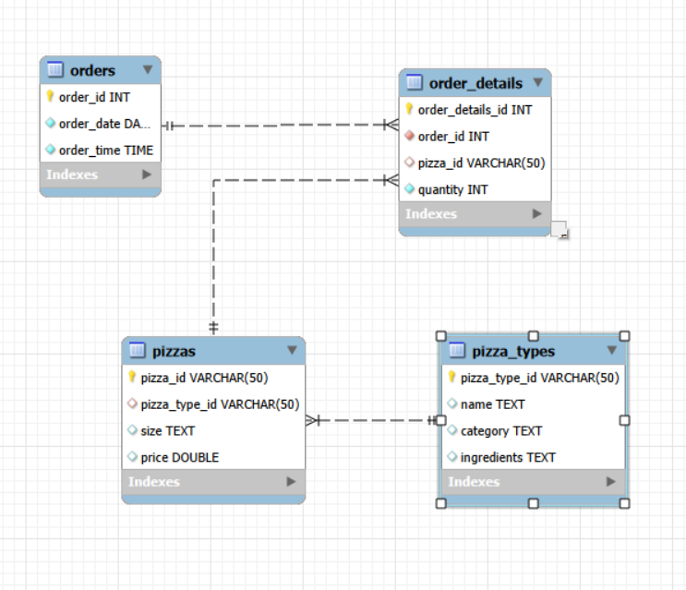
EER-DIAgram

Slide 4
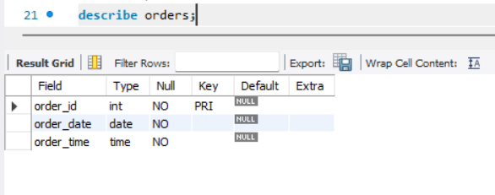
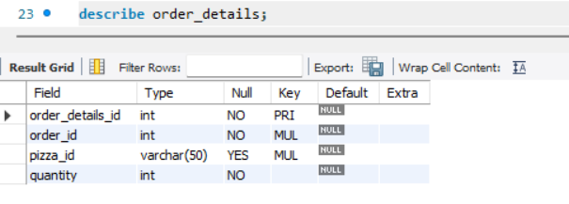
Schema for orders and order details
ORDERS TABLE
ORDER DETAILS

Slide 5
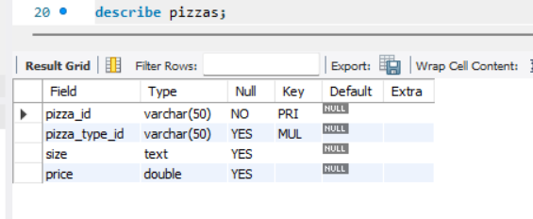
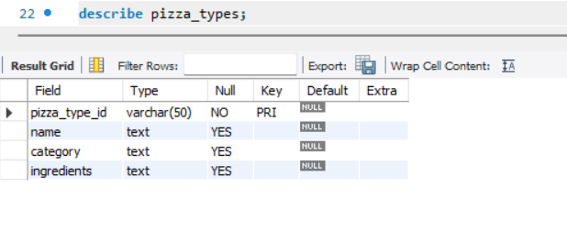
Schema for pizzas and pizza type
PIZZAS TABLE
PIZZA TYPE TABLE

Slide 6
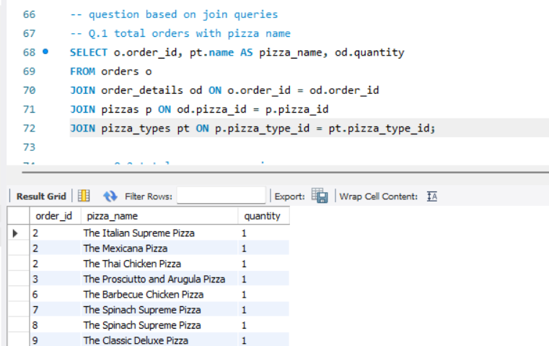
Total orders with pizza name
This SQL query combines multiple tables
Using JOINS to display order ID ,pizza name,
And quantity ordered.
It solves the problem of scattered data by
Linking order details with pizza information.
CONCLUSION:
“This query converts fragmented database
Records into a clear , structured order summary
For business analysis.”

Slide 7
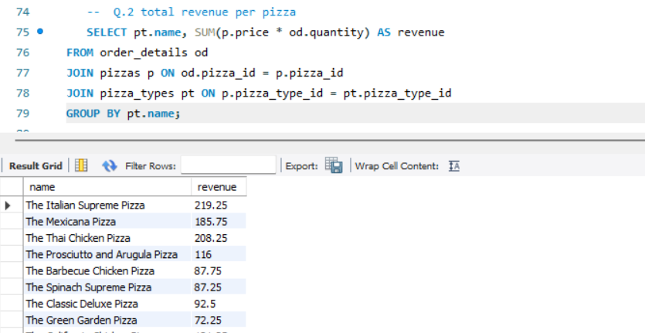
TOTAL REVENUE PER PIZZA
This SQL query calculates the total
Revenue generated by each pizza type
By multiplying price with quantity sold.
GROUP BY is used to summarize
Revenue for each pizza separately.
CONCLUSION:
This analysis helps identify the highest
Revenue-generating pizzas , supporting
Better sales strategy and menu planning.

Slide 8
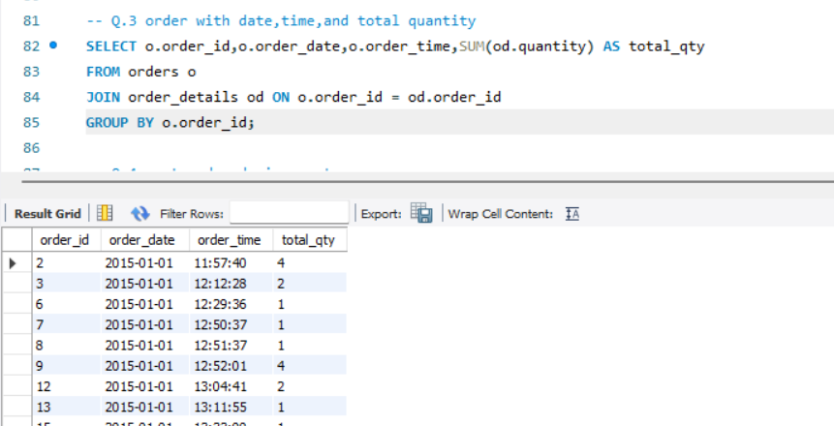
ORDER WITH DATE,TIME AND TOTAL QUANTITY
This SQL query retrieves each orders’s ID
date , time and total quantity of pizzas ordered.
GROUP BY organizes the data by individual orders , providing a complete order summary.
CONCLUSION:
This helps analyze customer order pattern by
Tracking order volume across different dates
And times.

Slide 9
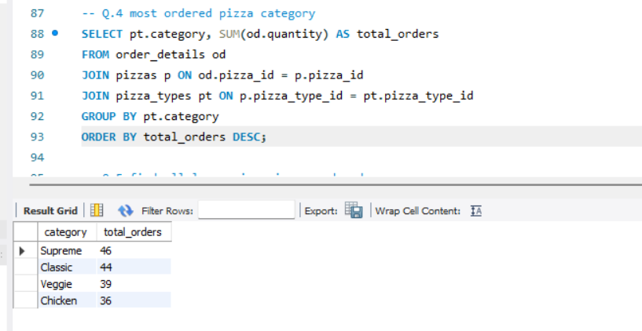
MOST ORDERED PIZZA CATEGORY
This SQL query identifies the most ordered
Pizza categories by summing total quantities
Sold foe each category.
It joins order details , pizzas , pizza types
Tables to categories sales data accurately.
CONCLUSION:
Supreme pizzas are the most popular , helping
Businesses focus on customer preferences and
Inventory planning.

Slide 10
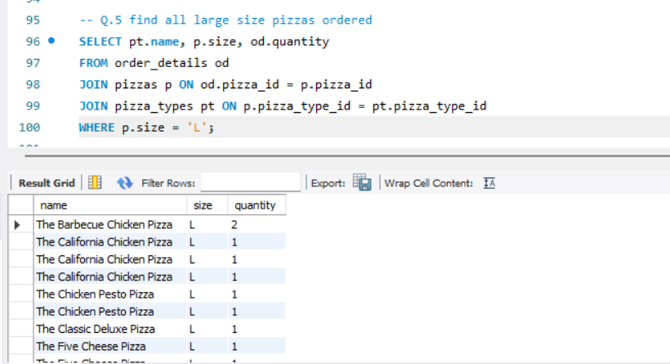
FIND ALL LARGE SIZE PIZZAS ORDERED
This query retrieves all pizzas where the size is Large (L).
It joins order details with pizza and pizza type tables to get names and quantities.
The result shows which large pizzas are most frequently ordered.
CONCLUSION:
Large-size pizzas are frequently ordered, showing strong customer preference for bigger portions and higher-value items.

Slide 11
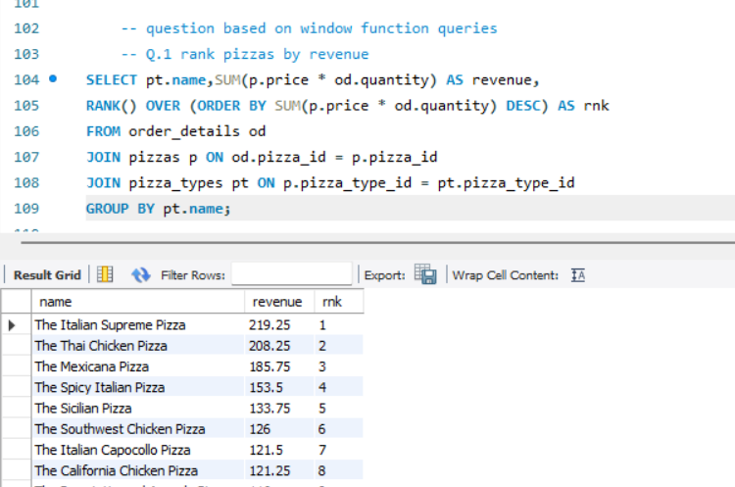
RANK PIZZAS BY REVENUE
This query calculates total revenue generated by each pizza.
It uses a RANK() window function to rank pizzas in descending order of revenue.
Higher rank indicates better-performing pizzas in terms of sales.
CONCLUSION:
A few pizzas generate the highest revenue, indicating key products that drive business profit.

Slide 12
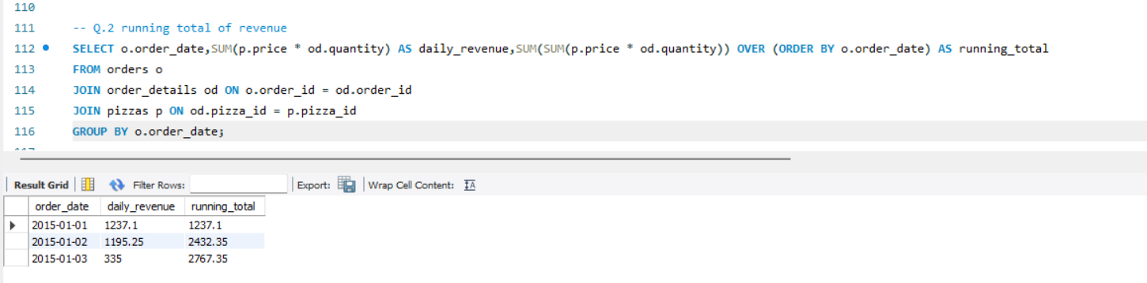
RUNNING TOTAL OF REVENUE
This query computes daily revenue and cumulative (running) revenue over time.
Uses SUM() OVER (ORDER BY date) to track growth.
Shows how revenue builds day by day.
CONCLUSION:
Revenue shows a steady increase over time, reflecting consistent sales performance.

Slide 13
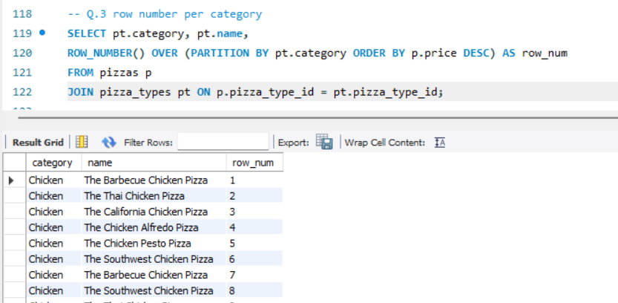
ROW NUMBER PER CATEGORY
Assigns a unique row number to pizzas within each category.
Uses ROW_NUMBER() with PARTITION BY category.
Helps compare items inside the same category.
CONCLUSION:
Pizzas are clearly ranked within categories, making it easier to compare options based on price.

Slide 14
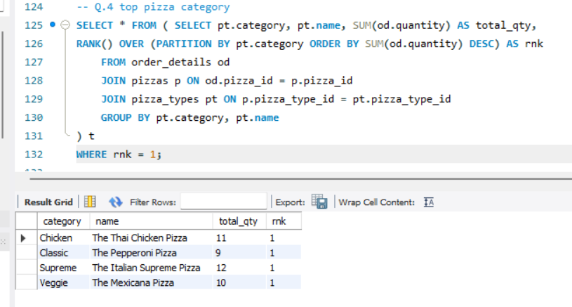
TOTAL PIZZA CATEGORY
Identifies the most ordered pizza in each category.
Uses RANK() partitioned by category based on total quantity sold.
Filters only rank = 1 to get top items.
CONCLUSION:
Each category has a clear best-selling pizza, helping identify customer favorites.

Slide 15
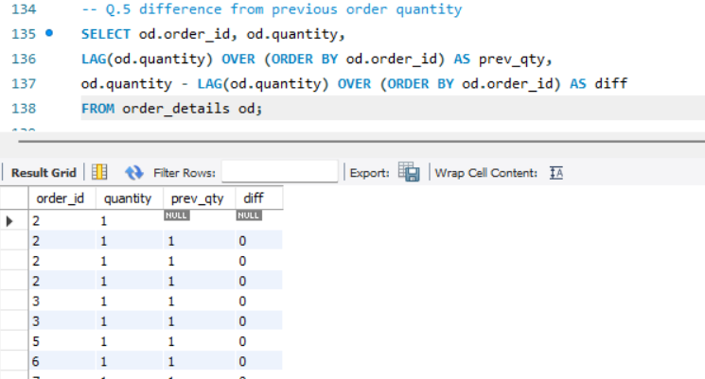
DIFFERENCE FROM PREVIOUS ORDER QUANTITY
Uses LAG() to access the previous row’s quantity.
Calculates the difference between current and previous order quantities.
Helps track changes or consistency in ordering patterns.
CONCLUSION:
Order quantities remain mostly stable, with minimal variation between consecutive orders.

Slide 16
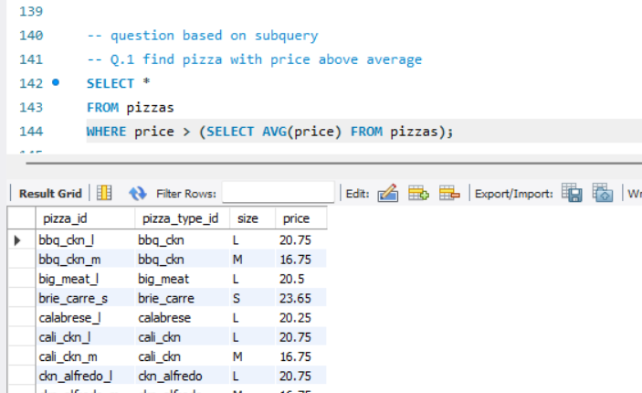
FIND PIZZA WITH PRICE ABOVE AVERAGE
Selects pizzas priced higher than the average price.
Uses a subquery to calculate average price.
Highlights premium or expensive pizzas.
CONCLUSION:
Some pizzas are priced above average, representing premium offerings in the menu.

Slide 17
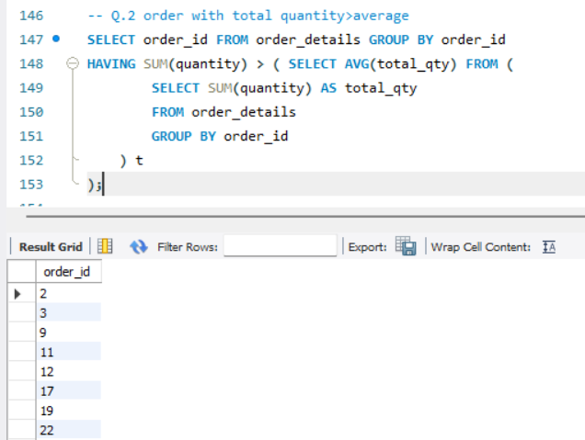
ORDER WITH TOTAL QUANTITY>AVERAGE
Finds orders where total quantity exceeds the average order quantity.
Uses aggregation and a nested subquery.
Identifies bulk or high-value orders.
CONCLUSION:
Certain orders exceed average quantity, indicating occasional bulk purchases.

Slide 18
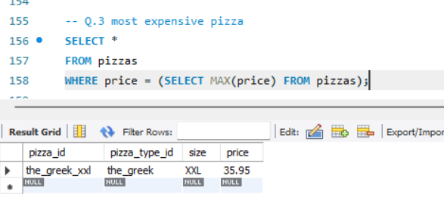
MOST EXPENSIVE PIZZA
Retrieves the pizza with the maximum price.
Uses a subquery with MAX(price).
Shows the costliest item on the menu.
CONCLUSION:
The highest-priced pizza represents a premium product with maximum value.

Slide 19
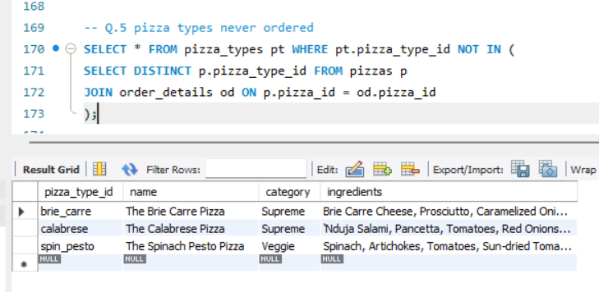
PIZZA TYPE NEVER ORDERED
Finds pizza types that were never included in any order.
Uses NOT IN with a subquery.
Helps identify unpopular or unused menu items.
CONCLUSION:
Some pizzas are never ordered, suggesting they may need removal or promotion.

Slide 20
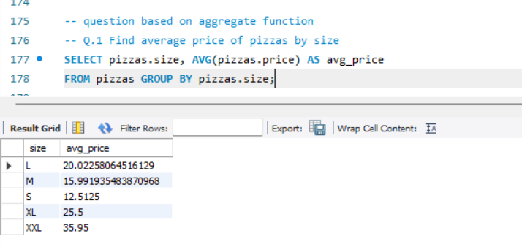
FIND AVERAGE PRICE OF PIZZAS BY SIZE
This query calculates the average price for each pizza size (S, M, L, XL, XXL).
It uses the AVG() function with GROUP BY size.
The result shows how price increases with size.
CONCLUSION:
Larger pizzas (XL, XXL) have higher average prices, while small sizes are the most affordable.

Slide 21
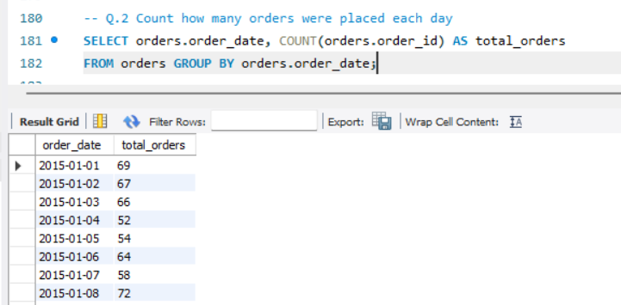
COUNT HOW MANY ORDERS WERE PLACED EACH DAY
This query counts how many orders were placed on each date.
It uses COUNT() grouped by order_date.
The result shows daily order activity.
CONCLUSION:
Order volume varies daily, helping identify peak business days for better planning.

Slide 22
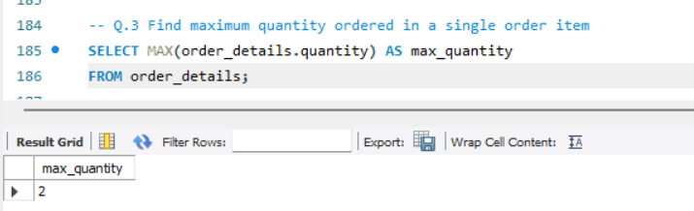
FIND MAXIMUM QUANTITY ORDERED IN A SINGLE ITEM
This query finds the highest quantity ordered in a single record.
It uses the MAX() function on quantity.
Shows the largest number of pizzas ordered at once in one item.
CONCLUSION:
The maximum quantity ordered at once is low (e.g., 2), indicating mostly small or individual orders.

Slide 23
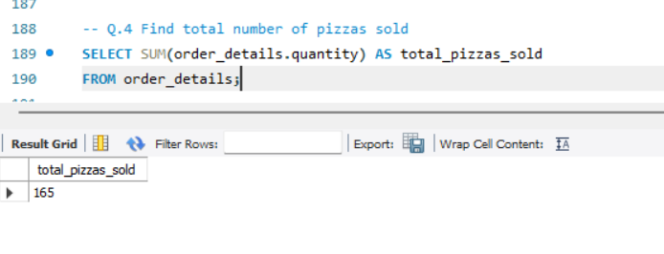
FIND TOTAL NUMBER OF PIZZAS SOLD
This query calculates the total pizzas sold across all orders.
It uses SUM(quantity) from order details.
Provides an overall sales volume.
CONCLUSION:
A total of 165 pizzas were sold, giving a clear picture of overall sales performance.

Slide 24
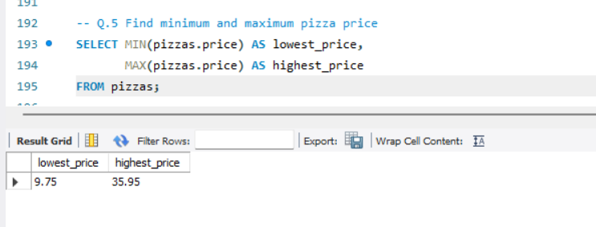
FIND MINIMUM AND MAXIMUM PIZZA PRICE
This query finds the lowest and highest priced pizzas.
It uses MIN() and MAX() functions.
Helps understand the price range of the menu.
CONCLUSION:
Pizza prices range from 9.75 to 35.95, showing a mix of budget and premium options.

Slide 25
conclusion
Identified top-selling pizzas and high revenue categories.
Observed sales patterns based on time and order quantity.
SQL joins and aggregation helped in meaningful insights.
Improved practical knowledge of database and data analysis.
Data-driven insights can help improve business decision.

