Slide 1
ALLDATA – Tech Assist
UI style specifications
Note:
This is not a 100% perfection style specifications.
Provided based on JPG/Screen shot image (since we don’t have source file from client)
Try to match nearest fonts for time being to start HTML development to meet the timelines. For now use ‘Arial’ font family and later need to change as per branding style guide.
Will change font style, color & sizes as per style guide - when we get it from client.
Hope this document will help to start HTML basic frame structure (to save time and instead of waiting
for client’s style documents).

Slide 2
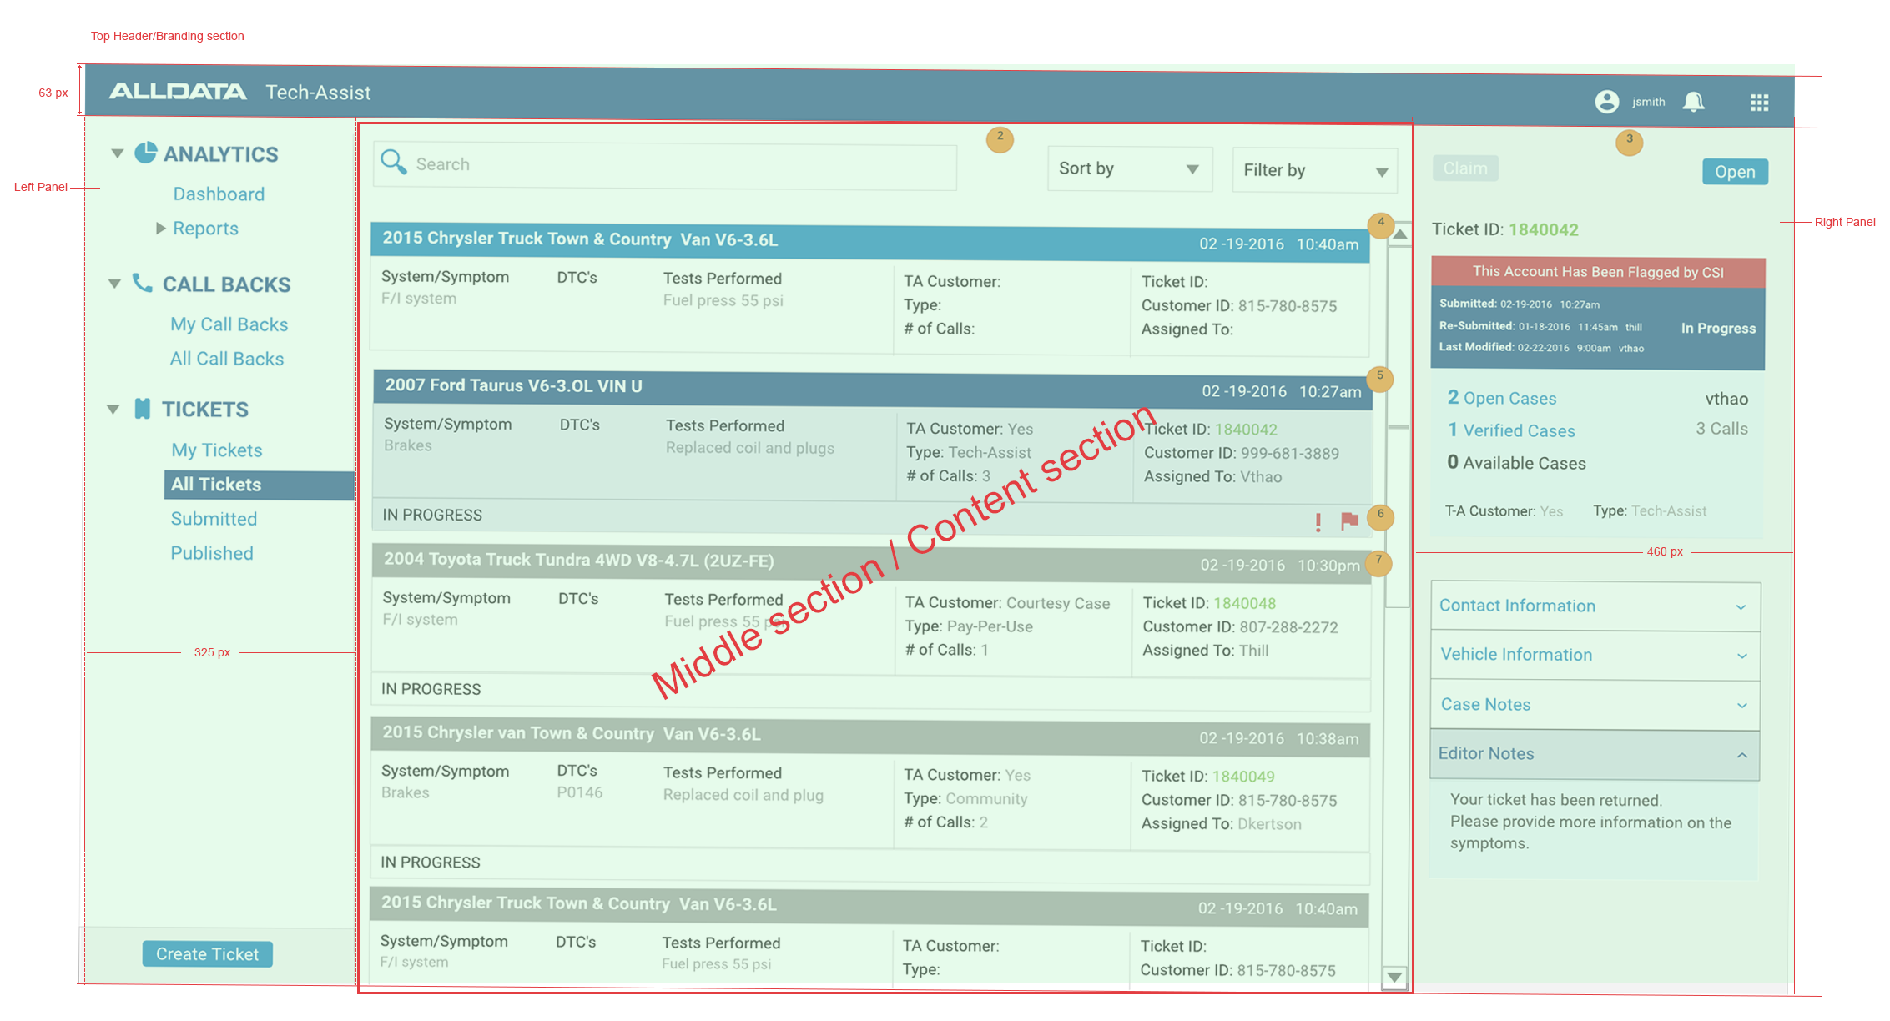

Slide 3
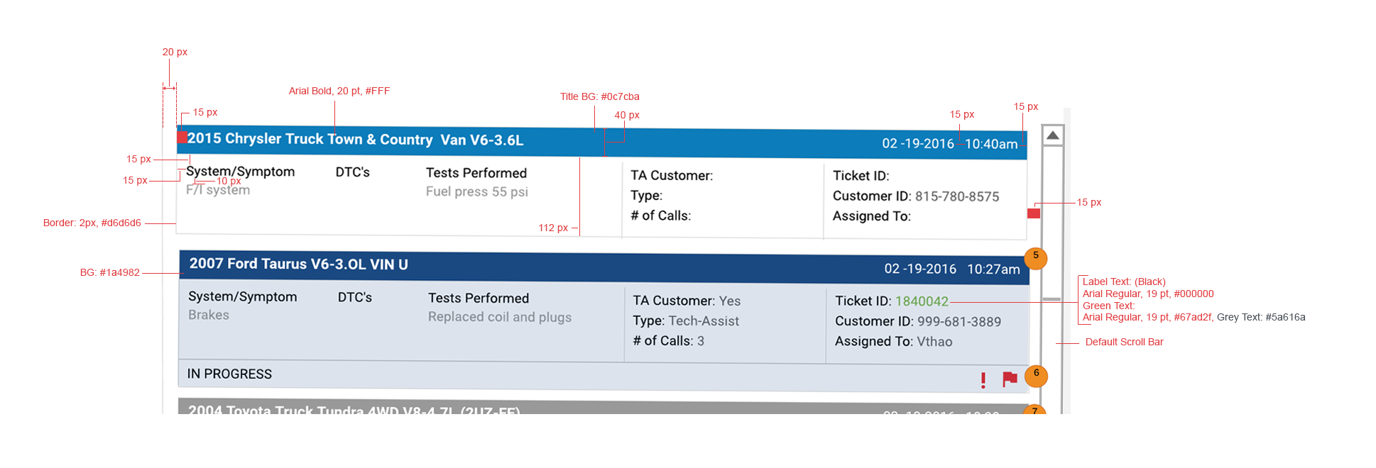

Slide 4
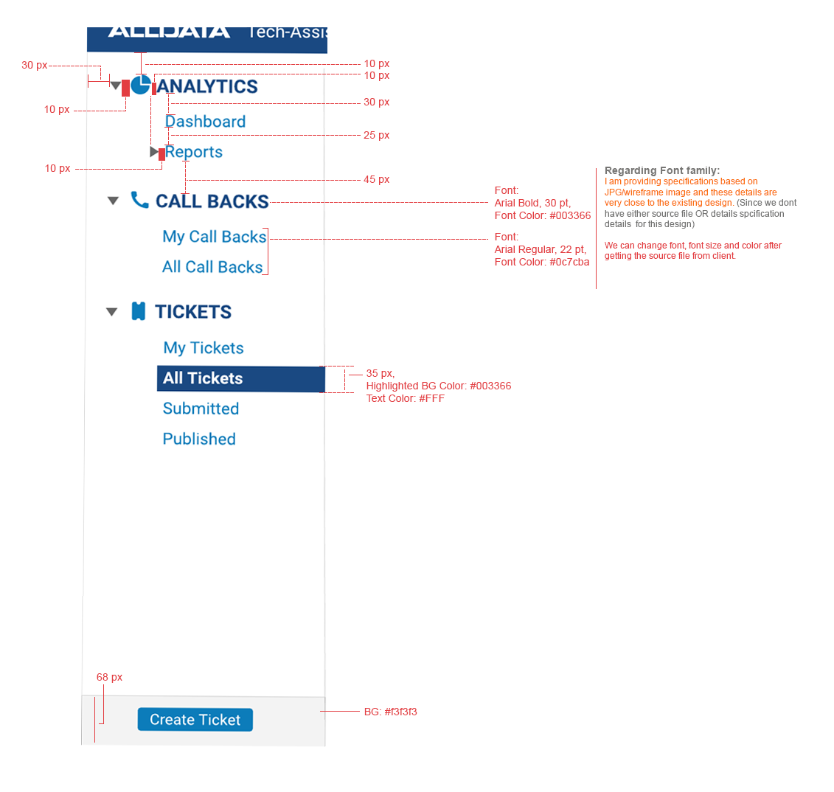

Slide 5
