Slide 1
DB2 UDB FOR Z/OS
Overview

Slide 2
DATABASE CONCEPTS

Slide 3
Objective of Session 1
What is a Database ?.
Why we need to use Database ?.
Database Management System Concept
Difference between File vs DBMS
DBMS Function
Database Model
RDBMS Concepts

Slide 4
What is a database ?
Data consists of facts and Information about people, objects, events or any other items.
A database is a tool for storing and organising information (data)
Example for Database:
Retail
Insurance
Banking
Financial
Storing Data
DATABASE
Organizing Data
Managing Data
Notes:
Examples:
Note Book
Digital Dairy

Slide 5
Why we need to use database?
Storing large amounts of information
Finding and displaying data quickly
Data can be updated and changed easily
Data available in different locations
Data can be transferred easily
Summaries of data easily available.
Data can be easily sorted, in different ways

Slide 6
Where does Database get stored ?.
FILES

Slide 7
Where does Database get stored ?.
Operating System
CPU
Database Software
Database
Memory
Hard Disk
Files
Files
Files

Slide 8
What is DBMS ?.
Overview

Slide 9
DBMS
Data: known facts that can be recorded and that have implicit meaning.
Database: Collection of related data
Database Management System: A computerized record-keeping system.
What Is a DBMS?
A very large, integrated collection of data.
_ Models real-world enterprise.
_ Entities (e.g., students, courses)
_ A Database Management System (DBMS) is a software package designed to store and manage databases.

Slide 10
Files vs. DBMS
Application must stage large datasets between main memory and secondary storage (e.g., buffering, page-oriented access, 32-bit addressing, etc.)
Special code for different queries
Must protect data from inconsistency due to multiple concurrent users
Crash recovery
Security and access control

Slide 11
Why use a DBMS ?.
Data independence and efficient access.
Reduced application development time.
Data integrity and security.
Uniform data administration.
Concurrent access, recovery from crashes.

Slide 12
DBMS Functions
Data Definition
Data Manipulation
Data Security and Integrity
Data Recovery and Concurrency
Performance

Slide 13
Database Models
File Management system
Hierarchical Management system
    Complex Retrieval
    Root – Parent –Sub Parent and Child Relationship
Network Management system
    Complex Retrieval
    Many – Many Relationship
Relational database Management system

Slide 14
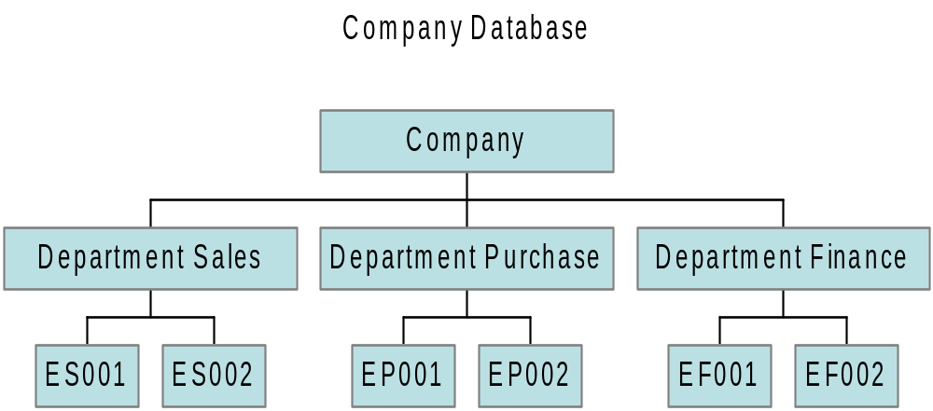
Hierarchical Management system

Slide 15
Relation Database Management System (RDBMS)
CUSTOMER
PAYMENT
ACCOUNT
ACCOUNT_TRANS
CUSTOMER – ACCOUNT (1:M)
  One Customer Many Account
ACCOUNT – PAYMENT (1:M)
  One Account Many Payment
  Example : CAR LOAN PAYMENT , TELEPHONE BILL PAYMENT
ACCOUNT – ACCOUNT TRANSACTION (1:M)
  One Account Many Transaction
  Example : Deposit Money , Payment Transfer Funds Withdraw Money

Slide 16
Different Type Of RDBMS
DB2 Universal Database
  Mainframe/AS400/UNIX/WINDOWS
ORACLE
SYBASE
SQL SERVER

Slide 17
DB2 Universal Database for Z/OS
RDBMS

Slide 18
Universal Database (UDB) DB2
DB2 is a RDBMS (Relational Database Management System)
RDBMS is used to view data in a Table Format (Rows and Columns )
Faster Search and Retrieval of Data
Better Secured (Security) and Control of Data
Data Independence (Physical and Logical )
Multiple Views
Backup and Recovery of Database
Data Shared

Slide 19

What is a Database?
Database – A collection of permanently stored data that is:
  Logically related (data relates to other data)
  Shared (many users may access data)
  Protected (access to data is controlled)
  Managed (data has integrity and value)
Win 2000
Win XP
Universal
Database(DB2)
UNIX
Client
Mainframe
Client

Slide 20
RDBMS Concepts
Overview

Slide 21
Review of Relational Concepts
Table | Rows and Columns
Row | A record
Column | A field
Data Value | Specific column for a specific row
Domain | Set of all possible data values for column(s).
Primary Key | Column(s) that uniquely identify a row.
Foreign Key | Column(s) that serve as a primary key in another table.

Slide 22
TABLE (Entity )
Entity Represents a Thing , For Example Employee ,Customer ,Account
EMPLOYEE
MANAGER
EMPLOYEE EMPLOYEE DEPT JOB LAST FIRST HIRE BIRTH SALARY
NUMBER NUMBER NUMBER CODE NAME NAME DATE DATE AMOUNT
PK
1006 1019 301 312101 Stein John 861015 631015 3945000
1008 1019 301 312102 Kanieski Carol 870201 680517 3925000
1005 0801 403 431100 Ryan Loretta 861015 650910 4120000
1004 1003 401 412101 Johnson Darlene 861015 560423 4630000
1007 1005 403 432101 Villegas Arnando 870102 470131 5970000
1003 0801 401 411100 Trader James 860731 570619 4785000
In a Employee (Entity)
  Employee Number, Dept Number, Job Code, Last Name, Hire Date ,Salary amount are called Attributes (Columns)
  Each Attributes has got his Own Behavior
  Employee Number Should be UNIQUE
  Dept Number should be valid and it should be present in Dept Table
  Salary Amount should be Numeric

Slide 23
Primary Key
Primary Key values uniquely identify each row in a table.
EMPLOYEE
MANAGER
EMPLOYEE EMPLOYEE DEPT JOB LAST FIRST HIRE BIRTH SALARY
NUMBER NUMBER NUMBER CODE NAME NAME DATE DATE AMOUNT
PK
1006 1019 301 312101 Stein John 861015 631015 3945000
1008 1019 301 312102 Kanieski Carol 870201 680517 3925000
1005 0801 403 431100 Ryan Loretta 861015 650910 4120000
1004 1003 401 412101 Johnson Darlene 861015 560423 4630000
1007 1005 403 432101 Villegas Arnando 870102 470131 5970000
1003 0801 401 411100 Trader James 860731 570619 4785000
In a relational model,
  A Primary Key is required for every table.
  Only one Primary Key is allowed in a table.
  It may consist of one or more columns.
  Primary Keys cannot have duplicate values.
  Primary Keys cannot be NULL.

Slide 24
Relational Databases
A Relational Database consists of a set of logically related tables.
A table is a two dimensional representation of data consisting of rows and
columns.
Column
EMPLOYEE
MANAGER
EMPLOYEE EMPLOYEE DEPT JOB LAST FIRST HIRE BIRTH SALARY
NUMBER NUMBER NUMBER CODE NAME NAME DATE DATE AMOUNT
1006 1019 301 312101 Stein John 861015 631015 3945000
1008 1019 301 312102 Kanieski Carol 870201 680517 3925000
1005 0801 403 431100 Ryan Loretta 861015 650910 4120000
1004 1003 401 412101 Johnson Darlene 861015 560423 4630000
1007 1005 403 432101 Villegas Arnando 870102 470131 5970000
1003 0801 401 411100 Trader James 860731 570619 4785000
Row
The employee table has nine columns of data.
It has six rows of data - one per employee.
There is no prescribed order for the rows of the table.
There is only one row “format” for the entire table.
Missing data values are represented by “nulls”.

Slide 25
Foreign Key
Foreign Key (FK) values identify table relationships.
EMPLOYEE (partial listing)
MANAGER
EMPLOYEE EMPLOYEE DEPT JOB LAST FIRST HIRE BIRTH SALARY
NUMBER NUMBER NUMBER CODE NAME NAME DATE DATE AMOUNT
PK FK FK FK
1006 1019 301 312101 Stein John 861015 631015 3945000
1008 1019 301 312102 Kanieski Carol 870201 680517 3925000
1005 0801 403 431100 Ryan Loretta 861015 650910 4120000
1004 1003 401 412101 Johnson Darlene 861015 560423 4630000
1007 1005 403 432101 Villegas Arnando 870102 470131 5970000
1003 0801 401 411100 Trader James 860731 570619 4785000
FK’s are optional - not all tables have them
More than one FK is allowed per table
FK’s can be made up of more than one column
Duplicate values are allowed
Missing (NULL) values are allowed
Changes are allowed
Each FK value must exist somewhere as a PK value
DEPARTMENT
MANAGER
DEPT DEPARTMENT BUDGET EMPLOYEE
NUMBER NAME AMOUNT NUMBER
PK FK
501 marketing sales 80050000 1017
301 research and development 46560000 1019
302 product planning 22600000 1016
403 education 93200000 1005
402 software support 30800000 1011
401 customer support 98230000 1003
201 technical operations 29380000 1025

Slide 26
Exercise: Answering Questions with a Relational Database
EMPLOYEE (partial listing)
MANAGER
EMPLOYEE EMPLOYEE DEPT JOB LAST FIRST HIRE BIRTH SALARY
NUMBER NUMBER NUMBER CODE NAME NAME DATE DATE AMOUNT
PK FK FK FK
1006 1019 301 312101 Stein John 861015 631015 3945000
1008 1019 301 312102 Kanieski Carol 870201 680517 3925000
1005 0801 403 431100 Ryan Loretta 861015 650910 4120000
1004 1003 401 412101 Johnson Darlene 861015 560423 4630000
1007 1005 403 432101 Villegas Arnando 870102 470131 5970000
1003 0801 401 411100 Trader James 860731 570619 4785000
DEPARTMENT
MANAGER
DEPT DEPARTMENT BUDGET EMPLOYEE
NUMBER NAME AMOUNT NUMBER
Questions:
1. Name the department in which James Trader works.
2. Who manages the Education Department?
3. Identify by name an employee who works for James Trader.
4. James Trader manages which department?
PK FK
501 marketing sales 80050000 1017
301 research and development 46560000 1019
302 product planning 22600000 1016
403 education 93200000 1005
402 software support 30800000 1011
401 customer support 98230000 1003
201 technical operations 29380000 1025

Slide 27
Advantages of a Relational Database Approach
The advantages of a Relational Database compared to other database methodologies are many.
Relational database methodology:
  Is easy to use
  Is easy to understand
  Makes applications easier to build
  Supports trend toward end-user computing
  Is the industry standard for most large enterprises
  Allows businesses to respond to changing conditions more flexibly than other types

Slide 28
Review Questions
Match each term with its definition below:
  ___ 1. Database
  ___ 2. Table
  ___ 3. Relational database
  ___ 4. Primary Key
  ___ 5. Null
  ___ 6. Foreign Key
  a - A set of columns which uniquely identify a row
  b - A set of logically related tables
  c - One or more columns that are a PK somewhere in the database
  d - The absence of a value
  e - A two-dimensional array of rows and columns
  f - A collection of permanently stored data

Slide 29
Objective of Session 2
Structured Query Language (SQL)
Simple Queries
Retrieving Data from Multiple Tables
Scalar Functions and Arithmetic
Column Functions and Grouping
Using Subqueries
Union Statement

Slide 30
DB2 UDB SQL
Overview

Slide 31
Introduction to SQL
Overview

Slide 32
Introduction to SQL
After completing this module, you will be able to:
Define the role of SQL in accessing a Relational Database.
Retrieve data from a relational table using the SELECT statement.

Slide 33
SQL –Structured Query Language
A complete data access maintenance language.
Designed for relational Database Management System (RDBMS).
An industry standard for relational databases.

Slide 34
SQL commands (DDL)
Data Definition Language (DDL) Examples
SQL statement | Function
CREATE | Define a database object (table, view, index, trigger or stored procedure)
DROP | Remove a table, view, index, trigger or stored procedure.
ALTER | Change a database object definition.

Slide 35
SQL commands (DML)
Data Manipulation Language (DML) Examples
SQL statement | Function
SELECT | Select data from one or more tables.
INSERT | Place a new row into table.
UPDATE | Change data values in one or more existing rows.
DELETE | Removes one or more rows from a table.

Slide 36
SQL commands (DCL)
Data Control Language (DCL) Examples
SQL statement | Function
GRANT | Give user privilege on database objects.
REVOKE | Remove user privileges on database objects.

Slide 37
CREATE Table Statement
Overview

Slide 38
Pre-Request
DATA Modeling knowledge
Identify Entity
Identify Entity Elements
Cardinality ( Relationship)
Normalization

Slide 39
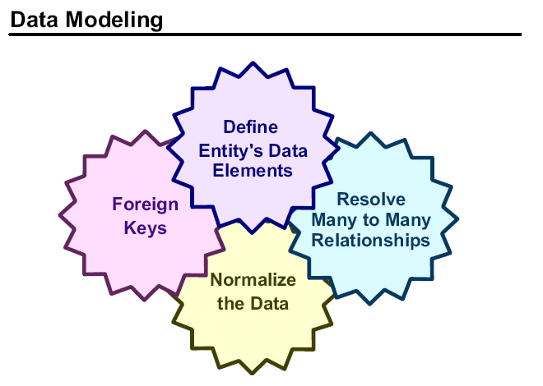
Data Modeling

Slide 40
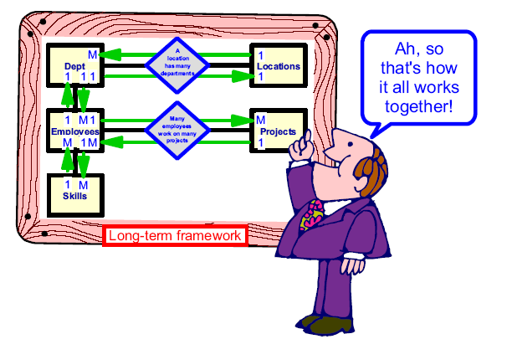
Business Modeling

Slide 41
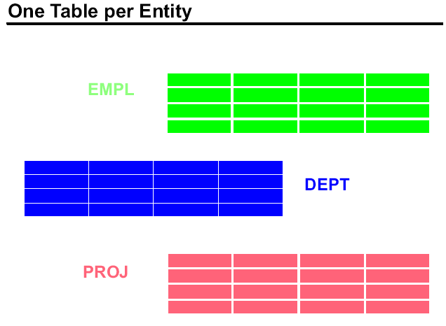
One Table Per Entity

Slide 42
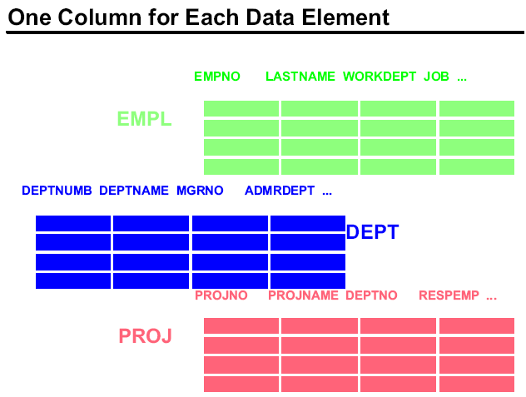
Attributes of Entity

Slide 43
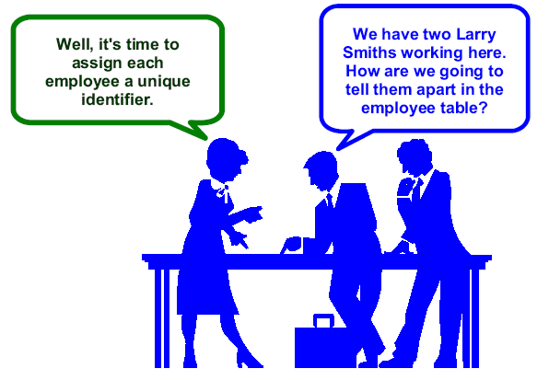
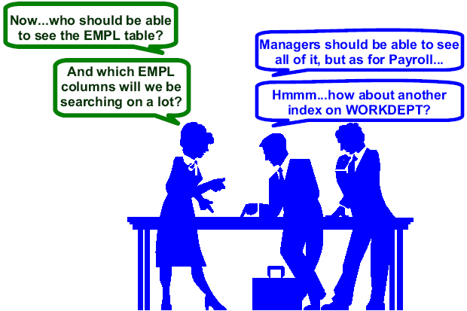
Identify Primary Key for Entity

Slide 44
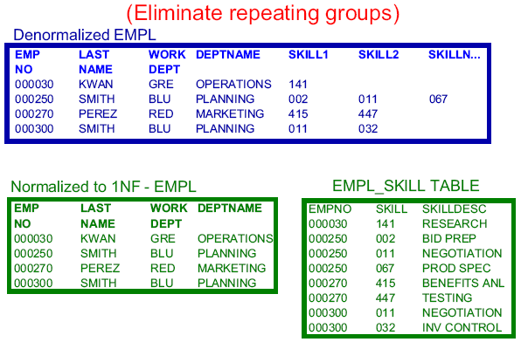
Normalization ( Avoid Redundancy ) – First Normal Form ( 1NF)

Slide 45
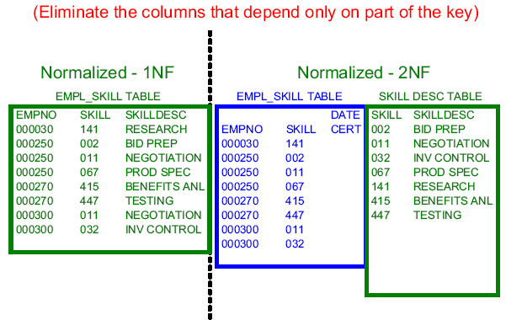
Normalization– Second Normal Form ( 2NF)

Slide 46
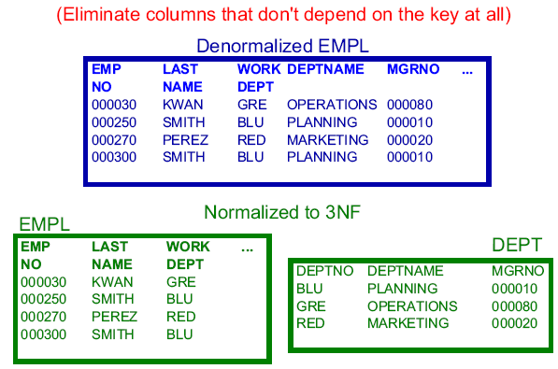
Normalization– Third Normal Form ( 3NF)

Slide 47
TABLE CREATION (ENTITY)
COLUMN NAME | DATA TYPE | LENGTH | BEHAVIOR OF COLUMN | MANDATORY
EMPNO | CHARACTER | 6 | UNIQUE | YES
FIRST_NAME | CHARACTER | 12
LAST_NAME | CHARACTER | 15
WORKDEPT | CHARACTER | 3
PHONENO | CHARACTER | 6
HIREDATE | DATE | 10 |  | YES
JOB | CHARACTER | 8
EDLEVEL | NUMERIC | 6
SEX | CHARACTER | 1 |  | YES
BIRTHDATE | DATE | 10 |  | YES
SALARY | NUMERIC | 11
BONUS | NUMERIC | 11
COMM | NUMERIC | 11
PASSPORTNO | CHARATER | 11 | UNIQUE

Slide 48
DATA TYPES
Overview

Slide 49
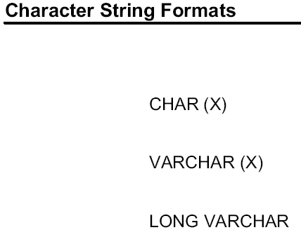
DATA TYPES—CHARACTER DATA TYPE
CHARACTERDATA | DESCRIPTION | EXAMPLE
CHAR(n) | Fixed length N=1 to 254 | Last_name CHAR(20) Ryan-----------
VARCHAR (n) | Variable length N= 1 to 64,000 | First_name VARCHAR (30) Loretta

Slide 50
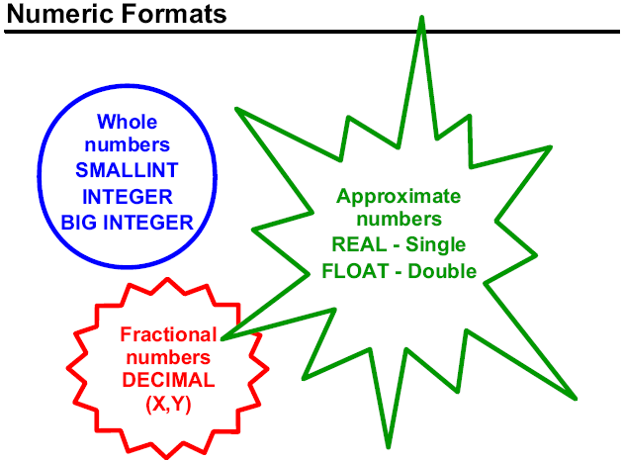
DATA TYPES—NUMERIC DATA
NUMERIC DATA | SIZE | DESCRIPTION | EXAMPLE
SMALLINT | 2 Bytes | Whole number range: -32,768 to 32,767 | Area_code SMALLINT +00213
BYTEINT | 1 Byte | Whole number range: -128 to 127 | Item_code BYTEINT +100
INTEGER | 4 Bytes | Whole number range: -2,147, 483,648 to 2,147,483,647 | Phone INTEGER +0006495252
DECIMAL (size,dec) | 2 to 8 Bytes | Decimal number max: 18 digits | Salary_amount DEC (10,2) +00035000.00
FLOAT | 8 Bytes | Floating Point Format (IEEE) 2 x 10⁻³⁰⁷ to 2 x 10-³⁰⁸ | Salary factor FLOAT 4.3540000000000E-001
DOUBLE PRECISION | 8 Bytes | Internally represented as FLOAT

Slide 51
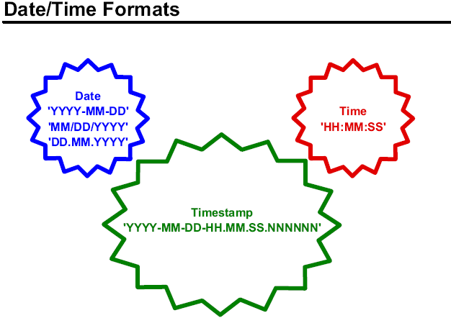
DATE/TIME DATA TYPES
DATE/TIME | DESCRIPTION
DATE | Special type of integer: YYMMDD thru 1999 YYYMMDD from 2000
TIME(n) | Stored as HHMMSS.nnnnnn
TIMESTAMP(n) | Stored as YYMMDD HHMMSS.nnnnnn

Slide 52
Data Definition Language
Data Definition Language (DDL) is used by SQL to create,
modify, and remove object definitions.
OBJECT DDL Statements
Tables Create TABLE
Alter Table
Drop Table

Slide 53
Column Definitions
Column name
  Name of the Column
Data Type
  Declare the column to be a character, byte, numeric, or graphic data type.
Data Type Attributes
  Specify DEFAULT, NOT NULL
Column-level Constraint Attributes
  Specify the single column as a primary or foreign key.
  Specify the single column as unique.

Slide 54
Column-level Constraints
CREATE TABLE JB (
JOBCODE VARCHAR(5) NOT NULL PRIMARY KEY ,
JOBNAME VARCHAR(25)
) IN LM01DB.LM01TS;
COMMIT;
CREATE TYPE 2 UNIQUE INDEX JBI ON JB (JOBCODE);
COMMIT;
CREATE TABLE DP (
DEPTNO SMALLINT NOT NULL PRIMARY KEY ,
DNAME VARCHAR(15)
) IN LM01DB.LM01TS;
CREATE TYPE 2 UNIQUE INDEX DPI ON DP (DEPTNO);
COMMIT;
Example:
CREATE TABLE EM (
EMPNO INTEGER NOT NULL PRIMARY KEY ,
ENAME VARCHAR(15) NOT NULL ,
DEPTNO SMALLINT,
JOBCODE VARCHAR(5),
SEX CHAR(1) ,
SALARY DECIMAL(9,2) ,
COMM DECIMAL(9,2),
FOREIGN KEY (DEPTNO) REFERENCES DP(DEPTNO),
FOREIGN KEY (JOBCODE) REFERENCES JB(JOBCODE)
) IN LM01DB.LM01TS;
COMMIT;
CREATE TYPE 2 UNIQUE INDEX EMI ON EM (EMPNO);
COMMIT;
Note: Table Dept and JOB should be created First.

Slide 55
Removing Tables
To remove all data associated with a table, as well as the table Structure
definition from the Data Dictionary, use the DROP TABLE statement.
Example:
DROP TABLE emp_data;
Deletes all data in emp_data;
Removes table headers for emp_data.
Removes the emp_data definition from the Data Dictionary.
Removes all explicit access rights on the table.

Slide 56
ALTER TABLE
ADD or drop a foreign key.
ADD a column in to a table.
ALTER TABLE emp_data
ADD educ_level CHAR(1), ADD insure_type SMALLINT;
ALTER TABLE emp_data
DROP educ_level, DROP insure_type;

Slide 57
INSERT STATEMENT
Overview

Slide 58
Insert Statement Example
INSERT INTO DEPT VALUES ( 10, 'SALES')
INSERT INTO DEPT(DEPTNO) VALUES ( 30)
INSERT INTO EMPLOYEE VALUES
( 104,'faj','jrish',10,'J1011','M',4000,.30)

Slide 59
UPDATE STATEMENT
UPDATE DEPT D
SET DNAME = ‘SALES FORCE’
WHERE D.DEPTNO = 30

Slide 60
DELETE STATEMENT
DELETE FROM EMPLOYEE
DELETE FROM EMPLOYEE WHERE EMPNO = 101

Slide 61
Simple SQL Queries
Overview

Slide 62
OBJECTIVE
After completing this unit, you should be able to:
Describe four clauses of an SQL SELECT statement
Use a SELECT statement to:
Retrieve all rows of a table
Retrieve specific columns
Retrieve rows based on comparisons to numeric or alphanumeric data
Retrieve rows based on specific columns containing NULL values
Use the keywords BETWEEN, IN, LIKE, DISTINCT
Order the resulting rows in a desired sequence

Slide 63
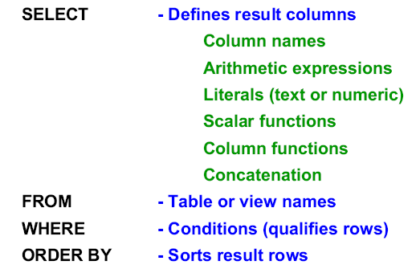
Structure of SQL Query

Slide 64
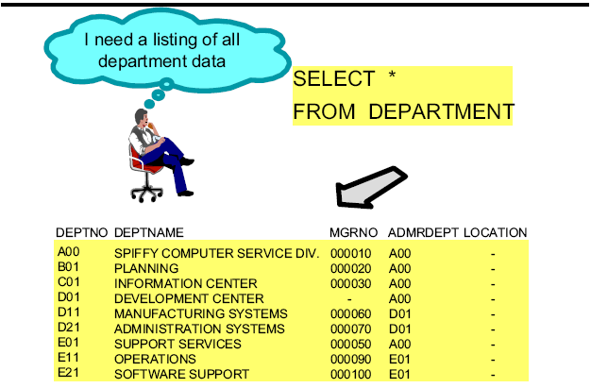
Retrieving All Column All Rows

Slide 65
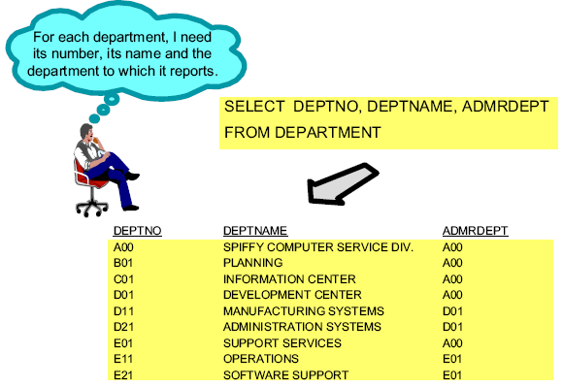
Selecting Specific Columns

Slide 66
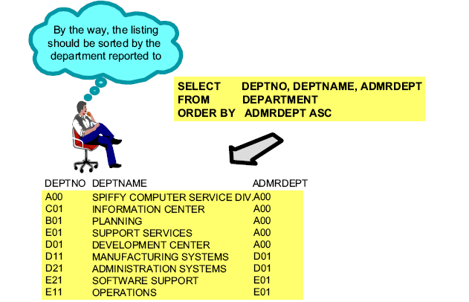
Select with Ordered Output

Slide 67
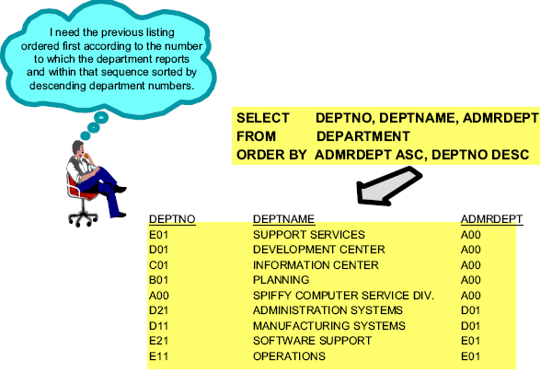
Select with Ordered Output

Slide 68
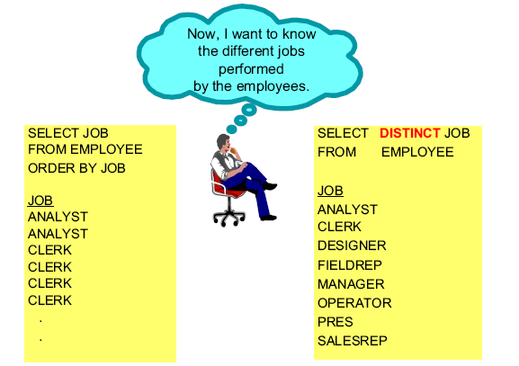
Suppressing Duplicate Output Rows

Slide 69
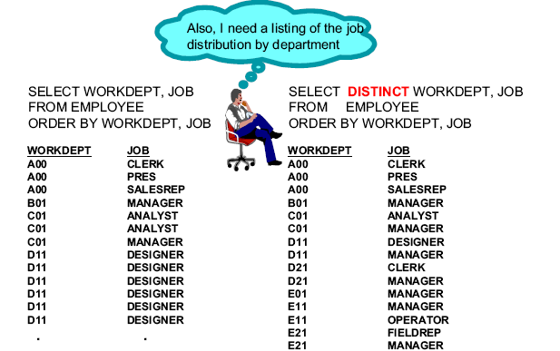
Suppressing Duplicate Output Rows

Slide 70
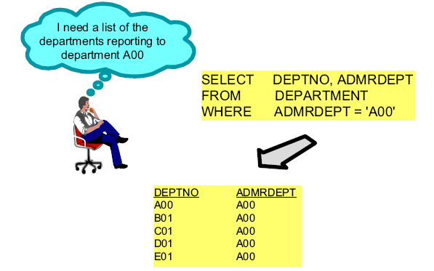
Retrieving Rows by Character Comparison

Slide 71
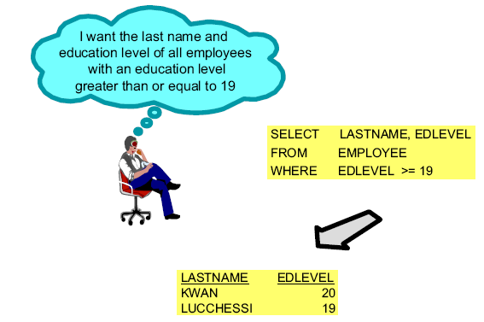
Retrieving Rows by Numerical Comparison

Slide 72
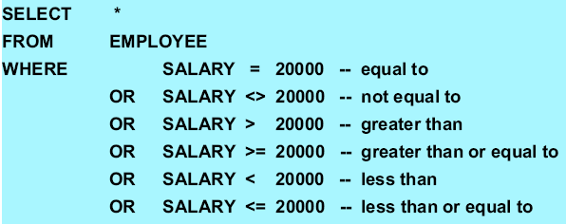
Comparison Operators

Slide 73
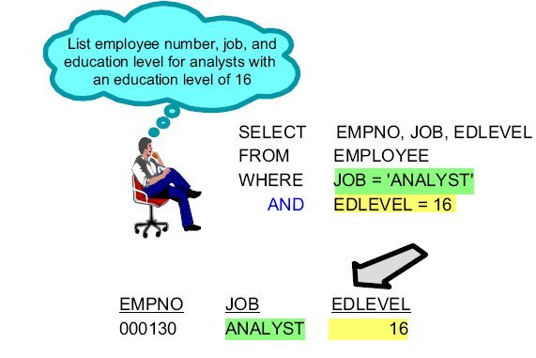
Multiple Conditions – AND

Slide 74
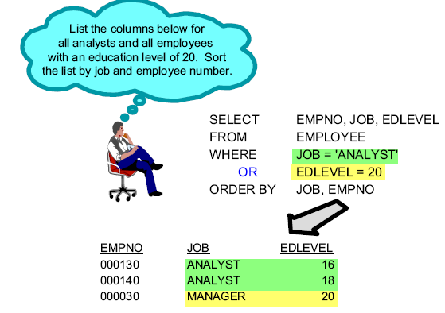
Multiple Conditions - OR

Slide 75
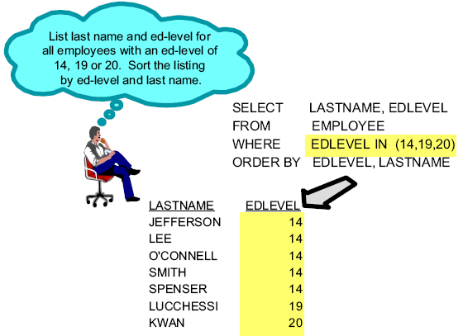
SELECT with IN

Slide 76
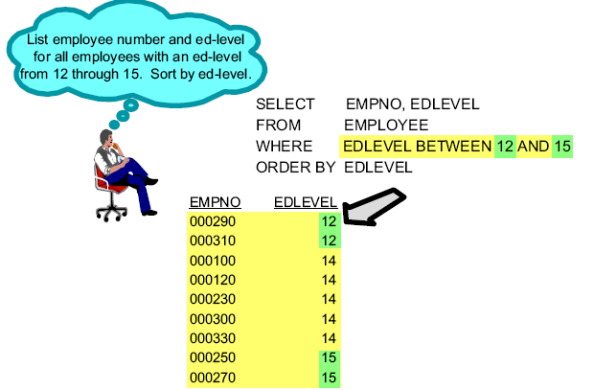
SELECT with BETWEEN

Slide 77
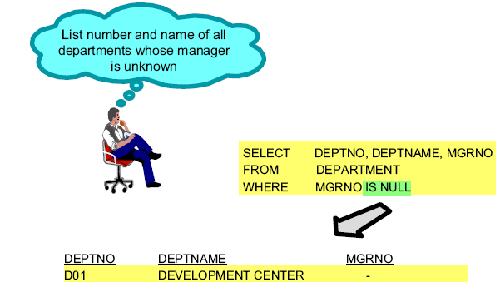
Retrieving Rows - Null Comparison

Slide 78
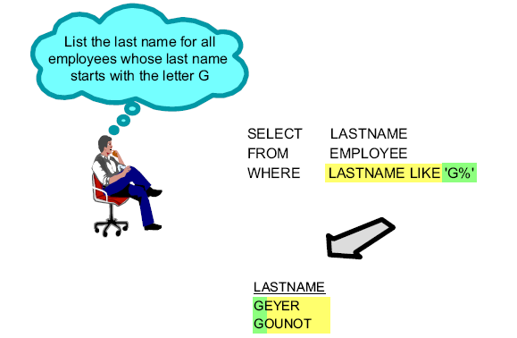
Partial String Search - LIKE

Slide 79
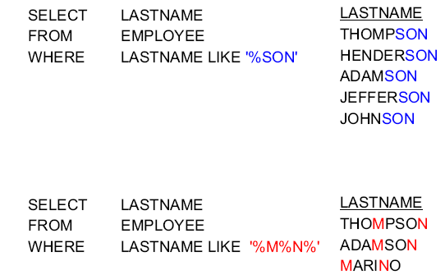
Partial String Search - Examples with '%'

Slide 80
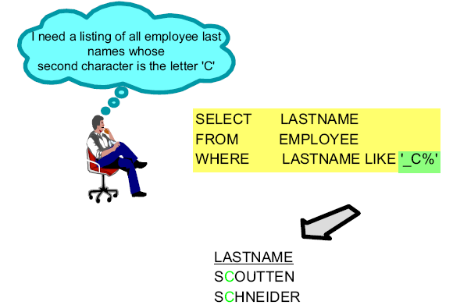
Partial String Search - Example with '_'

Slide 81
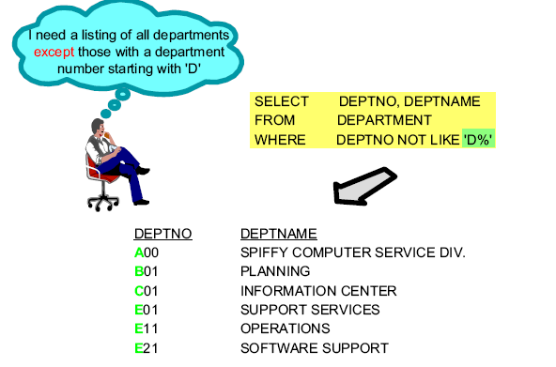
Negation

Slide 82
Retrieving Data From Multiple Tables
Overview

Slide 83
Join Operation
A Join is a concept in relational database theory.
A Join is a technique for accessing data from more than one table in a single answer set.
Each row in the answer set may contain data from columns of more than one table.
Tables should be joined on columns sharing common domains – rows that have identical values in the join column are matched up.
Joins can be used to make Views of data from more than one table.

Slide 84
Join TYPES
Inner Join | All matching rows.
Left Outer Join | Table to the left is used to qualify, table on the right has nulls when rows do not match.
Right Outer Join | Table to the right is used to qualify, table on the left has nulls when rows do not match.
Full Outer Join | Both Tables are used to qualify and extended with nulls.
Cross Join | Each row of one table is matched with each row of the other table.

Slide 85
Inner Join
An inner join returns an output row for each successful match between the join tables.
SELECT D.Department_number AS dept
,Department_name
,Last_name
,E.Department_number AS EMPDEPT
From Department D INNER JOIN
Employee E
ON E.Department_number = D.Department_number;
This result set contains:
Employee and department names where the employee’s department number matches an existing department.
This result set does not contains:
Employees with invalid or null department numbers.
Departments which have no employees assigned to them.

Slide 86
Left Outer Joins
A Left outer join returns inner join rows and non-matching rows from
The left table.
SELECT E.Department_number
,Department_name
,Last_name
FROM Employee E LEFT OUTER JOIN
Department D
ON E.Department_number = D.Department_number;
The results include:
Employees who have valid department numbers.
Employees who have invalid department numbers.
Employees who have no department number.

Slide 87
Right Outer Joins
A Right outer join returns inner join rows and non-matching rows from
the right table.
SELECT D.Department_number
,Department_name
,Last_name
FROM Employee E RIGHT OUTER JOIN
Department D
ON E.Department_number = D.Department_number;
The results include:
Departments and their associated employees.
Departments which have no employees.

Slide 88
Full Outer Joins
An full outer join returns inner join rows and non-matching rows from
both tables.
SELECT D.Department_number AS Dept
,Department_name
,Last_name
,E.Department_number AS EmpDept
FROM Employee E FULL OUTER JOIN
Department D
ON E.Department_number = D.Department_number;

Slide 89
Outer Joins of More Than Two Tables
Multi-Table Joins have the following requirements:
Only two tables may be joined at a time.
Each join must have an associated ON clause.
ON clause placement must associate the two tables
being joined.

Slide 90
Outer Joins of More Than Two Tables
SELECT Last_name AS Employee
,Department_Name AS Dept
,Description AS Job
FROM Department D RIGHT OUTER JOIN
Employee E
ON D.Department_Number = E.Department_Number
LEFT OUTER JOIN
Job J
ON E.Job_code = J.Job_code;
The query returns all employees including:
Employees with invlaid or null departments.
Employees with invalid or null job codes.

Slide 91
Outer Joins of More Than Two Tables
SELECT Last_name AS Employee
,Department_Name AS Dept
,Description AS Job
FROM Department D RIGHT OUTER JOIN
Employee E
ON D.Department_Number = E.Department_Number
LEFT OUTER JOIN
Job J
ON E.Job_code = J.Job_code;
The query returns all employees including:
Employees with invlaid or null departments.
Employees with invalid or null job codes.

Slide 92
Cross Join Example
Non-ANSI syntax
SELECT E.EMPNO,E.FIRSTNME,E.DEPTNO ,D.DEPTNO
FROM EMPLOYEE E , DEPT D
WHERE E.DEPTNO = D.DEPTNO

Slide 93
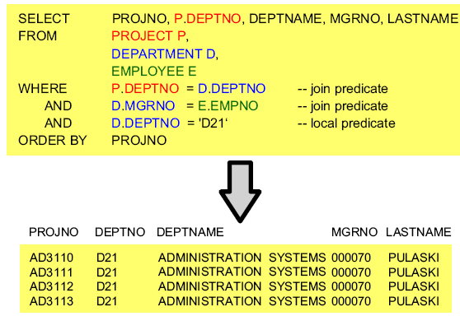
JOIN with Three Tables

Slide 94
Scalar Functions and Arithmetic

Slide 95
Objective
After completing this unit, you should be able to:
Use arithmetic in the SELECT and WHERE clauses
Use basic scalar functions such as COALESCE/VALUE,
DECIMAL, SUBSTR
Use date and time scalar functions
Use the CONCAT operator

Slide 96
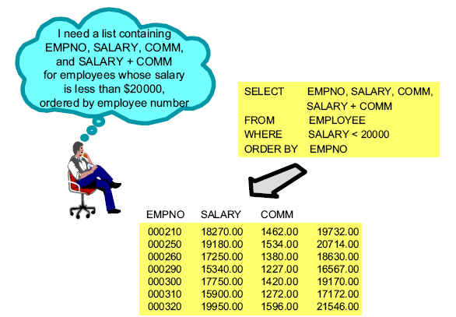
Selecting Calculated Values

Slide 97
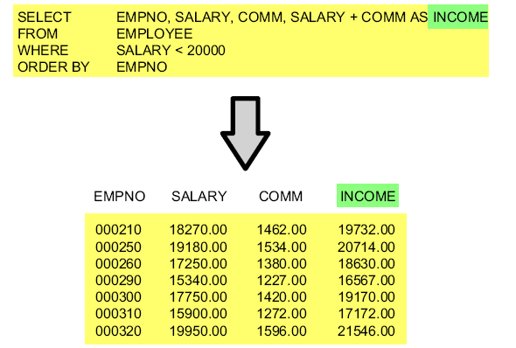
Naming Result Columns

Slide 98
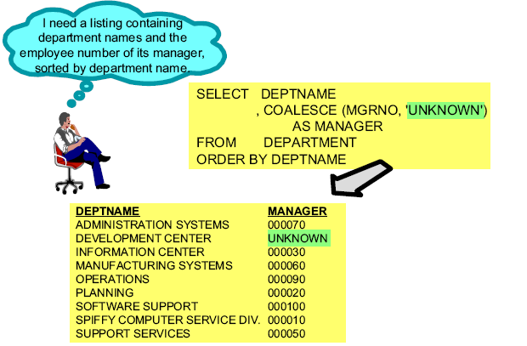
Substitution of NULL Values

Slide 99
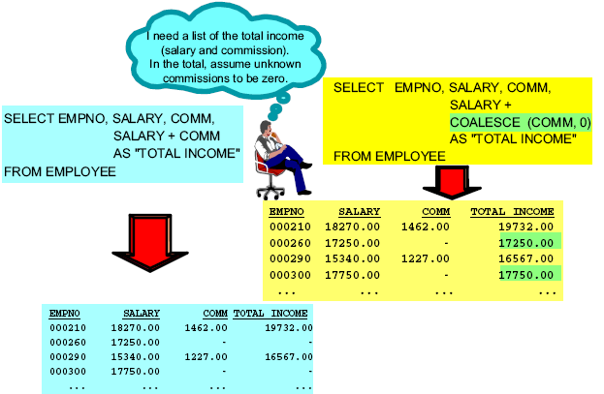
Arithmetic with NULL Values

Slide 100
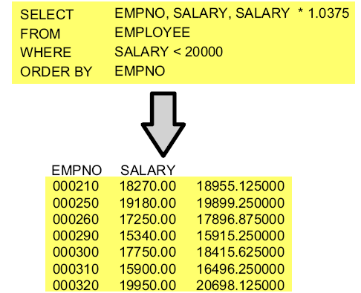
Calculated Values

Slide 101
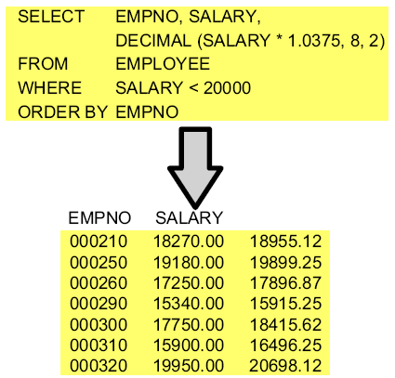
Decimal Representation of a Value

Slide 102
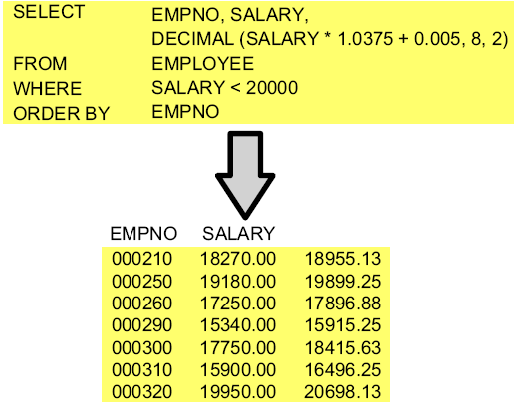
Decimal Values - Truncation and Rounding

Slide 103
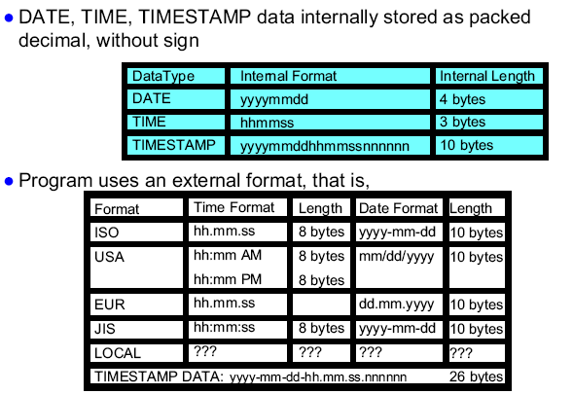
Date and Time

Slide 104
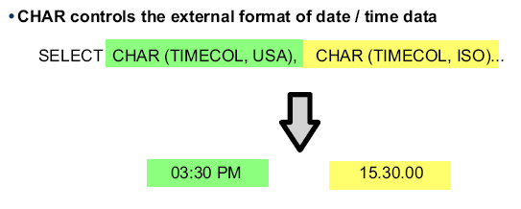
CHAR Function

Slide 105
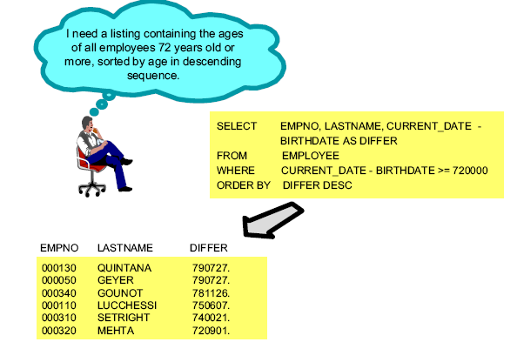
Comparison with Dates

Slide 106
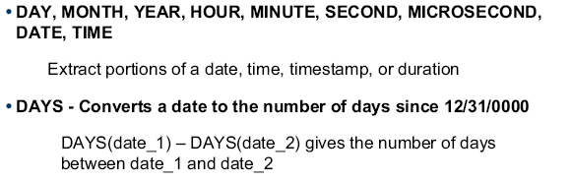
Date / Time Scalar Functions

Slide 107
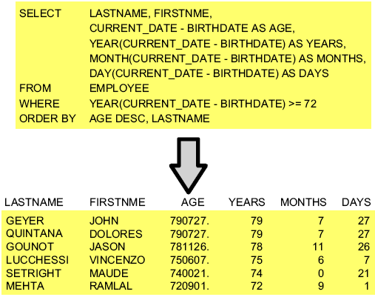
Date Scalar Functions

Slide 108
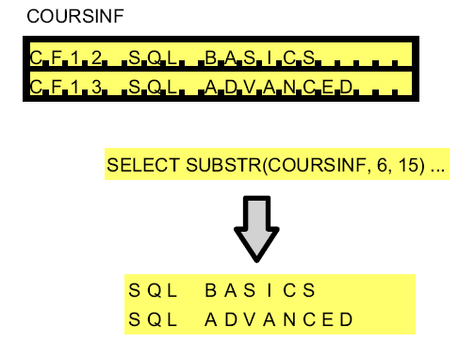
Substring of Strings

Slide 109
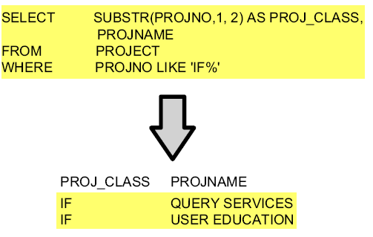
Substring of Strings

Slide 110
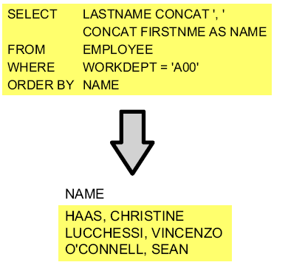
Concatenation of Values

Slide 111
Checkpoint
True or False? If you use the DECIMAL scalar function to
have two decimal positions instead of six, the result will be
rounded.
2. If you subtract two dates, the format of the result will be:
a. DD.MM.YYYY
b. YYYY-MM-DD
c. YYYYMMDD
3. Name several scalar functions.

Slide 112
Column Functions and Grouping

Slide 113
Unit Objectives
After completing this unit, you should be able to:
Describe the difference between scalar and column functions
List the more common DB2 column functions
Group rows into sets based on one or more columns

Slide 114
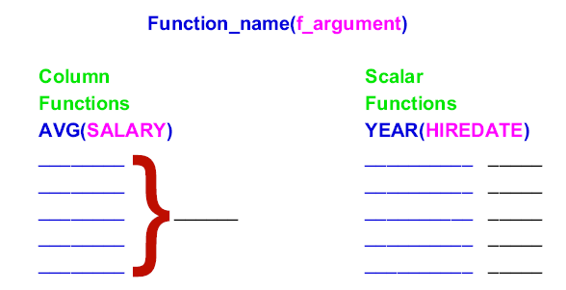
SQL Functions

Slide 115
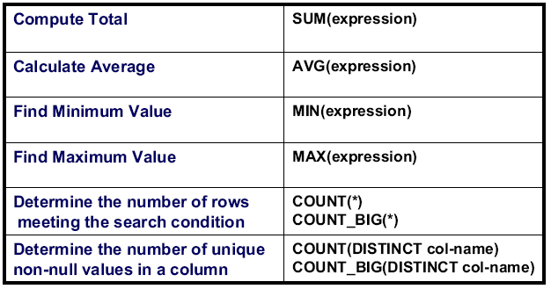
Column Functions

Slide 116

Sample Column Functions

Slide 117

Beware of Nulls

Slide 118

Column Functions Based on Subset

Slide 119

GROUP BY

Slide 120

GROUP BY more than one Column

Slide 121

GROUP BY, HAVING

Slide 122

GROUP BY, HAVING

Slide 123

Examples with HAVING

Slide 124

Restrictions

Slide 125
Checkpoint
1. True or False? A scalar function produces a summary row for a set of rows.
2. A SELECT statement whose SELECT list includes a column function (SUM, AVG, MIN, MAX, COUNT, and so forth) and three columns not in column functions does not require a GROUP BY clause.
3. Which clause qualifies groups for further processing?
  a. SELECT
  b. FROM
  c. WHERE
  d. GROUP BY
  e. HAVING
  f. ORDER BY
4. True or False? The following query is syntactically correct.
  SELECT WORKDEPT, AVG(SALARY) FROM EMPLOYEE
  WHERE AVG(SALARY) > 20000
  GROUP BY WORKDEPT
  HAVING COUNT(*) > 3
  ORDER BY 2 DESC

Slide 126
UNION

Slide 127

Multiple Queries - Multiple Reports

Slide 128

UNIONing Queries Together - Single Report

Slide 129

Union Rule Number 1

Slide 130

Union Rule Number 2

Slide 131

Union Rule Number 3

Slide 132

UNION ALL - Example 1

Slide 133

UNION ALL - Example 2

Slide 134

UNION ALL - Example 3

Slide 135


Slide 136

UNION

Slide 137
Checkpoint
1. True or False? The results of arbitrary SELECTs can be combined by means of UNION and ordered to get a new result.
2. Why or when should you use UNION?
  a. When all duplicate rows have to be eliminated.
  b. When SELECTs with an arbitrary number of columns should be combined.
3. Which rules do you have to consider when using UNION?

Slide 138
Using Subqueries

Slide 139
Unit Objectives
After completing this unit, you should be able to:
Use subqueries in WHERE and HAVING clauses
Code subqueries using basic predicates
Code subqueries using IN

Slide 140

Result Using Separate Selects

Slide 141

Same Result Using a Subquery

Slide 142

Subquery with Basic Predicates

Slide 143

Subquery Using IN

Slide 144

Variations on Predicates

Slide 145

Subquery Using IN

Slide 146

Subquery Using NOT IN

Slide 147

Subquery within HAVING Clause

Slide 148
Restrictions/Reminders
Subqueries
Must be on right side of search condition when used in WHERE clause or in HAVING clause
Must be enclosed in parentheses
Can return single or multiple values
Number of values subquery can return must be compatible with operator in outer SELECT
The subquery must return the same number of items as in the list to which it is compared

Slide 149
Checkpoint
True or False? Subqueries can be used in WHERE or HAVING
clauses of a SELECT.
2. If you want to list the employees whose salary is the highest,
the outer query's WHERE clause may be coded:
    a. WHERE SALARY > (SELECT SALARY FROM EMPLOYEE..)
    b. WHERE SALARY = (SELECT MAX(SALARY) FROM EMPLOYEE..)
    c. WHERE SALARY > ALL (SELECT SALARY FROM EMPLOYEE..)
3. What is the keyword taught in this topic that compares a single value to a set of values returned by a subquery, looking for a match?

Slide 150
Maintaining Data

Slide 151

Create Table TESTEMP

Slide 152

Create View PERSINFO

Slide 153

Insert Multiple Rows

