Slide 1
DB2 UDB FOR Z/OS
Overview

Slide 2
DB2 Application Programming
Using Embedded SQL

Slide 3
Program Structure
Overview

Slide 4
Why we need Embedded SQL ?.
Question

Slide 5
Where to Embedded SQL Statement ?.
Question

Slide 6
Host Languages
COBOL
PL/1
C
Assembler
FORTRAN
Notes:
Notes:
A DB2 application consists of embedded SQL statement in a host language. DB2 supports host languages like COBOL,C,PL/1. FORTRAN and Assembler.

Slide 7
Supporting Embedded SQL
Use delimiters to identify SQL statements in the application
Use host variables to provide values on the WHERE clause or receive values from SELECT statements
Use appropriate techniques to process null data
Use communications from DB2 to determine success or failure of SQL statements

Slide 8
Embedded SQL Types
Overview

Slide 9
Embedded SQL Types
Static SQL
  SQL Statements are presented in Program with same function and same table
Dynamic SQL
  SQL Statements are called at Run Time , Every time new Function , New Table

Slide 10
Embedded SQL
Delimited all SQL statements
Declare a Communication Area
Describe Host Variables
Code SQL statements to access DB2 data
Handle Exceptional Conditions
Notes:
Notes:
Data residing in DB2 tables can be accessed from 3GL languages like COBOL,C by embedding SQL statements in them.
For a COBOL program to communicate with DB2, certain steps have to be taken. In this session, each of the steps will be discussed in detail.

Slide 11
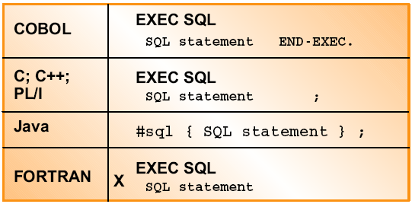
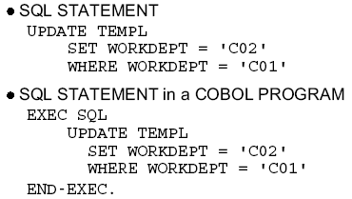
SQL Delimiters
Used by PRECOMPILER to identify SQL statements to be translated.
Must indicate beginning and end of each embedded SQL statement.
The EXEC SQL must not be coded before column 12.
COBOL comments are allowed any where within the delimiters
Notes:
Notes:
For the pre-compiler to extract the SQL from A COBOL program, the SQL statements must be delimited. Each SQL statement in a COBOL program must begin with EXEC SQL and end with ENDEXEC. There need not be a period after the END-EXEC. Period must be placed with care making sure that placing it will not end a IF statement inadvertently.
The EXEC and SQL statements must appear on one line and rest of the statements can appear on subsequent lines.
COBOL comments (* in column 7) can be included in the SQL statements.
If the EXEC SQL starts before the 12th column, that SQL statement is ignored by the precompiler. The EXEC SQL, END-EXEC and SQL statements should always;be coded between columns 17 to 72 (The MARGINS can be set by a pre-compiler option).
COBOL Language statements are not allowed to be placed between EXEC SQL and END-EXEC Only SQL is allowed between the delimiters.
Note that in PL/1 and C the embedded SQL statements are delimited by EXEC SQL and ;

Slide 12
Host Variables and Declaration
Overview

Slide 13
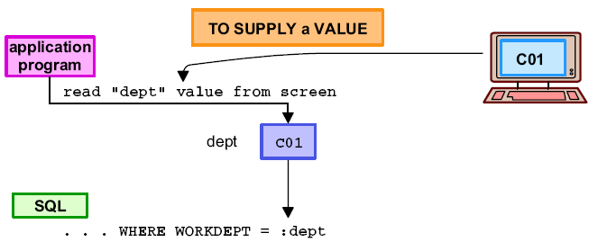
Host Variables
OPTIONAL, used to allow setting a value before statement is executed
Host language label in SQL statement preceded by a colon
Host variable must match column data type
Not usable for DB2 names (Tablename, columnname, . . .)
Notes:
Notes:
Host Variable is a data item declared in COBOL for use with an SQL statement. A host variable is used for the following purposes:
Retrieving data into the host variables for using it the application program
Place data into host variables to insert into a table or update a table
Use the data in the host variable when evaluating a WHERE or HAVING clause
Assign the values in the host variables to a special register
Insert NULL values into columns using an indicator host variable
Use host variables to process dynamic SQL statement
All Host variables must be declared before there first use in an SQL statement in the COBOL DATA DIVISION.
A colon(:) must precede all host variable in an SQL statement. Otherwise, the pre-compiler assumes the host variable to be a column name. But the colon is not required when the host variable is accessed outside the SQL statement. Placing the colon would result in a COBOL compiler error.

Slide 14
Host Variables Example
MOVE 2120 TO WS-EMPNO
EXEC SQL
SELECT EMPNO, LASTNAME,SEX
INTO :WS-EMPNO, :WS-LAST,:WS-SEX
FROM EMPLOYEE
WHERE EMPNO= : WS-EMPNO
END-EXEC
Notes:
Notes:
Host Variable is a data item declared in COBOL for use with an SQL statement. A host variable is used for the following purposes:
Retrieving data into the host variables for using it the application program
Place data into host variables to insert into a table or update a table
Use the data in the host variable when evaluating a WHERE or HAVING clause
Assign the values in the host variables to a special register
Insert NULL values into columns using an indicator host variable
Use host variables to process dynamic SQL statement
All Host variables must be declared before there first use in an SQL statement in the COBOL DATA DIVISION.
A colon(:) must precede all host variable in an SQL statement. Otherwise, the pre-compiler assumes the host variable to be a column name. But the colon is not required when the host variable is accessed outside the SQL statement. Placing the colon would result in a COBOL compiler error.

Slide 15
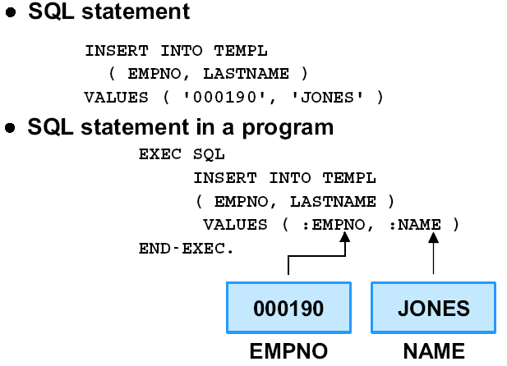
Host Variables - Insert - COBOL Program

Slide 16
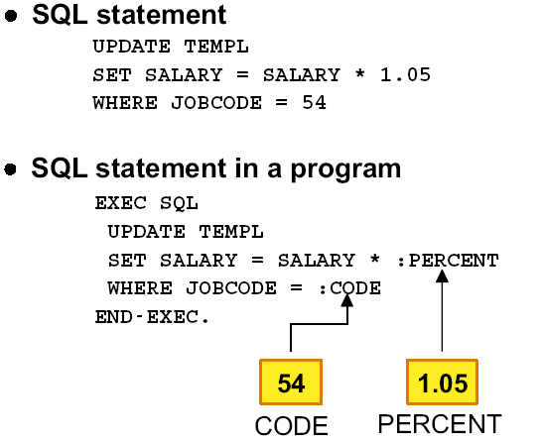
Host Variables - Update - COBOL Program

Slide 17
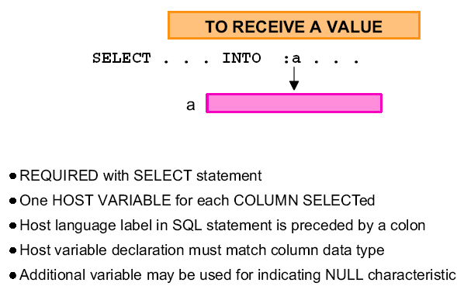
Host Variables - To Receive a Value

Slide 18
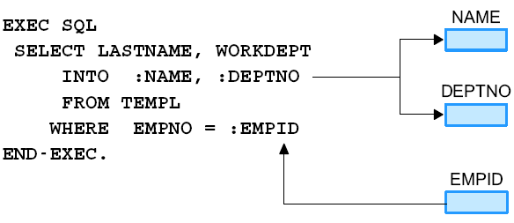
Receiving a Value - COBOL Program

Slide 19
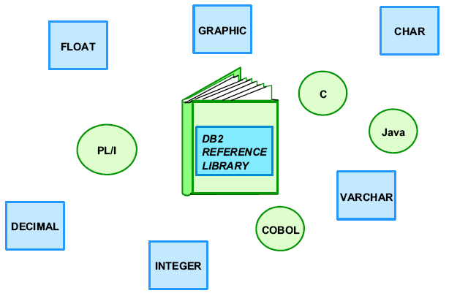
Declaring Host Variables Language Definitions

Slide 20
Declaring COBOL Host Variables
All COBOL host variables must be explicitly declared in the DATA DIVISION.
A colon ( : ) must precede all host variables in an SQL statement
The names of the host variables must be unique within the program.
Host variables, other than indicator variables, cannot be defined as arrays.
An OCCURS clause must only be specified when defining an indicator structure.
Notes:
Notes:
Let us summarize the rules regarding usage of COBOL host variables. Indicator variables are covered in the current session.
All host variables must be declared before there first use. Because of the ONE-PASS nature of the DB2 pre-compiler , we cannot place host variables after an SQL statement that references it.
Optionally, we can place the host variables between a BEGIN DECLARE SECTION and END DECLARE SECTION.
Common Pitfall: Since pre-compilation is the first step in the COMPILE Process, the COBOL COPY statements is not expanded during the pre-compile. Therefore, placing host variables in a copybook and using the COBOL COPY could result in a “UNDECLARED HOST VARIABLE” MESSAGE FROM THE PRE-COMPILER.

Slide 21
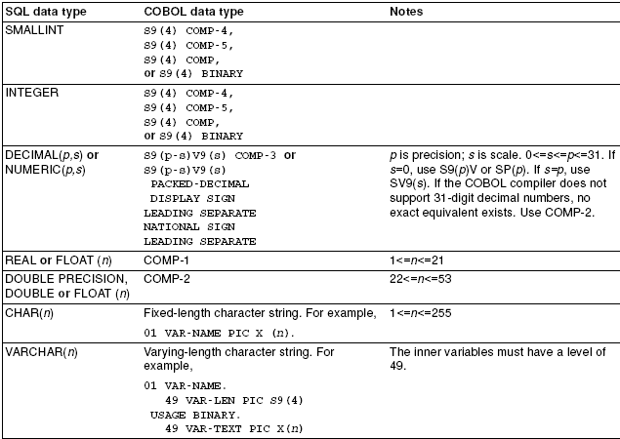
SQL Data Types Mapped to Typical COBOL Declarations

Slide 22
COBOL and SQL data types: Datetime
DATE PICX(10) - Format specified by an option
TIME PICX(08) - Format specified by an option
TIMESTAMP PIC X (26) String representation of timestamp has the format: yyy-mm-dd-hh.mm.ss.nnnnnn
Notes:
Notes:
In COBOL, there is no data type corresponding to the SQL data type DATE,TIME or TIMESTAMP . Each of these are represented as character strings.
DB2 stores DATE, TIME and TIMESTAMP in an internal format. But it also allows dates, times and timstamps to be specified as character strings.
For retrieval, datetime values must be assigned to a character string variable. When a date or time is assigned to a variable, the string format is determined by a pre-compiler option or a subsystem parameter.
In other operations (INSERT or UPDATE), the format of the datetime in the variable is converted by DB2 to internal format. Any valid format of the datetime value must be passed in the host variable.

Slide 23
Host Structure for COBOL Program
  Working-Storage Section.
  01 WS-EMP-STRUCT.
    05 WS-EMPNO PIC S9(9) USAGE COMP.
    05 WS-LAST PIC X (30).
    05 WS-SEX PIC X(01).
  MOVE 2120 TO WS-EMP.
  EXEC SQL
  SELECT EMPNO, LAST, SEX
  INTO : WS-EMP-STRUCT
  FROM EMPLOYEE
  WHERE EMPNO = :WS-EMP
  END-EXEC.
Notes:
Notes:
A host structure can be used everywhere a host variable is used. COBOL host structure have a maximum of two levels, even though the host structure might occur within a structure of multiple levels. That is, if we define a host structure as
01 A.
02 B.
03 C1.
03 C1.
A cannot be specified as a host structure. B can be specified as a host structure. B can be specified as a host structure.
Using a FILLER within a host structure is not allowed.

Slide 24
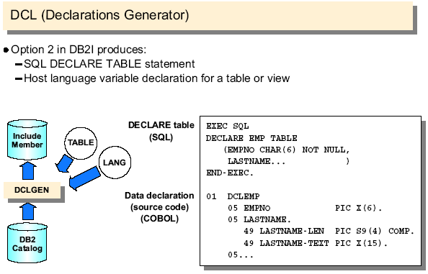
DCLGEN (Generating Host Variable )

Slide 25
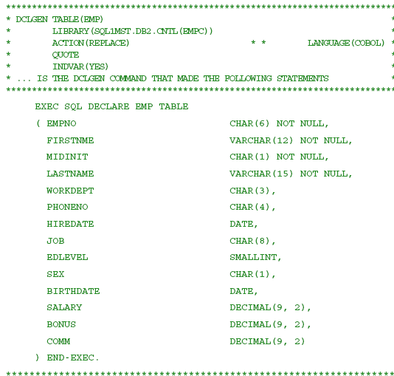
Example COBOL DCLGEN output:

Slide 26
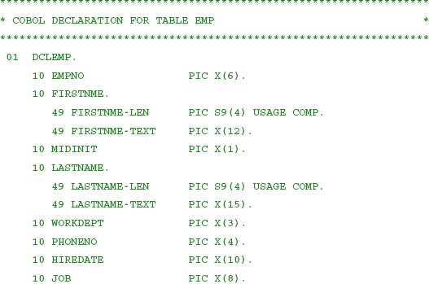
Example COBOL DCLGEN output:

Slide 27
How to include Host variable Declaration and SQL Communication Area predefined Declaration in Program
Overview

Slide 28
INCLUDE
    EXEC SQL
    INCLUDE SQLCA | SQLCA |member-name
    END-EXEC
Member-name
Member of the partitioned data set .
The member can contain any COBOL variable
declarations, source statements and any SQL statements
other than an INCLUDE statement.
Notes:
Notes:
To include SQL statement or COBOL host variable declarations from a member of a partitioned data set, we use the INCLUDE statement.
The DB2 pre-compiler expands the INCLUDE statement.
Nesting of INCLUDE statements is not allowed.
The SQL communication are (SQLCA) can be included using the statement
EXEC SQL
INCLUDE SQLCA
END-EXEC.

Slide 29
SQLCA (SQL Communication Area)
Overview

Slide 30
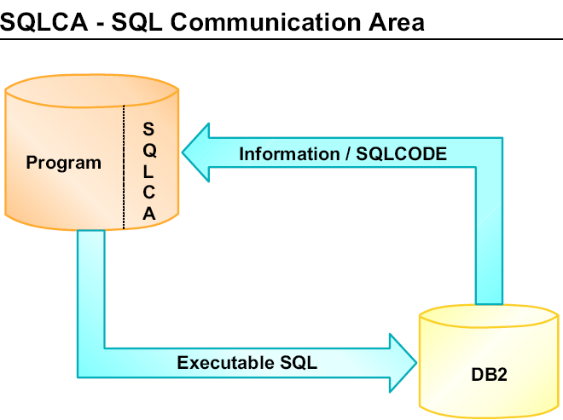
SQLCA

Slide 31
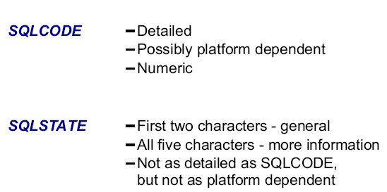
SQLCODE and SQLSTATE
SQLSTATE is set by the database manager after execution of each SQL statement.
Application programs can check the success of the execution of SQL statements by testing SQLSTATE instead of SQLCODE.

Slide 32
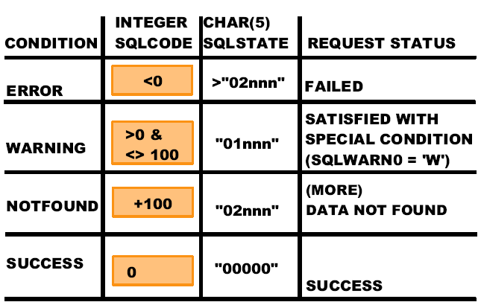
SQLCA ( SQLCODE & SQLSTATE) Examples

Slide 33
What is SQLCA Warring and why we require in Embedded SQL program
Question

Slide 34
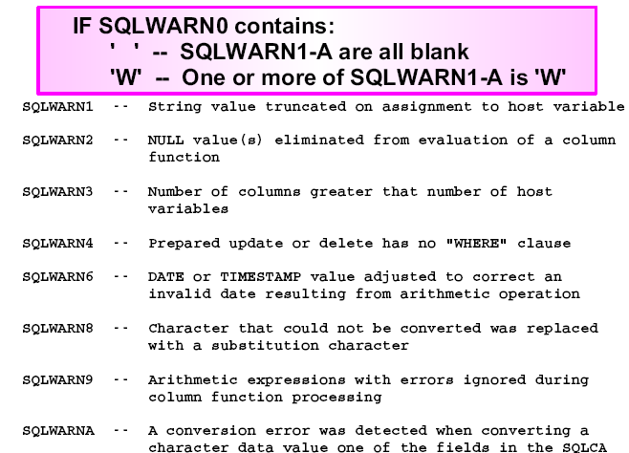
SQLCA Warnings

Slide 35
Example Program
Overview

Slide 36
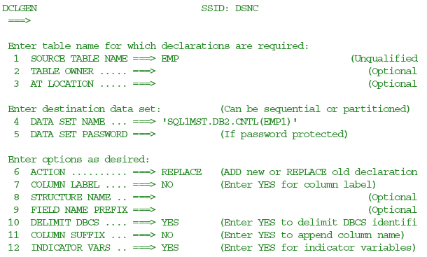
SPUFI screen to request DCLGEN:

Slide 37
Embedded SQL Program to Insert data into Employee Table
Overview

Slide 38
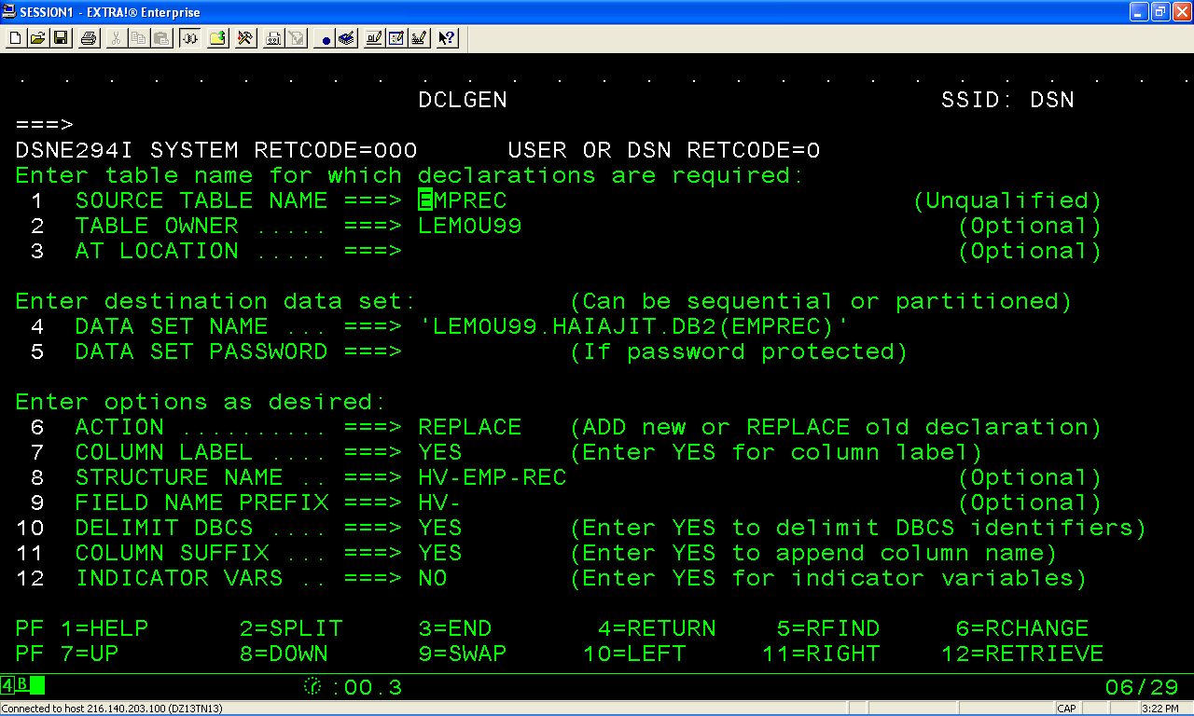
DCLGEN-Input

Slide 39
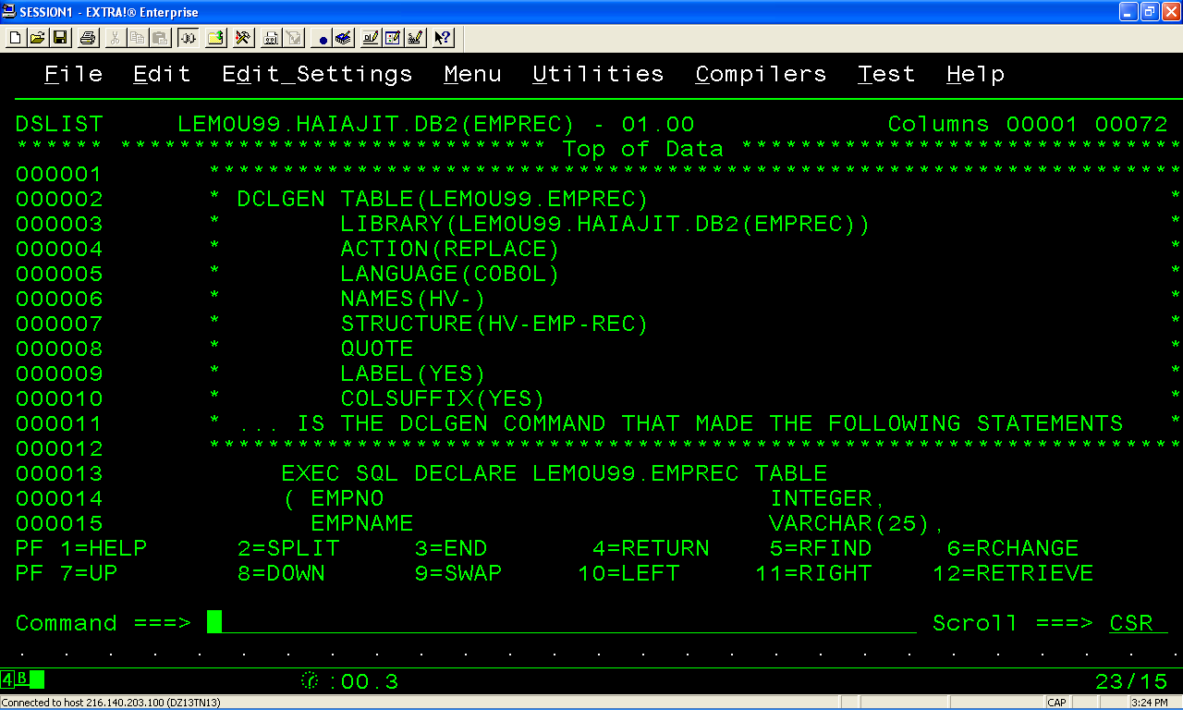
DCLGEN- Output

Slide 40
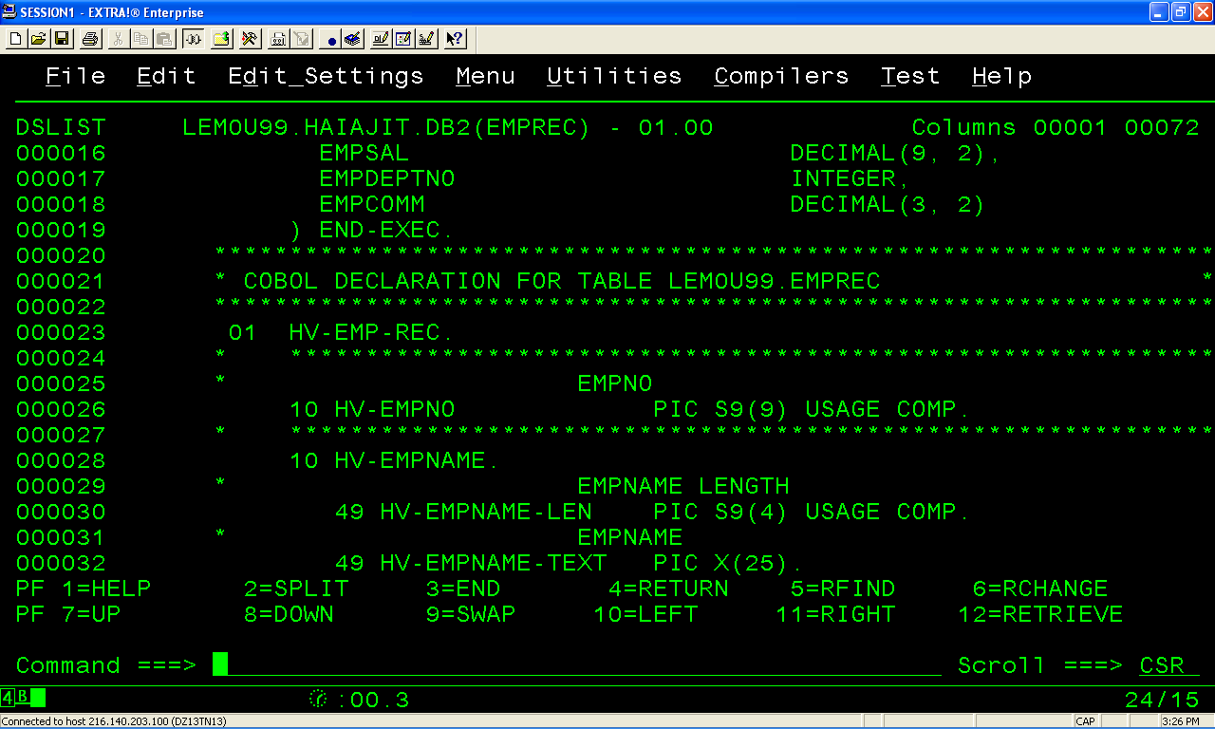
DCLGEN- Output

Slide 41
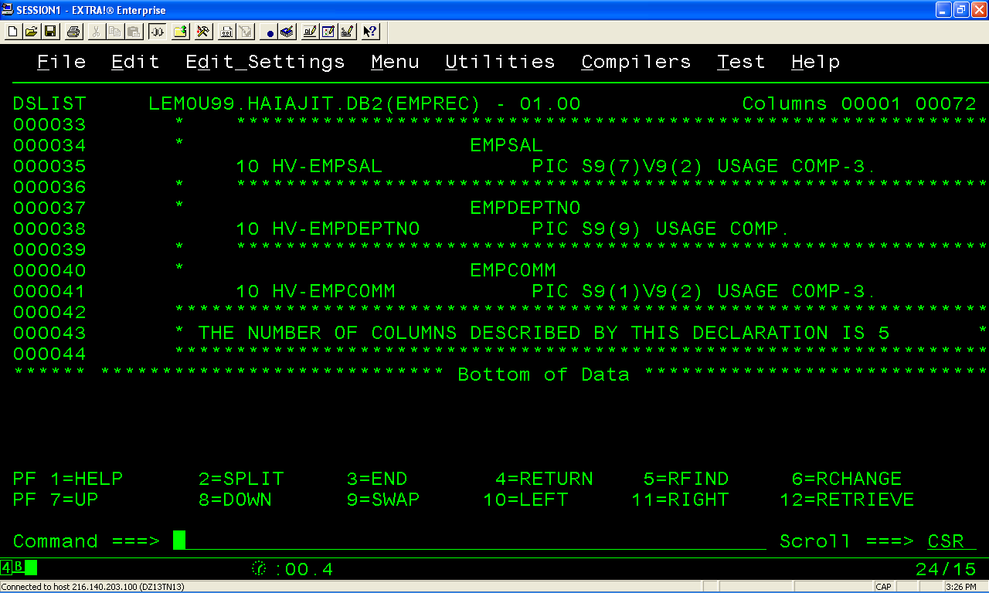
DCLGEN - Output

Slide 42
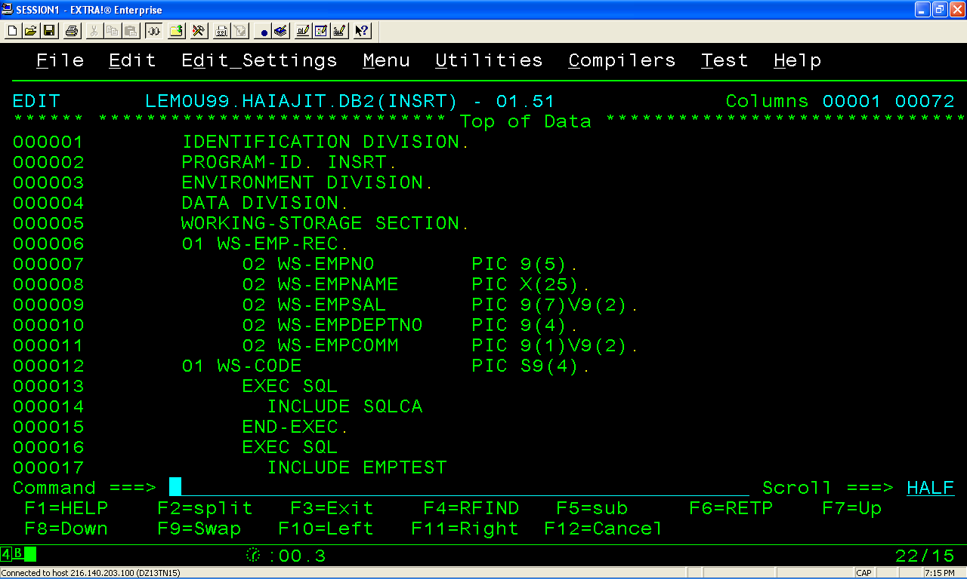
EMBEDED SQL –INSERT-COBOL Program

Slide 43
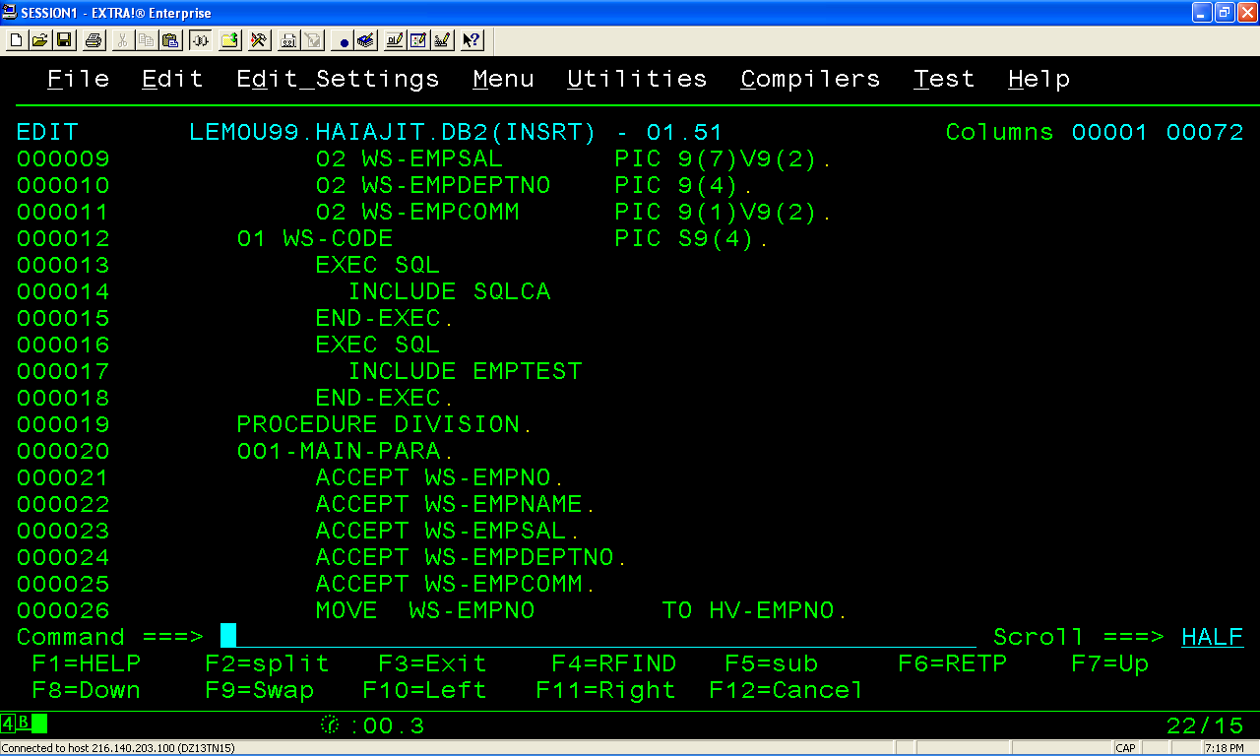
EMBEDED SQL –INSERT-COBOL Program

Slide 44
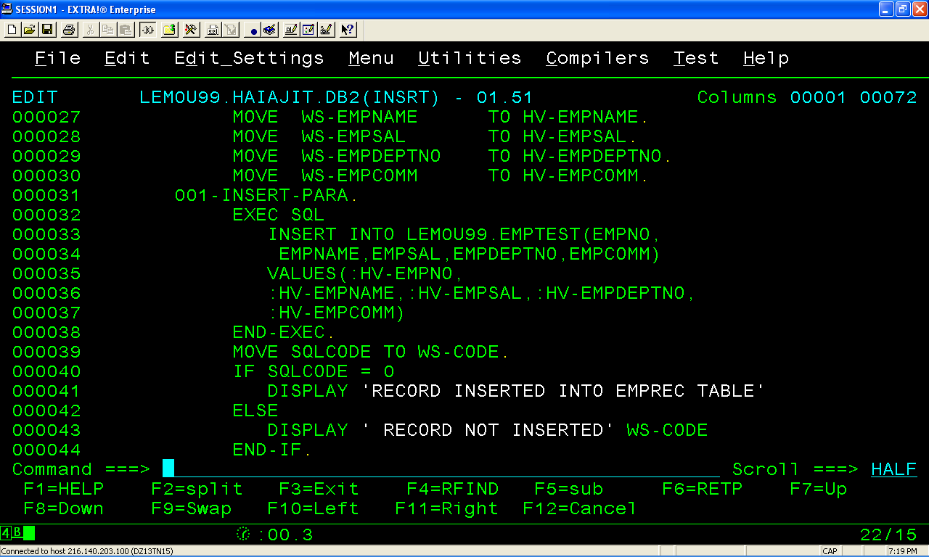
EMBEDED SQL –INSERT-COBOL Program

Slide 45
DB2 PRE-COMPILATION

Slide 46
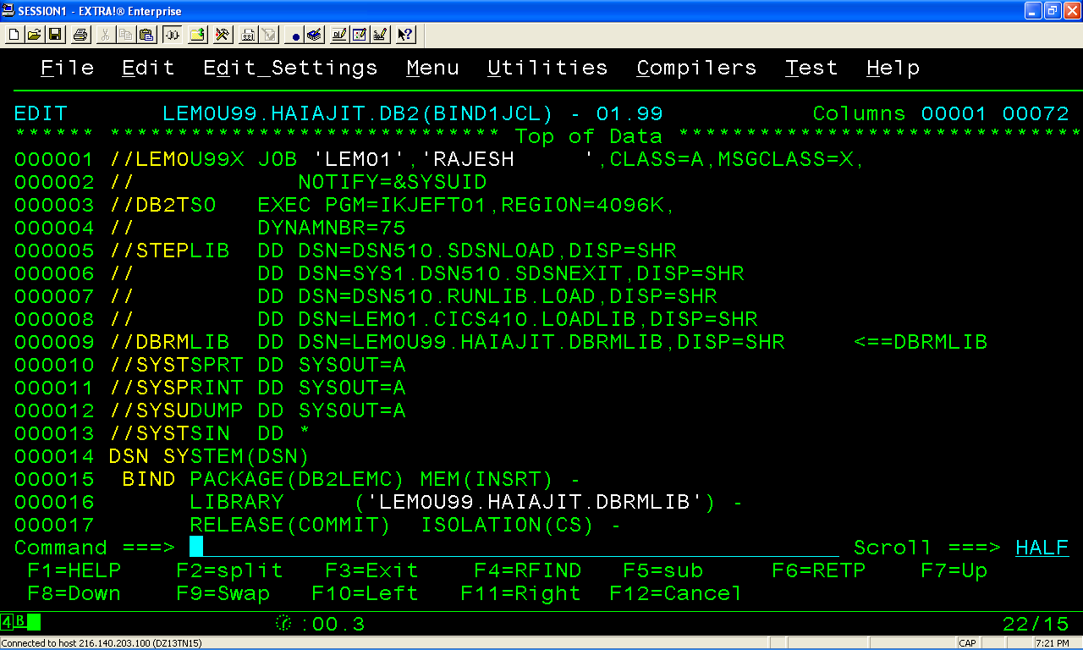
BIND JCL

Slide 47
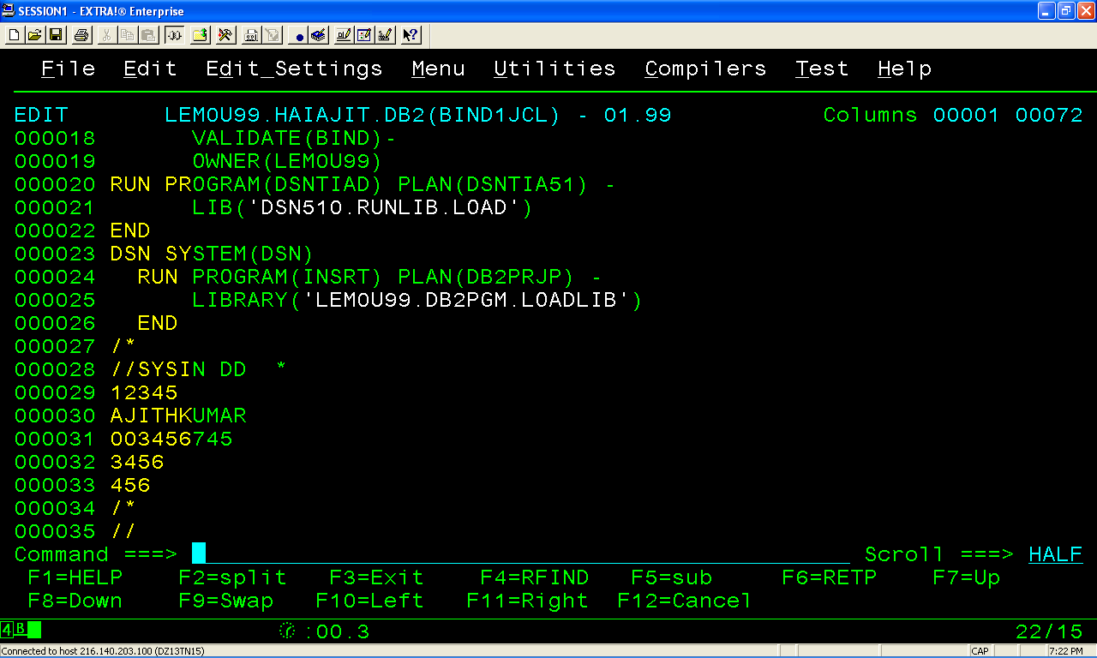
BIND JCL

Slide 48
Program Preparation

Slide 49
What This Unit Is About
How the Embedded SQL Program is going to be Processed by
  PRECOMPILER
  COMPILER
  BINDER
  PLAN and PACKAGE

Slide 50
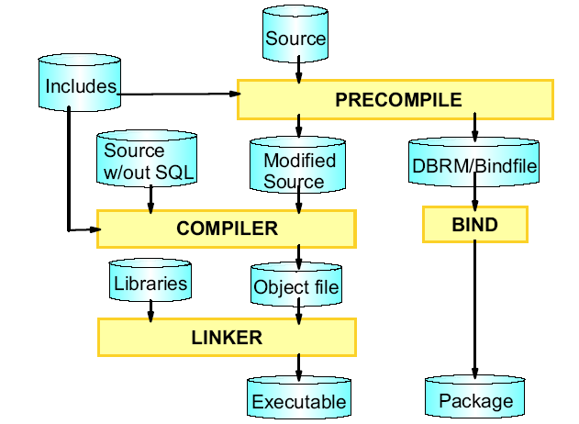
DB2 Program Preparation
Four Major steps for Program Preparation
  PRECOMPILE
  COMPILE
  LINK-EDIT
  BIND & RUN

Slide 51
What does DB2 Pre-compile does when you submit a Embedded SQL Program as Source ?.
Question

Slide 52
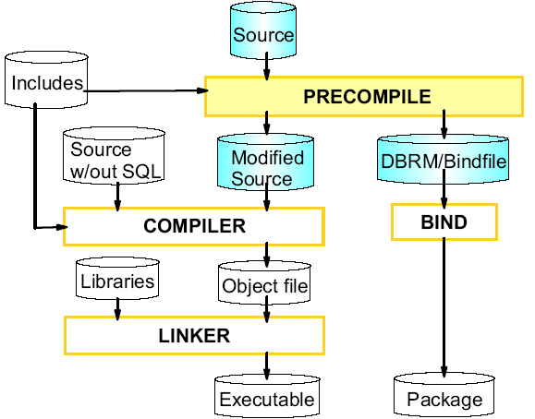
DB2 PRE-COMPILE Process
PRE-COMPILE Process
Embedded SQL Program has
  Application Code
  SQL Statements
Before the program can be compiled by the appropriate source code language compiler.
EXEC SQL statements embedded in the program must be removed and replaced by
CALL Statements in COBOL

Slide 53
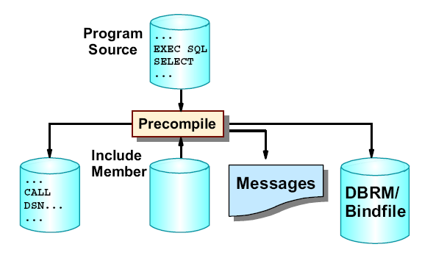
DB2 Pre-compile Process
PRECOMPILER prepares the source program for compilation by replacing EXEC SQL by a CALL and commenting out the EXEC SQL statement.
Verifies the SQL syntax.
PRECOMPILER process will include any files included with an
  EXEC SQL INCLUDE statement
  Including files produced by DCLGEN.

Slide 54
What is the Purpose of Database Request Module (DBRM) in DB2 Program Preparation ?.
Question

Slide 55
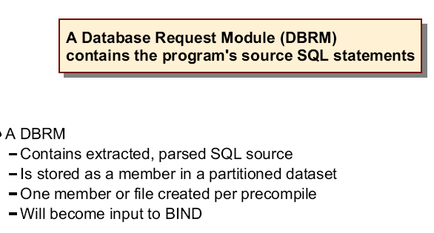
DBRM (Database Request Module )

Slide 56
COBOL Compile and Link-Edit Process
Overview

Slide 57
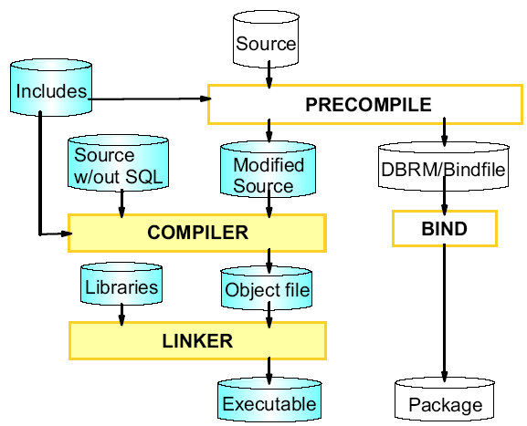
Compile and Link
After DB2 PRE-COMPILATION the modified Cobol program with CALL statements ( instead of EXEC SQL) is now ready to be compiled and link-edited.
LINK-EDIT process will have to include the necessary modules for the call to work properly.
Modified Embedded Cobol source file is
  Compiled and linked normally.
  Produce an executable file or load module.

Slide 58
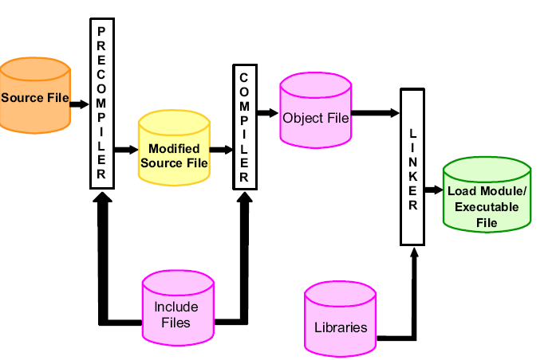
Compile and Link
After DB2 PRE-COMPILATION the modified Cobol program with CALL statements ( instead of EXEC SQL) is now ready to be compiled and link-edited.
LINK-EDIT process will have to include the necessary modules for the call to work properly.
Modified Embedded Cobol source file is
  Compiled and linked normally.
  Produce an executable file or load module .

Slide 59
Program Preparation : Bind Process
Overview

Slide 60
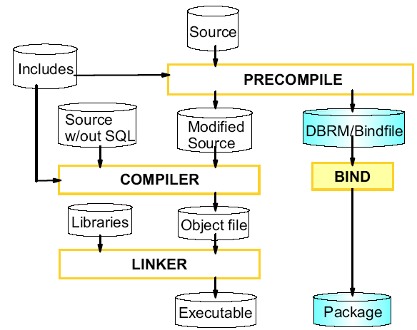
Bind Process
When the bind file or DBRM is bound to the database, a package is created in the database.
package contains instructions about how to execute the SQL statements that were included in the source code.

Slide 61
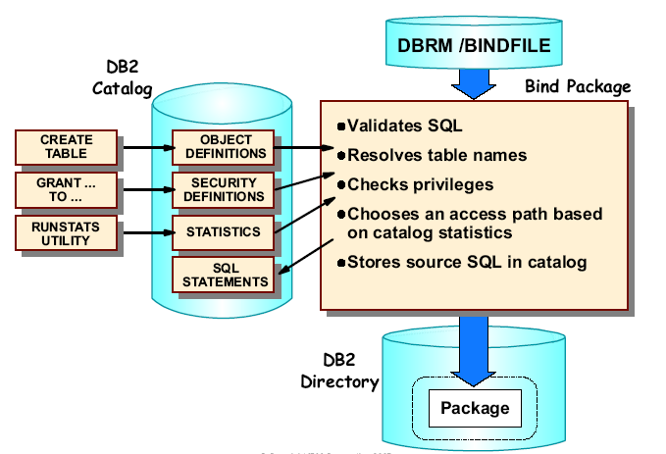
Bind Process

Slide 62
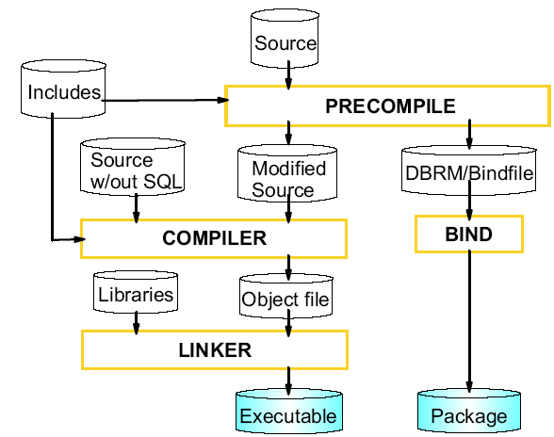
Run

Slide 63
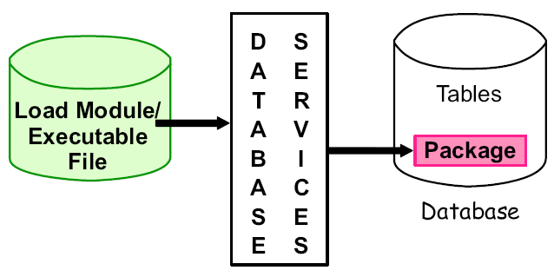
Run
Run Process
Accepts Input
Executes Load Module
Retrieves Information from DB2 Package when program call SQL statements

Slide 64
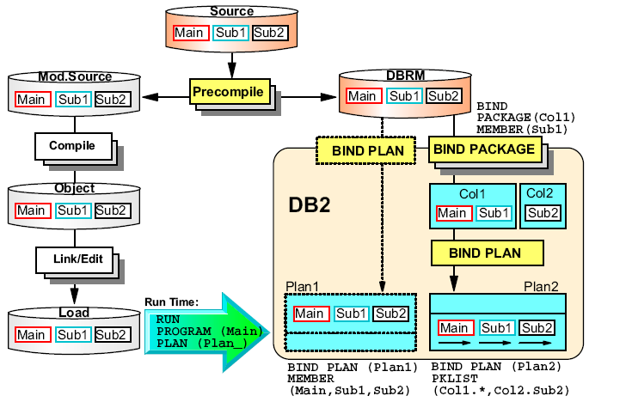
Bind Plan and Package

Slide 65
Embedded SQL Program to Update data into Employee Table
Overview

Slide 66
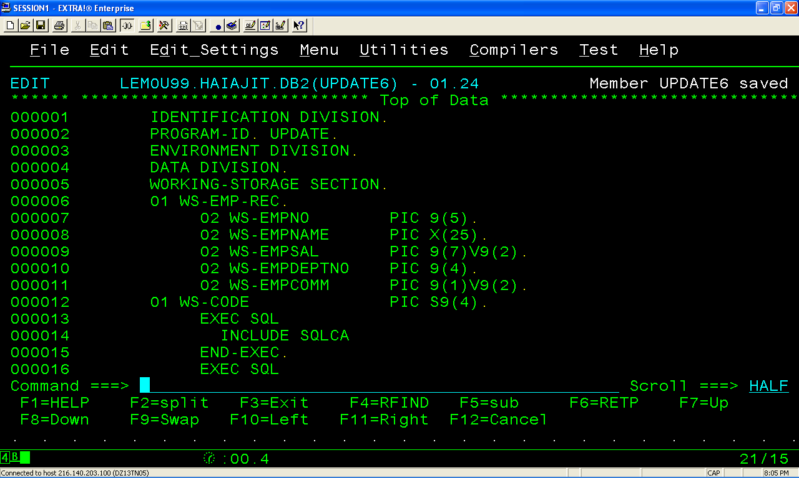
EMBEDED SQL –Update-COBOL Program

Slide 67
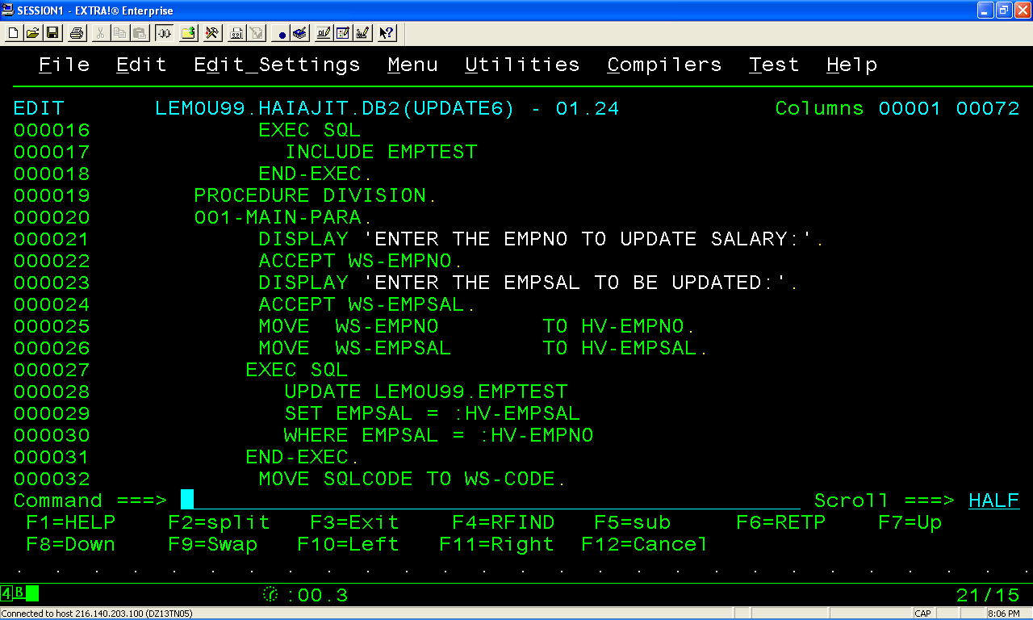
EMBEDED SQL –Update-COBOL Program

Slide 68
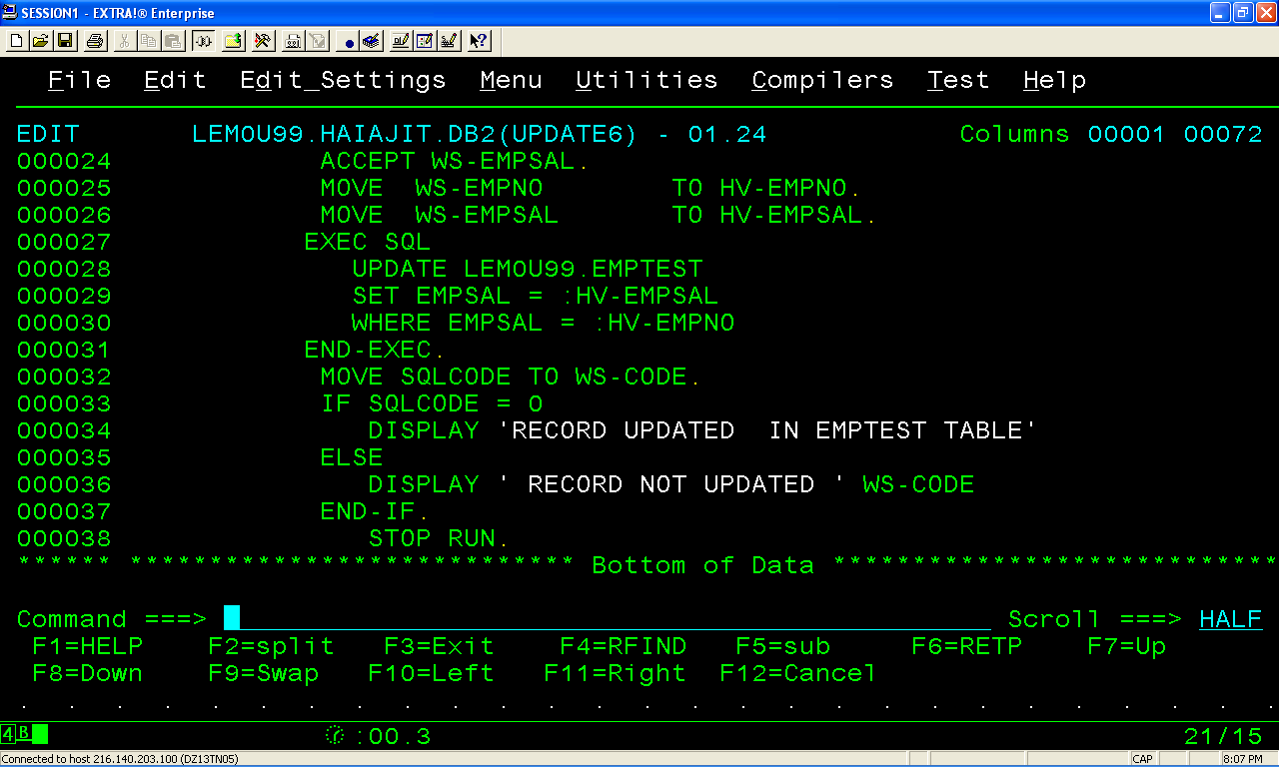
EMBEDED SQL –Update-COBOL Program

Slide 69
PRE-COMPILE

Slide 70
BIND JCL

Slide 71
OUTPUT

Slide 72
Embedded SQL Program to Delete data into Employee Table

Slide 73
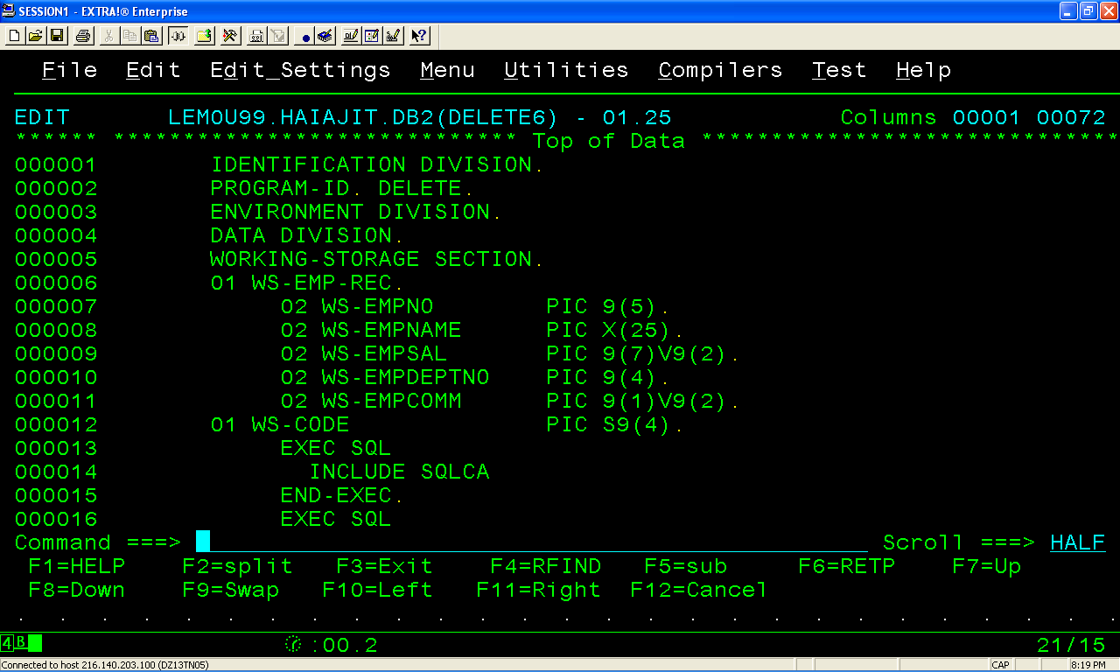
EMBEDED SQL –DELETE-COBOL Program

Slide 74
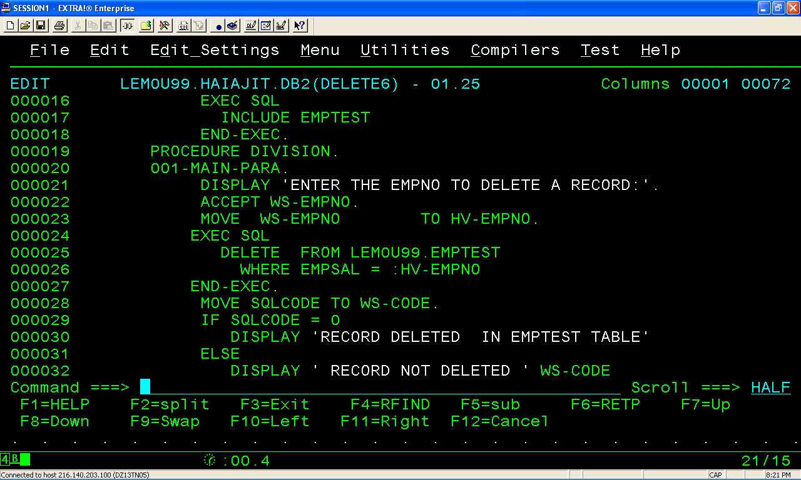
EMBEDED SQL –DELETE-COBOL Program

Slide 75
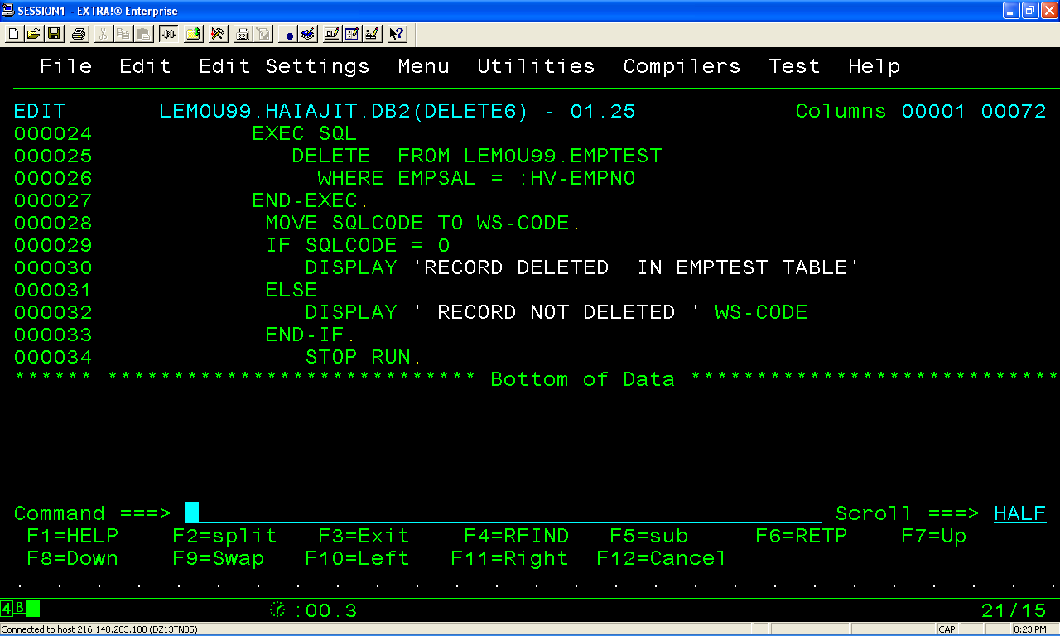
EMBEDED SQL –DELETE-COBOL Program

Slide 76
PRE-COMPILE

Slide 77
BIND JCL

Slide 78
OUTPUT

Slide 79
Embedded SQL Program to SELECT data FROM Employee Table
Overview

Slide 80
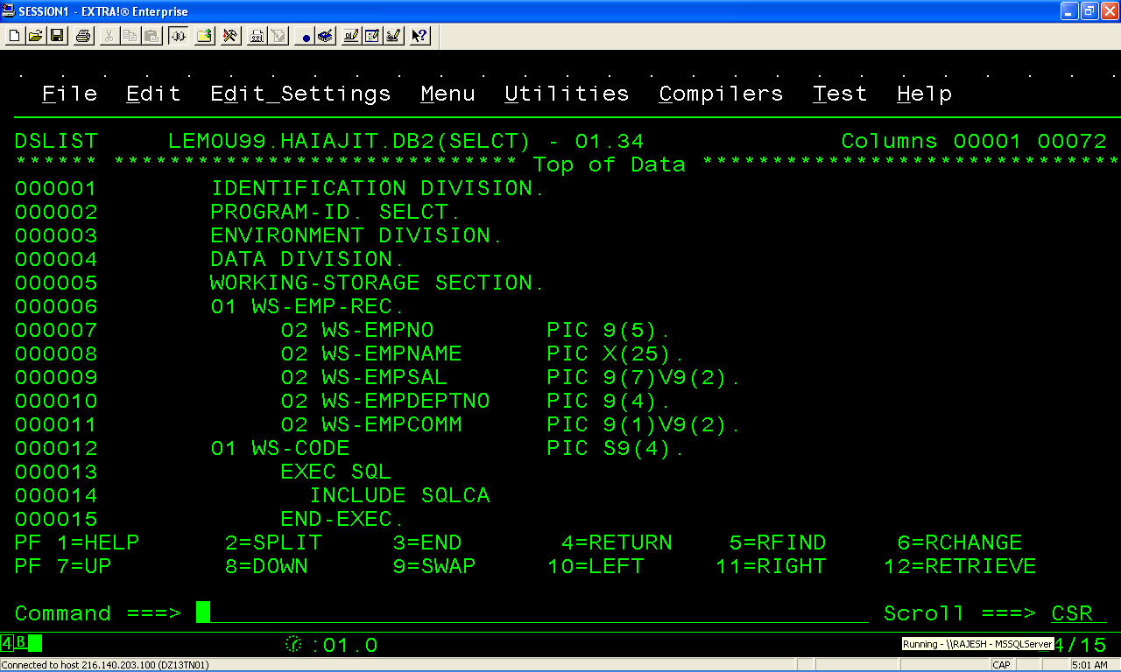
EMBEDED SQL –SELECT-COBOL Program

Slide 81
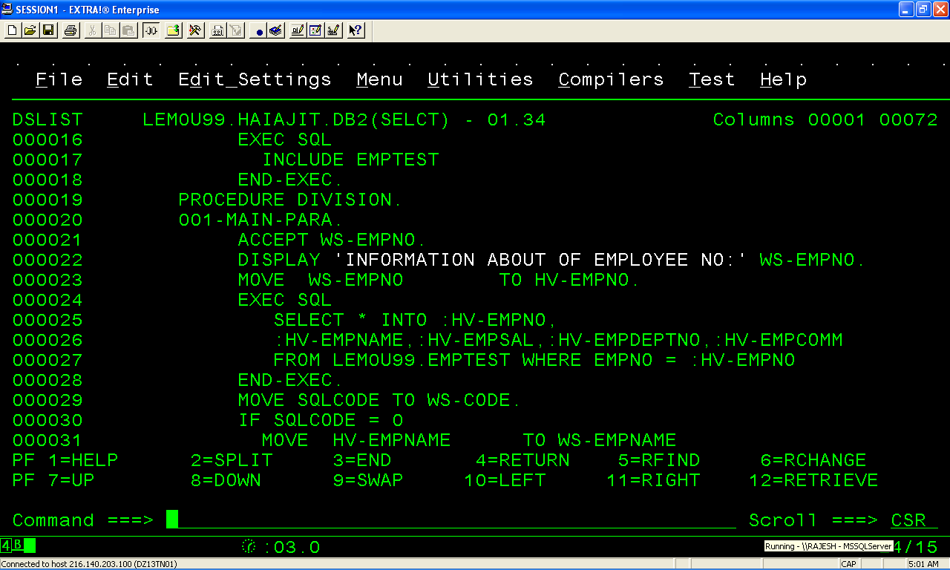
EMBEDED SQL –SELECT-COBOL Program

Slide 82
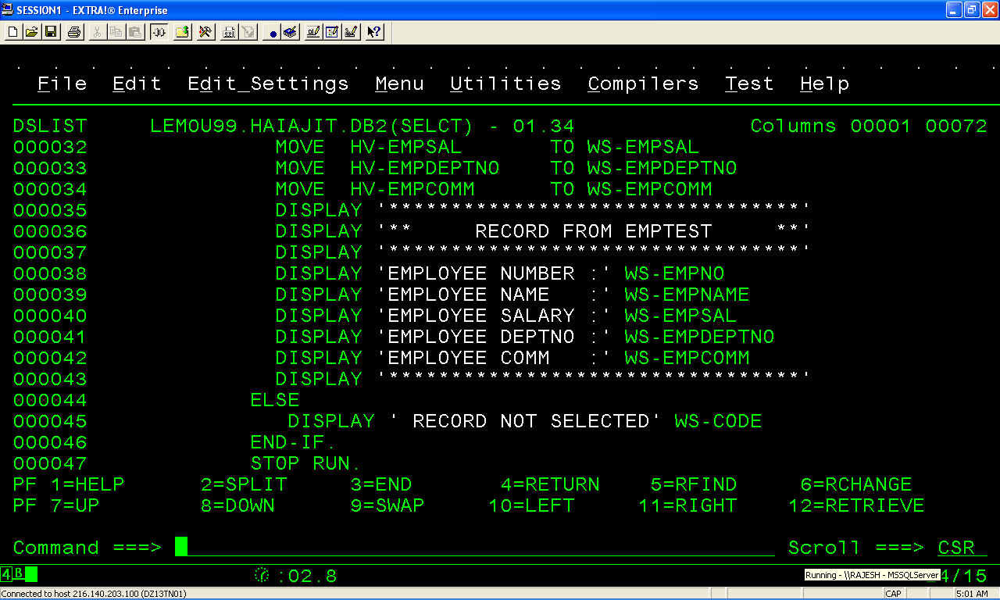
EMBEDED SQL –SELECT-COBOL Program

Slide 83
PRE-COMPILE

Slide 84
BIND JCL

Slide 85
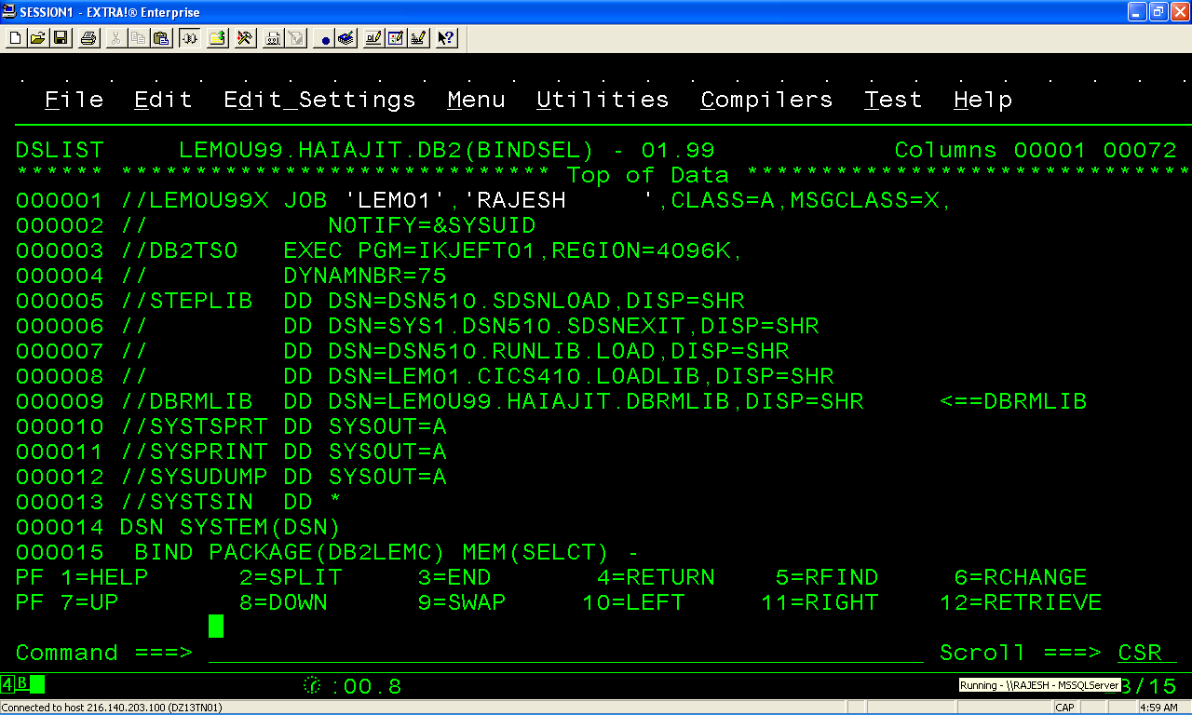
BINDJCL

Slide 86
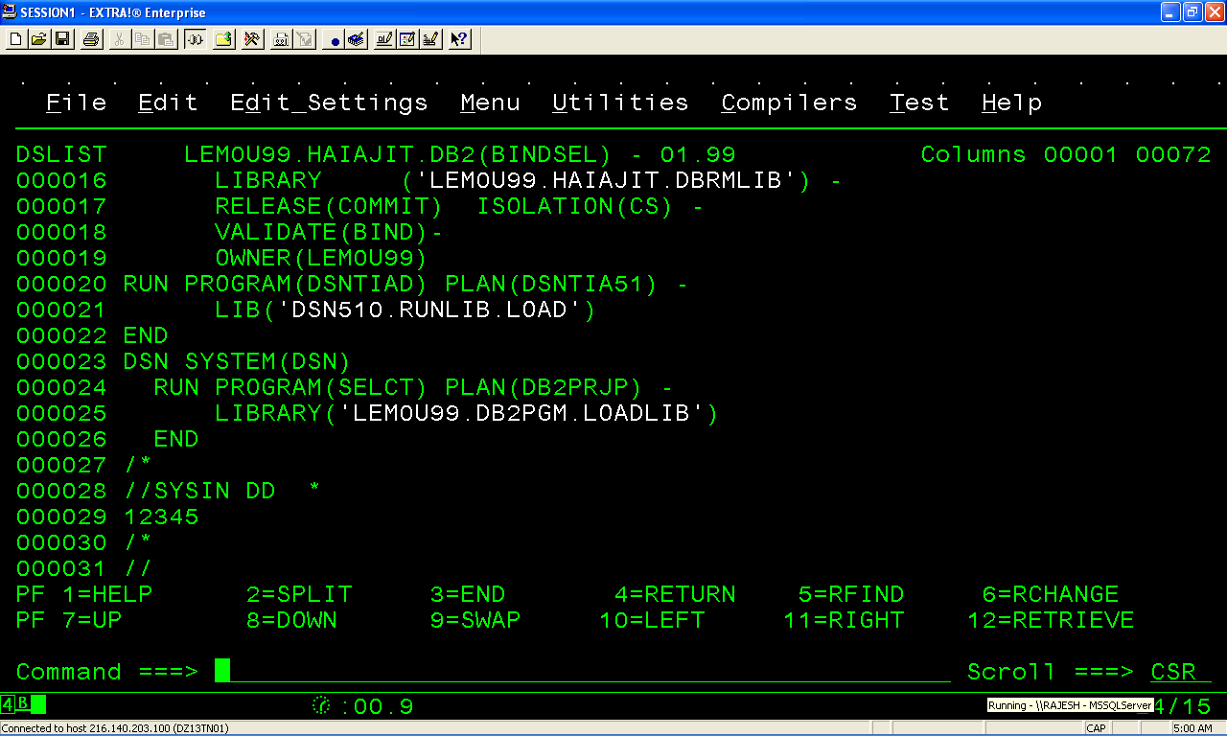
BINDJCL

Slide 87
OUTPUT

Slide 88
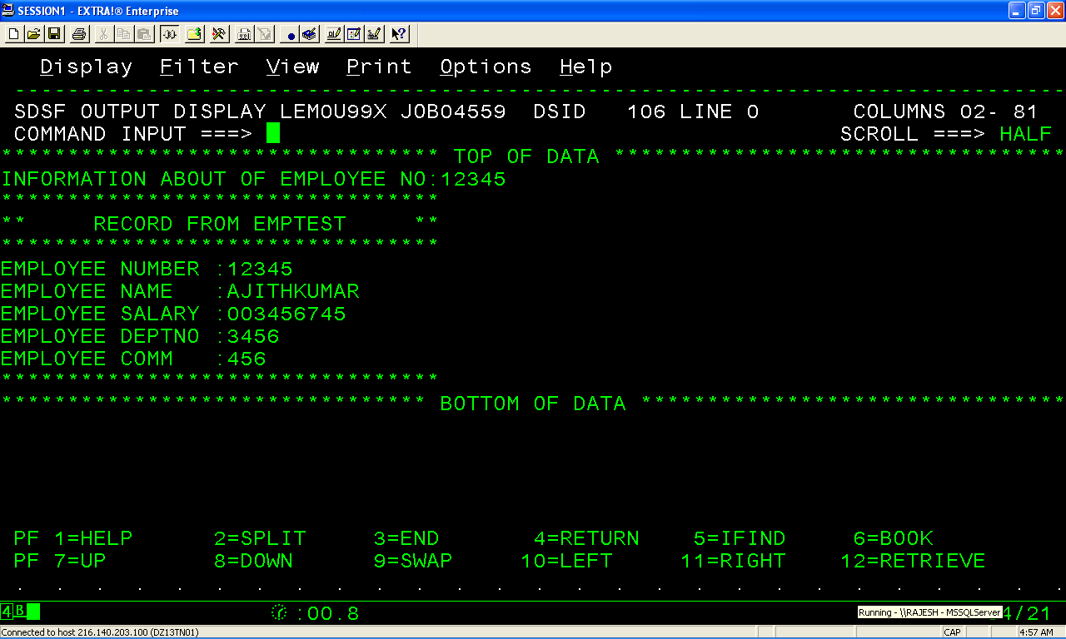
OUTPUT

Slide 89
Special Registers
EXEC SQL
SET :WS-TS = CURRENT TIMESTAMP
END-EXEC.
EXEC SQL
SET : WS-USER = USER
END-EXEC.
EXEC SQL
SET CURRENT SQLID = : WS - SQLID
END - EXEC.
Notes:
Notes:

Slide 90
Embedded SQL Program to handle NULL values (INDICATOR Variables )
Overview

Slide 91
Indicator Variables
Indicator variables are small integers that are used to :
Indicate whether the values of the associated host variables are NULL
Verify that the value of a retrieved character string has not been truncated
Insert and update NULL values from host variables into columns.
Notes:
Notes:
Since NULL is not a value but rather a marker for “missing information or information not applicable”., there must be a way to indicate to a COBOL program that the value in the associated column represents a NULL. This is done using indicator variables.
Indicator variables are declared as small integers: S(04) COMP.
When the value retrieved for a column is NULL, DB2 puts a negative value in the indicator variable. If no indicator variable is used and DB2 retrieves a NULL value, an error results.
NULL indicators are also used when the column functions MIN,MAX,SUM and AVG are used in the SELECT statement.

Slide 92
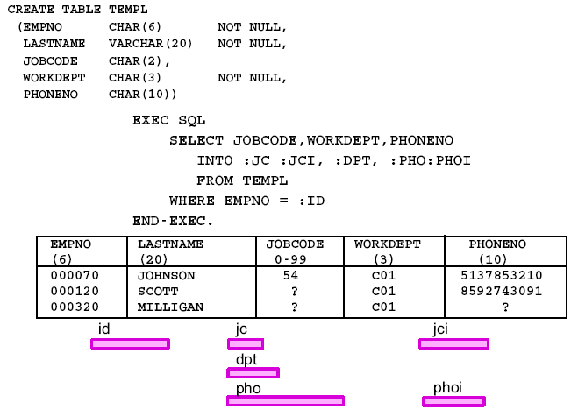
Indicator Variables Example - COBOL Program

Slide 93
INDICATOR VARIABLES
A variable of SMALLINT data type associated with a host variable
Must be declared.
Is preceded by a colon and directly follows its associated host variables, when used in an SQL statement.
EXEC SQL
SELECT HIREDATE’
INTO :HV – HIREDATE : IV – HIREDATE
FROM EMPLOYEE
WHERE EMPNO = :HV – EMPNO
END – EXEC.
Note * IV – HIREDATE is the indicator variable associated with the host variable
HV - HIREDATE

Slide 94
INDICATOR VARIABLES
DB2 returns one of the following values to an indicator variable:
if the vale returned to the associated host variable by DB2
0 is NOT NULL, not truncated
-1 is NULL
>0 is a truncated character string; the value in the indicator variable is the length of the character string before truncation.

Slide 95
Receiving NULL Values
MOVE ZEROES TO WS-LASTNAME-IND.
EXEC SQL
SELECT LASTNAME
INTO :WS-LAST :WS-LASTNAME-IND
FROM EMPLOYEE
WHERE EMPNO = :WS-EMPNO
END-EXEC.
IF WS-LASTNAME-IND < ZEROES
. . . . .
END-IF.
Notes:
Notes:
The indicator variable is specified, preceded by a colon(:), immediately after the host variable. Optionally, we can use the word INDICATOR between the host variable and its indicator variable (DB2 version 4 onwards)
We can test the indicator variable WS-LASTNAME-IND for a negative value. If it is negative, the corresponding value in the host variables WS-LAST is NULL, and therefore the contents of WS-LAST can be disregarded.
It is not necessary to initialize the WS-LASTNAME-IND before the SQL statement. DB2 will place a negative value or zero based on the contents of the column (NULL or NOT). But it is good programming practice to initialize all host variables and indicator variables.
If the indicator variable is not specified and a NULL value is returned., DB2 will flag an error conditions and the value in the WS- LAST column is undefined and unpredictable.

Slide 96
Updating Columns with NULL
MOVE 2120 TO WS-EMPNO.
MOVE SPACES TO WS-PHONE-NO.
MOVE - 1 TO WS-PHONE-NO-IND
EXEC SQL
UPDATE EMPLOYEE
SET PHONE = :WS-PHONE-NO :WS-PHONE-NO-IND
WHERE EMPNO = :WS-EMPNO
END-EXEC.
Notes:
Notes:
We can use an indicator variable to update NULL values into columns. The indicator variable, preceded by a colon(:), is placed next to the host variable in the SET clause of the UPDATE statement. DB2 checks the value in the null indicator. If it is negative, the column value is updated to NULL. If the indicator value is greater than -1., the value in the associated host variable is used to update the column value.

Slide 97
Inserting NULL values
MOVE - 1 TO WS-PHONE-NO-IND.
EXEC SQL
INSERT INTO EMPLOYEE
(EMPNO, SEX, AGE,PHONE)
VALUES (
:WS-EMPNO ,
:WS-SEX,
:WS-AGE,
:WS-PHONE-NO :WS-PHONE-NO-IND)
END-EXEC.
Notes:
Notes:
We can use an indicator variable to insert NULL values into columns. The indicator variable, precede by a colon(:) , is placed next to the host variable in the VALUE clause of the INSERT statement. DB2 checks the value in the null indicator. If it is negative, the column value is inserted as NULL. If the indicator value is greater than 1, the value in the associated host variable is used to insert the column value.
If more than one column needs to be made NULL, each host variable corresponding to such column must have indicator variables associated with them. The same indicator variable can be used with many host variables but it is not a recommended approach. Having a different variable with each host variable with each host variable enhances program readability and flexibility.

Slide 98

Indicator Variables

Slide 99
Updating Valid Values
MOVE 2120 TO WS-EMPNO
MOVE ‘616161’ TO WS-PHONE-NO
MOVE ZEROES TO WS-PHONE-NO-IND.
PERFORM UPDATE-PARA.
. . . . .
UPDATE-PARA.
EXEC SQL
UPDATE EMPLOYEE
SET PHONE = :WS-PHONE-NO :WS-PHONE-NO-IND
WHERE EMPNO = :WS-EMPNO
END-EXEC.
Notes:
Notes:
When we reuse SQL statements, the same SQL statement can be used to INSERT or UPDATE NULL values as well as valid values. Hose variables and indicator variables provide the flexibility to use the same SQL statement times by supplying multiple values in the host variables.
As we have seen, DB2 interrogates the indicator variable before either INSERTing or UPDATing and only if the indicator variable greater than - 1, it uses the value in the host variable.
Therefore to update a column with a valid value, made the value of the indicator variable 0 before executing the SQL statement.

Slide 100
EXAMPLE Embedded SQL Program to handle NULL values (INDICATOR Variables )
Overview

Slide 101

EMBEDED SQL –Handling NULL Values

Slide 102

EMBEDED SQL –Handling NULL Values

Slide 103

EMBEDED SQL –Handling NULL Values

Slide 104

EMBEDED SQL –Handling NULL Values

Slide 105
PRE-COMPILE

Slide 106
BIND JCL

Slide 107

output

Slide 108
OUTPUT

Slide 109
SQL CODE
EXEC SQL
SELECT EMPNO, LASTNAME, SEX
INTO :WS-EMPNO, :WS-LAST, :WS-SEX
FROM EMPLOYEE
WHERE EMPNO= :WS-EMPNO
END-EXEC.
EVALUATE SQLCODE
WHEN 0
DISPLAY ‘LAST NAME IS ‘WS-LAST’
WHEN 100
DISPLAY WS-EMPNO ‘DOES NOT EXIST’
END-EVALUATE
Notes:
Notes:
It is not mandatory to check the SQLCODE after the execution of each SQL statement. But it makes good sense to do so. For example, if we are looking for an employee in the EMPLOYEE table, then the program should be able to handle conditions whereby the passed EMPNO might not be present in the table.
Some common SQLCODES to check after a SQL statement:
INSERT 0, Successful Insert
-803, Duplicate Insert
UPDATE 0, Successful update
100, no row found
DELETE 0, Successful Delete
100, no row found
SELECT 0, successful
100, no row found
-811, Multiple rows retrieved.

Slide 110
Processing Multiple Rows

Slide 111

Processing Multiple Rows

Slide 112


Structured
Programming - Sequential File Read

Slide 113

SELECT with FETCH - COBOL Program

Slide 114
Processing Multiple Rows
TABLE
Multi-row
SELECT
RESULT
TABLE
Retrieve
One row
at a time
Notes:
Notes :
If we are unsure of the number of rows that will be returned, or if more than one row is returned, then we must use an programming mechanism called cursor, instead of using SELECT .. INTO (which will return an error code and any data returned is undefined and unpredictable.
A COBOL program does not know in advance the number of rows returned from a query. DB2 therefore returns only one row at a time to the program. Cursors enable an application to process a set of rows and retrieve each row sequentially from the result table until end-of-data is reached.
The number or rows obtained as a result of executing the SELECT statement can be zero. One or many depending on how many rows satisfy the predicate in the SEKECT statement.
WE can code multiple cursor in a program, each cursor requires its own
DECLARE CURSOR statement to define the cursor
OPEN and CLOSE statement to open and close the cursor
FETCH statement to retrieve rows, from the result table.

Slide 115
DECLARE CURSOR
EXEC SQL
DECLARE CUREMP01 CURSOR FOR
SELECT EMPNO, SEX, AGE, NAME
FROM EMPLOYEE
WHERE JOIN_DATE > : WS-JOIN-DATE
END-EXEC.
Notes:
Notes :
The DECLARE CURSOR statement defines and names the cursor, identifying the set of rows to be retrieved with the SELECT statement of the cursor. The SELECT statement defines the criteria for the rows that will make of the result table.
The DECLARE CURSOR statement is not an executable statement. Even though it can be placed anywhere in the program (DATA DIVISION or PROCEDURE DIVISION ), placing it in the DATA DIVISION is recommended. The DECLARE CURSOR should be placed before the other cursor related statement ( owing to the one pass nature of the precompiler ).
The SELECT statement could contain host variables in the predicate. These host variable must be defined before the DECLARE CURSOR statement. When the precompiler encounters the DECLARE CURSOR statement the host variables need not be populated.

Slide 116


OPEN
EXEC SQL
OPEN CURSOR-NAME
END EXEC.
EXEC SQL
OPEN CUR
END-EXEC
Notes:
Notes :
The cursor must be opened (with an OPEN statement ), before any rows are retrieved. When the program issues the OPEN statement, DB2 processes the SELECT statement that is within the DECLARE CURSOR statement using the current values of the any host variables specified in the SELECT statement. Therefore, the values of the host variables used variables used in the SELECT must have been filled before issuing the OPEN.
The OPEN statement is a executable statement and therefore, must have been placed in the PROCEDURE DIVISION.
The number of rows returned in the result table might be zero one or many.
The OPEN statement makes the first row of the result table ( if any rows exist at all), as the “current row”

Slide 117
FETCH
Syntax :
EXEC SQL
FETCH CURSOR-NAME
INTO :host-variable1, :host-variable2, …..
END-EXEC.
Example :
EXEC SQL
FETCH CUREMP01
INTO :WS-EMPNO, :WS-SEX, :WS-AGE
END-EXEC.
Notes:
Notes:
The FETCH statement is used to move the contents of a selected row into the host variables.
When the program issues a FETCH statement, DB2 moves the contents of the “current row” in the result table into the host variable specified with the INTO clause.
DB2 then makes the next row in the result table (if it exists), as the “‘current row “. This sequence repeats each time the program issues a FETCH until all the rows of the result table are processed.

Slide 118


End - of - Data Processing
RESULT TABLE
WS-EMPNO WS-JOIN-DATE
SQLCODE
FETCH
0
0
0
100
Notes:
Notes :
To determine all the rows in the result table are processed, we test the SQL CODE field.
DB2 sets the SQLCODE to 100 when all the rows in the result table are retrieved under subsequent FETCH techniques works:
First time we issue a fetch, the data for the current row EMPNO = 101 is moved into the host variables. SQLCODE after the fetch will be zero. DB2 then makes EMPNO 103 as the current row.
Second fetch retrieves the data from the current row EMPNO = 103 . SQLCODE is zero after the fetch and DB2 will make EMPNO = 102 as the current row.
When the fourth fetch is issued , the current row is EMPNO = 106. The contents of the host variables are populated with the details of the EMPNO = 106. The SQLCODE
is zero. DB2 moves the pointer ahead . But there are no rows after this. The “current rows” points to the END -OF-DATA.
When the fifth fetch is issued ,DB2 returns SQLCODE of 100. The values in the host variables are untouched.

Slide 119
Handling End-of-data
MAIN-PARA.
MOVE ‘01-01-1996’ TO WS-JOIN-DATE’.
PERFORM OPEN-PARA
PERFORM FETCH-PARA
PERFORM UNTIL SQLCODE = 100
PERFORM PROCESS-ROW
PERFORM FETCH-PARA
END-PERFORM
. . . .
Notes:
Notes:
Every program must be coded to handle an end-of-data condition whenever a cursor is used to fetch rows.
An alternate to this technique is to code the WHENEVER NOT FOUND statement. The WHENEVER NOT FOUND statement can branch to another part of the program.
EXEC SQL
WHENEVER NOT FOUND GO TO END-OF-CUREMPO1
END-EXEC

Slide 120
CLOSE
Syntax :
EXEC SQL
CLOSE cursor-name
END-EXEC.
Example :
EXEC SQL
CLOSE CUREMP01
END-EXEC.
Notes:
Notes:
When we finish processing the rows of the result table, we can issue the CLOSE statement to close the cursor. After the cursor is closed, it can be used again.
DB2 automatically closes the when the program terminates (in case no explicit CLOSE statement is issued).

Slide 121

EMBEDDED SQL PROGRAM -CURSOR

Slide 122

EMBEDDED SQL PROGRAM -CURSOR

Slide 123

EMBEDDED SQL PROGRAM -CURSOR

Slide 124

EMBEDDED SQL PROGRAM -CURSOR

Slide 125
PRE-COMPILE

Slide 126
BIND

Slide 127
OUTPUT

Slide 128

Output

Slide 129

Output

Slide 130

OUTPUT

Slide 131
FOR UPDATE OF
EXEC SQL
DECLARE CUREMP01 CURSOR FOR
SELECT EMPNO, AGE
FROM EMPLOYEE
FOR UPDATE OF SALARY
END-EXEC.
Notes:
Notes:
We can use the FOR UPDATE OF clause in DECLARE CURSOR statement to specify the names of each column that we want to update in the rows (all or some) of the result table.

Slide 132
UPDATE … WHERE CURRENT OF
PERFORM FETCH-PARA
PERFORM UNTIL SQLCODE =100
…..
EXEC SQL
UPDATE EMPLOYEE
SET SALARY = :WS-SALARY
WHERE CURRENT OF CUREMPO1
END-EXEC
PERFORM FETCH-PARA
END-PERFORM
Notes:
Notes:
When we want to obtain a copy of each row, examine it and update it , we can use special form of UPDATE statement specifically meant to be used with cursors.
When the program has retrieved the current row (using the FETCH statement ), we can update it using the UPDATE. Where CURRENT of statement.
Using this statement, we can update only one row, the current row. The WHERE clause identifies the cursor that points to the row to update.Every column that is used in the SET clause must be declared in the FOR UPDATE of clause of the D DECLARE CURSOR statement.
We need not use the special form of UPDATE statement. W e can use the UPDATE statement with a predicate to achieve the same result. The difference is that the FOR UPDATE of clause in the DECLARE cursor statement results in “locking” that will prevent other users from updating the rows.

Slide 133
DELETE … WHERE CURRENT OF
PERFORM OPEN-PARA
PERFORM FETCH-PARA.
PERFORM UNTIL SQLCODE =100
EXEC SQL
DELETE FROM EMPLOYEE
WHERE CURRENT OF CUREMP01
END-EXEC
PERFORM FETCH-PARA
END-PERFORM.
Notes:
Notes:
When we want to delete a set of rows from a table,we can do so using a general form of a DELETE statement that works in tandem with cursors.
When the program has retrieved the current row (using the FETCH statement).,we can delete it using the DELETE…WHERE CURRENT OF statement.
The DELETE … WHERE CURRENT OF statement deletes only one the current row. The WHERE clause identifies the cursor pointing to the row.
The FOR UPDATE OF clause in the DECLARE CURSOR statement must be used for DELETE …WHERE CURRENT OF statement.Using the clause course, prevents other users from changing or deleting the row concurrent.

Slide 134
DECLARE … WITH HOLD
EXEC SQL
DECLARE cursor-name CURSOR WITH HOLD FOR
SELECT column-name-list
FROM table-name
WHERE search-condition
FOR UPDATE OF column-name
END-EXEC.
Notes:
Notes:
When the program completes a unit of work (that is, it either commits or roll backs the changes) DB2 closes all the open cursors.
To prevent DB2 from closing a cursor after a commit or a rollback operation, we use the WITH HOLD option of the DECLARE CURSOR statement.
A cursor declared using a WITH HOLD option is closed when:
The program issues a CLOSE cursor statement or an explicit ROLLBACK statement
the program terminates
When the program abends, the cursor position is lost.

Slide 135
Dynamic SQL
Statement:
Acquired during execution,and function can
vary and can be done to different tables and
columns
Bind: One single statement
At statement execution
Access strategy not saved..
Notes:
Notes:
When the SQL statement changes at the time of execution of a program, it is considered as dynamic SQL. The SQL is prepared and executed when the program is running. Hose variables contain the SQL source rather than writing the SQL source in the application program.
The SQL statement is not available at BIND time. DOES the program get bound??
It does, at the time of execution, The access strategy and other error checking are done before the executing the statement. Since the SQL could change the time the program executes, the access strategy is not stored permanently.

Slide 136
Static SQL vs. Dynamic SQL
Statement:
Static : Object and Action known
Dynamic : Object or Action not known
Bind:
Static : is bound once
Dynamic : is bound every time.
Notes:
Notes:
Let us summarize the differences between Static and Dynamic SQL.
To be static the statement must have fixed object or objects that will be provided, and the function or action to be performed on them only the data could be missing at the time of binding the program.
If the object or the action is now known at BIND time, the statement will be handled dynamically.
The performance of static SQLK is better than dynamic SQL because the binding a done only once the program can be executed many times from the permanent plan generated from the bind stop whereas the for dynamic SQL an additional “run-time” overhead is involved. This additional processing is similar
If static SQL is better than dynamic SQL then why use it all?? It is based ion certain situations when part of the (or the complete) SQL statement will only be known at execution time, perhaps as part of the input from users.

Slide 137
Coding Dynamic SQL
Translate the input data into a SQL statement
Prepare the SQL statement to execute
Execute the SQL statement
Process the information returned
Handle SQL return codes
Notes:
Notes:
For a program to include dynamic SQL statement,certain steps need to be taken. This includes coding the SQL communication are (SQLCA) in the program.
There are basically three categories of dynamic SQL statements:
Dynamic SQL involving Non-SELECT statements
Dynamic SQL involving Fixed-List SELECT
Dynamic SQL involving Varying-List SELECT
We will look into the first two in this session. The third (and the most complex of all ) is not covered.

Slide 138
EXECUTE IMMEDIATE
Prepare and Execute the SQL statement present in
the COBOL host variable WS-STMT
MOVE ‘DELETE FROM EMPLOYEE’ TO WS-STMT-TEXT
MOVE 50 TO WS-STMT-LEN
EXEC SQL
EXECUTE IMMEDIATE :WS-STMT
END-EXEC.
Notes:
Notes:
We have to prepare (precompile and bind) static SQL before we execute them. But we cannot prepare dynamic SQL statements in advance.
The SQL statement EXECUTE IMMEDIATE causes an SQL statements to prepare and execute,dynamically, at runtime. The EXECUTE IMMEDIATE statement must be placed in the PROCEDURE DIVISION.
Suppose we want to write a system which reads SQL from a terminal and execute it.The input read from the terminal is moved into the host variable and executed using the EXECUTE IMMEDIATE statement. This causes the SQL in the host variable to be prepared (analyzed for errors and best access path and then executed.
The host variable WS-STMT must be defined in the COBOL program in a format similar to the VARCHAR data type, that is
01 WS-STMT.
05 WS-STMT-LEN PIC S9(04) COMP.
05 WS-STMT-TEXT PIC X (50)

Slide 139
Parameters Markers
Dynamic SQL statements cannot use Host Variables
Parameter Markers are used to substitute a parameter
“DELETE FROM EMPLOYEE WHERE EMPNO = ? “
Notes:
Notes:
Dynamic SQL statements cannot use host variables. However, we can use question mark (?) as a parameter marker to substitute a parameter.
Suppose we want to delete all the employee based on the EMPNO passed by the user. Then we can use a parameter marker to pass the employee number to the SQL statement. We can use a static SQL for this purpose. But let us assume that even the table name is passed by the user.Then we create the query using the following COBOL code fragment:
MOVE ‘DELETE FROM ‘ INTO WS-STMT-TEXT ( 1:20).
MOVE WS-TABLE-NAME INTO WS-STMT-TEXT ( 21:40).
MOVE ‘WHERE EMPNO = ?’ INTO WS-STMT-TEXT ( 41:30).
MOVE 70 INTO WS-STMT-LEN.

Slide 140
Prepare and Execute
PREPARE once
EXEC SQL
PREPARE S1 FROM :WS-STMT
EXEC-EXEC.
EXECUTE many times
EXEC SQL
PREPARE S1 FROM :WS-EMPNO
EXEC-EXEC.
Notes:
Notes:
Preparing a statement is an expensive step. To execute the same SQL multiple times, we can avoid the cost of preparing multiple times by preparing the statement only once and executing many times by using PREPARE and EXECUTE.
The PREPARE statement creates an executable SQL statement from a character string form the statement. The executable form is called prepared statement. The character string form is called a statement string.
EXECUTE executes a prepared SQL statement, naming a list of one or more host variables, or a host structure , that supplies a values for all the parameter markers. Each of the variables must match the data type of the columns. The number of variables must be the same as the number of parameter markers specified.
After we prepare a statement we can execute it many times within the same units of work. The COMMIT or ROLLBACK statements destroys the prepared statements needs to be prepared again.

Slide 141
DB2 LOCKS
Overview

Slide 142
DB2 LOCKS
DB2 LOCKS
* Are managed by IMS Resource Lock Manager, IRLM
* Are used to control Concurrency and guarantee the integrity of each user’s data
* Prevent access to uncommitted data
CONCURRENCY CONTROL
Concurrency is a situation wherein DB2 allows more than one application program to access same data at the same time.
Concurrency needs to be controlled due to many undesirable effects such as
i LOST UPDATES (or Double Updating),
ii ACCESS TO UNCOMMITTED DATA
iii UNREPEATABLE READS
DB2 makes up use of locks to control Concurrency

Slide 143
Concurrency Control Problem
Lost Updates
Without Concurrency control two application programs X and Y
  Both read the same Row from the table
  Both supply new values for one of its columns based on what they read.
  PROBLEM:
  If X updates the row with its value and then Y updates the same row, X’s updates are lost
Access To Uncommitted Data
Without concurrency control
  Application program X might update a value in the table
  Application program Y might read that value before it was committed
PROBLEM
If X’s value is not later committed but backed out, then Y’s calculations are based on uncommitted and presumably invalid data

Slide 144
Concurrency control Problem
Unrepeatable Reads
Without concurrency control
An application program X reads a row form the table and goes on to process other SQL statements.
X again reads the row it read the first time and must find the same values in it.
PROBLEM
Without Concurrency control, application program Y could have changed the same row between two reads of program X.

Slide 145
FACTORS CONTROLLING LOCKING
Overview

Slide 146
FACTORS CONTROLLING LOCKING
The Object Of A Lock
Is the resource being locked by DB2
Can be databases, table spaces, tables, tablespace page, index, indexspace, page/subpage and plans
The Size Of A Lock
Determines how large a portion of the resource is being locked
The LOCKSIZE parameter of CREATE TABLESPACE statement defines the locking protocol
DB2 being locking levels are:
  Tablespace locking
  Page locking
The Duration Of A Lock
Determines the length of time the lock is held
Varies according to ‘when the lock is acquired’ and ‘when it is released’

Slide 147
FACTORS CONTROLLING LOCKING
Duration Of Tablespace Locks
The duration of any tablespace lock held by an application program can be controlled by means of ACQUIRE and RELEASE parameters of BIND ACQUIRE specifies when resources should be allocated, I.e., when the locks should be acquired
RELEASE specifies when resources should be deallocated, I.e., when the locks should e freed or released.
Both the above parameters have two sub-parameters:
For ACQUIRE For RELEASE
USE COMMIT
ALLOCATE DEALLOCATE

Slide 148
Duration Of Page Locks
ISOLATION parameters controls the PAGE level locks
Bind Isolation Parameters
Influence the initial lock chosen by DB2 especially its duration
Ensure data consistency, an application program can be bound with any of the two values
Cursor Stability
Page lock is held only while the cursor is positioned on at page. When the cursor moves to another page, the lock is leased.
When a page is locked concurrent application programs cannot update or delete a row of locked page
If an application program updates or deletes data, the lock is held until the data is committed
Applies only to data is read. All changed data remains locked until COMMIT or ROLLBACK

Slide 149
Duration Of Page Locks
Repeatable Read (RR)
Page lock is held until the next commit point.
With this option if the application program returns to the same page and reads the same row again, the values would remain the same
It means that pages containing all the rows retrieved as well as the pages containing the current row are locked.
Concurrent application programs cannot insert, update,or delete a row in the locked page until the unit of recovery completes.

Slide 150
Modes of Locks for Table or Tablespace
S(SHARE)
Lock owner and concurrent application programs may only.
U(UPDATE)
Lock owner can read for updating it;
TABLE SHARING
Concurrent application programs may only read data.
X(EXCLUSIVE)
Lock owner can only read or change data in the table or tablespace;
TABLE EXCLUSIVE
No other concurrent application programs can is allowed access in the Tablespace;
IS(INDENT SHARE)
Lock owner can only read data in the table or tablespace;
Concurrent application programs can only read data in the locked page but can read and update data of other pages.
IX(INDENT EXCLUSIVE)
the lock owner can read and update in the table ir tablespace
PAGE EXCLUSIVE : Concurrent application programs can only read and update data of other pages.

