Slide 1
Digital Portfolio
STUDENT NAME: GNANAPRIYA S
REGISTER NO AND NMID: 24132011802522027
asanm20124132011802522027
DEPARTMENT: BSC COMPUTER SCIENCE
COLLEGE: ARIGNAR ANNA GOVERNMENT ARTS COLLEGE VILLUPURAM, ANNAMALAI UNIVERSITY

Slide 2
PROJECT TITLE
DIGITAL PORTFOLIO

Slide 3


AGENDA
Problem Statement
Project Overview
End Users
Tools and Technologies
Portfolio design and Layout
Features and Functionality
Results and Screenshots
Conclusion
Github Link
3/21/2024 Annual Review

Slide 4

PROBLEM STATEMENT
Conventional resumes lack interactivity and personalization.
A digital portfolio is required to showcase skills and achievements
in a creative and accessible way.

Slide 5

PROJECT OVERVIEW
This project develops an interactive digital portfolio to display personal details, skills, and projects. It provides an accessible platform for professional presentation and career growth

Slide 6

WHO ARE THE END USERS?
The end users are students, professionals, and job seekers who want to showcase their skills and achievements. Employers, recruiters, and educators also use it to evaluate candidate

Slide 7

TOOLS AND TECHNIQUES
The digital portfolio is developed using HTML, CSS, and JavaScript for design and interactivity. Hosting platforms and version control tools like GitHub ensure accessibility and updates

Slide 8
POTFOLIO DESIGN AND LAYOUT
The portfolio uses a clean, responsive design with sections for profile, skills, projects, and contact details. A simple layout with visuals and navigation ensures easy user experience
8

Slide 9
FEATURES AND FUNCTIONALITY
The portfolio allows showcasing personal details, skills, projects, and achievements with interactive navigation. It includes responsive design, contact forms, and easy sharing options.

Slide 10
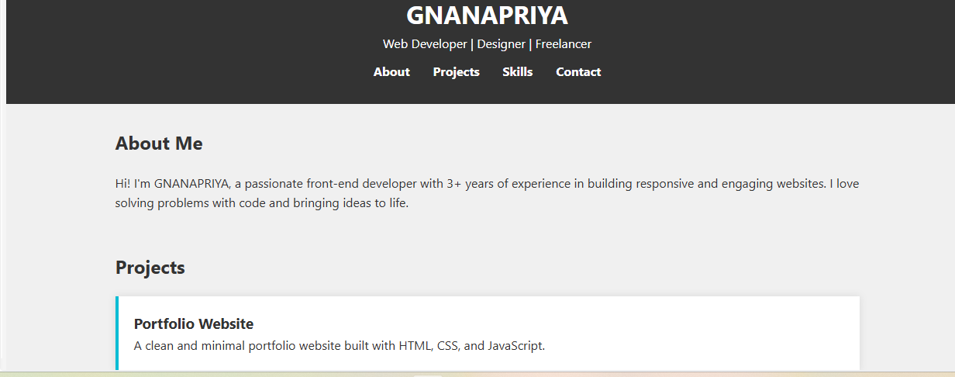
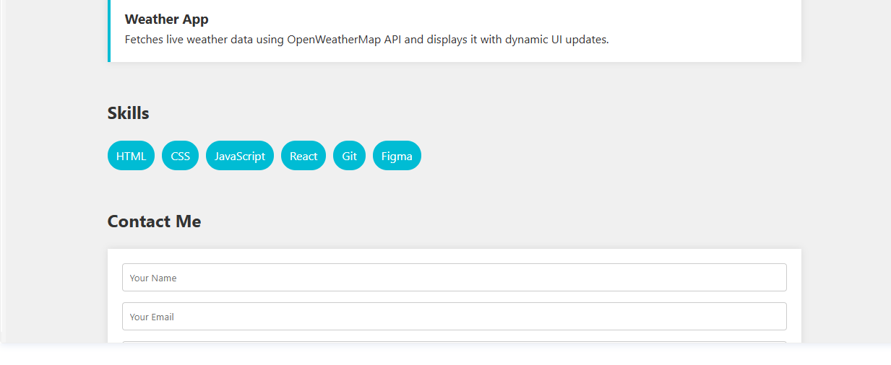
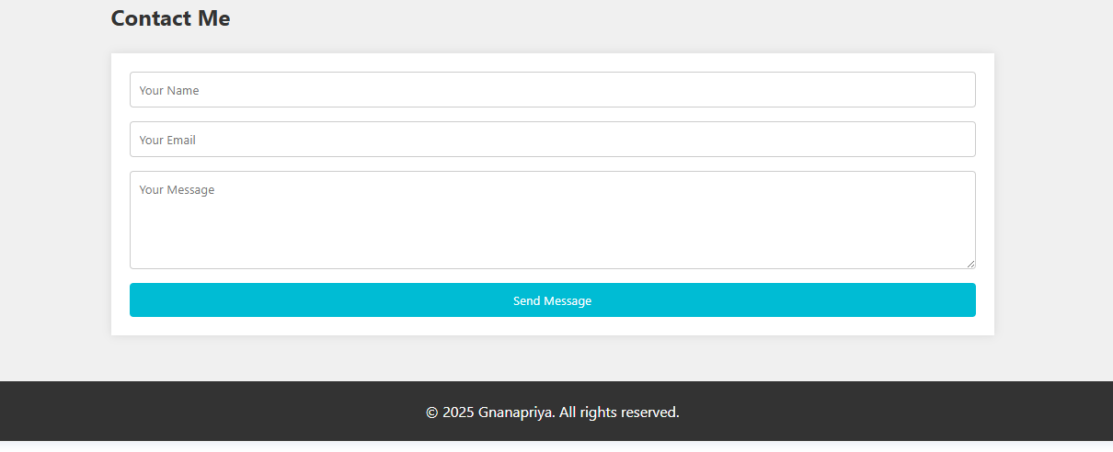
RESULTS AND SCREENSHOTS
The digital portfolio successfully presents skills, projects, and achievements in an interactive way. It enhances visibility, accessibility, and professional opportunities for the user.
3/21/2024 Annual Review
10

Slide 11
CONCLUSION
A digital portfolio is an effective platform to showcase skills and achievements interactively. It improves professional visibility, accessibility, and career growth opportunities.
11

