Slide 1
EA SPORTS
ASSIGNMENT
-PRIYA P

Slide 2
READOUT · PRODUCT DIRECTOR
Revenue is up ~3×. The ARPDAU drop is a change in player mix, not a monetisation problem
ARPDAU fell 16% (Jan → Apr), but ARPDAU rose in every country tier (+4% to +13%)
Cause: a March paid_video push into Tier-4 countries. Tier 4 went from 18% to 46% of daily players
Open question: does that campaign cost less than ~$1.14 per install?
Also: channels don't really differ once country is accounted for; churn is predictable, but offers must be tested first

Slide 3
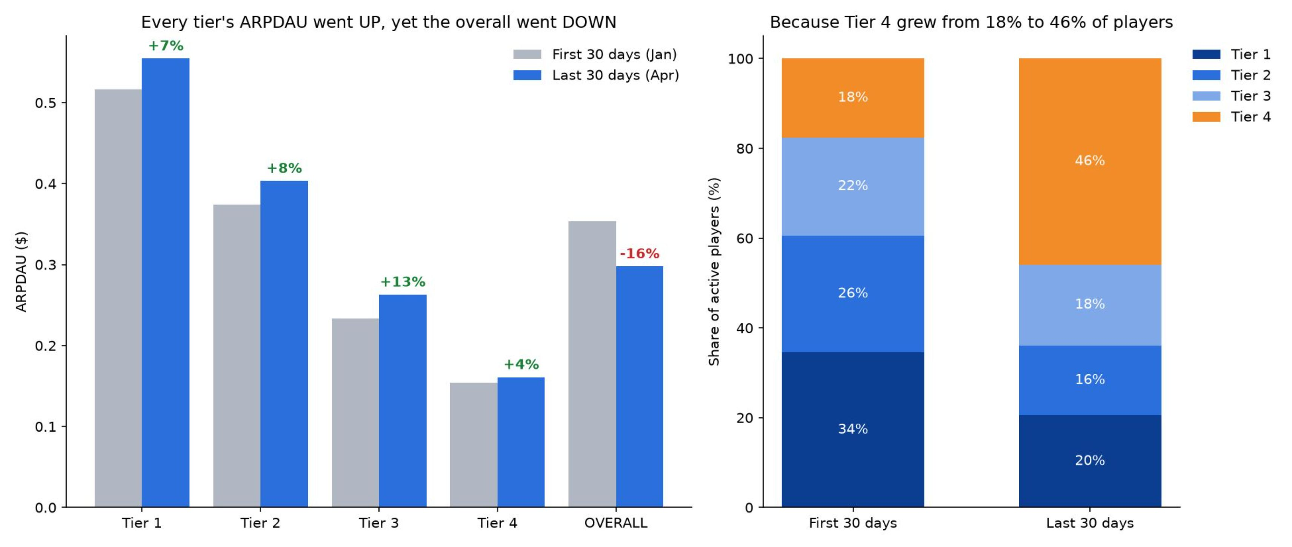
Every tier's ARPDAU went up, yet the overall went down
At January's tier mix, April ARPDAU would be $0.382, which is +8%, not −16%

Slide 4
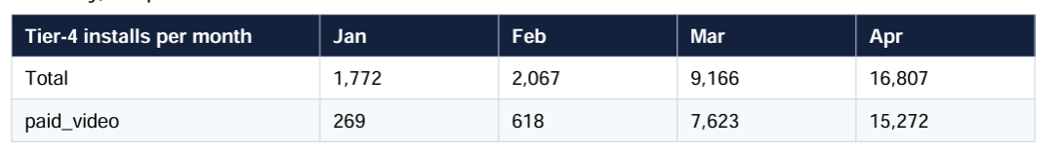
A Tier-4 video campaign roughly tripled installs from March
These are normal Tier-4 players: $1.14 per install in 30 days vs $1.02 for Tier-4 organic
Revenue grew from $29k (Jan 1–30) to $84k (Apr 1–30)

Slide 5
Don't "fix" monetisation. Check what the Tier-4 campaign costs
1
Don't change pricing or sales to chase blended ARPDAU
2
Report ARPDAU per tier (or at a fixed mix) from now on
3
Ask UA for cost per install by tier × channel. Keep the campaign only if CPI < ~$1.14 (30-day payback); if higher, it breaks the "no extra marketing spend" goal

Slide 6
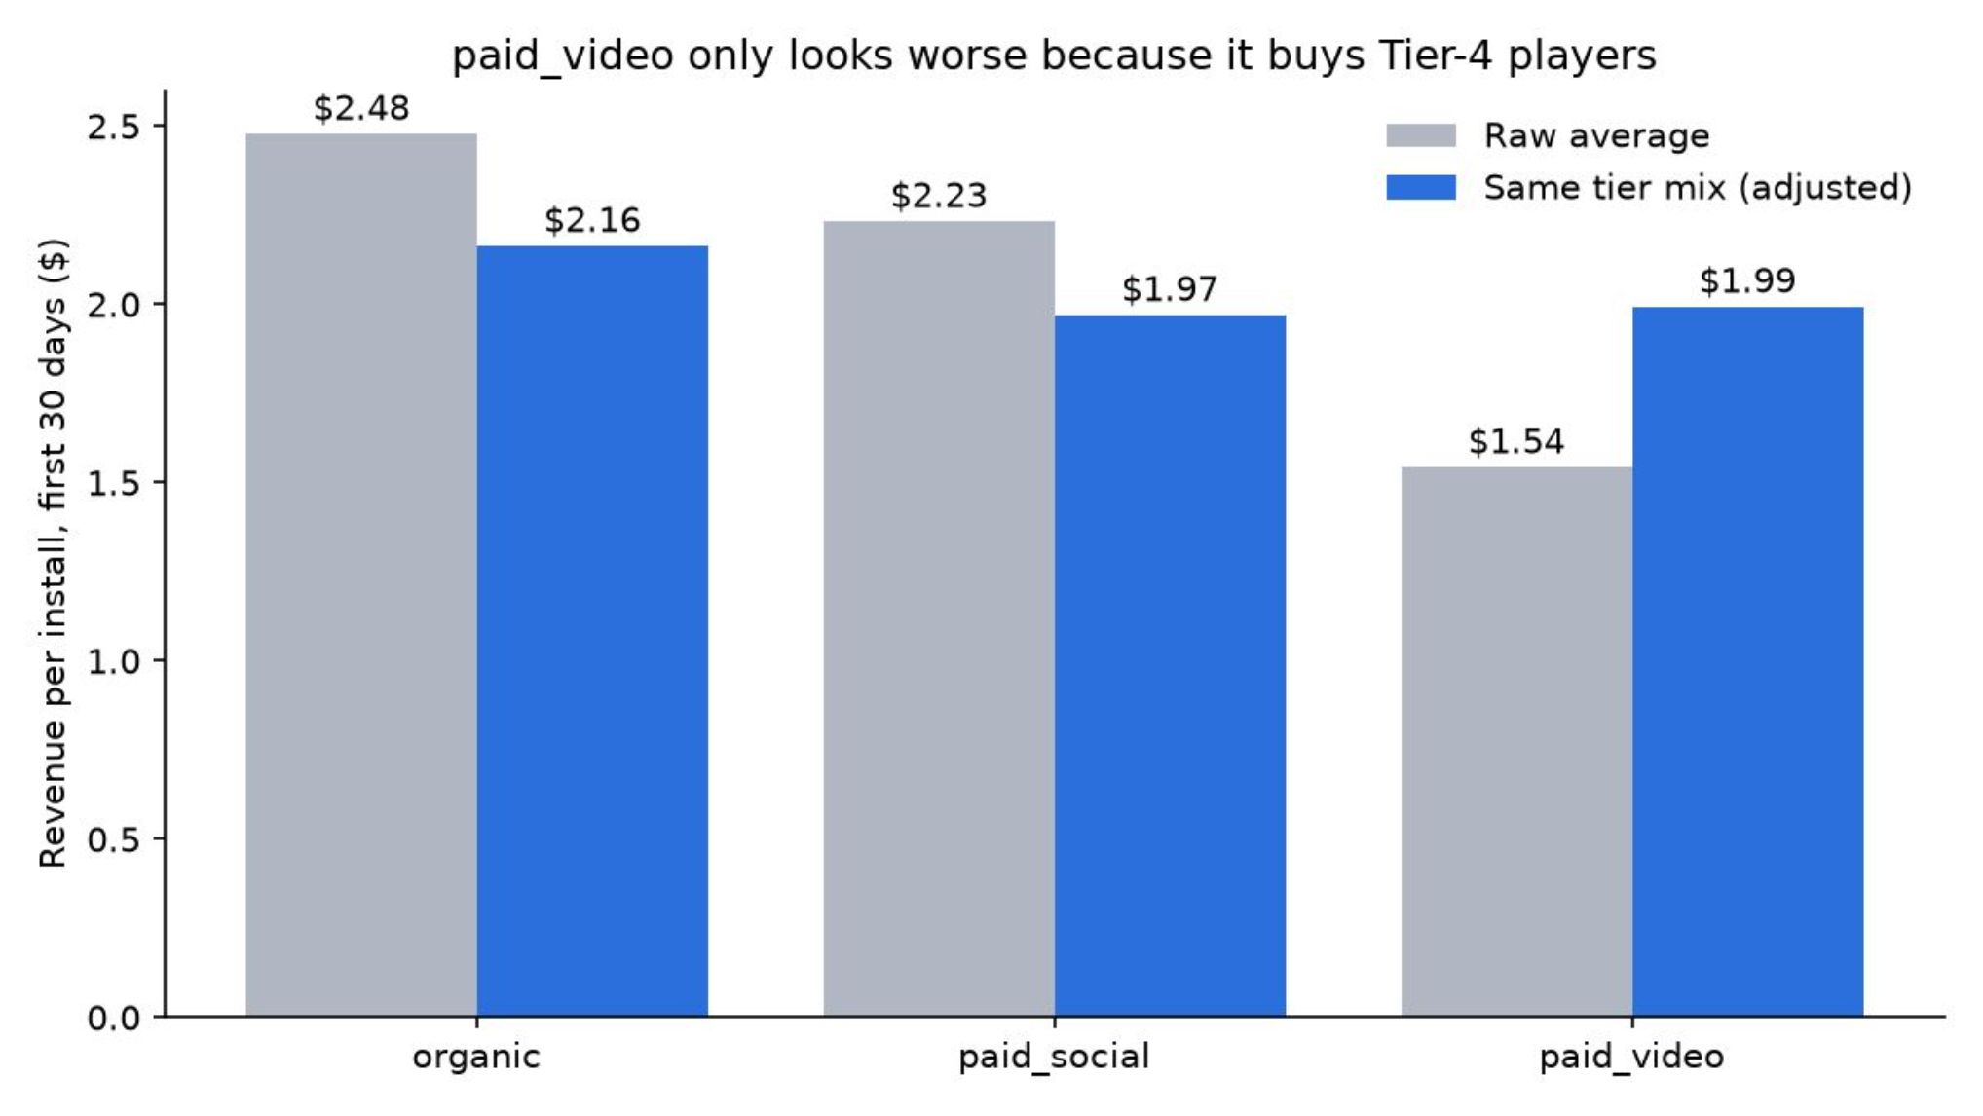
paid_video isn't worse. It just buys players in cheaper countries
Raw gap (paid_video $1.54 vs organic $2.48) is an artefact: 65% of paid_video installs are Tier 4
At the same tier mix: +$0.17, CI −0.14 to +0.49, not significant. Proving it would need ~59k installs per channel (we have ~11k)
Engagement gap is significant but tiny (0.1–0.3 days a month), so it's not a reason to move budget. Decide by tier × channel vs CPI

Slide 7
We can predict who will lapse, but 92% of lapsers come back on their own
Churn = no play in the next 14 days (for players active in the last 7)
Logistic regression, trained Feb–Mar 8 and tested Mar 29–Apr 16: AUC 0.73; top 10% riskiest lapse 46% vs 4% for the bottom 10%
Send an offer only if p(churn) × save rate × player value > offer cost
Run a holdout test first (offer to half of high-risk players), because most would return anyway

Slide 8
Retention is steady, the ad cap isn't binding, and two data issues had to be fixed first
Retention D1 47% / D7 25% / D30 14%, the same in every weekly cohort
iOS player worth 2× Android ($0.50 vs $0.25 ARPDAU); top 10% of players = 96% of revenue
Only 1% of ad-watching days hit the cap, so raising it won't add views
Data fixes: ad clock was 8h ahead (unmatched views 271,176 → 0); ad logging outage Mar 5–6

Slide 9
Uncertainty, what I dropped, next steps
Missing data
Dropped
Cost per install
Offer save rate
Ad revenue
Task 4b (optional). Only installs up to Jan 30 have 90 days of data
Next week
Uncertain
Test sales pull-forward
Holdout test for churn offers
4b with a longer window
30-day revenue understates lifetime value
Sales may only shift when people buy (8 sales, 15 days apart = the median repeat-purchase gap)

Slide 10
APPENDIX
Part 2: Data Quality & Analysis Evidence
Supporting SQL outputs, validation tables, and model diagnostics for the full data-quality audit. Each card maps to a specific source file and question number.

Slide 11
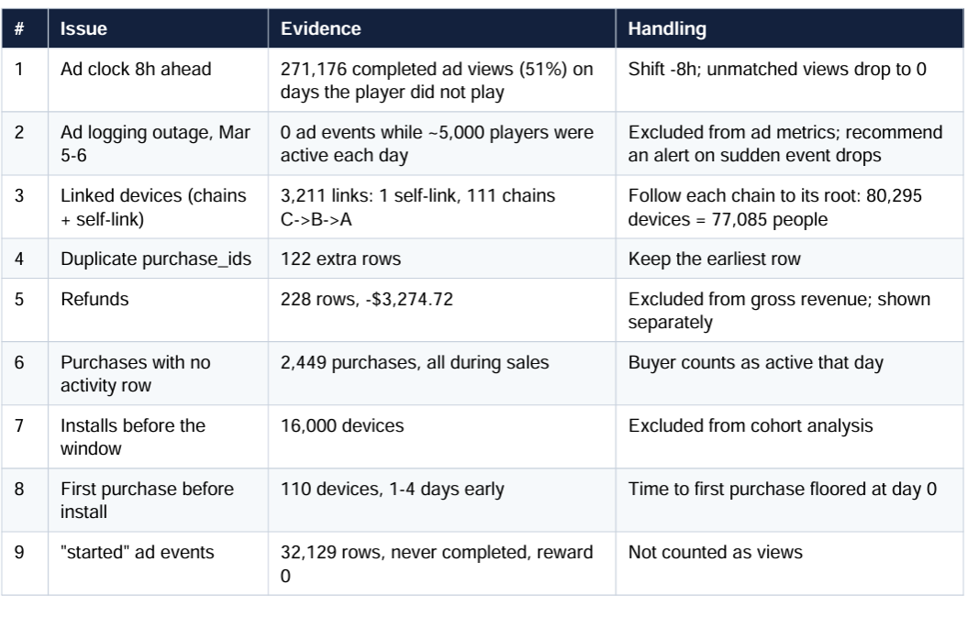
A1 · 01_DATA_QUALITY.SQL
Data-Quality Issues & Handling
Nine issue categories were identified and resolved during preprocessing. The table below documents each issue type, row count, and the handling decision applied.

Slide 12
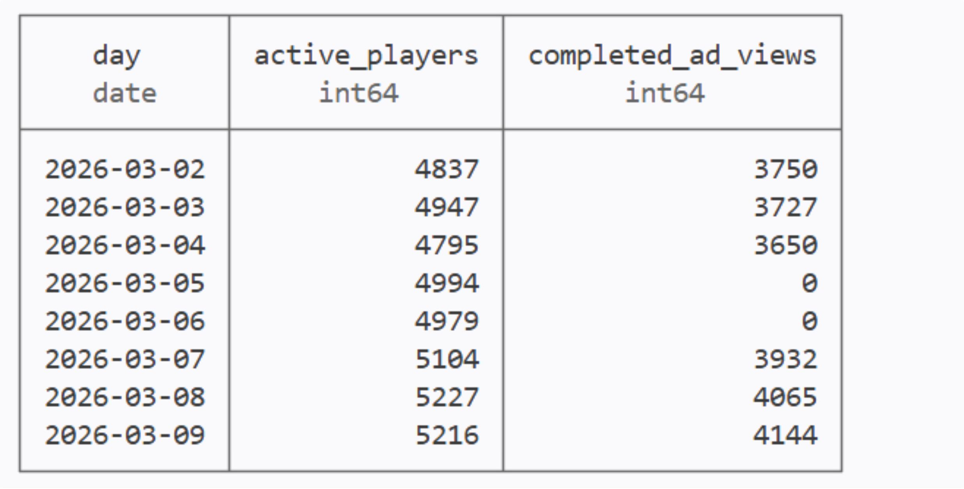

Slide 13
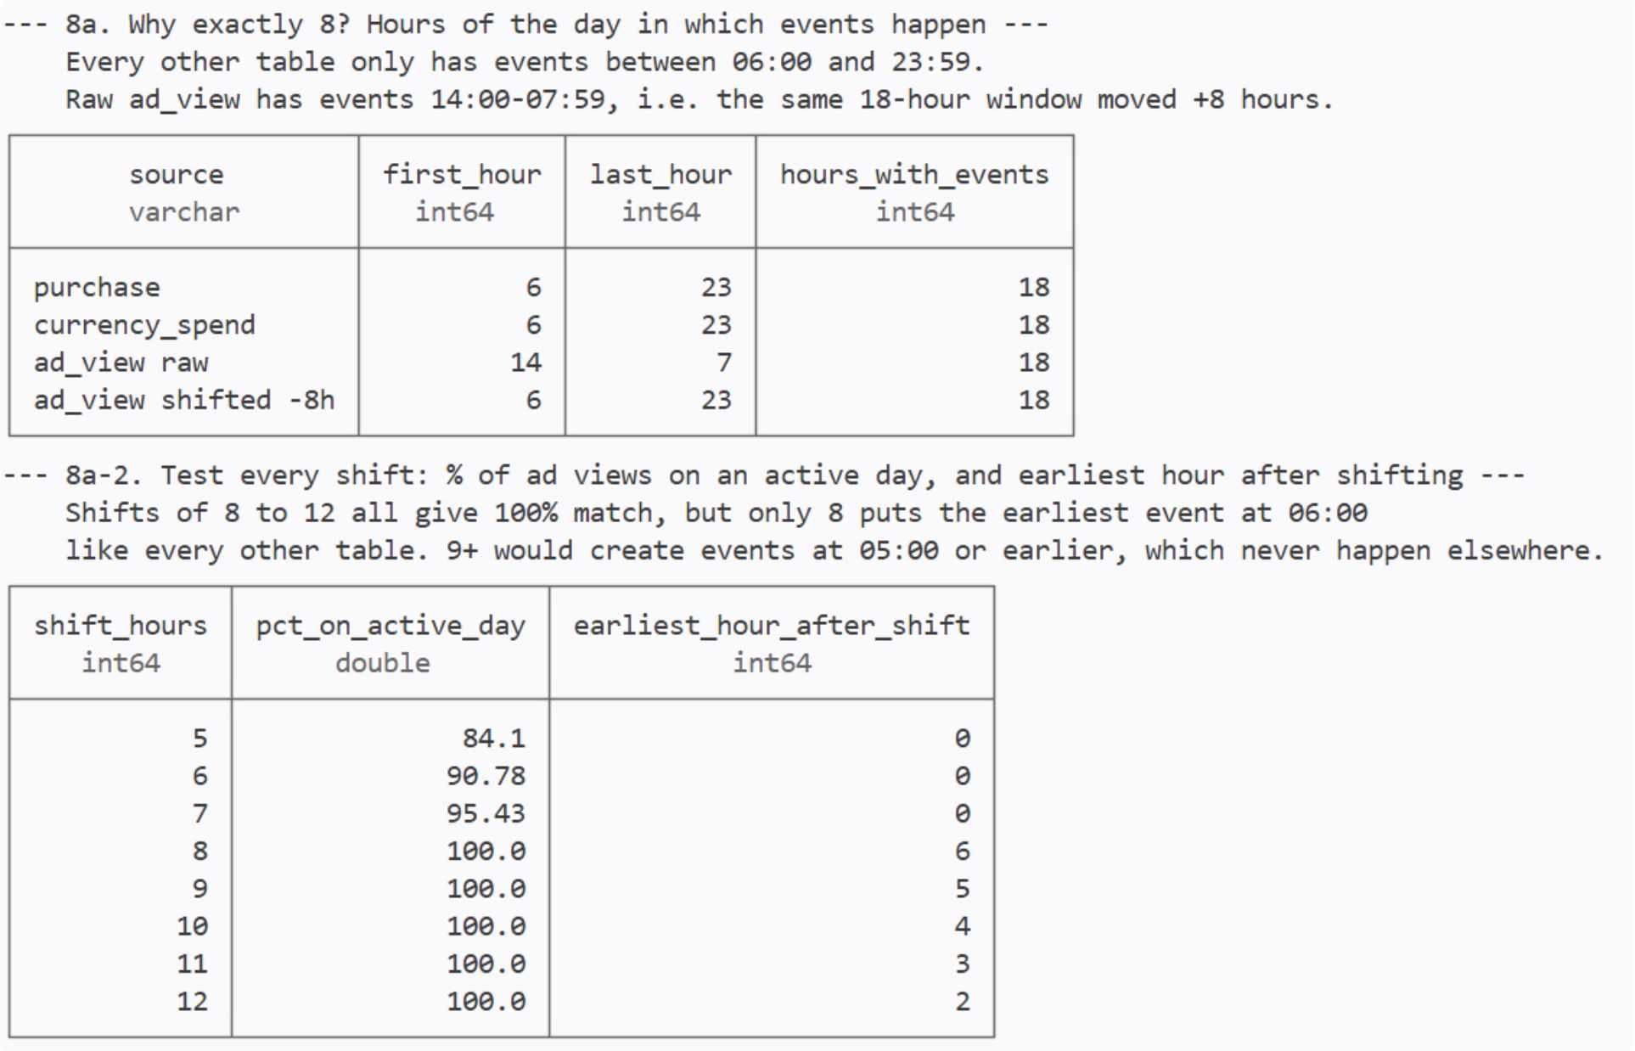

A2 · 01_DATA_QUALITY.SQL — SECTIONS 8A, 8A-2
Why the Ad Clock Shift Is Exactly 8 Hours
Validation Logic
Every other table has events only between 06:00 and 23:59. Raw ad_view has 14:00-07:59: the same 18-hour window moved +8h. Shifts of 8-12h all match ad views to active days 100%, but only 8h puts the first ad event at 06:00 like every other table. After the fix, unmatched ad views drop from 271,176 to 0.
All ad timestamps were shifted back by 8 hours (-8h) before joining to gameplay tables

Slide 14
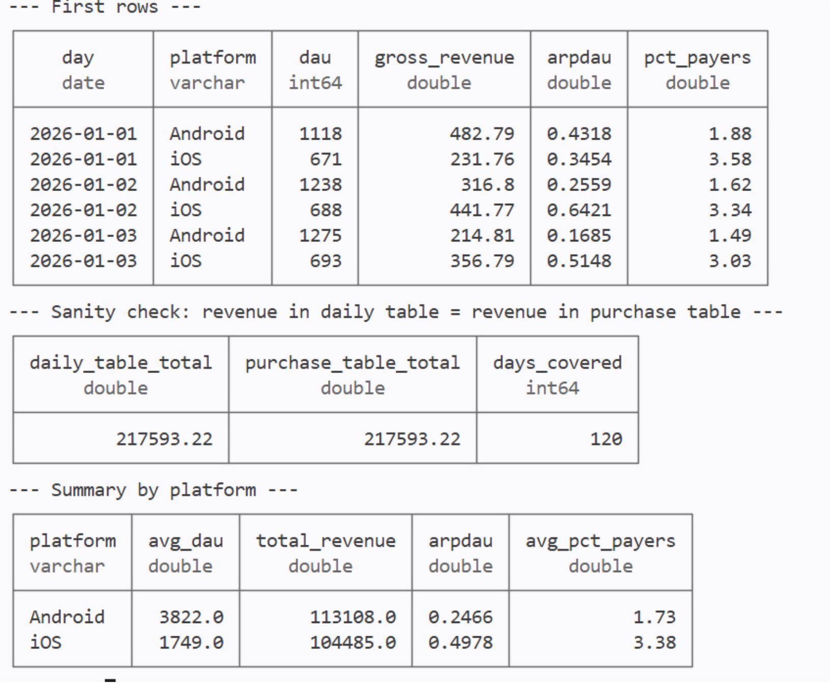

A3 · QUESTION 1(A)
Daily Health: Active Users & Revenue Sanity Check
Definition
Active = play or purchase. Linked devices are merged to avoid double-counting. Platform-level breakdowns and a grand-total sanity check confirm data completeness.
Grand-total revenue: $217,593.22 — matches source-of-truth ledger.

Slide 15
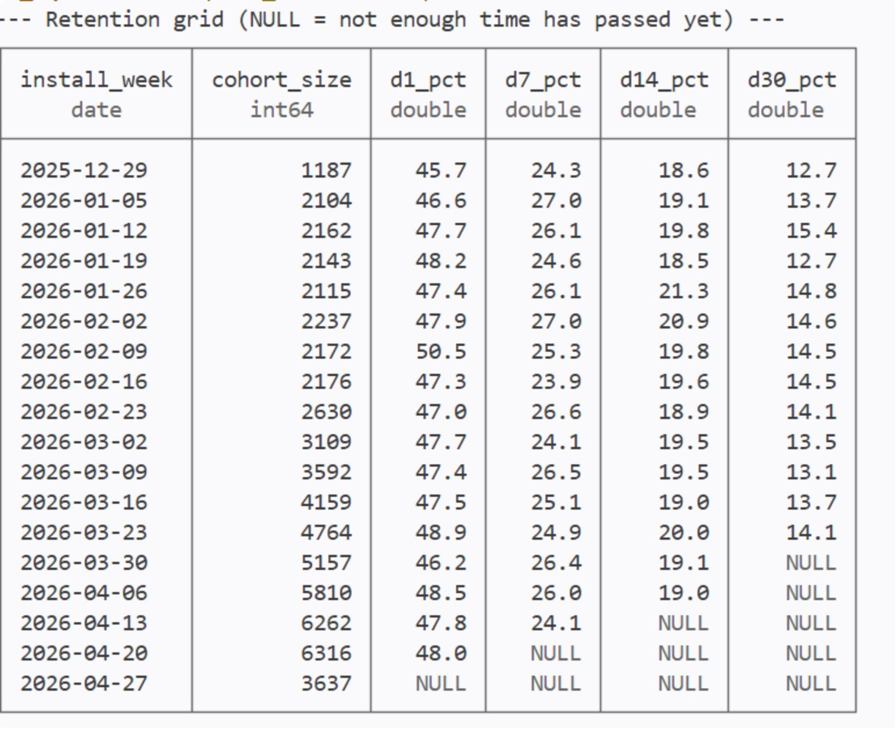
A4 · QUESTION 1(B)
Retention Grid
Full cohort-by-day retention matrix. Blank-cell rule: a cell is left blank (NULL) unless every player in that install week has reached day N by Apr 30. Showing 0% would wrongly suggest everyone quit; a partial % would mix players who had time to return with players who did not.

Slide 16
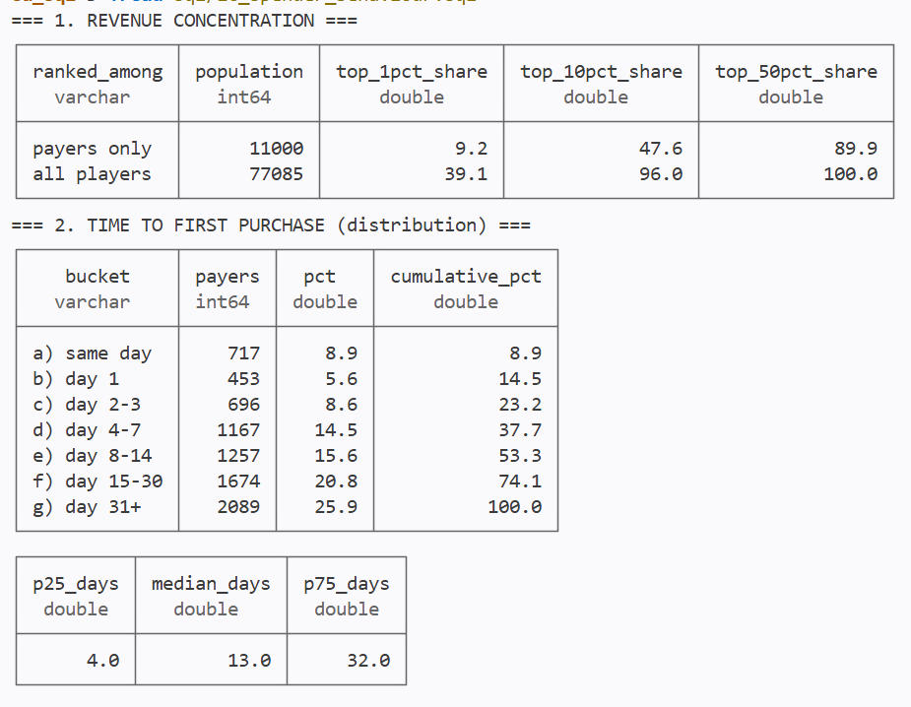
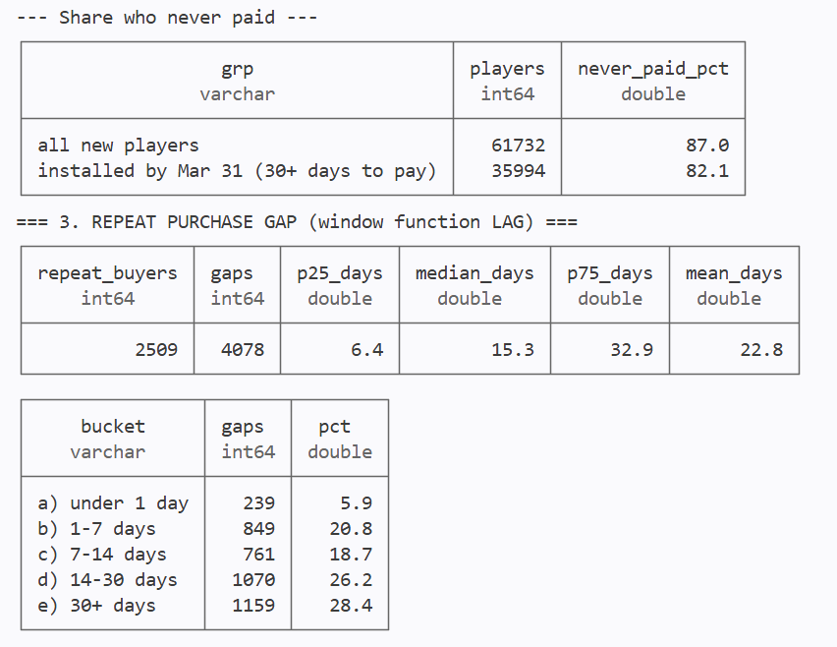
A5 · QUESTION 1(c)
SPENDER BEHAVIOUR

Slide 17
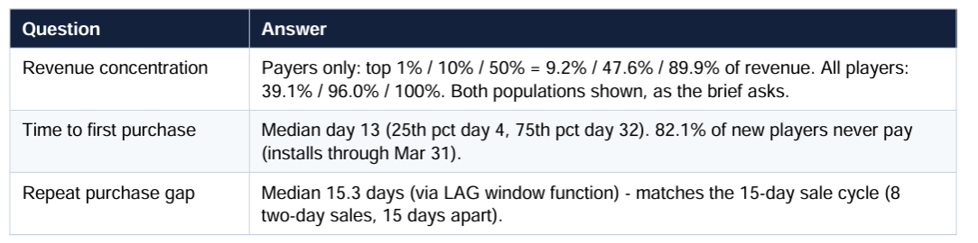

Slide 18
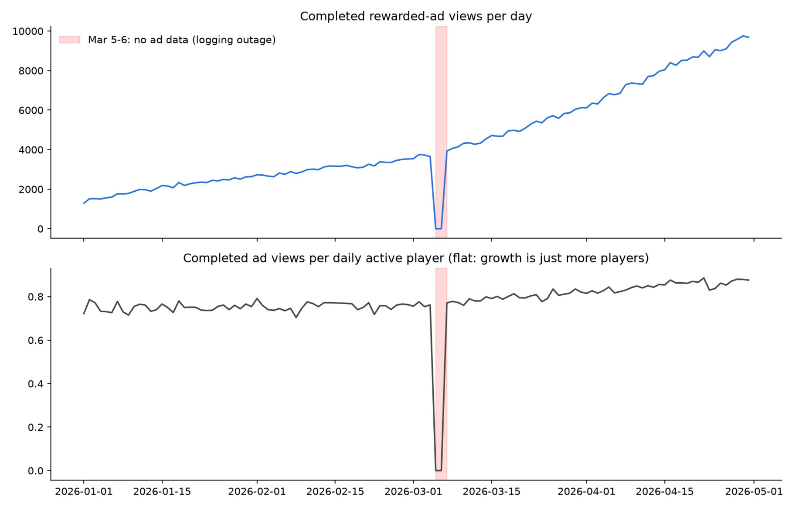
A6· 1(D)
Ad Engagement: Daily ad views: flat per player;
Mar 5-6 logging outage

Slide 19
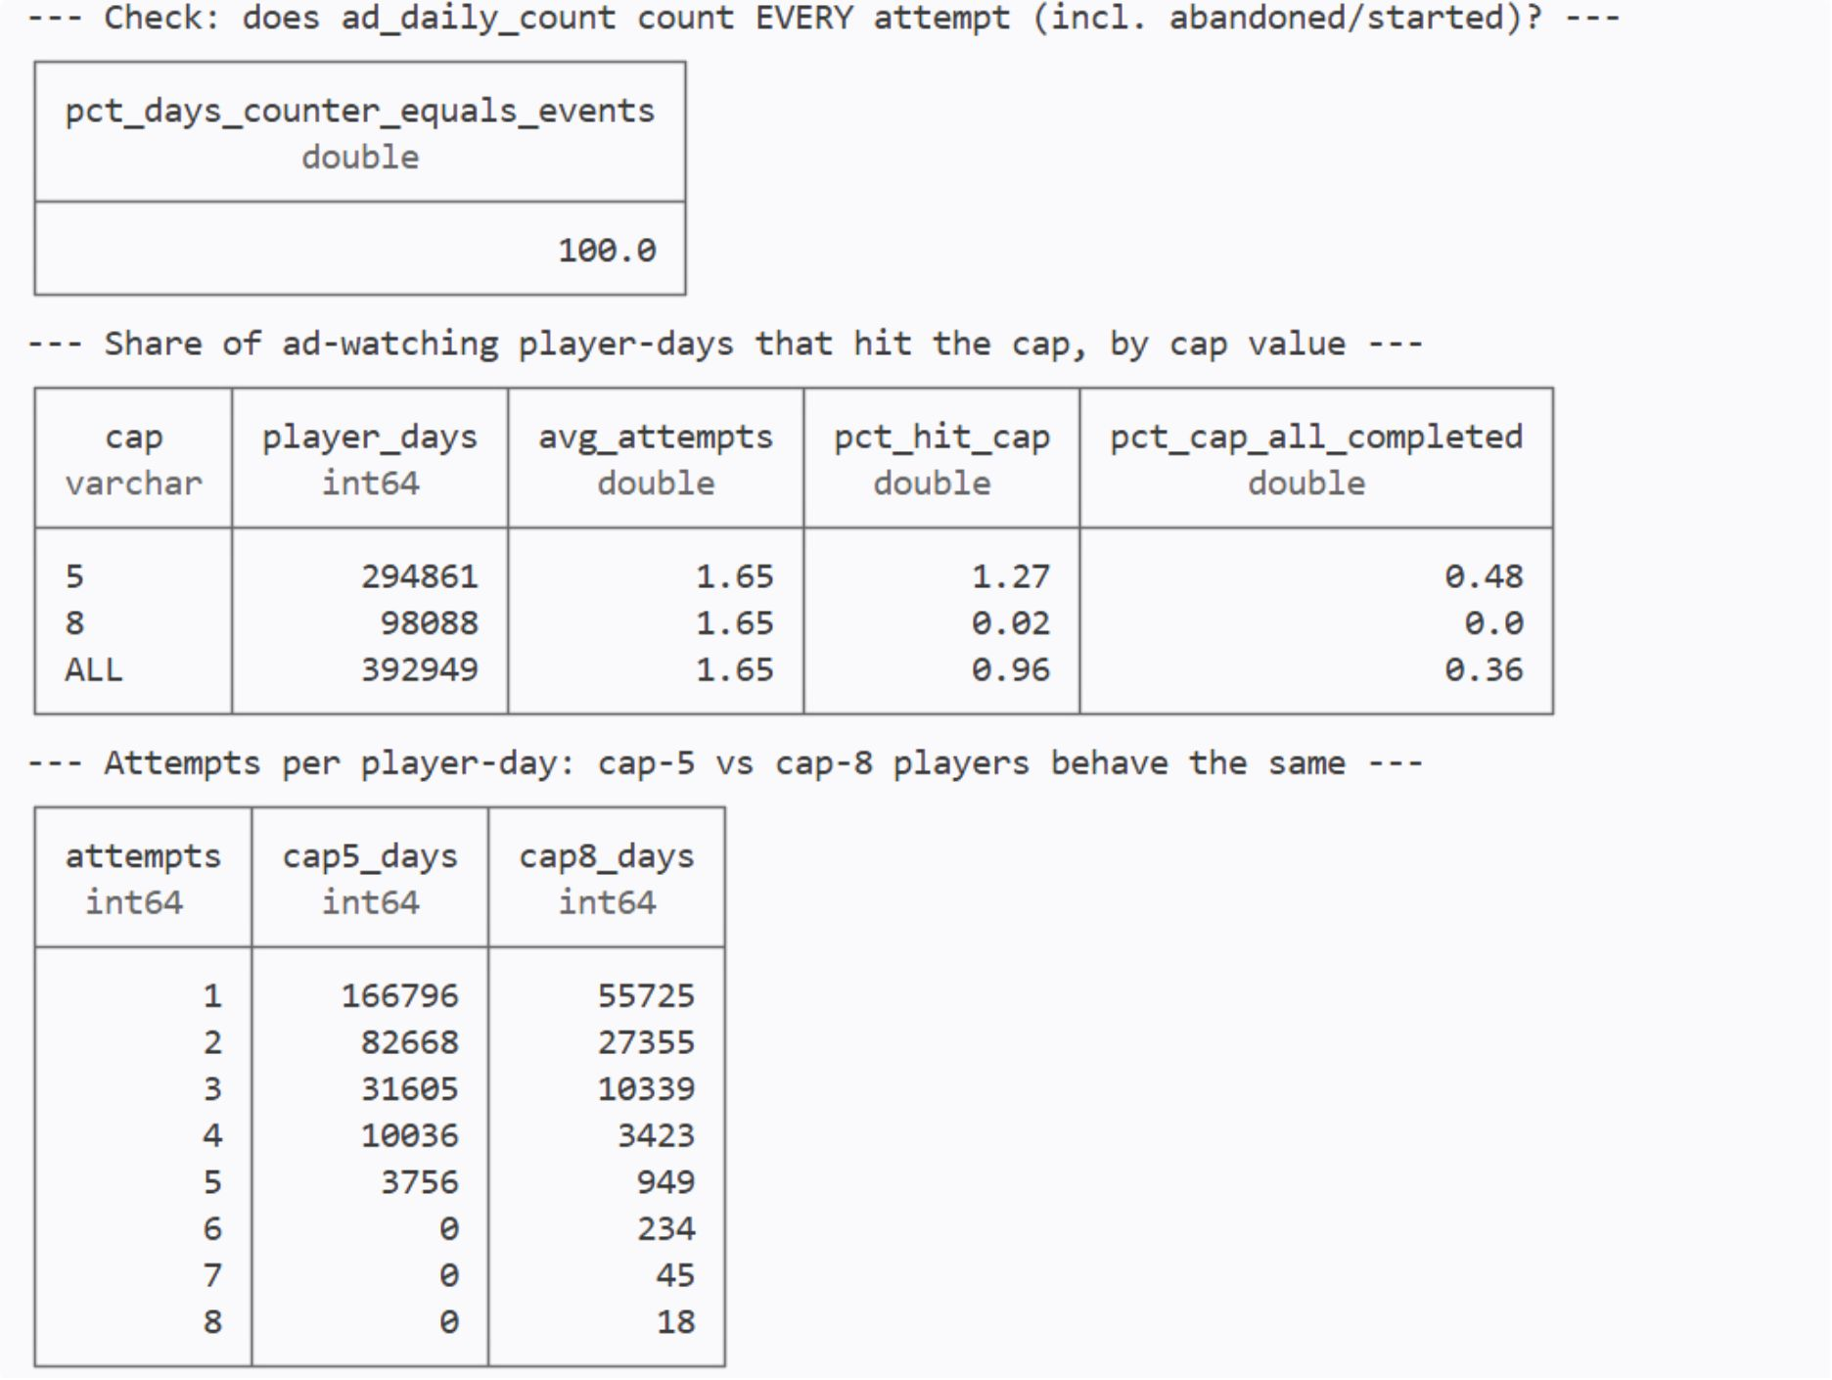
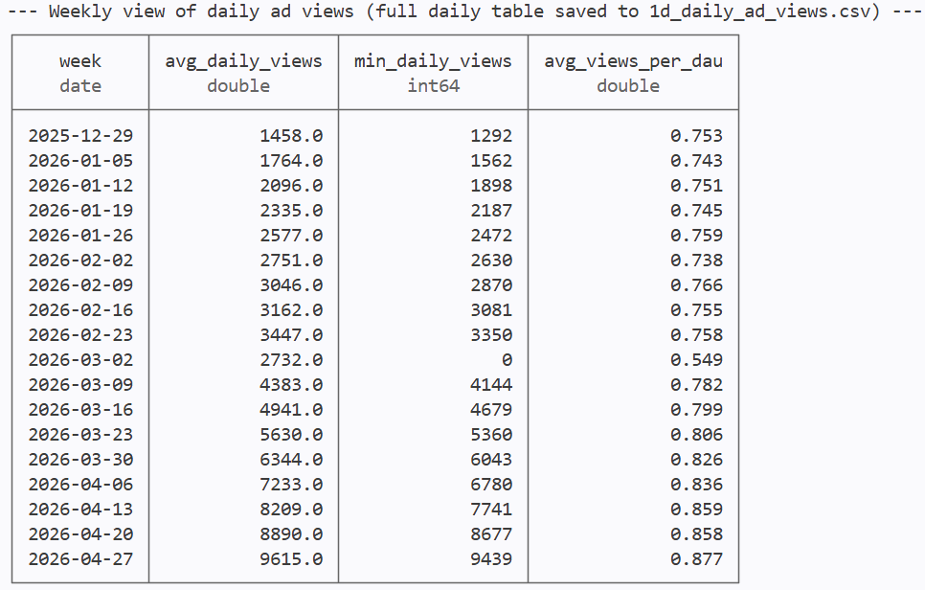
A6 · 1(D)
Only 1% of ad-watching days hit the cap
- the cap is not binding
What to tell the product team: cap-5 and cap-8 players make the same number of attempts,
so raising the cap will not add views. Improve rewards or ad placements instead.

Slide 20
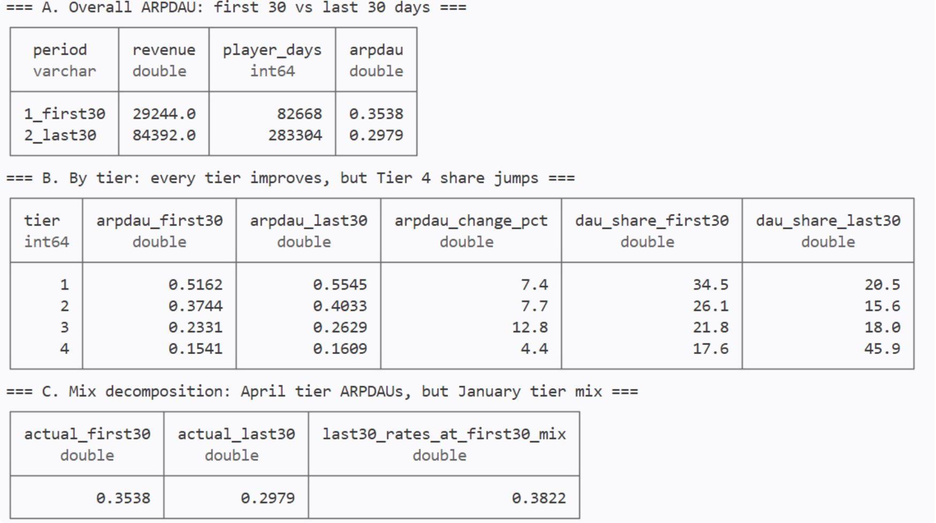
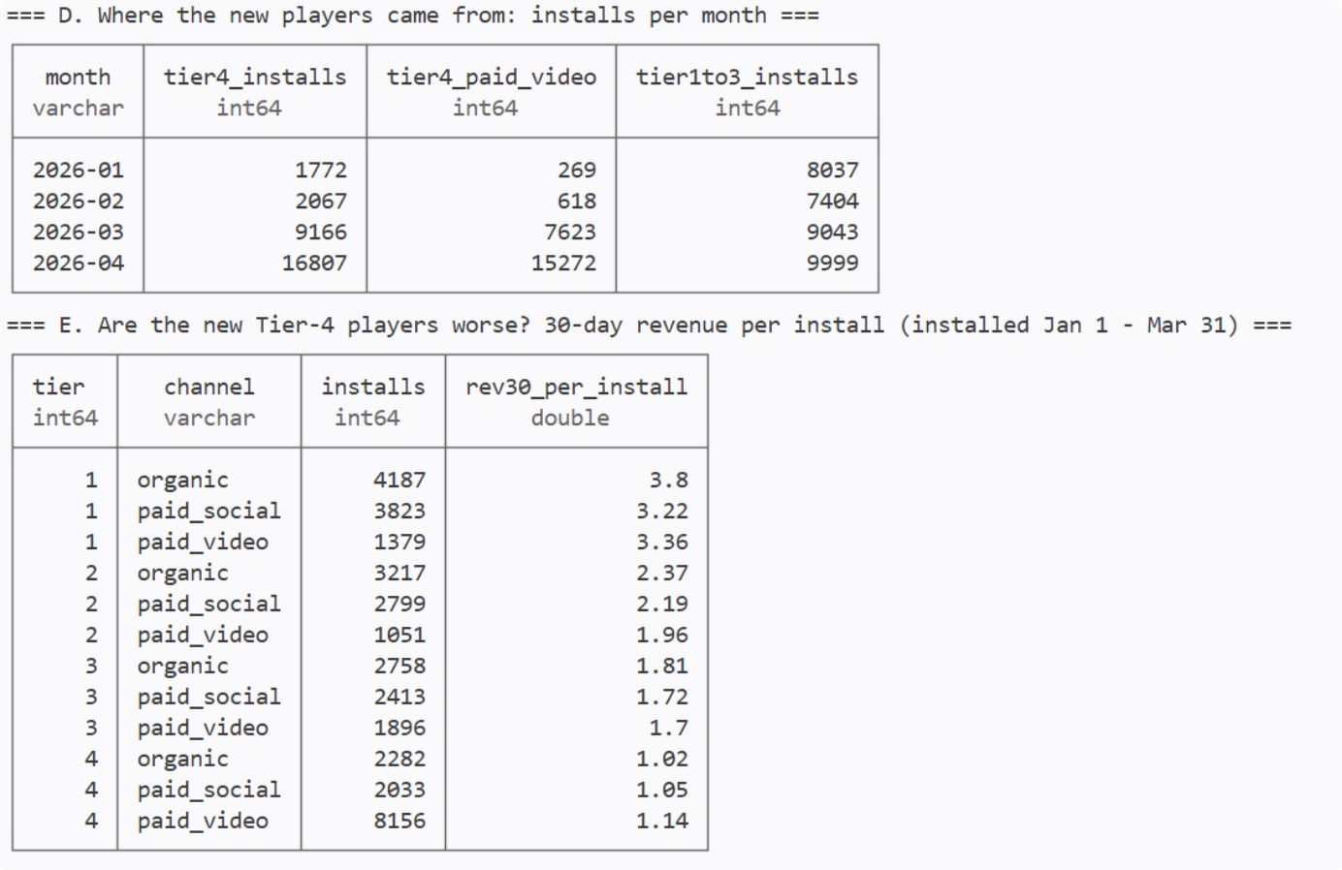
A7 · 2(A)
ARPDAU by country tier and mix decomposition

Slide 21
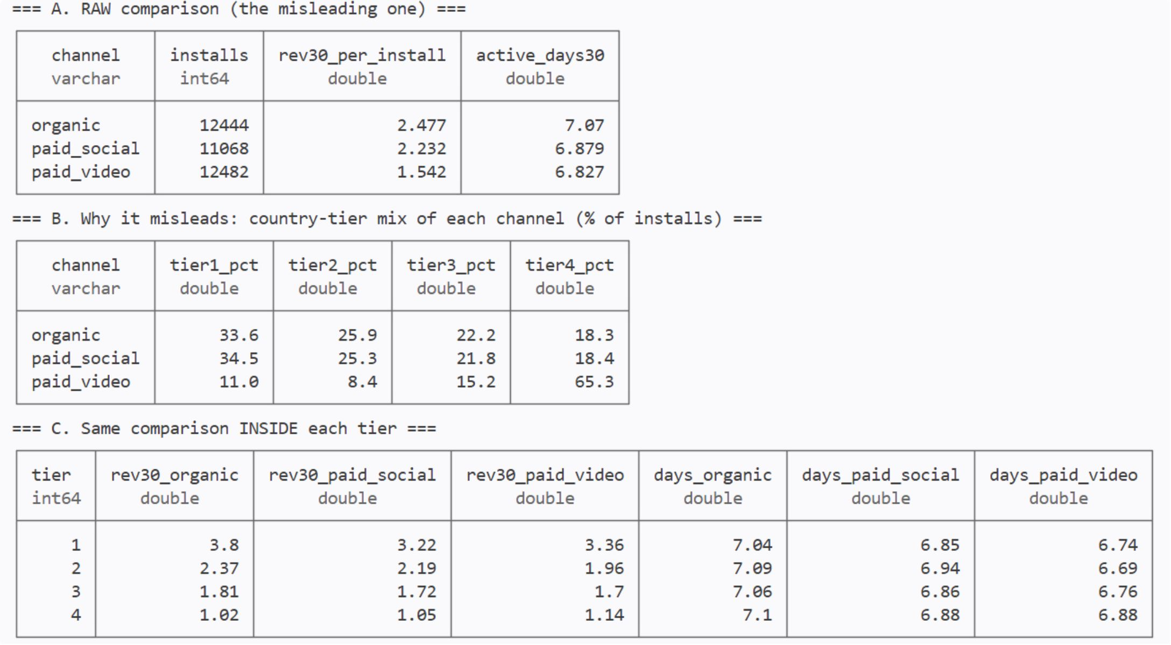
A8 · 3
Channel Attribution: Raw Data & Tier Mix

Slide 22
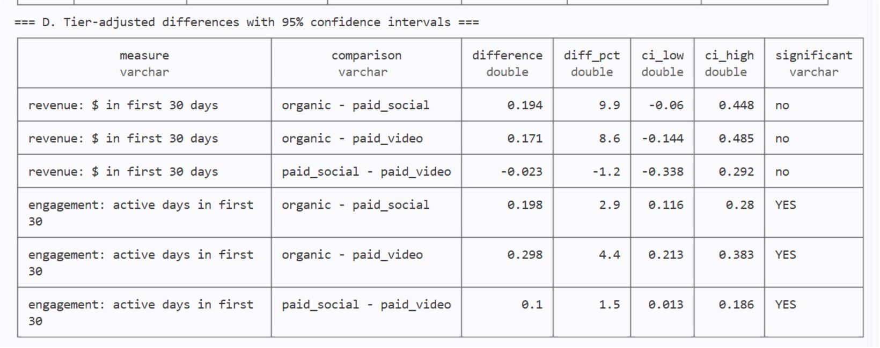
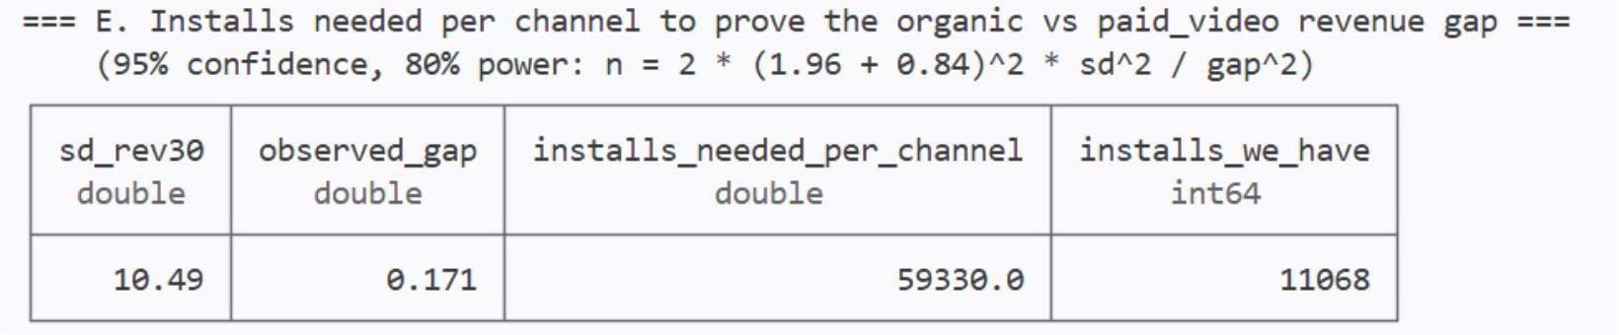
A8 · 3
Tier-adjusted channel differences with 95% CIs

Slide 23
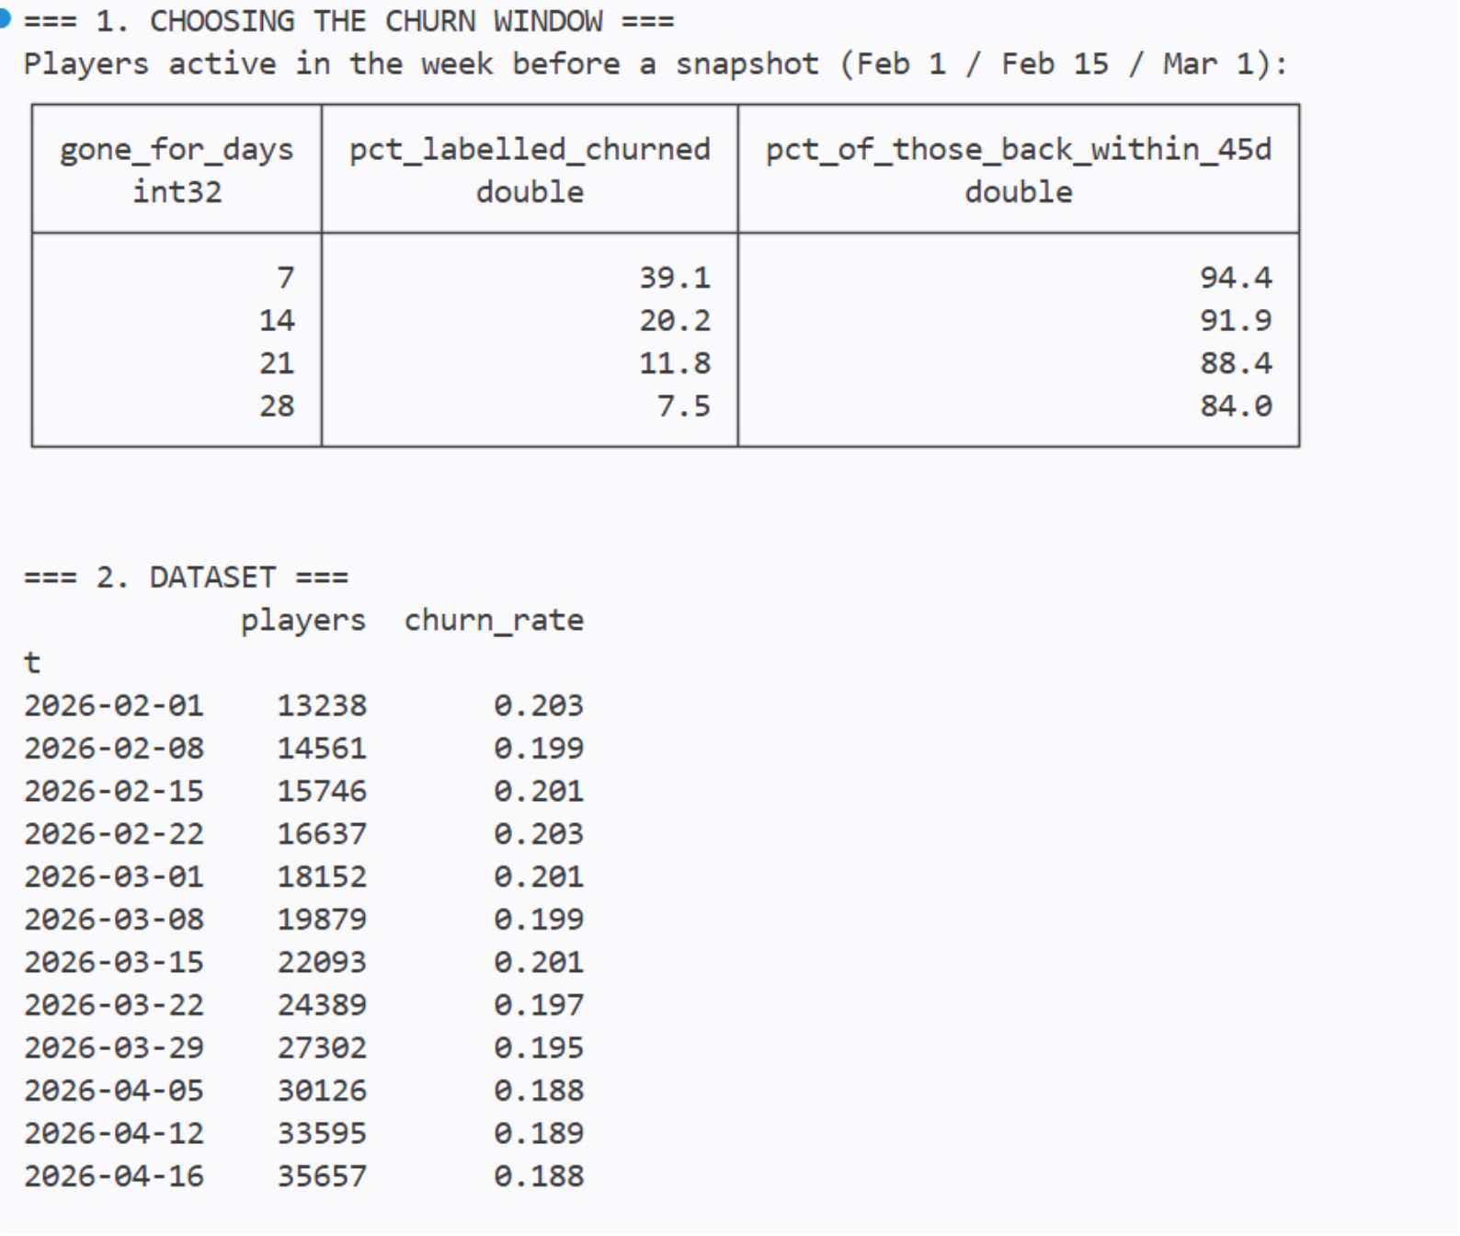
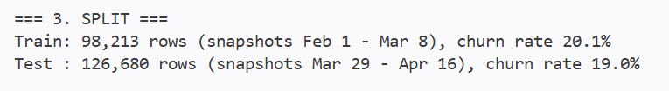
A9 · 4
Churn Model: Dataset Setup

Slide 24
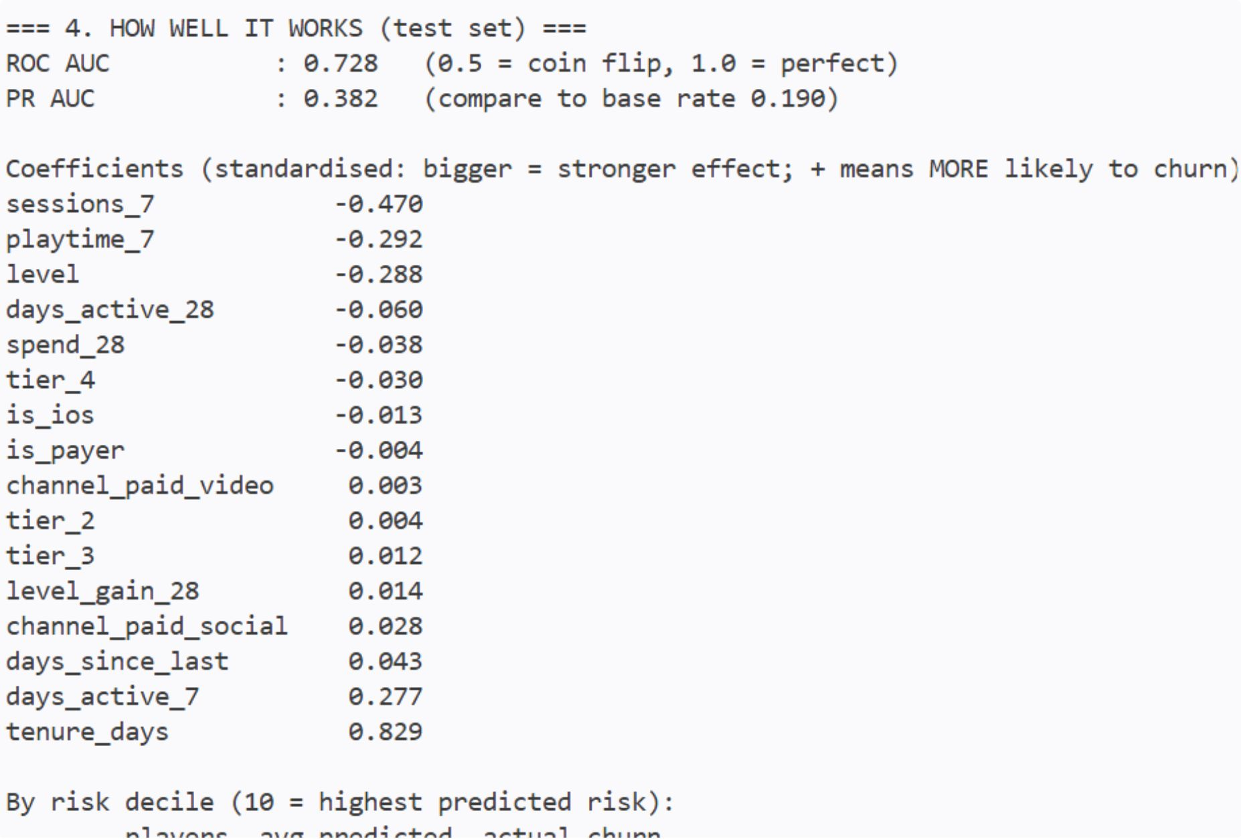
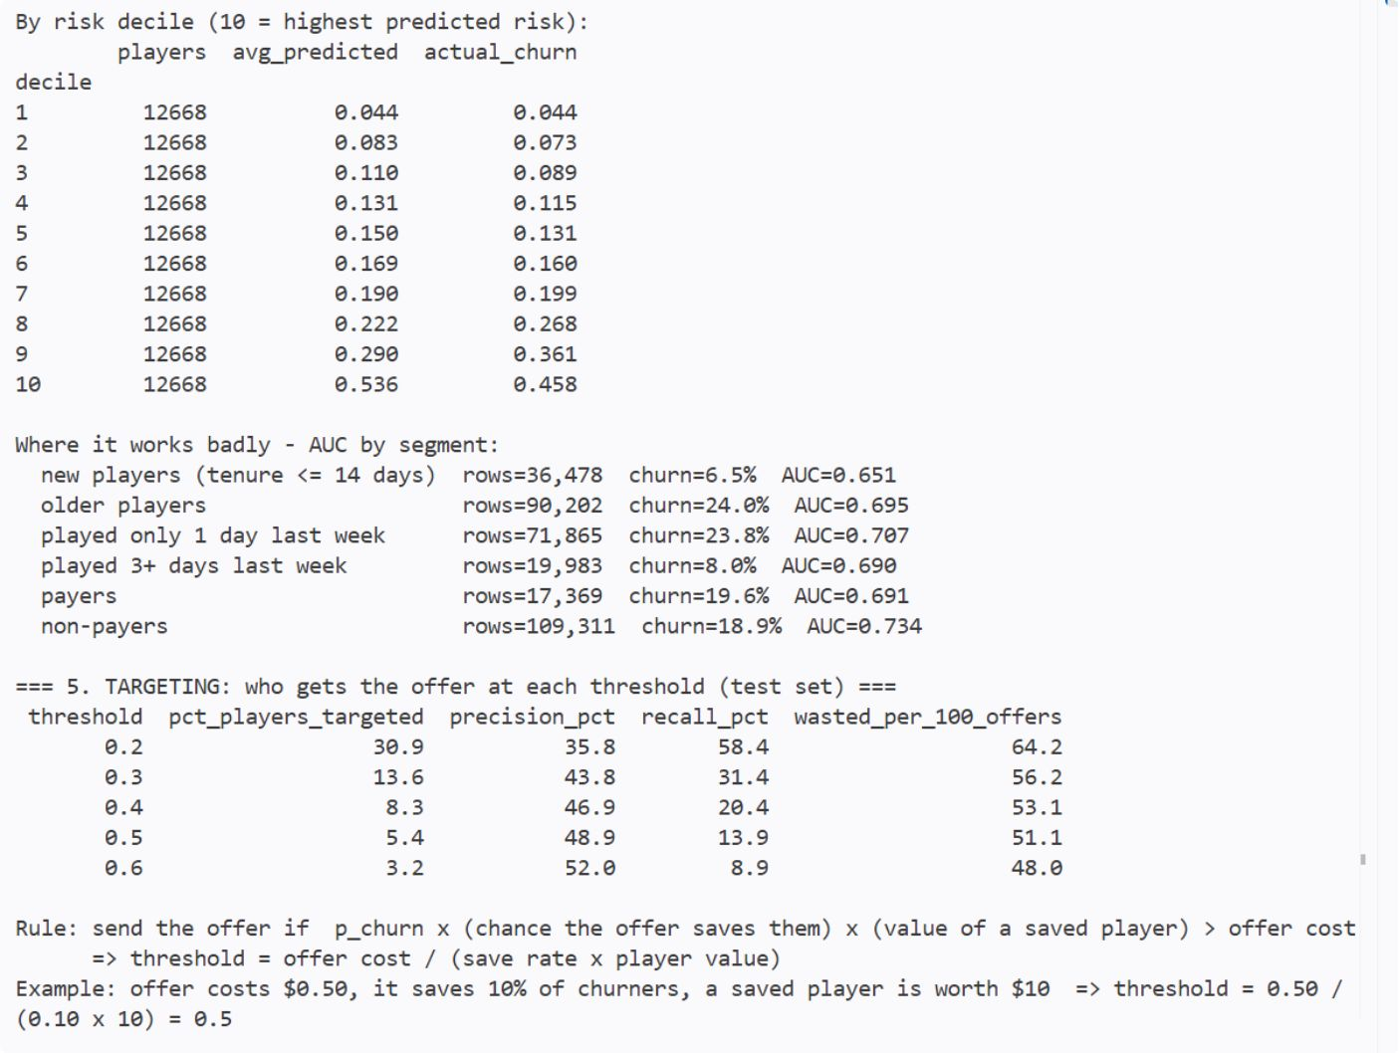
A9 · 4
Churn Model: Results

