Slide 1
LUNG CANCER DETECTION USING MACHINE LEARNING
Project Guide: Dr. Sairamesh L
Presented by
Muthupriya P
2019202035 (R)

Slide 2
Motivation and Objective
Lung cancer is one of the dangerous and life taking disease in the world. However, early diagnosis and treatment can save life.
Although, CT scan imaging is best imaging technique in medical field, it is difficult for doctors to interpret and identify the cancer from CT scan images.
Therefore, computer aided diagnosis can be helpful for doctors to identify the cancerous cells accurately.

Slide 3
Introduction
Machine learning (ML) allows software applications to become more accurate at predicting outcomes without being explicitly programmed to do so.
Machine learning algorithms use historical data as input to predict new output values.

Slide 4
Impacts and Significance
Machine learning has several practical applications that drive the kind of real business results - such as time and money savings.
Healthcare: It helps healthcare researchers to analyze data points and suggest outcomes.
Automation: It helps machines to perform repetitive tasks without human intervention.

Slide 5
Literature Review
S.No. | Author name & paper title | Concept in the paper | Paper details
1 | Pragya Chaturvedi, “Prediction and Classification of Lung Cancer Using Machine Learning Techniques” | Comparative study of various image processing techniques and image classification algorithms with Results. | IOP Conference Series: Materials Science and Engineering,2021.
2 | Prerana Prajapati, Vedika Hande, Aarti Ingale, Sanjeev Dwivedi, “Lung Cancer Detection and Classification Using SVM” | Implementation of SVM classifier is discussed. Detailed explanation about steps involved in lung cancer detection using SVM. | Journal of Emerging Technologies and Innovative Research (JETIR),2019.

Slide 6
Literature Review
S.No. | Author name & paper title | Concept in the paper | Paper details
3 | F. Taher, N. Prakash, A. Shaffie, A. Soliman, A. El-Baz, “An Overview of Lung Cancer Classification Algorithms and their Performances” | Various image classification algorithms are discussed and their performance are compared. | IAENG International Journal of Computer Science,2021..
4 | R.Sathishkumar, K.Kalaiarasan, A.prabakaran,M. Aravind, “Detection of Lung Cancer using SVM Classifier and KNN Algorithm” | Implementation of SVM classifier is discussed. Detailed explanation about steps involved in lung cancer detection using SVM. | IEEE,2019.

Slide 7
Literature Review
S.No. | Author name & paper title | Concept in the paper | Paper details
5 | Radhika P.R.,Rakhi A.S. Nair, Veena G, “A Comparative Study of Lung Cancer Detection using Machine Learning Algorithms” | Various image classification algorithms are discussed and their performance are compared. | IEEE,2019.
6 | Anjali Sevani,Hardik Modi, “Implementation of Image Processing Techniques for Identifying Different Stages of Lung Cancer ” | Various Image processing techniques are discussed to find the diameter of the tumour and stage of cancer is determined based it. | International Journal of Applied Engineering Research,2018.

Slide 8
Dataset Details
CT image is preferred for lung cancer detection rather than other available medical images.
There are many publicly available databases build to help the researcher. They can utilize those datasets for training and testing of their algorithms and models.
Among those databases, most commonly used are LIDC, TCIA, and Kaggle.
CT scan images are in png format.

Slide 9
Implementation and Framework
Language Used: Python
Tool: Jupyter notebook

Slide 10
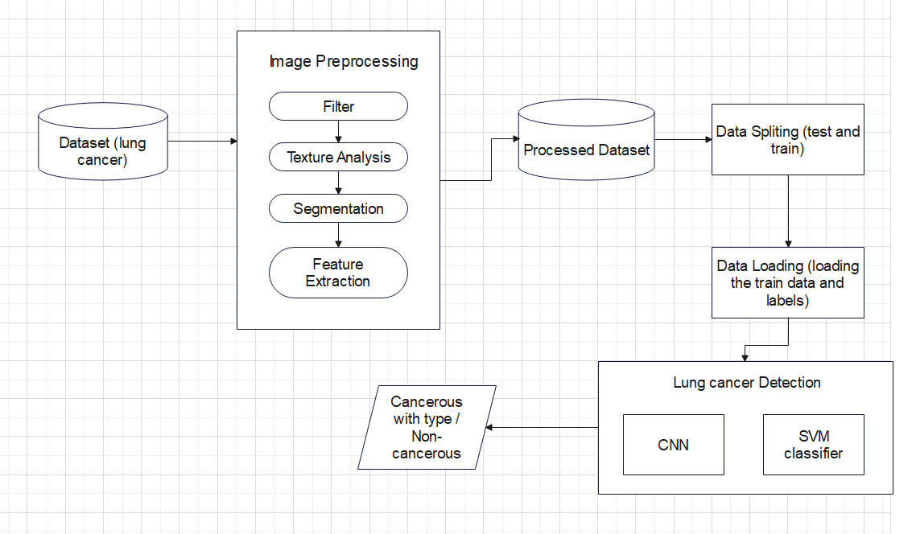
Overall Architecture

Slide 11
List of Modules
➢ Data Acquisition
➢ Pre-processing
➢ Feature extraction
➢ Classification
➢ Prediction

Slide 12
Data Acquisition
CT image is preferred for lung cancer detection rather than other available medical images.
There are many publicly available databases build to help the researcher. They can utilize those datasets for training and testing of their algorithms and models. Among those databases, most commonly used are LIDC, TCIA, and Kaggle.
Using os python library the data is append into the system for further image processing and classification.

Slide 13
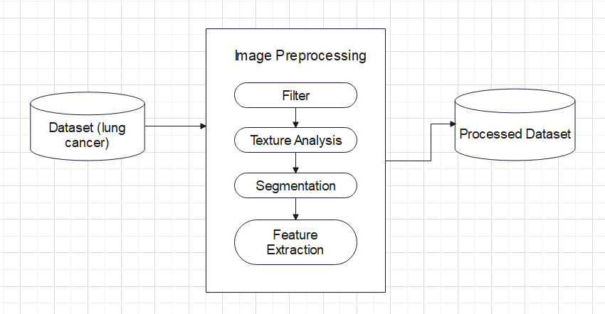
Pre-Processing
The Pre-processing makes the data more reliable to use it. Some filters like median filter are used to clean, smooth, eliminate noise.
Gabor filter is used for texture analysis. watershed algorithm is used for segmentation.

Slide 14
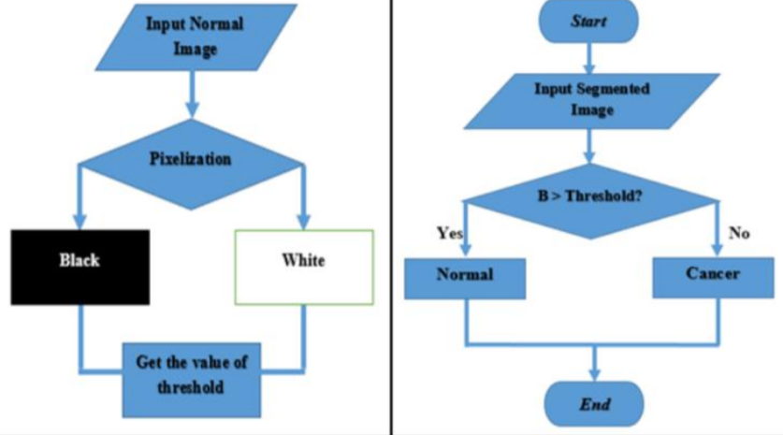
Feature Extraction
Binarization is the process of changing the color of the pixel values into two classes such as black and white.

Slide 15
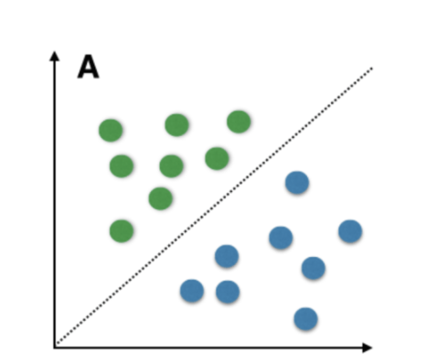
Classification
SVM is a supervised machine learning algorithm which can be used for classification or regression problems.
Here, the processed data undergoes train and test.

Slide 16
SVM
Step1: start.
Step2: Read the dataset.
Step3: Label the data if necessary.
Step4: Split the data for train(75%) and test (25%).
Step5: Train the data.
Step6: After trained the data successfully, Test the data.
Step7: Check accuracy.
Step8: End.

Slide 17
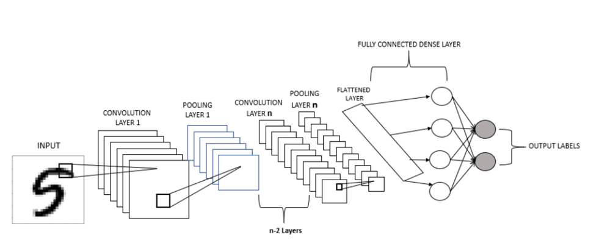
CNN
Convolutional Neural Networks is the subdomain of Machine Learning which is Deep Learning.
It can take an input image, assign importance (learnable weights and biases) to various aspects/objects in the image and be able to differentiate one from the other.

Slide 18
CNN
Step1: start.
Step2: Load the dataset.
Step3: Label the data if necessary.
Step4: Split the data for train and test.
Step5: Create the model.
Step6: Fit the data in the model and train it.
Step7: Check accuracy.
Step8: End.

Slide 19
Prediction
A new image is passed to the trained model for prediction. This image undergoes all image pre-processing techniques to bring it to the format of trained data.
Then the image is classified based by trained model and results are shown whether the tumor is cancerous or noncancerous.
If the tumor is cancerous then its type also shown in result.

Slide 20
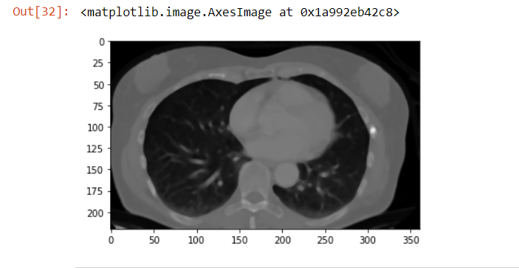
Module Based Output Screenshots
Pre-Processing:
Median Filter

Slide 21
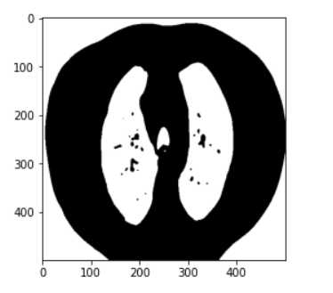
Module Based Output Screenshots
Binarization

Slide 22
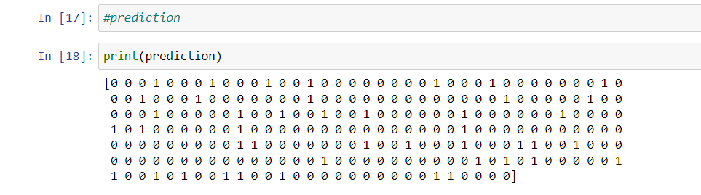
Module Based Output Screenshots
Prediction

Slide 23
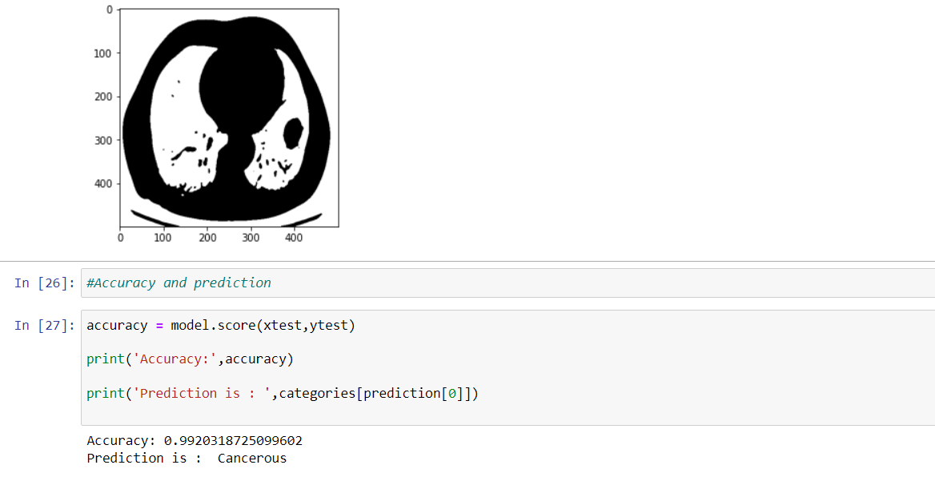
Module Based Output Screenshots
SVM

Slide 24
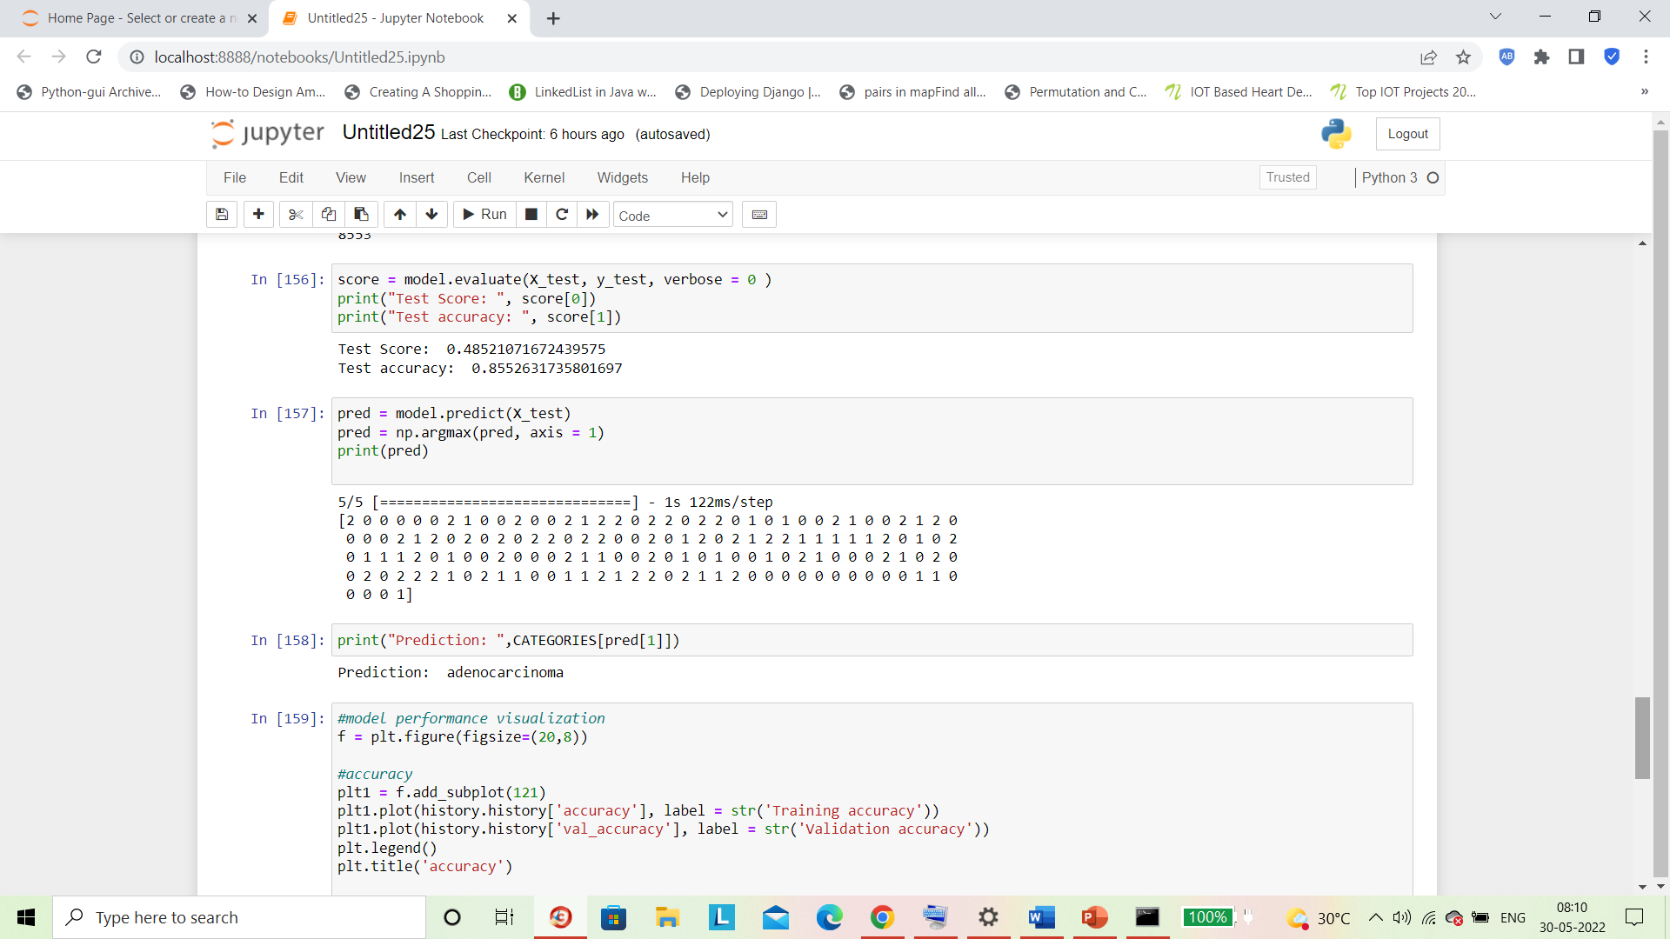
Module Based Output Screenshots
CNN

Slide 25
References
[1] Dr. M. Sangeetha, Department of Information Technology “Classification of lung cancer”
in International Journal of Engineering Research & Technology,2020.
[2] Pratyaksh Jain, “Lungs Cancer Detection System” in IRJET,2020.
[3] F. Taher, N. Prakash, A. Shaffie, A. Soliman, A. El-Baz, “An Overview of Lung Cancer
Classification Algorithms and their Performances” in IAENG International Journal of
Computer Science,2021.
[4] Prerana Prajapati, Vedika Hande, Aarti Ingale, Sanjeev Dwivedi, “Lung Cancer Detection
and Classification Using SVM” in JETIR,2019.
[5] Pragya Chaturvedi, “Prediction and Classification of Lung Cancer Using Machine Learning
Techniques” in IOP Conference Series: Materials Science and Engineering,2021.

Slide 26
Thank you

