Slide 1


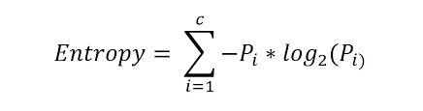
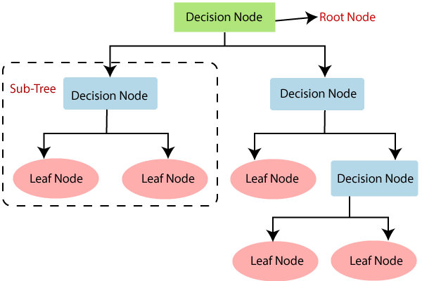
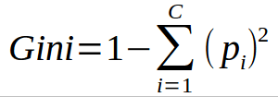
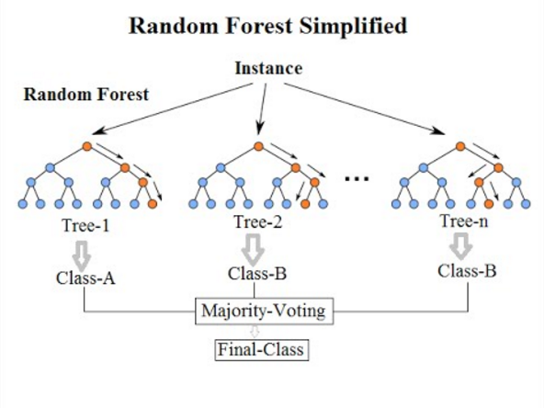
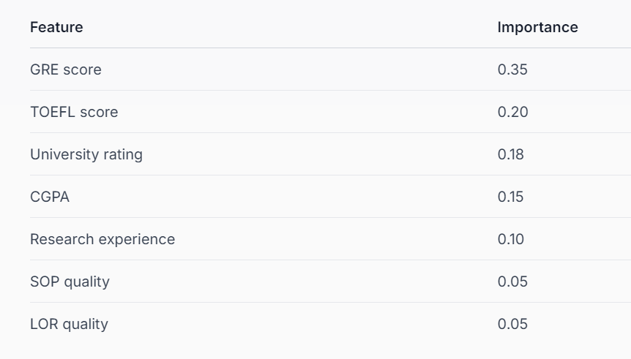
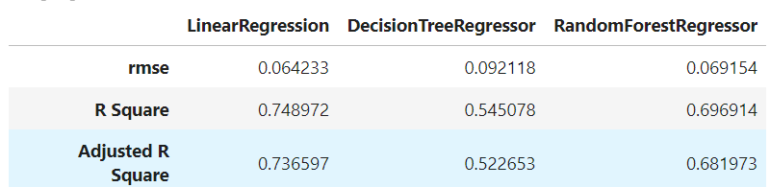
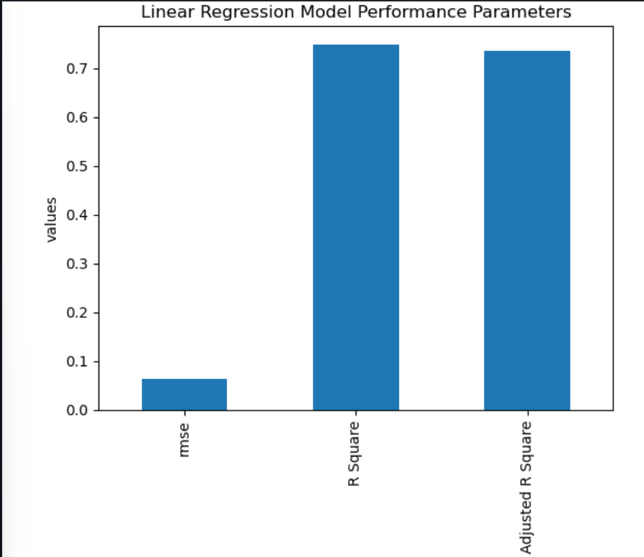
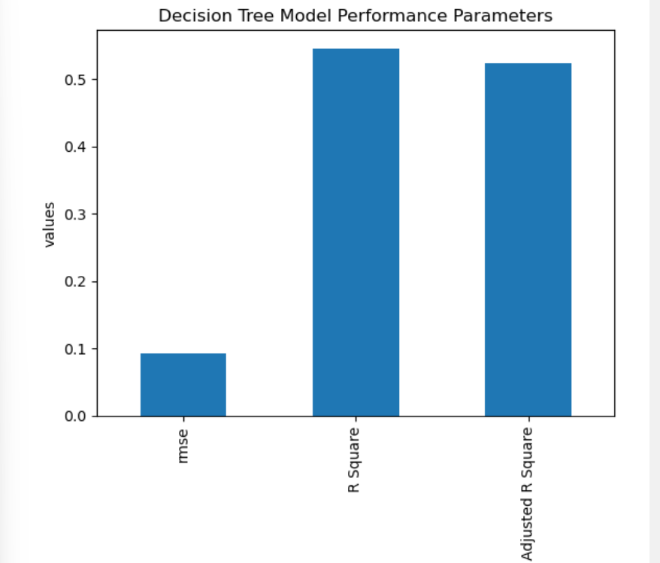
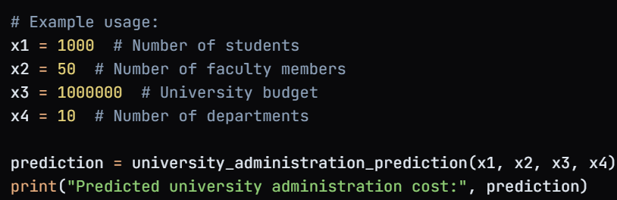

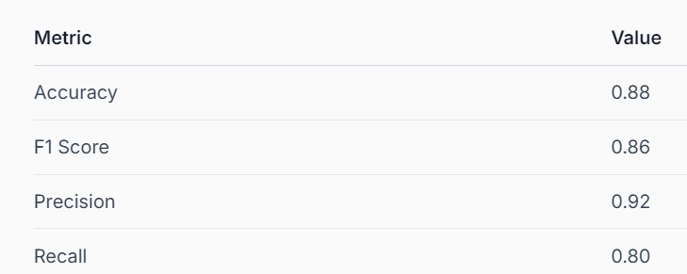
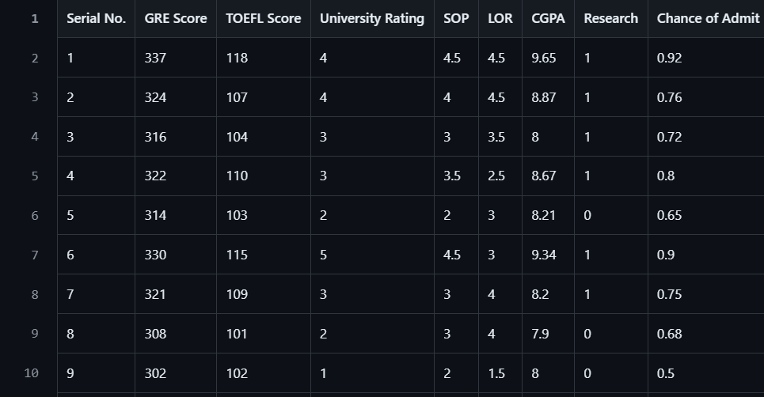
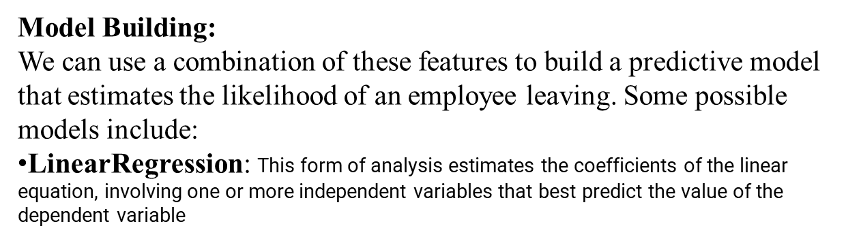
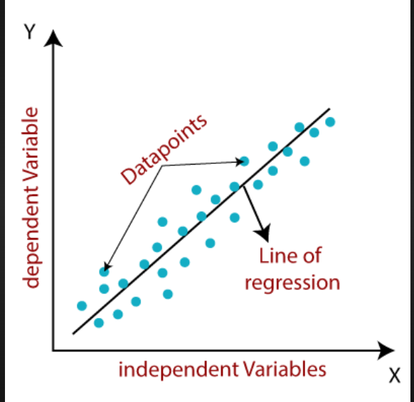
University Administration Prediction
Priya S. Roy
Computer Science Engineering
Government Polytechnic Daman.
Introduction
Decision Trees: A tree-based model that can handle both categorical and numerical features.
Model Interpretation: The results indicate that the model is able to predict the current year enrollment with a high degree of accuracy. The F1 score suggests that the model is able to balance precision and recall well. The precision of 0.92 indicates that the model is able to correctly predict the enrollment 92% of the time, while the recall of 0.80 indicates that the model is able to detect 80% of the actual enrollments.
Feature Importance:
The feature importance was calculated using the permutation importance method. The results are presented below :
University administration involves making informed decisions about student enrollment, faculty hiring, and resource allocation. Predicting these metrics accurately can help universities optimize their operations and improve student outcomes. This project aims to develop a predictive model using machine learning algorithms to forecast university administration metrics.
Random Forest: An ensemble method that combines multiple decision trees to improve accuracy and robustness.
Method
Our approach involves the following steps:
1.Data Collection: Gathering historical data on university administration metrics.
2.Data Preprocessing: Cleaning and preprocessing the data to ensure accuracy and consistency.
3.Feature Engineering: Extracting relevant features from the data to improve model performance.
4.Model Training: Training machine learning models on the preprocessed data.
Let's assume we have the following variables:
x1: Number of students
x2: Number of faculty members
x3: University budget
x4: Number of departments
And we want to predict the y: University administration cost using the following formula:
y = 0.5*x1 + 0.2*x2 + 0.3*x3 + 0.1*x4.
Data Visualization after evaluating rmse , r square, adjusted r square:
Model Development:
A logistic regression model was developed to predict the likelihood of admission based on the significant factors. The model was trained using 80% of the dataset, and the remaining 20% was used for testing.
Model Performance by graph of LR , DTR & RF :
Conclusion
The developed model accurately predicts the likelihood of admission based on the significant factors. The results suggest that the GRE score, TOEFL score, university rating, and CGPA are the most important factors in determining a candidate's chances of admission. The research experience and SOP quality also play a significant role, while the LOR quality has a relatively lower importance.
Problem Statement
How do different elements of an academic application, including GRE and TOEFL scores, university ratings, SOP, LOR, CGPA, and research experience, affect a candidate's chances of being admitted to a university? Our objective is to develop a model that accurately predicts the likelihood of admission based on these significant factors.
To develop a model that accurately predicts the likelihood of admission based on various academic application elements, we can use a machine learning approach. Here's a step-by-step guide to help you get started:
Data Collection
Gather a dataset that includes the following features:
GRE scores (Verbal, Quantitative, and Analytical Writing)
TOEFL scores (Reading, Listening, Speaking, and Writing)
University ratings (e.g., QS World University Rankings)
SOP (Statement of Purpose) quality (e.g., 1-5 rating)
LOR (Letter of Recommendation) quality (e.g., 1-5 rating)
CGPA (Cumulative Grade Point Average)
Refrences
Dataset
These references offer foundational insights into how do different elements of an academic application, including GRE and TOEFL scores, university ratings, SOP, LOR, CGPA, and research experience, affect a candidate's chances of being admitted to a university
https://priya7.streamlit.app/
Results
University Administration Prediction Results:
After evaluating, we obtained the following results:
Model Evaluation Metrics:
----------------------------
Confusion Matrix:
A confusion matrix is a table used to evaluate the performance of a classification model. It shows the number of true positives (TP), true negatives (TN), false positives (FP), and false negatives (FN) predicted by the model.76
Accuracy:
It's calculated using the following formula:
Accuracy = (TP + TN) / (TP + TN + FP + FN)
Precision:
It's calculated using the following formula:
Precision = TP / (TP + FP)
Recall:
It's calculated using the following formula:
Recall = TP / (TP + FN)
F1 Score:
The formula for F1 score is:
F1 Score = 2 * (Precision * Recall) / (Precision + Recall)

