Slide 1

TITLE - PI CONTROLLED CLOSED LOOP BUCK CONVERTER
NATIONAL INSTITUTE OF TECHNOLOGY DELHI
Submitted to - (Prof) Dr. Ujjwal Kumar Kalla
Group 16 –
Aishwarya Banoth (241230005)
Priya Sadulwar (241230045)
Sharvari Kulkarni (241230049)

Slide 2
Contents
Introduction
Objectives
Open Loop Buck Converter
Limitations of Open loop Buck Converter
PI Controlled Closed loop Buck Converter
Applications
Conclusion

Slide 3
Introduction
It operates using a switch (MOSFET), diode, inductor, and capacitor. This project models a Buck Converter in both open-loop and closed-loop configurations. In the open-loop, the output voltage is not regulated—it depends only on fixed duty cycle. In the closed-loop, a PI (Proportional-Integral) controller is used to automatically adjust the duty cycle to keep the output voltage stable, even with load or input changes. It is widely used in power supplies for electronic devices, battery charging systems, and electric vehicles
A buck converter is a DC-DC converter that steps down higher input DC voltage from its input to a lower output DC voltage.

Slide 4
Objective
Study open and closed loop buck converter circuits to understand their operation and control mechanisms
Design a closed loop buck converter to maintain stable DC output from varying input voltage.
Ensure Continuous Conduction Mode (CCM) operation for efficient and predictable performance.
Implement a PI controller to regulate output voltage and minimize steady-state error.
Simulate the system in MATLAB Simulink under varying load and input conditions.
Gain practical experience in digital control, embedded programming, and PI-based power electronics systems.

Slide 5
Open Loop Buck Converter
A buck converter is a type of DC-DC converter that steps down a higher input voltage (Vin) to a lower output voltage (Vout) using a switching mechanism. In the open-loop configuration, the converter operates without any feedback control.
Mode 1 ( Switch on )
During this period, the input voltage is applied across the inductor, causing the inductor current to increase linearly as it stores energy. The diode remains reverse biased, and the load receives power directly from both the input and the inductor.
Mode 2 (Switch off )
The inductor resists sudden changes in current, begins to discharge its stored energy. The diode becomes forward biased, allowing current to continue flowing to the load. The inductor current now decreases linearly, maintaining continuous output.
These two modes repeat every cycle, and their duration is controlled by the duty cycle, which ultimately determines the average output voltage.

Slide 6
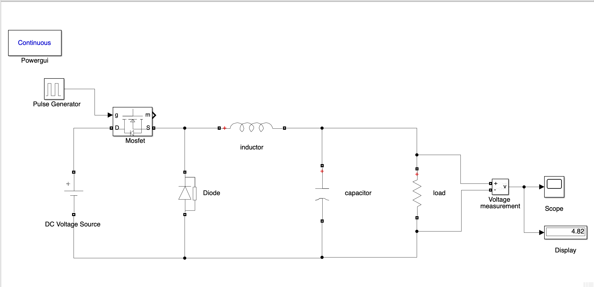
Circuit Diagram Of Open Loop Buck Converter
This is the model of open loop buck converter that we have designed using MATLAB Simulink

Slide 7
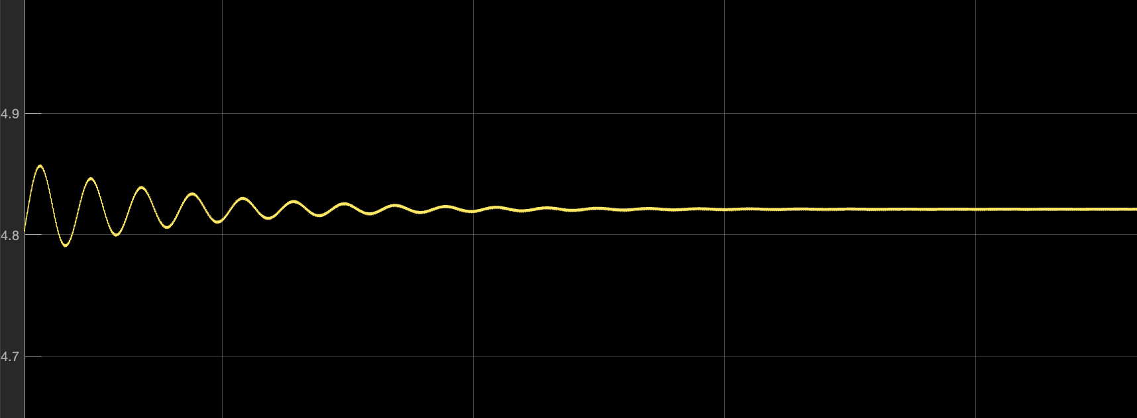
Waveform
Parameters | Value
Input Voltage(Vin) | 12 V
Output Voltage(Vout) | 5 V
Resistance(R) | 10 Ω
Frequency | 25 kHz
Duty cycle | 0.4
Inductance(L) | 100 µH
Capacitance(C) | 1000 µF
Output voltage v/s time

Slide 8
Limitations Of Open Loop Buck Converter
No feedback - cannot correct output voltage deviations
Poor voltage regulation under load or input changes
Fixed duty cycle – lacks adaptability
Sensitive to component tolerances
Inaccurate output for varying load conditions
Not suitable for precision or dynamic applications

Slide 9
PI Controlled Closed Loop Buck Converter
A closed-loop buck converter with Proportional-Integral (PI) control is designed to maintain a constant and regulated DC output voltage, even when the input voltage or load conditions change. Unlike open-loop systems, this converter uses feedback control to adjust its operation dynamically.
In this system, the output voltage is continuously monitored and compared with a fixed reference voltage. The difference (error) is processed by a PI controller, which adjusts the duty cycle of the PWM signal driving the switch. This regulation helps maintain a stable output.

Slide 10
PI Controlled Closed Loop Buck Converter
Role of the PI Controller:
Proportional Gain (Kp): Provides an immediate response to changes in the output voltage. A higher Kp results in faster correction.
Integral Gain (Ki): Accumulates the error over time and eliminates long-term steady-state errors, improving accuracy.
Together, Kp and Ki ensure that the converter:
Reacts quickly to disturbances.
Maintains long-term stability.

Slide 11
PI Controlled Closed Loop Buck Converter
System Implementation and Analysis:
The entire system is modeled and simulated in MATLAB Simulink.
The converter's performance is evaluated under a variety of input voltages and load conditions.
Key performance metrics include:
Voltage regulation quality
Dynamic response time
System stability and steady-state error
This approach provides a reliable and robust method of DC voltage regulation in practical power electronics applications.

Slide 12
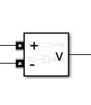
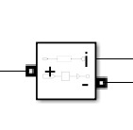
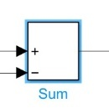
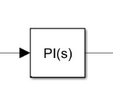

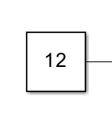
Blocks used in designing the Model
Voltage Measurement- Measures the voltage across the load resistance.
Current measurement – Measures the current passing through the inductor.
Sum – Compares desired v/s actual output and generates the error.
PID Controller – Implements the PI control for regulating the output voltage.
PWM Generator - Processes the error and generates a control signal to adjust the PWM
duty cycle to regulate output voltage.
Constant – It is used to provide a fix reference voltage.

Slide 13
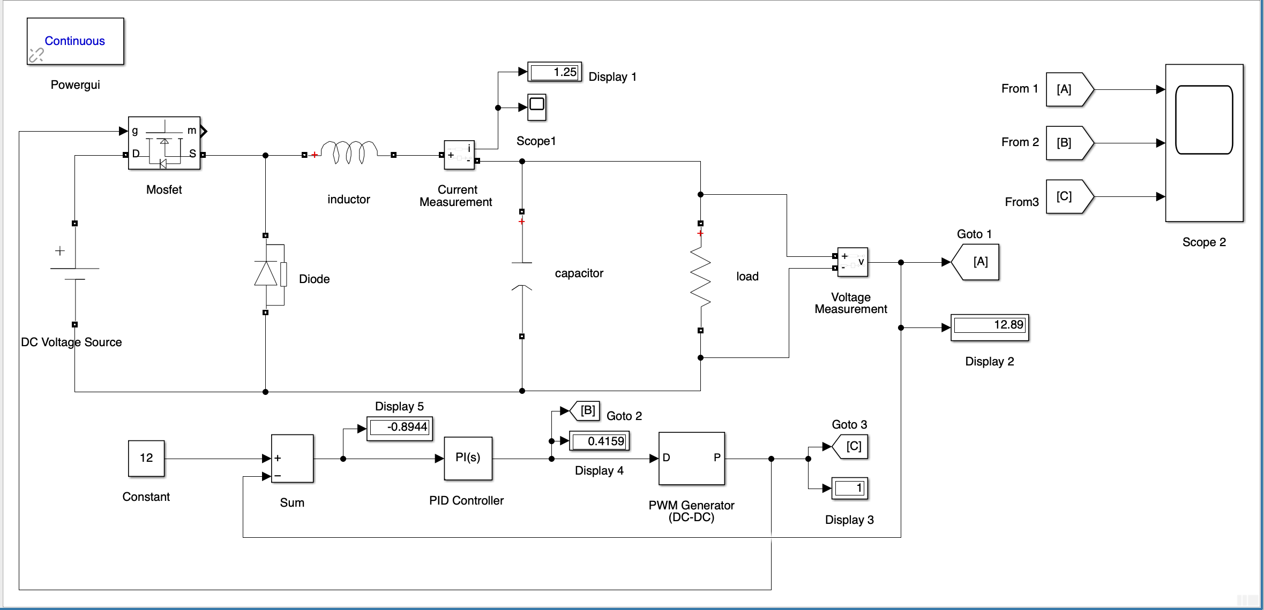
Circuit Diagram Of PI Controlled Closed Loop Buck Converter

Slide 14
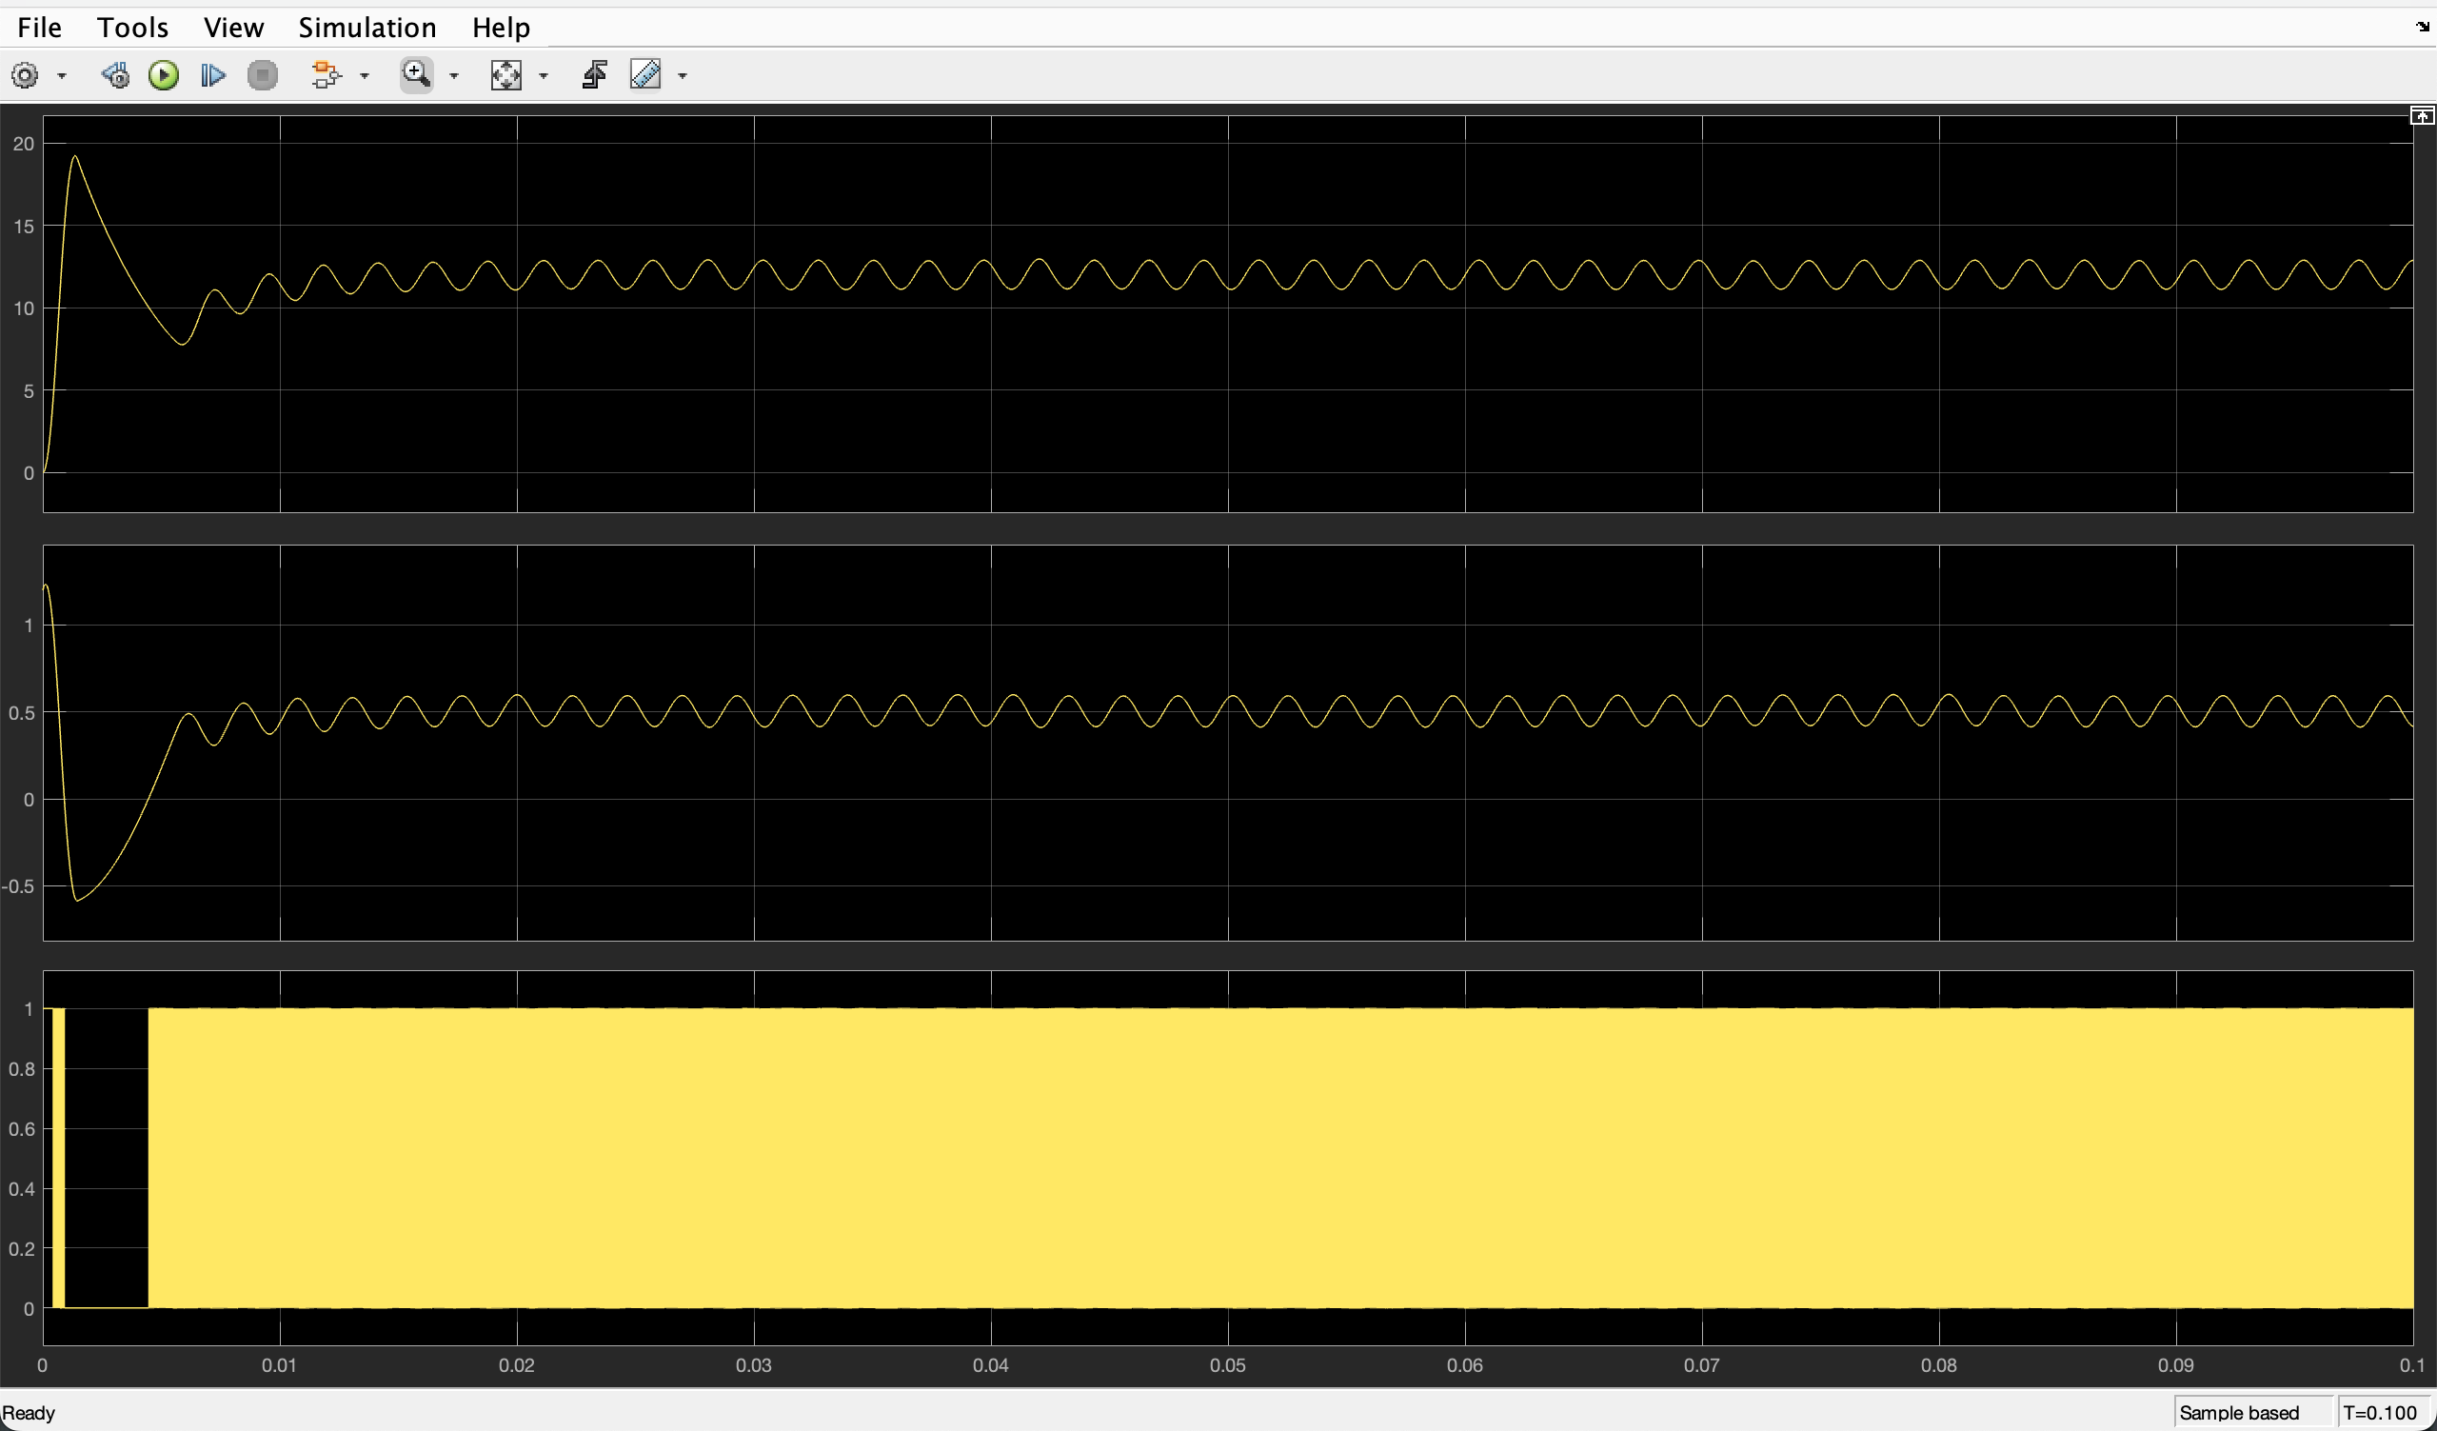
Waveform
Vin | 24 V
Vout | 12 V
Inductance(L) | 1 mH
Capacitance(C) | 470 µF
Resistance(R) | 10 Ω
Frequency | 25 kHz
Duty cycle | 0.4
Kp | 0.1
Ki | 50
1) Vout v/s Time 2) Duty cycle v/s Time 3) PWM Pulse v/s Time

Slide 15
Variation in Vout , Duty cycle
Case | Kp | Ki | Vout (V) | Duty cycle
1 | 0.05 | 20 | 11.6 | 0.4030
2 | 0.1 | 50 | 12.89 | 0.4159
3 | 0.2 | 60 | 13.1 | 0.4220
4 | 0.2 | 100 | 13.8 | 0.4300
5 | 0.3 | 150 | Unstable | >0.45
Here in this table by changing the Kp and Ki values we have analysed the variations in the values of output voltage and duty cycle and thus we use the hit and trial method to minimise the error in the output voltage in the result.

Slide 16
Analysis
Low Kp and Ki (Case 1): Slow response, small steady-state error, very stable.
Moderate Kp and Ki (Case 2): Faster response, small overshoot, good regulation.
High Ki or Kp (Cases 3-4): Faster settling but higher overshoot and risk of instability.
Very high Kp and Ki (Case 5): System becomes unstable—oscillations or divergence in output.

Slide 17
Applications
1. Mobile and Portable Device Chargers
Closed-loop buck converters with PI controllers are commonly used in mobile phone chargers, power banks, and other battery-powered devices to ensure consistent voltage supply, protect sensitive circuits, and extend battery life.
2. Electric Vehicles (EVs)
DC-DC converters with closed-loop control are critical in electric vehicles to supply stable voltage to various low-voltage systems such as lighting, instrumentation, and infotainment from high-voltage battery packs.
3. Renewable Energy Systems
In solar photovoltaic (PV) applications, buck converters are used to step down variable solar panel output voltages to usable levels for battery charging or grid-tied inverters. The PI controller ensures stable voltage despite changes in sunlight intensity or load.

Slide 18
Conclusion
This project involved the design, simulation, and analysis of a PI-controlled closed-loop buck converter aimed at maintaining a stable 5V output under varying input and load conditions. The implementation of a Proportional-Integral (PI) controller significantly improved system stability, response time, and accuracy compared to open-loop control.
Simulation results demonstrated that the converter effectively regulated the output voltage and quickly adapted to changes, confirming the benefits of PI control.
Overall, the project highlighted the importance of closed-loop control in enhancing the efficiency and reliability of modern power electronics systems

Slide 19
THANK YOU !

