Slide 1




National Institute of Technology Delhi
RFID Enabled EV Parking & Charging System
using ESP32
Presented By:
Priya Sadulwar (241230045) | Sharvari Kulkarni (241230049)
Department:
Electrical Engineering
Supervisor:
Dr. Anmol Saxena
Date – 11th May 2026

Slide 2
TABLE OF CONTENTS
Sr. no. | Content
 | Introduction
2. | Literature Survey
3. | Hardware and Software Used
4. | Algorithms and techniques
5. | Methodology
6. | Proposed System
7. | References

Slide 3
INTRODUCTION
The rapid growth of electric vehicles has increased the demand for smarter parking and charging solutions. Conventional parking systems are time-consuming and lack features such as real-time slot monitoring, automated charging control, and secure access management.
This project presents an RFID Enabled Smart EV Parking and Charging System using ESP32. The system uses RFID authentication for vehicle entry, IR sensors for slot detection, and a relay module for charging control. A Wi-Fi-based web dashboard provides live updates of slot availability, charging status, battery percentage, and temperature monitoring for both users and operators.
The project combines embedded systems and IoT technology to create an efficient, low-cost, and scalable smart EV parking solution.
More demand for charging points
Parking time wasted in cities

Slide 4
PROBLEM STATEMENT
Manual Parking
No Real-Time Monitoring
01
No automated system for slot detection or assignment; relies entirely on human effort.
04
Absence of any dashboard to monitor slot occupancy or charging progress remotely.
Time Wastage
Security Concerns
02
Drivers spend excessive time searching for available parking slots.
05
Unauthorized access to parking areas and charging stations is uncontrolled.
No Charging Management
03
No visibility into charging status, completion time, or energy consumption.

Slide 5
OBJECTIVES
01 Smart Parking Allocation
02 RFID Authentication
Automatically detect and assign available slots using IR sensors.
Secure entry gate control using RFID card verification via ESP32.
03 Automatic EV Charging
04 Real-Time Monitoring
Trigger charging relay automatically upon vehicle detection in slot.
Web dashboard displaying live slot status and charging progress.
05 Temperature Safety
06 Efficient Management
DHT11 monitors temperature; charging stops if threshold is exceeded.
Reduce manual effort and optimize use of parking and charging resources.

Slide 6
LITERATURE SURVEY - EXISTING vs PROPOSED SYSTEM
Parameter | Existing System | Proposed System
Parking Management | Manual | Smart auto-allocation via IR sensors
Gate Control | Manual/Ticketing | RFID-authenticated servo gate
Slot Tracking | No real-time tracking | Live IR-based occupancy monitoring
Charging Monitor | None available | Relay-controlled with % display
Safety System | No safety mechanism | DHT11 thermal protection cutoff
Monitoring Dashboard | Absent | IoT-based real-time web dashboard
Authentication | None / physical key | RFID card-based secure access

Slide 7
HARDWARE COMPONENTS
ESP32
RFID RC522
Main microcontroller. Handles WiFi, RFID data, sensor reading, and web server hosting.
Reads RFID cards at the entry gate for user authentication.
Servo Motor
IR Sensors (×3)
Controls the entry gate. Opens on successful RFID authentication.
Detects vehicle presence in each parking slot for occupancy tracking.
Relay Module
DHT11 Sensor
Switches charging circuit ON/OFF based on vehicle detection and safety conditions.
Measures temperature; triggers charging cut-off if overheating.

Slide 8
SOFTWARE & TECHNOLOGIES USED
Arduino IDE
Integrated Development Environment used to write, compile, and upload Embedded C++ code to the ESP32 microcontroller.
Wokwi Simulator
Online circuit simulation environment used to test the ESP32 circuit before physical assembly.
Firebase
Cloud backend used to interlink the ESP32 hardware with the web dashboard over Wi-Fi in real time.

Slide 9
ALGORITHM & TECHNIQUES
RFID Authentication
IR-Based Occupancy Detection
1. Read card UID via SPI from RC522
1. IR sensor emits infrared beam across slot
2. Compare UID against stored whitelist
2. Vehicle interrupts beam → output goes LOW
3. Trigger servo to open gate if match found
3. ESP32 reads LOW signal → marks slot Occupied
Automatic Charging Logic
Temperature Safety & Auto-Stop
1. Vehicle detected in slot (IR = LOW)
1. DHT11 reads temperature
2. Relay module energizes → charging begins
2. If temp > threshold → relay de-energizes
3. Counter simulates battery % increment
3. Also stops at 100% charge automatically

Slide 10
PROPOSED SYSTEM — SYSTEM ARCHITECTURE
RFID Card
Scan
ESP32
Controller
IR Sensor
Slot Check
Servo Gate
Opens
Slot
Assigned
Dashboard
Updated
DHT11
Monitors Temp
Relay Starts
Charging
IR Sensor
Detects
Vehicle
Parked
The proposed system integrates RFID authentication, automated slot detection, and smart charging control using the ESP32 microcontroller. It enables real-time monitoring of parking occupancy, charging status, and system data through a Wi-Fi-based web dashboard.

Slide 11
METHODOLOGY
PHASE 1
SIMULATION
The RFID Enabled Smart EV Parking System was first designed and tested using the Wokwi simulation platform. The simulation helped in verifying RFID authentication, slot detection, automatic gate control, charging logic, relay operation, and real-time sensor responses before implementing the hardware prototype.

Slide 12
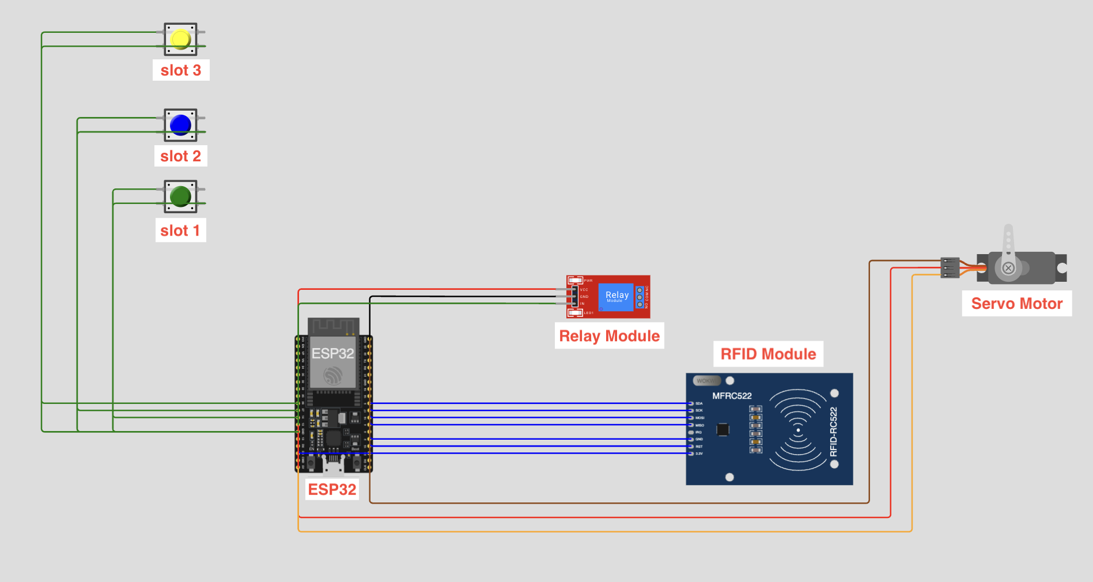
fig 1 : Wokwi Simulation Circuit

Slide 13
PHASE 2
HARDWARE SETUP
RFID Authentication: RFID cards are used to authenticate vehicles and allow authorized entry into the parking area.
Slot Detection: IR sensors continuously monitor parking slots and detect whether a slot is empty or occupied.
Automatic Gate Control: A servo motor automatically opens and closes the gate after successful RFID verification.
Vehicle Detection & Charging: Once the vehicle reaches the assigned slot, the relay module initiates the charging process automatically.
Temperature Monitoring: The DHT11 sensor monitors temperature conditions during charging for safer operation.
Real-Time Monitoring: Firebase and the web dashboard provide live updates of slot status, charging percentage, temperature, and occupancy information.

Slide 14
PHASE 3
FIREBASE INTEGRATION AND WEB-DASHBOARD DEVELOPMENT
Operator Dashboard
Live slot occupancy (Empty / Occupied)
Real-time battery charging percentage
Charging status (Charging/ Stopped)
Estimated time to full charge
Temperature displayed
Auto-refresh without page reload

Slide 15
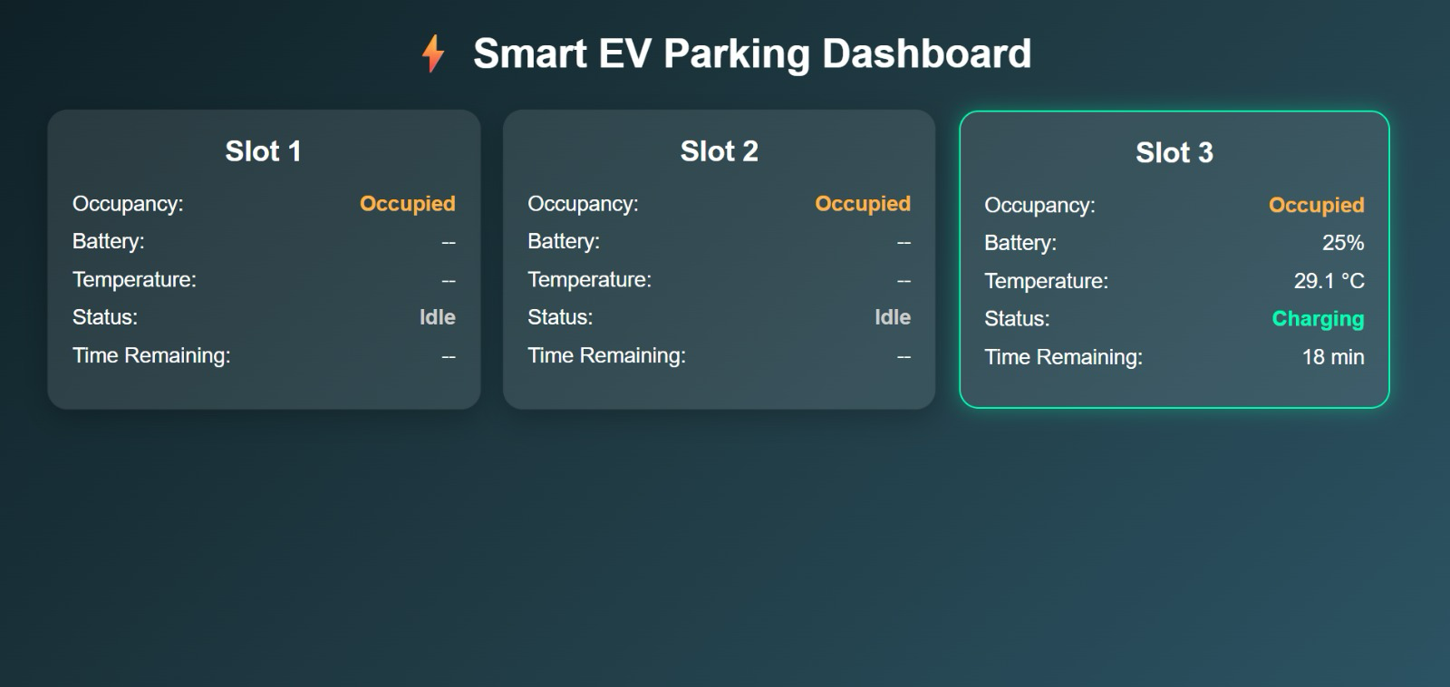
fig 2 : Web Dashboard - Operator View

Slide 16
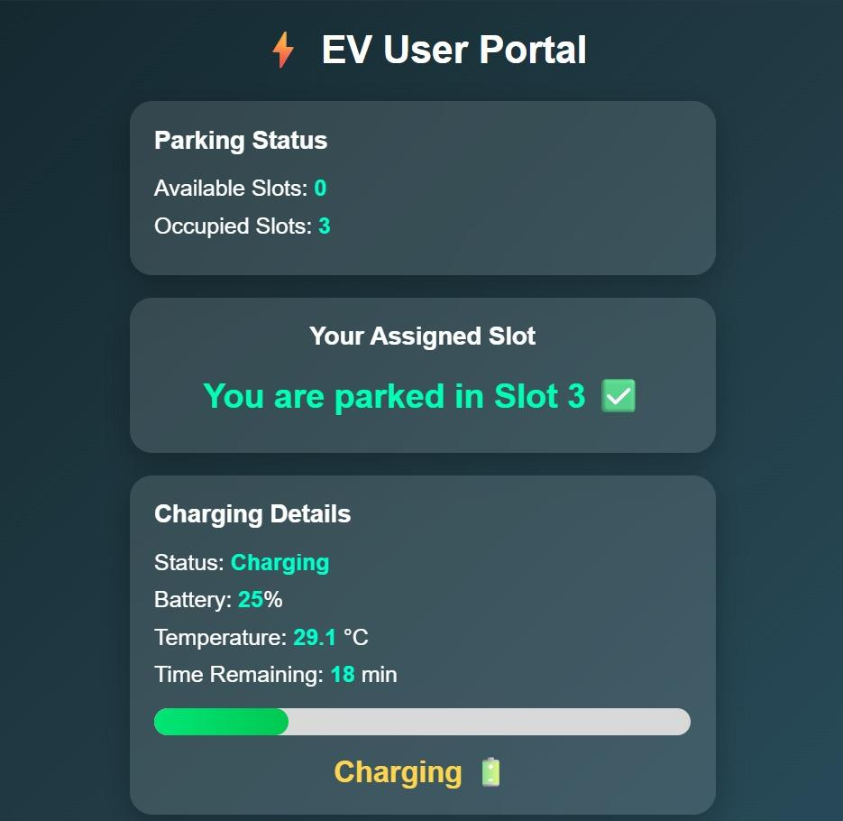
WEB DASHBOARD - USER VIEW
2. The user dashboard has two stages:
Before parking
Shows the user their allotted slot number and a directional message to navigate to it.
2. After vehicle parks
Once the IR sensor detects the vehicle, the dashboard switches to show:
•Charging percentage & progress
•Estimated time remaining
• Live temperature reading
• Charging ON / OFF status
• Slot occupancy status
fig 3 : Web Dashboard - User View

Slide 17
OUTPUT & RESULTS
RFID Authentication
Authorized card UID verified; gate opened within seconds of scan.
Automatic Gate Control
Servo motor rotated 90° on authentication; closed after 3 seconds.
Slot Detection
IR sensors correctly identified Occupied/Empty status for all 3 slots.
Automatic Charging
Relay activated on vehicle detection; charging initiated without manual input.
Dashboard Monitoring
Web interface served by ESP32; data refreshed in real time via HTTP.
Temperature Safety
DHT11 reading exceeded threshold → relay de-energized automatically.

Slide 18
ADVANTAGES
Fully automated - no manual intervention
RFID ensures secure entry control
Real-time slot occupancy monitoring
EV charging managed and monitored live
Temperature-based safety protection

Slide 19
FUTURE SCOPE
01
Mobile App Integration
02
Online Payment System
03
AI-Based Slot Prediction
Android/iOS app for remote slot booking, status monitoring, and push alerts.
UPI/card-based payment gateway for automated charging billing.
Machine learning to predict peak hours and pre-allocate parking intelligently.
04
Real EV Charging Hardware
05
Smart City Integration
Replace simulated charging with actual high-voltage EV charging circuitry.
Connect to municipal smart city infrastructure for city-wide EV management.

Slide 20



CONCLUSION
This project successfully demonstrates a complete Smart EV Parking and Charging Management System using the ESP32 microcontroller. By integrating RFID-based authentication, IR sensor-driven slot monitoring, relay-controlled charging simulation, temperature safety via DHT11, and an IoT web dashboard, the system provides an end-to-end automated solution for modern EV infrastructure needs.
Secure
Access
Smart
Parking
Auto
Charging
Safety
System
Live
Monitoring
The system validates the feasibility of IoT-based automation for EV parking facilities, laying a solid foundation for future-scale real-world deployment.

Slide 21
REFERENCES
[1] R. Kumar, A. Sharma, "IoT Based Smart Parking Management System Using RFID and ESP32," IEEE Transactions on Intelligent Transportation Systems, vol. 22, no. 6, pp. 3812–3820, Jun. 2022.
[2] S. Patel, M. Verma, "Design and Implementation of RFID-Based Vehicle Parking with Automated Charging Notification," International Journal of Embedded Systems, vol. 14, no. 2, pp. 150–158, 2023.
[3] Espressif Systems, "ESP32 Technical Reference Manual," Version 4.9, Available: https://www.espressif.com/documentation, 2023.
[4] Arduino Project Hub, "Using RFID RC522 with Arduino and ESP32," Available: https://create.arduino.cc/projecthub, Accessed: 2024.
[5] NXP Semiconductors, "MFRC522 Standard Performance MIFARE and NTAG Frontend Datasheet," NXP Document Rev. 3.9, 2022.
[6] T. Nguyen, L. Tran, "Electric Vehicle Charging Infrastructure Using IoT Monitoring: A Systematic Review," Energies, MDPI, vol. 15, no. 8, p. 2847, 2022.
[7] Aosong Electronics, "DHT11 Temperature & Relative Humidity Sensor Data Sheet," Available: https://www.aosong.com, 2023.

Slide 22




Thank You
RFID Enabled EV Parking System using ESP32
Department of Electrical Engineering

