Slide 1
Linear Regression

Slide 2
Y=dependent Variable
y=b0+b1x
X=Independent Variable

Slide 3
Positive Relationship
Y=dependent Variable
Positive relationship
Grades
b0
X=Independent Variable
Study hours

Slide 4
Negative Relationship
Y=dependent Variable
Negative Relationship
b0
Grades
X=Independent Variable
Facebook hours

Slide 5
Finding Relationship for given table
x | y
1 | 2
2 | 4
3 | 5
4 | 4
5 | 5

Slide 6
Graph Plotting
Y=dependent Variable
X=Independent Variable

Slide 7
Statistical values
x | Y | x-xbar | y-ybar | (x-xbar)square | (x-xbar) (y-ybar)
1 | 2
2 | 4
3 | 5
4 | 4
5 | 5
Mean xbar =3 | Mean ybar=4 |  |  | Mean= | Mean=

Slide 8
Y=dependent Variable
X=Independent Variable

Slide 9
Statistical values
x | Y | x-xbar | y-ybar | (x-xbar)square | (x-xbar) (y-ybar)
1 | 2
2 | 4
3 | 5
4 | 4
5 | 5
Mean xbar =3 | Mean ybar=4 |  |  | Mean= | Mean=

Slide 10
Statistical values
x | Y | x-xbar | y-ybar | (x-xbar)square | (x-xbar) (y-ybar)
1 | 2 | -2 | -2 | 4 | 4
2 | 4 | -1 | 0 | 1 | 0
3 | 5 | 0 | 1 | 0 | 0
4 | 4 | 1 | 0 | 1 | 0
5 | 5 | 2 | 1 | 4 | 2
Mean xbar =3 | Mean ybar=4 |  |  | Mean=10 | Mean=6

Slide 11
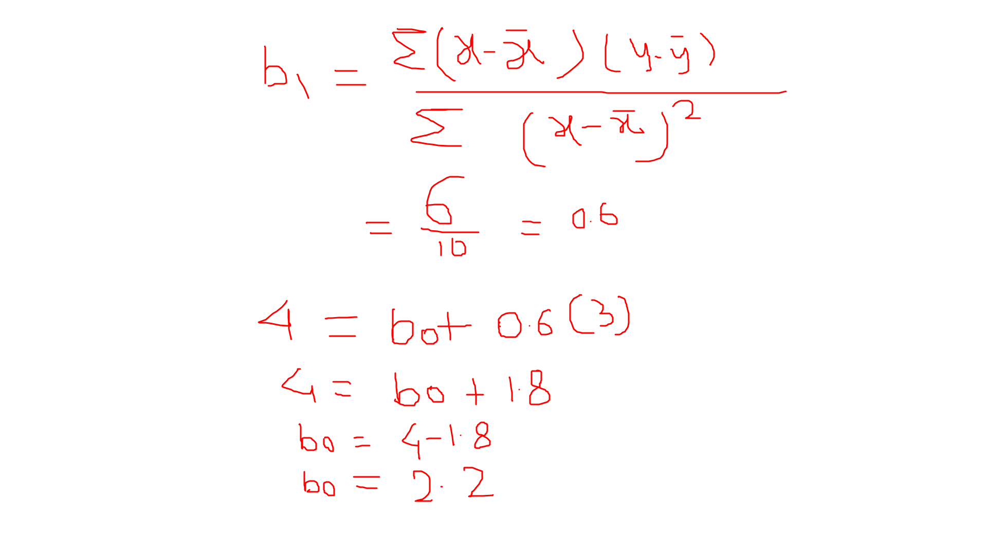
Solving for value of b0

Slide 12
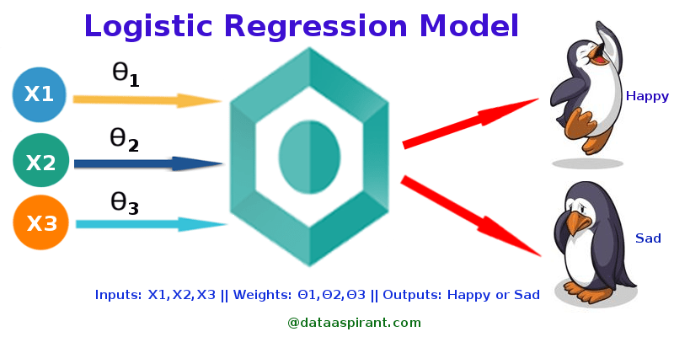

Slide 13
Logistic Regression is used when the dependent variable(target) is categorical. For example, To predict whether an email is spam (1) or (0) Whether the tumor is malignant (1) or not (0) Consider a scenario where we need to classify whether an email is spam or not. If we use linear regression for this problem, there is a need for setting up a threshold based on which classification can be done. Say if the actual class is malignant, predicted continuous value 0.4 and the threshold value is 0.5, the data point will be classified as not malignant which can lead to serious consequence in real time. From this example, it can be inferred that linear regression is not suitable for classification problem. Linear regression is unbounded, and this brings logistic regression into picture. Their value strictly ranges from 0 to 1.

Slide 14
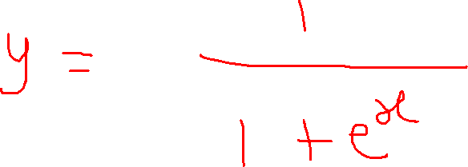

Slide 15
