Slide 1
The Wardrobe
Your personal stylist
Dee Lee • Priya Bhardwaj • Sonam Shrestha

Slide 2
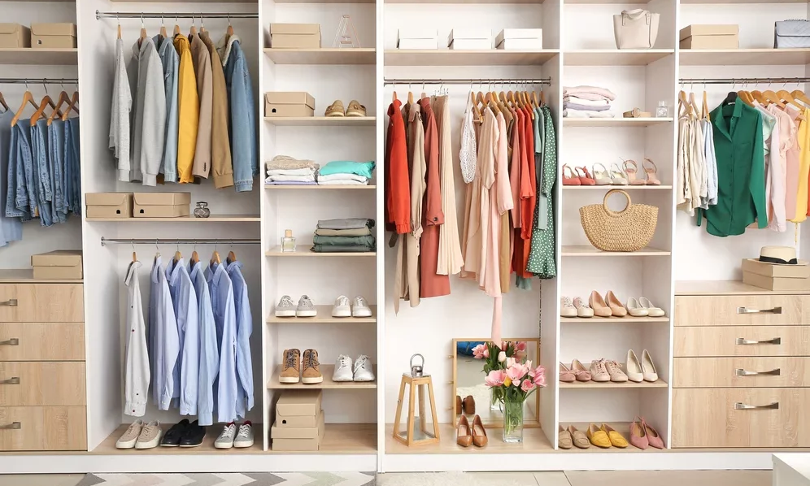
PROBLEM STATEMENT
How might we provide …
personalized solutions for the users,
and sustainable solution for the business?

Slide 3
C O N T E N T
Problem overview
Goals
Database solution
Application demo

Slide 4
P R O B L E M O V E R V I E W

Slide 5
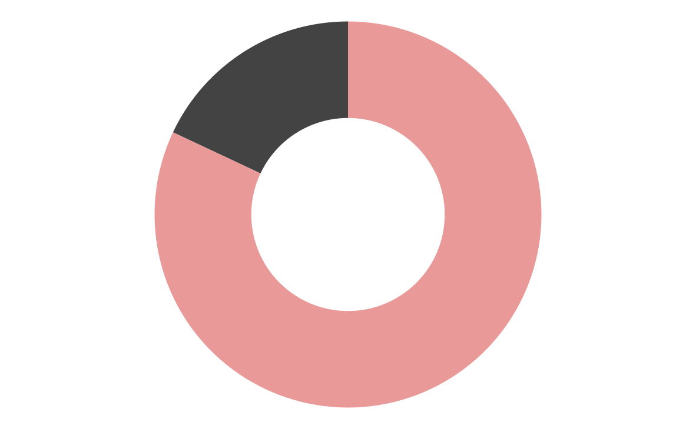
Problem overview
Americans only wore 18% of their wardrobe
Clothes waste
Worn
18%
$50 billion/year
Cost of storing or destroying clothes
Unworn
82%
*Source: https://fashionunited.uk/news/fashion/people-do-not-wear-at-least-50-percent-of-their-wardrobes-according-to-study/2018081638356

Slide 6
G O A L S

Slide 7
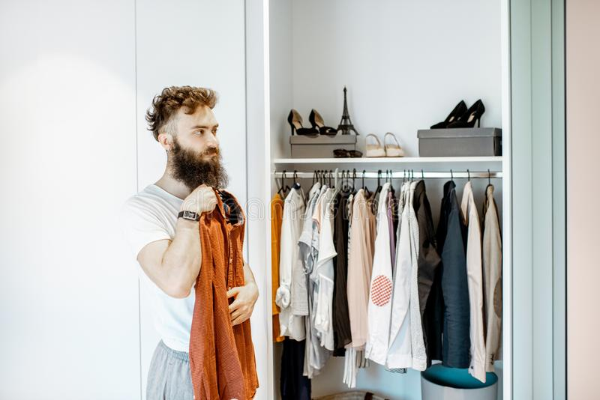
User goals
User: JOHN
Personal style curation - Clothes match suggestion
Wardrobe organization
Shopping with intention - Save money and time

Slide 8
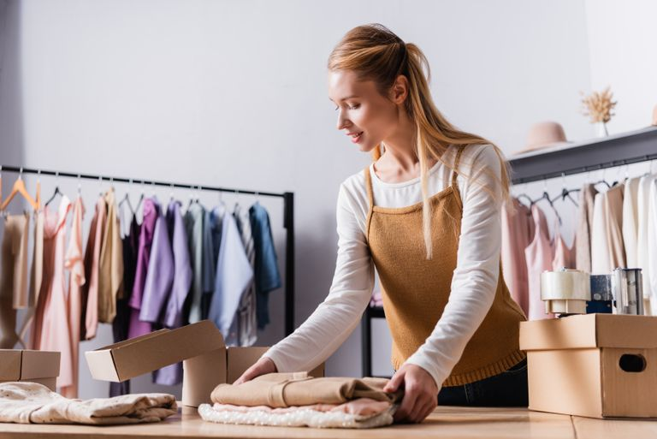
Business goals
Business: JILL
Understand local clothing trends
Customer/demographic preference
Notes:
Meet our business stakeholder, Jill!
Jill owns a local clothing shop who wants to expand her business to a larger user group.
She needs to understand popular styles and sizes each season, so she can buy next season’s items from the clothing vendors, and therefore she can minimize clothing supply waste.
She also needs to understand user demographics like gender and age to better supply personalized clothing items, which will lead her to make bigger profits.
Now you’ve seen both user and the business goals.
I will pass it on to Sonam to introduce how we tried to solve these problems.
Next slide please

Slide 9
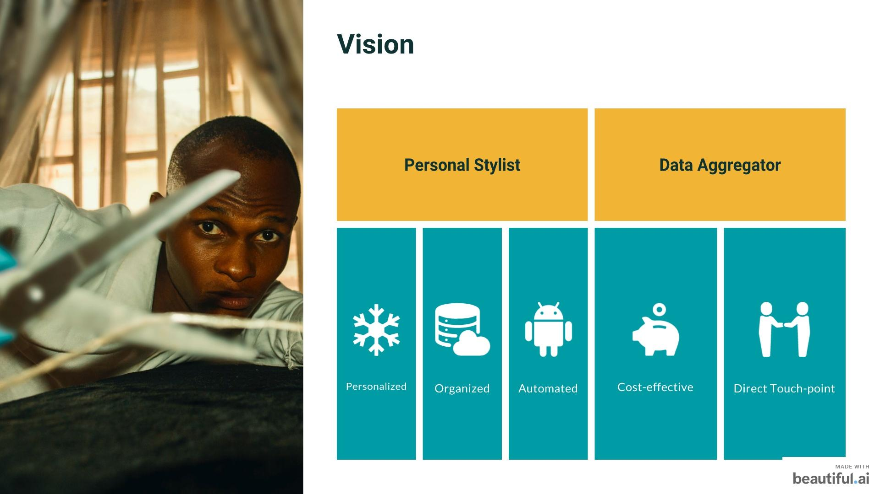

Slide 10
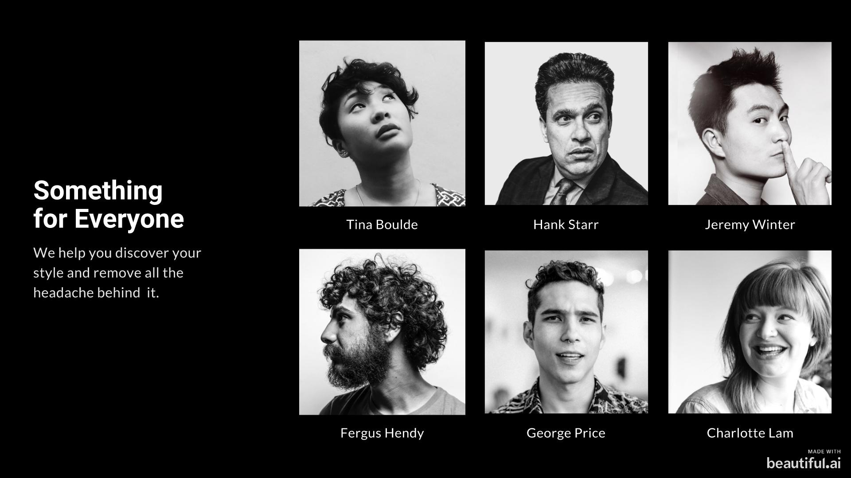

Slide 11
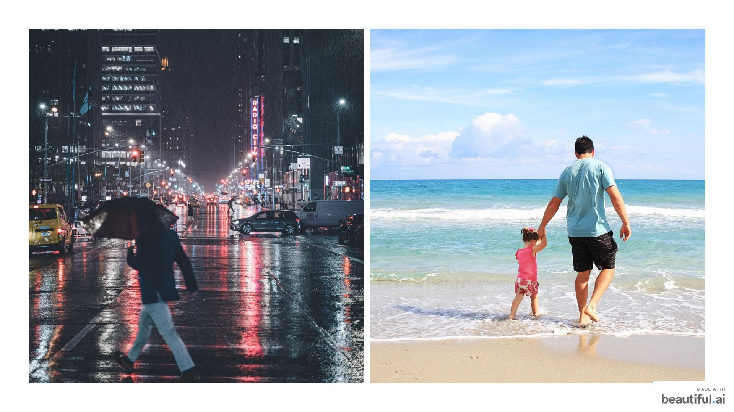

Slide 12
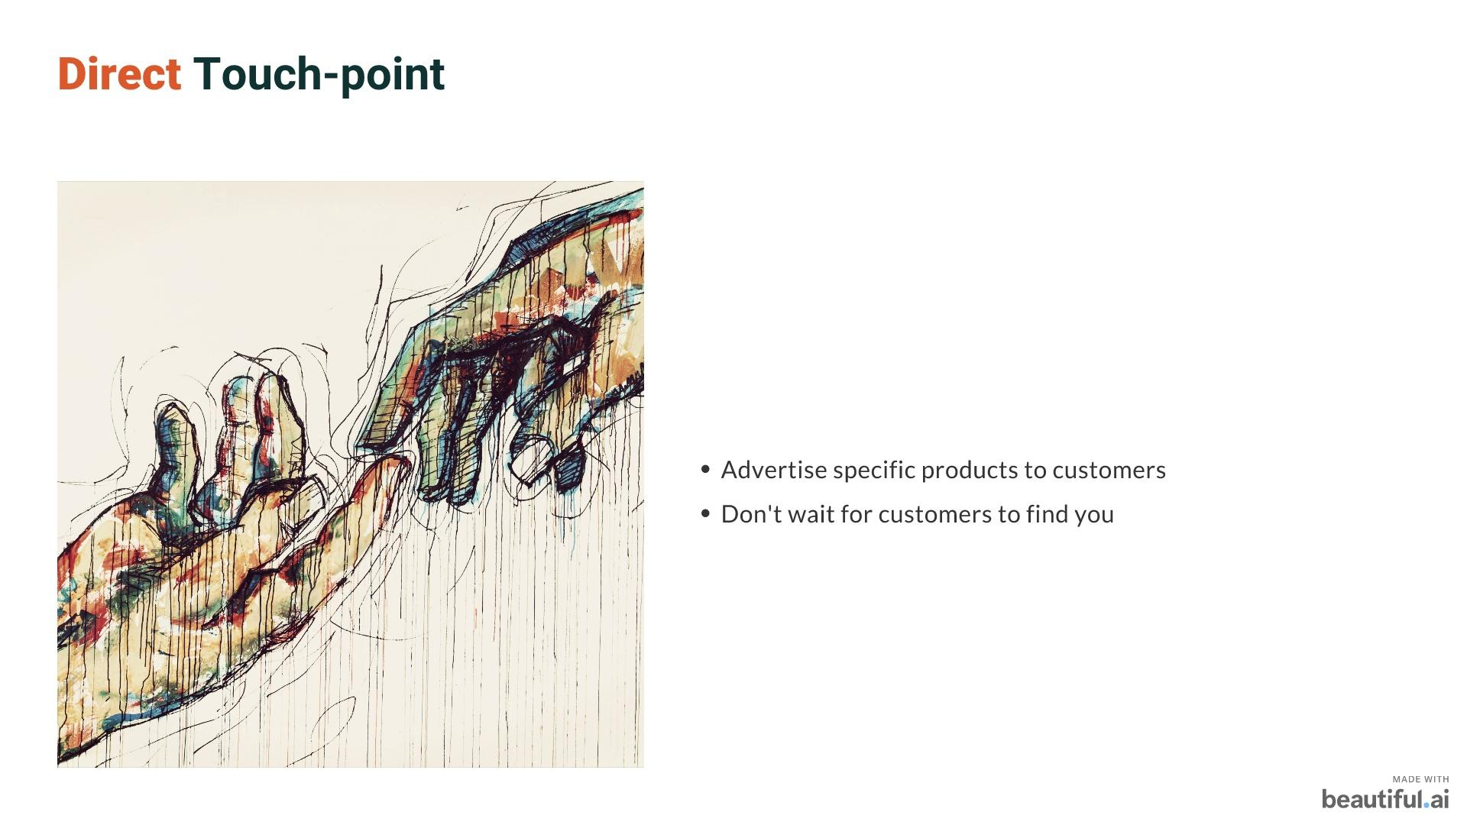

Slide 13
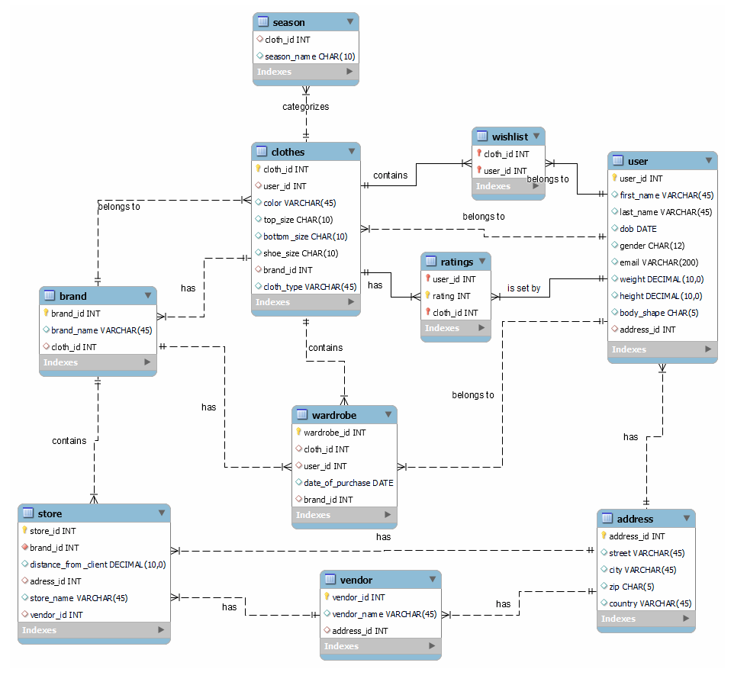
ERD

Slide 14
A P P L I C A T I O N D E M O

Slide 15
T H A N K Y O U !
Dee • Priya • Sonam

